Slide 1

Choosing a Career as a Computer Programmer
ГАПОУ СО
“Каменск-Уральский политехнический колледж”
Кормышев Егор
Информационные системы и программирование 3 курс группа ИСиП-21-301
Бердышева Ольга Юльевна, преподаватель
Каменск-Уральский
2024

Slide 2
The purpose and the task of my work
The purpose of my work: Popularization of programming as a profession The tasks of my work: Increasing motivation to professional activity

Slide 3
Introduction
Graduating from college is a major milestone.
And for me it is also a big step in my life that opens a lot of roads for my future. I chose a way of computer programmer because I am enjoying the process of working with a computer and also there are excellent job prospects for a well-educated programmers with relevant experience and a passion to their work

Slide 4

The ability to create software that can solve complex problems and enhance human experiences is both fascinating and deeply rewarding. Programming is not just about writing code; it is a blend of logical thinking, problem-solving skills and creativity that fuels innovation.

Slide 5

The IT industry is constantly evolving and so must the skills of those who wish to excel within it. Continuous learning is essential, whether through formal education, online courses, or hands-on experience. Mastering programming languages and frameworks is the foundation but understanding the principles behind algorithms, data structures and design patterns is equally crucial.

Slide 6
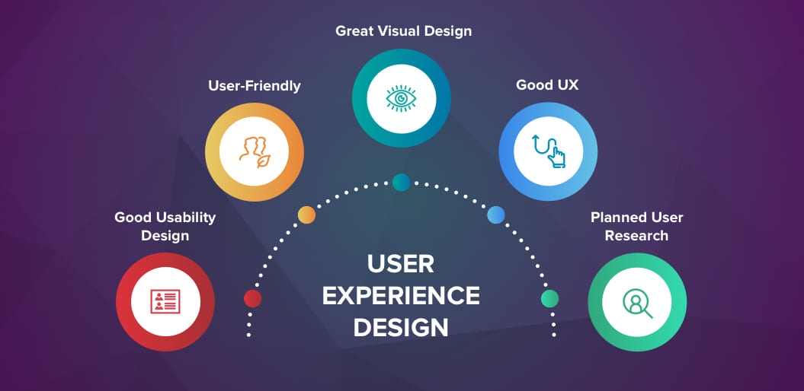
Programming also requires a strong understanding of business logic and user experience, ensuring that the products developed are not only functional but also intuitive and accessible. Emphasizing quality assurance and testing is paramount to delivering reliable software that meets the users’ needs.

Slide 7

The prospect of working as a programmer is exciting, not only for the intellectual challenge but also for the potential to shape the future of technology. It is a profession that allows for a great deal of personal growth and the opportunity to work on cutting-edge technologies.

Slide 8

Conclusion
Ultimately, my goal is to contribute to the field of programming in a way that pushes boundaries and drives forward the next generation of digital solutions. Whether it’s through developing new features optimizing existing systems or pioneering new technologies I aim to use my skills to make a positive impact on society and the environment.
Next year I will graduate and after a college I want to work as a freelancer or in IT company

