Slide 1
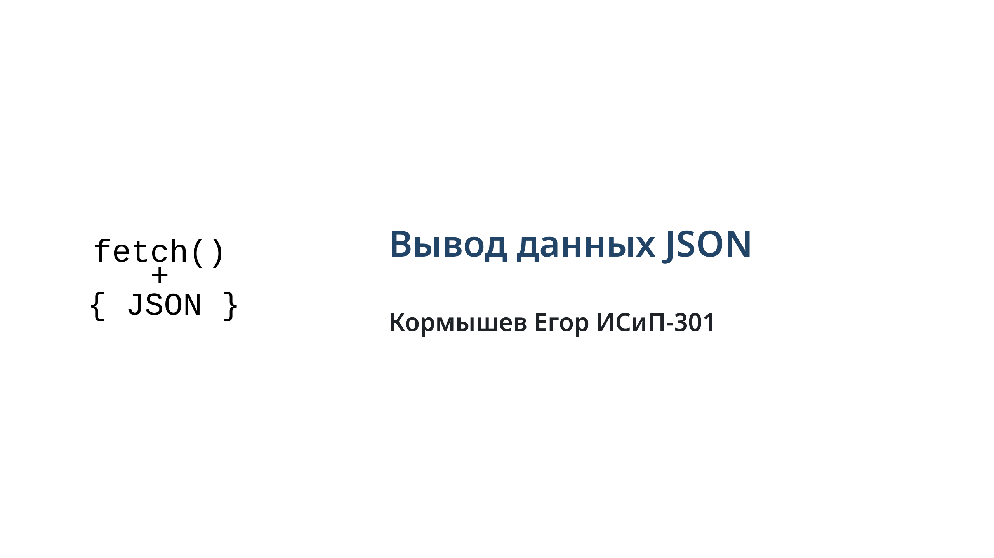
Notes:
slide 1

Slide 2
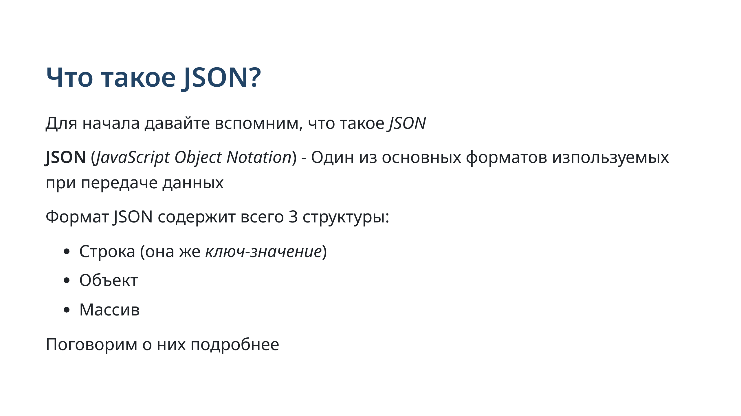
Notes:
slide 2: what is JSON

Slide 3
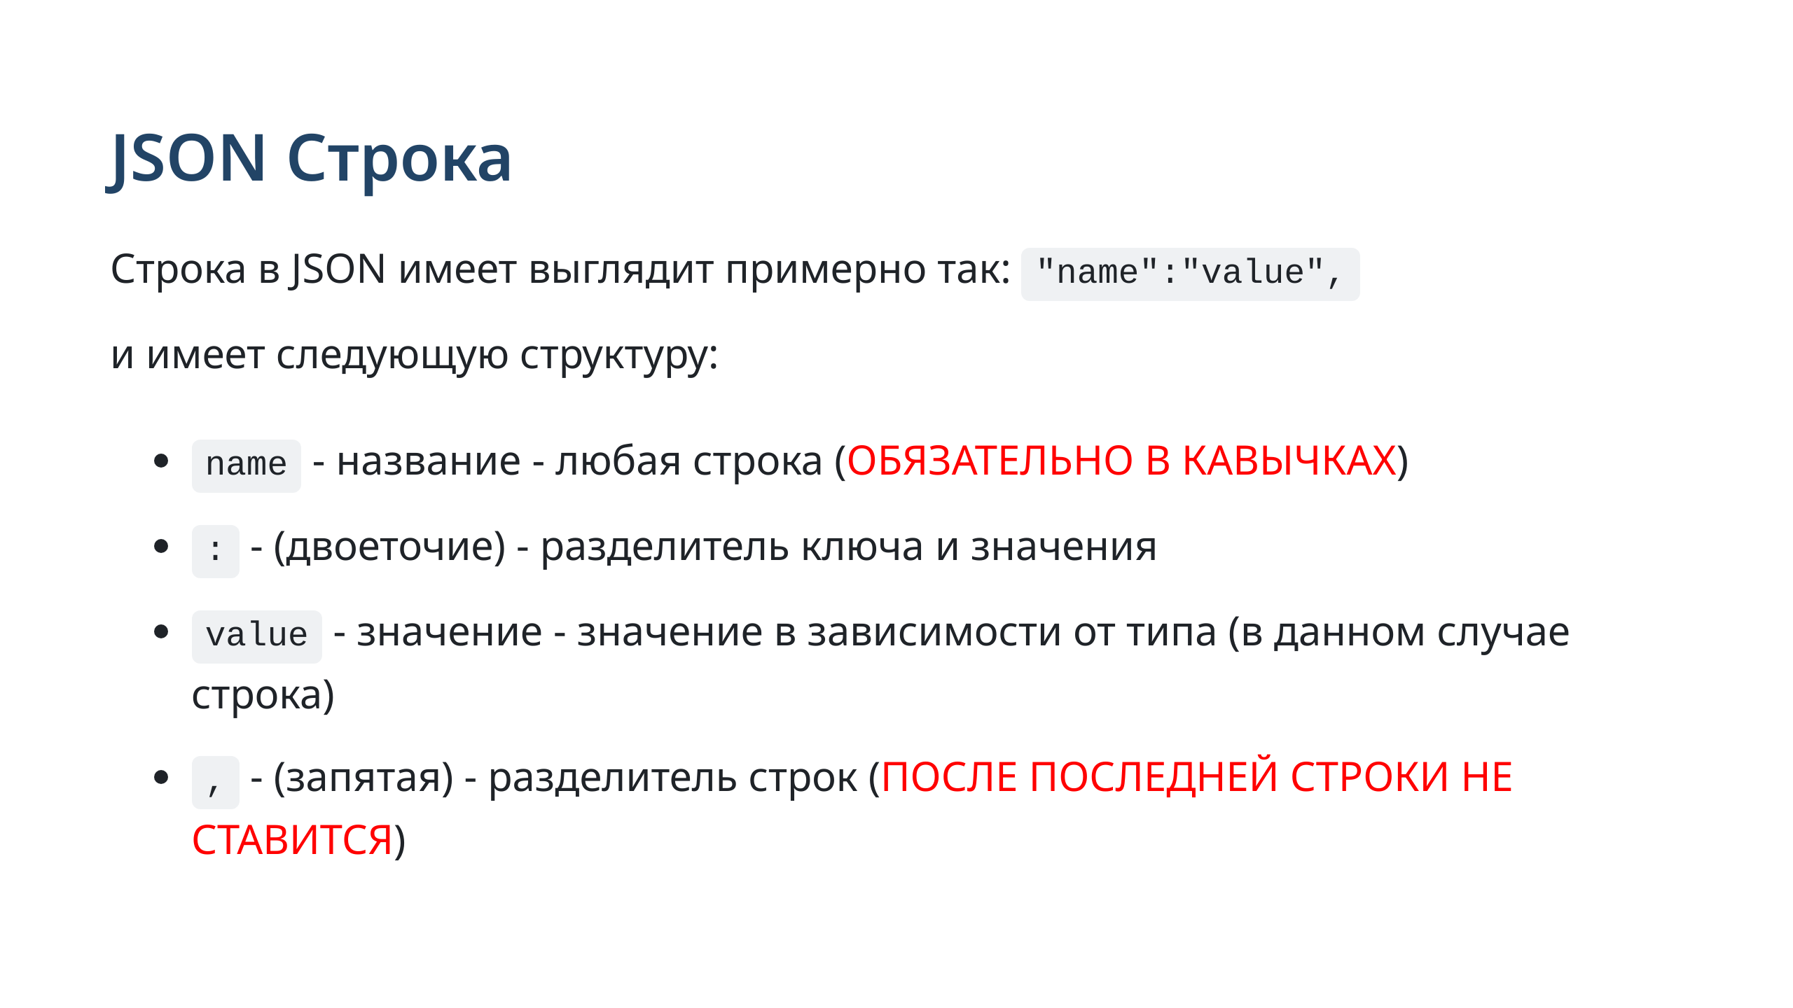
Notes:
slide 3: json string

Slide 4
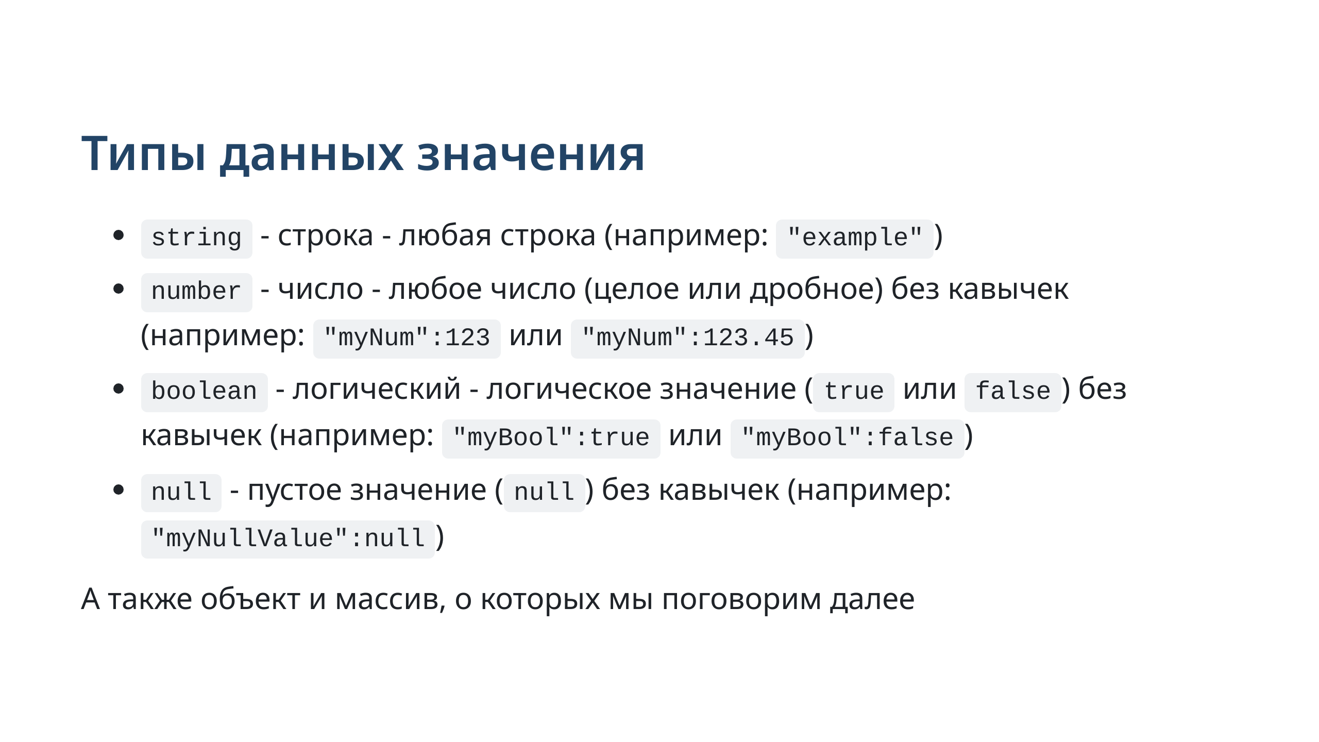
Notes:
slide 4: datatypes in JSON

Slide 5
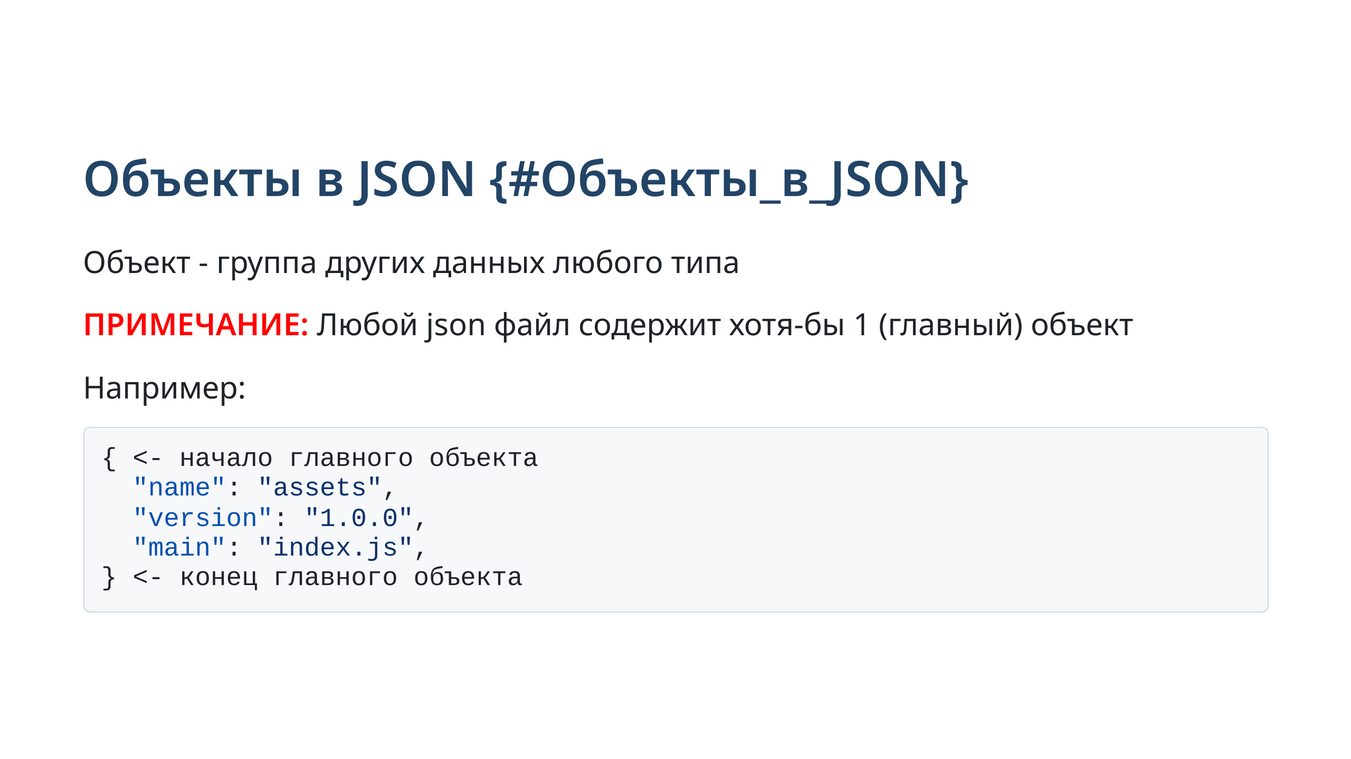
Notes:
slide 5: JSON object

Slide 6
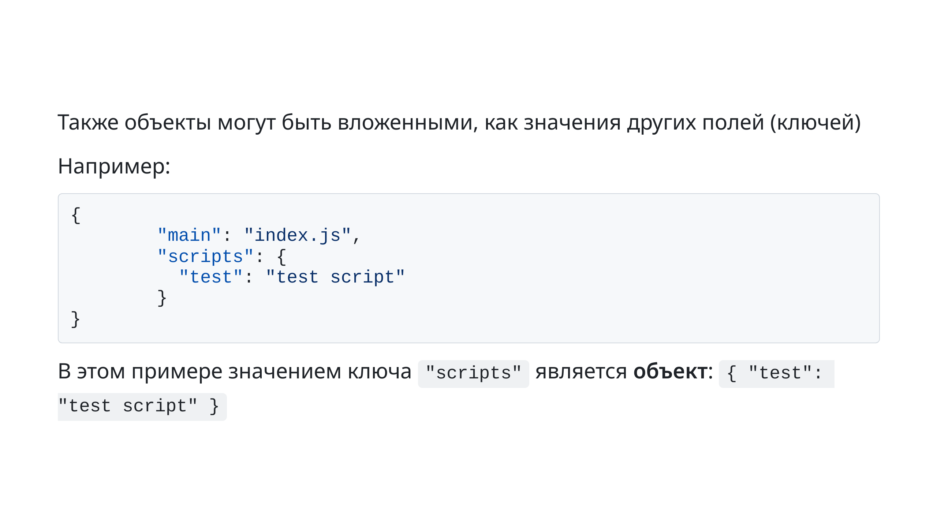
Notes:
slide 6: inner objects in json

Slide 7
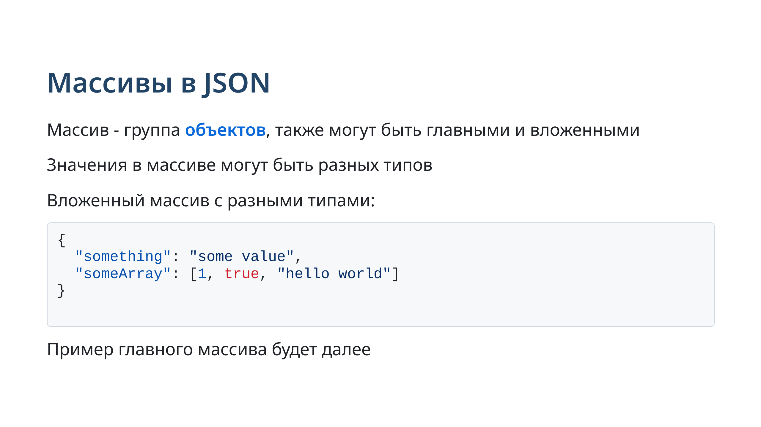

Slide 8
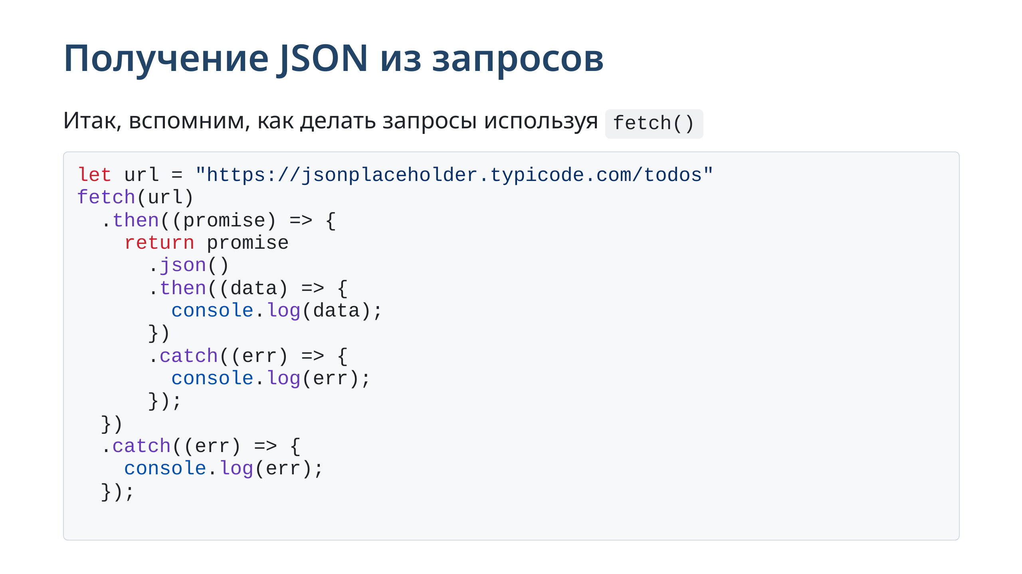
Notes:
slide 7: Requests

Slide 9
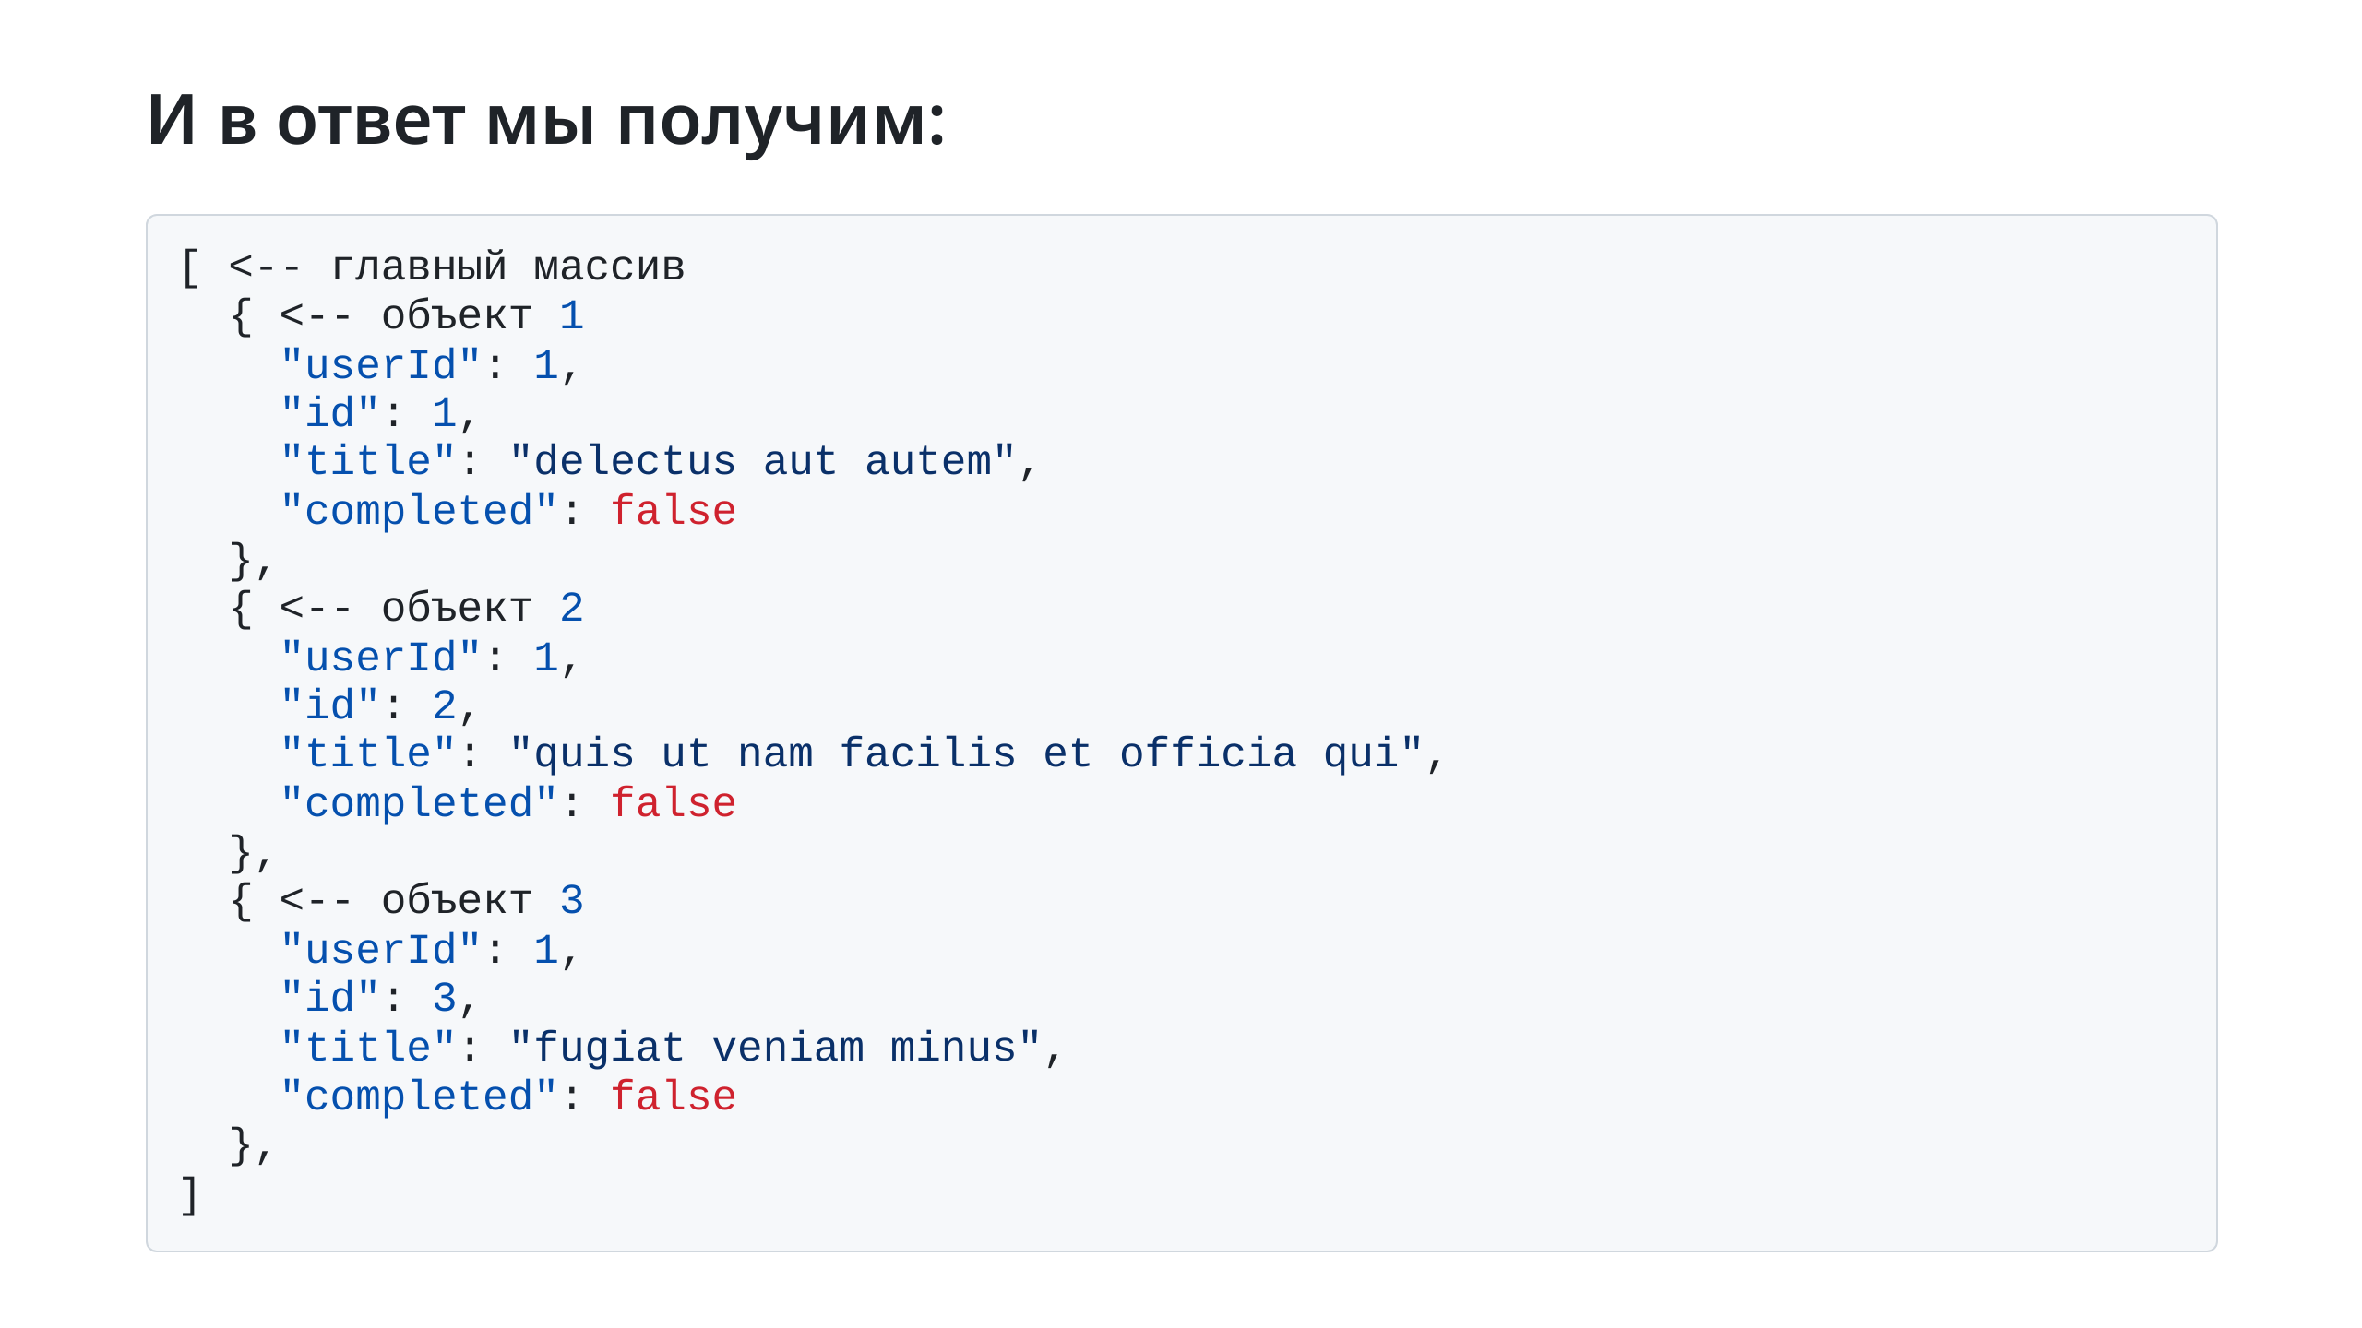
Notes:
sldie 8: json response

Slide 10
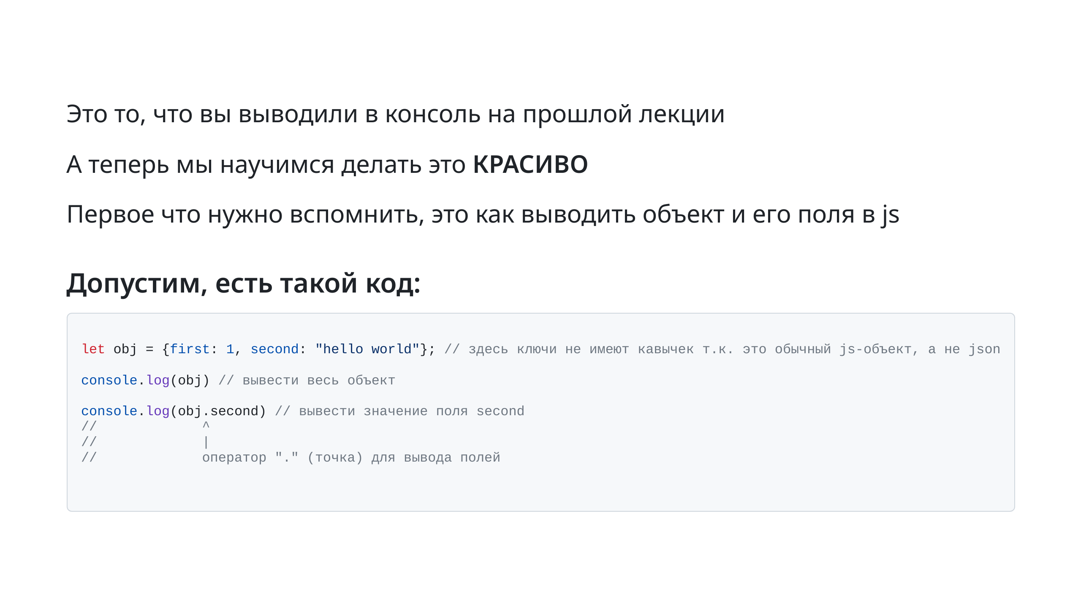
Notes:
slide 10: road to html

Slide 11
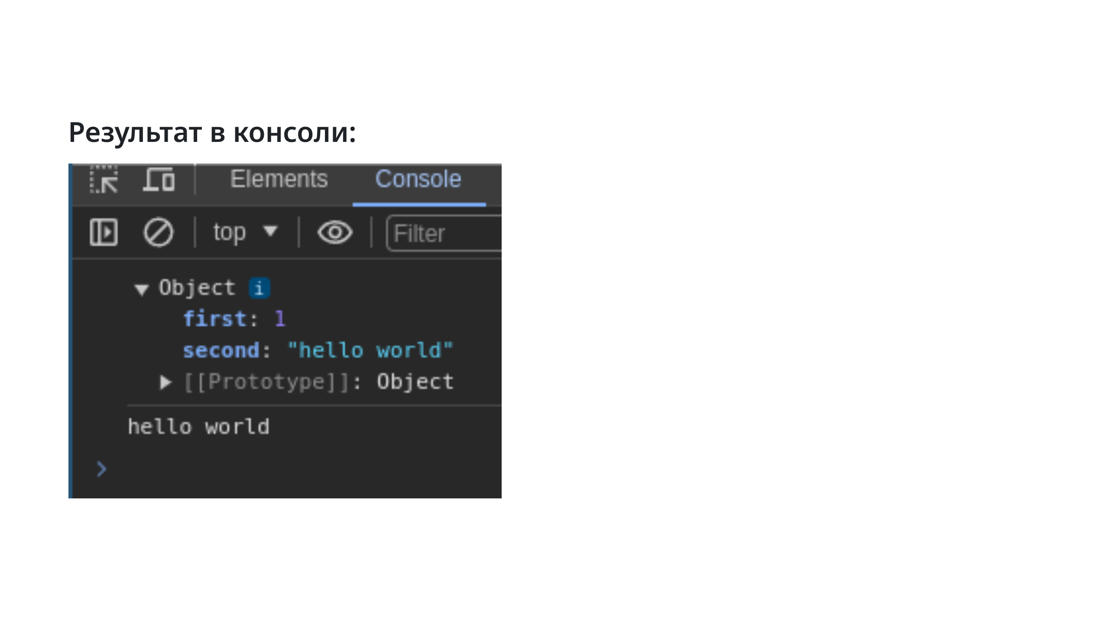
Notes:
slide 11: console result

Slide 12
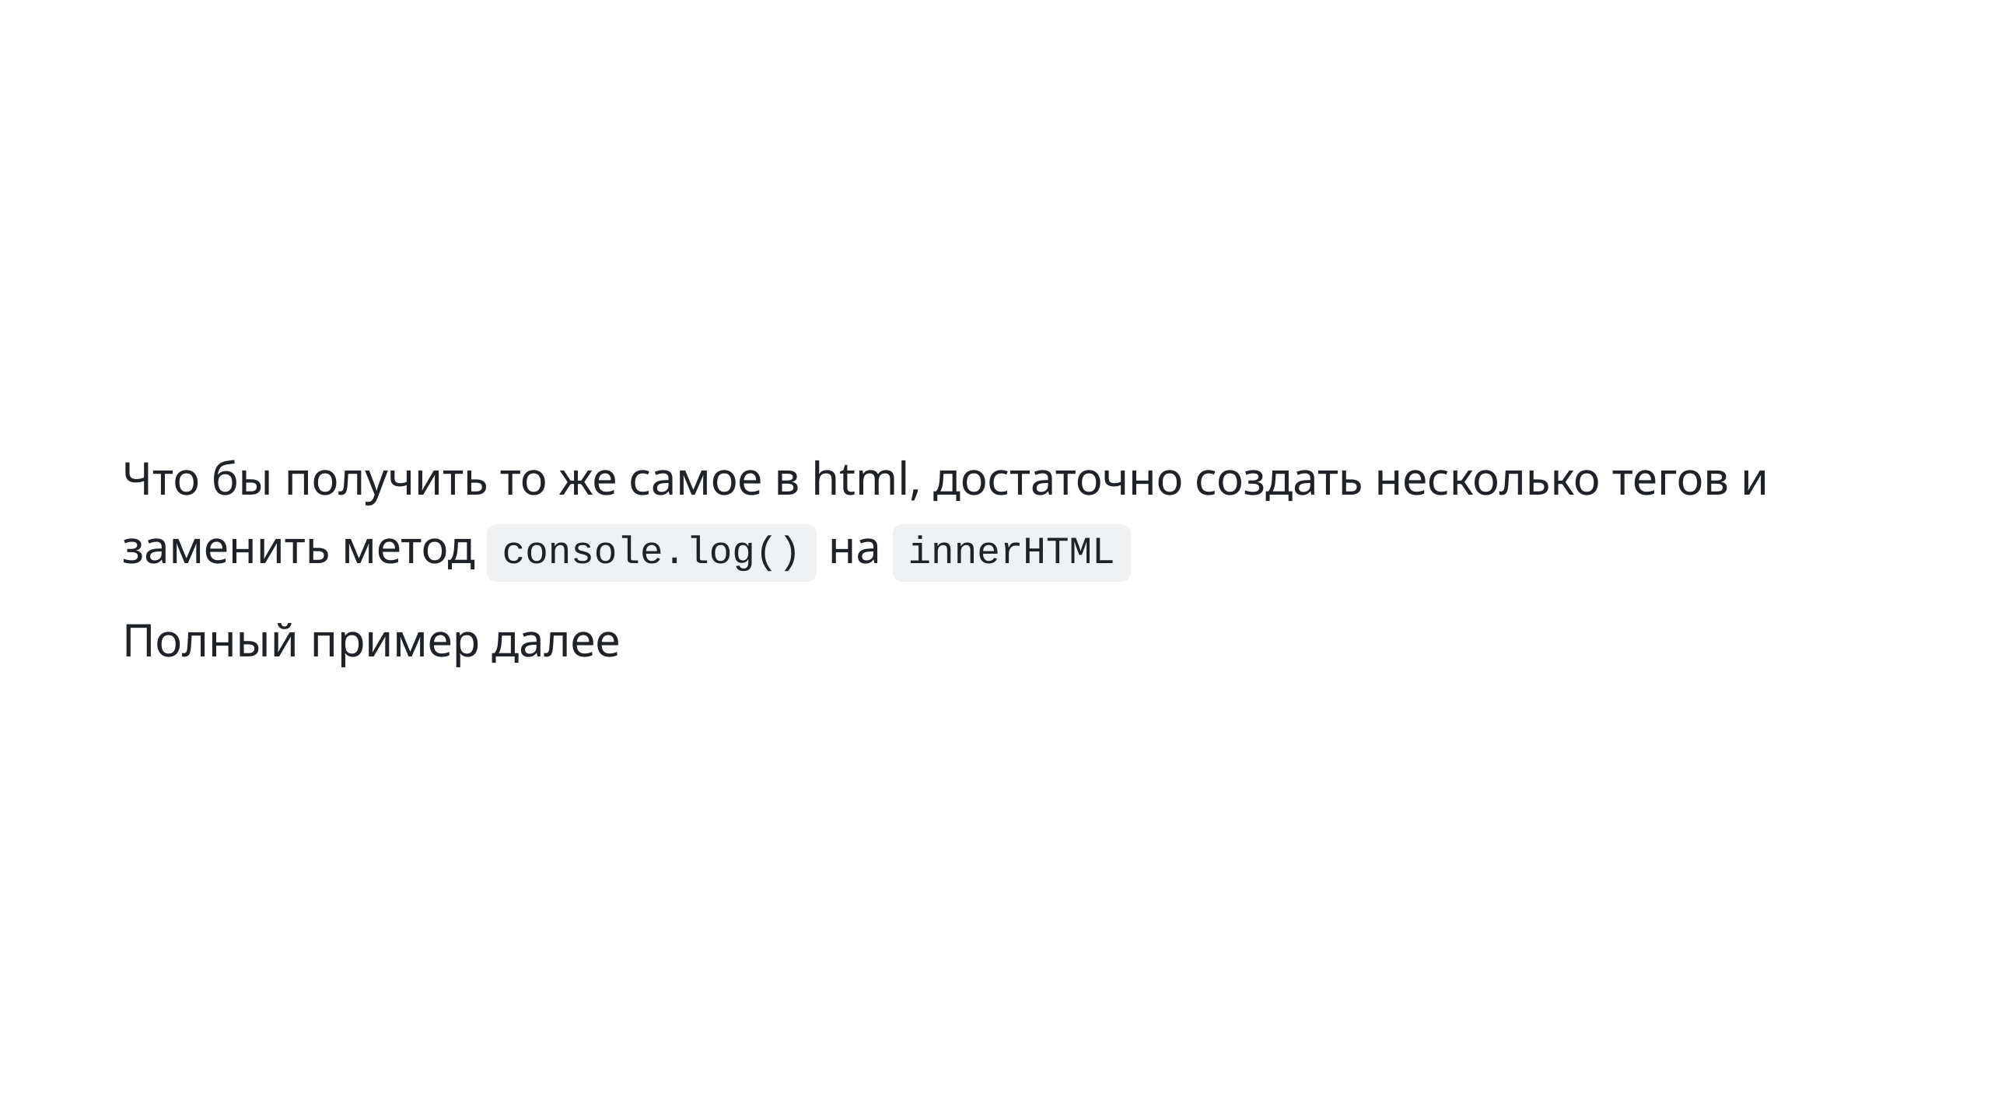
Notes:
slide 12: same in html

Slide 13
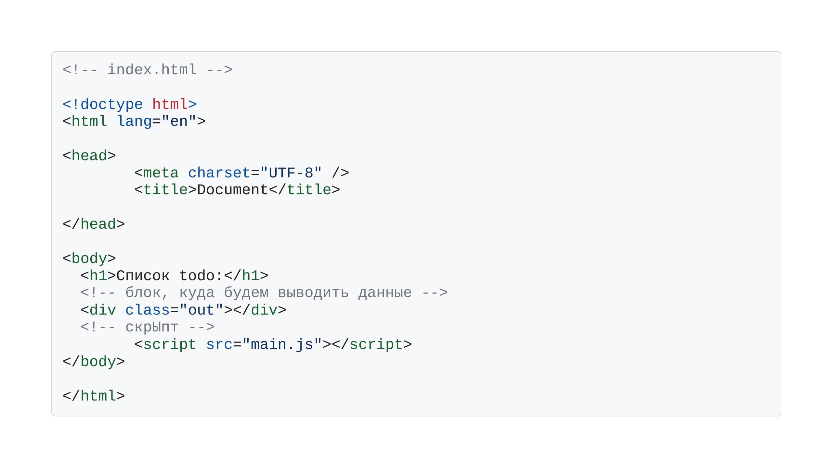
Notes:
slide 13: example

Slide 14
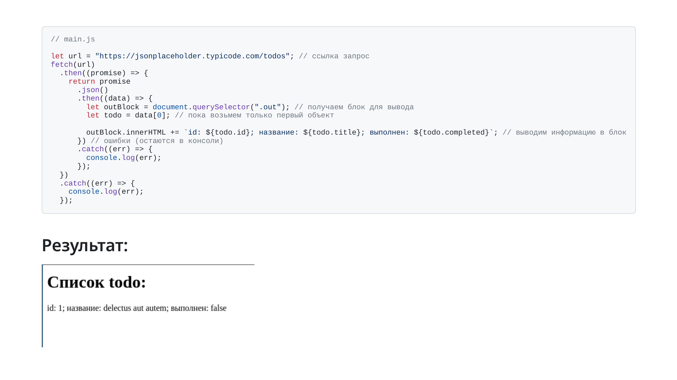

Slide 15
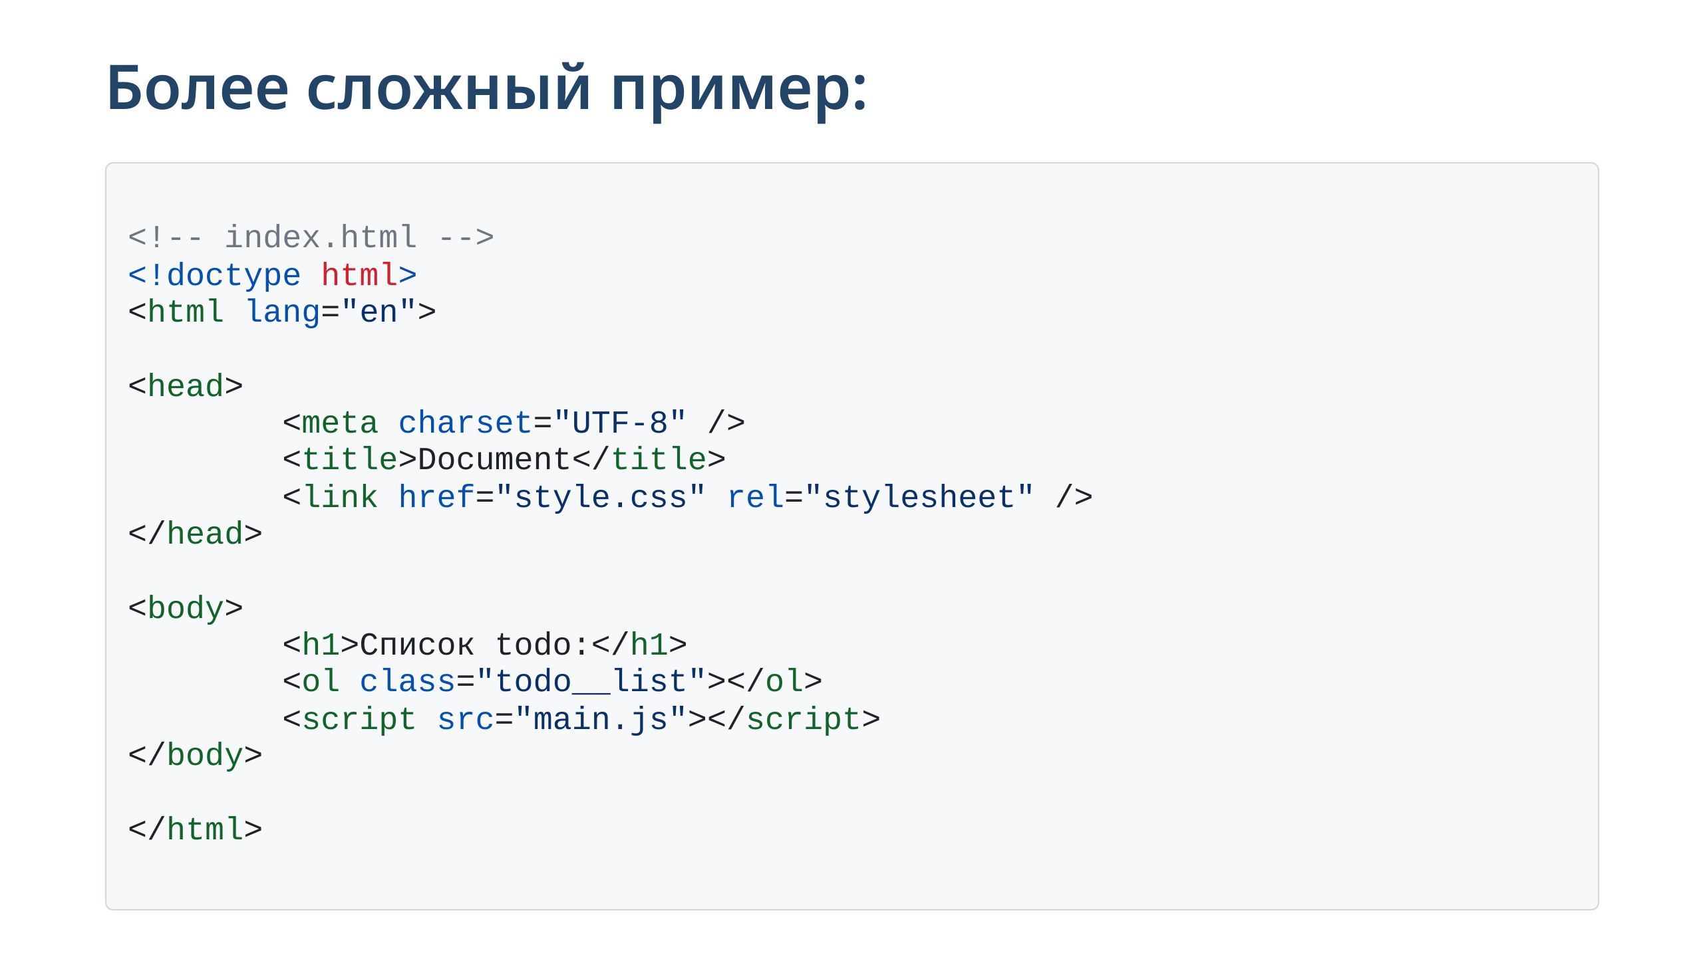

Slide 16
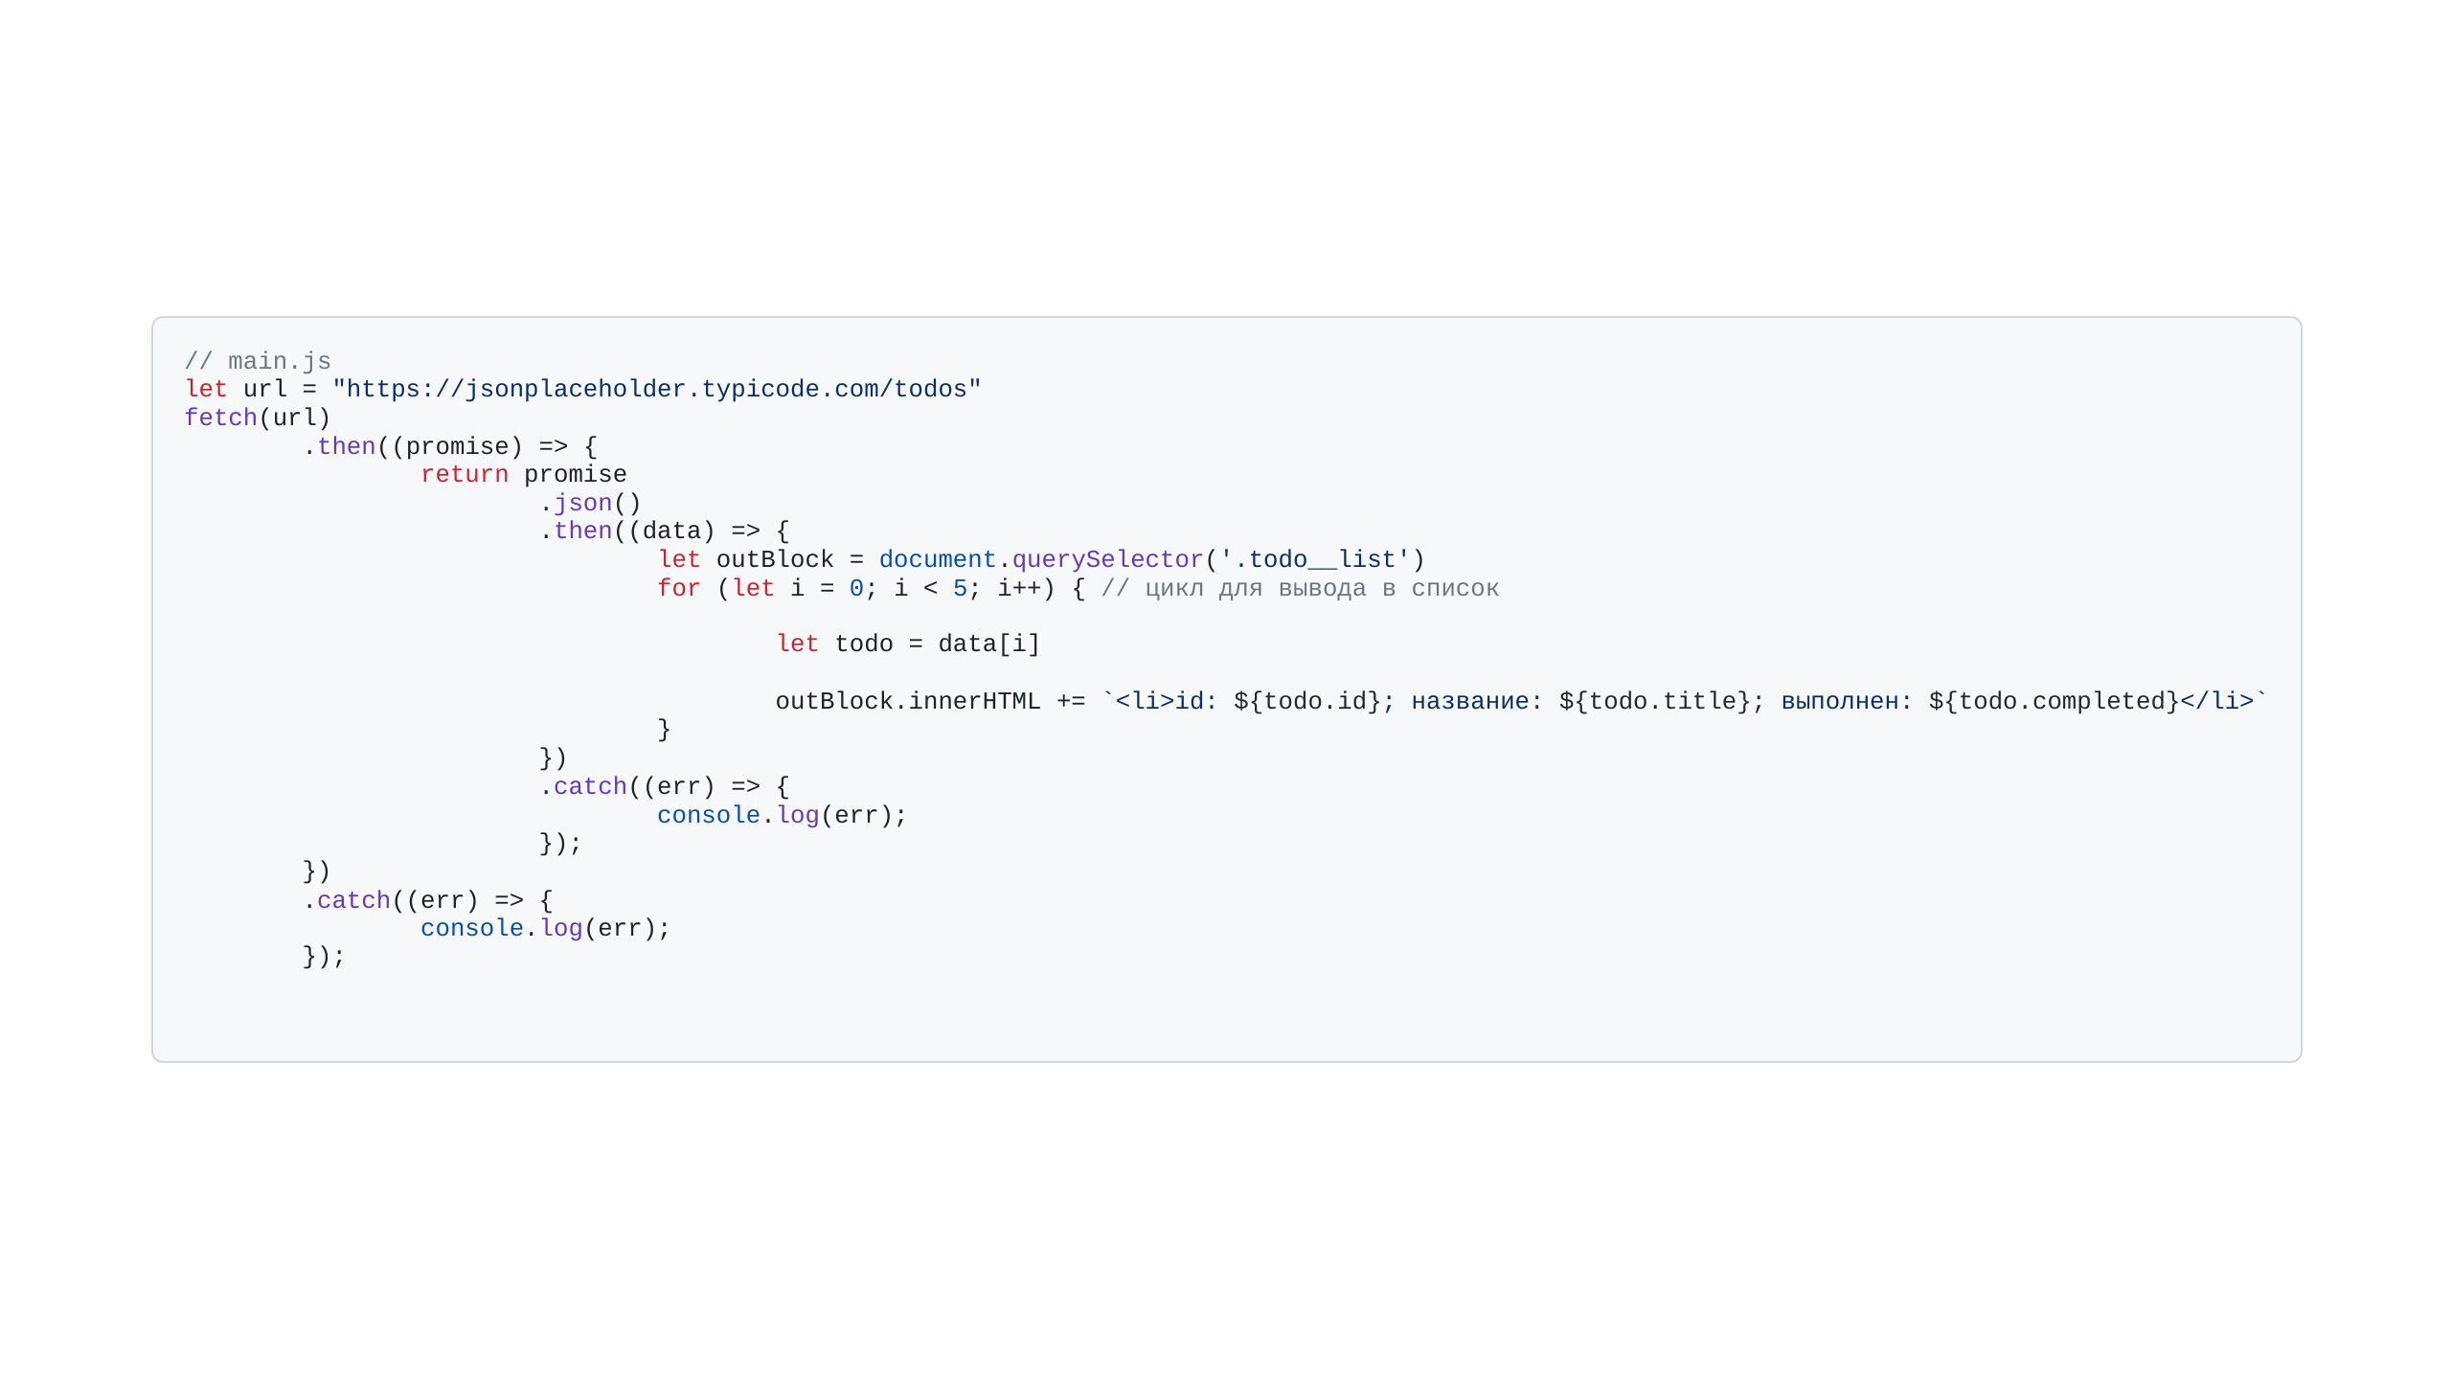

Slide 17
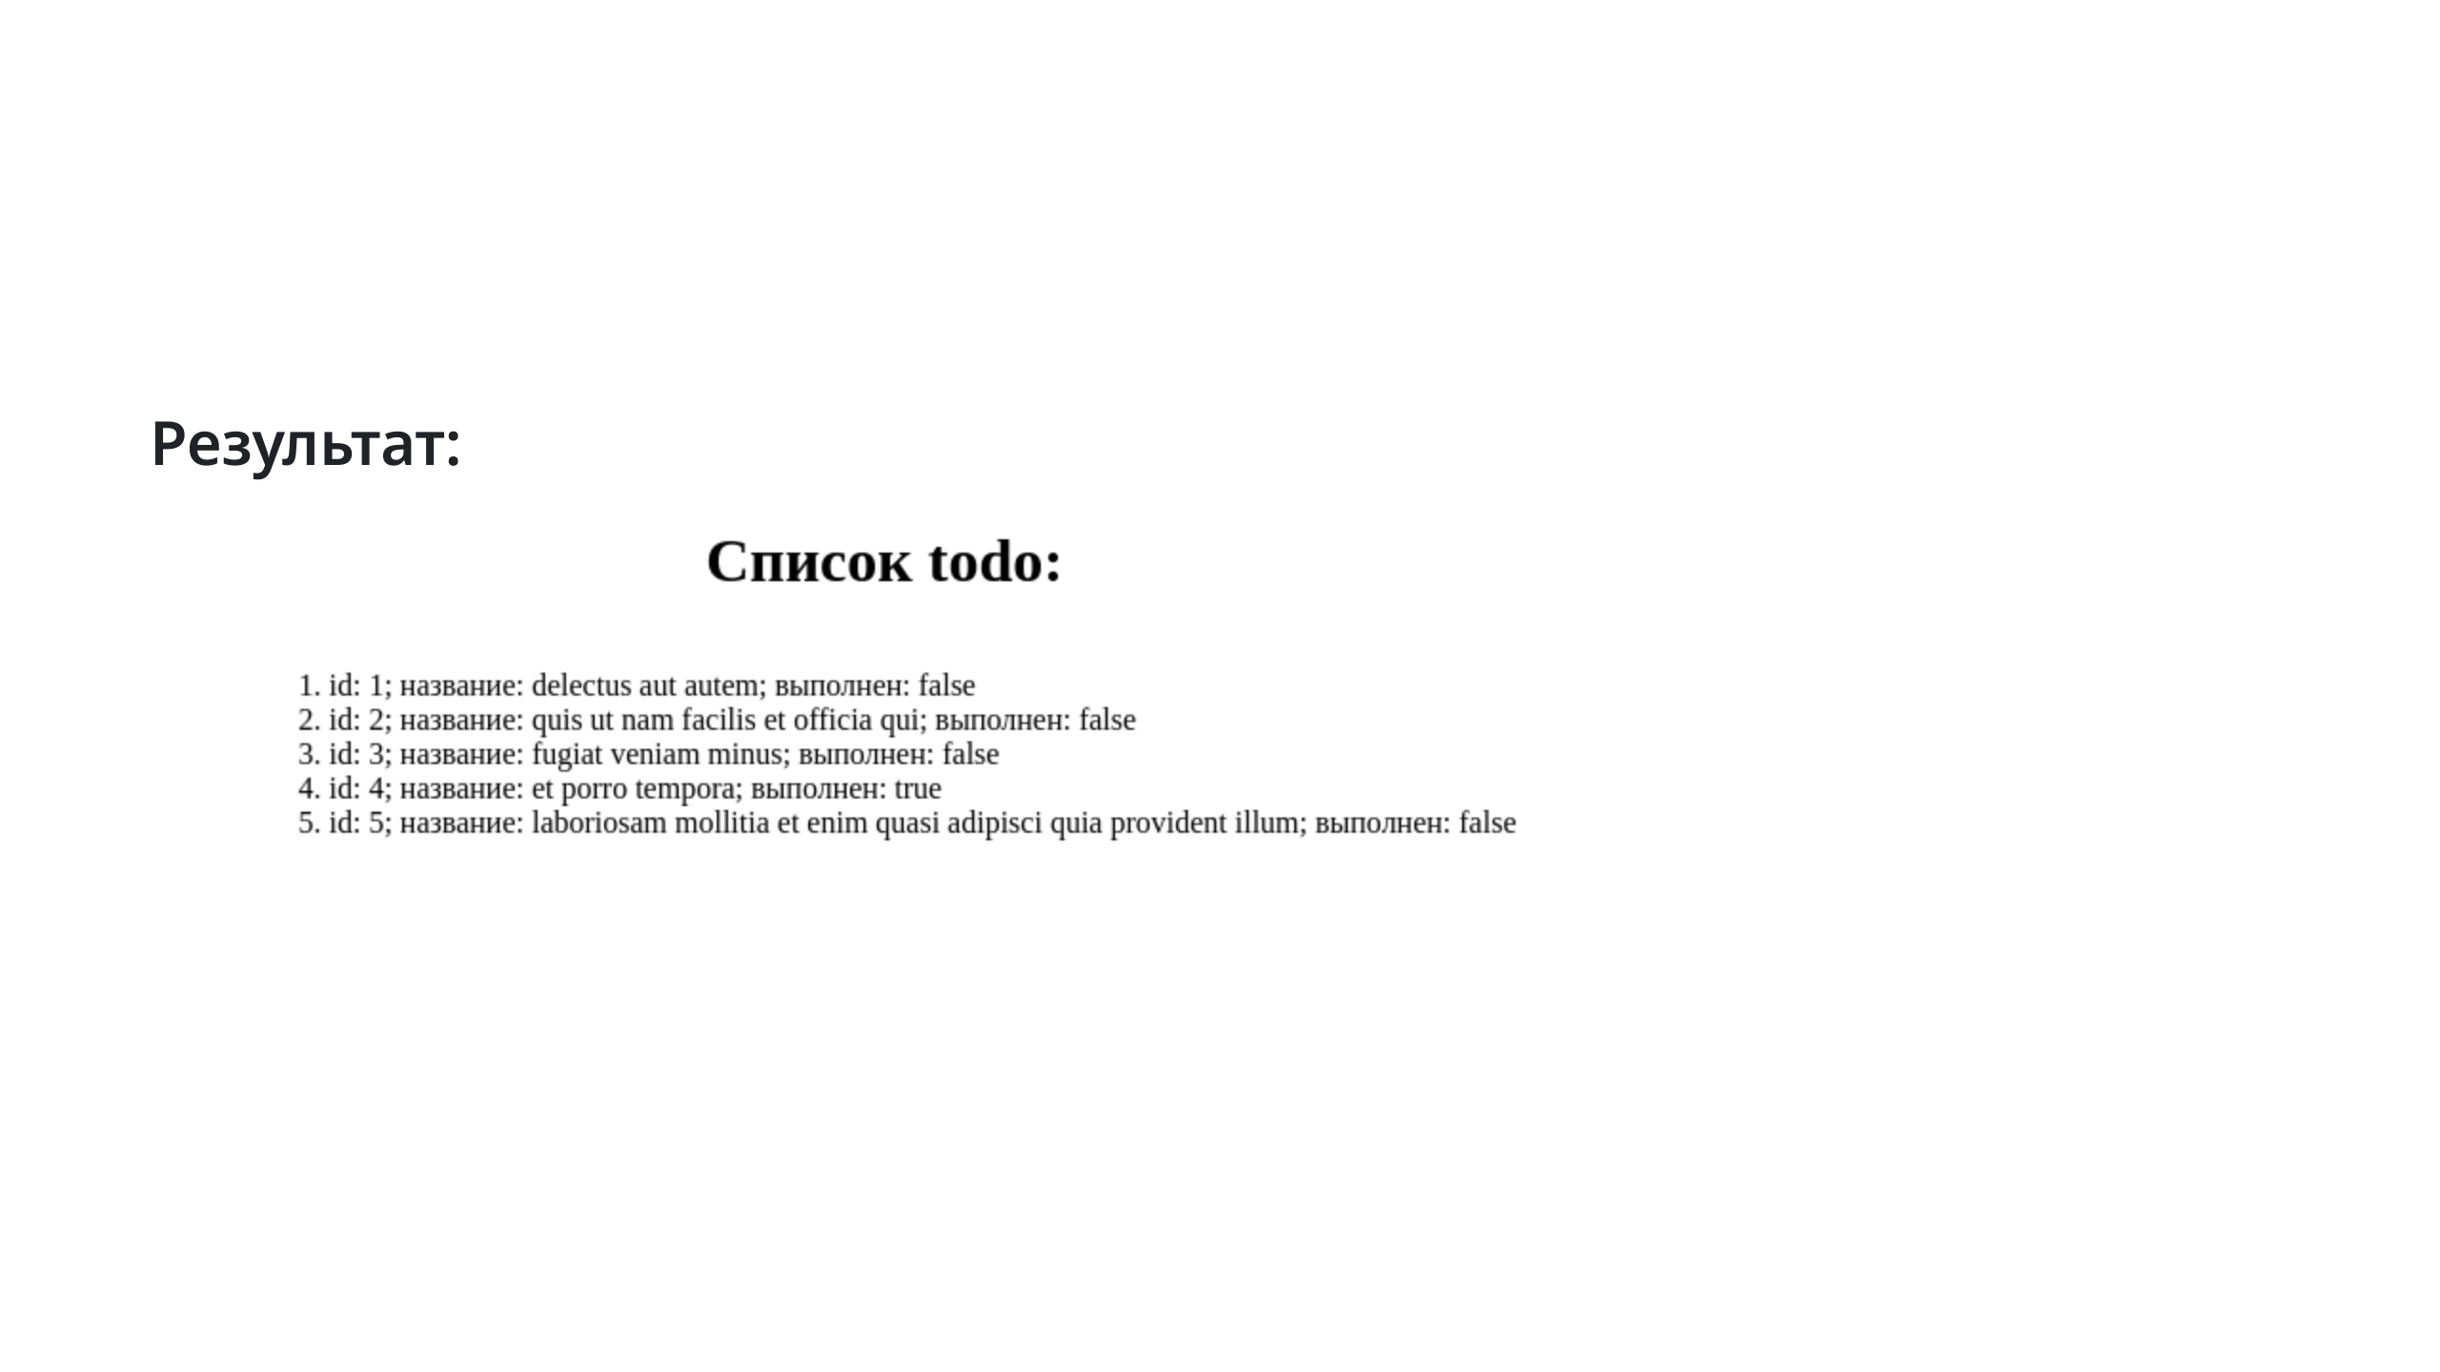

Slide 18
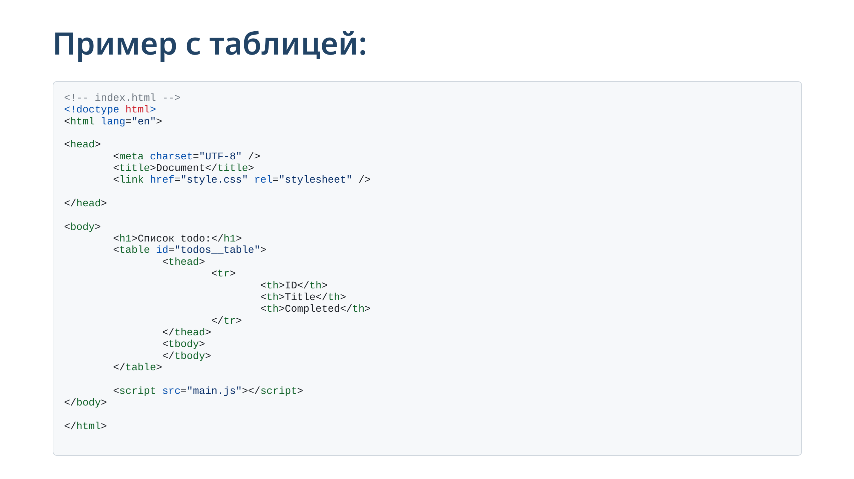

Slide 19
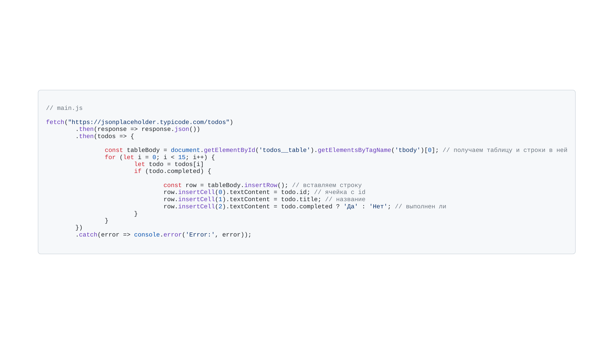

Slide 20
