Slide 1
Project/Thesis Proposal Management System
Presented by
Ashfia Khatun
Dept. of ITM
3rd Batch
ID: 211 51 038
Supervised by
Ms. Nusrat Jahan
Assistant Professor
Head of the ITM Dept, DIU

Slide 2
Background
Overview of current challenges:
  Overloaded email inboxes.
  Risk of losing proposals.
  Lack of centralized supervisor tracking.

Slide 3
Objective
Streamline proposal submission.
Centralized document management.
Automated supervisor assignment.
Enhance communication and transparency.
Secure data storage and retrieval.

Slide 4
Expected Outcomes
Fully functional web application.
Centralized repository for proposals.
Automated tracking of supervisor assignments.
Transparent workflows and enhanced communication.

Slide 5
Features
Student Portal: Proposal submission and feedback tracking.
Teacher Portal: Proposal review and provide feedback.
Admin Portal: Manage users, departments, reports, and supervisor assignment.
Real-time email notifications and status updates.

Slide 6
Functional Requirements
01
User Authentication & Authorization
User Management
02
Department Segmentation
03
Project/Thesis Proposal Submission
Document Management
04
07
Admin and Supervisor Management
Search and Filter
05
08
Feedback Mechanism
Reporting
06
09
Notifications
10
Audit Trial
11

Slide 7
Non-functional Requirements
01
Scalability: Ensure system handles growing users and data as university expands.
02
Response Time: Optimize for quick user actions like proposal submission and search.
03
Security: Implement data encryption and strong user authentication.
04
Usability: Design an intuitive, accessible interface following WCAG (Perceivable, Operable, Understandable and Robust) standards.
05
Reliability: Aim for high availability, regular backups, and disaster recovery.
06
Maintainability: Use modular codebase and provide comprehensive documentation.

Slide 8
Stakeholders
01
Super Admin: Manages the entire system, including user management, department configuration, and maintenance.
02
Admin (Advisor): Oversees department-specific user accounts, manages the proposal submission process and approves or rejects proposals.
03
Supervisor (Teacher): Reviews, and provides guidance and feedback to students.
04
Students: Submit proposals, track their status, and receive feedback from supervisors.

Slide 9
System Architecture
01
Frontend: Laravel Blade templates, Bootstrap, and JavaScript
Backend: PHP, Laravel
02
Database: MySQL, XAMPP Server
03
04
Hosting: XAMPP during development, scalable AWS deployment.

Slide 10
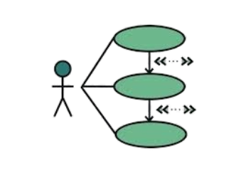
Use Case Diagram
Actors
01
Super Admin
02
Admin
03
Supervisor
04
Student
Diagrams

Slide 11
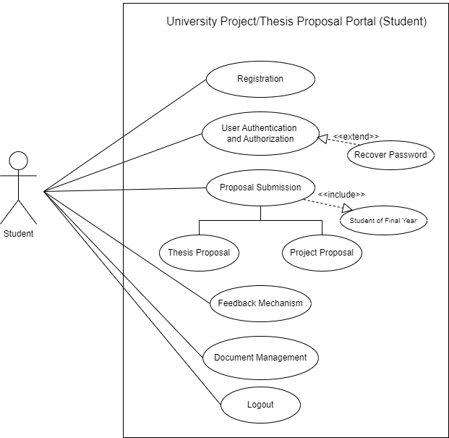
Student
Diagrams

Slide 12
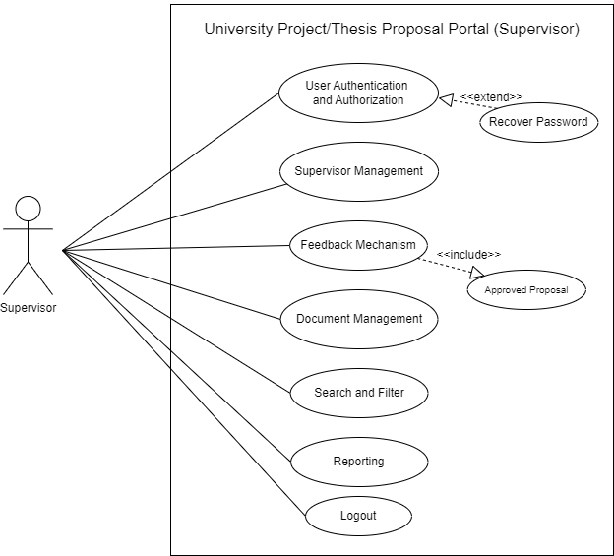
Supervisor
Diagrams

Slide 13
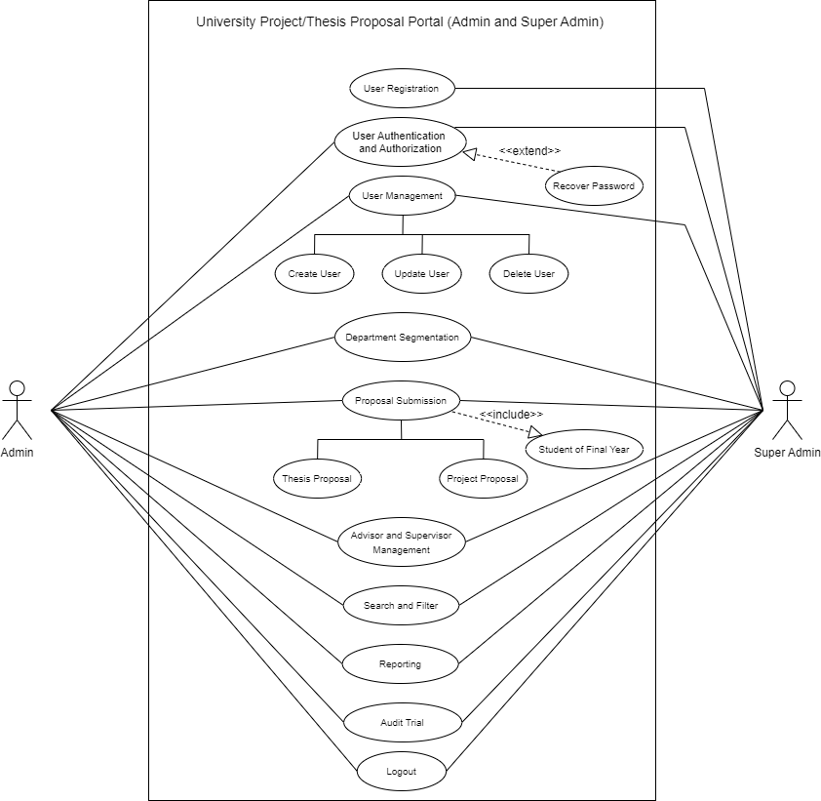
Admin &
Super Admin
Diagrams

Slide 14
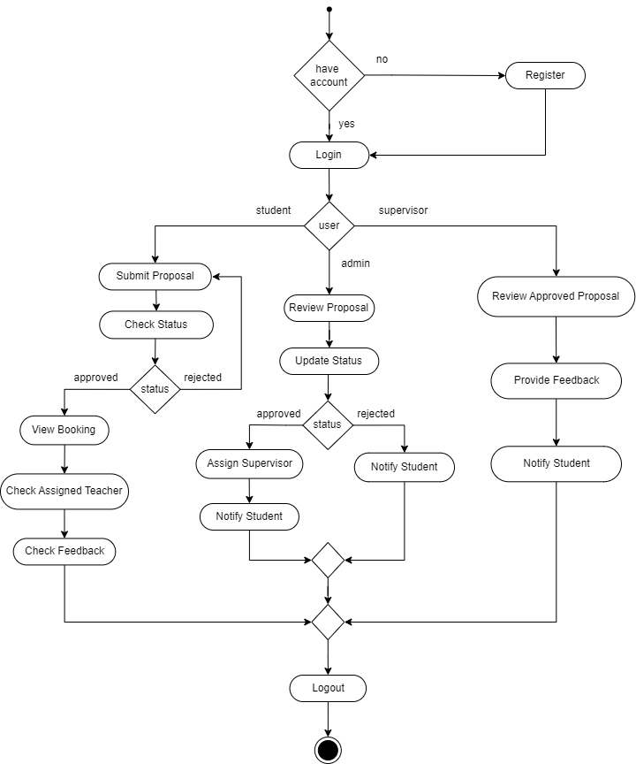
Activity Diagram
Diagrams

Slide 15
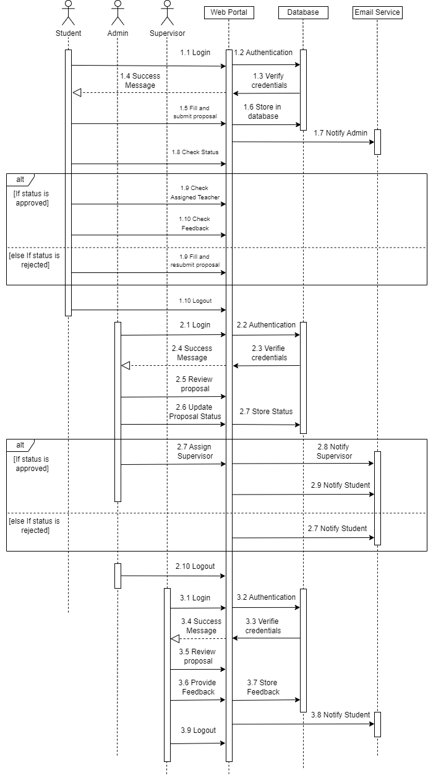
Sequence Diagram
Diagrams

Slide 16
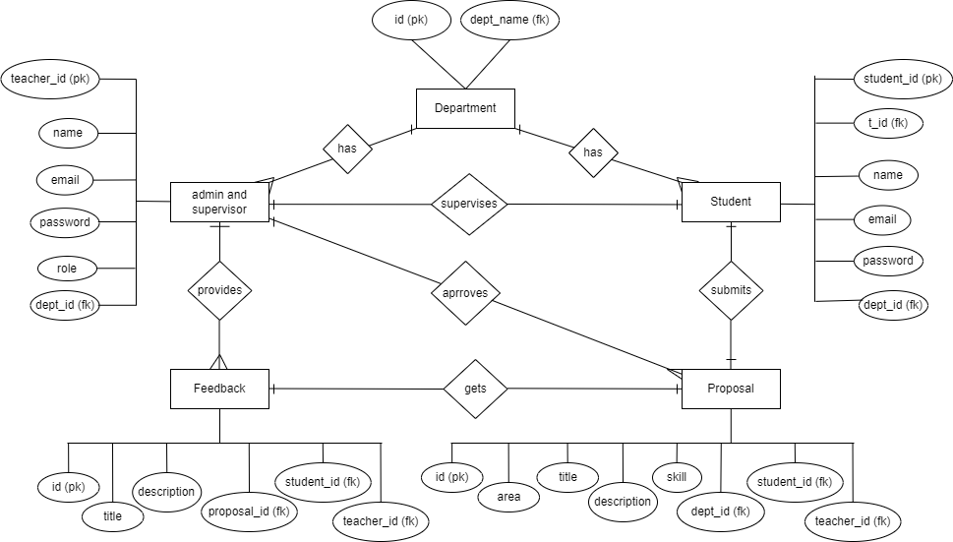
Entity Relationship Diagram (ERD)
Diagrams

