Slide 1


Project LoanSafe
A Neural Net ML To Predict Loan Dollars
Prepared for: GE Credit Branch Stakeholders
Created By: GE Data Analytics Team
Presented By: Richard Snyder
Notes:
Hello Everyone, my name is Richard Snyder. I am part of the GE Data Analytics Team and will be presenting Project Loansafe to you today. Project LoanSafe is a neural network model that can predict how much the company should lend out to our customers. My goal for this presentation is to showcase why this project is so critical to the future of our lending services department and how we can further use the information learned to improve other parts of our business. I will be taking questions at the end of the presentation and I appreciate your time today.

Slide 2
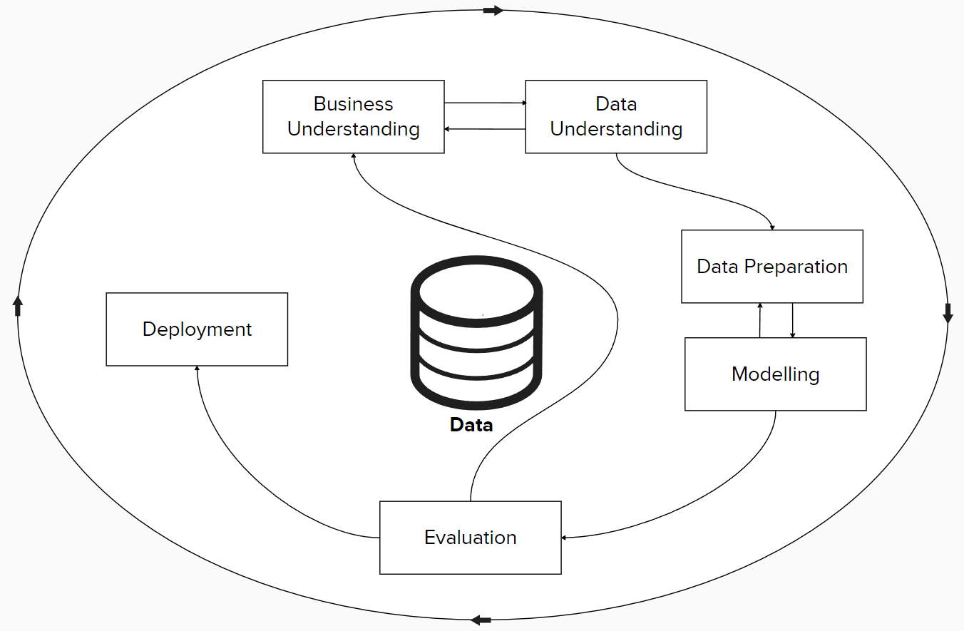

Introduction: CRISP-DM Overview
2. Business Understanding
3. Data Understanding
4. Plan & Model
5. Results
6. Implementation
7. Conclusion
8. Implications
9. Recommendation
10. Q&A
Project LoanSafe
1. Introduction
Notes:
For project LoanSafe, We used the Cross-Industry Standard Process for Data Mining (CRISP-DM) as a framework for this model to ensure that the project stayed on track, guided the analytic plan, and ultimately met the requirements set by the stakeholders. The CRISP-DM methodology is extremely flexible and allows the project to be completely agile and reactive as new discoveries are uncovered during the project. This framework includes business understanding, data understanding, data preparation, modelling, evaluation, and deployment which we will cover in the upcoming slides.
There are many different models we could use for this project, but ultimately we wanted a method which was shown to be succesful in other projects.

Slide 3
Business Understanding
1. Introduction
2. Business Understandi
3. Data Understanding
4. Plan & Model
5. Results
6. Implementation
7. Conclusion
8. Implications
9. Recommendation
10. Q&A
Project LoanSafe
Problem: The GE credit branch do not have an accurate model to calculate how many dollars to lend to each individual customers.
2. Business Understanding
Purpose: To have a way to identify an appropriate dollar range to lend to customers based on their individual situations
Notes:
Starting out, As part of the business understanding phase, we looked at the problem and the purpose of this project. The problem at the core is that the GE Credit Branch does not have an accurate or reliable method to calculate how much to lend to each of our customers. This leads into the purpose of this project which is to identify a method to calculate this number, based on each and every customers unique situation. Understanding this phase lays the groundwork for all other phases, and it is extremely important as we move forward (Stefanovsky, 2023).

Slide 4
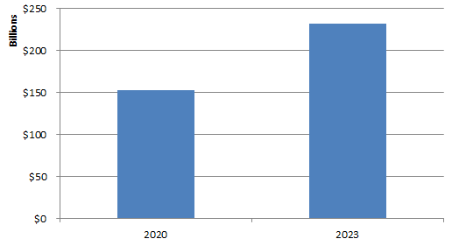
Business Understanding (Continued)
1. Introduction
2. Business Understandi
3. Data Understanding
4. Plan & Model
5. Results
6. Implementation
7. Conclusion
8. Implications
9. Recommendation
10. Q&A
Project LoanSafe
Background: GE needs to be a reputable financial service provider. Trust in the company will equal more customer business and referrals.
2. Business Understanding
Industry Information:
Personal Loan Balances
2020 :$153 Billion
2023: $232 Billion
Delinquency Rates increased from 3.10% to 3.62%
Average Debt $8,895 to $11,548 per borrower. https://newsroom.transunion.com/q2-2023-ciir/
Notes:
Now to take a step back a bit and provide some context to this project and the industry itself. Businesses no longer can rely on the days that a customer may not have a choice in whom they using for banking services. This is a competitive and growing industry and we must find ways to get an advantage. We have seen personal loan balances increase across the US from $153 Billion in 2020 to $232 Billion in 2023. This project and others like it will seek to promote providing appropriate and fair loans to our customers and lower delinquency rates at our company (TransUnion, 2023). Background: having a model in place will increase profits through lower defaults and less overall risk.

Slide 5
Business Understanding (Continued)
1. Introduction
2. Business Understandi
3. Data Understanding
4. Plan & Model
5. Results
6. Implementation
7. Conclusion
8. Implications
9. Recommendation
10. Q&A
Project LoanSafe
Data Mining Goals:
Identify Important Variables
Create a model to calculate target variable amount.
2. Business Understanding
Concerns:
Limited & Biased Data
Current Macroeconomic Climate
Principles of the data problem:
May not have the necessary variables
Notes:
The goals of this project are to determine what factors determine how much we should loan out to a customer. This will lead us to creating a model that we can use to solve complex business problems, such as lowering risk levels in lending. We also have some concerns as we undertook this project which includes the fact that we may not have all the data we need to be as accurate as we would like with this model. We may need more customer variables, such as credit score, that we did not have available during the development to create a truly accurate model. The team needs to also acknowledge that outside factors can impact this model heavily. For example, during the 2008 financial crisis, many people had to suddenly deal with being out of work, among other critical life events, which may have prevented them from being able to pay back a loan (Weinberg, n.d.).

Slide 6
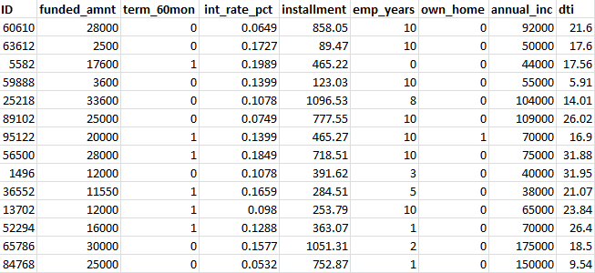
Data Understanding
1. Introduction
2. Business Understanding
3. Data Understandin
4. Plan & Model
5. Results
6. Implementation
7. Conclusion
8. Implications
9. Recommendation
10. Q&A
5k
Project LoanSafe
5k Records
74 Variables
3. Data Understanding
Notes:
The dataset selected is the GE Credit Branch customer credit amount dataset. This dataset itself consists of 5,000 records and 74 variables, which reflect both information on the borrower and the specific loan details. Many of the variables will be included in the initial model as we seek to understand what drives the target variable, funded amount.

Slide 7
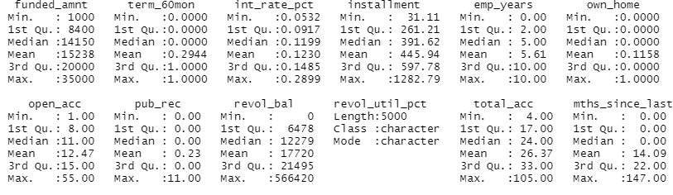
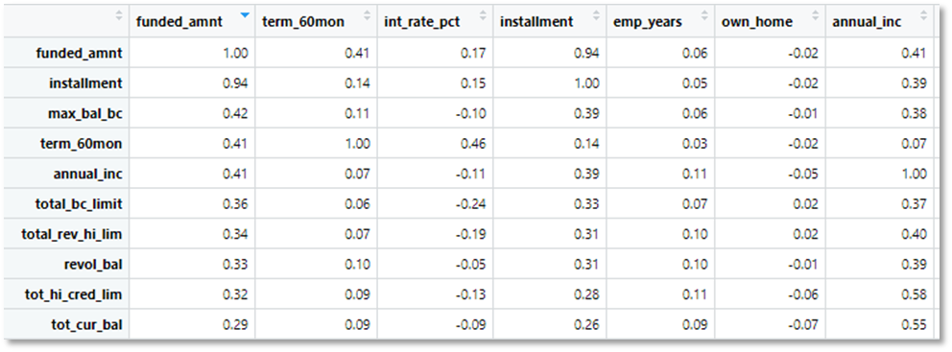
Data Understanding (Continued)
CRISP-DM Data Understanding Phase: Describe your data, explore your data, and verify your data (discuss the types of data in the dataset and rationale for inclusion or exclusion, descriptive statistics analysis).
1. Introduction
2. Business Understanding
3. Data Understanding
4. Plan & Model
5. Results
6. Implementation
7. Conclusion
8. Implications
9. Recommendation
10. Q&A
Project LoanSafe
3. Data Understanding
Notes:
To understand the dataset we used the programming language r along with many of its available packages. Our team first used descriptive statistics we were able to get a summary of the dataset. This provided the min, max, mean, median, and quartiles for each variable. This also allowed us to get an idea as to the distribution for all of the variables (Soetewey, 2020). Here we can see the distribution of the data and will be alerted to any problems with the quality of the data that was provided (Hotz, 2024). We can see that mean home ownership is 0.1158, which given it is a binary data type, tells us that most people applying for this credit do not own a home. Many of the variables appear to be correlated, so we next used the corr function (Pearson?) to see get the specific values of how they related to one another. The loan installment, max balance on a bank card, whether it was a 36 or 60 month loan, and annual income were the most correlated with the funding amount target (Bobbitt, 2021). Our understanding of the data also tells us that installment would not be useful as it was derived from the funded amount, interest rate, and length of the loan.

Slide 8
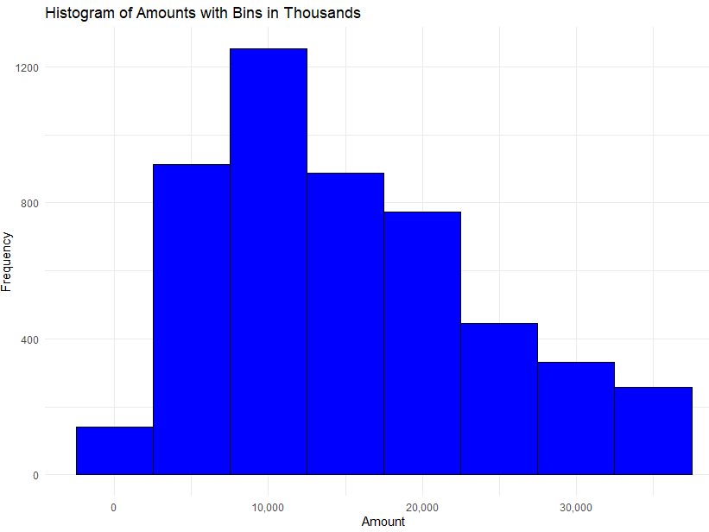
Data Understanding (Continued)
Data Understanding (Continued)
CRISP-DM Data Understanding Phase: Describe your data, explore your data, and verify your data (discuss the types of data in the dataset and rationale for inclusion or exclusion, descriptive statistics analysis).
1. Introduction
2. Business Understanding
3. Data Understandin
4. Plan & Model
5. Results
6. Implementation
7. Conclusion
8. Implications
9. Recommendation
10. Q&A
Project LoanSafe
Number of Loans vs Amount
3. Data Understanding
Notes:
It was also a good idea at this point to get an understanding of the target variable, funded amount. We can see in the chart that most of our loans are within the $5 to $25k range. This information as helpful to identify outliers and to also determine if this dataset is a good representative of the population of loans held by our customers. A breakdown like this lets really start to understand what the data is telling us.

Slide 9
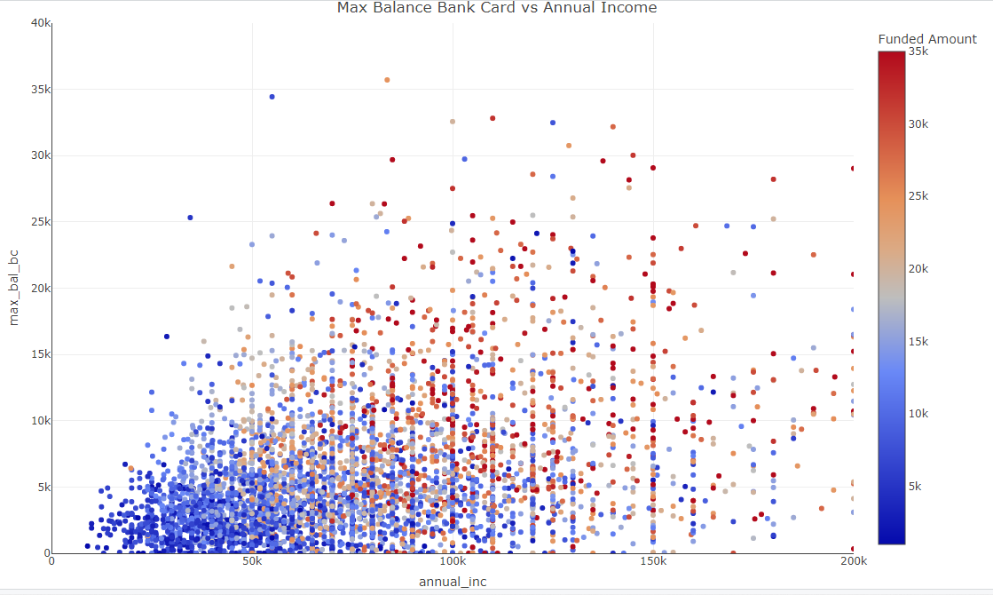
Data Understanding (Continued)
Data Understanding (Continued)
CRISP-DM Data Understanding Phase: Describe your data, explore your data, and verify your data (discuss the types of data in the dataset and rationale for inclusion or exclusion, descriptive statistics analysis).
Initial Variable Exclusion :
1. Introduction
2. Business Understanding
3. Data Understanding
4. Plan & Model
5. Results
6. Implementation
7. Conclusion
8. Implications
9. Recommendation
10. Q&A
Project LoanSafe
ID
INSTALLMENT
3. Data Understanding
Notes:
As mentioned before, Many of the variables will be included in the initial model; however, some of the loan details, such as installment (monthly payment), may not be useful as they are derived from the loan amount, interest rate, and term. Because of this we will exclude it from the model. We will also remove the first column, which is the unique identifier variable of the customers, as this variable has no bearing on the credit amount. Further, we can see how certain variables interact with the target variable. In this chart we can see the max balance held on a credit card the higher the income for our customers to some degree. We can also see that most of our customer base is clustered together.

Slide 10

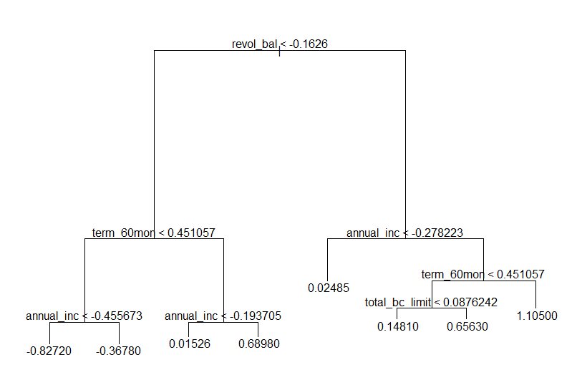

Data Understanding (Continued)
Data Understanding (Continued)
CRISP-DM Data Understanding Phase: Describe your data, explore your data, and verify your data (discuss the types of data in the dataset and rationale for inclusion or exclusion, descriptive statistics analysis).
1. Introduction
2. Business Understanding
3. Data Understanding
4. Plan & Model
5. Results
6. Implementation
7. Conclusion
8. Implications
9. Recommendation
10. Q&A
Project LoanSafe
Decision Tree Variable Inclusion:
Revol_Bal
Term_60mon
Annual Inc
Total_bc_limit
3. Data Understanding
Notes:
After this getting a basic understanding of the data and removing a few variables. We can then start using certain models, such as a basic decision tree and a random forest to assist in further determining which variables would be best to include in building the neural network.
Here we used a decision tree that let us know that certain variables, such as revolving credit balance, were the primary deciding factor in predicting the dollar amount of a loan to provide. Annual income is also important as well as the max balance on a bank card.

Slide 11
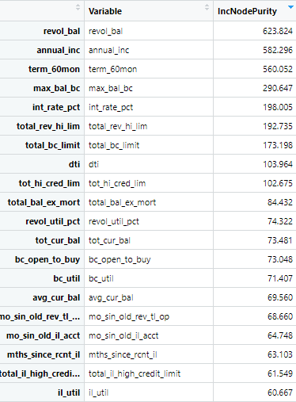

Data Understanding (Continued)
Data Understanding (Continued)
CRISP-DM Data Understanding Phase: Describe your data, explore your data, and verify your data (discuss the types of data in the dataset and rationale for inclusion or exclusion, descriptive statistics analysis).
1. Introduction
2. Business Understanding
3. Data Understanding
4. Plan & Model
5. Results
6. Implementation
7. Conclusion
8. Implications
9. Recommendation
10. Q&A
Project LoanSafe
Random Forest Variable Inclusion:
Revol_Bal
Annual Inc
Term_60mon
Max_Bal_bc
Int_rat_pct
Total_rev_hi_lim
Total_bc_limit
3. Data Understanding
Notes:
To go further and find more variables to include, we also ran a random forest model which allowed us to see the importance of the variables, and from here we can see that non-loan specific information, such as revolving balance, annual income, and the max balance of a customer’s bank card were again scored highly. This let us know we were on the right track in choosing to include and exclude certain variables and we were ready to now build the model.

Slide 12
Plan Definition
Plan Definition: This should include the CRISP-DM Data Preparation phase: Create a data analytic architecture pattern; include the details for full implementation. Details will need to address data quality, data integrity, and protection specific to the organization, industry, and problem that you are addressing. You will create visualizations representing your solutions for various stakeholders that you will need to identify. Develop a project plan detailing the involved stakeholders, the timeline, and strategies for professional and effective collaboration to be used to ensure success.
1. Introduction
2. Business Understanding
3. Data Understanding
4. Plan & Model
5. Results
6. Implementation
7. Conclusion
8. Implications
9. Recommendation
10. Q&A
Project LoanSafe
Data Quality
Integrity
Protection
4. Plan & Model
Notes:
After the business and data understanding phases comes the data preparation phase for this project. Data cleaning for this dataset includes both imputation for missing values and checking the structure of the data. There were missing values for a few of the variables and one in particular, the ratio of total current balance to the credit limit, had 12.48% of the values missing. To expedite the process, we used the median value of this field to fill in these missing values. Another issue was that one of the fields that represent the revolving utilization percentage was set as a character type and needed to be converted to numeric type.
After the data was cleaned we could work on preparing it for the neural network model. . The target variable funded amount itself does have a right-skew, and we will use a log transformation on this data to have it normally distributed this dataset represents many different data types, and to get them to a state where they can be compared they need to be scaled correctly. We can use z-score transformation for this task, and this can be done using the caret package. This is needed as we are comparing different values like percentages and dollar amounts which require normalization for them to contribute to the model equally (Ross, 2022).

Slide 13
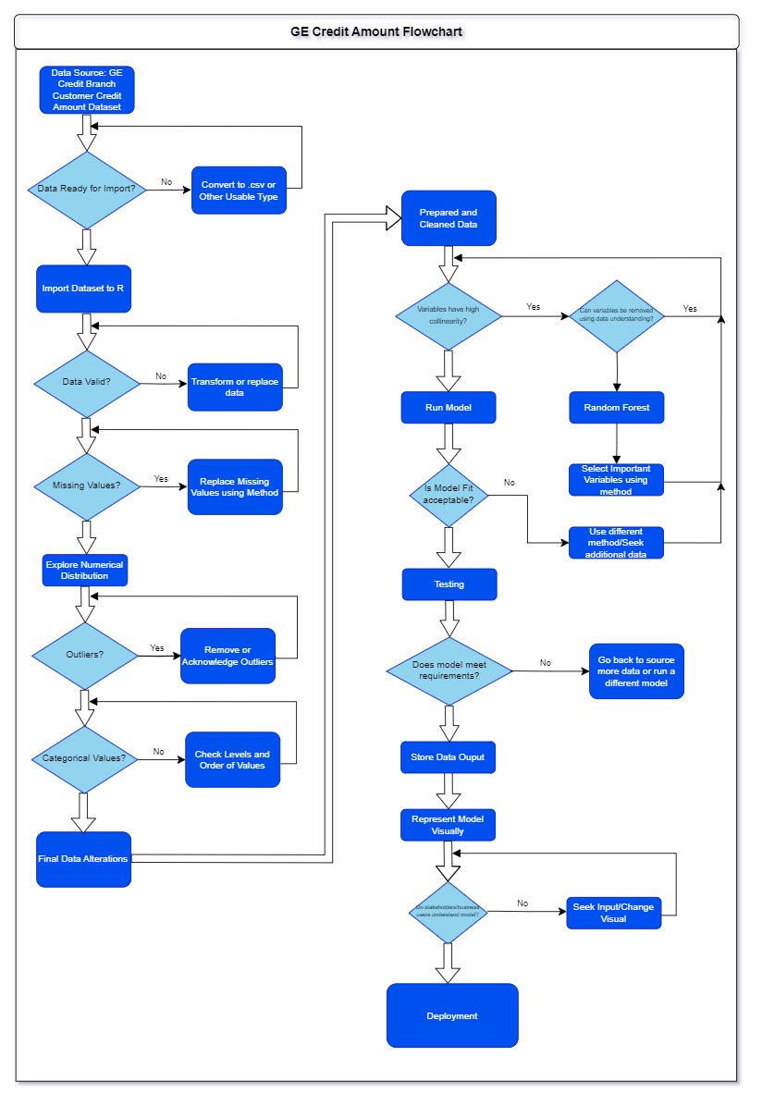
Plan Definition
Plan (Continued)
Plan Definition: This should include the CRISP-DM Data Preparation phase: Create a data analytic architecture pattern; include the details for full implementation. Details will need to address data quality, data integrity, and protection specific to the organization, industry, and problem that you are addressing. You will create visualizations representing your solutions for various stakeholders that you will need to identify. Develop a project plan detailing the involved stakeholders, the timeline, and strategies for professional and effective collaboration to be used to ensure success.
1. Introduction
2. Business Understanding
3. Data Understanding
4. Plan & Model
5. Results
6. Implementation
7. Conclusion
8. Implications
9. Recommendation
10. Q&A
Project LoanSafe
4. Plan & Model
Notes:
As can be seen in the graphic we followed a strict flowchart to ensure that our data and project was structured with a sound pathway to produce results. Moving back or to prior phases in CRISP-DM allows us to acquire more data as needed, and this flowchart made it easy to ensure that none of the required steps were missed. The dataset was split into train and test datasets at an 80/20 split which will allow us to score the model after it has been created (Data Detective, 2020).

Slide 14
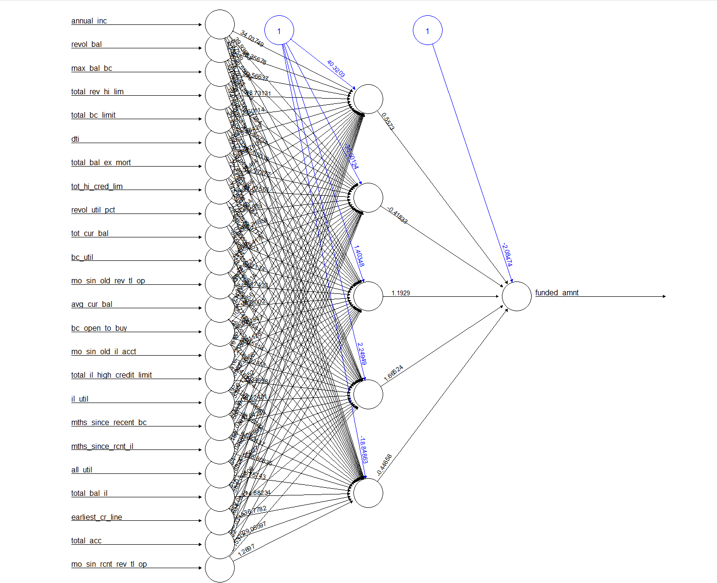
Model
You will create visualizations representing your solutions for various stakeholders that you will need to identify. Develop a project plan detailing the involved stakeholders, the timeline, and strategies for professional and effective collaboration to be used to ensure success.
1. Introduction
2. Business Understanding
3. Data Understanding
4. Plan & Model
5. Results
6. Implementation
7. Conclusion
8. Implications
9. Recommendation
10. Q&A
Project LoanSafe
4. Plan & Model
Notes:
Finally, the model was run. We can see the neural network displayed which shows how certain variables moved into the model and had weights and other measures adjusted to come to a conclusion on the funded amount target variable. Neural network are very open to receive new data, and over time it will improve model results.

Slide 15
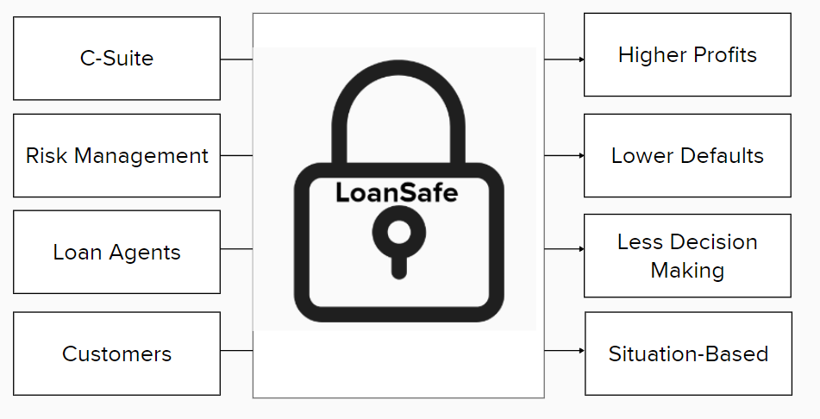
Model (Continued)
1. Introduction
2. Business Understanding
3. Data Understanding
4. Plan & Model
5. Results
6. Implementation
7. Conclusion
8. Implications
9. Recommendation
10. Q&A
Project LoanSafe
4. Plan & Model
Notes:
The project plan itself acknowledges the importantance of keeping stakeholders involved during development and during production. This model will be launched and used in a pilot capacity first to ensure that calculations are being done a proper manner. We will be able to see the results of the model over the first month. More strategic decision making, situation-based lending will be the direct result of this project. We will also be constantly seeking feedback from all stakeholders to see how we can improve any aspect of the project including communication and collaboration efforts.

Slide 16
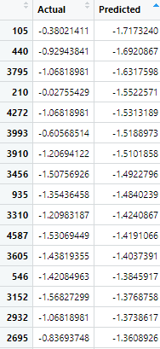
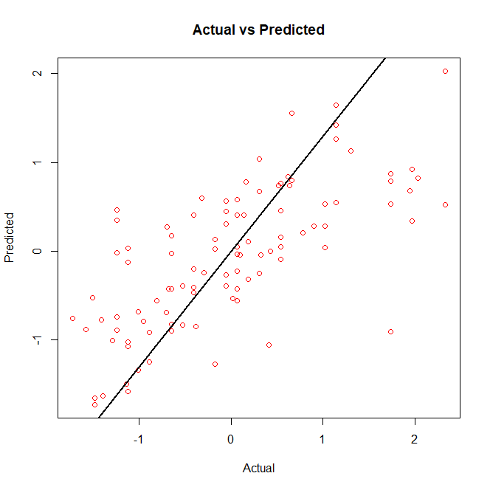
Results
1. Introduction
2. Business Understanding
3. Data Understanding
4. Plan & Model
5. Results
6. Implementation
7. Conclusion
8. Implications
9. Recommendation
10. Q&A
Project LoanSafe
5. Results
Notes:
Okay, this is where we score the model based on predictive accuracy, and if the model will meet the objectives of the project. While there was no specific accuracy goal for this project, the model performed well given the limited amount of variables, and produces a solid data driven prediction of the target variable funded amount. It is my belief however, while the model was successfully able to give the specific dollar amount that should be lent to customers, we should use the findings as a starting point and consider funding amounts above the calculated measure. This process alongside human review, will allow us to use the results in a safe manner and so that the model will improve over time. As the model improves using months of newly input loan data the company can then tighten the threshold range of what dollar amount to provide to the customer and also potentially rely on the value more often.
To give specifics for those interested, we used the measures R-Squared, the Mean Squared Error (MSE), and Root Mean Squared Error (RMSE) to determine the accuracy of this model (LinkedIn, n.d.). The MSE is 0.724 which is based on the range of values of -1.64 to 2.28 and is considered good for this model. We also had an R-Squared value of 0.48 which lets us know that forty-eight percent of target funding amount variable can be explained by the variables we included (Orulluoglu, 2023). . The next step of this plan is to evaluate it in a testing environment, and see how it works alongside other systems before it is moved to production. The team should also look at outliers discovered in the model to see if those customers may have issues in the future repaying a loan. The findings of this model will go far to mitigate risk to the lending division, and provide customers a loan that they will more likely be able to pay back.

Slide 17
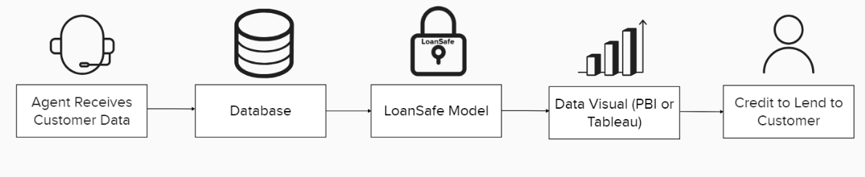
Plan Implementation
1. Introduction
2. Business Understanding
3. Data Understanding
4. Plan & Model
5. Results
5. Results
6. Implementation
7. Conclusion
8. Implications
9. Recommendation
10. Q&A
Project LoanSafe
6. Implementation
Notes:
The Deployment plan is based on how things are currently done. We will provide agents a loan amount to provide to a customer. This is done by first receiving required infomration over the phone or mail from the customer. This information is received by the agent and input within a the database. The loansafe model will be an overnight job that can be run and gives a target funded amount value. This value can be put into a visual, such as PBI or tableau and fed into a CRM system that the agent uses. Over time the model will need to be updated with new data as economic and customer situations change. Maintenance of the model must be done to ensure that patches and protections are in place.

Slide 18
Conclusion
1. Introduction
2. Business Understanding
3. Data Understanding
4. Plan & Model
5. Results
6. Implementation
7. Conclusion
8. Implications
9. Recommendation
10. Q&A
Project LoanSafe
Valuable Output
Immediate Actionable Results
Model will improve over time
7. Conclusion
Notes:
To provide specifics we need to have a full time data analytics team that can tackle new projects as they are prioritized. In addition, we may have lower lending dollars initially as we may be less likely to give certain loans to prospective customers. This will be paid back over time as we protect against customers that are unable to pay back loans.

Slide 19
Implications
1. Introduction
2. Business Understanding
3. Data Understanding
4. Plan & Model
5. Results
6. Implementation
7. Conclusion
8. Implications
9. Recommendation
10. Q&A
Project LoanSafe
Costs:
Low costs, will require team to review model, additional data protections
Benefits:
Safer Loans, Less Defaults, Higher Customer Satisfaction, More Business
8. Implications
Notes:
we can use lessons learned for other projects and the benefits it has are immense. We can consider the use of this model for other completely different divisions within GE.

Slide 20
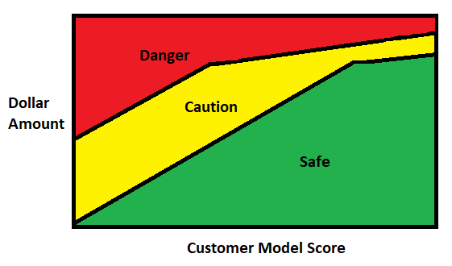

Recommendations
1. Introduction
2. Business Understanding
3. Data Understanding
4. Plan & Model
5. Results
6. Implementation
7. Conclusion
8. Implications
10. Q&A
Project LoanSafe
9. Recommendations
Notes:
The recommendation is to move forward and deploy this model into production. We can use a data visualization that will produce a value that we can safely provide the customer to take out as a loan. This value can even have safe, caution, and danger values where a human review may be necessary. Customer Agents will be able to know that this decision was made using data and not a gut feeling and allows the customer to not take on more debt than they can handle.

Slide 21
Questions?
1. Introduction
2. Business Understanding
3. Data Understanding
4. Plan & Model
5. Results
6. Implementation
7. Conclusion
8. Implications
9. Recommendation
Project LoanSafe
Email: DataAnalyticsTeam@GE.com
Phone: 555-302-2030
10. Q&A
Notes:
At this point, I would like to open up the meeting and its participants to any questions you may have regarding the model, work, or anything else. If you have any questions in the future please contact our shared email box at DataAnalyticsTeam@GE.com.

Slide 22
References
Stefanovskyi, O. (2023). The most important phase of CRISP-DM you need to get right: Business understanding. Medium. Website. https://medium.com/@stefanovskyi/business-understanding-crisp-dm-1111bfbc7b8d#:~:text=The%20CRISP%2DDM%20methodology%20consists,and%20determining%20the%20success%20criteria.
Hotz, N. (2024). What is CRISP DM?. Data Science Process Alliance. Website. https://www.datascience-pm.com/crisp-dm-2/
Data Detective (2020). Finally: Why we use an 80/20 split for training and Test Data Plus an alternative method (oh yes...). Medium. Website. https://towardsdatascience.com/finally-why-we-use-an-80-20-split-for-training-and-test-data-plus-an-alternative-method-oh-yes-edc77e96295d
Weinberg, J. (n.d.). The Great Recession and its aftermath. Federal Reserve History. Retrieved July 13, 2024, from https://www.federalreservehistory.org/essays/great-recession-and-its-aftermath
4o

Slide 23
References
Ross, J (2022). Caret Walkthrough. Rpubs. Website. https://rpubs.com/jwross83/933577
Soetewey, A. (2020). Descriptive statistics in R. Stats and R. Website. https://statsandr.com/blog/descriptive-statistics-in-r/
Soetewey, A. (2020). Descriptive statistics in R. Stats and R. Website. https://statsandr.com/blog/descriptive-statistics-in-r/

Slide 24
References
LinkedIn. (n.d.). What are the Best Methods for Evaluating a Model Trained on Continuous Variables? LinkedIn. Website. https://www.linkedin.com/advice/1/what-best-methods-evaluating-model-trained-continuous-vyuhf
Orulluoglu, O (2023). R-Squared in Machine Learning: A Powerful Tool for Evaluating Model Performance. Medium. Website. https://medium.com/@bayramorkunor/r-square-in-machine-learning-a-powerful-tool-for-evaluating-model-performance-f90b43e23d9b
TransUnion. (July 2023). TransUnion's Q2 2023 Consumer Insights Index Report. TransUnion. Retrieved from https://newsroom.transunion.com/q2-2023-ciir ​

