Slide 1
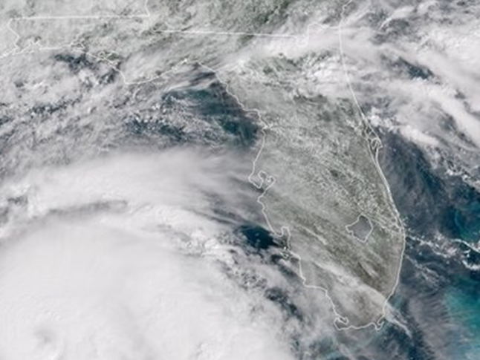
Florida Storm Event Activity
Prepared for the State Budget Office
Notes:
Hello and welcome to the presentation on Florida storm activity that has been prepared for the budget office. I thank you all for your attendance and the goal of this presentation is to deliver data of how storms have impacted Florida at a monetary level to ensure that dollars can go to those in need to protect our people and communities from these events. This presentation will also give information on the areas where the major damage of these events have occurred.

Slide 2
Why?
Monetary Reserve Fund Establishment
Allocation of stand-by emergency resources
Notes:
Today we will be discussing two main topics: The establishment of a Monetary Reserve Fund and the allocation of stand-by emergency resources. The monetary reserve fund will serve as a solution to allow Florida to get dollars to areas that have been hit by storm events without going through all the red tape. The stand-by emergency resource allocation will be based on a few factors such as where the most loss of life and damage has occurred.

Slide 3
Reserve Fund: By the Numbers
State Property and Crop Damage 2015-2016
STATE | FLORIDA
Month | Property Damage | Crop Damage
January | $16,673,200.00 | $0.00
February | $29,484,000.00 | $0.00
March | $500,500.00 | $0.00
April | $620,500.00 | $0.00
May | $957,000.00 | $5,000.00
June | $4,289,300.00 | $0.00
July | $3,726,550.00 | $500.00
August | $17,799,500.00 | $0.00
September | $314,572,000.00 | $5,000.00
October | $2,751,977,500.00 | $0.00
November | $1,609,000.00 | $0.00
December | $105,000.00 | $1,000,000.00
Grand Total | $3,142,314,050.00 | $1,010,500.00
Notes:
This slide shows by the numbers here the damage for both property and crops from 2015-2016.Total property damage of $3 billion and crop damage of roughly $1 million has occurred over the two years. These kind of numbers prove the needs for the reserve fund to make certain that areas hit can get back up and running quickly.

Slide 4
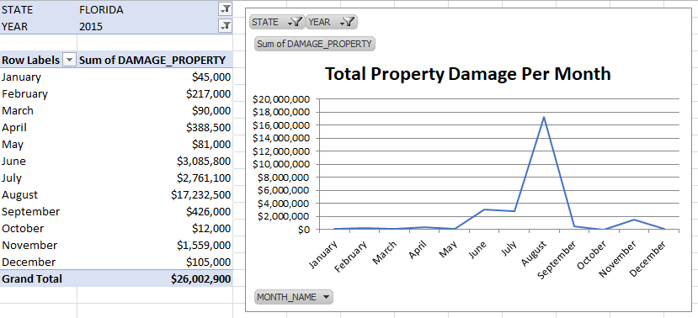
Property Damage 2015
2015 Total Property Damage: $26,002,900
Notes:
Looking into this data a bit further, Property Damage itself in 2015 totaled $26 million dollars with most of the damages occurring in in the third quarter, specifically August which falls in line with hurricane season in Florida, which is typically August through October.

Slide 5
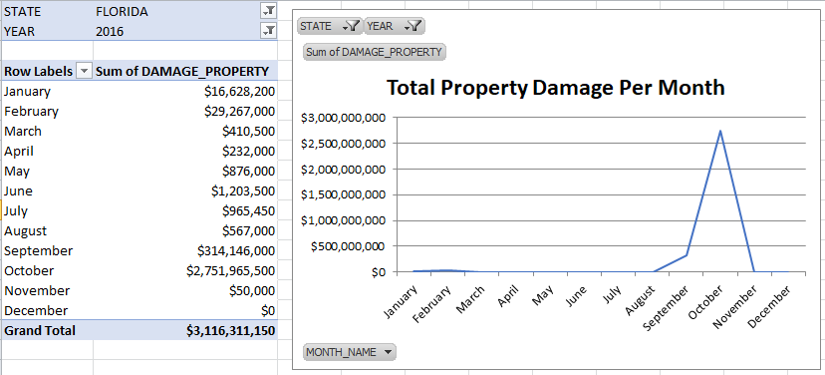
Property Damage 2016
2015 Total Property Damage: $3,116,311,150
Notes:
On this slide we can see the following year 2016. October alone accounted for $2 billion dollars which was mostly from hurricane Matthew. Having this fund will help solve getting equipment into the hands of emergency personal quickly. Major events like hurricane Matthew will be prepared and accounted for at a monetary level with the fund.

Slide 6
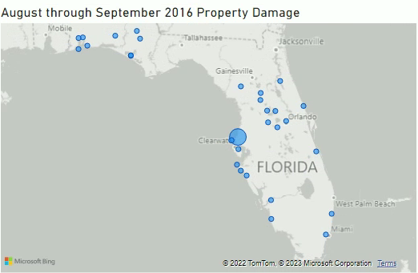
Allocating Emergency Resources
Notes:
Given the location data at hand and the property damage amounts we can best determine where we may need to send the most resources during a certain season. In this visual you can see that we would want to focus on the coast in southern Florida, inland and on the coast near Clearwater and near the western border of the state. With this information we will be efficient and find the best locations for supplies, and where dollars may be needed the most.

Slide 7
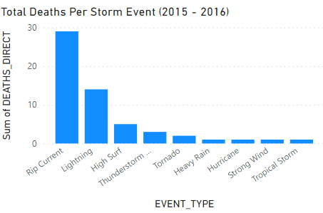
Storms Event Deaths
Notes:
This page shows the total death for each event over the two years covered. Events near the ocean such as Rip Current and High Surf are a major cause of life loss and consideration should be made towards allocating life saving equipment near the coast. We can use this and the location data to improve allocation of resources even further. Resources that may prevent rip current deaths such as stand by emergency personnel and extra life guards on the coastal areas will go a long way in safeguarding the people of Florida.

Slide 8
Climate Change
Storm Event Costs to Florida:
$3.1 Billion
White House Coastal Disaster increased costs:
$22 Billion to $94 Billion Annually (Valhsing, 2022)
Notes:
As discussed early the sum of the total property damage from 2015 to 2016 has been roughly $3.1 billion dollars to the state. At a federal level the White House expects increased hurricane frequency which could drive up annual spending in the United States by $22-$94 Billion for coastal disaster relief. As Florida is especially impacted by climate change we need to lead a response at the state level. Making room in the budget for the recommended actions will go far to lessen the costs as climate change makes these storm events more common. If cities and towns are able to rebuild quickly they will be better protected against future events and have less risk. These actions must be taken to protect both the people and communities of Florida.

Slide 9
Recommendations
Establish the Reserve Fund
Improve Emergency Resource Allocation
Future: Use Data, ML, AI detection, Further Inflation Protection
Notes:
The emergency fund creation will ultimately save lives and allow the state to recover quickly from weather events. The people of Florida will feel more comfortable having this fund established as the storm events impact every single person in the state. The data we have will allow us to figure out ways to distribute resources, dollars, and people quickly. Further, using technologies such as machine learning and AI detection we could bring Florida to a much stronger future state for storm preparedness. Given the current market we would also expect that these actions would protect against inflation as damage to crops and businesses would be mitigated. These actions will allow Florida to be better prepared as these events become more common due to climate change.

Slide 10

Questions?
Email: stormevent@datasolutions.com
Phone: 800-555-1235
Twitter: StormEventsFlorida
Data source for all visuals: the National Centers for Environmental Information Storm Events Database 2015-2016
Notes:
We thank you for your attendance at this presentation. Please use the contact information to follow up with us on anything you wish to know more about.
We now will open up the floor to questions that you may have.
Reference
Vahlsing, C. (2022, April 4). Quantifying risks to the federal budget from climate change. The White House. Website. https://www.whitehouse.gov/omb/briefing-room/2022/04/04/quantifying-risks-to-the-federal-budget-from-climate-change/

