Slide 1
CoLink: An Unsupervised Framework for User Identity Linkage
Zexuan Zhong, Yong Cao, Mu Guo and Zaiqing Nie
AAAI 2018
2018.10.26

Slide 2
1
PRE
Sequence to sequence learning
P
X
Y
Z
<EOS>
A
B
C
P
P
P
P
<EOS>
Encoder
Decoder
Reference: Machine Learning and having it deep and structured (2018,Spring) (Lung-yi Lee, NTU)
Notes:
但是这种最简单的seq2seq模型存在2个问题：
1、输入的序列无论长度都是编码成一个固定长度的向量，对于长句子来说，信息被过度压缩。输入序列的长度便是一个非常大的瓶颈，如机器翻译问题，当要翻译的句子较长时，一个c可能存不下那么多信息，就会造成翻译精度的下降。
2、在Encode中喂进去的是一样的W，但是其实翻译的时候每个单词都不是一样的，其侧重点也不同。除此之外因此出现了Attention-based model。相当于网络会自动截取自己所需要的信息喂进Decoder
每个时刻的输出是一个概率分布向量，其中最大值的下标决定了输出哪个词。

Slide 3
1
PRE
Attention-based seq2seq
C1
C2
C3
C4
X
Y
Z
<EOS>
h1
h2
h3
h4
A
B
C
C1
C2
C3
C4
<EOS>
Encoder
Decoder
Reference: Machine Learning and having it deep and structured (2018,Spring) (Lung-yi Lee, NTU)
Notes:
RNN每一个输入都会有一个output，记为h1,h2,h3,h4
比如，网络在生成X之前，先去h1,h2,h3,h4中搜寻，并将其变化成c1

Slide 4




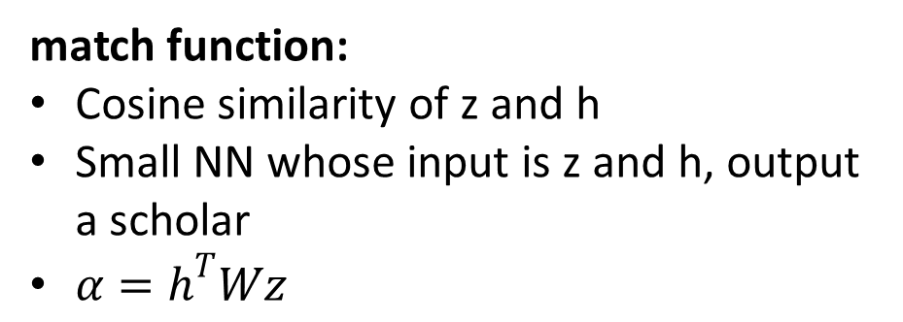

1
PRE
Attention-based seq2seq
$$α_{0}^{1}$$
$$α_{0}^{2}$$
$$α_{0}^{3}$$
$$α_{0}^{4}$$
match
match
match
match
$$z^{0}$$
h1
h2
h3
h4
match function:
Cosine similarity of z and h
Small NN whose input is z and h, output a scholar
$α=h^{T}Wz$
A
B
C
<EOS>
Encoder
Reference: Machine Learning and having it deep and structured (2018,Spring) (Lung-yi Lee, NTU)

Slide 5







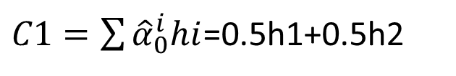






1
PRE
Attention-based seq2seq
X
Y
Z
<EOS>
C1
$C1=\sum{{\hat{α}}_{0}^{i}hi}$=0.5h1+0.5h2
$$z^{0}$$
$$z^{1}$$
$$z^{2}$$
$$z^{3}$$
$$z^{4}$$
$${\hat{α}}_{0}^{1}$$
$${\hat{α}}_{0}^{2}$$
$${\hat{α}}_{0}^{3}$$
0.5
0.5
0.0
0.0
$${\hat{α}}_{0}^{4}$$
softmax
C1
C2
C3
C4
$$α_{0}^{1}$$
$$α_{0}^{2}$$
$$α_{0}^{3}$$
$$α_{0}^{4}$$
h1
h2
h3
h4
A
B
C
<EOS>
Reference: Machine Learning and having it deep and structured (2018,Spring) (Lung-yi Lee, NTU)

Slide 6
1
PRE
Applications of seq2seq
Machine translation.
Speech recognition.
Image caption generation.
Reference: Machine Learning and having it deep and structured (2018,Spring) (Lung-yi Lee, NTU)

Slide 7
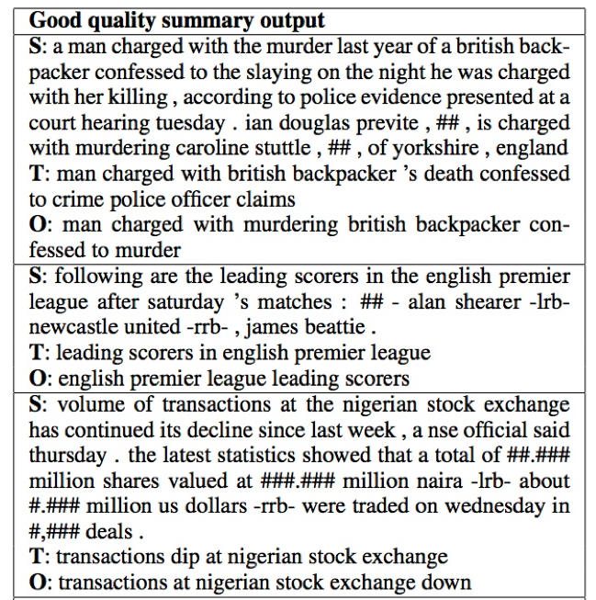
1
PRE
Applications of seq2seq
Summary generation.

Slide 8
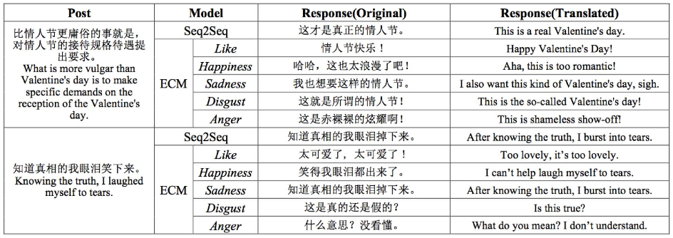
1
PRE
Applications of seq2seq
Chatbot.

Slide 9
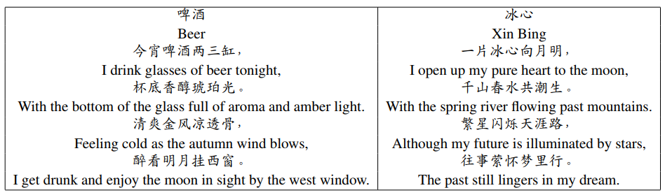
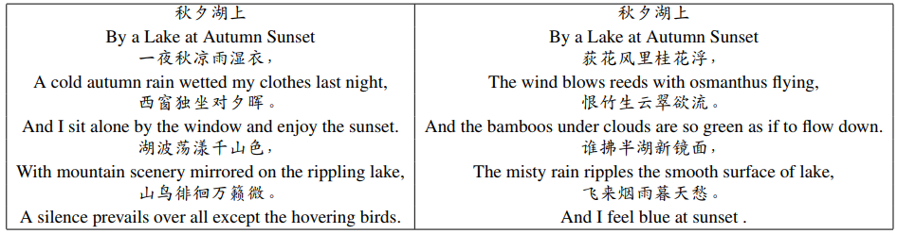
1
PRE
Applications of seq2seq
Poetry generation.

Slide 10
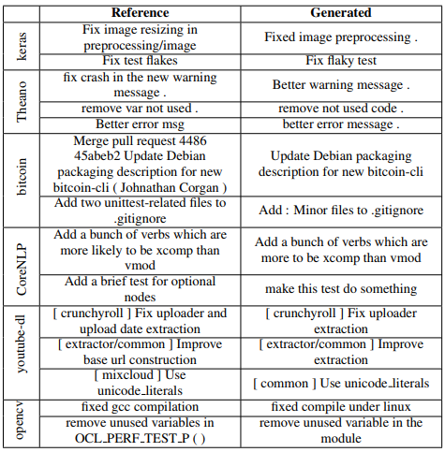
1
PRE
Applications of seq2seq
Commit message generation.

Slide 11
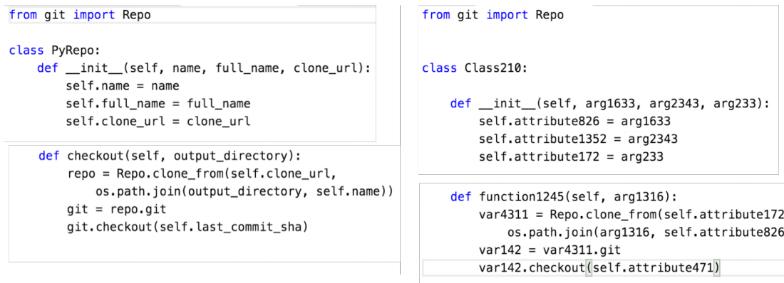
1
PRE
Applications of seq2seq
Python code suggestion.

Slide 12
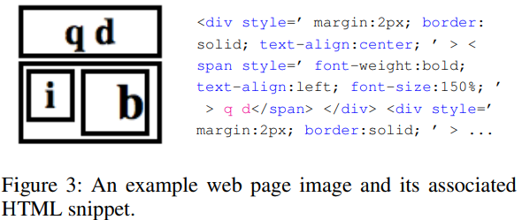
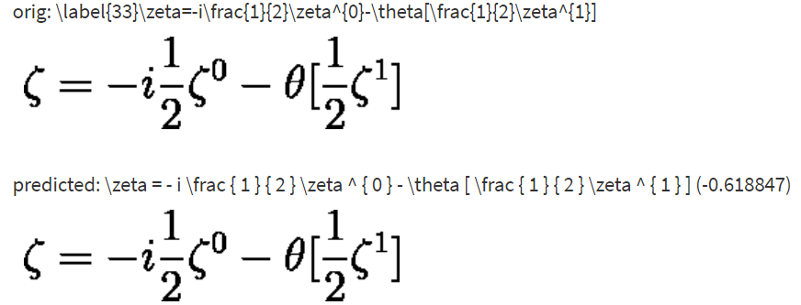
1
PRE
Applications of seq2seq
Convert image to html and latex code.
http://lstm.seas.harvard.edu/latex/

Slide 13
1
PRE
Sequence to sequence learning
background:
DNNs can not capture sequence features and can only be applied to problems whose inputs and targets can be sensibly encoded with vectors of fixed dimensionality.
It is difficult to train RNNs due to the resulting long term dependencies.
C
X
Y
Z
<EOS>
LSTM
LSTM
LSTM
LSTM
LSTM
LSTM
LSTM
LSTM
A
B
C
<EOS>
Zhong Z, Cao Y, Guo M, et al. CoLink: An Unsupervised Framework for User Identity Linkage[J]. 2018.
Notes:
background:
DNNs can only be applied to problems whose inputs and targets can be sensibly encoded with vectors of fixed dimensionality.主要是指，因为DNN的全连接层需要明确指定W参数的维度，所以需要事先固定输入维度，但是对于一些序列来说，不能提前得到其长度。
RNN：当序列长度变长时会引起梯度消失的问题（偶尔会引起梯度爆炸的问题）

Slide 14
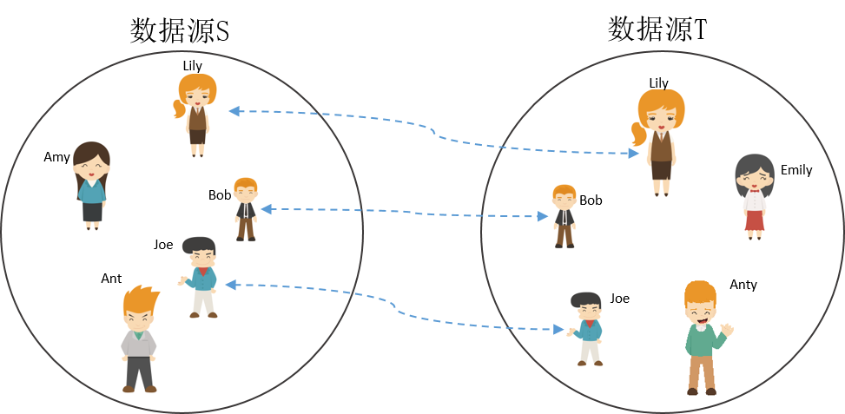
2
BAC
Introduction
UIL(User Identity Linkage):

Slide 15
2
BAC
Background
It’s expensive to collect manually liked user pairs as training data.
The user attributes in different networks are usually defined and formatted very differently.
The traditional method based on string comparison is not applicable.
acronyms, abbreviations, synonyms and translations.
“ESCAL ENG” == “Escalation Engineer”
implicit connections.
“SUNNYVALE1020/6221” –”San Francisco Bay Area”
One-to-one linkage constraint.

Slide 16
2
ALG
Solution
CoLink:
1. Unsupervised.
2. Considering attribute and relationship between pairs.
3. Employing a co-training algorithm to make attribute model and relationship model reinforce each other iteratively.
Attribute model:
Binary classifiers, treating it as a machine translation problem.
Automatically captures the word-level mapping and sequence-level mapping with almost no feature engineering.
Only requires positive examples.
Relationship model:
Binary classifiers, considering the related users.

Slide 17
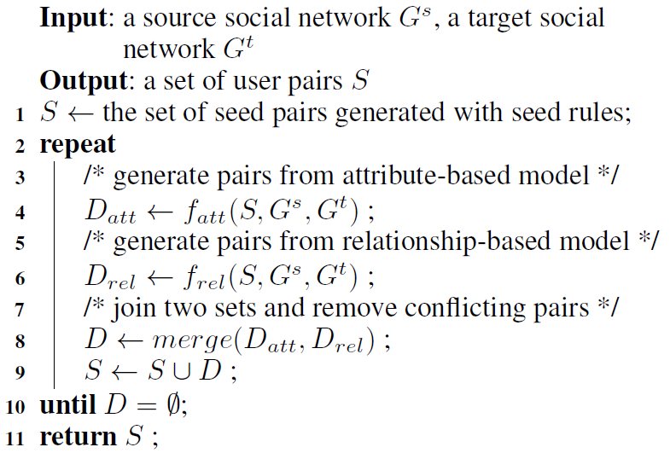
2
ALG
CoLink Framework
At each co-training iteration, both models are retrained with linked pair set.
Need seed set to kick off the co-training process.
Seed Rules:
User name uniqueness.
Attribute value mapping.
Relationship propagation.

Slide 18








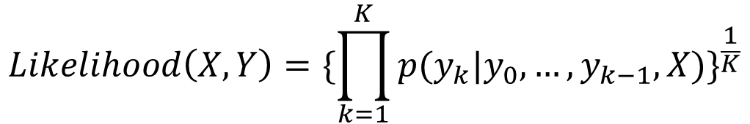














2
ALG
Attribute-based Model
$$y_{1}$$
$$y_{2}$$
$$…$$
$$y_{T}$$
$$…$$
Seq2seq Model:
Softmax
$$…$$
$$c_{1}$$
$$c_{2}$$
$$…$$
$$c_{T}$$
$$…$$
Dense Layer
$$…$$
Attention
$$…$$
LSTM
LSTM
LSTM
LSTM
LSTM
LSTM
LSTM
LSTM
$$…$$
$$…$$
$$c_{1}$$
$$c_{2}$$
$$…$$
$$c_{T}$$
$$x_{1}$$
$$x_{2}$$
$$…$$
$$x_{t}$$
Decoder
Encoder
$$Likelihood\left(X,Y\right)={\{\prod_{k=1}^{K}{p(y_{k}|y_{0},…,y_{k−1},X)}\}}^{\frac{1}{K}}$$

Slide 19
2
PART
Attribute-based Model
SVM:
Bag-of-words similarity.
Jaccard similarity.
Jaro string distance.
using Radial Basic Function(RBF) as the SVM kernel.

Slide 20

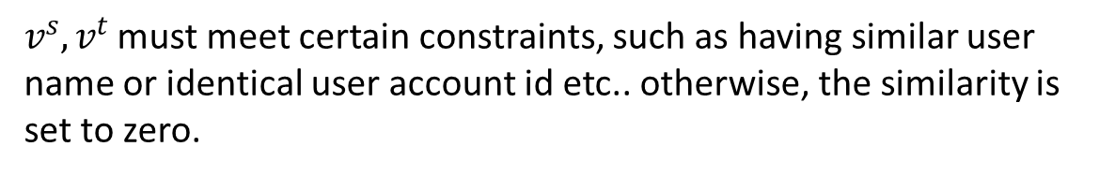
2
PART
Relationship-based Model
$$RelSim\left(v^{s},v^{t}\right)=|\{{\hat{v}}^{s},{\hat{v}}^{t}\}|$$
$v^{s},v^{t}$ must meet certain constraints, such as having similar user name or identical user account id etc.. otherwise, the similarity is set to zero.

Slide 21
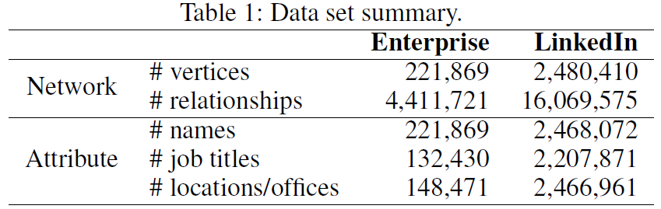
3
EXP
Experiments
Data Set:
Candicate Filter:
user name.
organization.
After filtering, get 758,046 candidate user pairs.
Seq-to-seq:
The encoder deep LSTM and decoder deep LSTM both have 2 LSTM stacked.
In each LSTM, the recurrent unit has a size of 512, embedding vector size is 512.

Slide 22
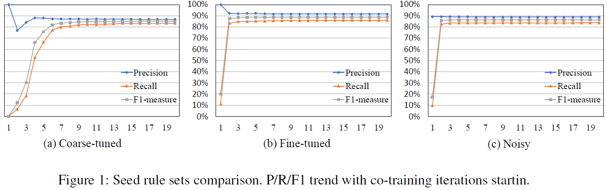
3
EXP
Experiments Results
Coarse-tuned: The title attribute must contain the string “account manager”.
Collecting 81 initial linked pairs.
Fine-tuned: At least 2 related users.
Collecting 19, 241 initial linked pairs.

Slide 23
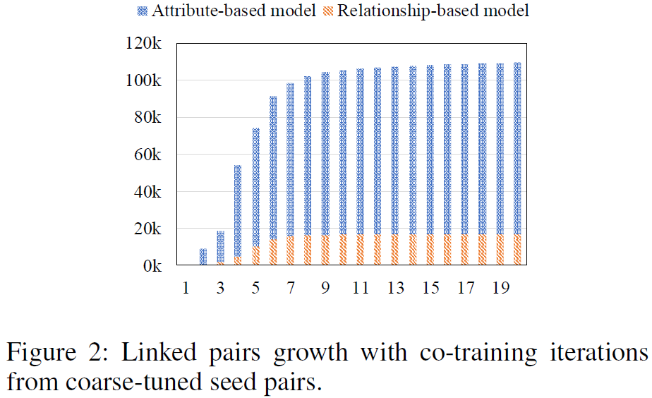
3
EXP
Experiments Results

Slide 24
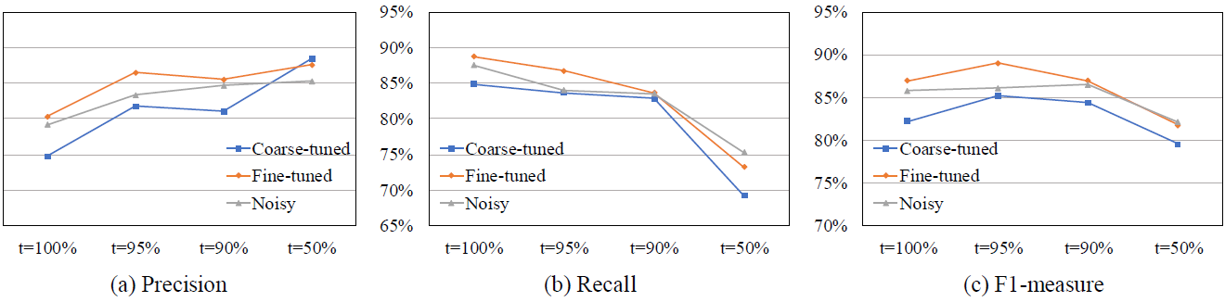
3
EXP
Experiments Results

Slide 25
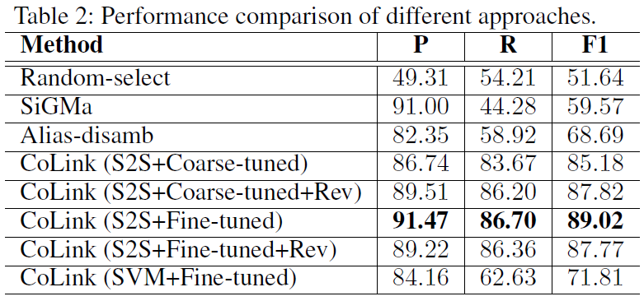
3
EXP
Experiments Results

Slide 26
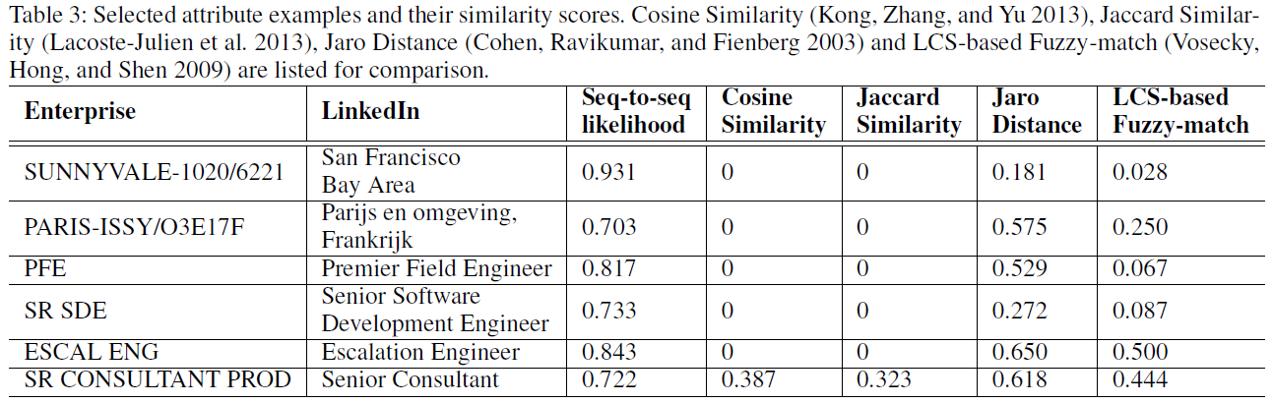
3
EXP
Experiments Results

Slide 27
4
CON
Conclusion
Strongness:
The first to model the attribute alignment problem as machine translation.
Outperform the state-of-art unsupervised approaches by an F1 increase of 20%.
Improveness:
No revise process and the former misclassified sample has an important influence on the later prediction.
Weakly-supervised.

Slide 28
THANKS!

