Slide 1
Knowledge-aware Attentive Neural Network for Ranking Question Answer Pairs
Ying Shen, Yang Deng, Min Yang, Yaliang Li, Nan Du, Wei Fan, Kai Lei
Tingting Liu
2018/11/2

Slide 2
Why KBQA?
关联性数据 – 更丰富知识表示
纯文本: 文本句子的内部理解
知识图谱: 关联性数据，提供文本理解的语义背景
• 数据质量 – 更高的知识准确率
纯文本: 文本错误或者不同文本的知识矛盾
知识图谱：人工标注或解析自网页表格的高质量数据
• 结构化数据 – 查询效率
纯文本: 倒排表
知识图谱: 存储于数据库，使用索引加速查询

Slide 3
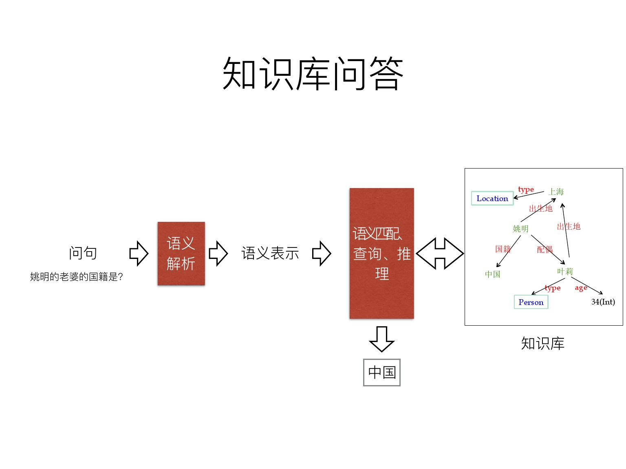
KB-based QA

Slide 4
Ranking Question Answer Pairs
Aims:
Pick out the most relevant answer from a set of candidates.
Recent Work:
Deep neural networks, such as CNN, RNN to automatically select answers.
Notes:
The key idea behind deep neural networks is to encode the input sentences as vector representations. Based on the representations, an output layer is utilized to provide the matching score of two texts.

Slide 5
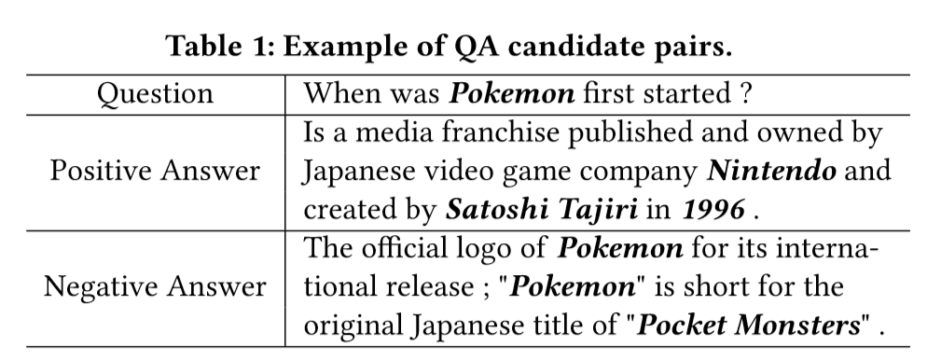
Challenges
The background knowledge from open-domain knowledge graphs (KGs) plays a crucial role in question answering.
Facts in KG：
(Pokemon, owned_by, Nintendo)
(Pokemon, created_by, Satoshi Tajiri)
(Pokemon, created_in, 1996)
Existing context-based models: score(positive answer) < score(negative answer)

Slide 6
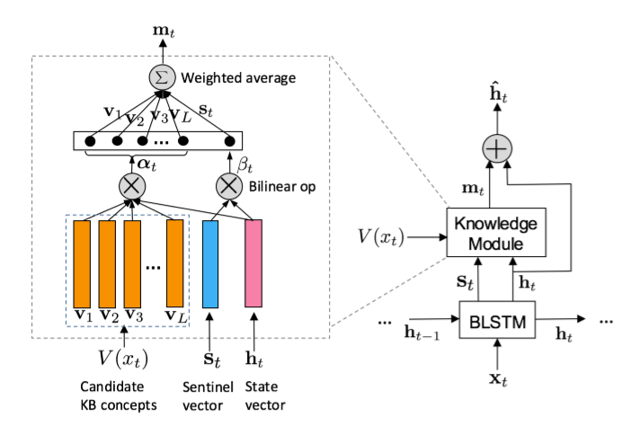
Challenges
The interrelations between different sentences is not captured.

Slide 7
KABLSTM
Use TransE to pre-train the knowledge embeddings from KG.
Design a knowledge module to learn the knowledge-based sentence representation from discrete candidate entity embeddings in KG.
Present a knowledge-aware attention mechanism to learn knowledge-aware sentence representations of questions and answers.
Notes:
knowledge-aware attentive neural network: to interactively learn knowledge-based sentence representations and context-based sentence representations for ranking QA pairs.

Slide 8
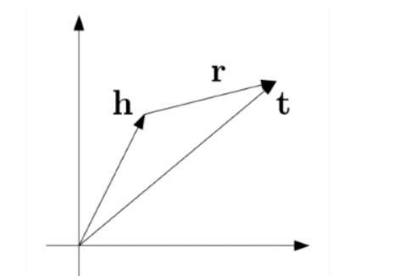
TransE
基本思想：将知识图谱中的实体和关系的语义信息用低维向量表示。
TransE将每个三元组实例（head, relation, tail）中的关系relation看做是从实体head到实体tail的翻译，通过不断调整h，r和t，使得（h+r）尽可能与t相等。即h + r = t

Slide 9
KABLSTM
Use TransE to pre-train the knowledge embeddings from KG.
Design a context-guided attentive CNN to learn the knowledge-based sentence representation from discrete candidate entity embeddings in KG.
Present a knowledge-aware attention mechanism to learn knowledge-aware sentence representations of questions and answers.
Notes:
knowledge-aware attentive neural network: to interactively learn knowledge-based sentence representations and context-based sentence representations for ranking QA pairs.

Slide 10
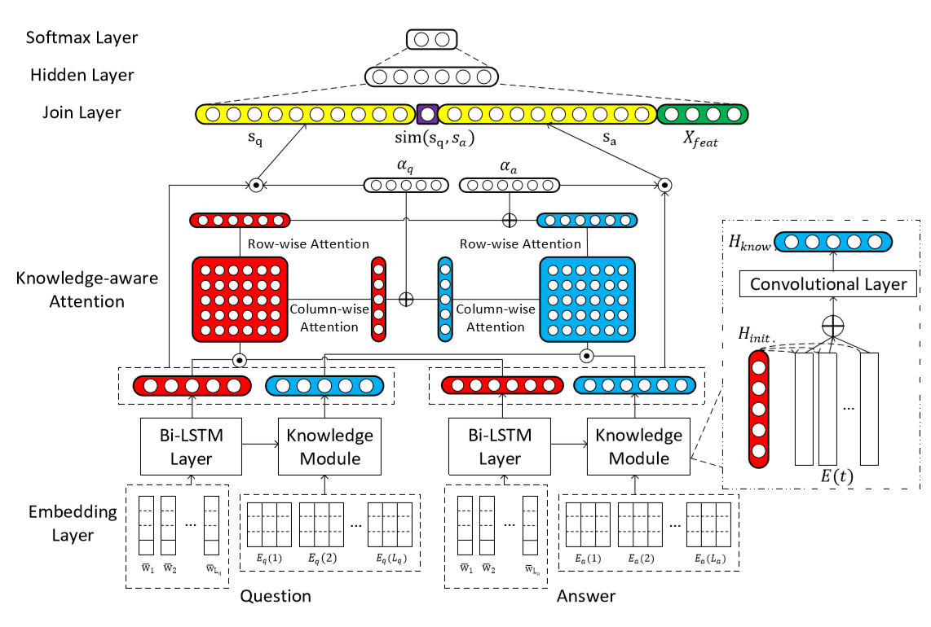

Slide 11
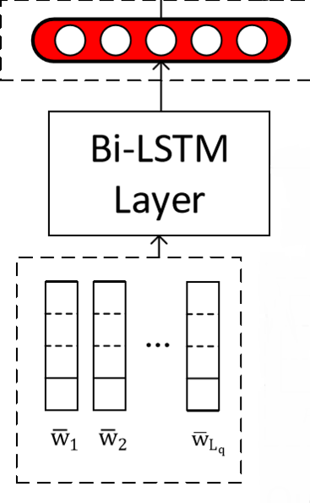



Bi-LSTM Layer
To generate the initial contextual sentence representation.

Slide 12
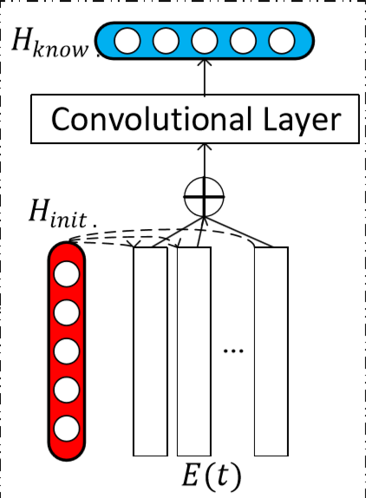
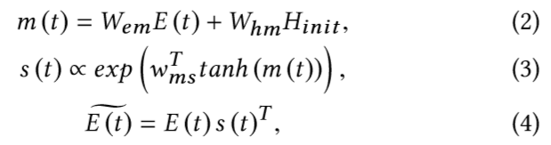
Knowledge Module
To learn knowledge-based sentence representations.

Slide 13
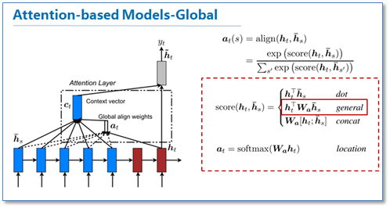
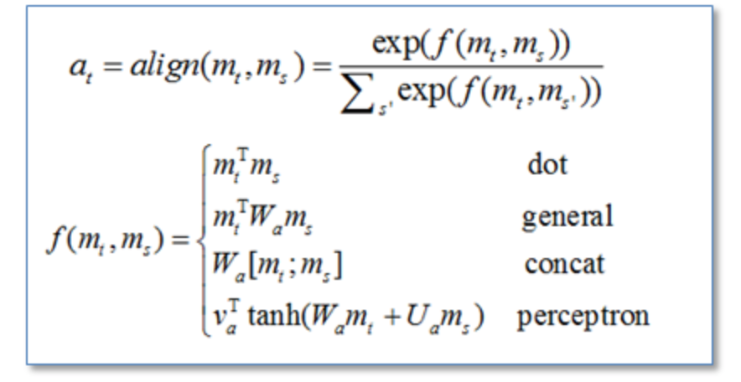
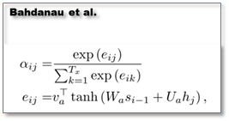
Attention Matrix

Slide 14
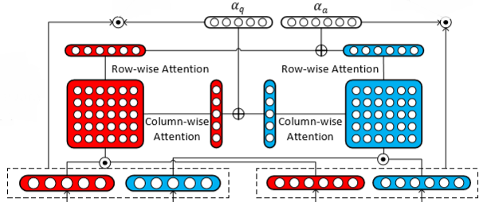
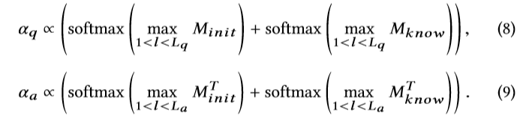
Knowledge-aware Attention
$$M_{init}=\tanh\left(Q_{init}U_{init}{A_{init}}^{T}\right) (6)$$
$$M_{know}=\tanh\left(Q_{know}U_{know}{A_{know}}^{T}\right) (7)$$
The final knowledge-aware attention vectors are:
Notes:
M_init and M_know are attention matrices
Column-wise and row-wise max-pooling

Slide 15


Slide 16
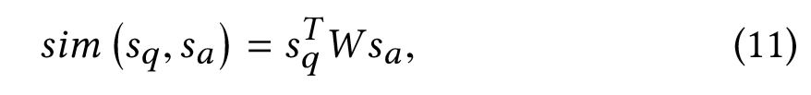
Knowledge-aware Attention
Obtain final knowledge-aware attentive sentence representations.
The bilinear similarity score between final attentive QA vectors:

Slide 17

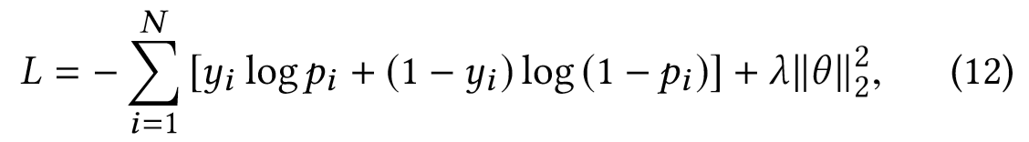
Hidden Layer and Softmax Layer
Features:
Word overlap feature: word overlap and idf-weighted word overlap.
Cross-entropy loss function

Slide 18
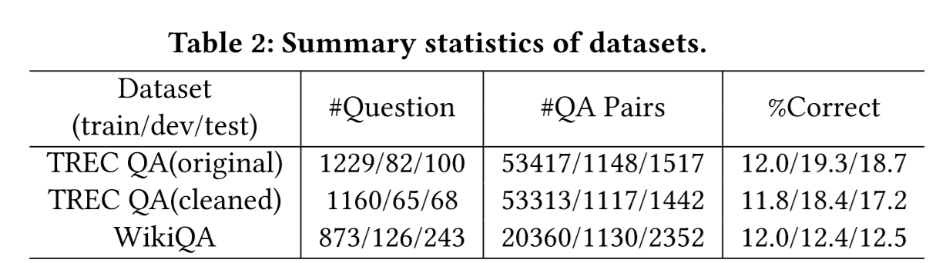
Experiment
Datasets: TREC QA and WikiQA
Metrics: MAP(Mean average precision) and MRR(Mean reciprocal rank)

Slide 19
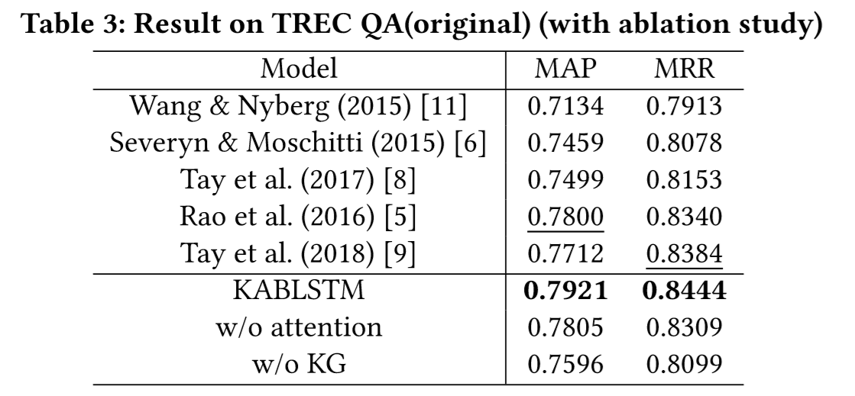
Experiment

Slide 20
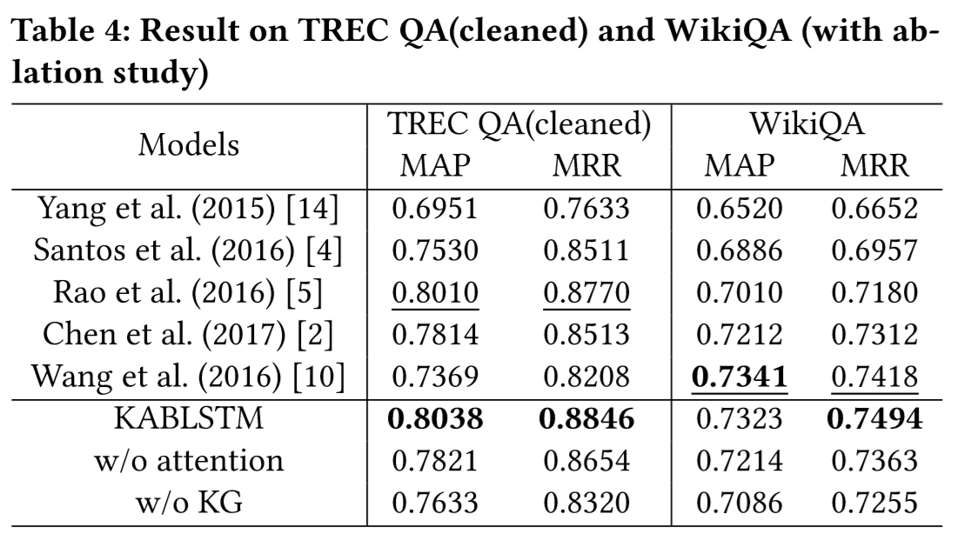
Experiment

Slide 21
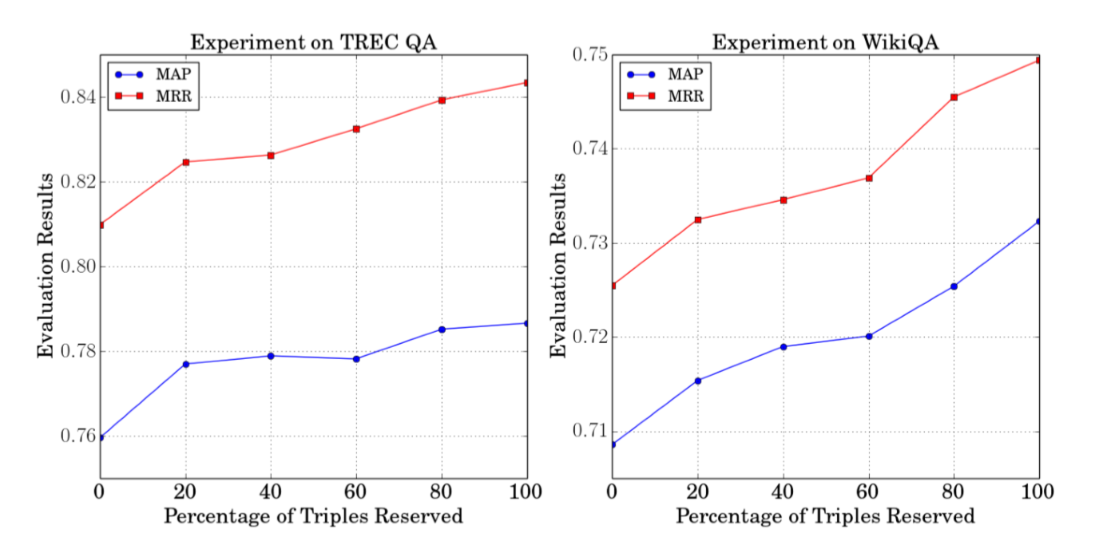
Experiment
Notes:
shows that our model is robust and achieves excellent performance on the KG with different completeness.

Slide 22
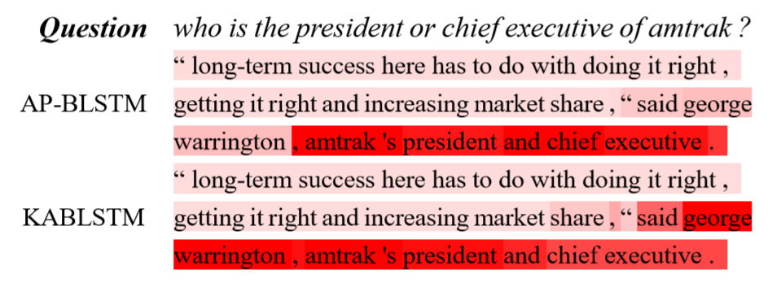
Experiment

Slide 23
Analysis
Full utilize all features
such as: answer type, path, context

Slide 24
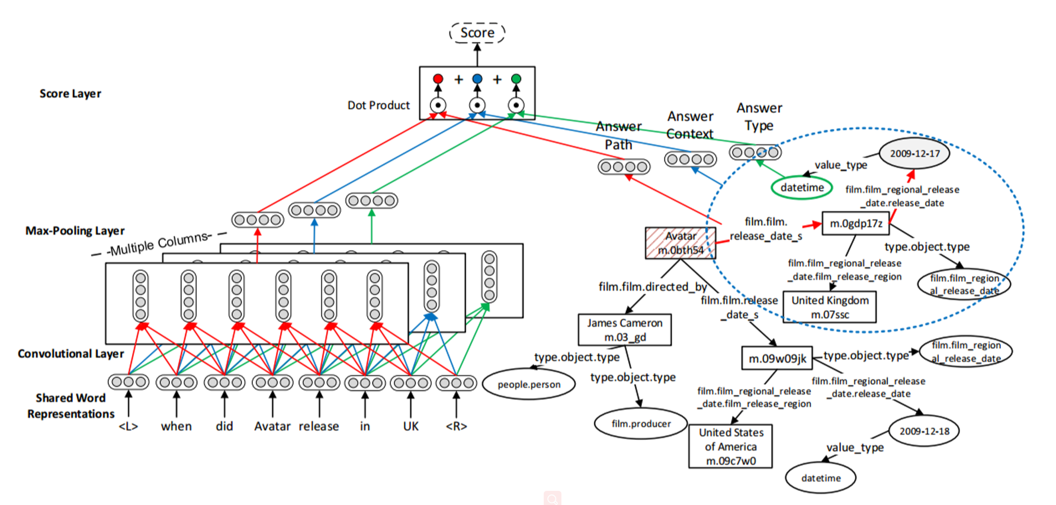

Slide 25
