Slide 1
Improving Knowledge Graph Embedding Using Simple Constraints
Boyang Ding, Quan Wang, Bin Wang, Li Guo
周晓旭

Slide 2
Representation Learning
现实世界里要处理的数据往往是无结构离散的，要想计算机更好地对这些数据进行智能处理，如何很好地表示它们是一个至关重要的问题。

Slide 3
1-hot Representation
Star = [0,0,…,0,0,1,0,…0]
Sun = [0,0,…,0,1,0,0,…0]
每一个词都可以表示成一个非常长的向量，这个向量的长度就是词汇的数量。例如汉语常用词有6000个，就把每个词表示成6000维的向量。每个词对应的向量中有一维设置为1，其他维度设置为0.
但是两个向量完全独立，忽略了它们之间语义关系。

Slide 4
KG Embedding
在保留语义结构的同时，将知识图谱中的实体和关系映射到连续的稠密的低维向量空间

Slide 5
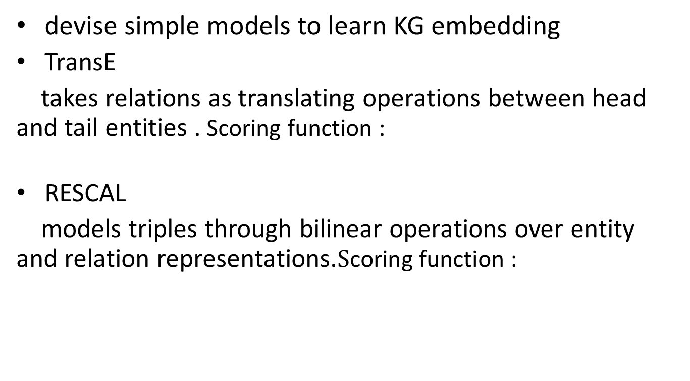
Early Works
devise simple models to learn KG embedding
TransE
takes relations as translating operations between head and tail entities . Scoring function :
RESCAL
models triples through bilinear operations over entity and relation representations.$\text{S}\text{coring} \text{function}$:

Slide 6
Recent Works
Design more complicated triple scoring models ,Like the TransE extensions, the RESCAL extensions, the (deep) neural Owing to the asymmetry of this scoring function
Integrate extra information beyond triples, like entity types , relation paths , textual descriptions

Slide 7
Model in the paper
The Basic Embedding Model, ComplEx
ComplEx represents each entity and relation as a
complex-valued vector:
d is the dimensionality of the embedding space.
Scoring function:

Slide 8
1.Non-negativity Constraints on Entity Representation
In ComplEx, both positive and negative properties of an entity can be encoded in its representation. However, it would be uneconomical.
cats, positive properties: cats are mammals, cats eat fishes, and cats have four legs……
negative properties : cats are not vehicles, cats do not have wheels, cats are not used for communication……

Slide 9

To better compare different entities on the same scale, the model require entity representations to stay within the hypercube of ${[0,1]}^{d}$, as approximately Boolean embeddings

Slide 10
2.Approximate Entailment Constraints over Relation Representations.
, λ is confidence level.
The former approximately entails the latter with confidence level λ .
BornInCountry and Nationality state that a person born in a country is very likely, but not necessarily, to have a nationality of that country.

Slide 11
consider , when λ = +∞
When λ = +∞， states that if relation holds ， relation must also hold，then
hold.
Given Eq. (2), a sufficient condition for Eq. (3) to hold, is to further impose

Slide 12
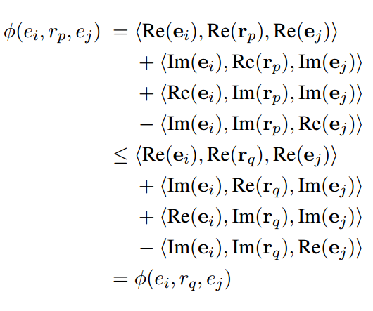
Proof:

Slide 13
In general,
are slack variables

Slide 14
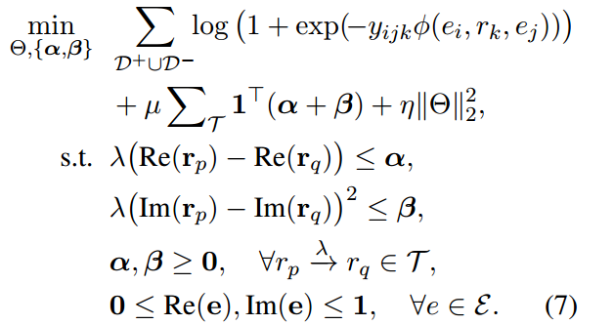
The overall model :
D+ ,D- : the sets of positive and negative training triples;
=±1 : the label (positive or negative) of triple ;
; µ ≥ 0 : a penalty coefficient ;
η ≥ 0 is the regularization coefficient.

Slide 15
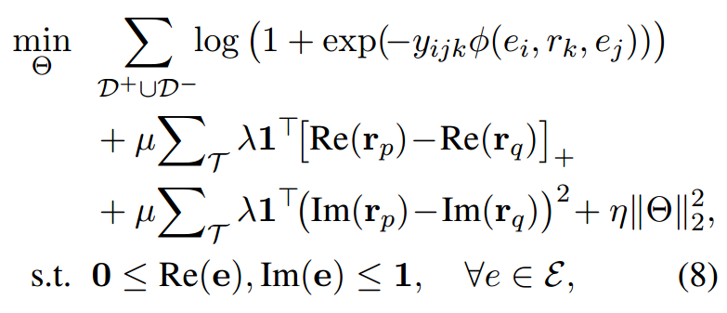

Slide 16
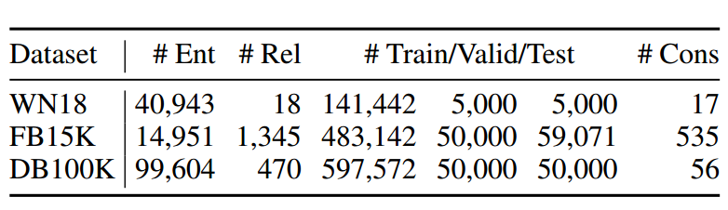
Experiment
Datasets
use AMIE+ to extract approximate entailments automatically with PCA confidence higher than 0.8

Slide 17
Link Prediction
Predict given ( ; ) or predict given ( ; ).
For each test triple ,replace its head entity with every entity , and calculate score for the corrupted triple
Then sort these scores in descending order, and get the rank of the correct entity .
Repeat the step while replacing the tail entity .

Slide 18
use SGD in mini-batch model ,with AdaGrad to tune the learning rate.
report the mean reciprocal rank (MRR) and the proportion of correct entities ranked in the top n (HITS@N), with n = 1; 3; 10 on the test set

Slide 19
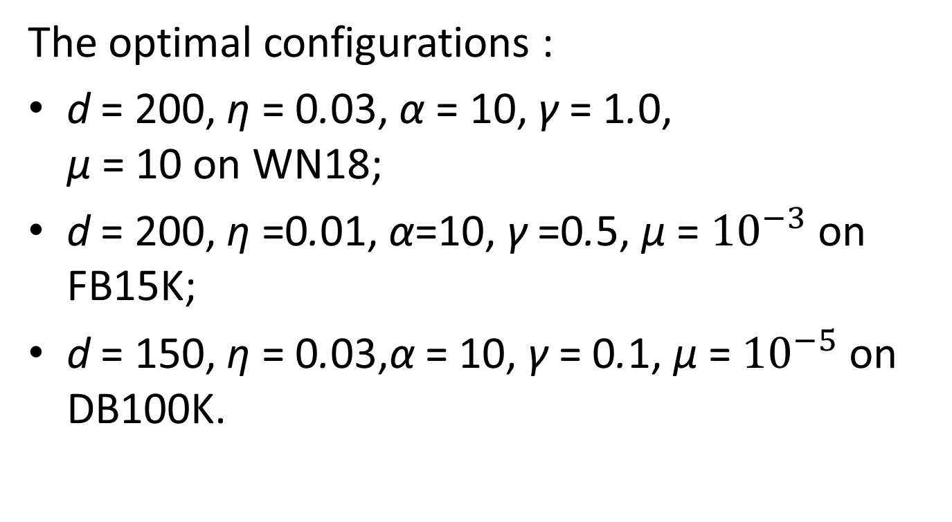
The optimal configurations :
d = 200, η = 0.03, α = 10, γ = 1.0, µ = 10 on WN18;
d = 200, η =0.01, α=10, γ =0.5, µ = ${10}^{−3}$ on FB15K;
d = 150, η = 0.03,α = 10, γ = 0.1, µ = ${10}^{−5}$ on DB100K.

Slide 20
Result Compare Performance against 3 Groups
This paper: ComplEx-NNE (only the Non-Negativity constraints on Entity representations) ComplEx-NNE+AER(Approximate Entailment onstraints over Relation representations besides those non-negativity ones)
Simple models: TransE ,DistMult ,HolE ,ComplEx ,ANALOGY
Other extensions :RUGE and ComplExR
Latest developments or implementations:R-GCN , ConvE ,Single DistMult

Slide 21
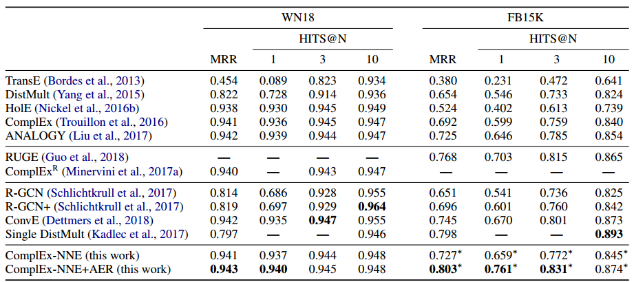
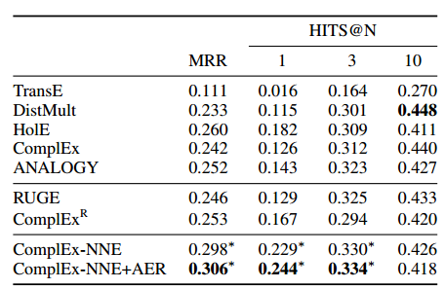

Slide 22

Analysis on Entity Representations
On DB100K, pick 4 types reptile, wine region, species, and programming language, and randomly select 30 entities from each type.
normalize the real component of each entity by

Slide 23
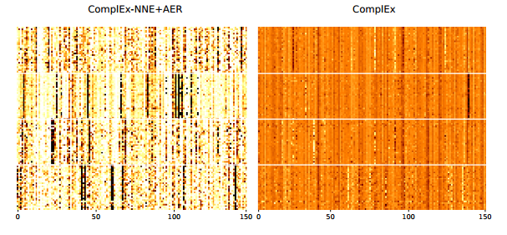
Each entity is represented by only a relatively small number of “active” dimensions. And entities with the same type tend to activate the same set of dimensions.
Obtain compact and interpretable representations for entities.

Slide 24
Analysis on Relation Representations
In the DB100K ,group relation pairs involved entailment constraints into 3 classes: equivalence, inversion,and others
choose 2 pairs of relations from each class. randomly pick 5 dimensions from both its real and imaginary components.

Slide 25
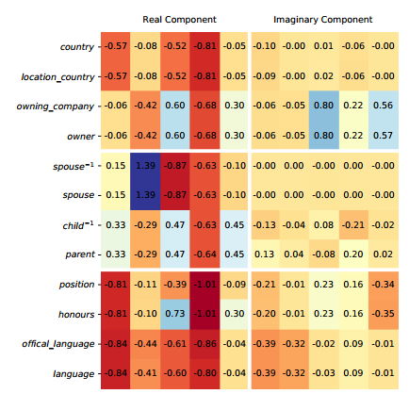

Slide 26
space complexity : O(nd+md) , n is the number of entities. m is the number of relations
time complexity (per iteration): O(sd) , s is the average number of triples in a mini-batch
space and time complexity are the same as that of ComplEx

