Slide 1

by coffeelake

Slide 2
Simplify Your Trips

Slide 3
What all we offer?
Personalized Location Selection
Custom Package Selection
Packages personalized for couples and bachelors
Selection of rooms based on package preference
Suggests Restaurants
Suggests tourists spots to visit
Optional guides, with suits you the most
Book taxi from the app
All your payments from a single portal

Slide 4
Eye-Catching Suggestion
Based on cluster data analysis

Slide 5
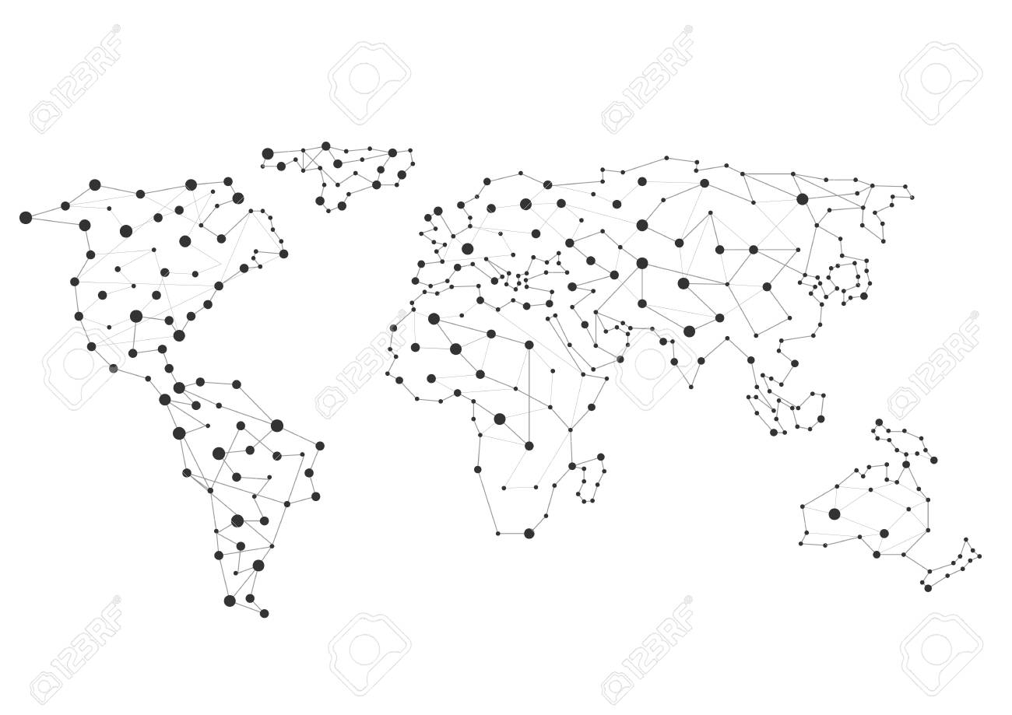
finds trending location using cluster data analysis
trending

Slide 6
Intelligent System for detecting fake reviews
Based on sentence classification and captcha

Slide 7
Pattern Recognition
Suggesting trips when it’s time

Slide 8

Based on

Slide 9
Carrier Availability
Telling about the carrier strength of the user at destination before hand

Slide 10

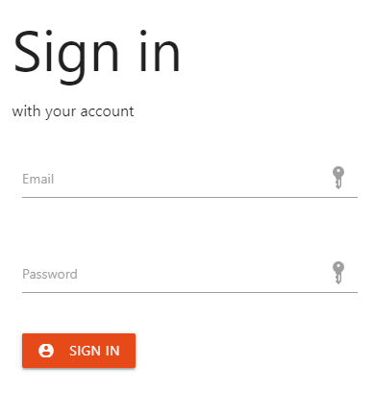
Optimized for Mobiles, PCs, Webs

