Slide 1

by coffeelake

Slide 2
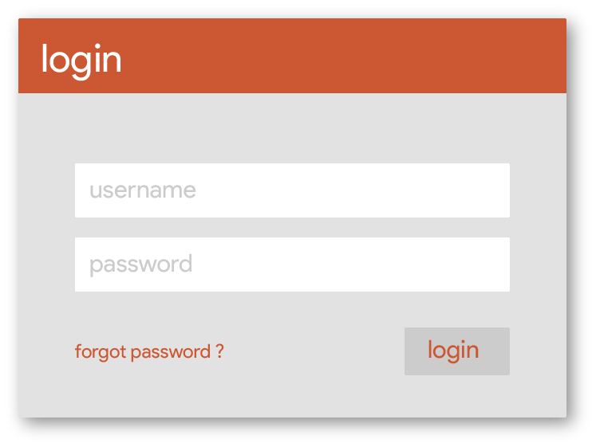

Slide 3
