Slide 1

by coffeelake

Slide 2
Your digital AI assistant to plan your trips
What all we offer?
Personalized Location Selection
Custom Package Selection
Packages personalized for couples and bachelors
Selection of rooms based on package preference
Suggests Restaurants
Suggests tourists spots to visit
Optional guides, with suits you the most
Book taxi from the app
All your payments from a single portal

Slide 3
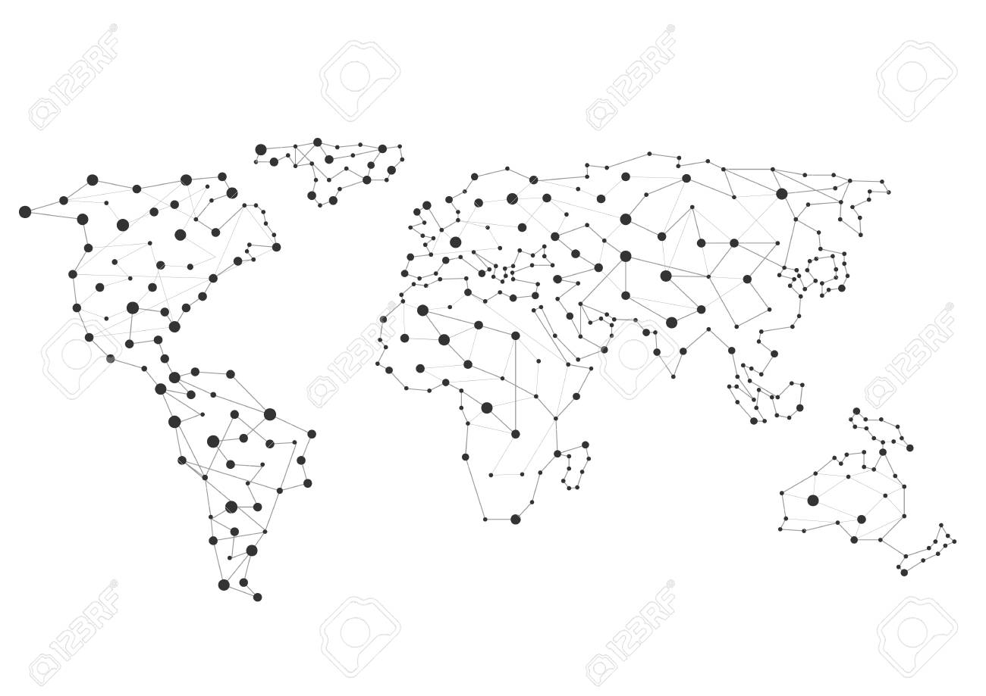
finds trending location using cluster data analysis
trending

Slide 4

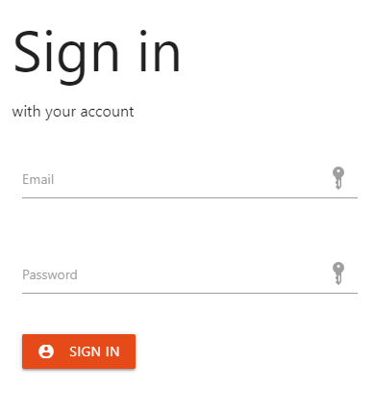
Optimized for Mobiles, PCs, Webs

