Slide 1
MSDS 6306
Case Study 02
Carl Keusseyan

Slide 2
Introduction
DDSAnalytics is an analytics company that specializes in talent management solutions for Fortune 100 companies.
The executive leadership has identified predicting employee turnover as its first application of data science for talent management.
The following are the data analysis requests from the executive leadership
Identify Job role specific trends
Identify factors that contribute to turnover
Explain the model to predict Attrition
Explain the model to predict Salaries

Slide 3
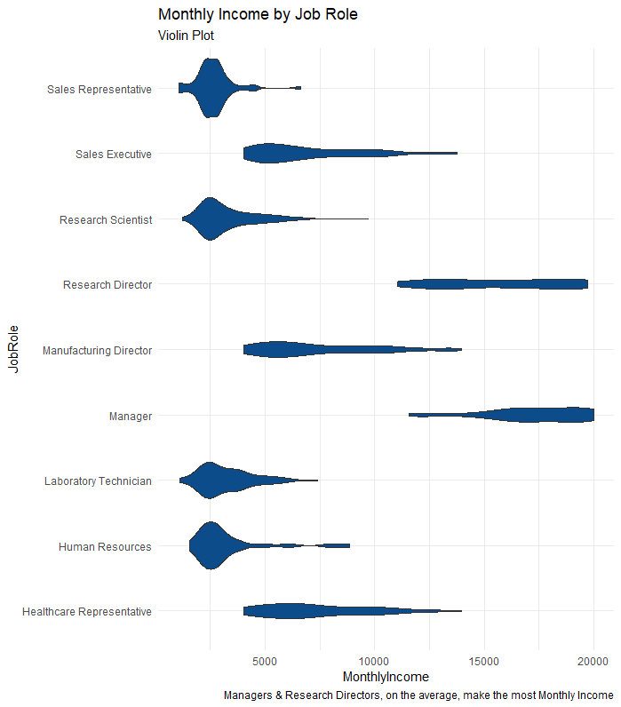
Job role specific trends
Let us see which Job role makes the most Monthly Income on the average and which makes the least.
Observation:
Most :
Managers
Research Directors
Least:
Sales Representatives
Research Scientists
Laboratory Technicians
Human Resources

Slide 4
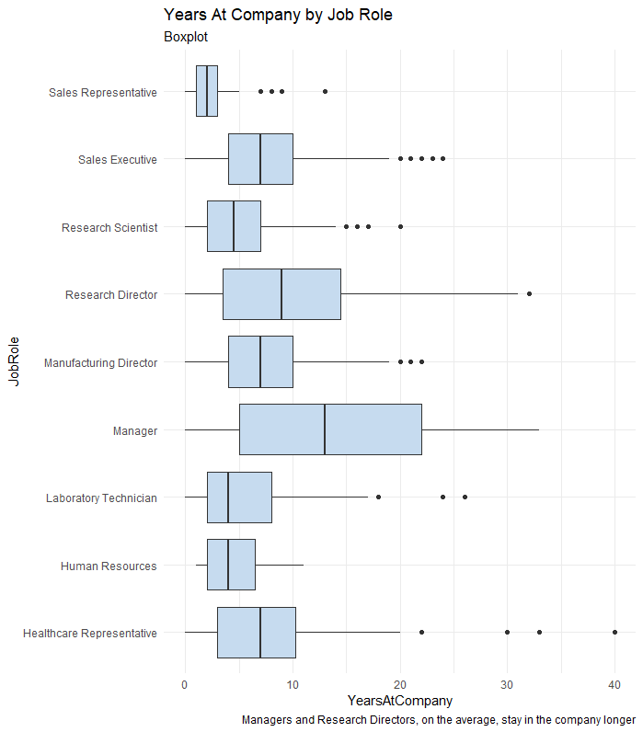
Job role specific trends
Let us see which Job role, on the average, stays in the company the longest
Observation:
Data suggests the following job roles may stay in the company longer
Managers
Research Directors
Sales Executives

Slide 5
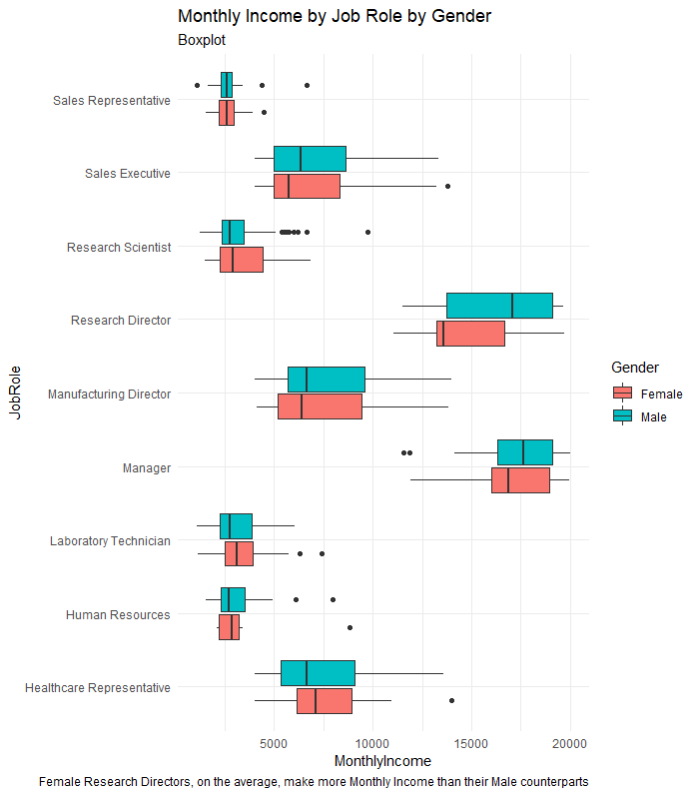
Job role specific trends
Let us see Gender disparity in Monthly Income
Observation:
Data suggests that Male Research Directors, on the average, may make more Monthly Income than their Female counterparts.

Slide 6
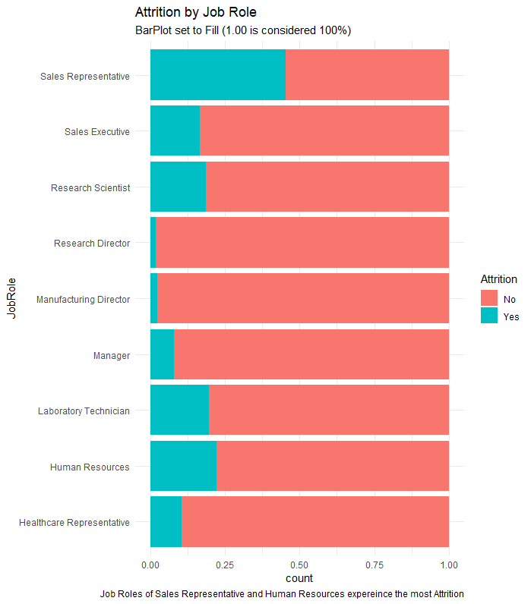
Job role specific trends
Let us see which Job Role(s) have the most Attrition
Observation: Data suggests the following job roles may experience the most attrition
Sales Representative
Human Resources

Slide 7
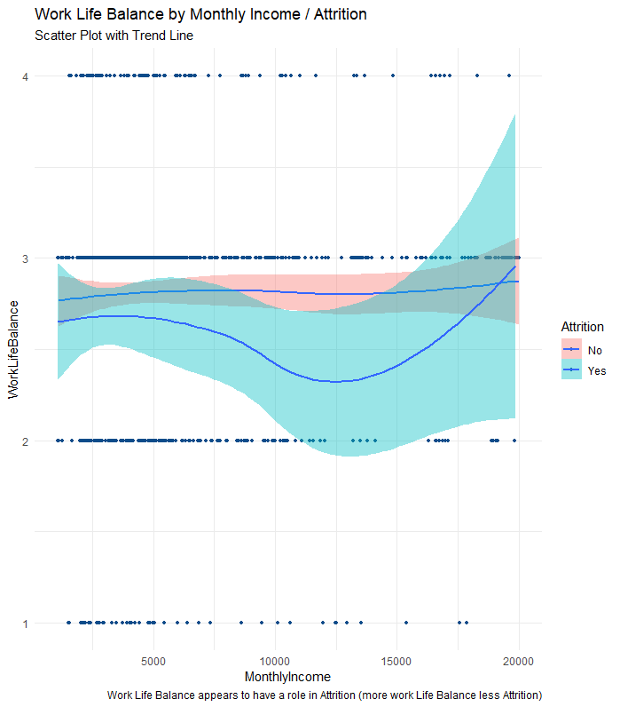
Factors contribution to turnover
Let us see if Work Life Balance has any effect on Attrition
Observation: Work Life Balance appears to have a role in Attrition (more Work Life Balance less Attrition)

Slide 8
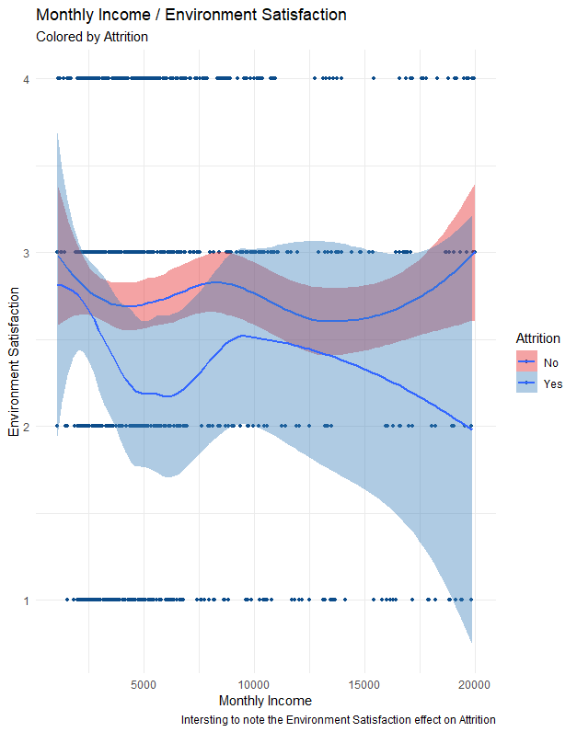
Factors contributing to turnover
Let us see if Environment Satisfaction has any effect on Attrition
Observation: Environment Satisfaction appears to have a role in Attrition (more Environment Satisfaction less Attrition)

Slide 9
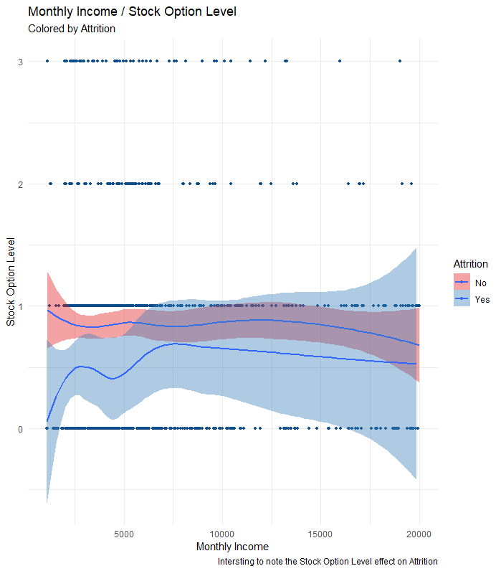
Factors contributing to turnover
Let us see if Stock Option Level has any effect on Attrition
Observation: Stock Option Level appears to have a role in Attrition (more Stock Option Level less Attrition)

Slide 10
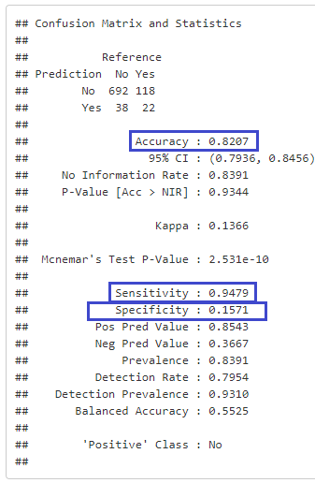
Attrition Prediction Model
KNN (K-nearest Neighbor) models where optimized to achieve the highest Accuracy, Sensitivity, Specificity
KNN Model (with optimized tuning parameters)
Optimum K = 3
(K values ranging from 3 to 20 (√ Observations) where tested, and K =3 was optimum)
Optimum features/attributes selection
Work Life Balance
Environment Satisfaction
Stock Option Level
Monthly Income
Years At Company
Distance From Home

Slide 11
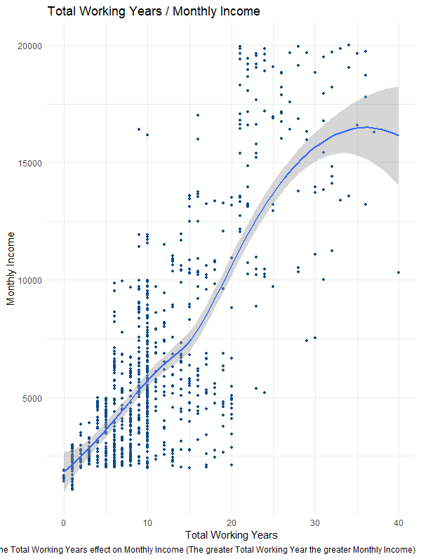
Income Prediction Model
Let us see if Total Working Years has any effect on Monthly Income
Observation: Interesting to note the Total Working Years effect on Monthly Income (The greater Total Working Year the greater Monthly Income)

Slide 12
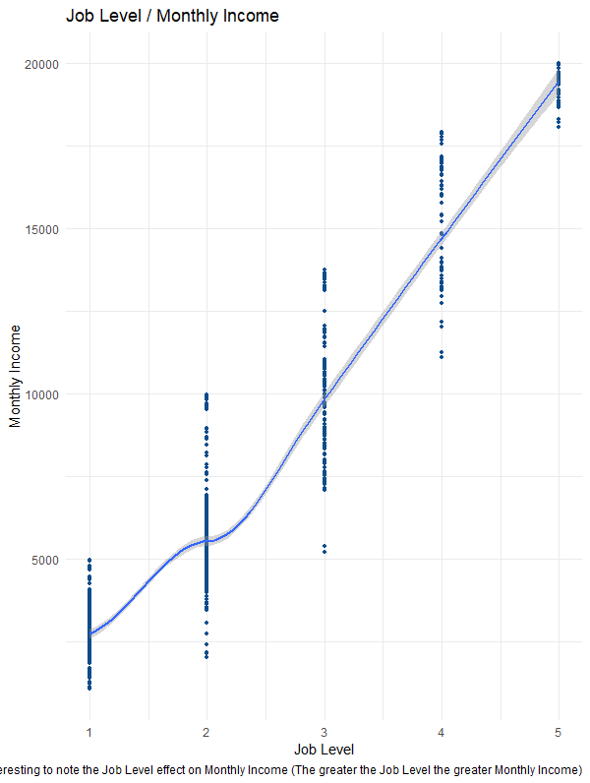
Income Prediction Model
Let us see if Job Level has any effect on Monthly Income
Observation: Interesting to note the Job Level effect on Monthly Income (The greater the Job Level the greater Monthly Income)

Slide 13
Income Prediction Model
LINEAR MODELS where optimized achieving
Lowest RMSE
Highest Adjusted R-squared
Lowest p-value
Linear Model (with optimized tuning parameters)
Optimum formula
Monthly Income ~ Total Working Years +
Job Level +
Job Role

Slide 14
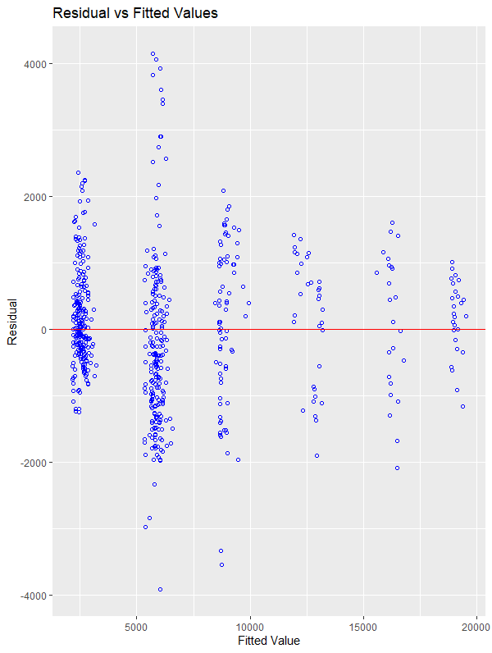
Income Prediction Model
Examining the Characteristics of the Linear Model
Observation: Here we are going to start with the Residual vs Fitted Values. Looks like the residuals are equally dispersed horizontally and vertically.

Slide 15
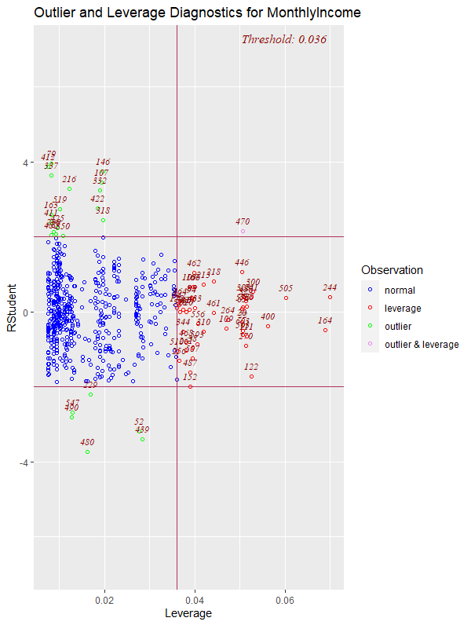
Income Prediction Model
Examining the Characteristics of the Linear Model
Observation: GOOD! we do not have wild outliers or high leverage points.

Slide 16
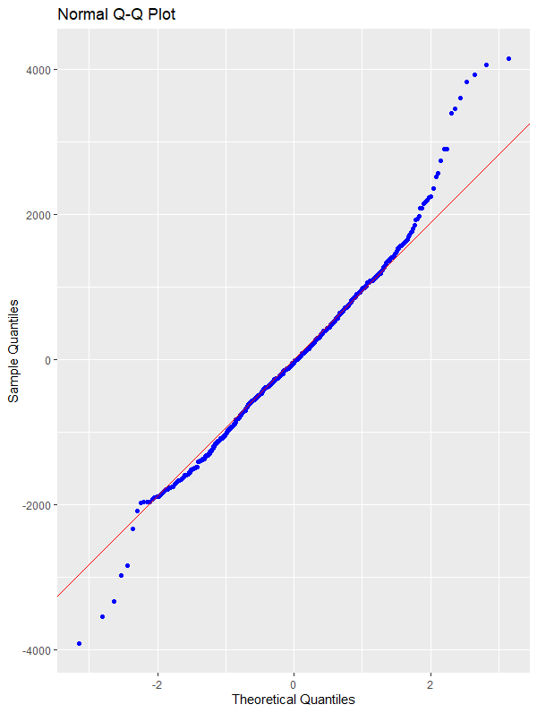
Income Prediction Model
Examining the Characteristics of the Linear Model
Observation: GOOD! Normality of Distribution - the points lie along a straight line.

Slide 17
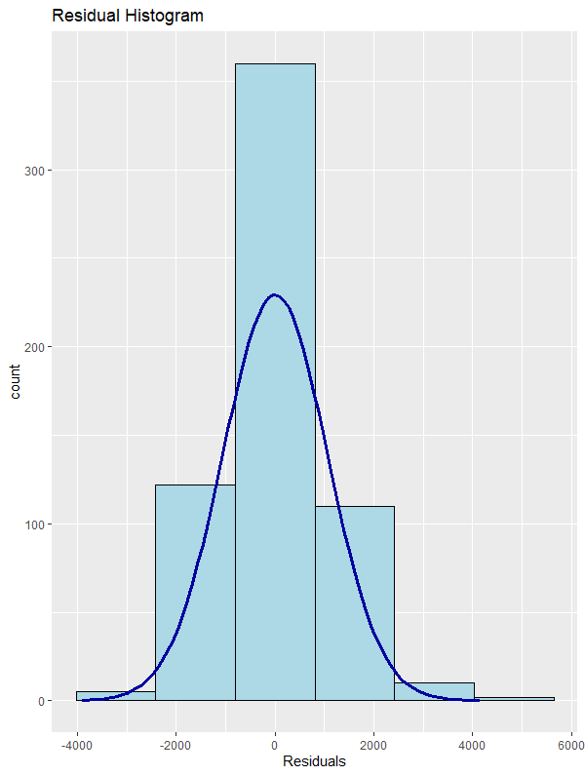
Income Prediction Model
Examining the Characteristics of the Linear Model
Observation: GOOD! Equal Standard Deviations - Bell Shaped Curve

Slide 18
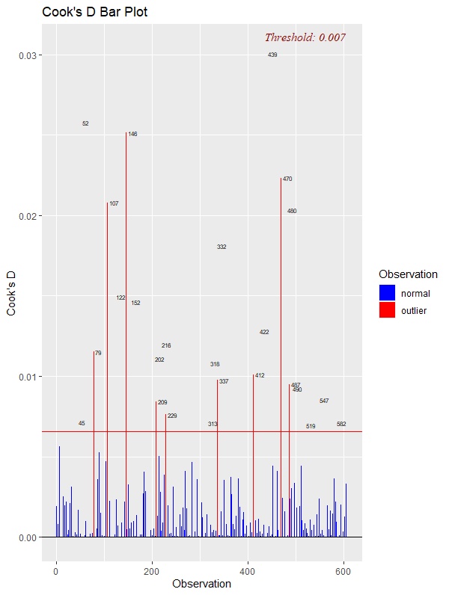
Income Prediction Model
Examining the Characteristics of the Linear Model
Observation: GOOD! We do not have any large Cook's D points that could influence the fitted values
Note: Data point having a large cook's D indicates that the data point strongly influences the fitted values.

Slide 19
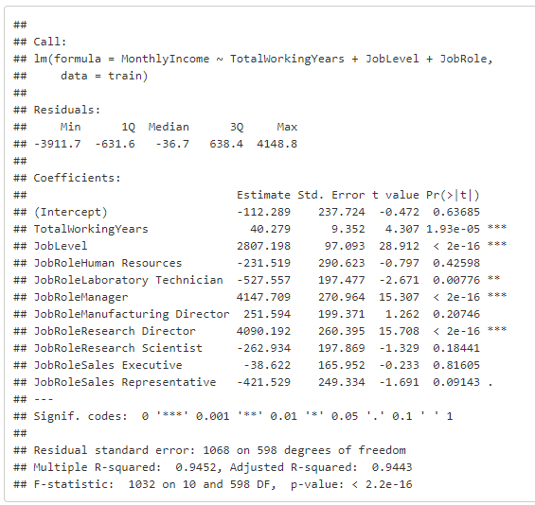
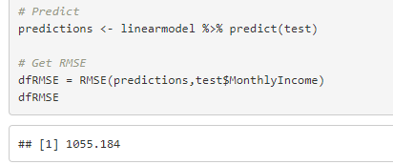
Income Prediction Model
Examining the Characteristics of the Linear Model
Observation:
Adjusted R-squared: 0.9443
p-value of < 2.2e-16
RMSE: $1055.184
Conclusion: This is a good Predictive Model

