Slide 1
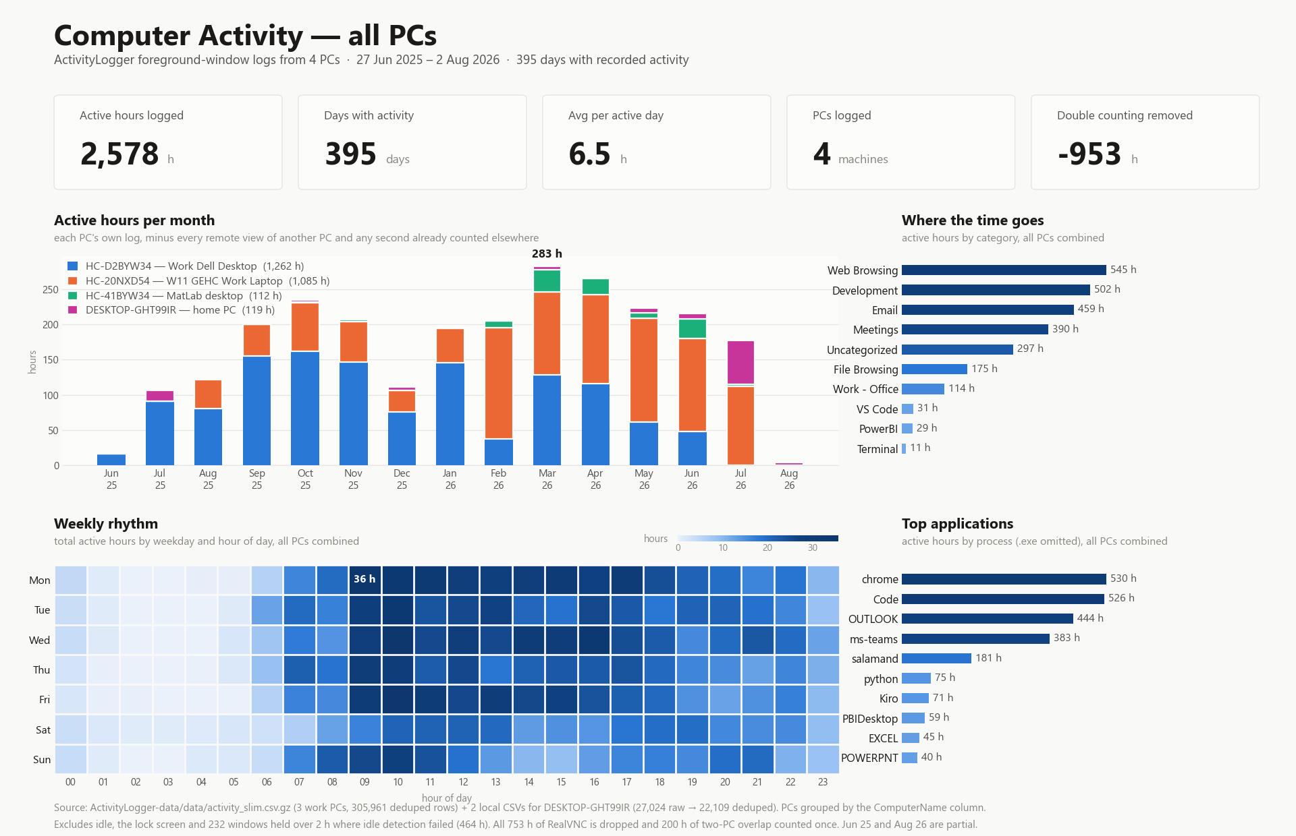
All PCs - 27 Jun 2025 to 2 Aug 2026 - 2,578 active hours across 4 machines, double counting removed (-953 h)

Slide 2
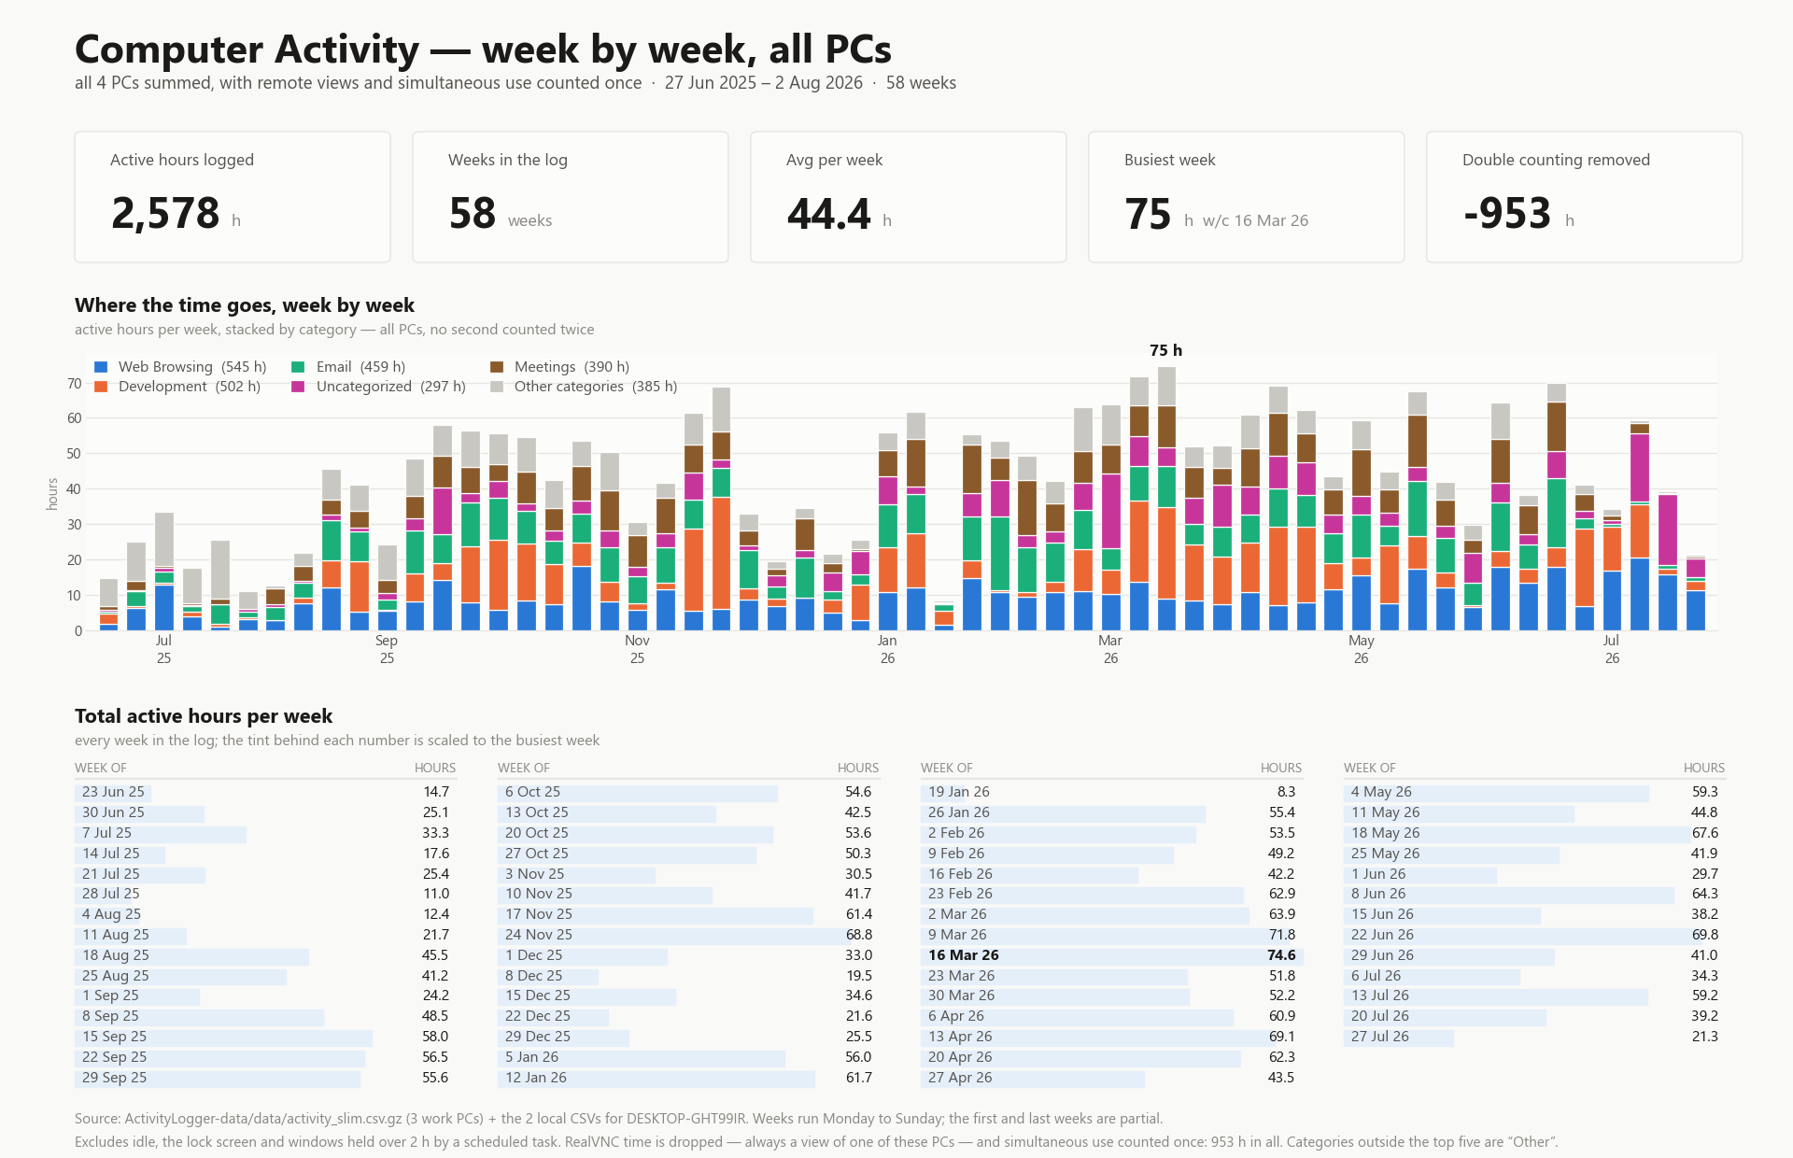
Week by week, all PCs - 58 weeks, 2,578 active hours, busiest week 74.6 h w/c 16 Mar 2026

Slide 3
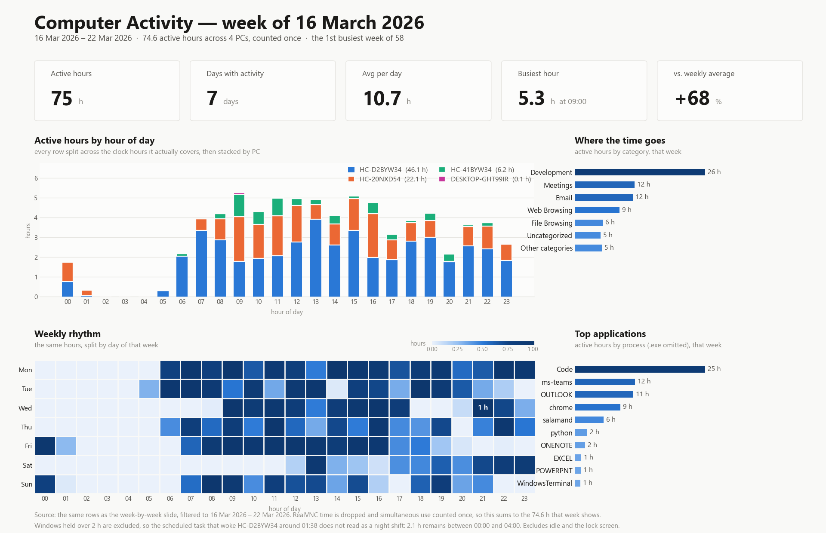
Week of 16 March 2026 - 74.6 active hours, hour by hour and stacked by PC

Slide 4
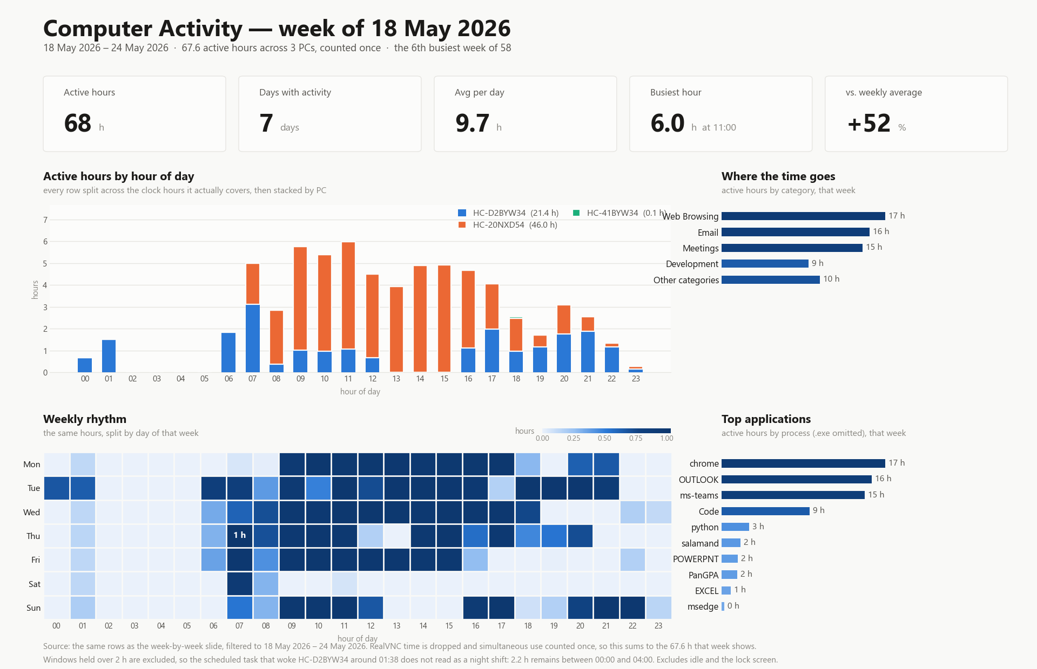
Week of 18 May 2026 - 67.6 active hours, hour by hour and stacked by PC

Slide 5
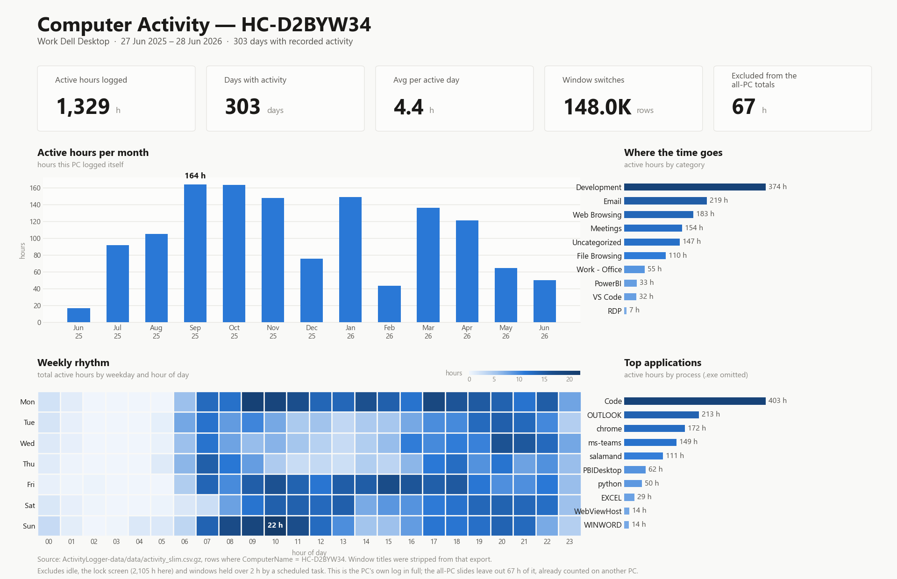
HC-D2BYW34 - Work Dell Desktop - 27 Jun 2025 to 28 Jun 2026 - 1,329 active hours

Slide 6
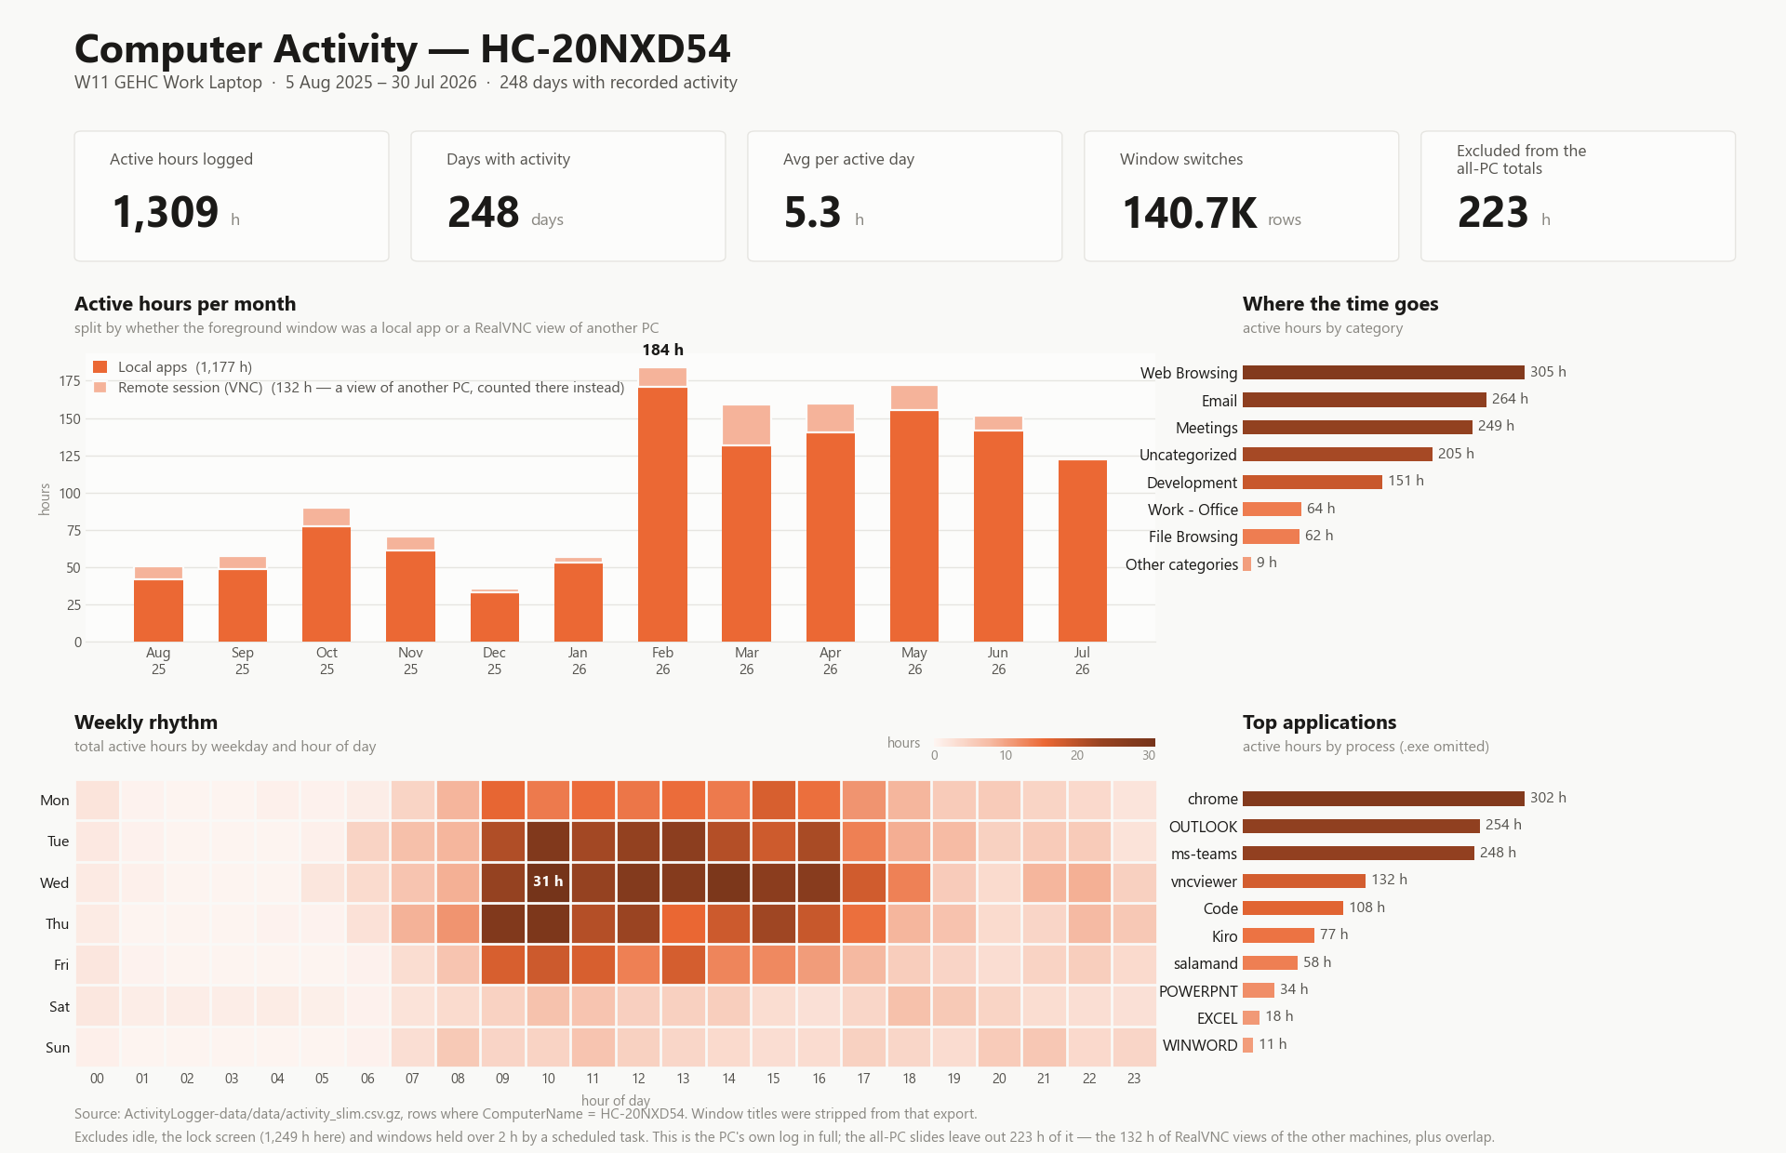
HC-20NXD54 - W11 GEHC Work Laptop - 5 Aug 2025 to 30 Jul 2026 - 1,309 active hours, plus 132 h of RealVNC views counted on the PC being driven

Slide 7
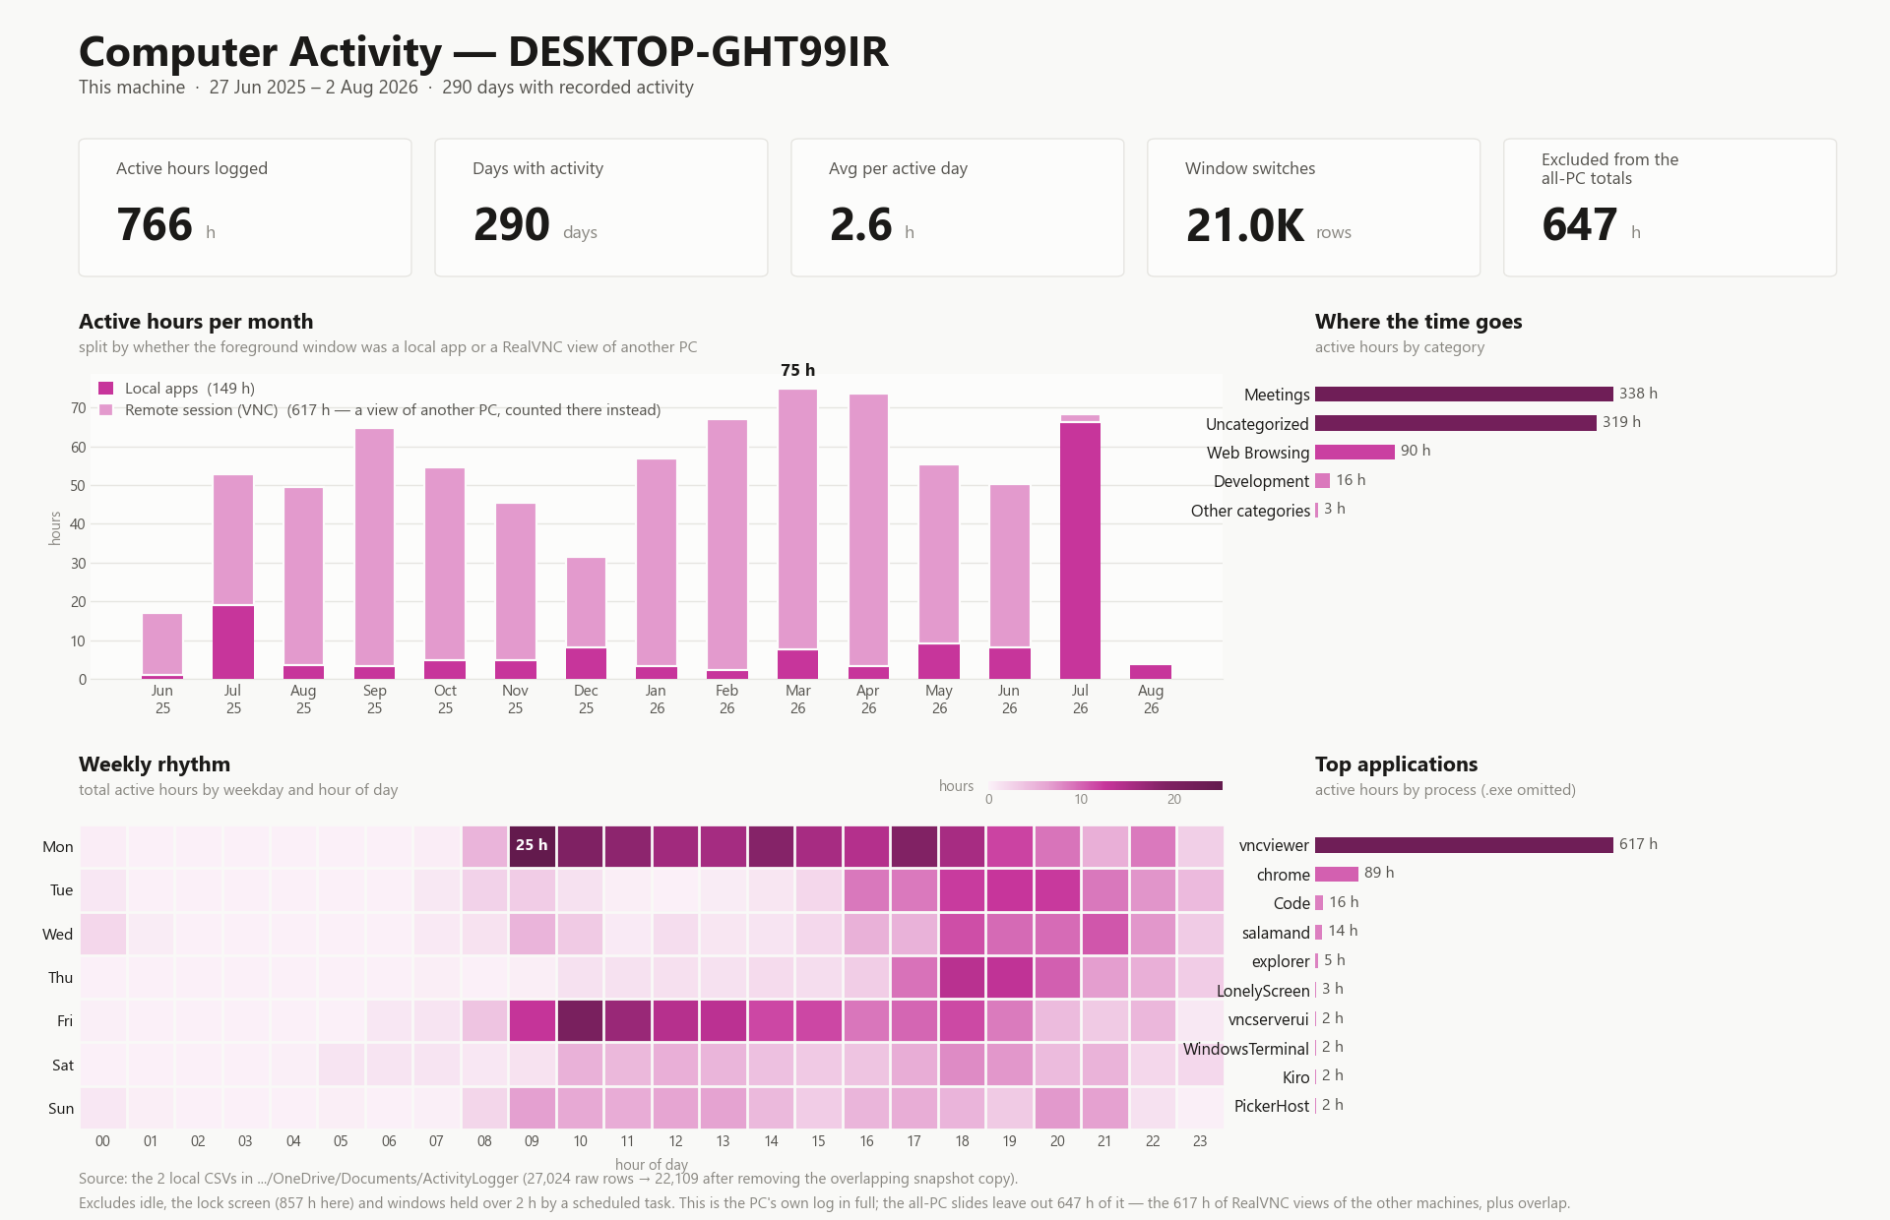
DESKTOP-GHT99IR - home PC - 27 Jun 2025 to 2 Aug 2026 - 766 active hours, plus 617 h of RealVNC views counted on the PC being driven

Slide 8
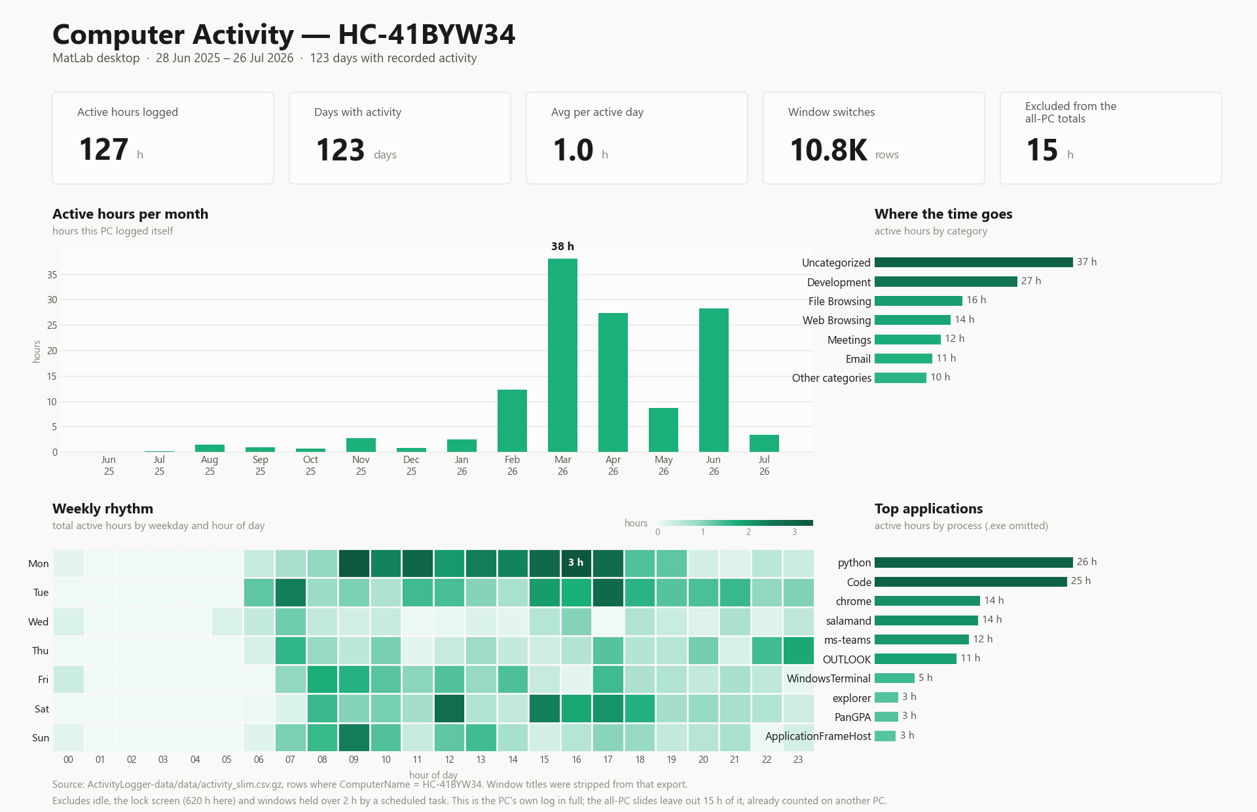
HC-41BYW34 - MatLab desktop - 28 Jun 2025 to 26 Jul 2026 - 127 active hours

