Slide 1
Goals:
Learn basics of developing for Android
Access data from sensors
Create a functional app
Load app onto phone

Slide 2
Activity Code
public class MainActivity extends AppCompatActivity {
public static boolean spinningFast = false;
@Override
protected void onCreate(Bundle savedInstanceState) {
super.onCreate(savedInstanceState);
setContentView(R.layout.activity_main);
SensorManager mansens = (SensorManager)this.getSystemService(SENSOR_SERVICE);
Sensor sens = mansens.getDefaultSensor(Sensor.TYPE_ACCELEROMETER);
Sensor spinsens = mansens.getDefaultSensor(Sensor.TYPE_GYROSCOPE);
Context c = getApplicationContext();
AccelerationListener l = new AccelerationListener(c, this);
SpinListener s = new SpinListener();
mansens.registerListener(l,sens,1);
mansens.registerListener(s,spinsens,1);
}
}

Slide 3
public class AccelerationListener implements SensorEventListener{
private MediaPlayer mediaplayer;
private MainActivity ma;
private boolean screaming;
private Context con;
private static long sTime = 0;
public AccelerationListener(Context c, MainActivity a){
mediaplayer = MediaPlayer.create(c, R.raw.r2d2_scream);
mediaplayer.setLooping(true);
con = c;
screaming = false;
ma = a;
}
@Override
public void onAccuracyChanged(Sensor sensor, int accuracy) {
}
@Override
public void onSensorChanged(SensorEvent event) {
float x = event.values[0];
float y = event.values[1];
float z = event.values[2];
double f = Math.sqrt(x*x+y*y+z*z);
Log.d("#jacob","X: "+x+" Y: "+y+" Z: "+z + " ||V||: " + f);
boolean falling = (-2 < f && f < 2);
boolean notFalling = (-7 > f || f > 7);
boolean scared = falling || MainActivity.spinningFast;
boolean safe = notFalling && !MainActivity.spinningFast;
if(mediaplayer == null) {
mediaplayer = MediaPlayer.create(con, R.raw.r2d2_scream);
mediaplayer.setLooping(true);
}
boolean playing = mediaplayer.isPlaying();
boolean atZero = mediaplayer.getCurrentPosition() == 0;
if(scared && !playing) {
mediaplayer.start();
sTime = System.currentTimeMillis();
}
else if(safe && playing) {
mediaplayer.stop();
mediaplayer.release();
mediaplayer = null;
long eTime = System.currentTimeMillis();
long timeElapsed = eTime - sTime;
float num = (float)timeElapsed/1000;
TextView dropText = (TextView) ma.findViewById(R.id.drop_text);
String fillDropText = String.format("I was scared for\n%.3f\nseconds :(", num);
dropText.setText(fillDropText);
}
}
}

Slide 4
A Quick Video

Slide 5
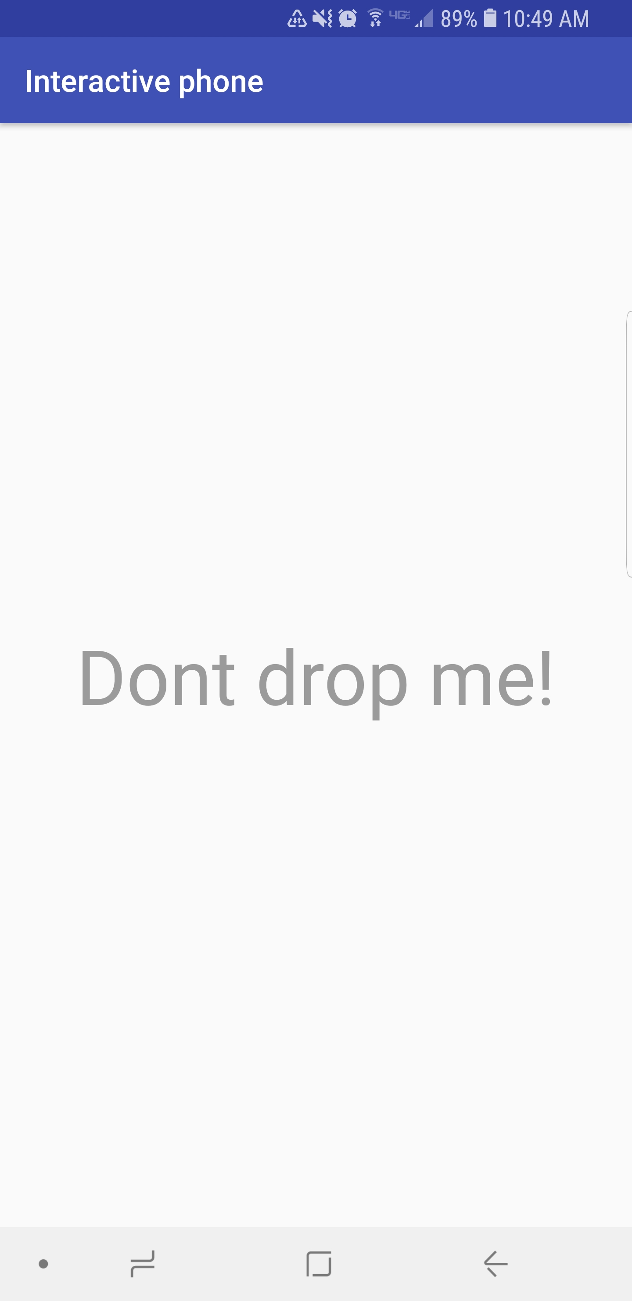
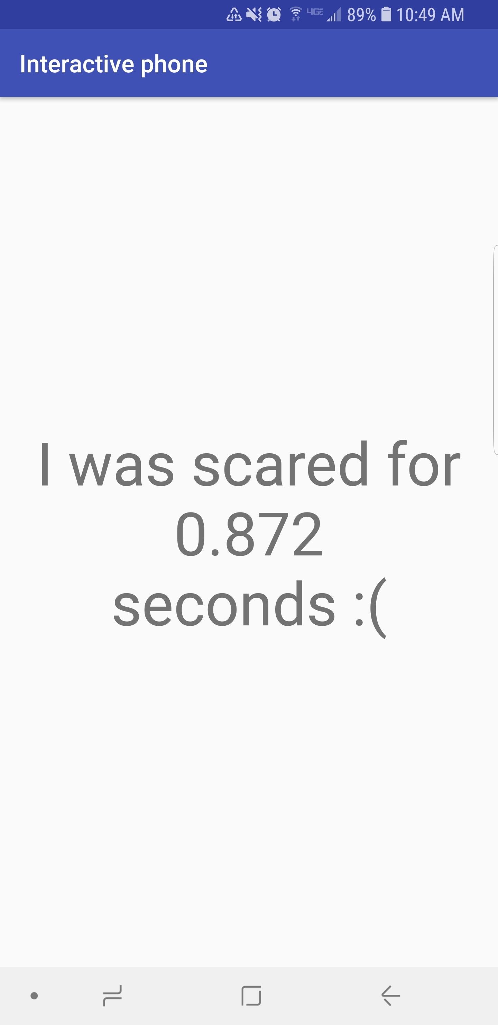

Slide 6
What did we learn?
Android Studio is amazing
An app does NOT need permission to read motion sensors
Developing for mobile is hard
Documentation saves lives

Slide 7
Questions?

