Slide 1
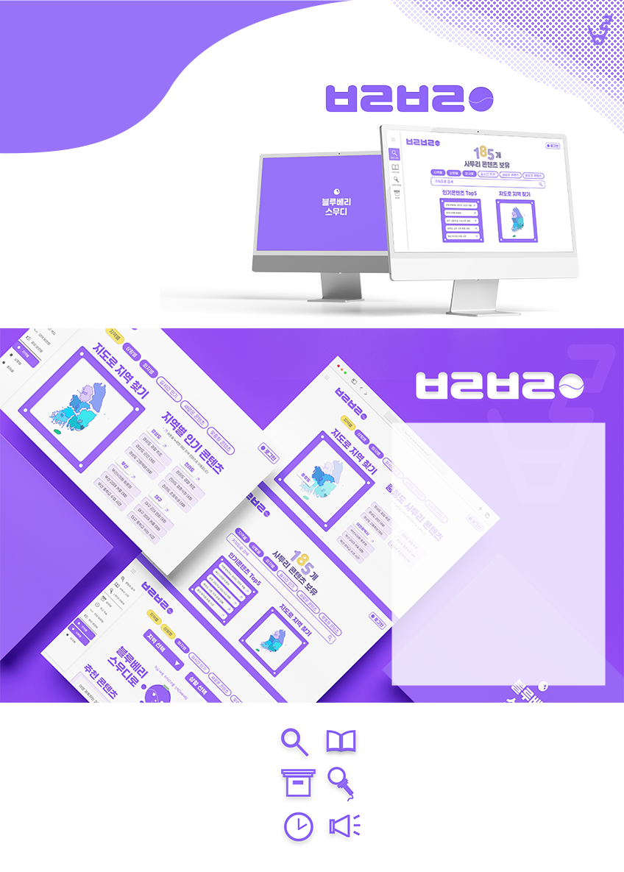
Blue-vary-Smoothie is
Team Blue-vary-Smoothie began as part of the
ICT Industry Collaboration Project course at
Yonsei University in 2022, with the goal of preserving local culture and promoting diversity.
An Audio Data–Based
Korean Dialect Learning Service
We recognized the distinctive value that characters speaking natural regional dialects bring to popular films and TV dramas. While exploring how actors learn dialects for their roles, we found that there were few effective ways to learn a dialect other than receiving direct help from native speakers.
This inspired us to develop a service that collects and preserves Korean dialect data while enabling users to practice authentic, natural-sounding dialects using the collected data.
Preserving Local Culture
& Promoting Diversity
1. Decline in Dialect Use
Regional dialects are gradually disappearing due to social preferences for Standard Korean and the decline of regional populations caused by increasing population concentration in the Seoul metropolitan area.
We therefore saw a need to build a database of regional dialects to preserve this linguistic and cultural heritage.
2. The Importance of Dialects in Korean Media
In films and TV dramas spanning diverse genres, historical periods, and regional settings, dialects have become an essential element for creating realistic settings and giving characters and dialogue a distinctive and memorable identity.
3. Lack of Dialect Learning Platforms
Although demand for natural dialect speaking skills is increasing, we found that there are few platforms offering dedicated video materials or learning services for dialect learners.
This led us to identify the need for a learning platform built around structured audio data rather than relying primarily on existing video content.
Content Search
Dialect Dictionary
Search content by region, situation, or speaker
Search and explore expressions
by converting between regional dialects and Standard Korean
Saved Content
My Practice Room
Save your favorite content for quick and easy access anytime
Practice with friends or mentors
while viewing scripts and sharing your screen
Recent Practice
Audio Data
Practice makes perfect! Quickly revisit your recent learning history
All features and services are powered by dialect audio data

