Slide 1
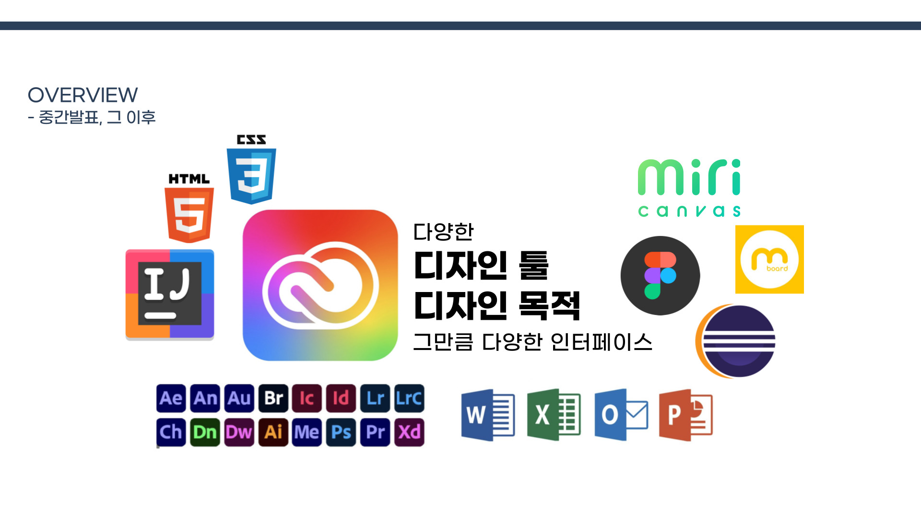
Background
Various
Design Tools
Design Purposes
Different Interfaces
for Different Needs
1 / 19

Slide 2
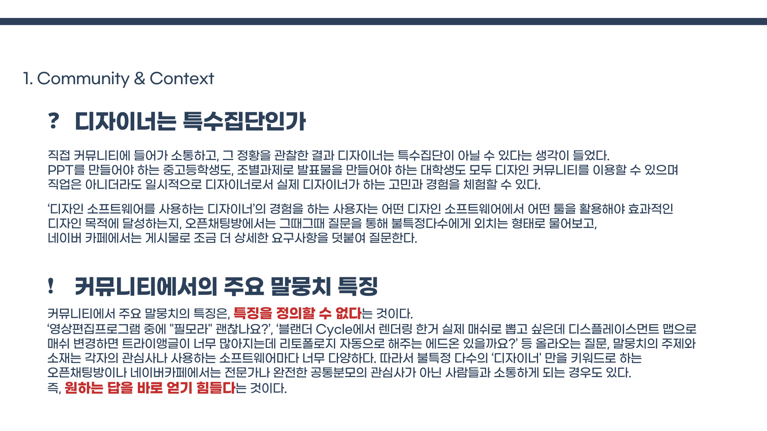
Background
? Are Designers a Specialized Group
After directly participating in design communities, interacting with users, and observing how they communicate, I came to realize that designers may not necessarily constitute a specialized user group. Middle and high school students creating PowerPoint presentations, as well as university students preparing presentations for group projects, may all use design communities. Even if design is not their profession, they can temporarily take on the role of a designer and encounter many of the same concerns and experiences as professional designers.
Users engaging in the experience of a “designer using design software” often need to determine which tools within a particular design program will help them achieve their design goals effectively.
In open chat rooms, users typically ask immediate questions to a broad and unspecified audience. In online communities, they tend to post more detailed questions that include specific requirements and context.
! Key Characteristics of Community Conversations
A key characteristic of conversations within these communities is that their characteristics are difficult to define consistently.
“Is Filmora a good video editing program?”
"I want to convert something rendered in Blender Cycles into an actual mesh,
but using a displacement map creates too many triangles. Is there an add-on that can automatically handle retopology?”
The topics and content of these conversations vary greatly depending on each user’s interests and the software they use. Questions such as those above frequently appear in these communities.
As a result, open chat rooms or online communities built around the broad keyword “designer” often bring together people who do not necessarily share the same expertise or interests.
In other words, it is difficult for users to get the answers they need immediately.
2 / 19

Slide 3
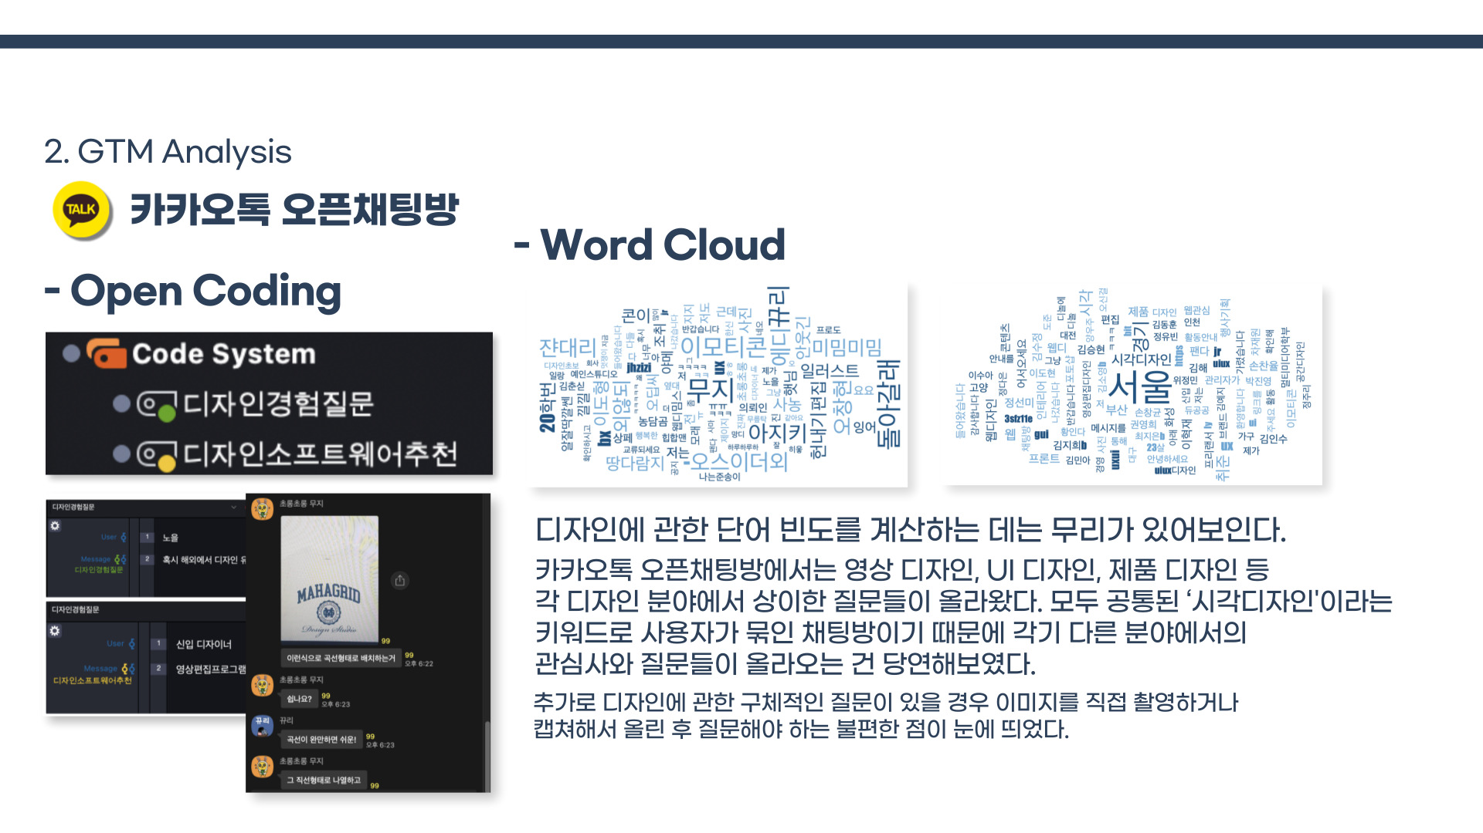
Text Analysis of Online Communities
KakaoTalk open Chat Rooms
- Open Coding
Design Experience Questions
Design Software Recommendations
Calculating simple word frequencies related to design did not appear to provide particularly meaningful insights.
In the KakaoTalk open chat rooms, users raised a wide variety of questions across different fields, including video design, UI design, and product design. Since users with different interests were grouped together under the broad category of “visual design,” it was unsurprising that their interests and questions varied considerably across different areas of design.
I also observed that when users had specific design-related questions, they often had to take a photo or capture a screenshot and upload it before asking their question, adding an extra layer of inconvenience to the process.
3 / 19

Slide 4
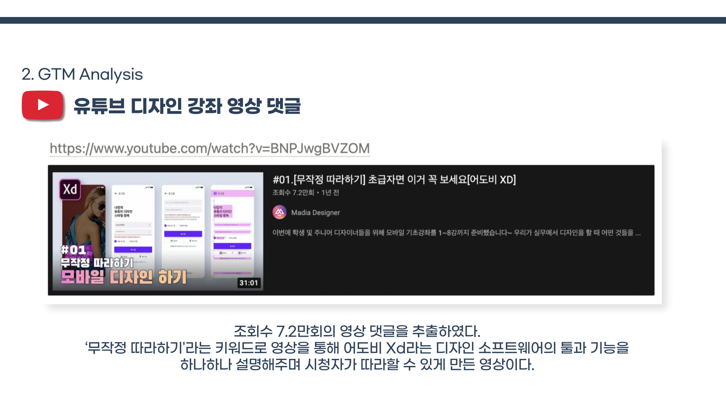
Text Analysis of Online Communities
#01. [Follow Along] A Must-Watch for Beginners [Adobe XD]
Comments were collected from a video with approximately 72,000 views.
Using a “follow-along” format, the video explains the tools and features of Adobe XD step by step,
allowing viewers to follow the process themselves.
4 / 19

Slide 5
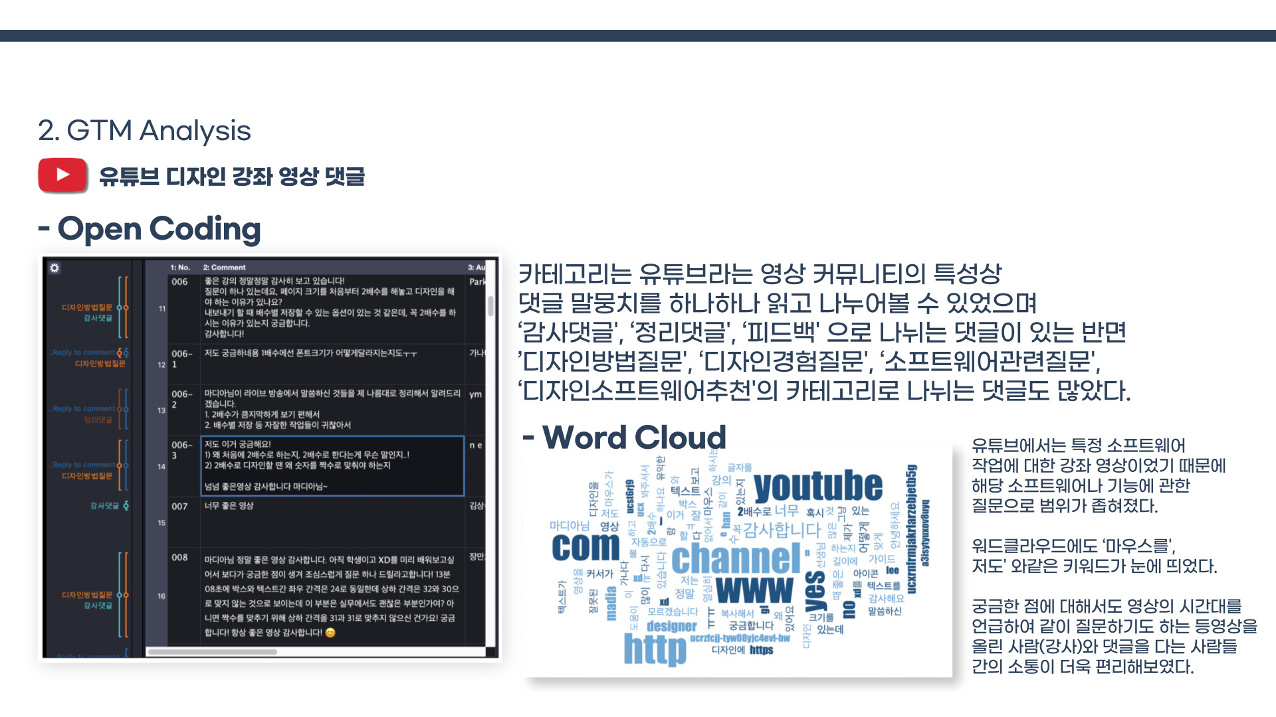
Text Analysis of Online Communities
Comments on a YouTube Design Tutorial
Given the nature of YouTube as a video-based community,
I were able to read and categorize individual comments.
Some comments could be classified as “Appreciation,” “Summary,” or “Feedback,” while many others fell into categories such as “Design Method Questions,” “Design Experience Questions,” “Software-Related Questions,” and “Design Software Recommendations.”
Because the YouTube video was a tutorial focused on a specific software application, the scope of the questions was narrowed to that particular software and its features.
Keywords such as “mouse” and “me too” also stood out in the word cloud.
Users could also refer to specific timestamps in the video when asking questions, making communication between the video creator (instructor) and viewers more convenient and context-specific.
5 / 19

Slide 6
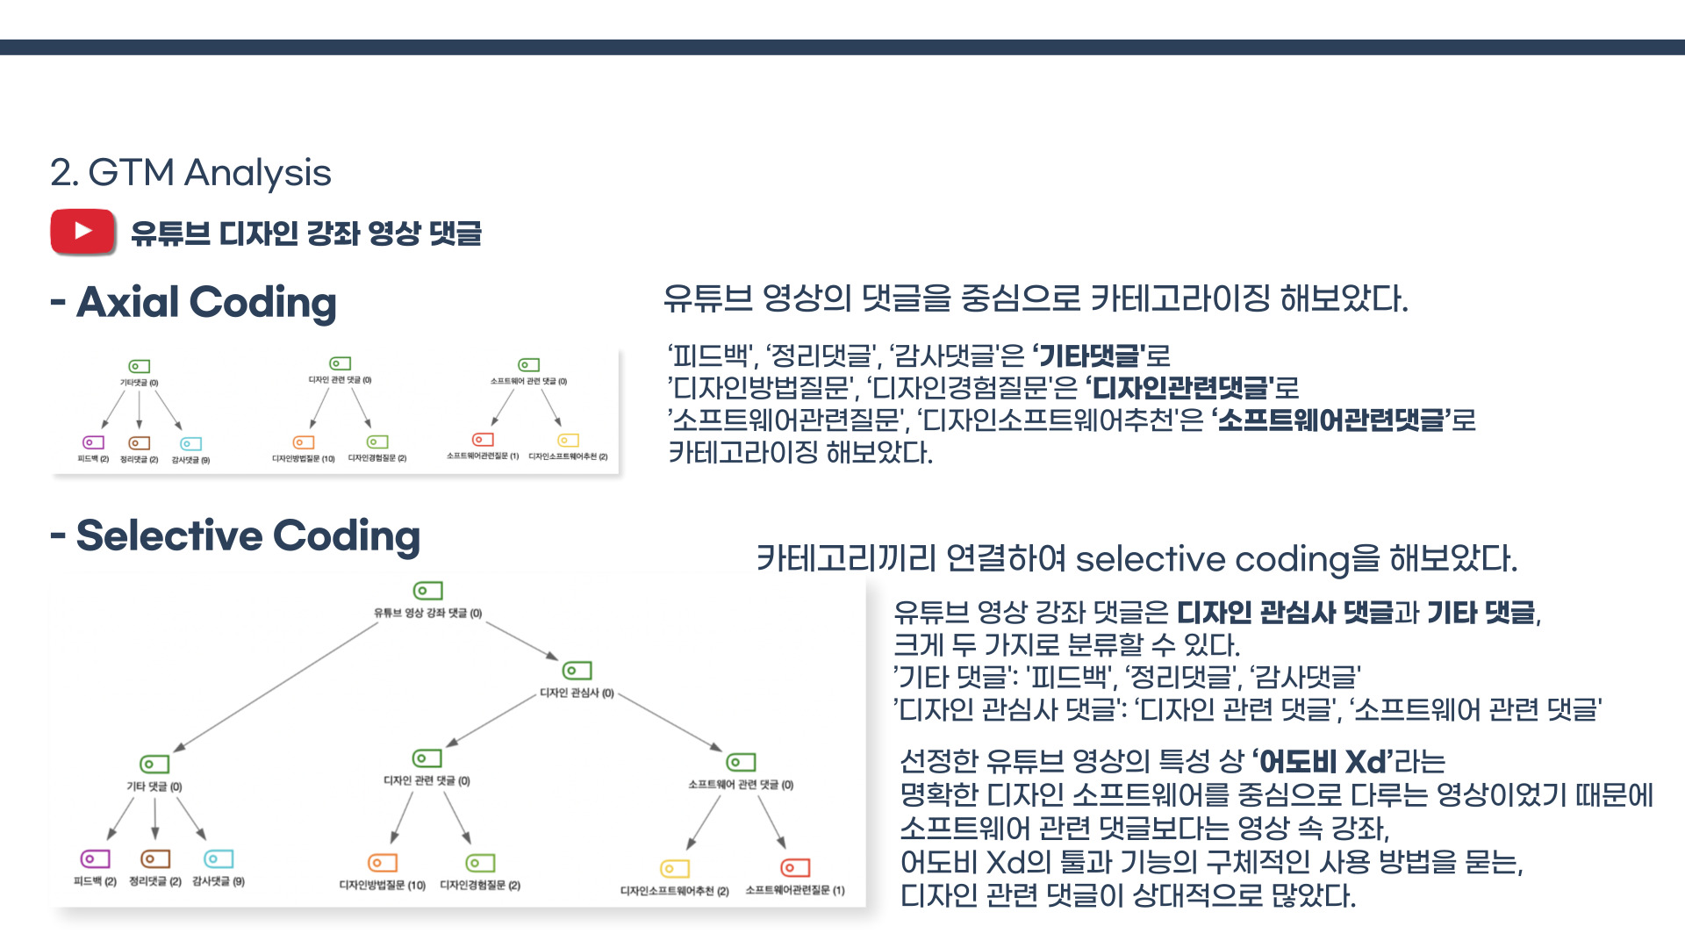
Text Analysis of Online Communities
I grouped “Feedback,” “Summary Comments,” and “Appreciation Comments” under “Other Comments.”
“Design Method Questions” and “Design Experience Questions” were grouped under “Design-Related Comments,” while “Software-Related Questions” and “Design Software Recommendations” were grouped under “Software-Related Comments.”
I then conducted selective coding by identifying relationships among the categories.
Comments on the YouTube design tutorial could broadly be divided into two categories: Design-Interest Comments and Other Comments.
Since the selected YouTube video focused on a specific design tool, Adobe XD, there were relatively more design-related comments asking about specific ways to use the tools and features demonstrated in the tutorial than general software-related comments.
6 / 19

Slide 7
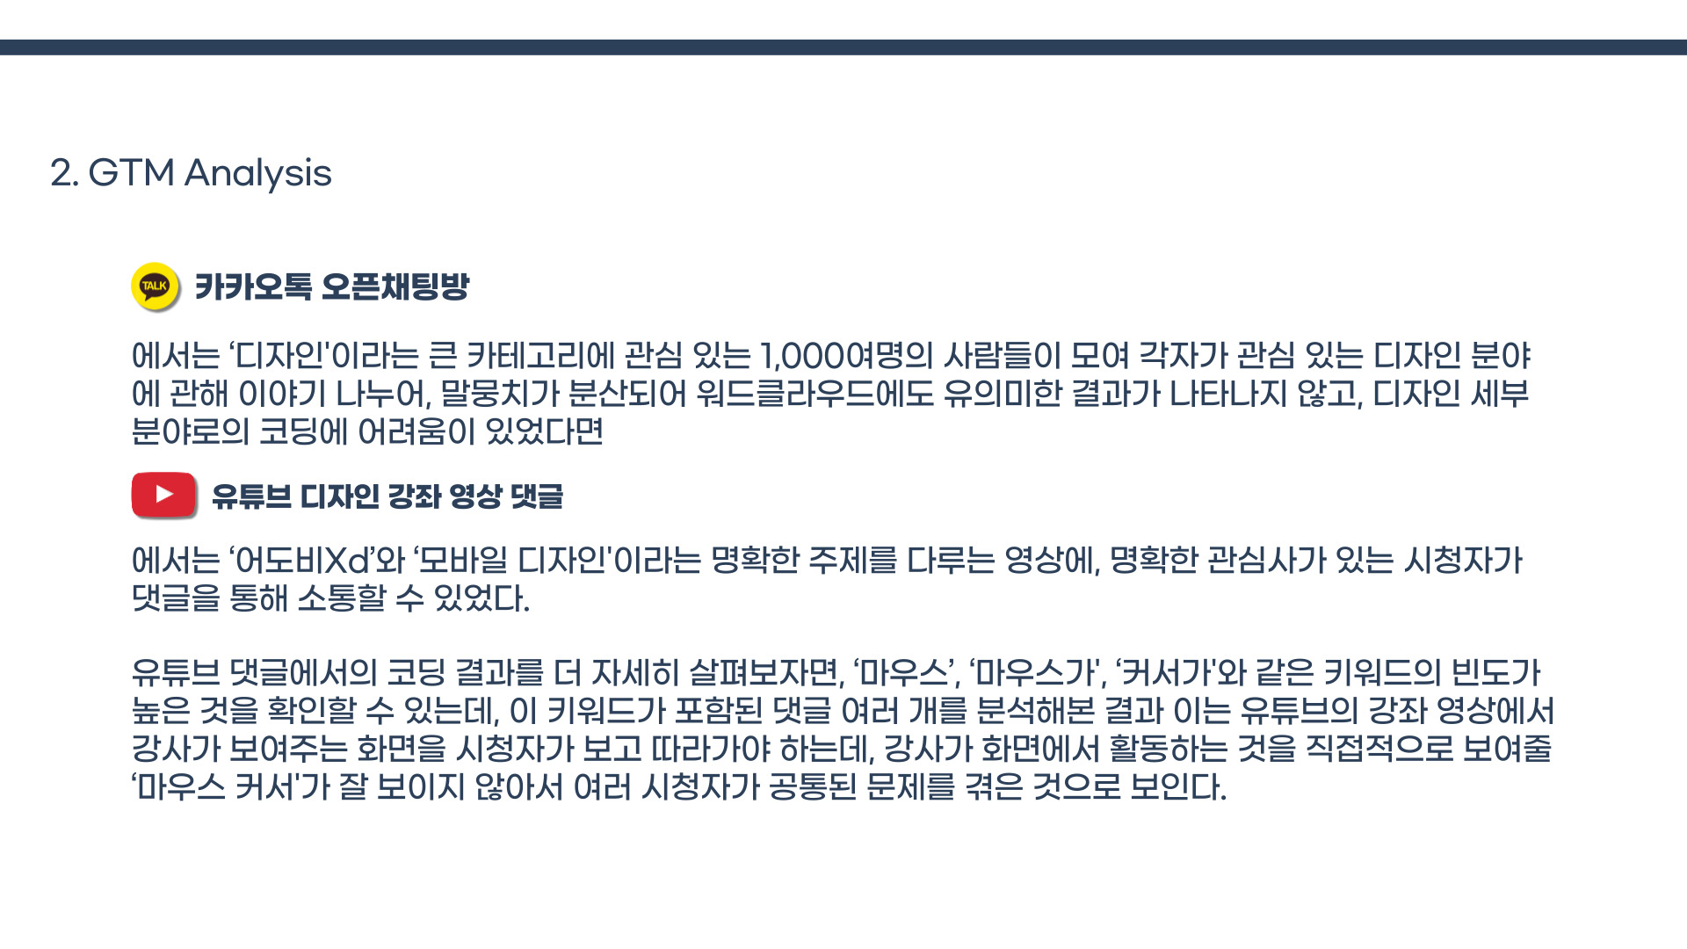

Text Analysis of Online Communities
In the KakaoTalk Open Chat Room, approximately 1,000 users interested in the broad category of “design” gathered to discuss their respective areas of interest.
Because the conversations were spread across many different design fields, the corpus was highly fragmented. As a result, the word cloud did not reveal particularly meaningful patterns, and it was difficult to code the conversations into specific design subfields.
In contrast, the YouTube design tutorial focused on clearly defined topics—Adobe XD and mobile design—allowing viewers with shared and specific interests to communicate through the comments.
A closer examination of the coding results from the YouTube comments revealed a high frequency of keywords such as “mouse” and “cursor.”
After analyzing multiple comments containing these keywords, we identified a recurring issue: viewers needed to follow the instructor’s actions on screen, but the mouse cursor was difficult to see clearly. This appeared to be a common usability problem experienced by multiple viewers.
7 / 19

Slide 8
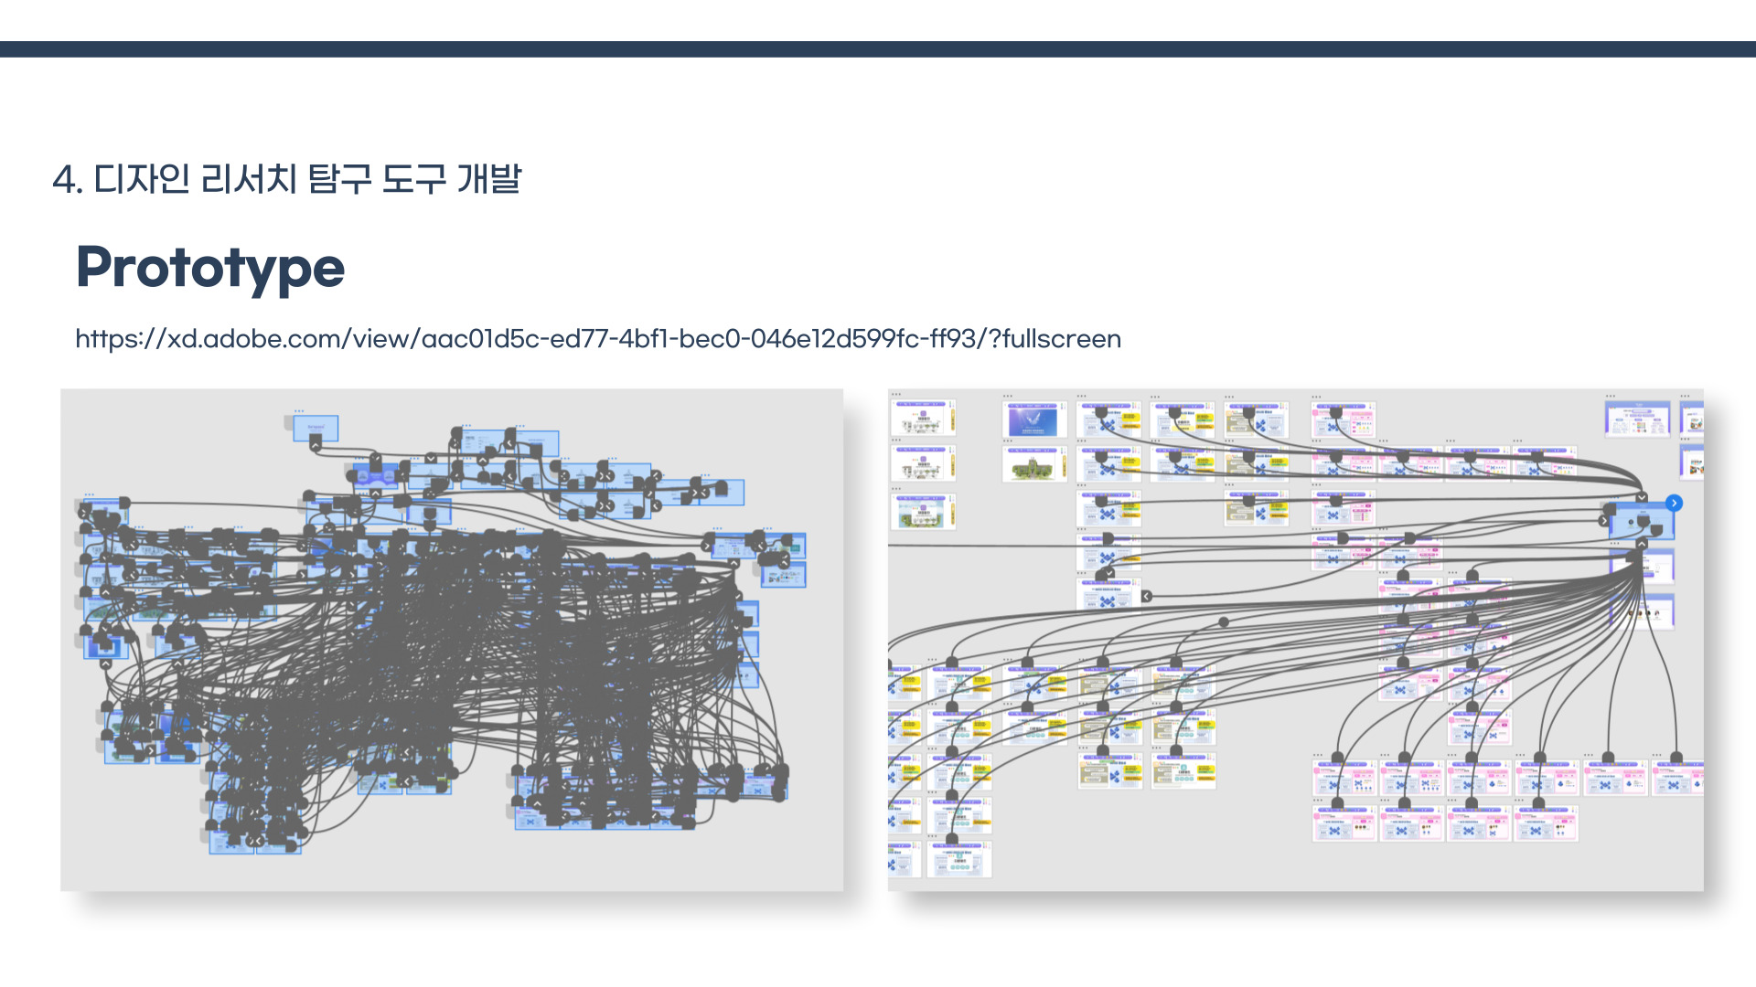
8 / 19

Slide 9
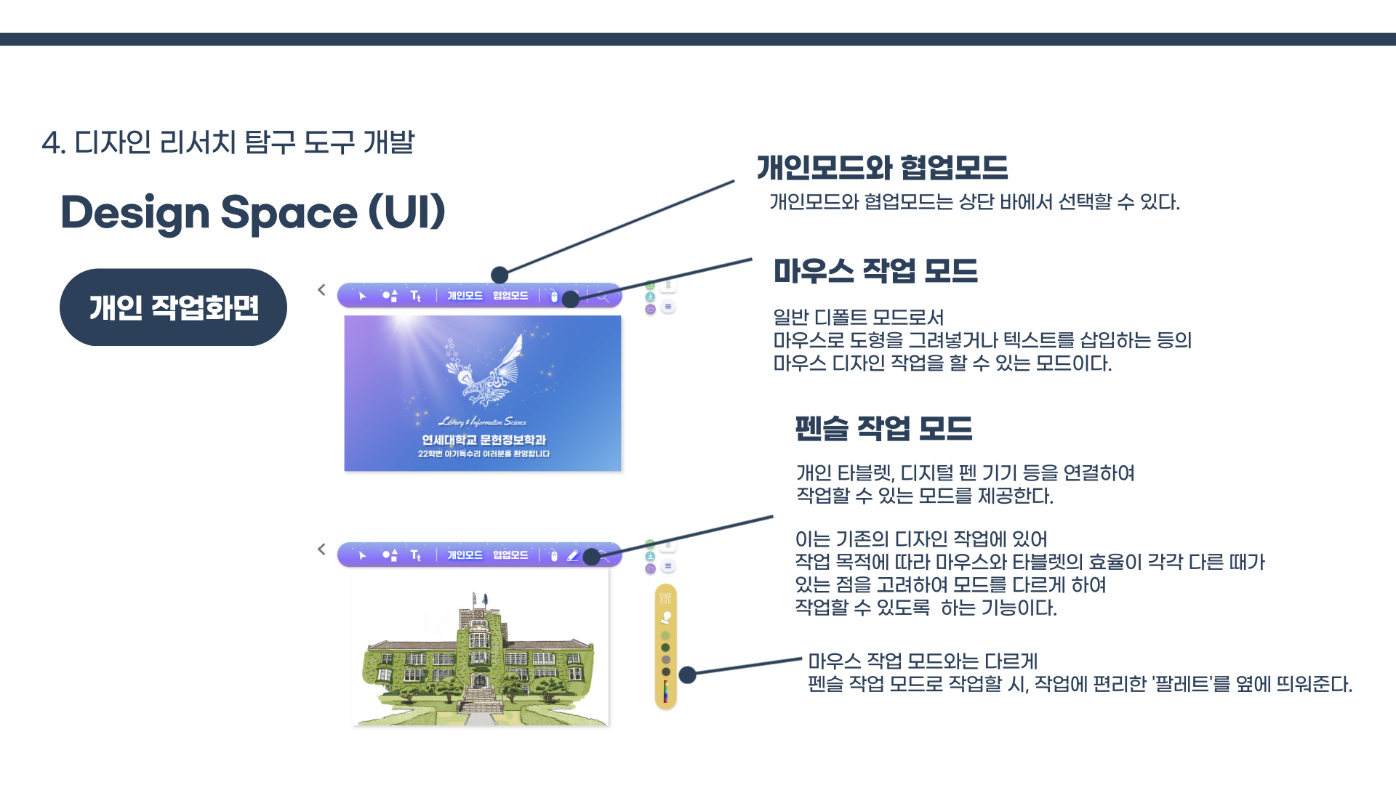
Page-by-page functions #1
Individual Workspace
Individual & Collaboration Modes
Users can switch between Individual Mode and Collaboration Mode from the top toolbar.
Mouse Mode
This is the default mode, allowing users to perform mouse-based design tasks such as drawing shapes and inserting text.
Pencil Mode
This mode allows users to work with a connected drawing tablet, digital pen, or other pen-based input device.
Since the efficiency of mouse and tablet input can vary depending on the design task, users can switch between input modes according to their needs.
Unlike Mouse Mode, Pencil Mode displays a convenient color palette alongside the workspace.
9 / 19

Slide 10
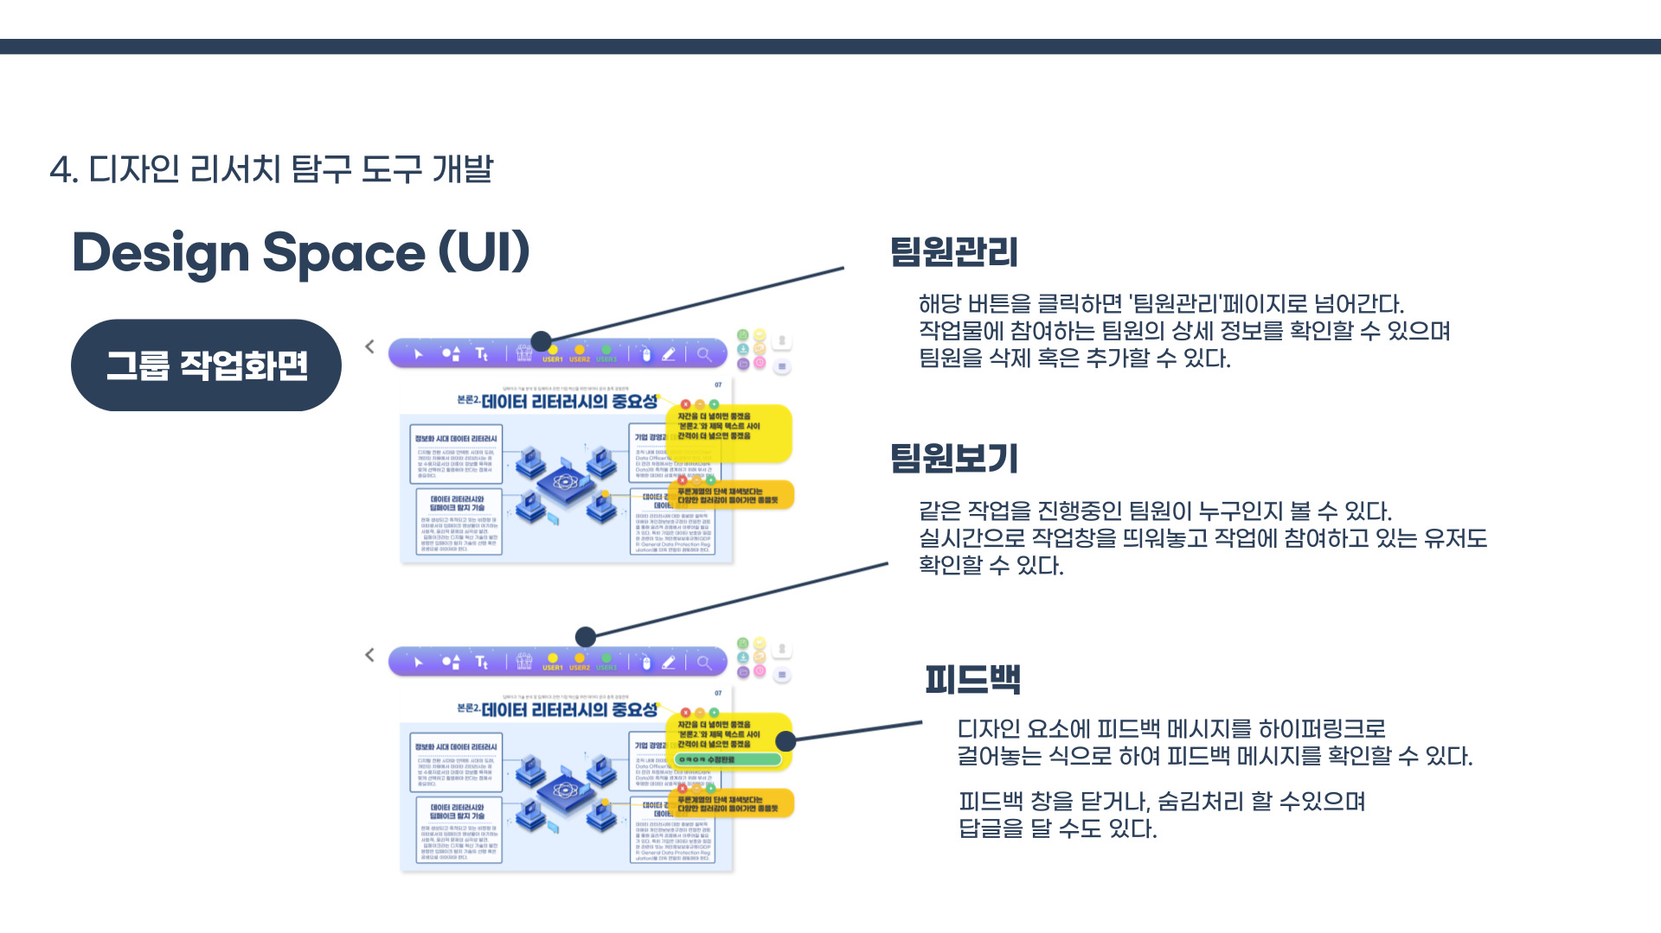
Page-by-page functions #2
Group Workspace
Team Management
Clicking this button opens the Team Management page, where users can view detailed information about team members participating in the project and add or remove members.
View Team Members
Users can see who is collaborating on the same project and identify which team members are currently active in the shared workspace in real time.
Feedback
Users can see who is collaborating on the same project and identify which team members are currently active in the shared workspace in real time.
Users can close or hide feedback panels and reply directly to individual feedback messages.
10 / 19

Slide 11
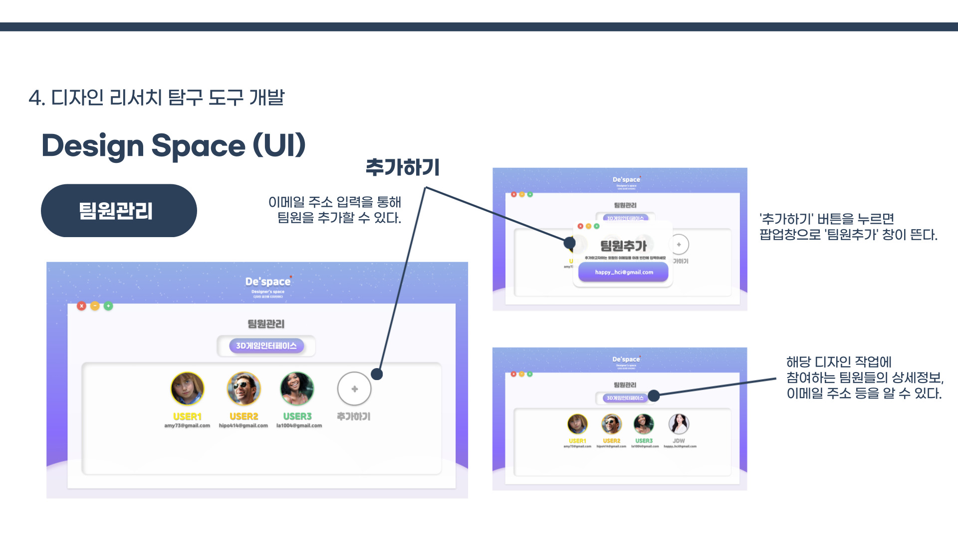
Page-by-page functions #3
Team Management
Add Member
Team members can be added by entering their email addresses.
Clicking the “Add” button opens an “Add Team Member” pop-up window.
Users can view detailed information about the team members participating in the design project, including their email addresses.
11 / 19

Slide 12
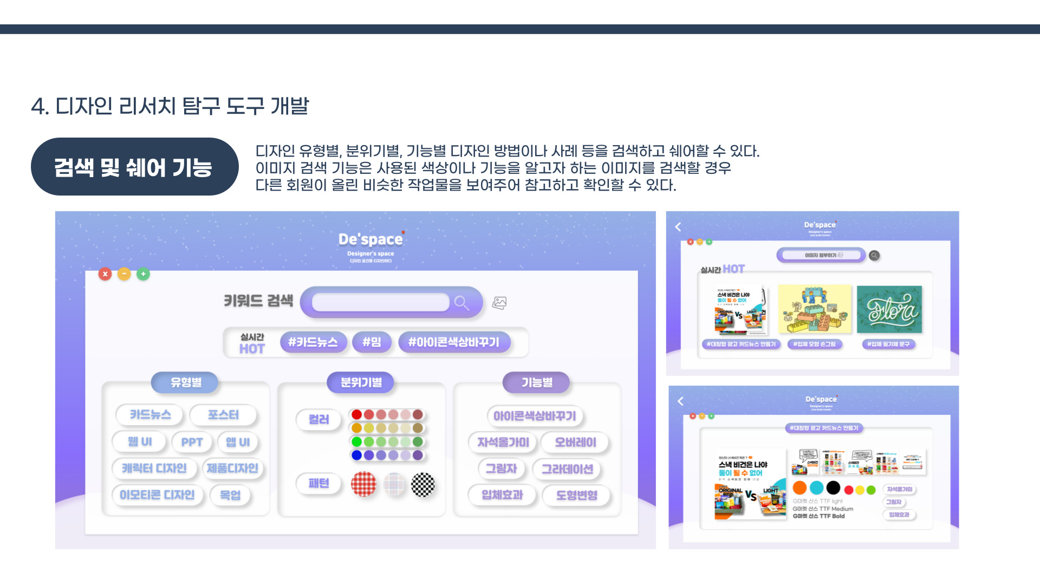
Page-by-page functions #4
Search & Share
Users can search for and share design methods and examples by design type, visual style, or function.
The image search feature allows users to search for visual references based on elements such as colors or functions. Similar works uploaded by other users are displayed as references for further exploration.
12 / 19

Slide 13
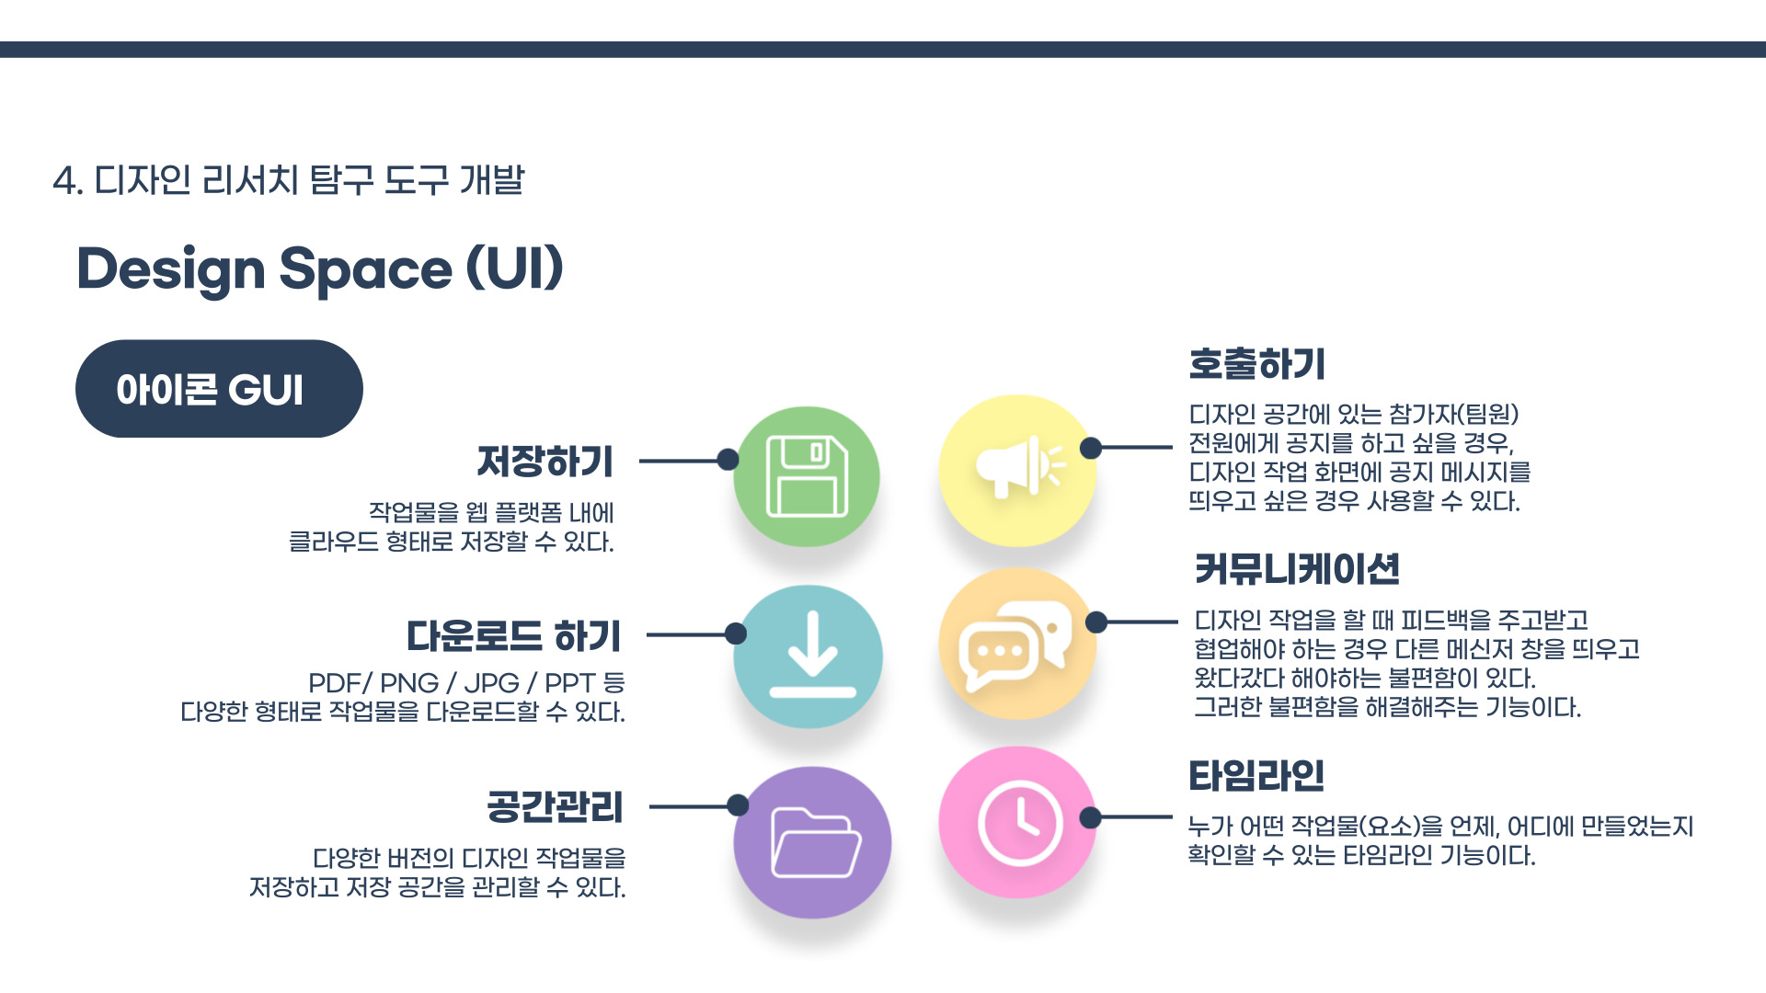
Features by Interface
Primary Icon GUI
Save
Broadcast
Save design projects
to the web platform's cloud storage.
Broadcast announcements to all team members in the design space by displaying a message directly within their workspaces.
Download
Communication
Download design projects in various formats, including PDF, PNG, JPG, and PPT.
This feature enables users to exchange feedback and collaborate without having to switch back and forth between the design workspace and external messaging applications.
Workspace Management
Timeline
Save multiple versions of design projects and manage workspace storage.
This feature enables users to exchange feedback and collaborate without having to switch back and forth between the design workspace and external messaging applications.
13 / 19

Slide 14
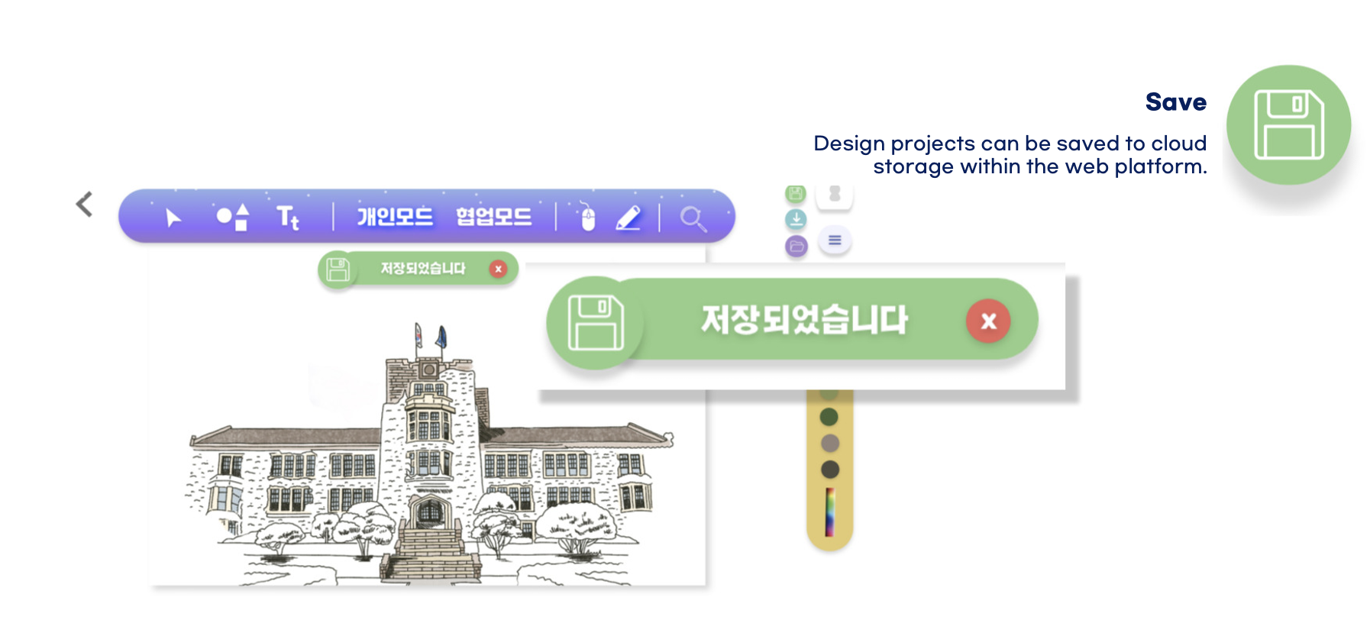
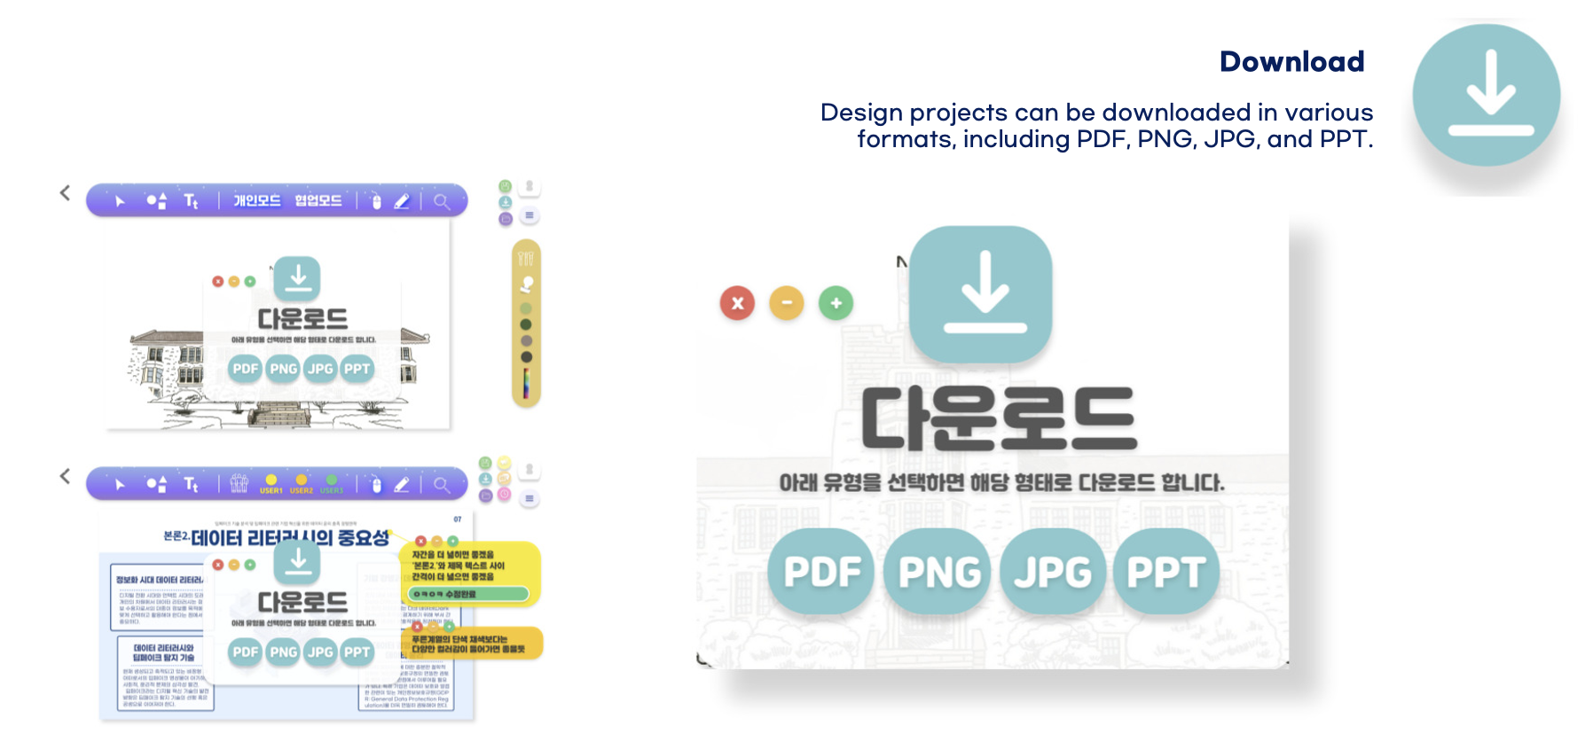
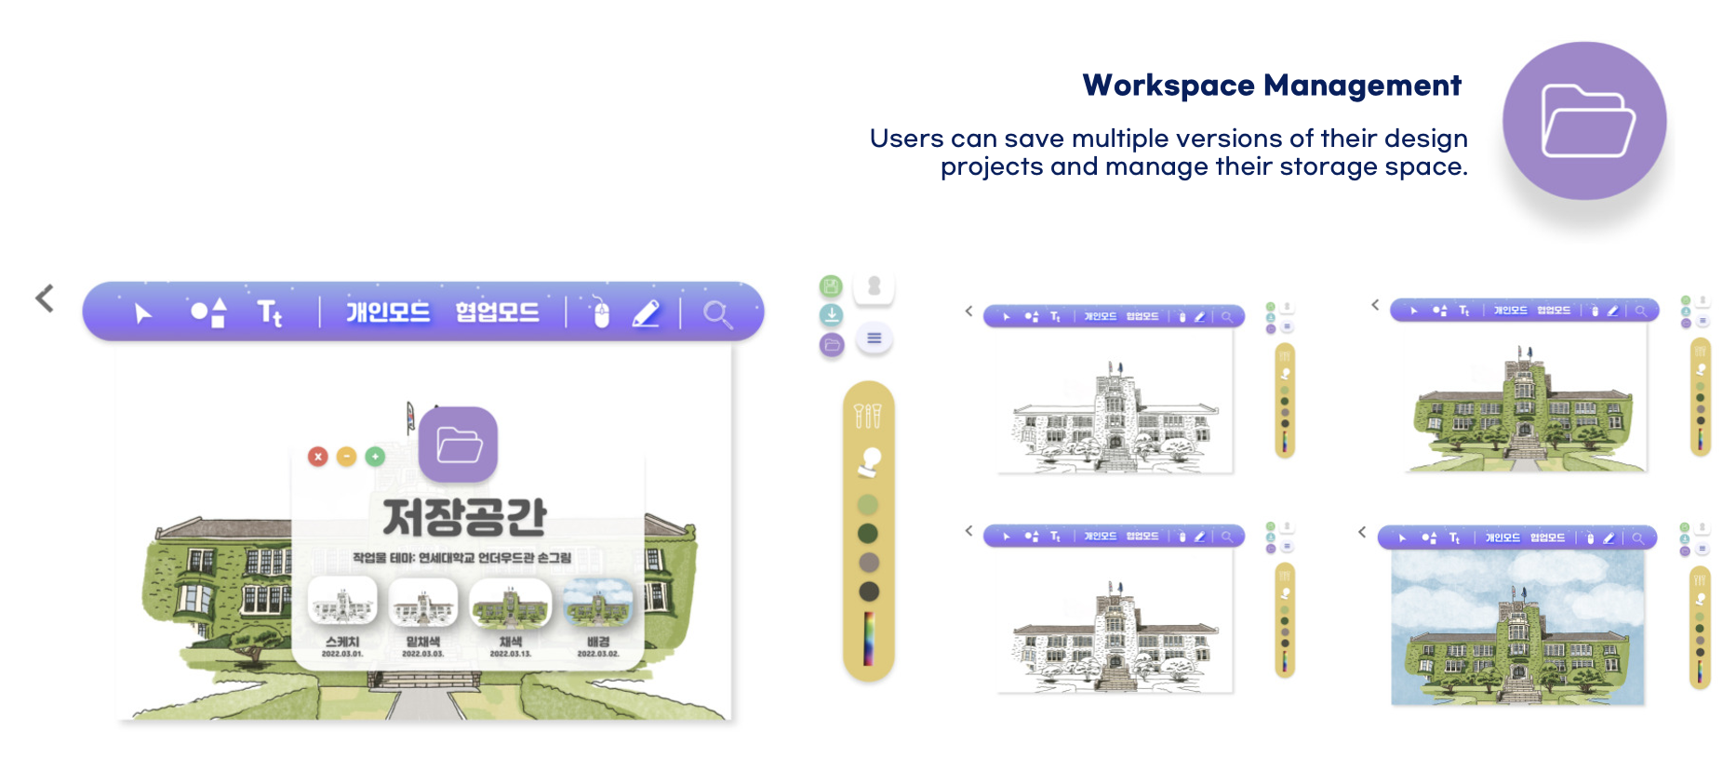
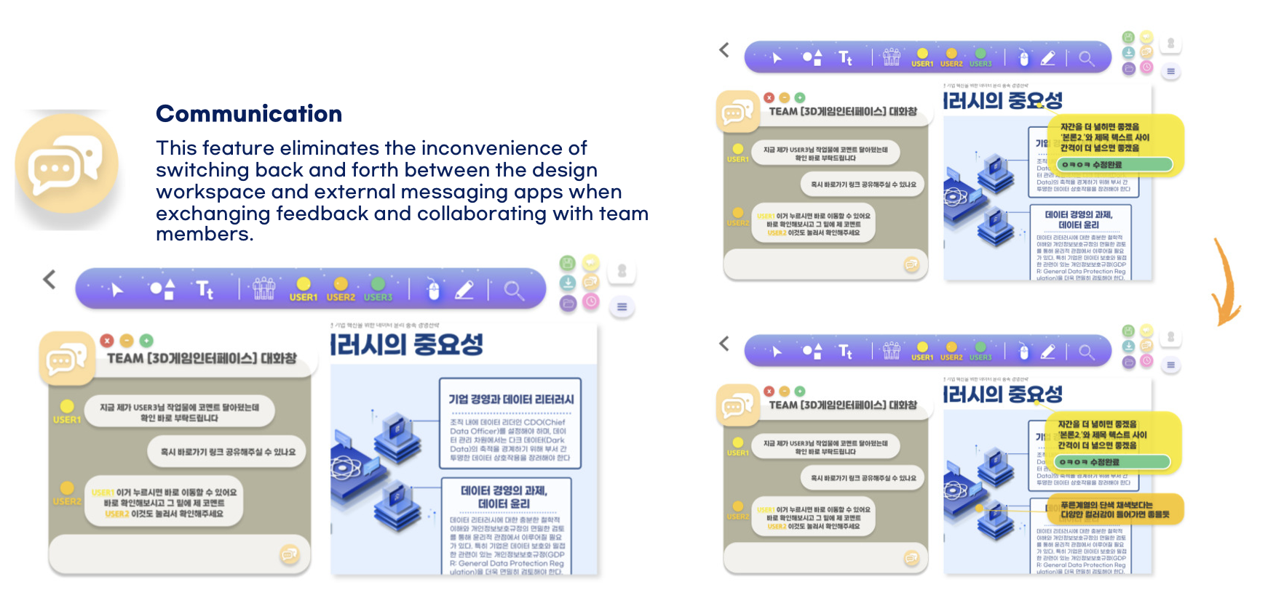
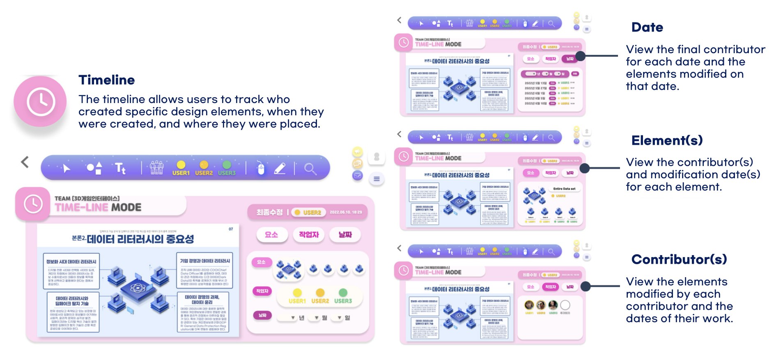
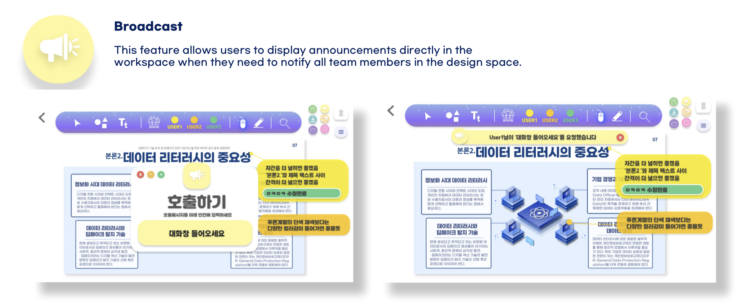

Slide 15
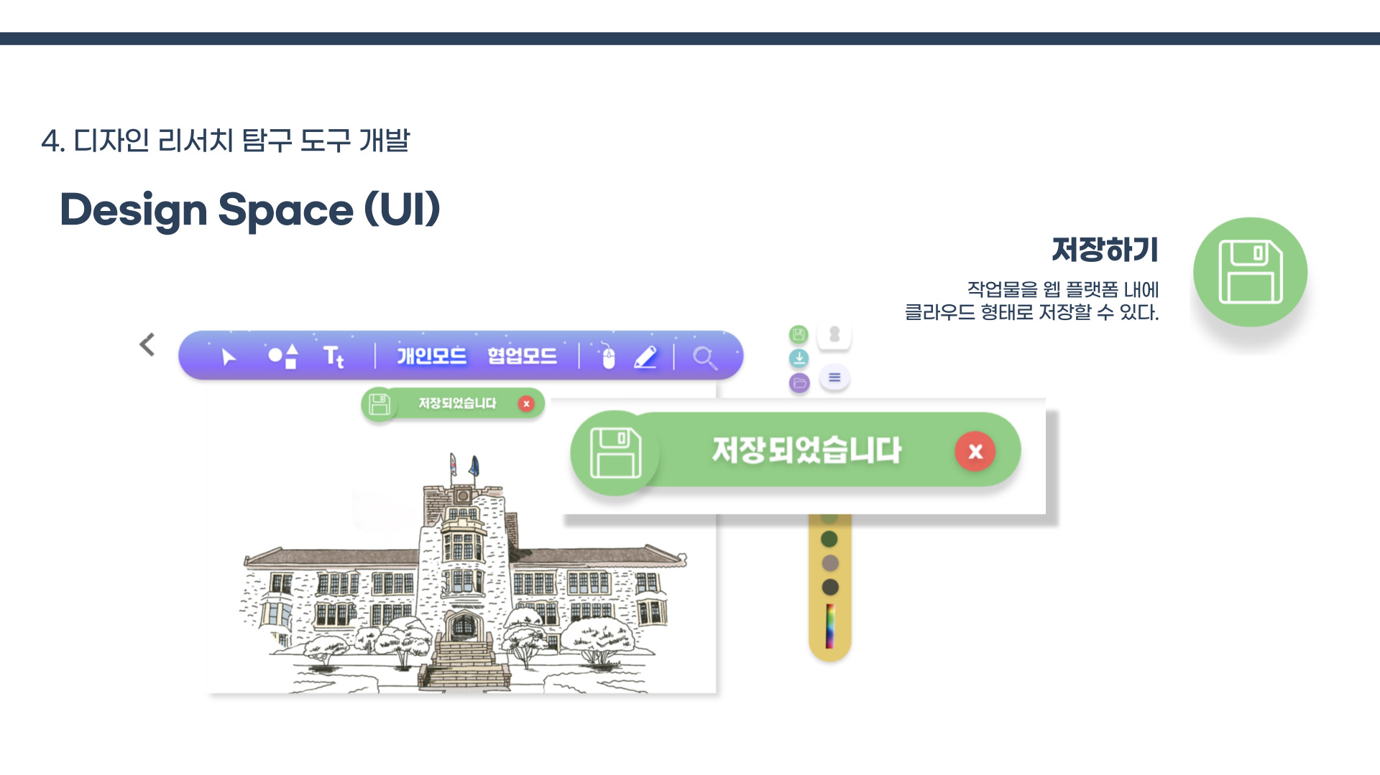
Features by Interface
Save
Design projects can be saved to cloud storage within the web platform.

Slide 16
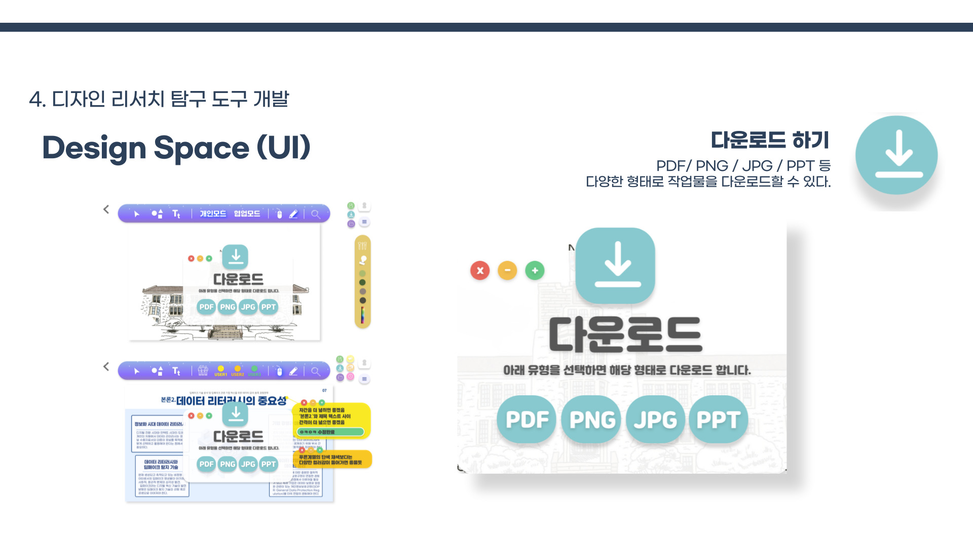
Features by Interface
Download
Design projects can be downloaded in various formats, including PDF, PNG, JPG, and PPT.

Slide 17
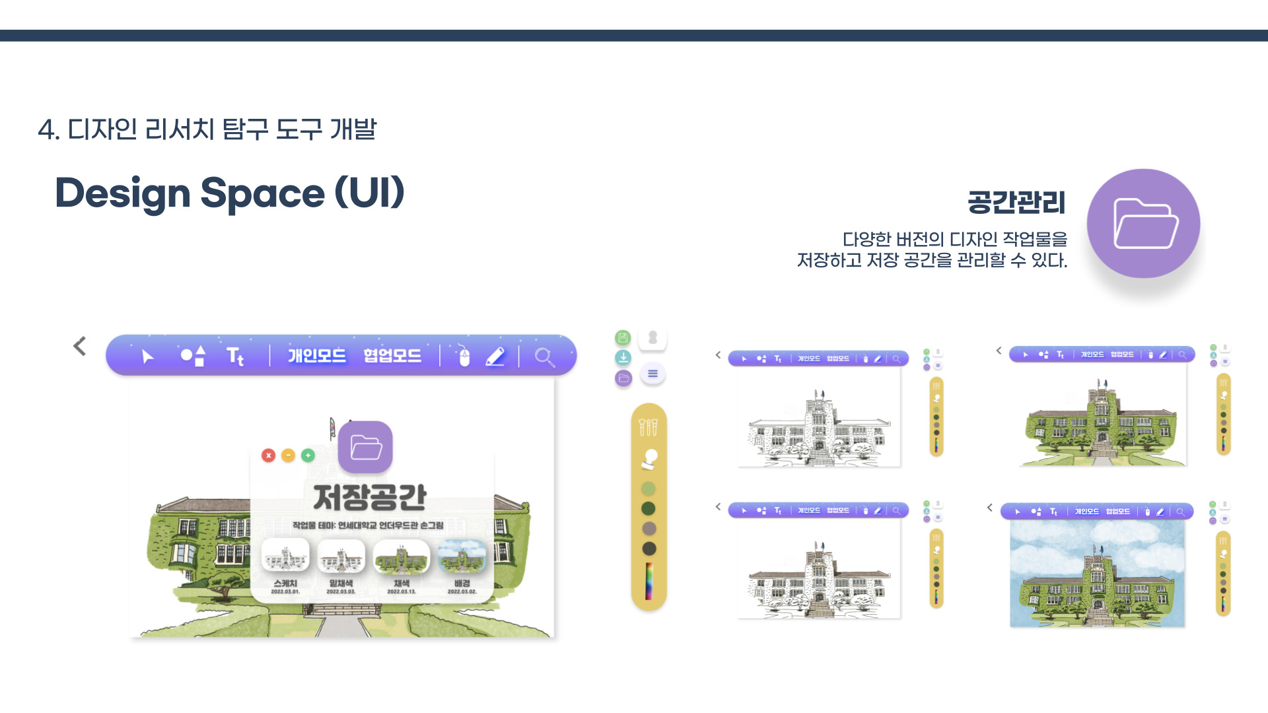
Features by Interface
Workspace Management
Users can save multiple versions of their design projects and manage their storage space.

Slide 18
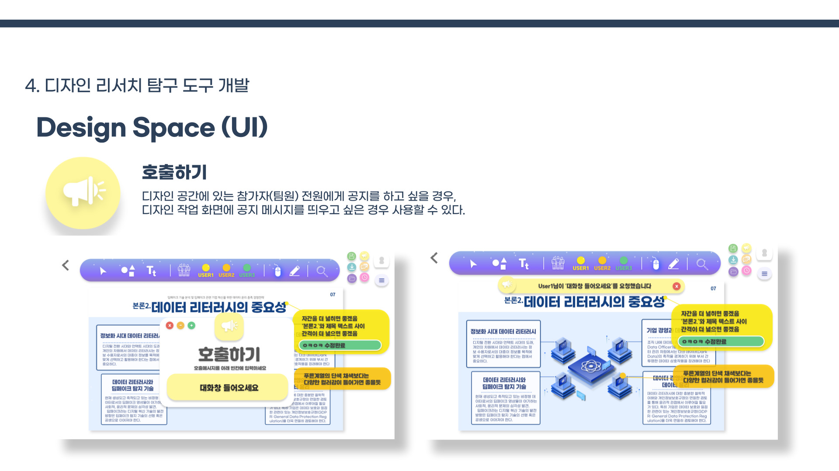
Features by Interface
Broadcast
This feature allows users to display announcements directly in the workspace when they need to notify all team members in the design space.

Slide 19
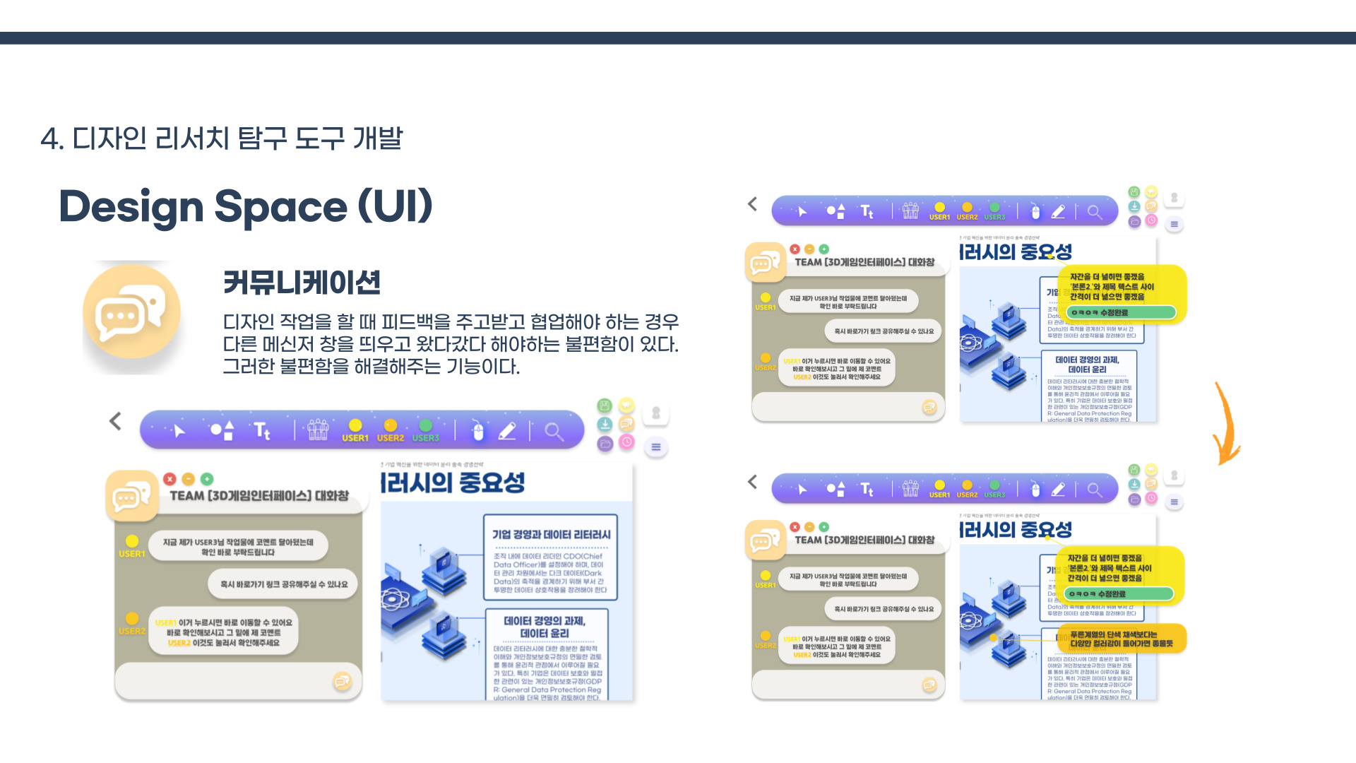
Features by Interface
Communication
This feature eliminates the inconvenience of switching back and forth between the design workspace and external messaging apps when exchanging feedback and collaborating with team members.

Slide 20
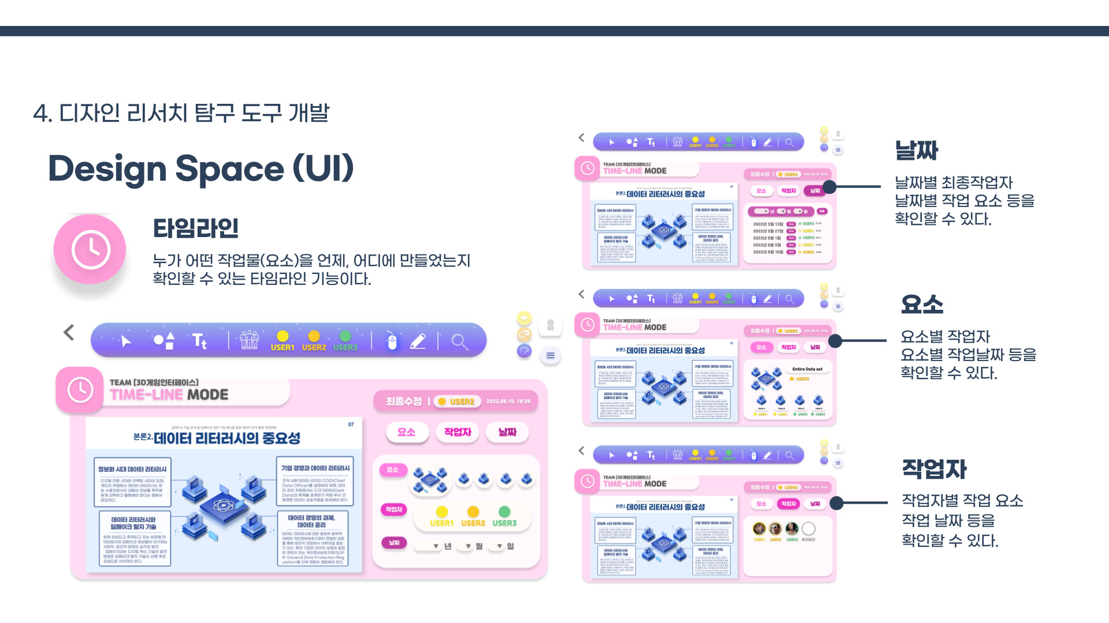
Features by Interface
Date
View the final contributor for each date and the elements modified on that date.
Timeline
The timeline allows users to track who created specific design elements, when they were created, and where they were placed.
Element(s)
View the contributor(s) and modification date(s) for each element.
Contributor(s)
View the elements modified by each contributor and the dates of their work.

