Slide 1
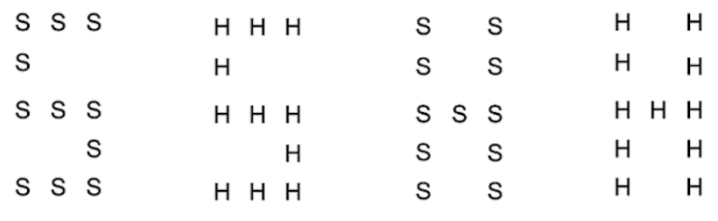
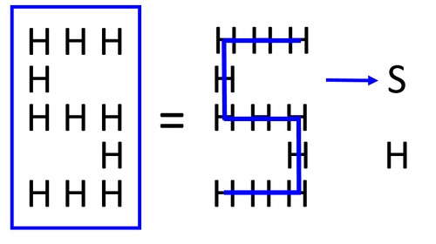
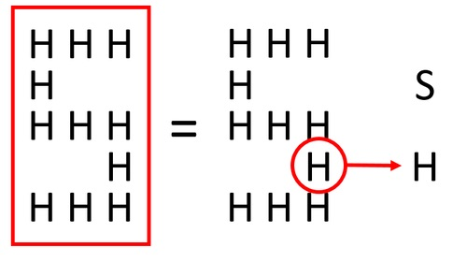
Instructions: Intro screen (seen whether starting with Practice 1, Practice 3, or just Main Task
In this task, you will see one of the following on each trial:
You will indicate either the small letters or the large shape,
based on the color of the rectangle around the letters.

Slide 2
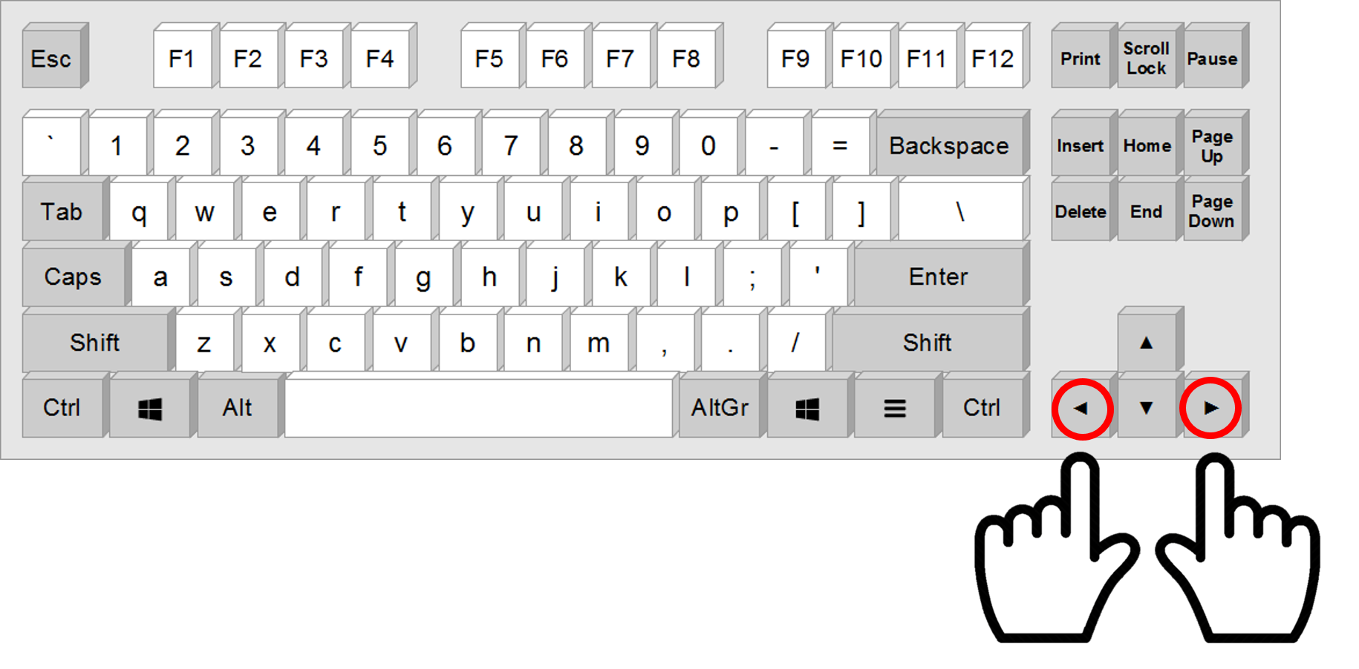
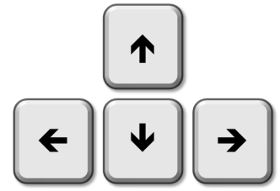
Instructions: First Practice
In this practice task, indicate if the large shape of the letter is an S or an H,
using the left and right arrow keys.
S
H
Press space to begin.

Slide 3
Instructions: Second Practice
In this practice task, indicate if the small letters are an S or an H,
using the left and right arrow keys.
S
H
Press space to begin.

Slide 4
Instructions: Third Practice
In this practice, indicate either the large shape or the small letters,
based on the color of the rectangle.
S
H
Press space to begin.

Slide 5
Instructions: Main Task
In this task, indicate either the large shape or the small letters,
based on the color of the rectangle.
S
H
Press space to begin.

