Slide 1
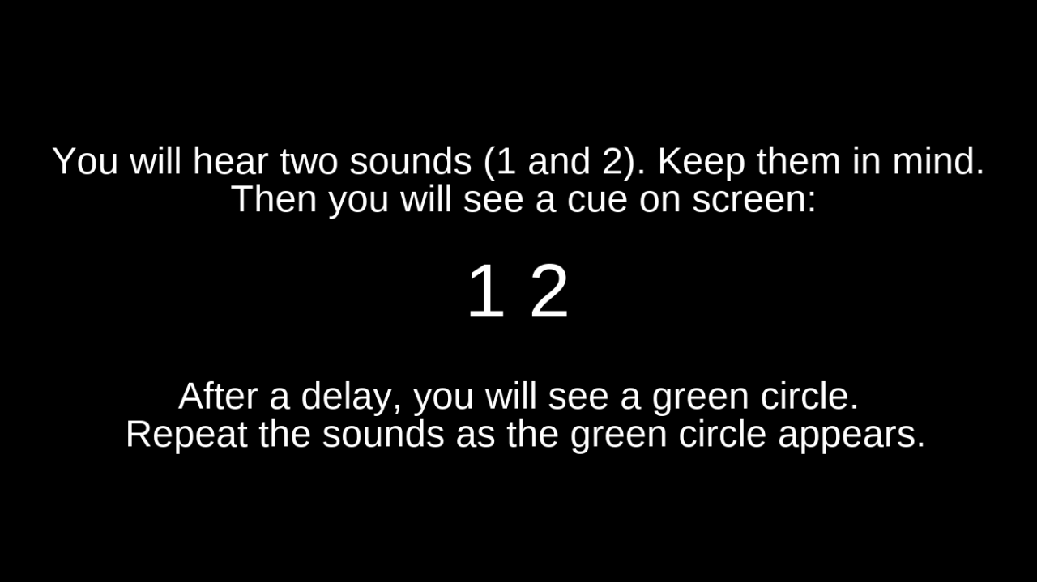

Slide 2

You will hear two sounds (sounds 1 and 2).
Keep them in mind.
After a delay, you will see a cue on screen:
After another delay, you will see a .
Repeat the sounds once the appears.

Slide 3
You will hear two sounds (sounds 1 and 2).
Keep them in mind.
After a delay, you will see a cue on screen:
After another delay, you will see a green circle.
Repeat the sounds once the circle appears.

Slide 4
You will hear two sounds (sounds 1 and 2).
Keep them in mind.
After a delay, you will see a cue on screen:
After another delay, you will see a green circle ( ).
Repeat the sounds once the circle appears.

Slide 5
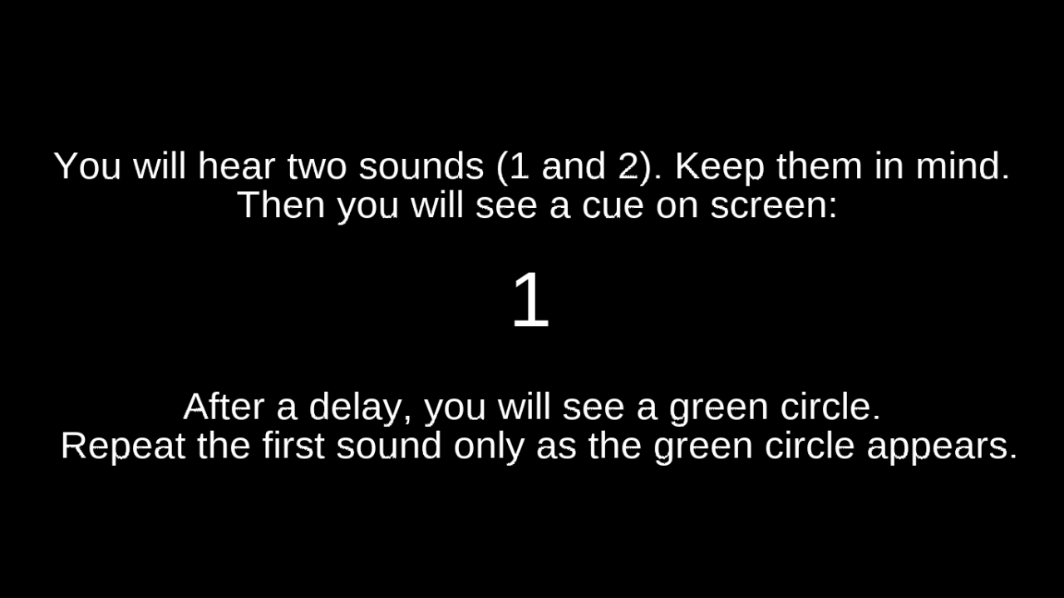

Slide 6
You will hear two sounds (sounds 1 and 2).
Keep them in mind.
After a delay, you will see a cue on screen:
After another delay, you will see a green circle ( ) .
Repeat the first sound once the circle appears.

Slide 7
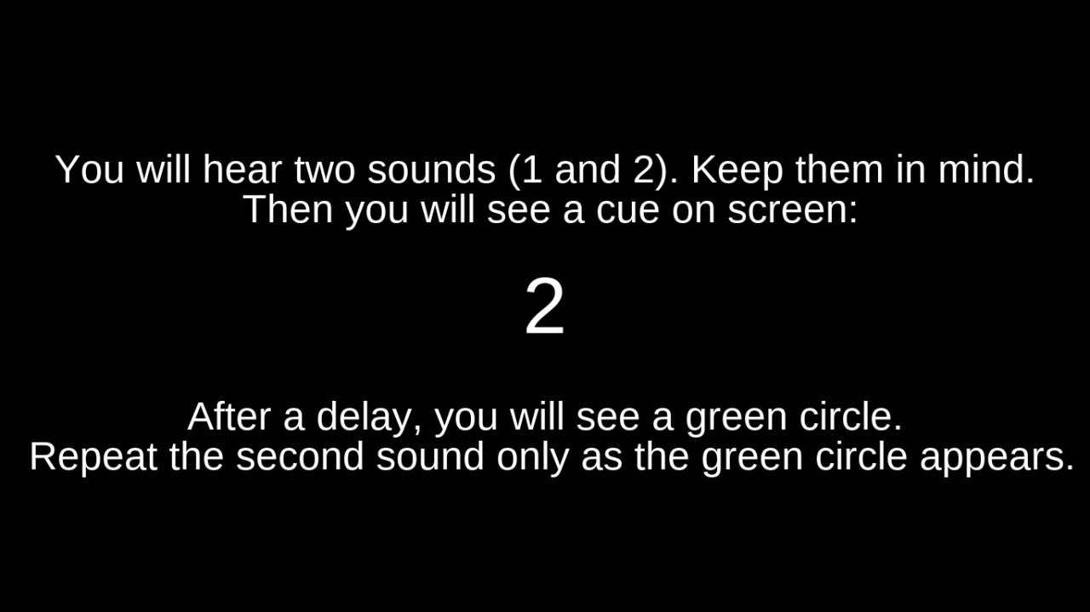

Slide 8
You will hear two sounds (sounds 1 and 2).
Keep them in mind.
After a delay, you will see a cue on screen:
After another delay, you will see a green circle ( ).
Repeat the second sound once the circle appears.

Slide 9
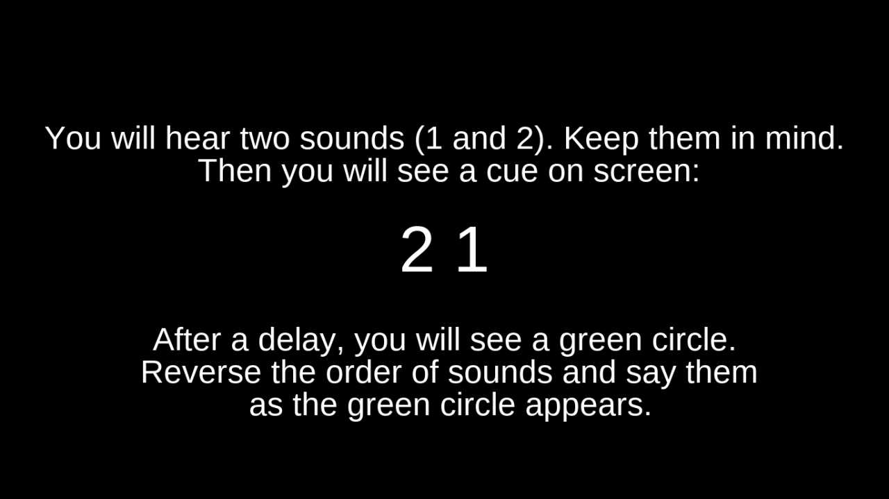

Slide 10
You will hear two sounds (sounds 1 and 2).
Keep them in mind.
After a delay, you will see a cue on screen:
After another delay, you will see a green circle ( ).
Reverse the order of sounds and say them
once the circle appears.

Slide 11
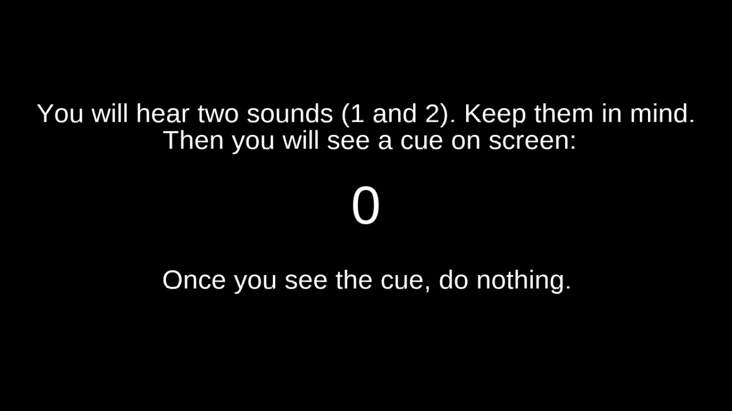

Slide 12
You will hear two sounds (sounds 1 and 2).
Keep them in mind.
After a delay, you will see a cue on screen:
Once you see the cue, do nothing.

Slide 13
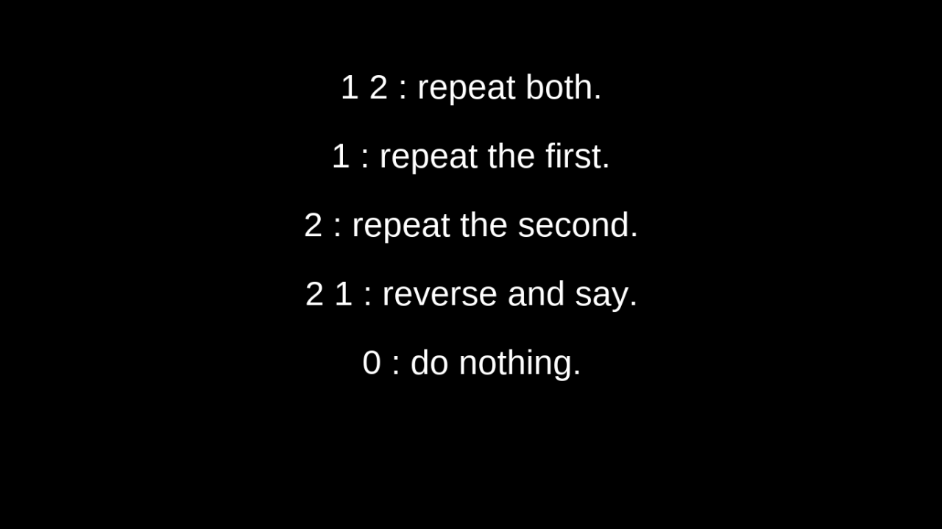

Slide 14
1 2 Repeat both.
1 Repeat the first.
2 Repeat the second.
2 1 Reverse and say.
0 Do nothing.

Slide 15
Space Continue the experiment.
Q Quit.
R Repeat the whole practice.
P Repeat the mixed practice only.

