Slide 1
SecurET

Slide 2
Biometrics Identification
Biometrics Identifiers : unique and measurable characteristics which enable to describe individuals

Slide 3
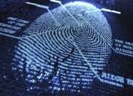


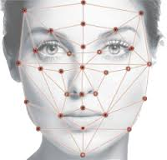

Biometrics Identification
Biometrics Identifiers : unique and measurable characteristics which enable to describe individuals
Physiological VS Behavioral

Slide 4
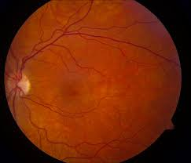
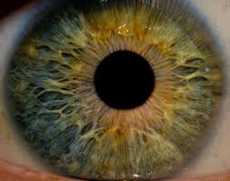
Biometrics Identification
Biometrics Identifiers : unique and measurable characteristics which enable to describe individuals
Physiological VS Behavioral
Eyes : Biometrical cues are mostly physiological (Retina¹, Iris²,...)

Slide 5
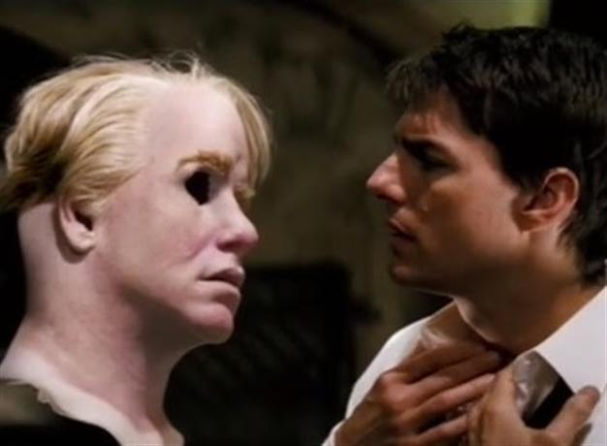
Biometrics Identification
Biometrics Identifiers : unique and measurable characteristics which enable to describe individuals
Physiological VS Behavioral
Eyes : Biometrical cues are mostly physiological (Retina, Iris,...)
Major drawback : easy to counterfeit and no need for alive person

Slide 6
Biometrics Identification
Biometrics Identifiers : unique and measurable characteristics which enable to describe individuals
Physiological VS Behavioral
Eyes : Biometrical cues are mostly physiological (Retina, Iris,...)
Major drawback : easily counterfeit and no need for alive person
  =>What about Eye Movements ?

Slide 7
Biometrics Eye Movements
A growing Subject : Eye Movement Verification and Identification Competition in 2012 and 2014
Saccades vs Fixation (drift, micro-saccades, tremor)
Experiments with jumping dots³ ⁴
      => Error Rate 10-19%
Experiments on a less constrained task (reading⁵, watching a video⁶)
      => Error Rate 27-30%

Slide 8


Authentication VS Identification
Pickles
What is the pasword ?
What is
the pasword?
I know you.
You can go !
I Know
I am

Slide 9
Our device : SecurET
Authentication
Module
Individual N
EM Characteristic
Data Base
EM Signature
Template
Individual N
Eye
Movements
Analyses
Comparaison
Module
EM Signature
Trial
Match ?
YES / NO

Slide 10
Our device : SecurET
Authentication
Module
Individual N
EM Characteristic
Data Base
EM Signature
Template
Individual N
Eye
Movements
Analyses
Comparaison
Module
EM Signature
Trial
Match ?
1st Part : Which features for identification ?
YES / NO

Slide 11
Our device : SecurET
2nd Part : Which code for authentication ?
Authentication
Module
Individual N
EM Characteristic
Data Base
EM Signature
Template
Individual N
Eye
Movements
Analyses
Comparaison
Module
EM Signature
Trial
Match ?
1st Part : Which features for identification ?
YES / NO

Slide 12
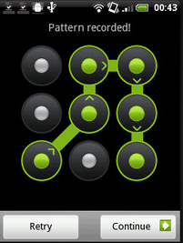
Authentication : a 9 points lock pattern

Slide 13
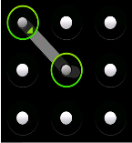
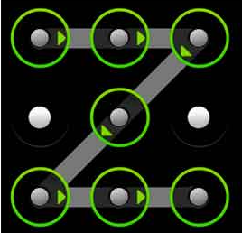
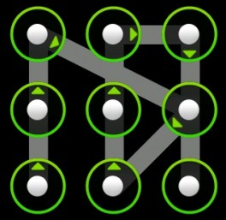
Lock pattern : reproducibility
Experiment to study reproducibility of the pattern with Occulomotor movements
    - Pattern condition : Saccade number, direction changes
    - Total trial number to reach 10 correct trials

Slide 14
Further investigation
Is the lock pattern suitable for based Eye Movement identification ?
    - Numerous trial in the studies
    - Behaviour changes with learning⁶
What type of Eye Tracker ?
    - Optimal : spatial accuracy 0,5° and 250Hz temporal resolution7
Combination of biometrical measures for better performance ?

Slide 15
Bibliographie
1: K. Hollingsworth, K. W. Bowyer, and P. J. Flynn, "All Iris Code Bits are Not Created Equal," in Biometrics: Theory, Applications, and Systems, 2007. BTAS 2007. First IEEE International Conference on, 2007, pp. 1-6
2: A. Jain, L. Hong, and S. Pankanti, "Biometric identification," Commun. ACM, vol. 43, pp. 90-98, 2000.
3: KASPROWSKI, P. 2004. Human Identification Using Eye Movements. PhD thesis, Silesian University of Technology, Institute of Computer Science, Gliwice, Poland
4:O. V. Komogortsev, A. Karpov, L. Price, C. Aragon. Biometric Authentication via Oculomotor Plant Characteristic. Proceedings of the IEEE/IARP International Conference on Biometrics (ICB), pp. 1-8, 2012
5:C. Holland, O. V. Komogortsev. Biometric Identification via Eye Movement Scanpaths in Reading, IEEE International Joint Conference on Biometrics (IJCB), 2011.
6:Tomi Kinnunen and Filip Sedlak and Roman Bednarik Towards Task-Independent Person Authentication Using Eye Movement Signals.School of Computing.University of Eastern Finland, Joensuu, Finland
7:C. Holland, O. V. Komogortsev. Biometric Verification via Complex Eye Movements: The Effects of Environment and Stimulus. IEEE Fifth International Conference on Biometrics:Theory, Applications and Systems (BTAS 2012).

