Slide 1
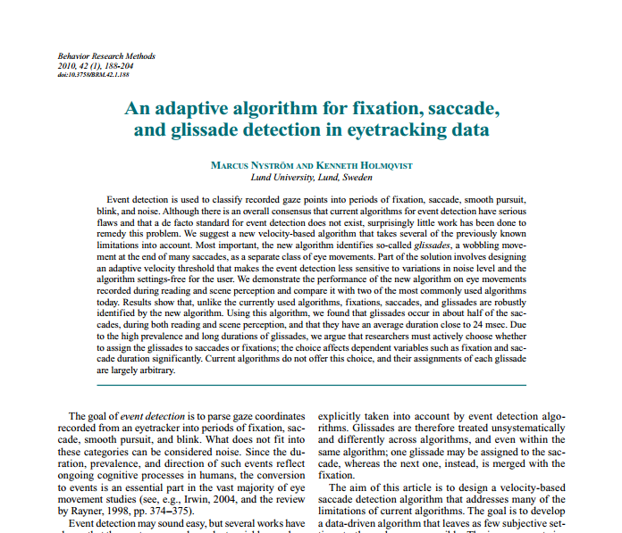
An event detection approach

Slide 2
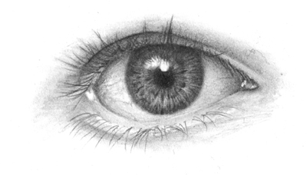
The method briefly
1. Filtering and denoising
Savitzky-Golay method
Angular velocity
Filter positions outside of the screen
Filter positions with unphysiological eye movements
Filter nois onset/offset
2. Peak saccade detection
Velocity threshold estimation
3. Saccade onset/offset detection
4. Glissade detection
Low/high-velocity glissade
5. Fixation detection

Slide 3
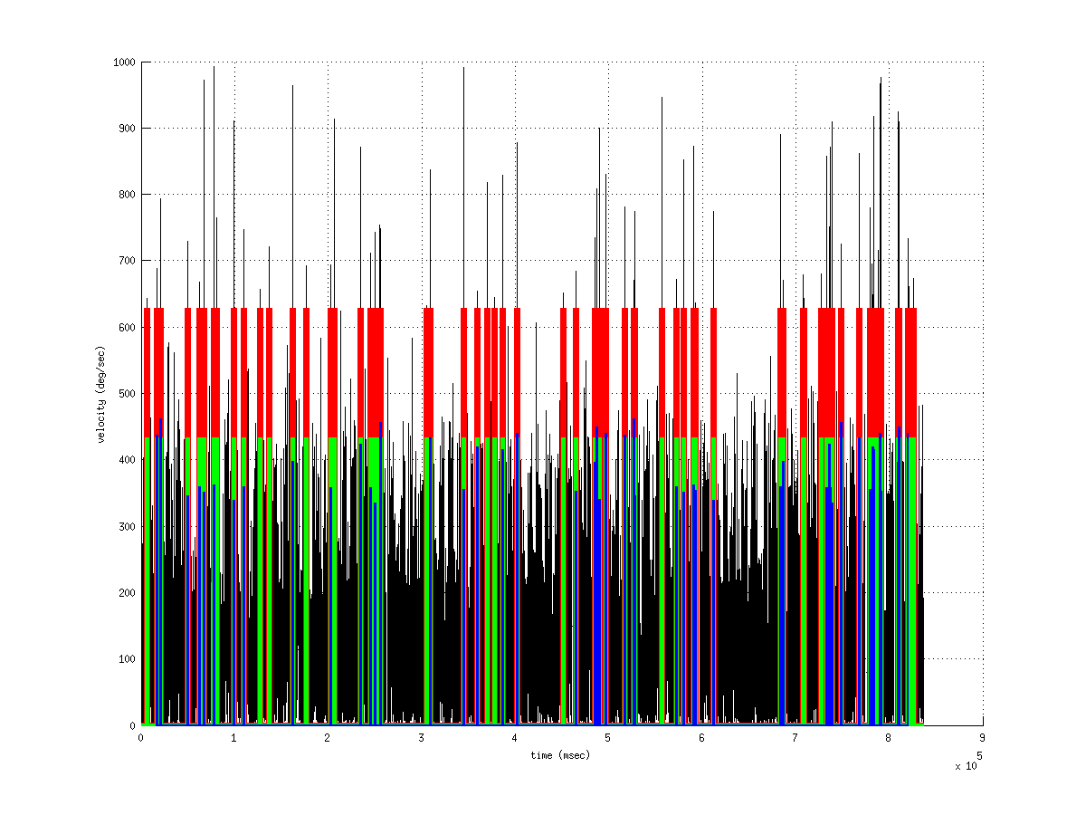
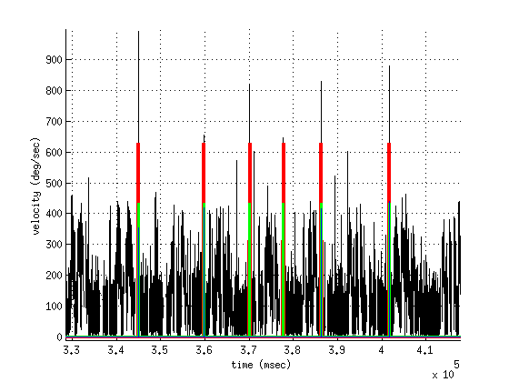
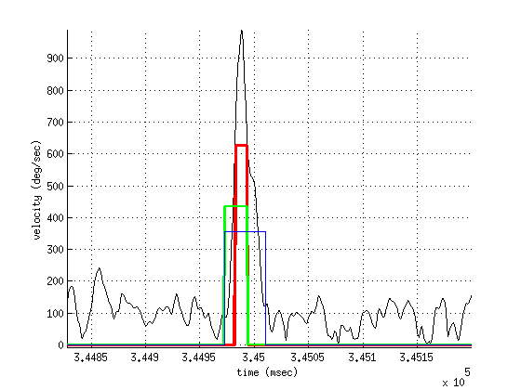
An example of the method

Slide 4
Work to continue
1. Analysis of saccades
Histogram of saccade directions
2. Analysis of glissades
Velocity profiles of glissades
3. Analysis of fixations
Any idea ?

Slide 5
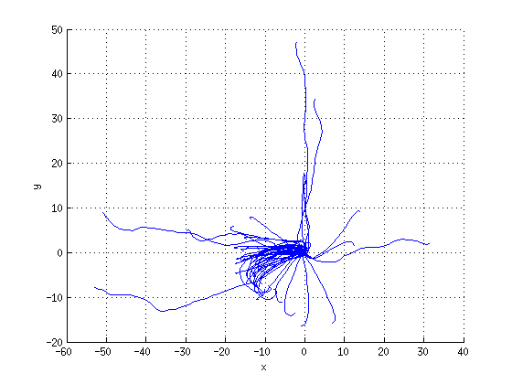
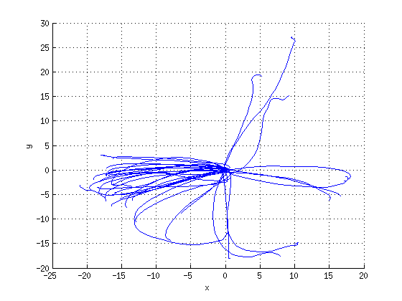
A glimpse into saccade analysis

Slide 6
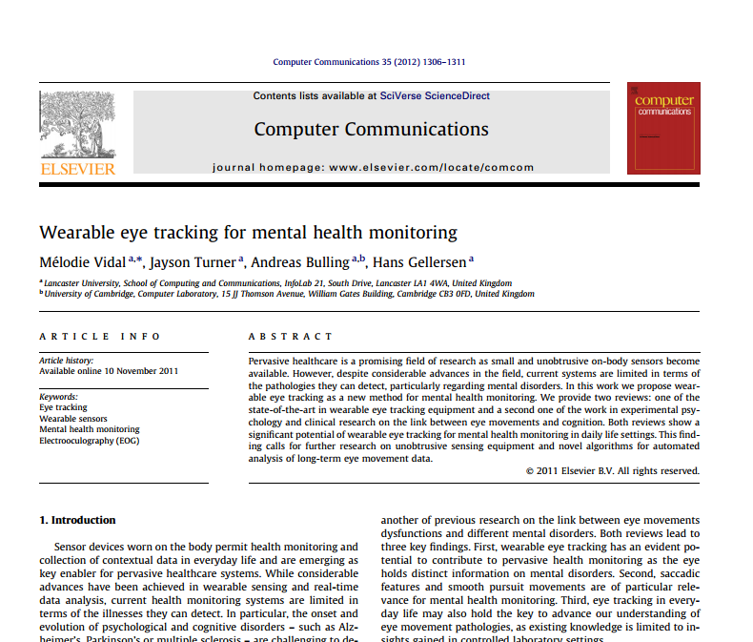
An argument to support this approach

