Slide 1
Standard Deviation

Slide 2
Standard Deviation - a measure of the dispersion or variation of a set of data values.
Denoted by lower case Greek sigma σ, or sd, or s.
A low σ indicates the data are tightly clustered around the mean.
A high σ indicates the data are widely dispersed.

Slide 3
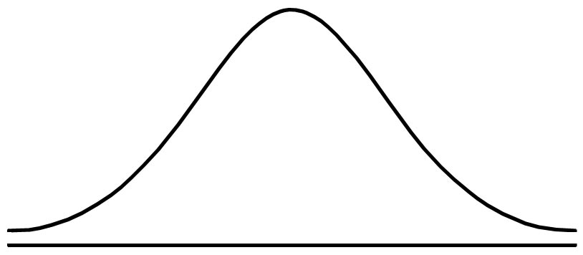
σ
Normal Distribution – Bell shaped curve

Slide 4
σ
In Normal Distribution, Mean = Median = Mode

Slide 5
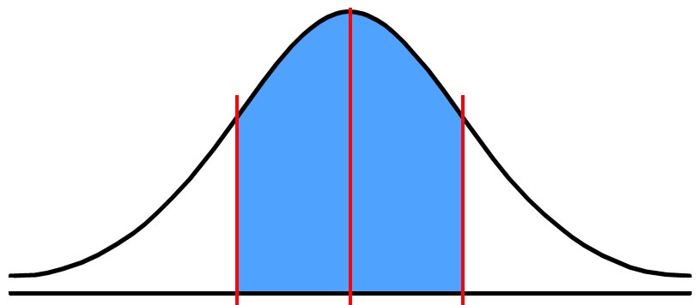
σ
σ
σ
34.1%
34.1%

Slide 6
σ
σ
σ
34.1%
34.1%
68.3%

Slide 7
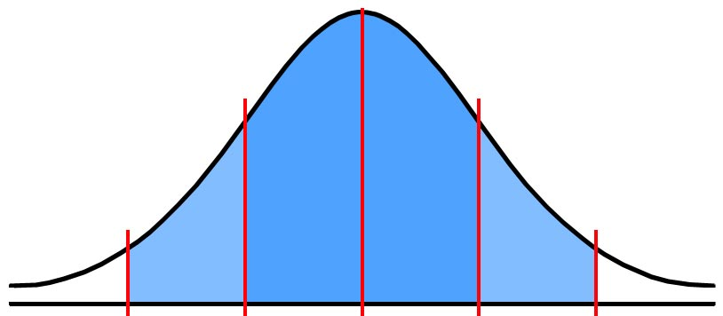
σ
σ
σ
2σ
2σ
13.6%
34.1%
34.1%
13.6%
68.3%

Slide 8
σ
σ
σ
2σ
2σ
13.6%
34.1%
34.1%
13.6%
68.3%
95.4%

Slide 9
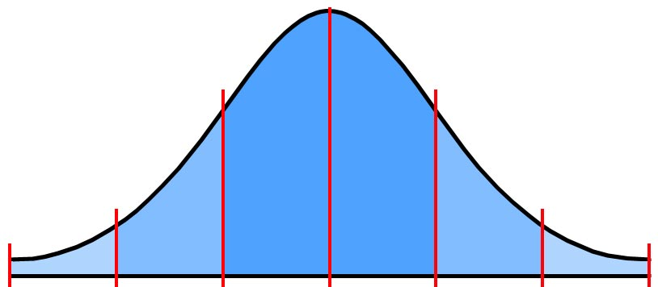
σ
σ
σ
2σ
2σ
2.3%
13.6%
34.1%
34.1%
13.6%
2.3%
3σ
3σ
68.3%
95.4%

Slide 10
σ
σ
σ
2σ
2σ
2.3%
13.6%
34.1%
34.1%
13.6%
2.3%
3σ
3σ
68.3%
95.4%
99.7%

Slide 11
73 | 73 | 76 | 77 | 81 | 100
Calculating Standard Deviation

Slide 12
73 | 73 | 76 | 77 | 81 | 100
Sum
Count
Mean (average) =

Slide 13
73 | 73 | 76 | 77 | 81 | 100
Sum
Count
Mean (average) =
73 + 73 + 76 + 77 + 81 + 100
6
=

Slide 14
73 | 73 | 76 | 77 | 81 | 100
Sum
Count
Mean (average) =
73 + 73 + 76 + 77 + 81 + 100
6
=
480
6
=

Slide 15
73 | 73 | 76 | 77 | 81 | 100
Sum
Count
Mean (average) =
73 + 73 + 76 + 77 + 81 + 100
6
=
480
6
=
=
80

Slide 16
Mean = 80
73 | 73 | 76 | 77 | 81 | 100

Slide 17
Mean = 80
73 | 73 | 76 | 77 | 81 | 100
Standard Deviation =
Σ (x – x)²
N

Slide 18
Mean = 80
73 | 73 | 76 | 77 | 81 | 100
Standard Deviation =
Σ (x – x)²
N
Σ greek Sigma, means summation
x x-bar or x-not, means average of x values
N count of values (or number of numbers)

Slide 19
Mean = 80
73 | 73 | 76 | 77 | 81 | 100
Standard Deviation =
Σ (x – x)²
N

Slide 20
Mean = 80
73 | 73 | 76 | 77 | 81 | 100
Standard Deviation =
Σ (x – x)²
=
(x₁ – x)² + (x₂ – x)² + …(x_{n} – x)²
N
N

Slide 21
Mean = 80
73 | 73 | 76 | 77 | 81 | 100
Standard Deviation =
Σ (x – x)²
=
(x₁ – x)² + (x₂ – x)² + …(x_{n} – x)²
N
N
=
(73-80)² + (73-80)² + (76-80)² + (77-80)² + (81-80)² + (100-80)²
6

Slide 22
Mean = 80
73 | 73 | 76 | 77 | 81 | 100
Standard Deviation =
Σ (x – x)²
=
(x₁ – x)² + (x₂ – x)² + …(x_{n} – x)²
N
N
=
(73-80)² + (73-80)² + (76-80)² + (77-80)² + (81-80)² + (100-80)²
6
=
524
=
9.3
6

Slide 23
Mean = 80
σ = 9.3
73 | 73 | 76 | 77 | 81 | 100
70
80
90
100

Slide 24
Mean = 80
σ = 9.3
73 | 73 | 76 | 77 | 81 | 100
70
80
90
100

Slide 25
Mean = 80
σ = 9.3
73 | 73 | 76 | 77 | 81 | 100
Mean
80
70
80
90
100

Slide 26
Mean = 80
σ = 9.3
73 | 73 | 76 | 77 | 81 | 100
Mean
80
Mean + σ
70
80
90
100

Slide 27
Mean = 80
σ = 9.3
73 | 73 | 76 | 77 | 81 | 100
Mean
80
Mean - σ
Mean + σ
70
80
90
100

