Slide 1
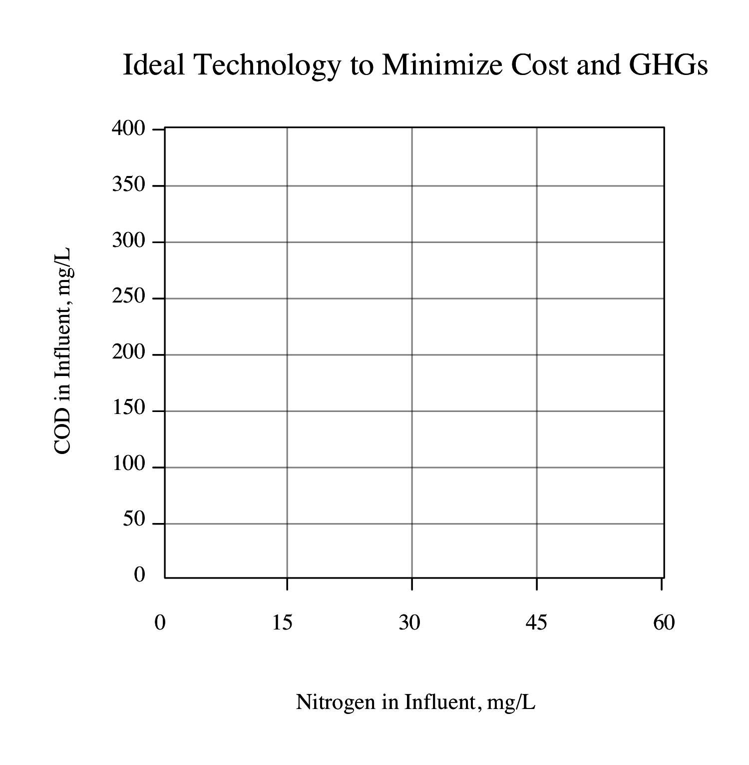
AnMBR/Anammox/N-damo
AnMBR/
Anammox
HRAS/
Anammox/
N-damo
Conventional
System
HRAS/
Anammox

