Slide 1
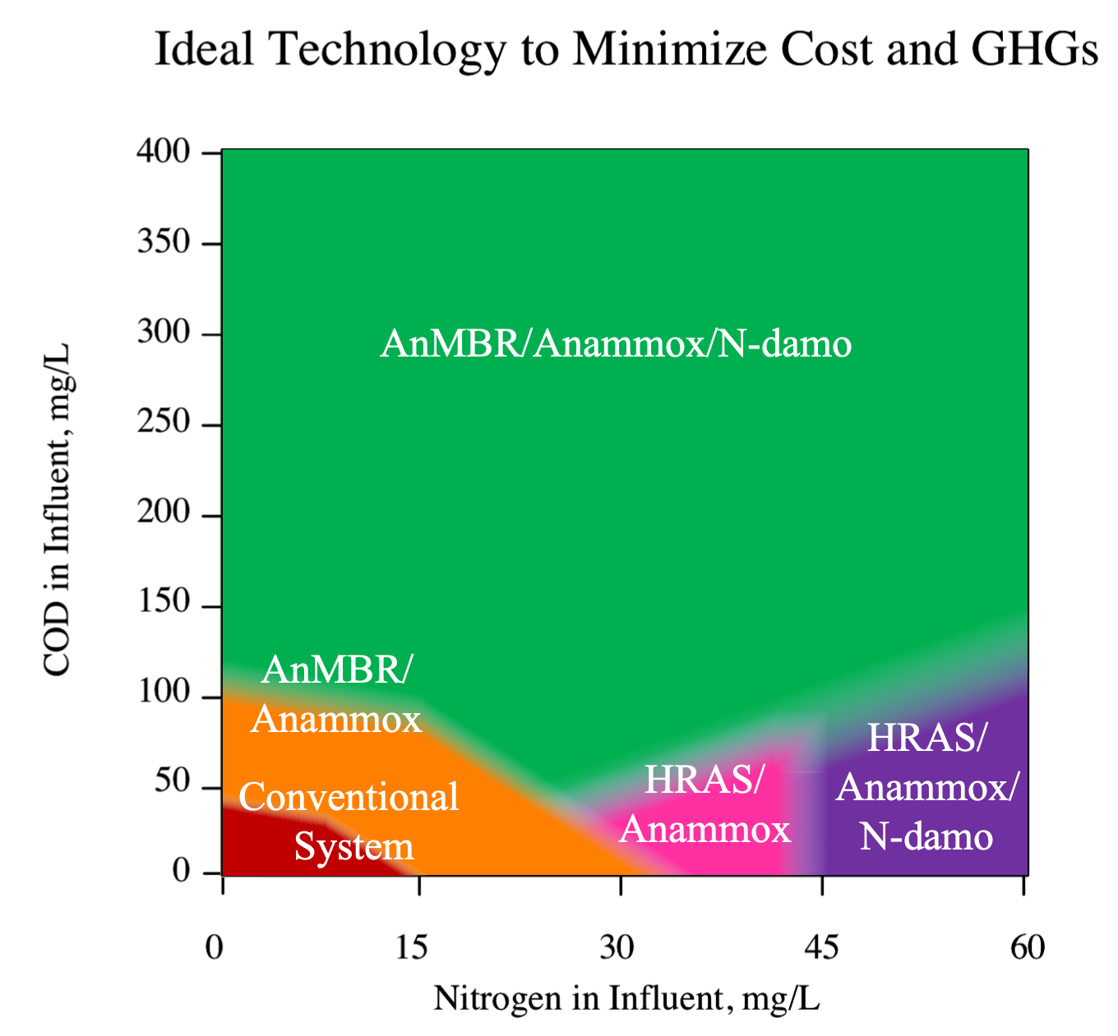
(a)
(b)
Impact of Adding N-damo to Anammox
Anammox/N-damo
(No selection pressure
For AOB Required)
Operational Cost & GHG Emissions
Anammox
(Tightly Control DO to select for AOB over NOB)
Complexity of Aeration Management

