Slide 2
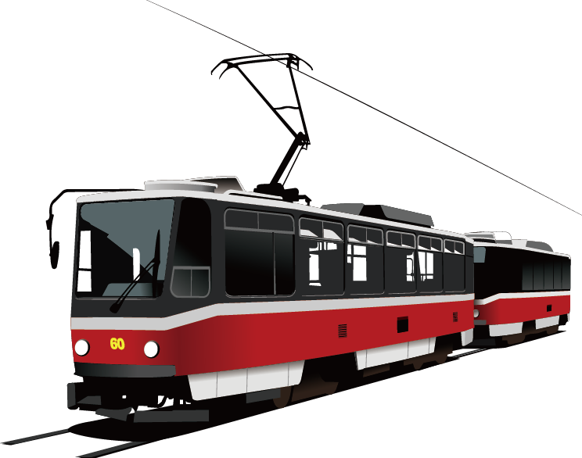

Public Transport
Connections
David Girou & Aurélie Martin

Slide 3
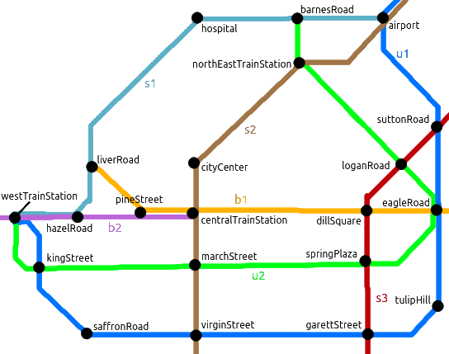
Public Transport Connections
Main usage
Girou - Martin
?- route(pineStreet, airport, Route).
Route = [pineStreet, liverRoad, hospital, barnesRoad,
airport].
Public Transport
Connections
?- route(kingStreet, loganRoad, Route, Time).
Route = [kingStreet, marchStreet, springPlaza, eagleRoad,
loganRoad],
Time = 24.
David Girou & Aurélie Martin

Slide 4
Public Transport Connections
Main usage
The code
Declaring the stops
Girou - Martin
?- route(pineStreet, airport, Route).
Route = [pineStreet, liverRoad, hospital, barnesRoad, airport].
stop(airport, [u1,s1,s2]).
stop(suttonRoad, [u1,s3]).
stop(eagleRoad, [u1,u2,b1]).
stop(tulipHill, [u1]).
stop(garettStreet, [u1,s3]).
stop(virginStreet, [u1,s2]).
stop(saffronRoad, [u1]).
stop(kingStreet, [u1,u2]).
stop(westTrainStation, [u1,u2,s1,b2]).
stop(barnesRoad, [u2,s1]).
stop(northEastTrainStation, [u2,s2]).
stop(loganRoad, [u2,s3]).
stop(springPlaza, [u2,s3]).
stop(marchStreet, [u2,s2]).
stop(hospital, [s1]).
stop(liverRoad, [s1,b1]).
stop(hazelRoad, [s1,b2]).
stop(cityCenter, [s2]).
stop(centralTrainStation, [s2,b1,b2]).
stop(dillsquare, [s3,b1]).
stop(pineStreet, [b1,b2]).
?- route(kingStreet, loganRoad, Route, Time).
Route = [kingStreet, marchStreet, springPlaza, eagleRoad, loganRoad],
Time = 24.

Slide 5
Public Transport Connections
The code
Declaring adjacent stops
Girou - Martin
Declaring the stops
stop(airport, [u1,s1,s2]).
stop(suttonRoad, [u1,s3]).
stop(eagleRoad, [u1,u2,b1]).
stop(tulipHill, [u1]).
stop(garettStreet, [u1,s3]).
stop(virginStreet, [u1,s2]).
stop(saffronRoad, [u1]).
stop(kingStreet, [u1,u2]).
stop(westTrainStation, [u1,u2,s1,b2]).
stop(barnesRoad, [u2,s1]).
stop(northEastTrainStation, [u2,s2]).
stop(loganRoad, [u2,s3]).
stop(springPlaza, [u2,s3]).
stop(marchStreet, [u2,s2]).
stop(hospital, [s1]).
stop(liverRoad, [s1,b1]).
stop(hazelRoad, [s1,b2]).
stop(cityCenter, [s2]).
stop(centralTrainStation, [s2,b1,b2]).
stop(dillsquare, [s3,b1]).
stop(pineStreet, [b1,b2]).
adjacent(X,Y):- adjacent_stops(X,Y).
adjacent(X,Y):- adjacent_stops(Y,X).
%u1
adjacent_stops(airport,suttonRoad).
adjacent_stops(suttonRoad,eagleRoad).
adjacent_stops(eagleRoad,tulipHill).
adjacent_stops(tulipHill,garettStreet).
adjacent_stops(garettStreet,virginStreet).
adjacent_stops(virginStreet,saffronRoad).
adjacent_stops(saffronRoad,kingStreet).
adjacent_stops(kingStreet,westTrainStation).

Slide 6
Public Transport Connections
The code
Declaring adjacent stops
Girou - Martin
The sameLine rule
adjacent(X,Y):- adjacent_stops(X,Y).
adjacent(X,Y):- adjacent_stops(Y,X).
sameLine(Stop1, Stop2, Line):-
stop(Stop1, Line1),
stop(Stop2, Line2),
member(Line, Line1),
member(Line, Line2).
%u1
adjacent_stops(airport,suttonRoad).
adjacent_stops(suttonRoad,eagleRoad).
adjacent_stops(eagleRoad,tulipHill).
adjacent_stops(tulipHill,garettStreet).
adjacent_stops(garettStreet,virginStreet).
adjacent_stops(virginStreet,saffronRoad).
adjacent_stops(saffronRoad,kingStreet).
adjacent_stops(kingStreet,westTrainStation).
?- sameLine(saffronRoad, suttonRoad, Line).
Line = u1.
?- sameLine(airport, pineStreet, Line).
false.

Slide 7
Public Transport Connections
The code
The findAllStops rule
Girou - Martin
The sameLine rule
sameLine(Stop1, Stop2, Line):-
stop(Stop1, Line1),
stop(Stop2, Line2),
member(Line, Line1),
member(Line, Line2).
findAllStops(Line, ListOfStops):-
findall(Stop,(stop(Stop,NewLine),
member(Line, NewLine)), ListOfStops).
?- findAllStops(b2, Stops).
Stops = [westTrainStation, hazelRoad,
centralTrainStation, pineStreet].
?- sameLine(saffronRoad, suttonRoad, Line).
Line = u1.
?- sameLine(airport, pineStreet, Line).
false.

Slide 8
Public Transport Connections
The code
The numberOfLines rule
Girou - Martin
The findAllStops rule
numberOfLines(Stop, NumberOfLines) :-
stop(Stop,Line),
length(Line, NumberOfLines).
findAllStops(Line, ListOfStops):-
findall(Stop,(stop(Stop,NewLine),
member(Line, NewLine)), ListOfStops).
?- numberOfLines(centralTrainStation, Lines).
Lines = 3.
?- findAllStops(b2, Stops).
Stops = [westTrainStation, hazelRoad,
centralTrainStation, pineStreet].

Slide 9
Public Transport Connections
The code
The route calculation
Girou - Martin
The numberOfLines rule
calcRoute(Stop1, Stop2, Route):-
tempRoute(Stop1, Stop2, [], Return),
reverse([Stop2|Return],Route).
numberOfLines(Stop, NumberOfLines) :-
stop(Stop,Line),
length(Line, NumberOfLines).
tempRoute(Stop1, Stop2, Temp, Route):-
adjacent(Stop1, Stop2),
\+member(Stop1, Temp),
Route = [Stop1|Temp].
?- numberOfLines(centralTrainStation, Lines).
Lines = 3.
tempRoute(Stop1, Stop2, Temp, Route):-
adjacent(Stop1,Next),
Next \== Stop2,
\+member(Stop1, Temp),
tempRoute(Next, Stop2, [Stop1|Temp], Route).

Slide 10
Public Transport Connections
The code
The route calculation
Girou - Martin
The routeTime rule
calcRoute(Stop1, Stop2, Route):-
tempRoute(Stop1, Stop2, [], Return),
reverse([Stop2|Return],Route).
routeTime(Stop1, Stop2, Route, RouteTime):-
calcRoute(Stop1, Stop2, Route),
length(Route, Time),
RouteTime is (Time -1) * 6.
tempRoute(Stop1, Stop2, Temp, Route):-
adjacent(Stop1, Stop2),
\+member(Stop1, Temp),
Route = [Stop1|Temp].
?- routeTime(airport, eagleRoad, Route, Time).
Route = [airport, suttonRoad, eagleRoad],
Time = 12 .
tempRoute(Stop1, Stop2, Temp, Route):-
adjacent(Stop1,Next),
Next \== Stop2,
\+member(Stop1, Temp),
tempRoute(Next, Stop2, [Stop1|Temp], Route).

Slide 11
Public Transport Connections
The code
The route rule
Girou - Martin
The routeTime rule
route(Stop1, Stop2, Route):-
limit(1, (order_by([asc(Time)],
(routeTime(Stop1, Stop2, Route, Time))))).
routeTime(Stop1, Stop2, Route, RouteTime):-
calcRoute(Stop1, Stop2, Route),
length(Route, Time),
RouteTime is (Time -1) * 6.
route(Stop1, Stop2, Route, Time):-
limit(1, (order_by([asc(Time)],
(routeTime(Stop1, Stop2, Route, Time))))).
?- routeTime(airport, eagleRoad, Route, Time).
Route = [airport, suttonRoad, eagleRoad],
Time = 12 .
?- route(hospital, pineStreet, Route, Time).
Route = [hospital, liverRoad, pineStreet],
Time = 12.

Slide 12
Public Transport Connections
Things we could change
The code
The route rule
Girou - Martin
Having a custom time between each stop
route(Stop1, Stop2, Route):-
limit(1, (order_by([asc(Time)],
(routeTime(Stop1, Stop2, Route, Time))))).
Outputing where to change line and to which line
route(Stop1, Stop2, Route, Time):-
limit(1, (order_by([asc(Time)],
(routeTime(Stop1, Stop2, Route, Time))))).
Helping the user avoiding changing lines when not necessary
?- route(hospital, pineStreet, Route, Time).
Route = [hospital, liverRoad, pineStreet],
Time = 12.

Slide 13
Thank you

