Slide 1
Generating Game Content Using L-Systems
Calum Lindsay
BSc Hons Computing (Software)
UHI Shetland

Slide 2
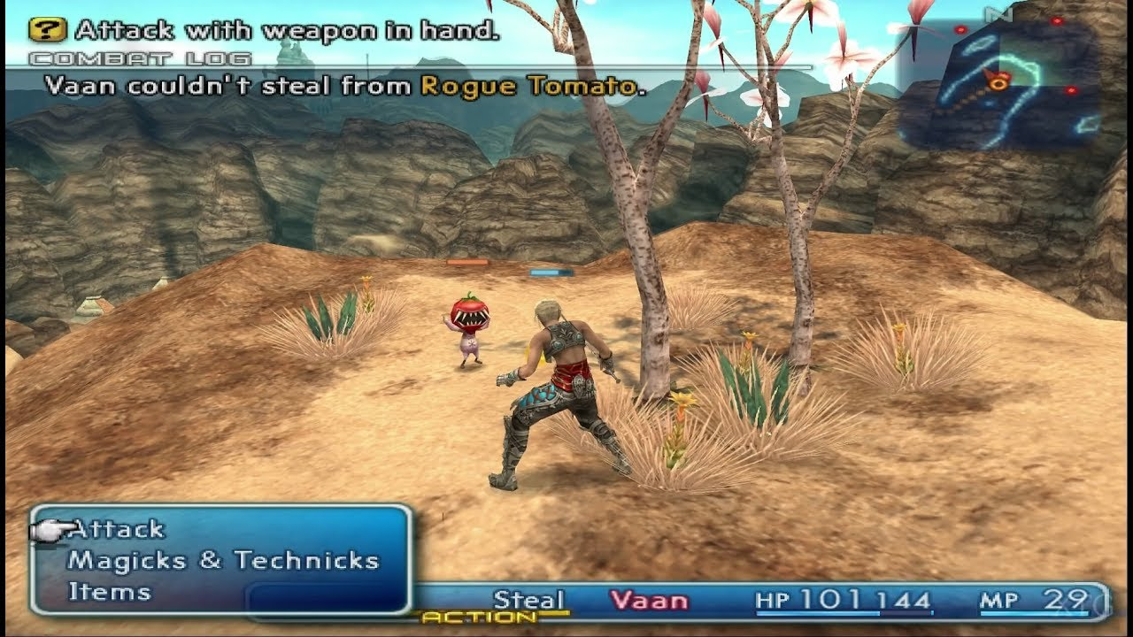
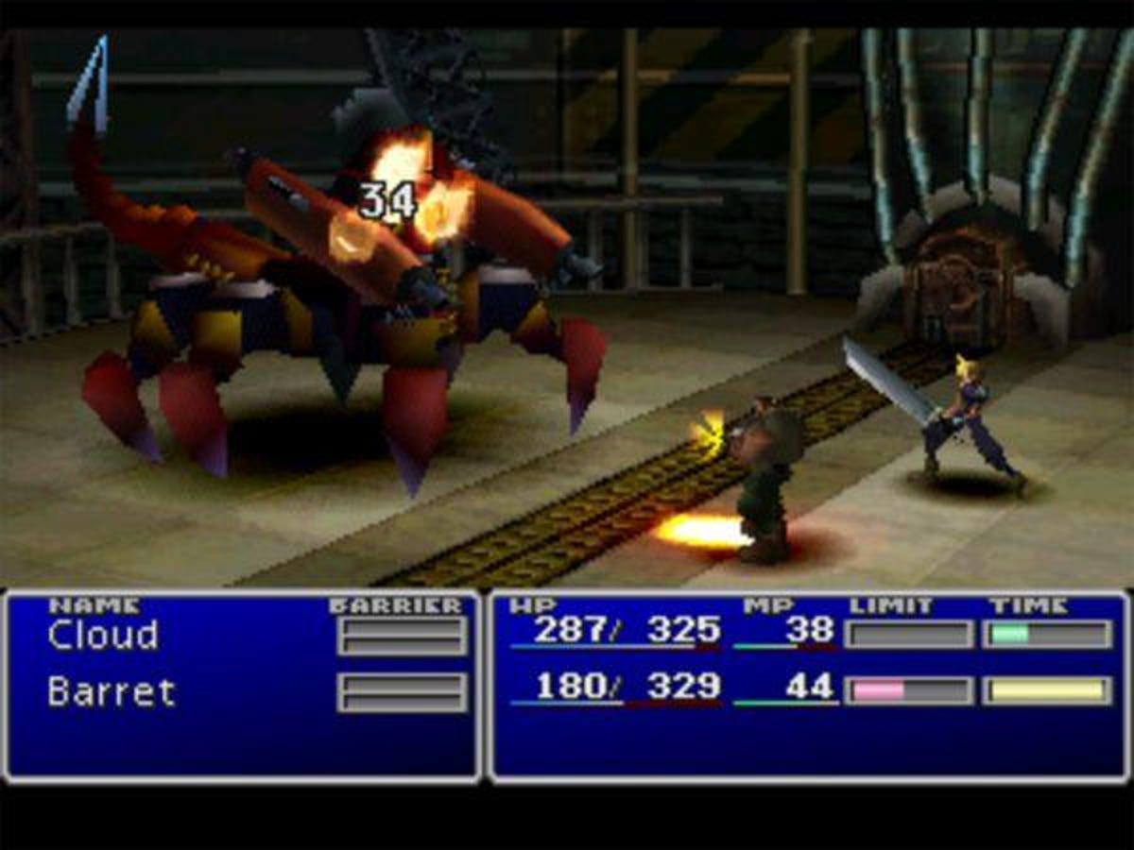
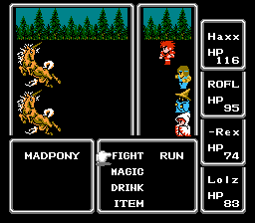
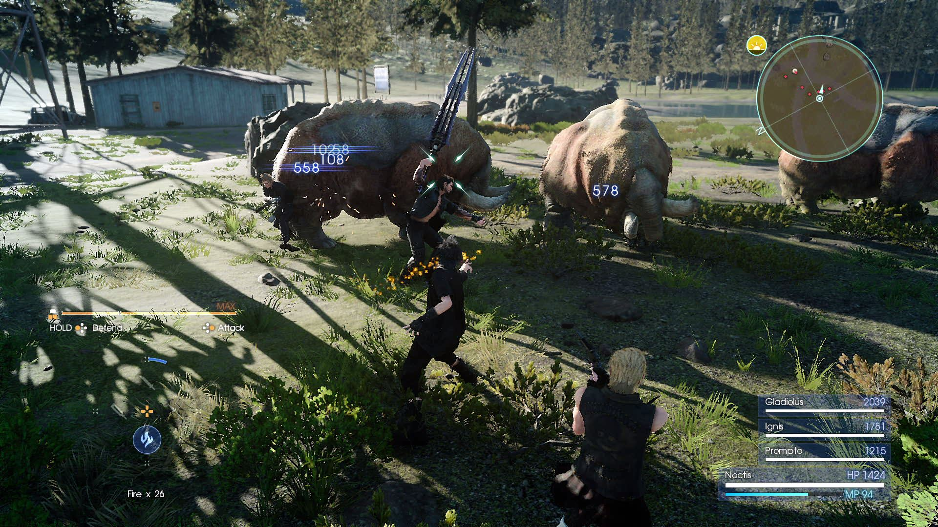

2006
1997
1987
2016
2023

Slide 3
General PCG Techniques
Hmmmm A diagram of workflow w/ vs wo/ ….?
Could show results of general techniques but I dunno how clear that is..

Slide 4

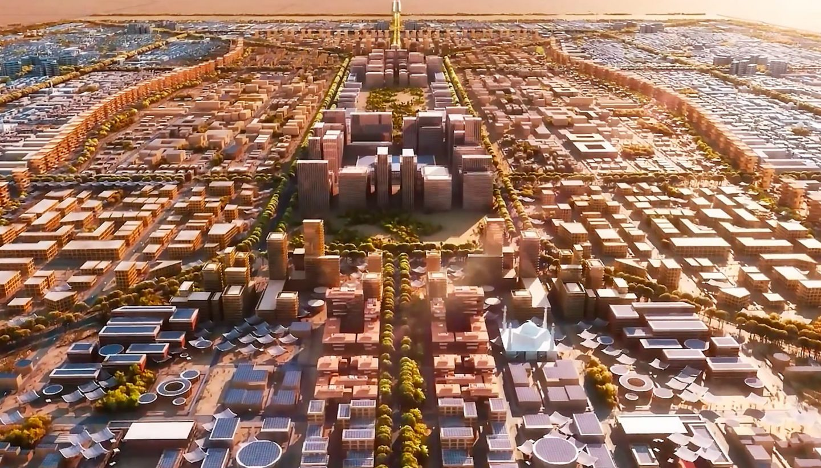
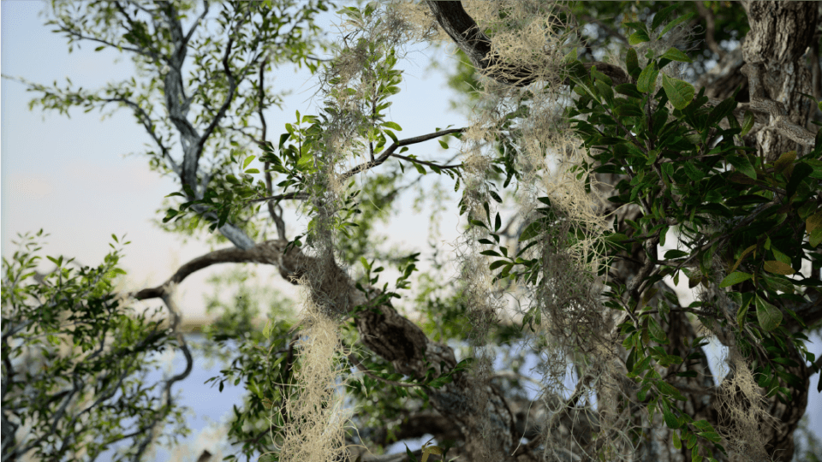
Plant and City Generation

Slide 5

Axiom: “GNU!”
Rules:
“G” “GNU”
“N” “ is Not “
“U” “Unix”
Iteration 0: GNU!
Iteration 1: GNU is Not Unix!
Iteration 2: GNU is Not Unix is Not Unix!
Iteration 3: GNU is Not Unix is Not Unix is Not Unix!
Iteration 4: GNU is Not Unix is Not Unix is Not Unix is Not Unix!
Iteration 5: GNU is Not Unix is Not Unix is Not Unix is Not Unix is Not Unix!
Iteration 6: GNU is Not Unix is Not Unix is Not Unix is Not Unix is Not Unix is Not Unix!

Slide 6

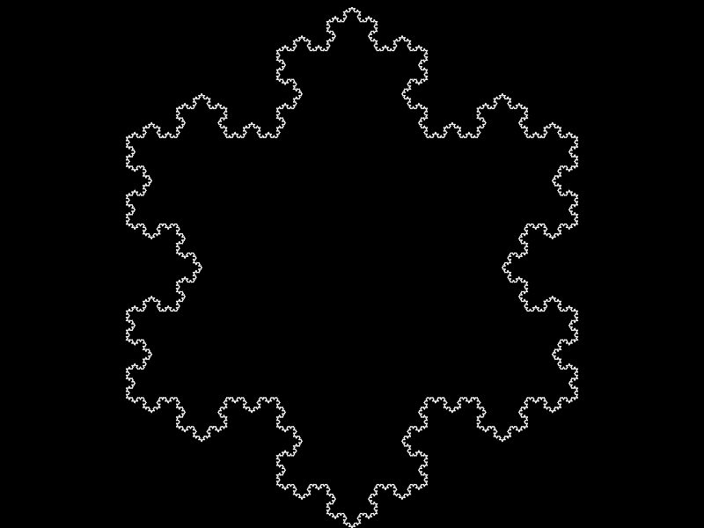



Slide 7
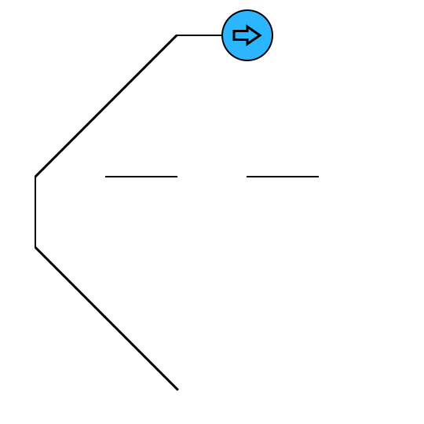

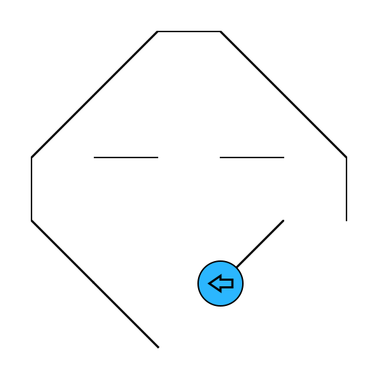
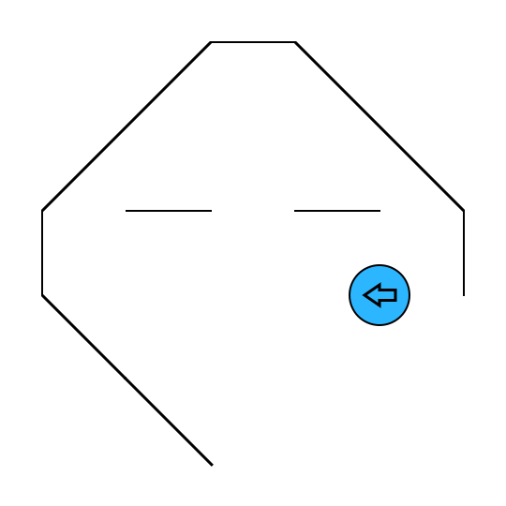
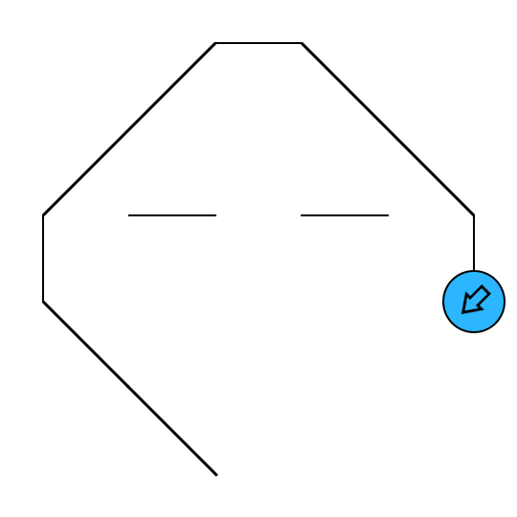
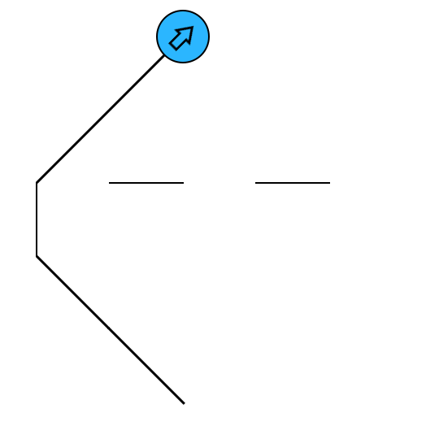
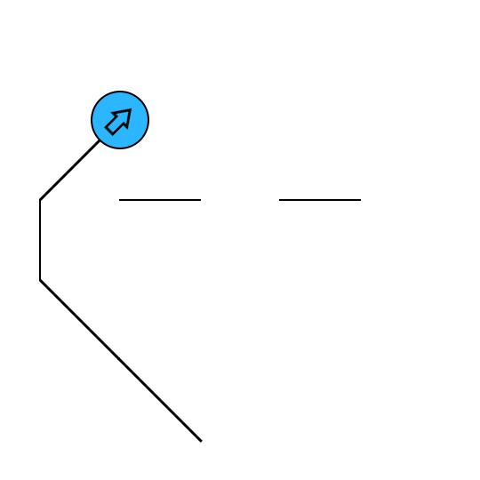
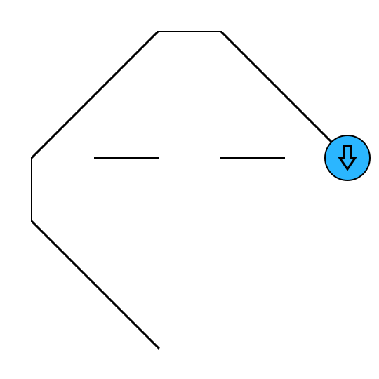

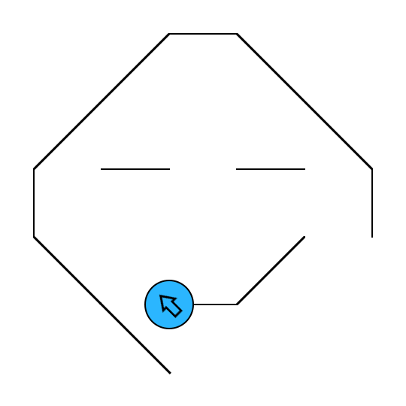


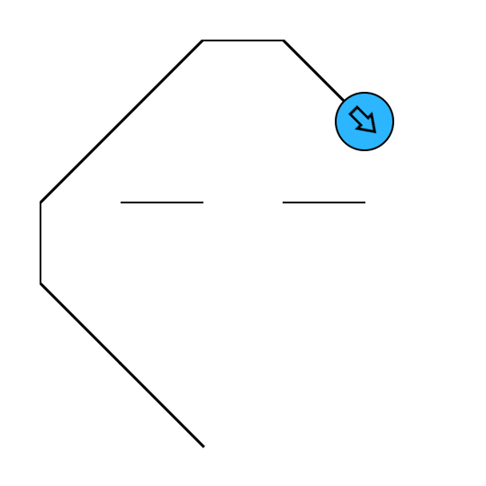
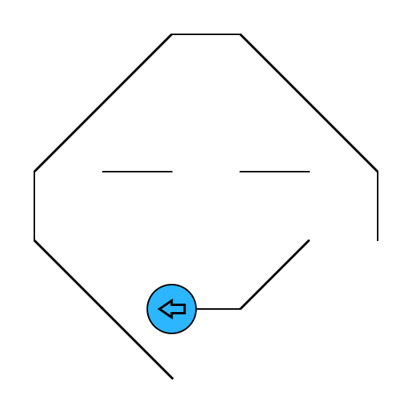
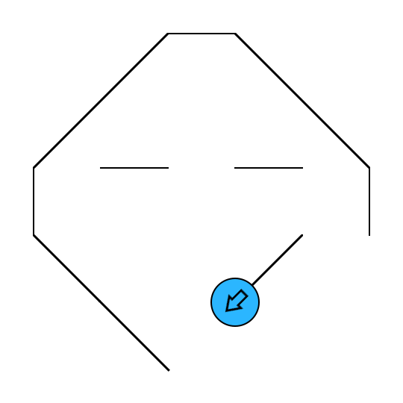

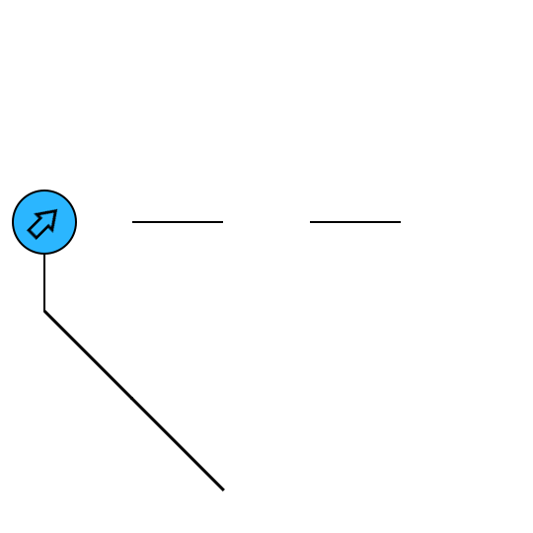
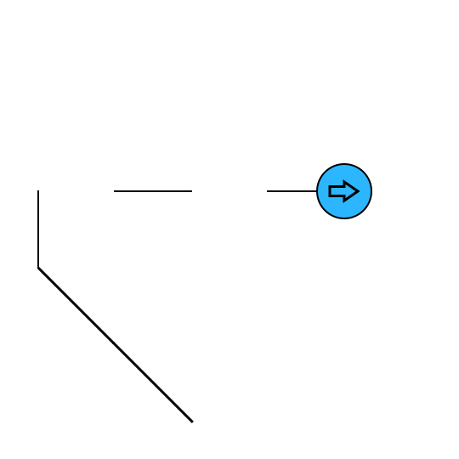
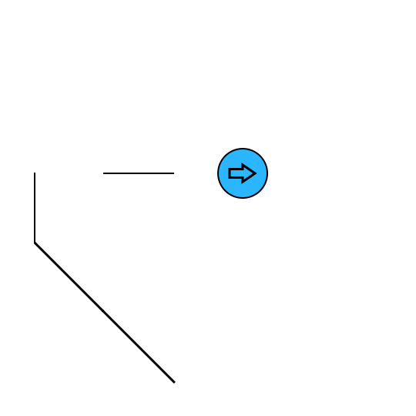
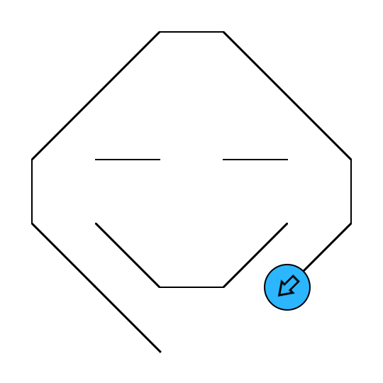
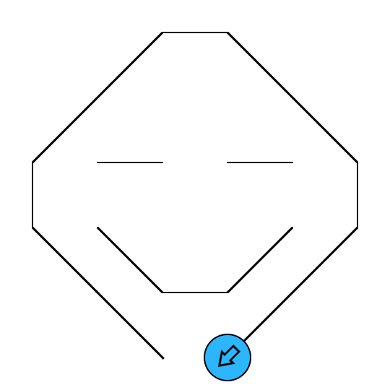

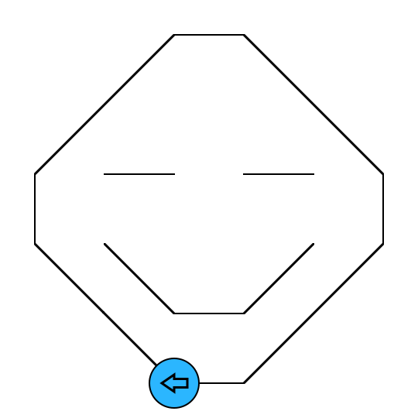

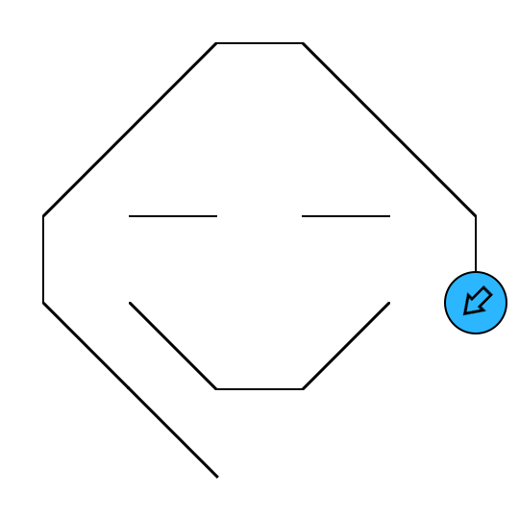
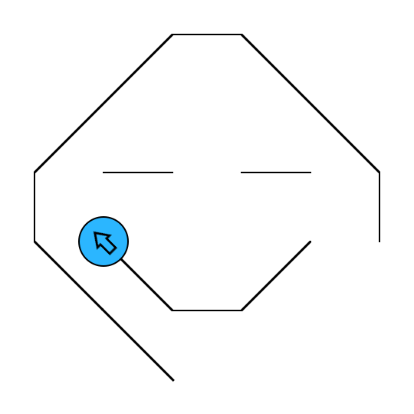
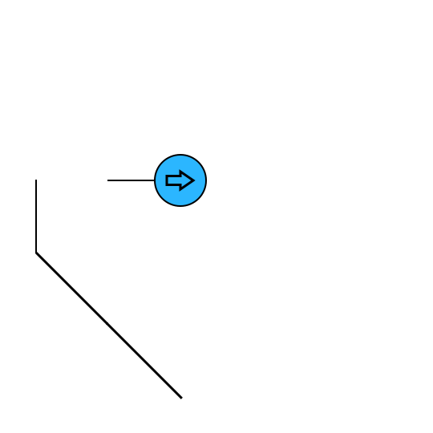

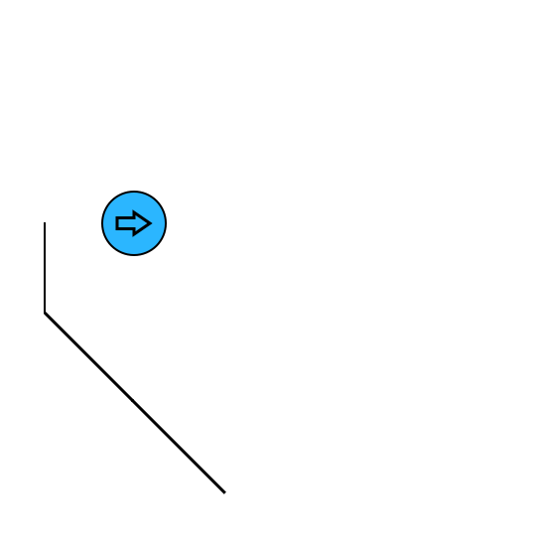
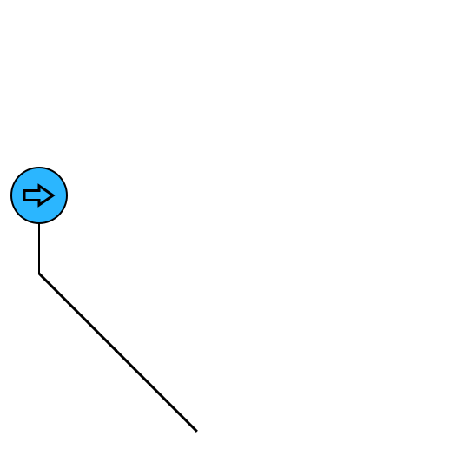


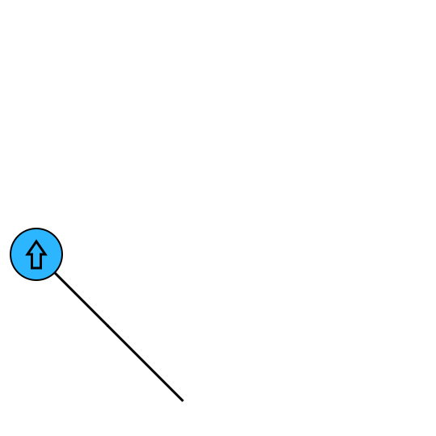

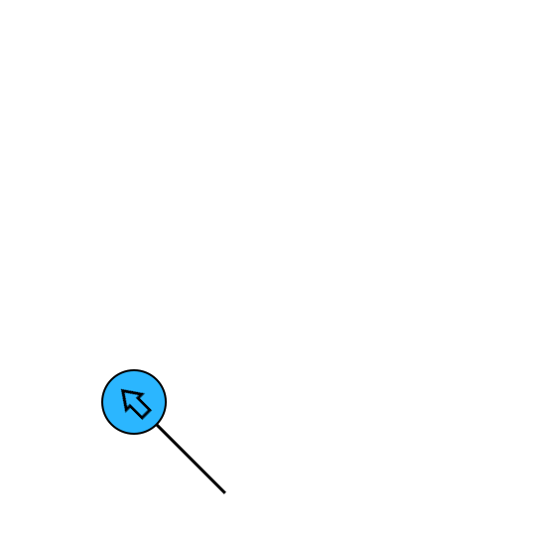

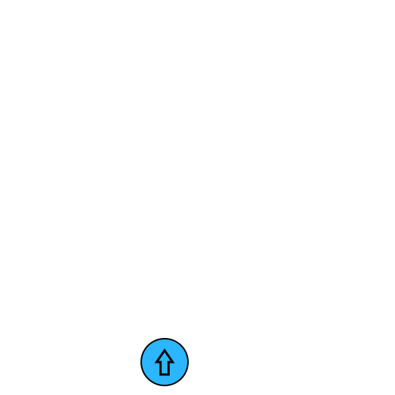
Turtles
String:
-FF+F+[+fFfF]FF+F+FF+F+
[+f-F+F+F]FF+F

Slide 8
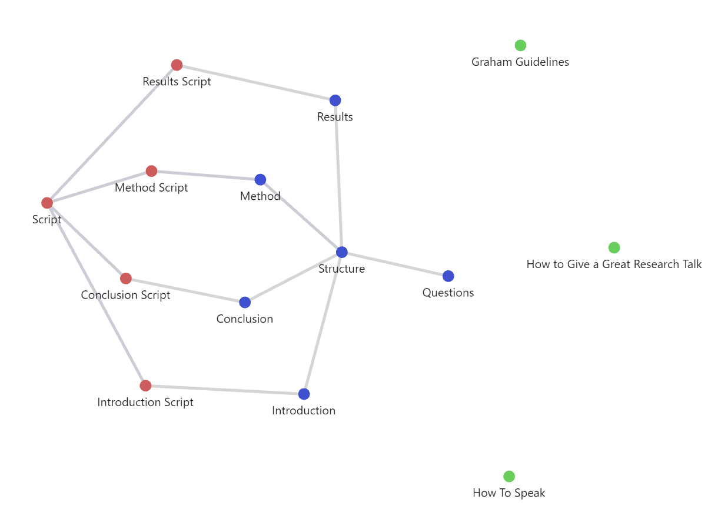
Obsidian

Slide 9
Agile + KanBan

Slide 10
Regression Testing

Slide 11
Game Engine (Systems Included Diagram)

Slide 12
Unreal Engine

Slide 13
Terrain Generation (Description)
Grid of Cells
Wrapping

Slide 14
Terrain Generation (Examples)

Slide 15
Stochastic L-Systems

Slide 16
Multi-Stage L-Systems

Slide 17
Indiscrete L-Systems

Slide 18
Maze Generator (Description)

Slide 19
Maze Generator (Demo)

Slide 20
Summary

Slide 21
Future Work
Full Maze Game
Composable Generation Systems
Text Generation

Slide 22
Closing Statement
This could just say thank you or something to that effect
Another option is a flow diagram of what I am describing

