Slide 1
AI Expert 프로그램 실습
9/11 Graphical Models, Gaussian Process, Hawkes Process

Slide 2
Overview
This tutorial is three-fold as follows:
Graphical Models - 80 min.
Gaussian Process (GP) - 80 min.
Hawkes Process (HP) - 80 min.
* 10 minutes break between each part.

Slide 3
Environments
Python 3.6
virtualenv
Gpy
Matplotlib
Scipy
Image
Tqdm
Ipykernel
Tick Module for statistical learning, with a particular emphasis on time-dependent modelling

Slide 4
Part 0. Environment Setting
Download the source code
cogito@digits-1:~$ git clone https://github.com/cogito288/samsung-ds-kaist.git

Slide 5
Part 0. Environment Setting
Create the virtual environment and activate it
cogito@digits-1:~$ virtualenv -p python3 samdung-ds-0710-env
Already using interpreter /usr/bin/python3
Using base prefix '/usr'
New python executable in /home/cogito/samdung-ds-0710-env/bin/python3
Also creating executable in /home/cogito/samdung-ds-0710-env/bin/python
Installing setuptools, pkg_resources, pip, wheel...done.
cogito@digits-1:~$ source samdung-ds-0710-env/bin/activate
(samdung-ds-0710-env) cogito@digits-1:~$
Install ipykernel package
(samdung-ds-0710-env) cogito@digits-1:~$ pip install ipykernel
(samdung-ds-0710-env) cogito@digits-1:~$ pip install matplotlib
(samdung-ds-0710-env) cogito@digits-1:~$ pip install scipy==1.0.0
(samdung-ds-0710-env) cogito@digits-1:~$ pip install image
(samdung-ds-0710-env) cogito@digits-1:~$ pip install tqdm

Slide 6
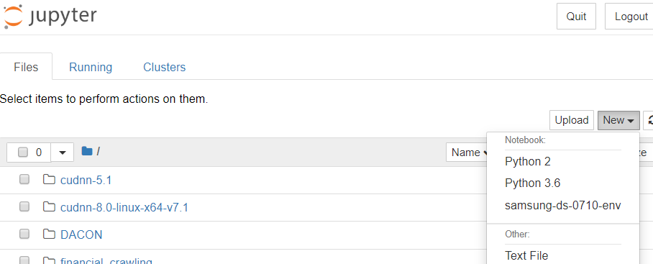
Part 0. Environment Setting
Add virtualenv to Jupyter kernel
cogito@digits-1:~$ python3 -m ipykernel install --user \
--name samsung-ds-0710-env --display-name "samsung-ds-0710-env“
Installed kernelspec samsung-ds-0710-env in /home/cogito/.local/share/jupyter/kernels/samsung-ds-0710-env
cogito@digits-1:~$ jupyter notebook

Slide 7
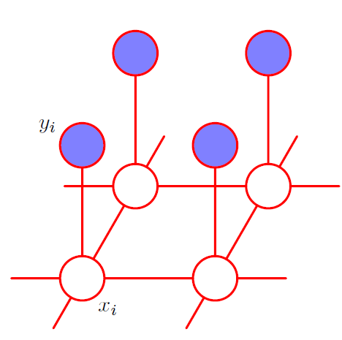




Part 1. Graphical Models (recap)
Markov Random Field
Markov Property
$p\left(x_{i}, x_{j}\right)≠p\left(x_{i}\right)p(x_{j})$ for $x_{j}∈nbr_{i}$
$p\left(x_{i},x_{k}\right)=p\left(x_{i}\right)p\left(x_{k}\right)$ for $x_{k}∉nbr_{i}$
Energy Based Model
$p\left(x\right)=\frac{1}{Z}\exp\left(−E\left(x\right)\right)$
$$x_{k}$$
$$x_{j}$$
$$nbr_{i}$$

Slide 8
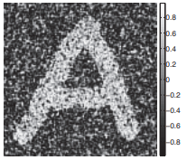
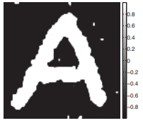
Part 1. Graphical Models (recap)
Image Denoising using Ising Model
Denoising
Noisy Image
Clean Image

Slide 9

Part 1. Graphical Models (recap)
Ising Model
$y_{i}:$ noisy pixel value for $i^{th}$pixel
$x_{i}:$ binary state value for $i^{th}$pixel $∈\{−1, 1\}$
$nbr_{i}=\{x_{i←},x_{i→},x_{i↑},x_{i↓}\}$
$p\left(x\right)=\frac{1}{Z_{0}}\exp\left(−E_{0}\left(x\right)\right)$
$E_{0}\left(x\right)=−\sum_{i=1}^{D}{\sum_{j∈nbr_{i}}{W_{ij}x_{i}x_{j}}}$

Slide 10



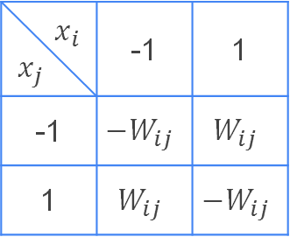
Part 1. Graphical Models (recap)
Ising Model
$p\left(x\right)=\frac{1}{Z_{0}}\exp\left(−E_{0}\left(x\right)\right)$
$E_{0}\left(x\right)=−\sum_{i=1}^{D}{\sum_{j∈nbr_{i}}{W_{ij}x_{i}x_{j}}}$
$W_{ij}>0$
When $x_{i}=x_{j}$, $p(x)$ is high.
When $x_{i}≠x_{j}$, $p(x)$ is small
$W_{ij}<0$
When $x_{i}≠x_{j}$, $p(x)$ is high.
When $x_{i}=x_{j}$, $p(x)$ is small
$$x_{i}$$ $$x_{j}$$ | -1 | 1
-1 | $${−W}_{ij}$$ | $$W_{ij}$$
1 | $$W_{ij}$$ | $${−W}_{ij}$$
$$E_{0}\left(x\right)$$

Slide 11
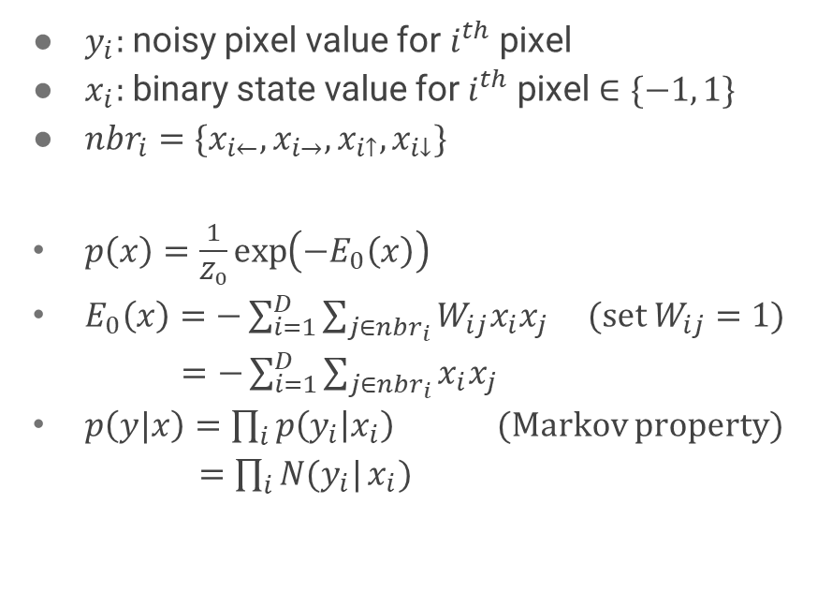
Part 1. Graphical Models (recap)
Ising Model
$y_{i}:$ noisy pixel value for $i^{th}$pixel
$x_{i}:$ binary state value for $i^{th}$pixel $∈\{−1, 1\}$
$nbr_{i}=\{x_{i←},x_{i→},x_{i↑},x_{i↓}\}$
$p\left(x\right)=\frac{1}{Z_{0}}\exp\left(−E_{0}\left(x\right)\right)$
$E_{0}\left(x\right)=−\sum_{i=1}^{D}{\sum_{j∈nbr_{i}}{W_{ij}x_{i}x_{j}}}$ (set $W_{ij}=1$)
$=−\sum_{i=1}^{D}{\sum_{j∈nbr_{i}}{x_{i}x_{j}}}$
$p\left(y|x\right)=\prod_{i}{p\left(y_{i} | x_{i}\right)}$ (Markov property)
$=\prod_{i}{N(y_{i}|}x_{i})$

Slide 12

Part 1. Graphical Models (recap)
$p\left(x\right)=\frac{1}{Z_{0}}\exp\left(−E_{0}\left(x\right)\right)$
$E_{0}\left(x\right)=−\sum_{i=1}^{D}{\sum_{j∈nbr_{i}}{x_{i}x_{j}}}$
$p\left(y|x\right)=\prod_{i}{N(y_{i}|}x_{i})$
$p\left(x|y\right)=\frac{1}{Z}p\left(y | x\right)p\left(x\right)=\frac{1}{Z}\exp\left(−E_{0}\left(x\right)+\log{\prod_{i}{N(y_{i}|}x_{i})}\right)$
$=\frac{1}{Z}\exp\left(\sum_{i=1}^{D}{\sum_{j∈nbr_{i}}{x_{i}x_{j}}}+\log{\prod_{i}{N(y_{i}|}x_{i})}\right)$

Slide 13
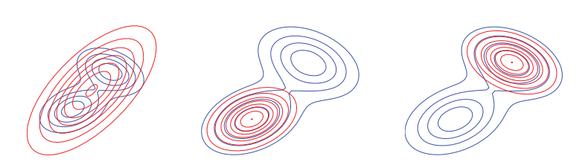
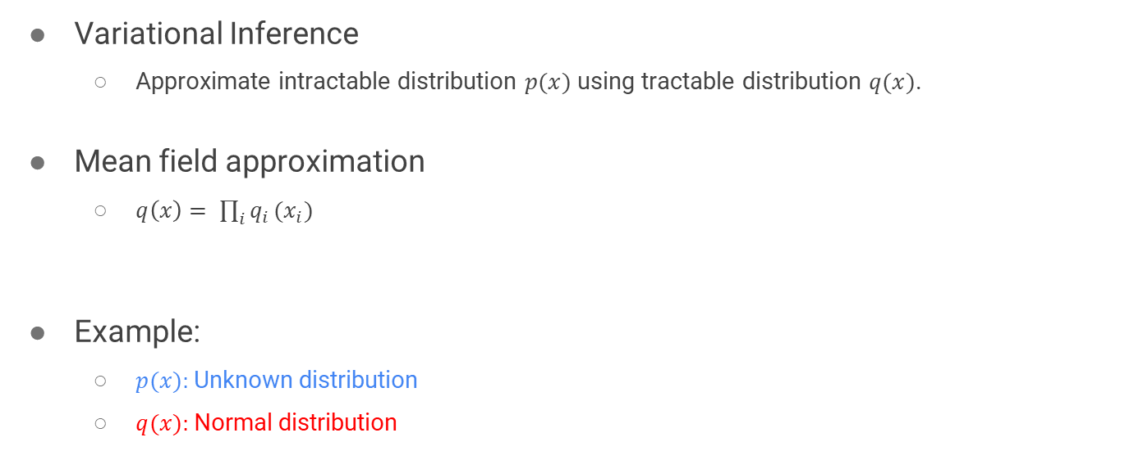
Part 1. Graphical Models (recap)
Variational Inference
Approximate intractable distribution $p(x)$ using tractable distribution $q(x)$.
Mean field approximation
$q\left(x\right)= \prod_{i}{q_{i}}(x_{i})$
Example:
$p(x):$Unknown distribution
$q(x):$Normal distribution
Target distribution
Proposal distribution

Slide 14
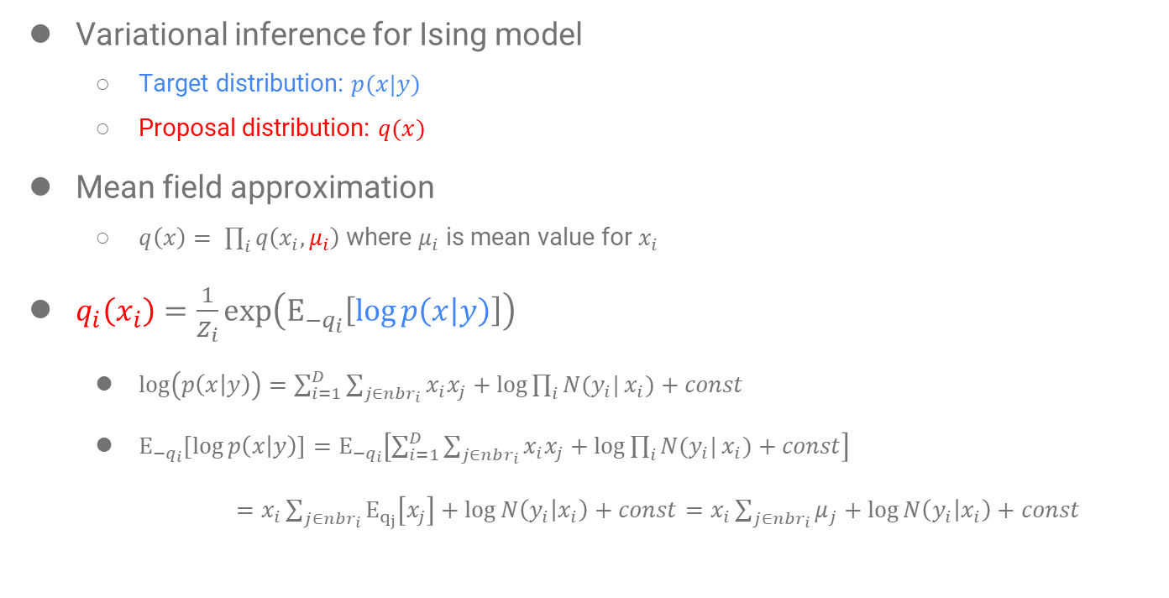
Part 1. Graphical Models (recap)
Variational inference for Ising model
Target distribution: $p(x|y)$
Proposal distribution: $q(x)$
Mean field approximation
$q\left(x\right)= \prod_{i}{q\left(x_{i},μ_{i}\right)}$ where $μ_{i}$ is mean value for $x_{i}$
$q_{i}\left(x_{i}\right)=\frac{1}{Z_{i}}\exp\left(Ε_{−q_{i}}\left[\log{p\left(x | y\right)}\right]\right)$
$\log\left(p\left(x | y\right)\right)=\sum_{i=1}^{D}{\sum_{j∈nbr_{i}}{x_{i}x_{j}}}+\log{\prod_{i}{N(y_{i}|}x_{i})}+const$
$Ε_{−q_{i}}\left[\log{p\left(x | y\right)}\right]=Ε_{−q_{i}}\left[\sum_{i=1}^{D}{\sum_{j∈nbr_{i}}{x_{i}x_{j}}}+\log{\prod_{i}{N(y_{i}|}x_{i})}+const\right]$
$=x_{i}\sum_{j∈nbr_{i}}{Ε_{q_{j}}\left[x_{j}\right]}+\log{N\left(y_{i} | x_{i}\right)}+const=x_{i}\sum_{j∈nbr_{i}}{μ_{j}}+\log{N\left(y_{i} | x_{i}\right)}+const$

Slide 15
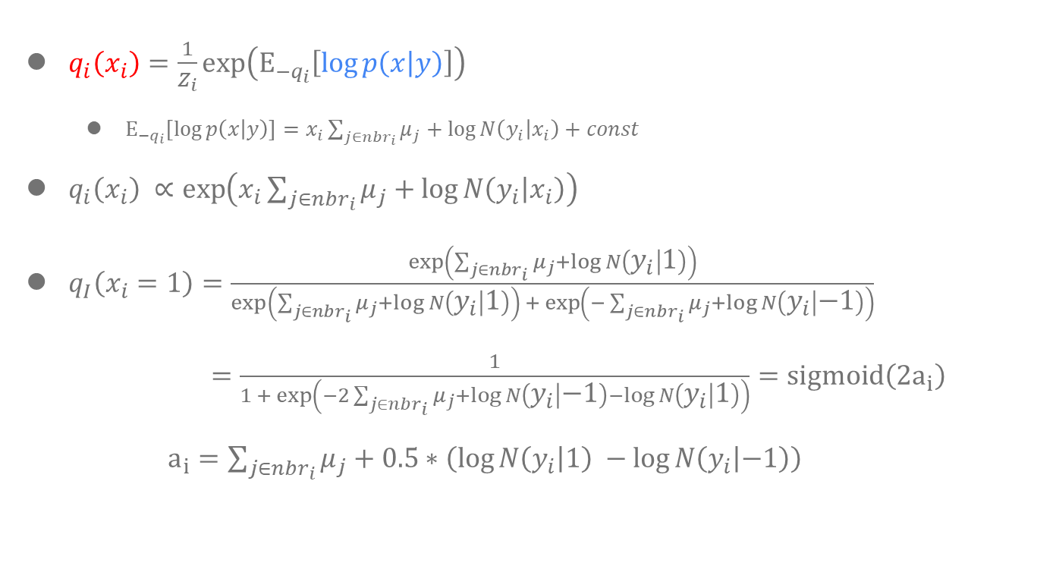
Part 1. Graphical Models (recap)
$q_{i}\left(x_{i}\right)=\frac{1}{Z_{i}}\exp\left(Ε_{−q_{i}}\left[\log{p\left(x | y\right)}\right]\right)$
$Ε_{−q_{i}}\left[\log{p\left(x | y\right)}\right]=x_{i}\sum_{j∈nbr_{i}}{μ_{j}}+\log{N\left(y_{i} | x_{i}\right)}+const$
$q_{i}\left(x_{i}\right) ∝\exp\left(x_{i}\sum_{j∈nbr_{i}}{μ_{j}}+\log{N\left(y_{i} | x_{i}\right)}\right)$
$q_{I}\left(x_{i}=1\right)=\frac{\exp\left(\sum_{j∈nbr_{i}}{μ_{j}}+\log{N\left(y_{i} | 1\right)}\right)}{\exp\left(\sum_{j∈nbr_{i}}{μ_{j}}+\log{N\left(y_{i} | 1\right)}\right) +\exp\left(−\sum_{j∈nbr_{i}}{μ_{j}}+\log{N\left(y_{i} | −1\right)}\right)}$
$=\frac{1}{1 + \exp\left(−2\sum_{j∈nbr_{i}}{μ_{j}}+\log{N\left(y_{i} | −1\right)}−\log{N\left(y_{i} | 1\right)}\right)}=sigmoid\left(2a_{i}\right)$
$a_{i}=\sum_{j∈nbr_{i}}{μ_{j}}+0.5∗\left(\log{N\left(y_{i} | 1\right)} −\log{N\left(y_{i} | −1\right)}\right)$

Slide 16
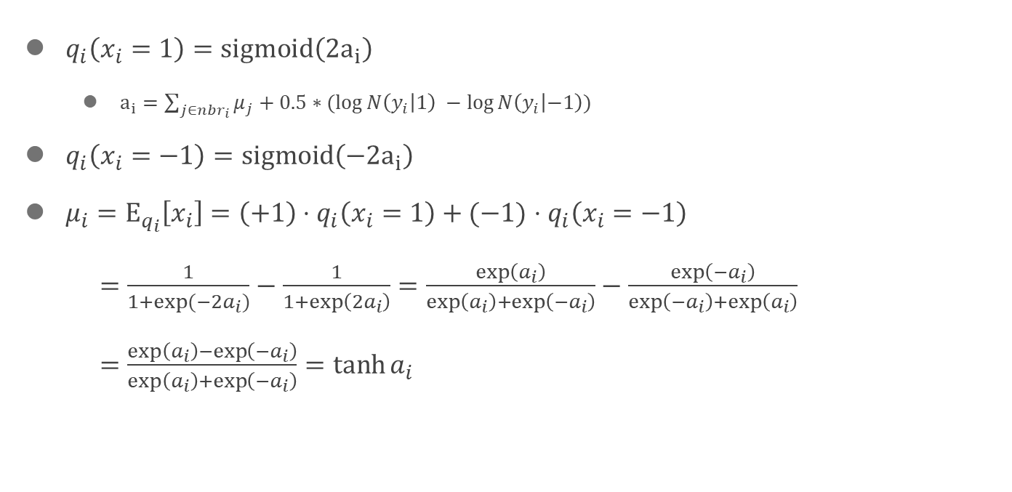
Part 1. Graphical Models (recap)
$q_{i}\left(x_{i}=1\right)=sigmoid\left(2a_{i}\right)$
$a_{i}=\sum_{j∈nbr_{i}}{μ_{j}}+0.5∗(\log{N\left(y_{i} | 1\right)} −\log{N\left(y_{i} | −1\right)})$
$q_{i}\left(x_{i}=−1\right)=sigmoid\left(−2a_{i}\right)$
$μ_{i}=Ε_{q_{i}}\left[x_{i}\right]=\left(+1\right)⋅q_{i}\left(x_{i}=1\right)+(−1)$ $⋅q_{i}\left(x_{i}=−1\right)$
$=\frac{1}{1+\exp{(−2a_{i})}}−\frac{1}{1+\exp\left(2a_{i}\right)}=\frac{\exp\left(a_{i}\right)}{\exp\left(a_{i}\right)+\exp\left(−a_{i}\right)}−\frac{\exp\left({−a}_{i}\right)}{\exp\left({−a}_{i}\right)+\exp\left(a_{i}\right)}$
$=\frac{\exp\left(a_{i}\right)−\exp\left({−a}_{i}\right)}{\exp\left(a_{i}\right)+\exp\left(−a_{i}\right)}=\tanh{a_{i}}$

Slide 17
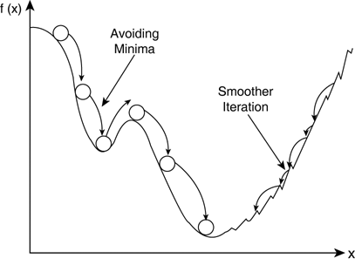

Part 1. Graphical Models (recap)
Update variational parameter $μ_{i}$
$μ_{i}=\tanh{{(a}_{i}) }=\tanh\left(\sum_{j∈nbr_{i}}{μ_{j}}+0.5∗\left(\log{N\left(y_{i} | 1\right)} −\log{N\left(y_{i} | −1\right)}\right)\right)$
$μ_{i}^{t}=\tanh\left(\sum_{j∈nbr_{i}}{μ_{j}^{t−1}}+0.5∗\left(\log{N\left(y_{i} | 1\right)} −\log{N\left(y_{i} | −1\right)}\right)\right)$
(fixed point algorithm)
$μ_{i}^{t}=\left(1−λ\right)μ_{j}^{t−1}+λ\tanh\left(\sum_{j∈nbr_{i}}{μ_{j}^{t−1}}+0.5∗\left(\log{N\left(y_{i} | 1\right)} −\log{N\left(y_{i} | −1\right)}\right)\right)$
(damped update)

Slide 18
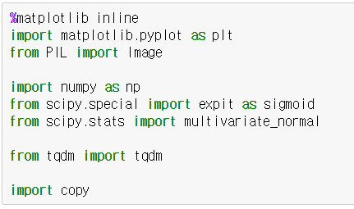
Part 1. Graphical Models (code)
To visualize data (e.g. plot)
Import library
To handle image data (e.g. open)
Mathematical library/function/class
To visualize progress
(e.g. iteration of loop)
For deep copy of array

Slide 19
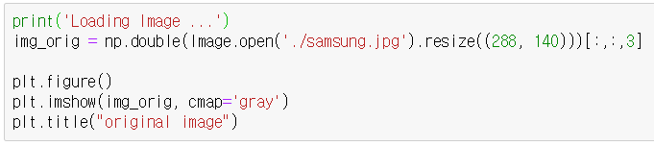
Part 1. Graphical Models (code)
Load image file as array
Load image from jpg file

Slide 20
Part 1. Graphical Models (code)
Load image file as array
Resize image for fast experiment
Load image from jpg file

Slide 21
Part 1. Graphical Models (code)
Load image file as array
Type cast from image to double array
Resize image for fast experiment
Load image from jpg file

Slide 22
Part 1. Graphical Models (code)
Load image file as array
Type cast from image to double array
Resize image for fast experiment
Load image from jpg file
Height x Width X RGBA

Slide 23
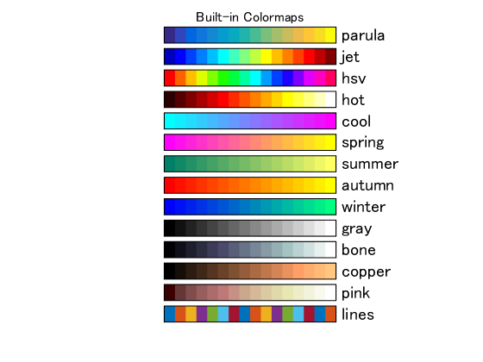
Part 1. Graphical Models (code)
Load image file as array
Type cast from image to double array
Resize image for fast experiment
Load image from jpg file
Height x Width X RGBA
Open new window
Plot image gray color map
Set title to plot

Slide 24
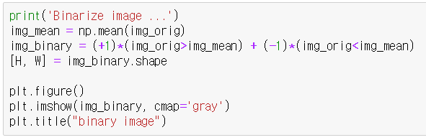
Part 1. Graphical Models (code)
Binarize pixel value of image
Compute mean pixel value of image
Binarize image based on mean pixel value
Get image size (Height and Width)

Slide 25
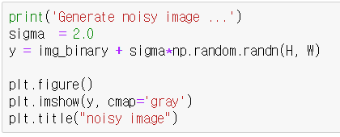


Part 1. Graphical Models (code)
Generate noisy image
Set the noise level (standard deviation=2.0)
Add noise ($N\left(0, σ^{2}\right)$) to binarized image
$$N\left(0, σ^{2}\right)=σN(0, 1)$$

Slide 26
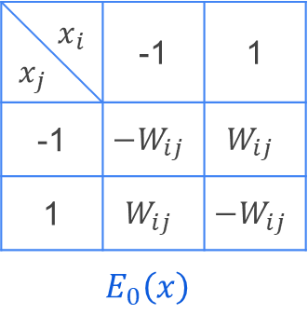
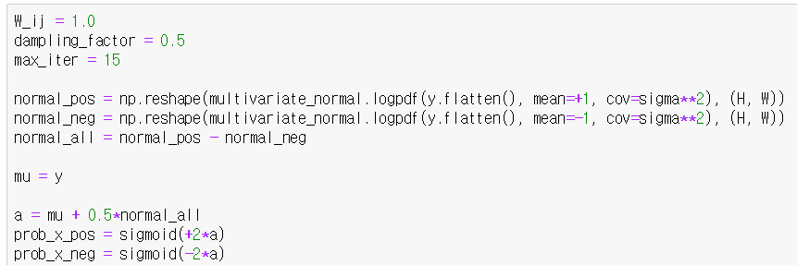
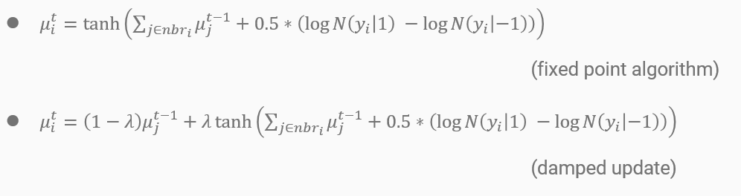
Part 1. Graphical Models (code)
Build Ising model

Slide 27
Part 1. Graphical Models (code)
Build Ising model

Slide 28
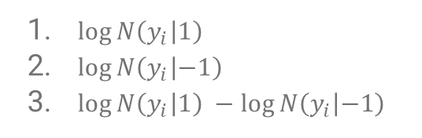
Part 1. Graphical Models (code)
Build Ising model
$\log{N\left(y_{i} | 1\right)}$
$\log{N\left(y_{i} | −1\right)}$
$\log{N\left(y_{i} | 1\right)} −\log{N\left(y_{i} | −1\right)}$

Slide 29

Part 1. Graphical Models (code)
Build Ising model
Initial $μ$ = $y$
$\log{N\left(y_{i} | 1\right)}$
$\log{N\left(y_{i} | −1\right)}$
$\log{N\left(y_{i} | 1\right)} −\log{N\left(y_{i} | −1\right)}$

Slide 30
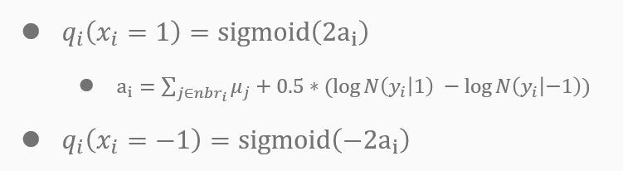

Part 1. Graphical Models (code)
Build Ising model
$\log{N\left(y_{i} | 1\right)}$
$\log{N\left(y_{i} | −1\right)}$
$\log{N\left(y_{i} | 1\right)} −\log{N\left(y_{i} | −1\right)}$
Initial $μ$ = $y$

Slide 31
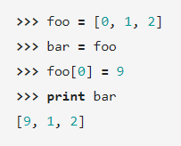
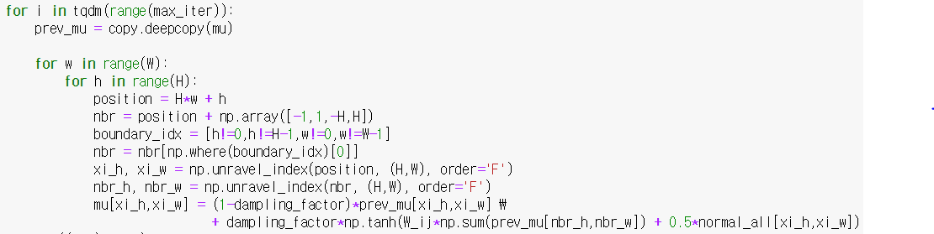
Part 1. Graphical Models (code)
Mean field variational inference
Visualize loop progress
(e.g. time per loop)
Deep copy for array

Slide 32

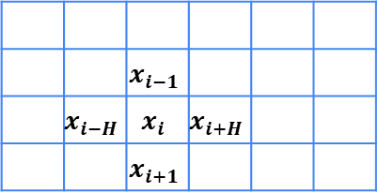

Part 1. Graphical Models (code)
Width (W)
Mean field variational inference
 |  | $$x_{i−1}$$
 | $$x_{i−H}$$ | $$x_{i}$$ | $$x_{i+H}$$
 |  | $$x_{i+1}$$
Height (H)
Loop for each pixel
Current pixel position ($x_{i}$)
$nbr_{i}$ pixel position

Slide 33
Part 1. Graphical Models (code)
Width (W)
Mean field variational inference
h=0 w=0
 |  |  |  |  | h=1 w=W-1
 |  | h=H-1 w=2
Height (H)
Loop for each pixel
Current pixel position ($x_{i}$)
Check whether current position is boundary

Slide 34
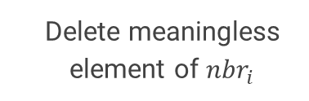
Part 1. Graphical Models (code)
Width (W)
Mean field variational inference
h=0 w=0
 |  |  |  |  | h=1 w=W-1
 |  | h=H-1 w=2
Height (H)
Loop for each pixel
Current pixel position ($x_{i}$)
Delete meaningless element of $nbr_{i}$

Slide 35
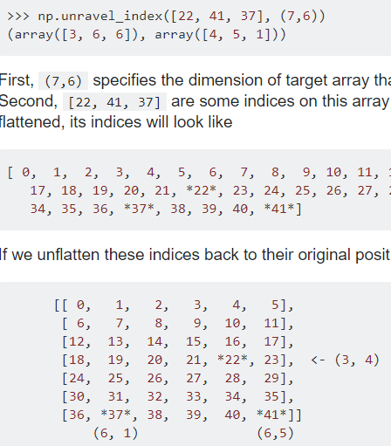
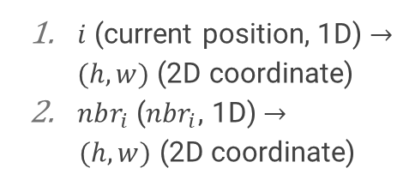
Part 1. Graphical Models (code)
Mean field variational inference
Loop for each pixel
$i$ (current position, 1D) $→(h,w)$ (2D coordinate)
$nbr_{i}$ ($nbr_{i}$, 1D) $→$
$(h,w)$ (2D coordinate)
Current pixel position ($x_{i}$)

Slide 36
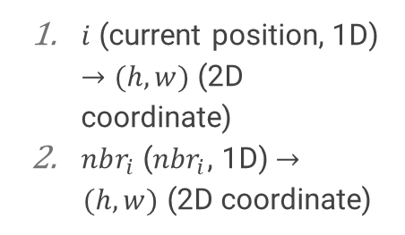
Part 1. Graphical Models (code)
Mean field variational inference
Loop for each pixel
$i$ (current position, 1D) $→(h,w)$ (2D coordinate)
$nbr_{i}$ ($nbr_{i}$, 1D) $→$
$(h,w)$ (2D coordinate)
Current pixel position ($x_{i}$)

Slide 37
Reference
[1] K. Murphy, “Machine Learning: A Probabilistic Perspective”, The MIT Press, 2012
[2] https://towardsdatascience.com/variational-inference-ising-model-6820d3d13f6a
[3] https://github.com/vsmolyakov/experiments_with_python/blob/master/chp02/mean_field_mrf.ipynb

