Slide 1
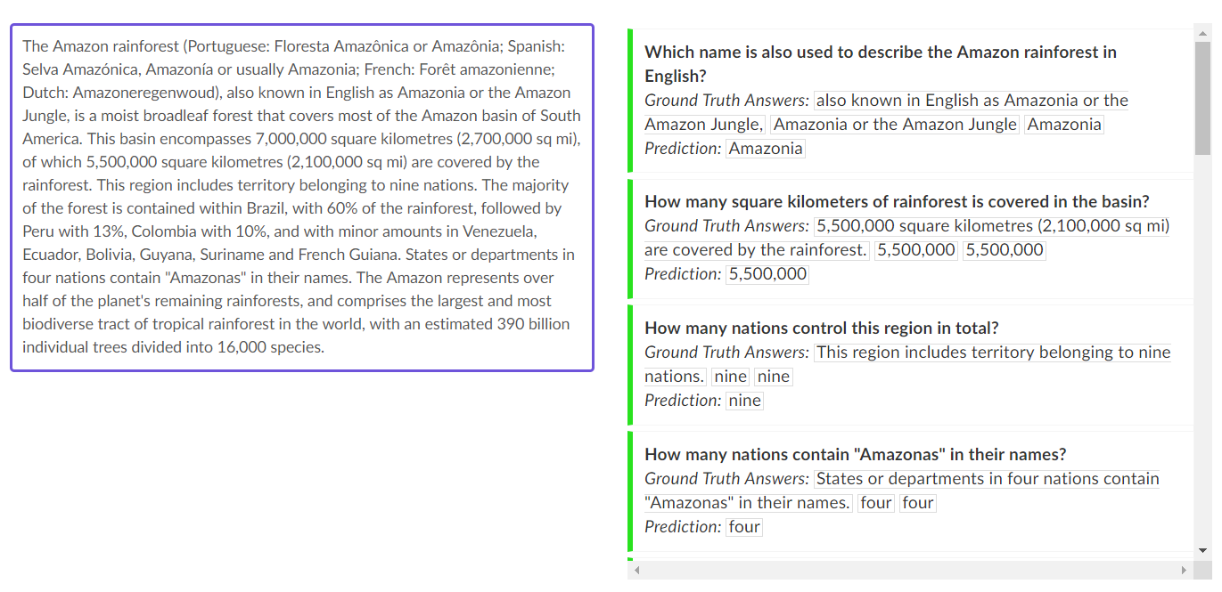
Question Answering using BERT
Stanford Question Answering Dataset (SQuAD)
https://rajpurkar.github.io/SQuAD-explorer/

Slide 2
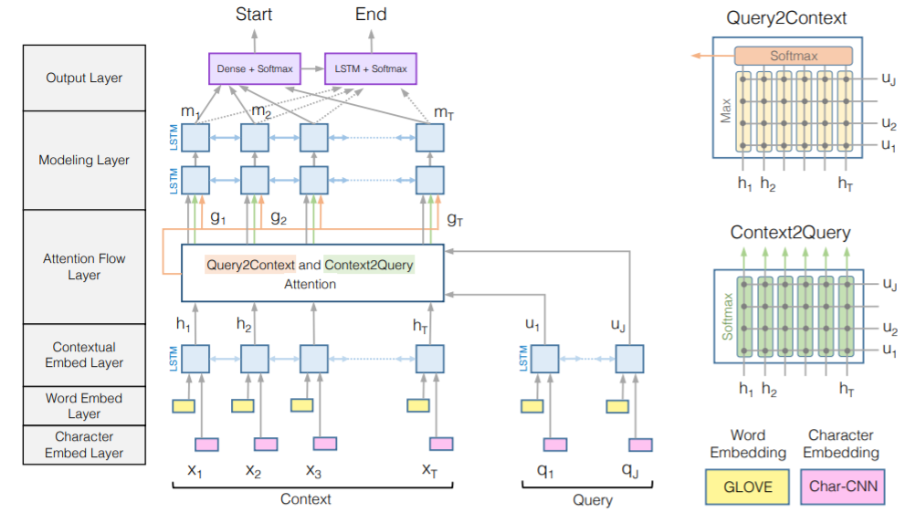
Question Answering using BERT
RNN based model - BiDAF
Seo, Minjoon, et al. "Bidirectional attention flow for machine comprehension." arXiv preprint arXiv:1611.01603 (2016).

Slide 3
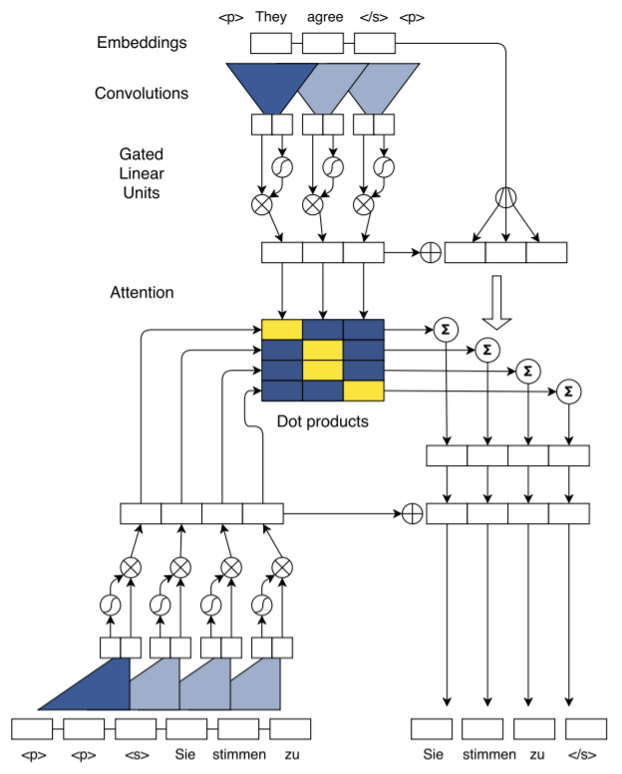
Question Answering using BERT
CNN based model – ConvS2S
Gehring, Jonas, et al. "Convolutional sequence to sequence learning." Proceedings of the 34th International Conference on Machine Learning-Volume 70. JMLR. org, 2017.

Slide 4
Question Answering using BERT
CNN based model – ConvS2S
Gehring, Jonas, et al. "Convolutional sequence to sequence learning." Proceedings of the 34th International Conference on Machine Learning-Volume 70. JMLR. org, 2017.

Slide 5
Question Answering using BERT
CNN based model – ConvS2S
Gehring, Jonas, et al. "Convolutional sequence to sequence learning." Proceedings of the 34th International Conference on Machine Learning-Volume 70. JMLR. org, 2017.

Slide 6
Question Answering using BERT
CNN based model – ConvS2S
Gehring, Jonas, et al. "Convolutional sequence to sequence learning." Proceedings of the 34th International Conference on Machine Learning-Volume 70. JMLR. org, 2017.

Slide 7
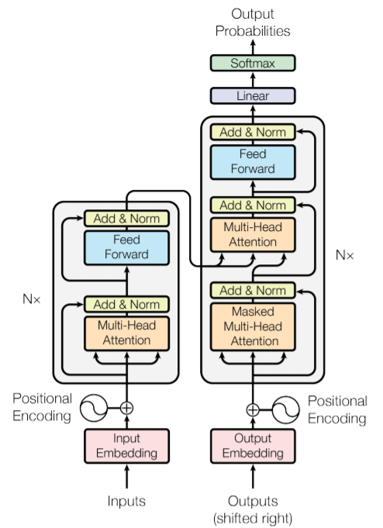
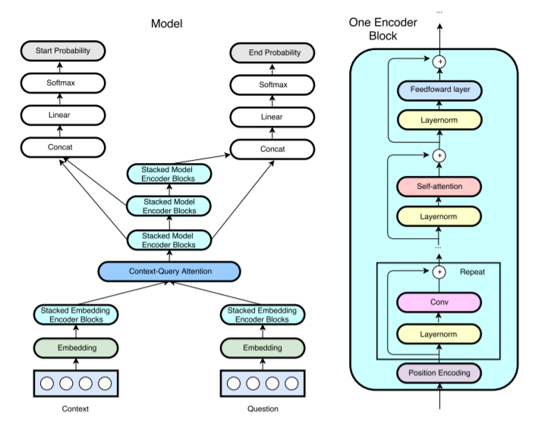
Question Answering using BERT
Attention based model – Transformer, QANet
Vaswani, Ashish, et al. "Attention is all you need." Advances in neural information processing systems. 2017.
Yu, Adams Wei, et al. "Qanet: Combining local convolution with global self-attention for reading comprehension." arXiv preprint arXiv:1804.09541 (2018).

Slide 8
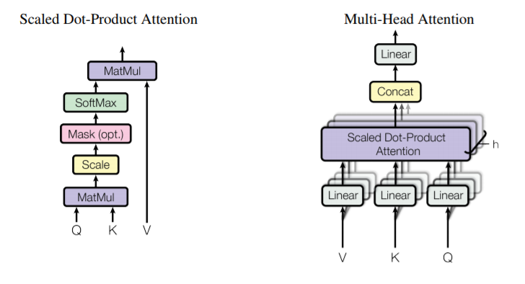




Question Answering using BERT
Transformer
Query $∈R^{l_{q}×d_{k}}$
Value $∈R^{{l×d}_{v}}$
Key$∈R^{{l×d}_{k}}$

Slide 9







Question Answering using BERT
Transformer
$$T$$
$$Q$$
$$K^{T}$$
Query $∈R^{l_{q}×d_{k}}$
Value $∈R^{{l×d}_{v}}$
Key$∈R^{{l×d}_{k}}$
$$QK^{T}$$

Slide 10
Question Answering using BERT
Transformer
$$T$$
$$Q$$
$$K^{T}$$
Query $∈R^{l_{q}×d_{k}}$
Value $∈R^{{l×d}_{v}}$
Key$∈R^{{l×d}_{k}}$
$$QK^{T}$$

Slide 11
Question Answering using BERT
Transformer
$$T$$
$$Q$$
$$K^{T}$$
Query $∈R^{l_{q}×d_{k}}$
Value $∈R^{{l×d}_{v}}$
Key$∈R^{{l×d}_{k}}$
$$QK^{T}$$

Slide 12
Question Answering using BERT
Transformer
$$T$$
dot-product
$$Q$$
$$K^{T}$$
Query $∈R^{l_{q}×d_{k}}$
Value $∈R^{{l×d}_{v}}$
Key$∈R^{{l×d}_{k}}$
$$QK^{T}$$

Slide 13




Question Answering using BERT
Transformer
$$l$$
$$l_{q}$$
$$QK^{T}$$
$$softmax(QK^{T})$$
Query $∈R^{l_{q}×d_{k}}$
Value $∈R^{{l×d}_{v}}$
Key$∈R^{{l×d}_{k}}$

Slide 14


Question Answering using BERT
Transformer
$$softmax(QK^{T})$$
$$V$$
Query $∈R^{l_{q}×d_{k}}$
Value $∈R^{{l×d}_{v}}$
Key$∈R^{{l×d}_{k}}$

Slide 15
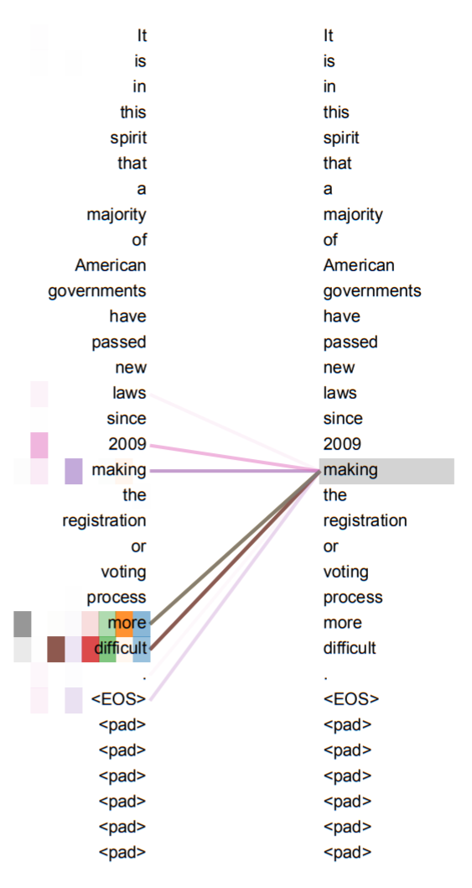
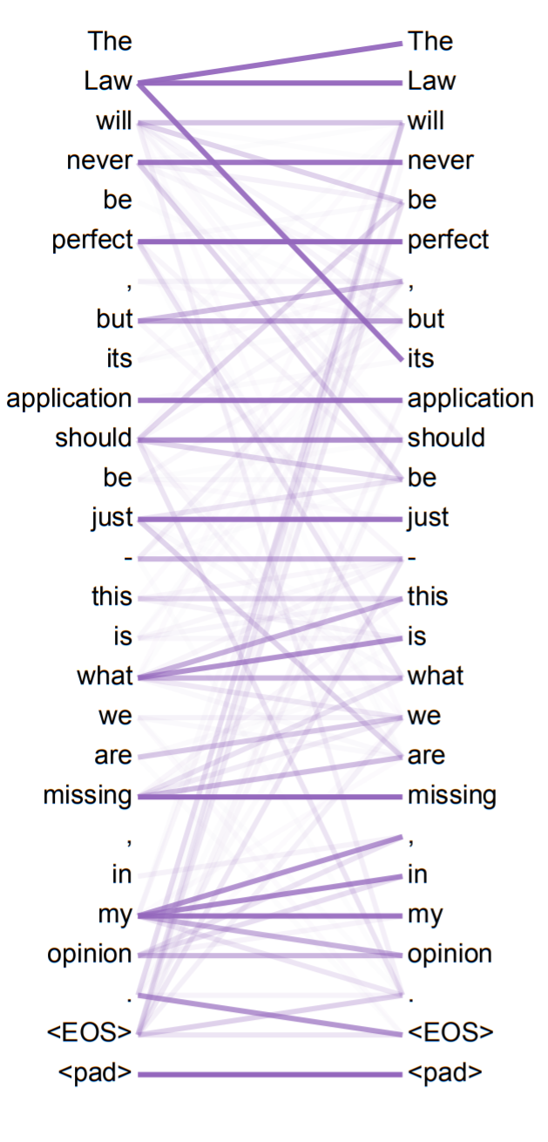

Question Answering using BERT
Transformer
$$softmax(QK^{T})$$

Slide 16

Question Answering using BERT
Transformer

Slide 17
Question Answering using BERT
Transformer – self-attention

Slide 18
Question Answering using BERT
Transformer – self-attention

Slide 19
Question Answering using BERT
Transformer – self-attention

Slide 20
Question Answering using BERT
Transformer – self-attention

Slide 21
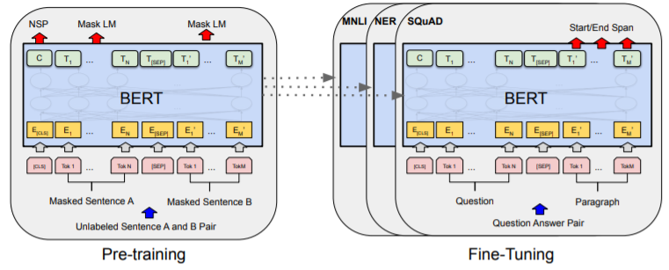
Question Answering using BERT
Bidirectional Encoder Representations from Transformers (BERT)

Slide 22
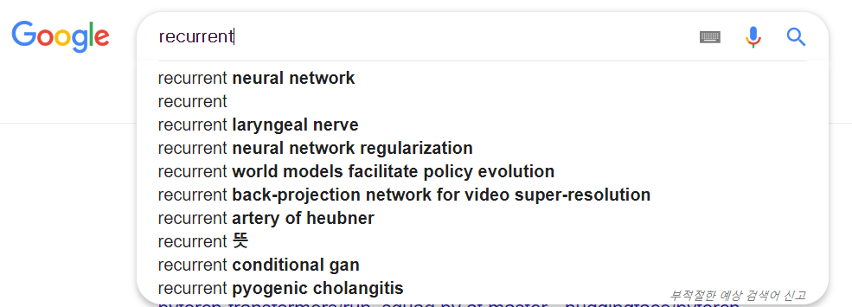

Question Answering using BERT
BERT – Masked Language Model
Goal of Language Model: Inference $P({word}_{predict}|{word}_{given})$

Slide 23
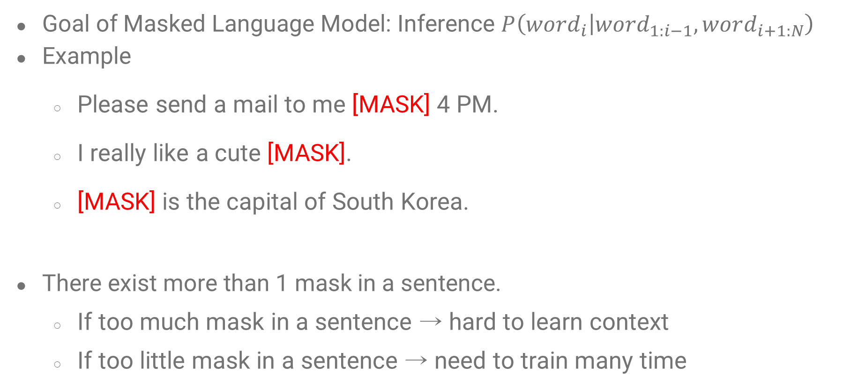
Question Answering using BERT
BERT – Masked Language Model
Goal of Masked Language Model: Inference $P\left({word}_{i} | {word}_{1:i−1},word_{i+1:N}\right)$
Example
Please send a mail to me [MASK] 4 PM.
I really like a cute [MASK].
[MASK] is the capital of South Korea.
There exist more than 1 mask in a sentence.
If too much mask in a sentence → hard to learn context
If too little mask in a sentence → need to train many time

Slide 24

Question Answering using BERT
BERT – Next Sentence Prediction
Given two sentences $Sentence_{1}, Sentence_{2}$,
Classify whether $Sentence_{2}$ is the next sentence of $Sentence_{1}$ or not.
Example

Slide 25
Question Answering using BERT
BERT – Fine-Tuning

Slide 26
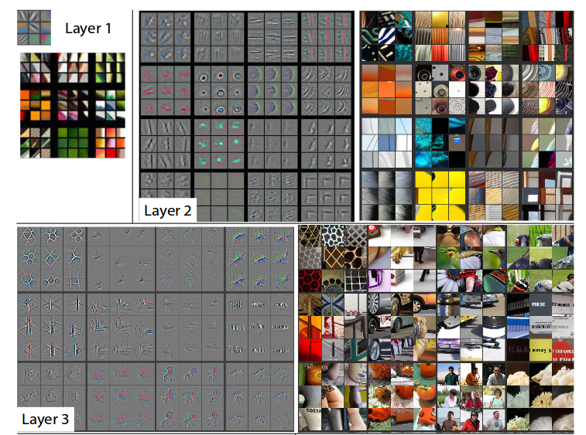
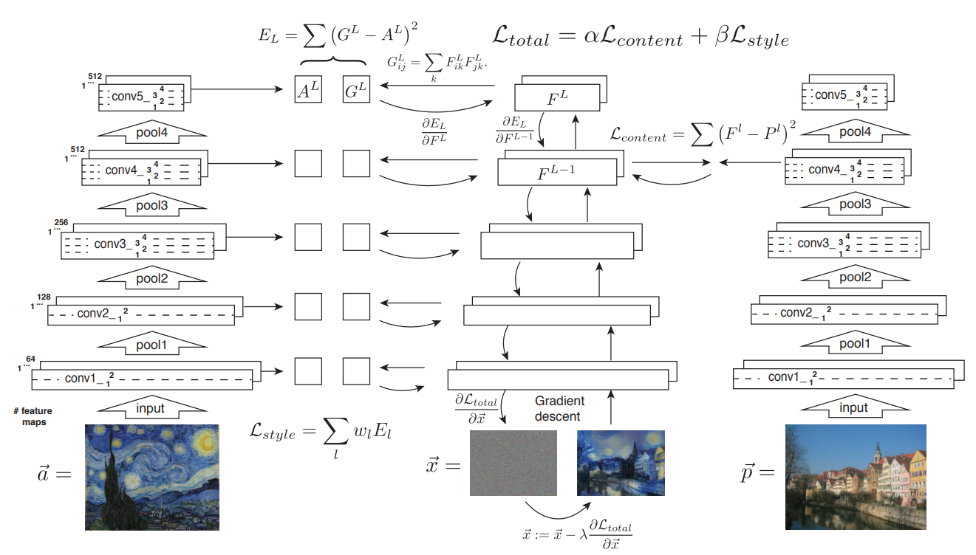
Question Answering using BERT
BERT – Fine-Tuning

Slide 27
Question Answering using BERT
Bidirectional Encoder Representations from Transformers (BERT)
Remove Top Layer

Slide 28
Question Answering using BERT
Bidirectional Encoder Representations from Transformers (BERT)
Attach New Top Layer & Update All Parameter

Slide 29
Reference
[1] https://rajpurkar.github.io/SQuAD-explorer/
[2] Seo, Minjoon, et al. "Bidirectional attention flow for machine comprehension." arXiv preprint arXiv:1611.01603 (2016).
[3] Gehring, Jonas, et al. "Convolutional sequence to sequence learning." Proceedings of the 34th International Conference on Machine Learning-Volume 70. JMLR. org, 2017.
[4] Vaswani, Ashish, et al. "Attention is all you need." Advances in neural information processing systems. 2017.
[5] Yu, Adams Wei, et al. "Qanet: Combining local convolution with global self-attention for reading comprehension." arXiv preprint arXiv:1804.09541 (2018).
[6] Devlin, Jacob, et al. "Bert: Pre-training of deep bidirectional transformers for language understanding." arXiv preprint arXiv:1810.04805 (2018).
[7] https://nlp.stanford.edu/seminar/details/jdevlin.pdf
[8] https://blog.nerdfactory.ai/2019/04/25/learn-bert-with-colab.html

