Slide 1
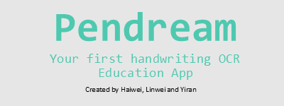
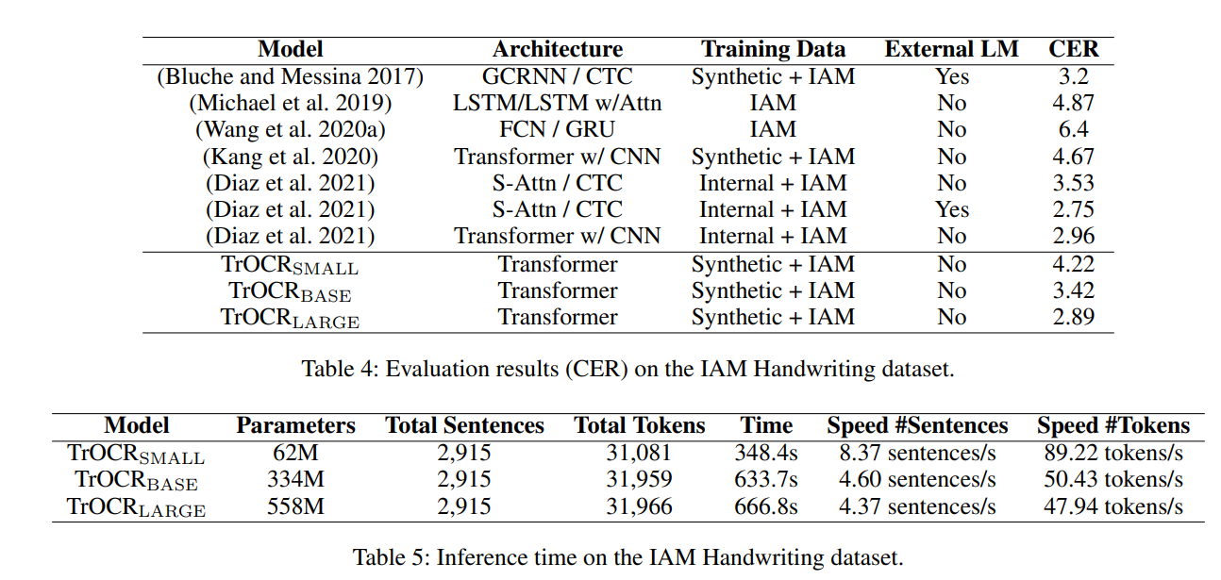
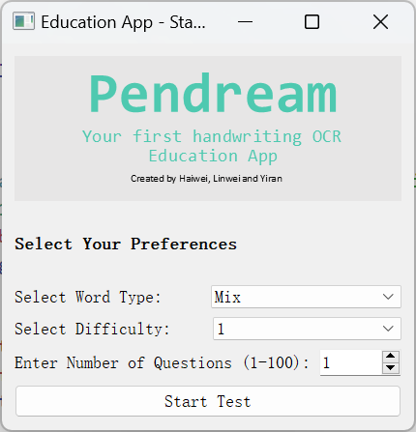
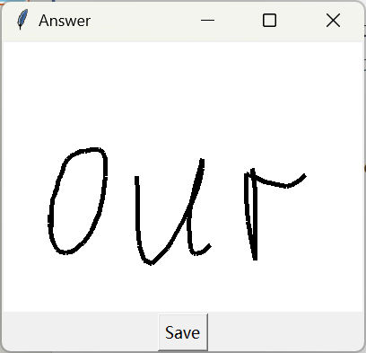
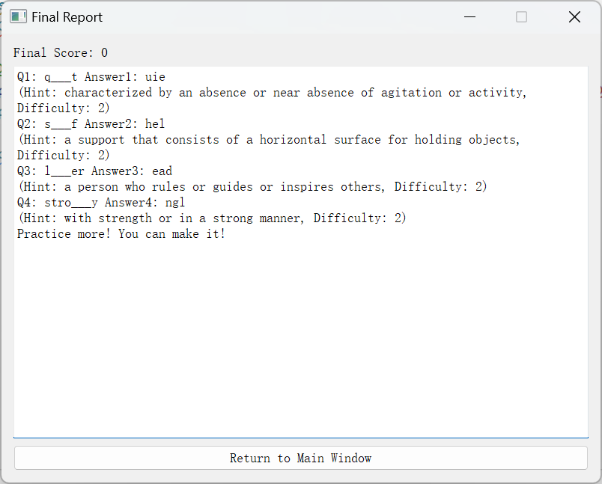
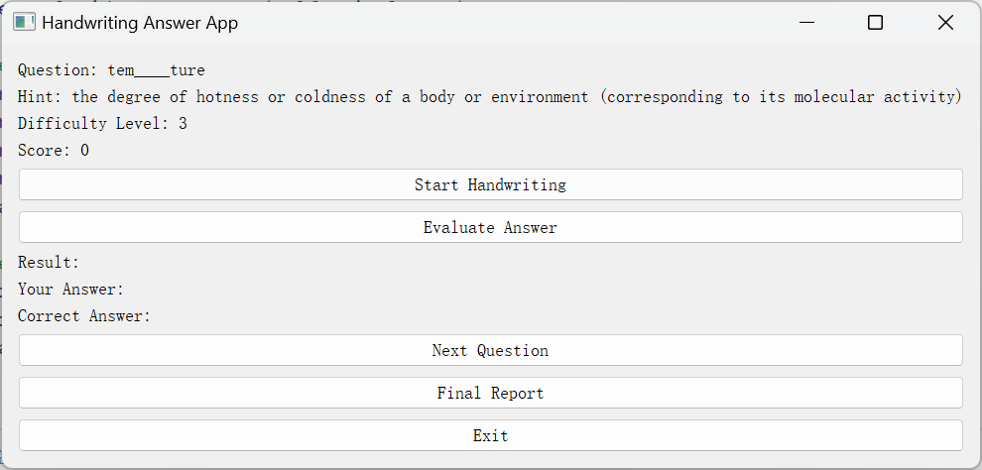
Pendream--An Interactive Spelling Practice System with an OCR Model
Haiwei Du, Linwei Wu, Yiran Wang
Introduction
Practice System
TrOCR Model
Spelling proficiency is a foundational skill for young children. To enhance spelling practice, we propose developing a handwriting-based spelling fill-in-the-blank application.
Leveraging deep learning model for handwriting recognition, this software will provide a user-friendly platform for learners to practice spelling in a natural and interactive manner.
The system will allow users to handwrite their answers directly and receive automated evaluations, offering personalized feedback for improvement.
Main Functionalities:
The Microsoft-backed TrOCR model is an encoder-decoder model, consisting of an image Transformer as encoder, and a text Transformer as decoder. The image encoder was initialized from the weights of BEiT, while the text decoder was initialized from the weights of RoBERTa.
The TrOCR model has the characteristics of high accuracy and strong generalization ability, which is well in line with the system application expectations.
Difficulty Levels:
Options: 1 (Easy), 2 (Medium), 3 (Hard).
Word Type Selection:
Users can choose from Mix, Noun, Verb, Adjective.
Customizable Practice:
Select the number of spelling questions for practice.
Interactive Spelling Session:
View a hint and type the correct letters in the blank spaces.
Write answers using a handwriting board.
Submit answers using the Evaluate button for automatic correction.
Dictionary & questions
Learning Process Overview
Start Practice:
Configure settings for word type, difficulty, and question count.
Begin the spelling practice by clicking "Start".
Question Interface:
Users view a hint with the word's blanks and difficulty.
Click "Start Handwriting" to write answers using the handwriting board.
Click "Evaluation" to validate answers:
Correct: Score increases by 1.
Incorrect: No score penalty, encouragement provided.
Word Bank Creation
We selected 1,000 common words as the test question bank and divided them into nouns, verbs, and adjectives/adverbs. The meanings of these words were filtered out through dictionary files and processed into the form of {word: meaning} for subsequent use.
Question Generation
A specified number of words are randomly selected from the question bank.
Letters in each word are replaced based on the chosen difficulty level:
Higher Difficulty: More letters are replaced.
Lower Difficulty: Fewer letters are replaced.
How to Play
You’ll be shown the definition of a word along with a partially obscured version of the word.
Using the definition and remaining letters, try to guess the word.
CER: Character Error Rate. The lower the CER, the lower the model error rate.
Interfaces
Customized Report Details
Report Includes:
1. Total score achieved.
2. All questions and answers attempted in the session.
3. Encouragement messages based on accuracy:
Perfect! You've done a great job! (100%)
Good job! Keep practicing! (60%-99%)
Try harder! You can do it better! (30%-59%)
Practice more! You can make it! (<30%)

