Slide 1
Interactive Clustering GUI > Figures
Erwan SCHILD

Slide 2
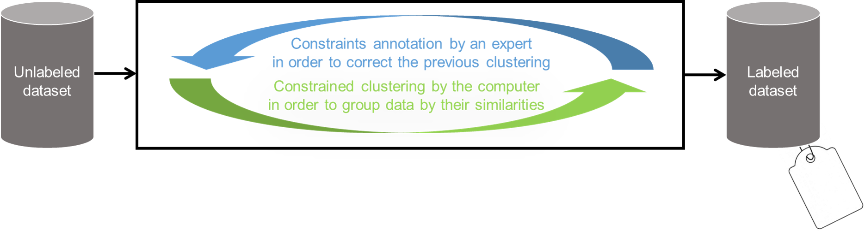
Interactive-clustering

Slide 3
interactive-clustering-example
(1)
(2)
(3)
(4)
(5)
MUST-LINK
CANNOT-LINK
Unlabeled dataset
Unconstrained clustering
Constraints sampling
Constraints annotation
New constrained clustering
Initialization
Iteration 1

Slide 4
interactive-clustering-comparative-study
performance
(vmeasure)
groundtruth
(1b) Efficiency
(optimization)
(1a) Effectiveness
(convergence)
(7,8,9) Robustness
(error simulation)
(5) Relevance
(business value)
(6) Rentability
(benefits vs costs)
iterations
(nb of annotations)
(2,3,4) Cost
(needed time)

Slide 5
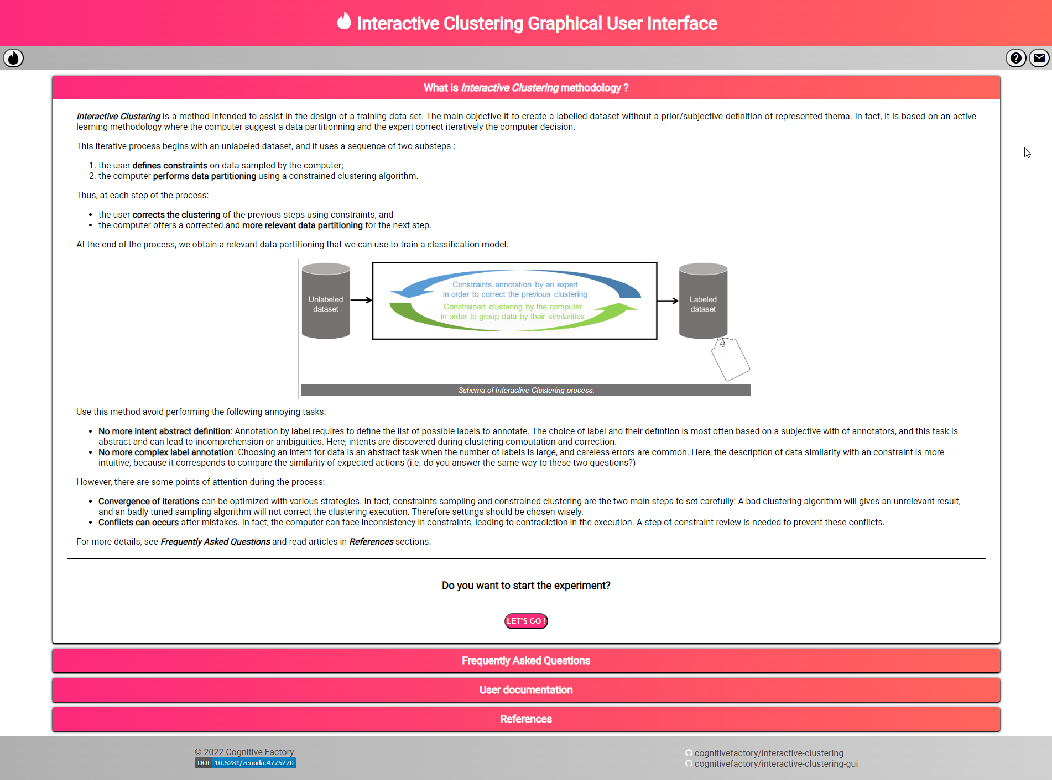
interactive-clustering-gui-welcome-page

Slide 6
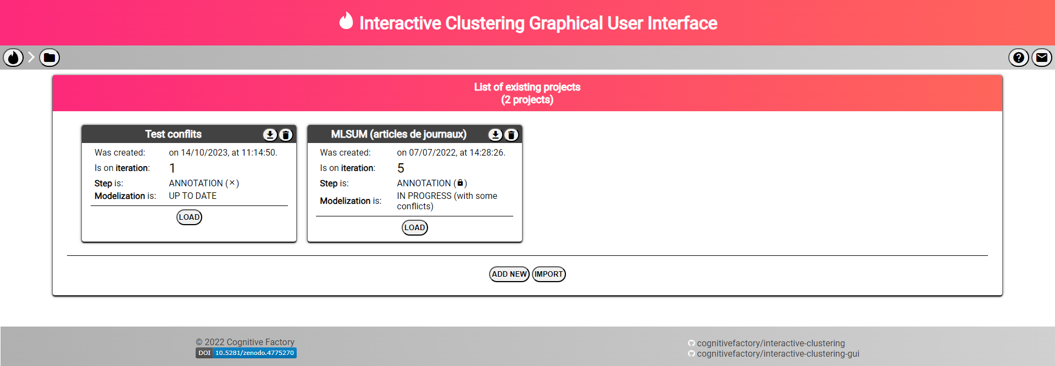
interactive-clustering-gui-projects-list

Slide 7
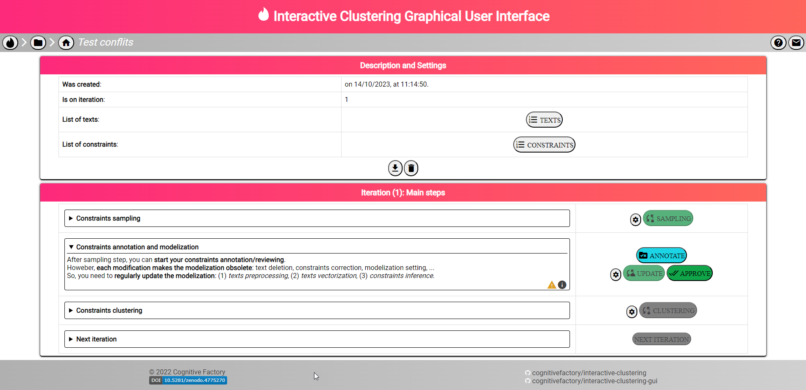
interactive-clustering-gui-project-home

Slide 8
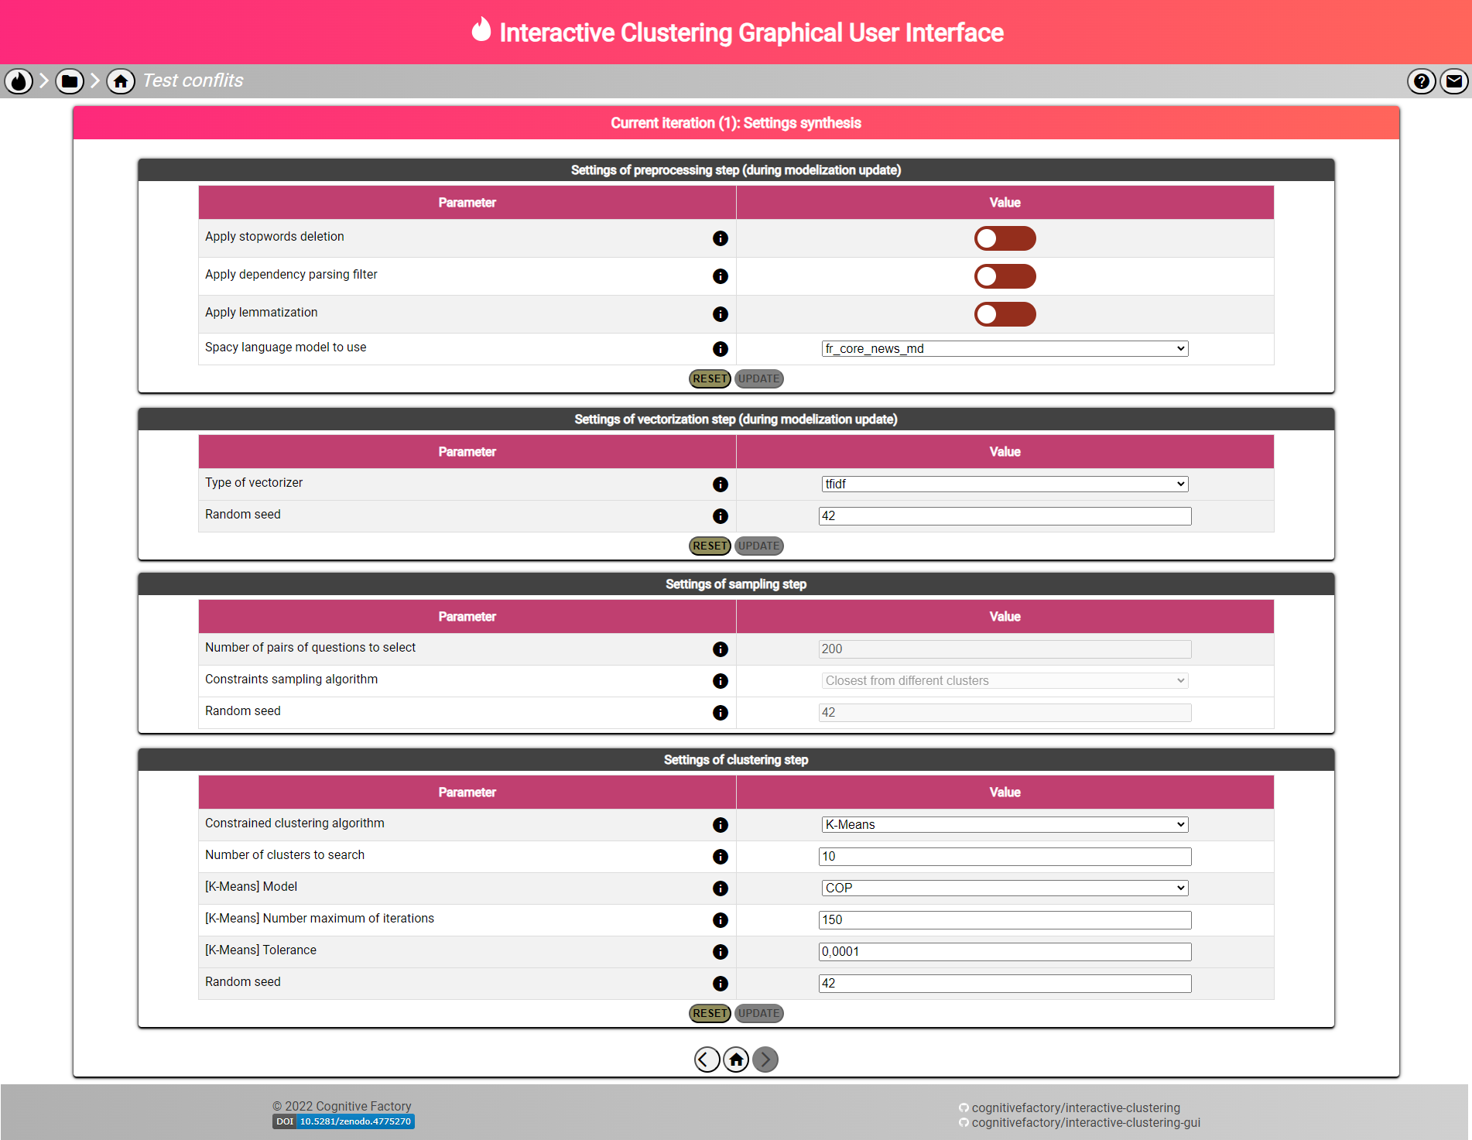
interactive-clustering-gui-settings

Slide 9
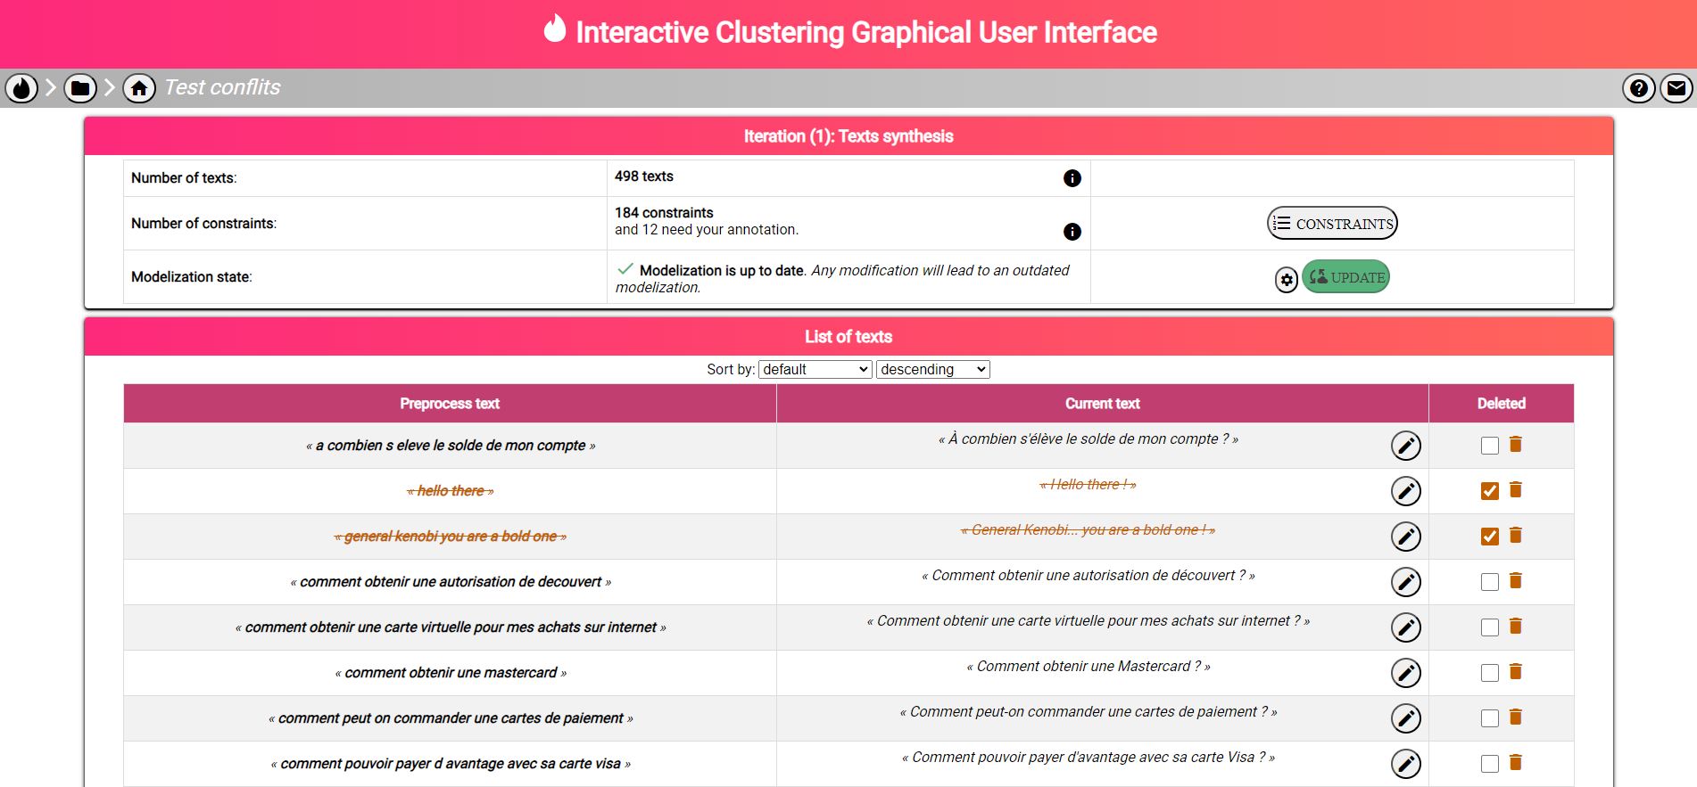
interactive-clustering-gui-texts

Slide 10
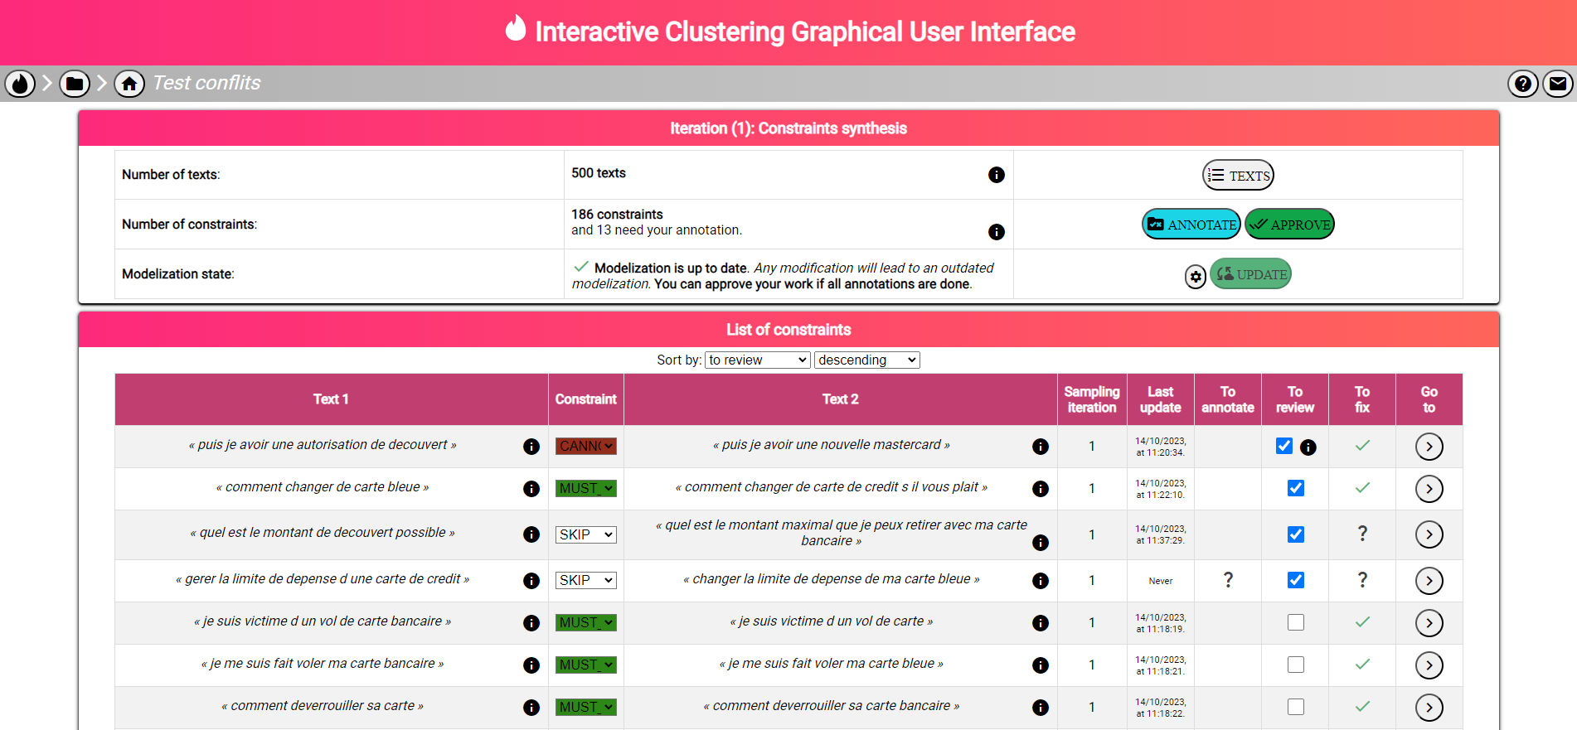
interactive-clustering-gui-contraints

Slide 11
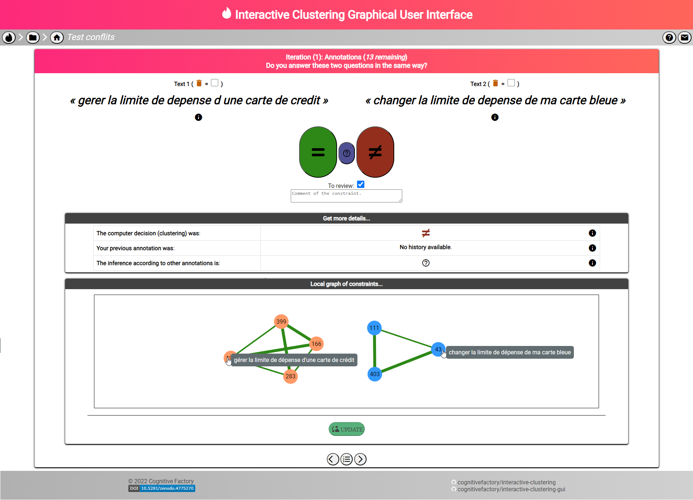
interactive-clustering-gui-annotation

