Slide 1
Interactive Clustering GUI > Figures
Erwan SCHILD

Slide 2
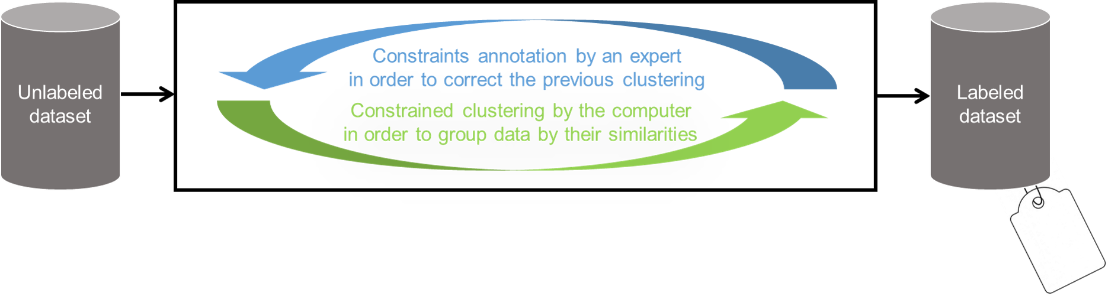
Interactive-clustering

Slide 3
interactive-clustering-example
(1)
(2)
(3)
(4)
(5)
MUST-LINK
CANNOT-LINK
Unlabeled dataset
Unconstrained clustering
Constraints sampling
Constraints annotation
New constrained clustering
Initialization
Iteration 1

Slide 4
interactive-clustering-comparative-study
performance
(vmeasure)
groundtruth
(1b) Efficiency
(optimization)
(1a) Effectiveness
(convergence)
(7,8,9) Robustness
(error simulation)
(5) Relevance
(business value)
(6) Rentability
(benefits vs costs)
iterations
(nb of annotations)
(2,3,4) Cost
(needed time)

Slide 5
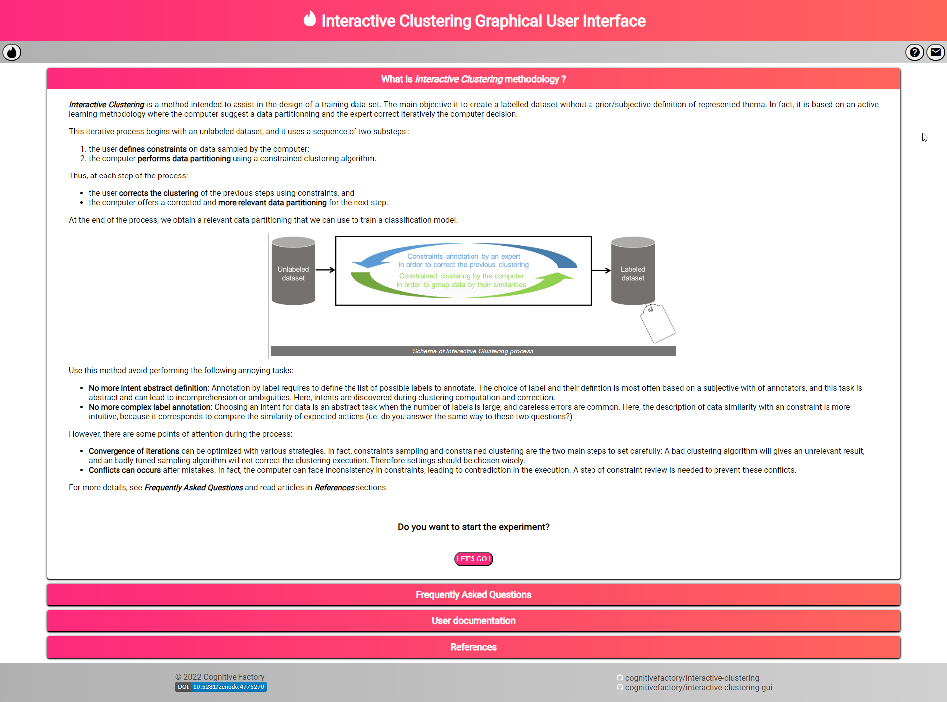
interactive-clustering-gui-welcome-page

