Slide 1
Cognoma Project Launch Party 🎉

Slide 2
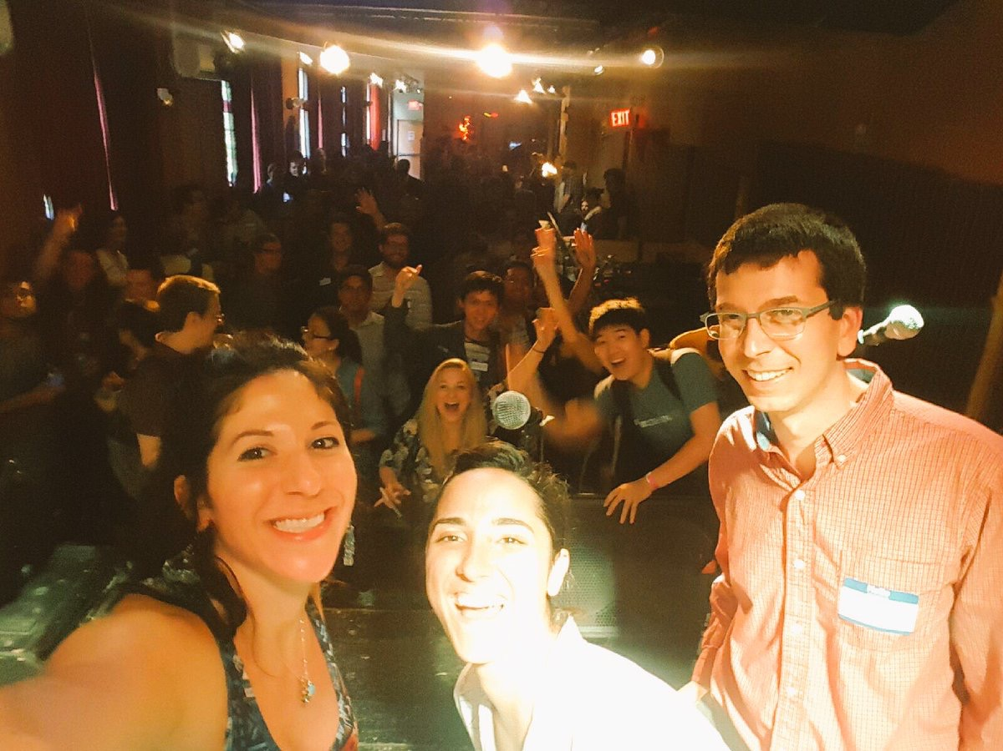

Slide 3
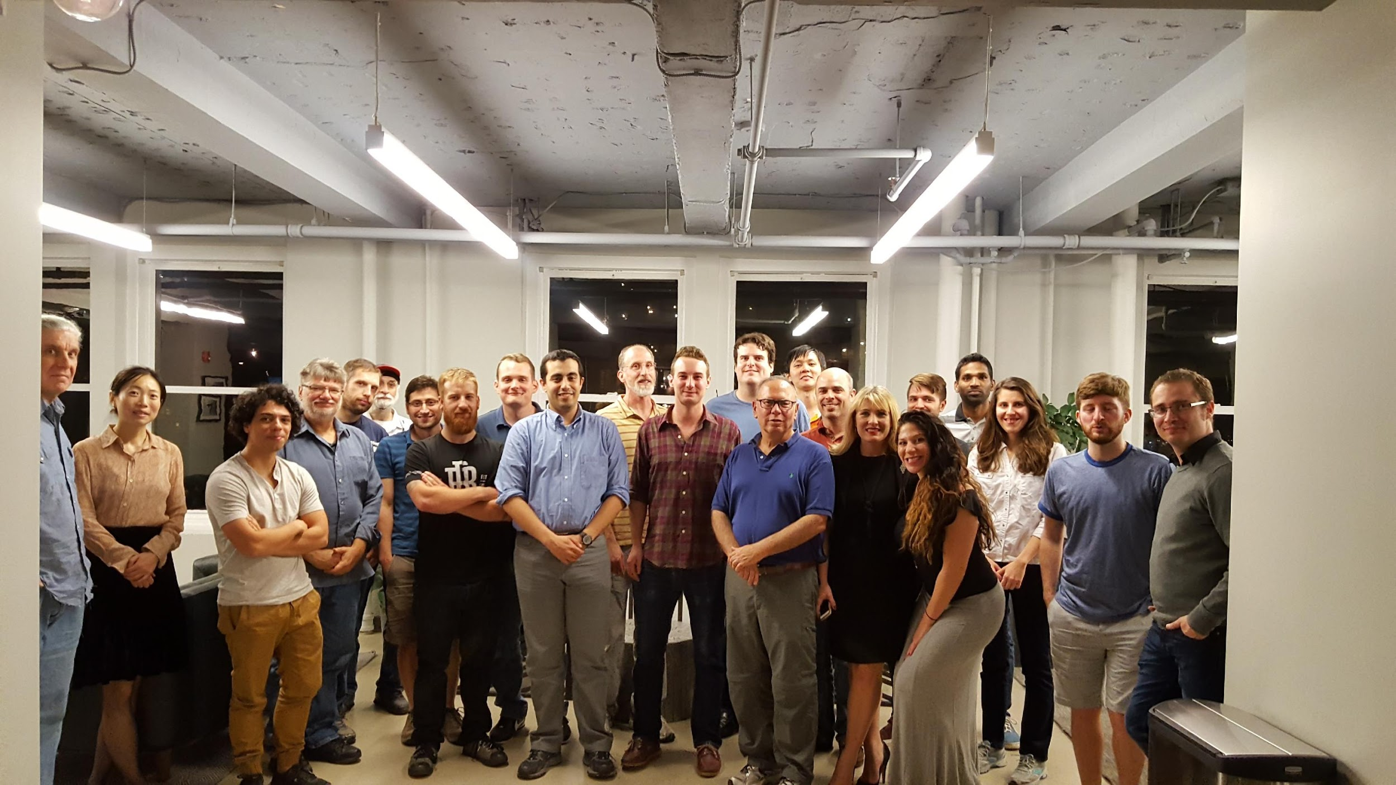

Slide 4
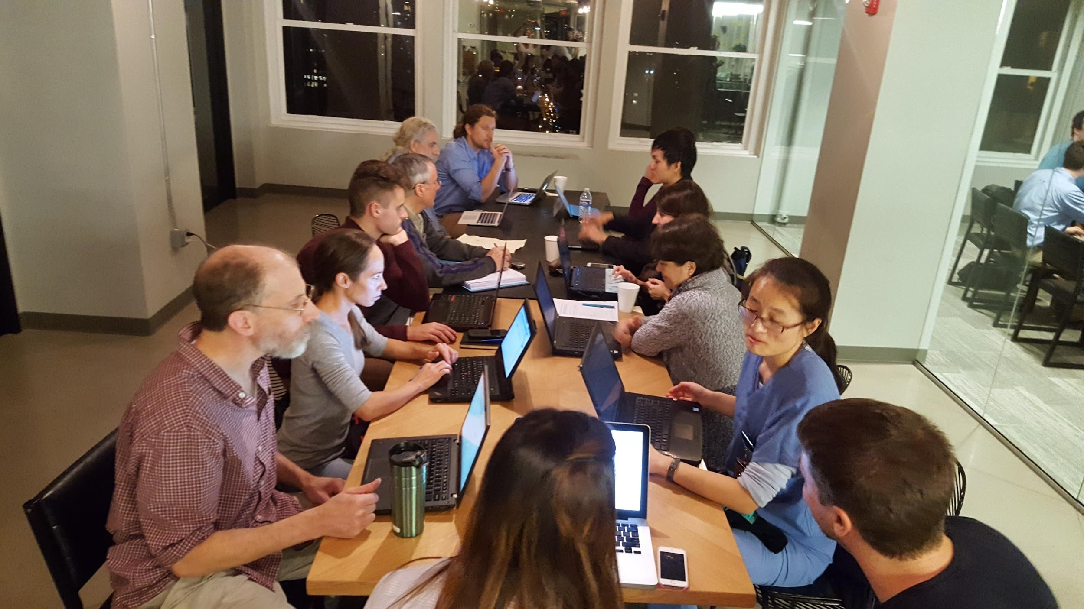

Slide 5
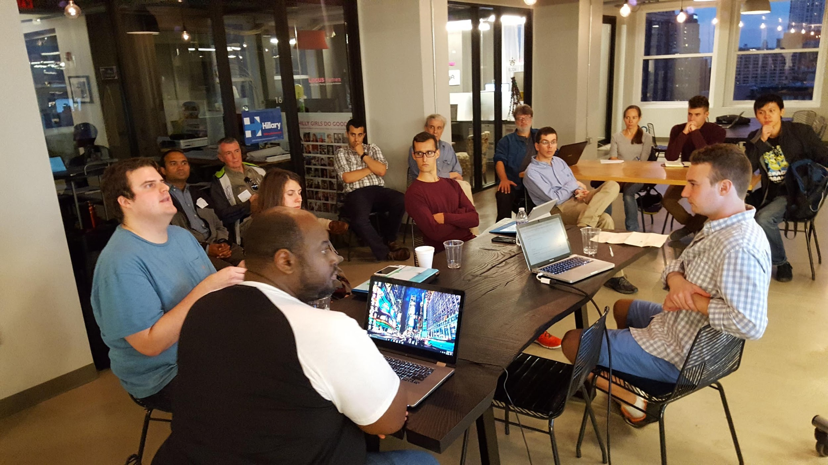

Slide 6
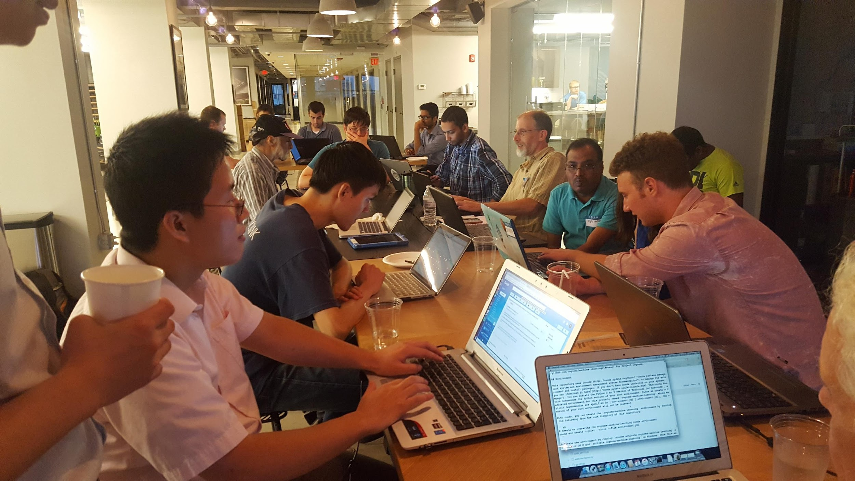

Slide 7
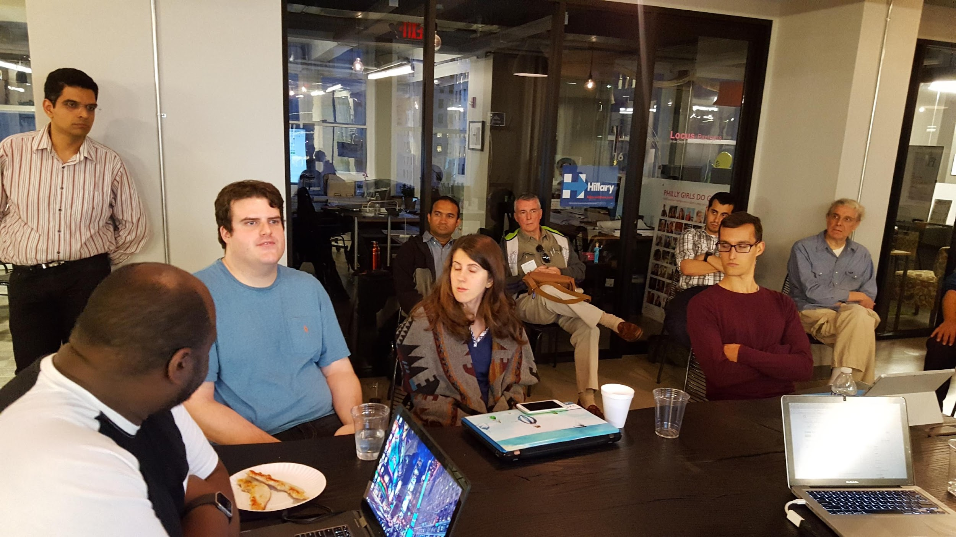

Slide 8
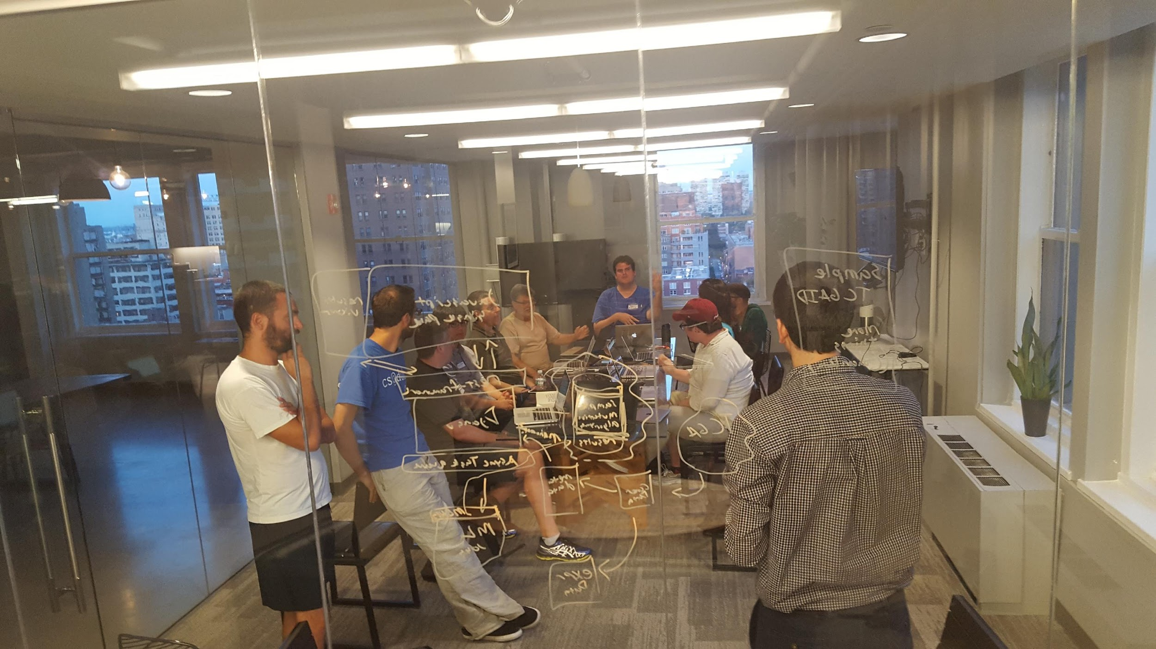

Slide 9
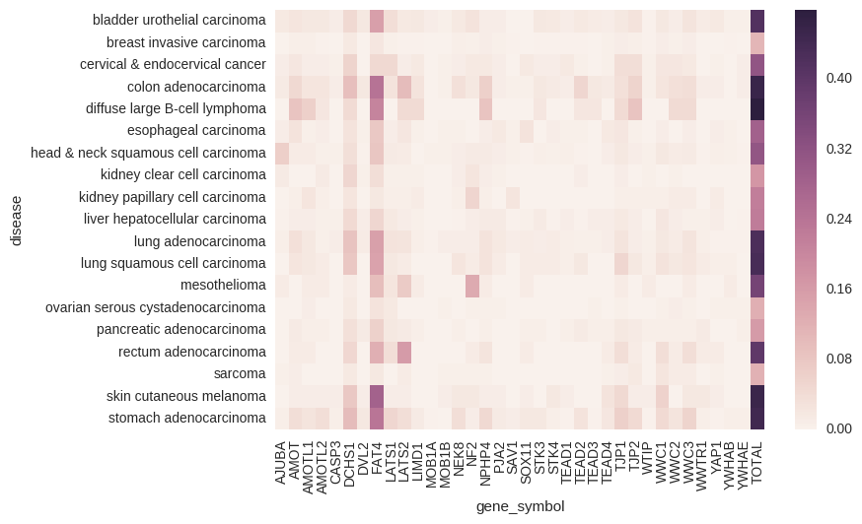

Slide 10
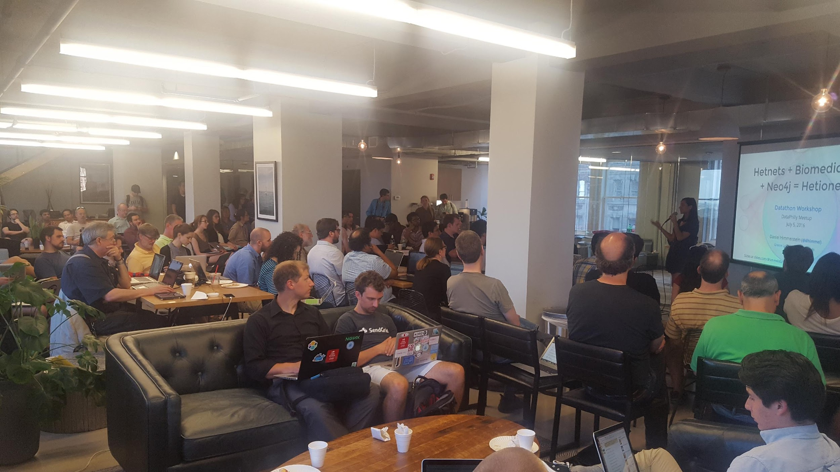

Slide 11
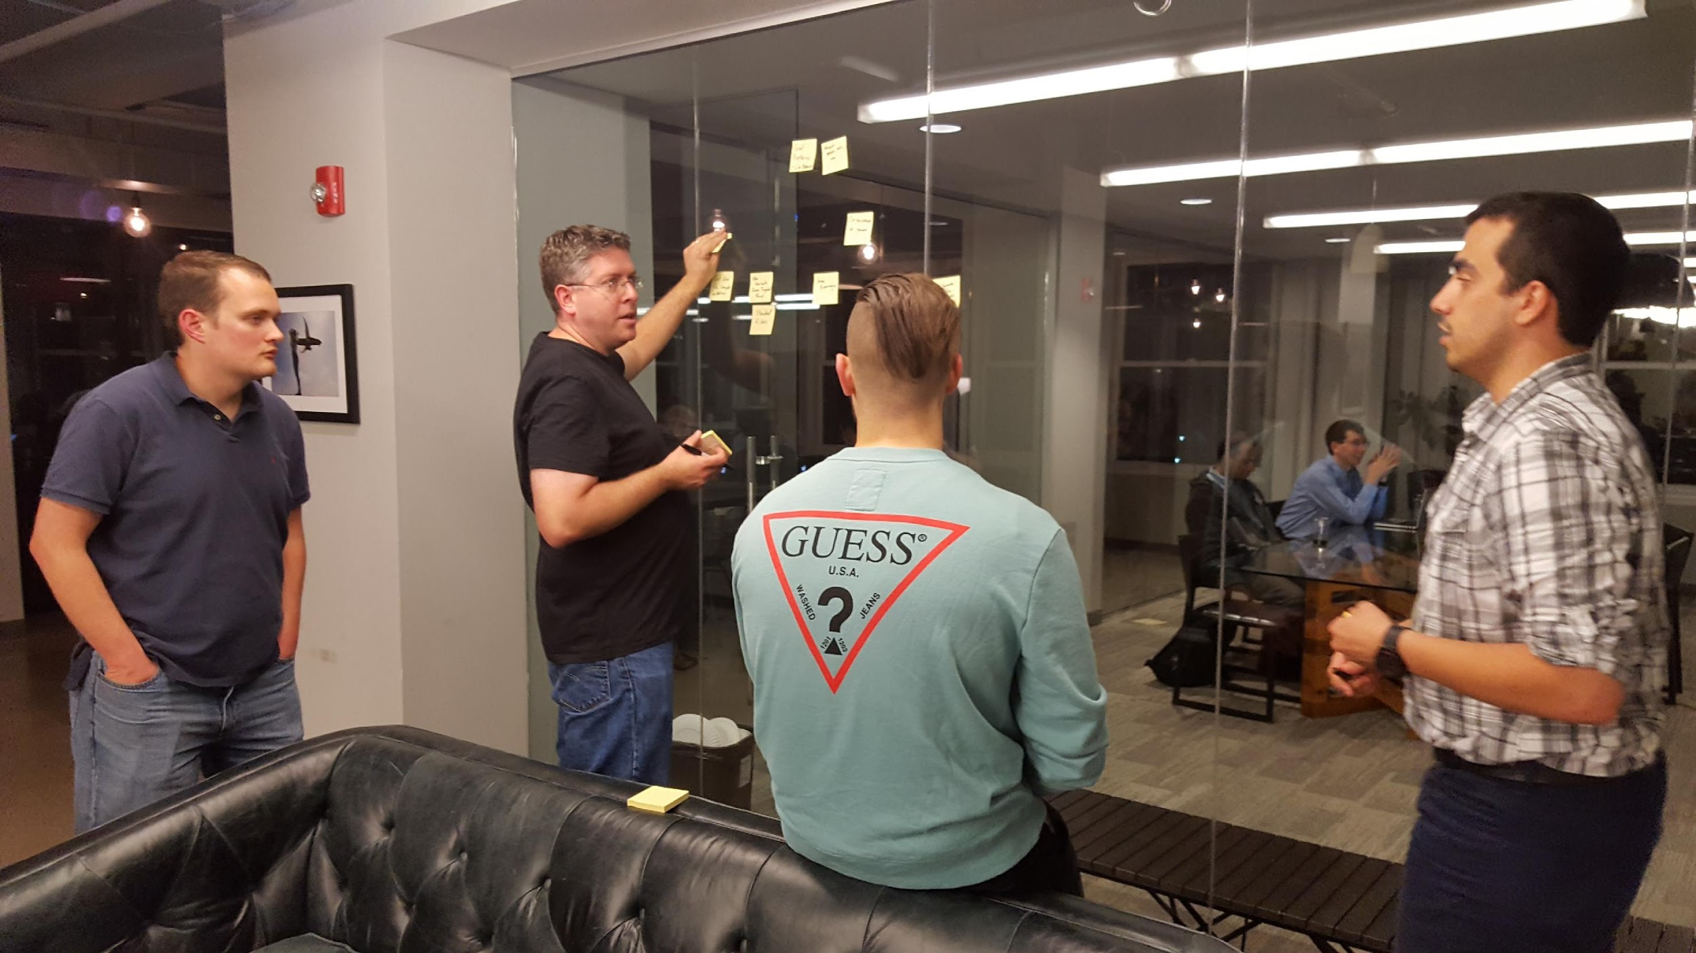

Slide 12
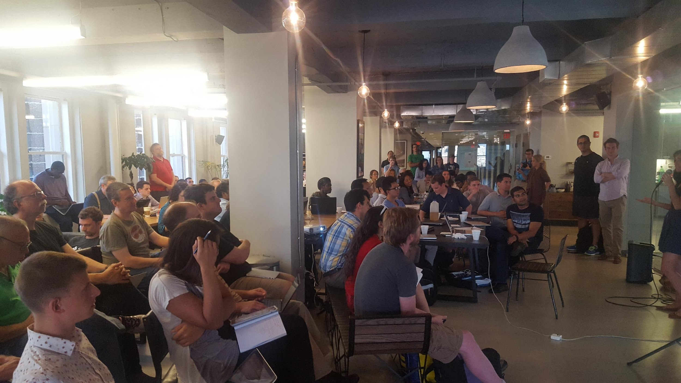

Slide 13
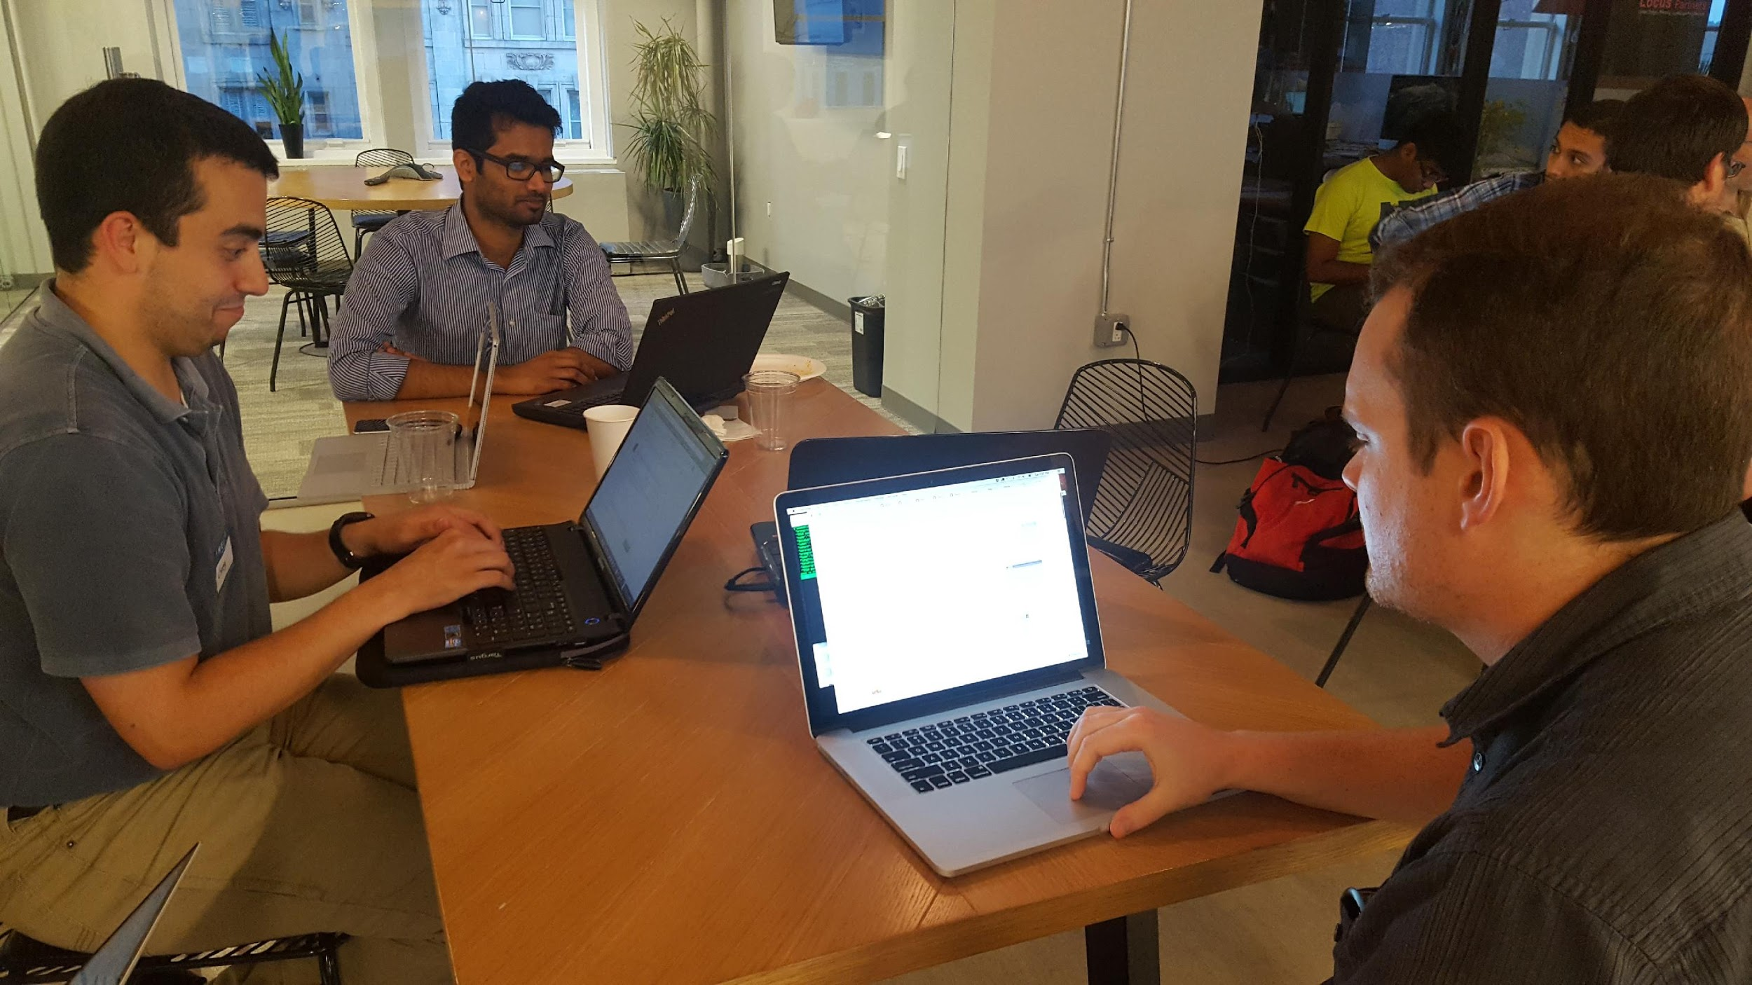

Slide 14
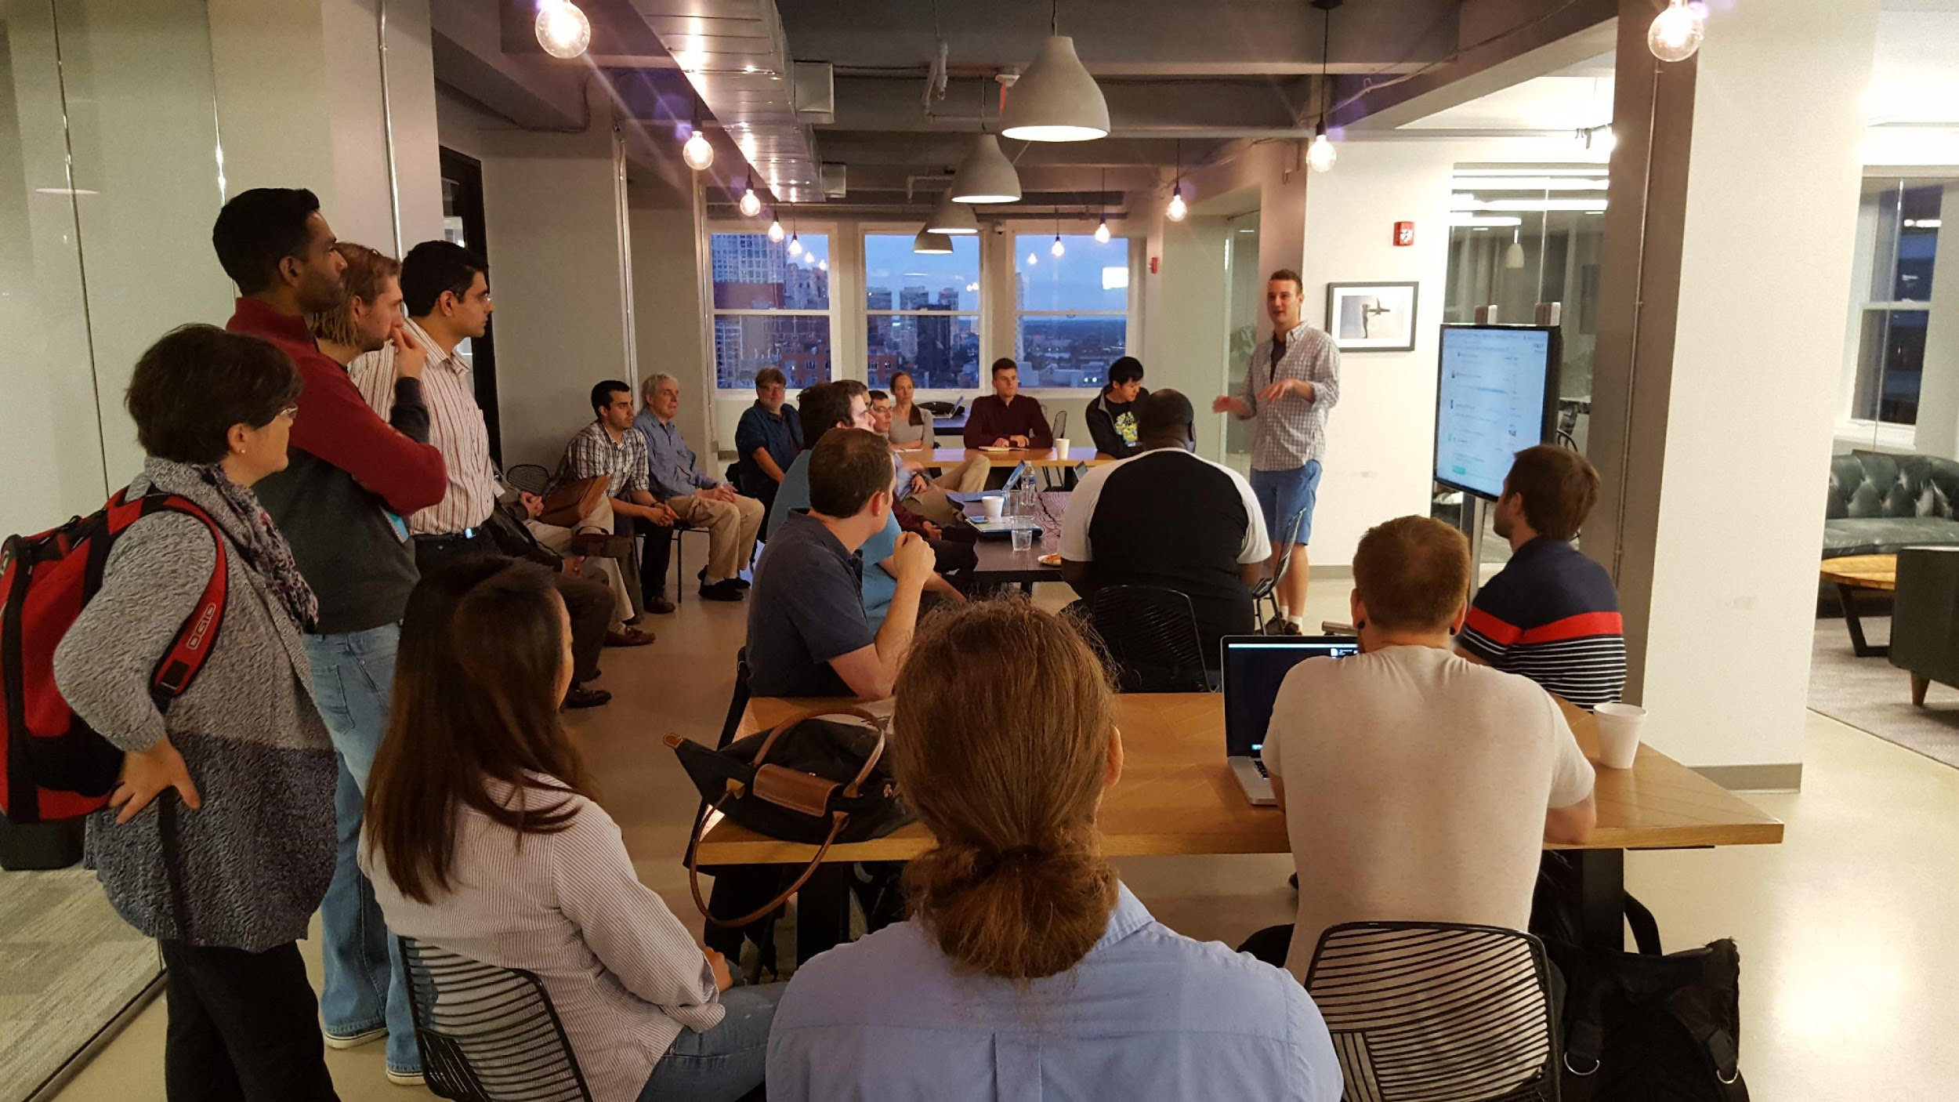

Slide 15
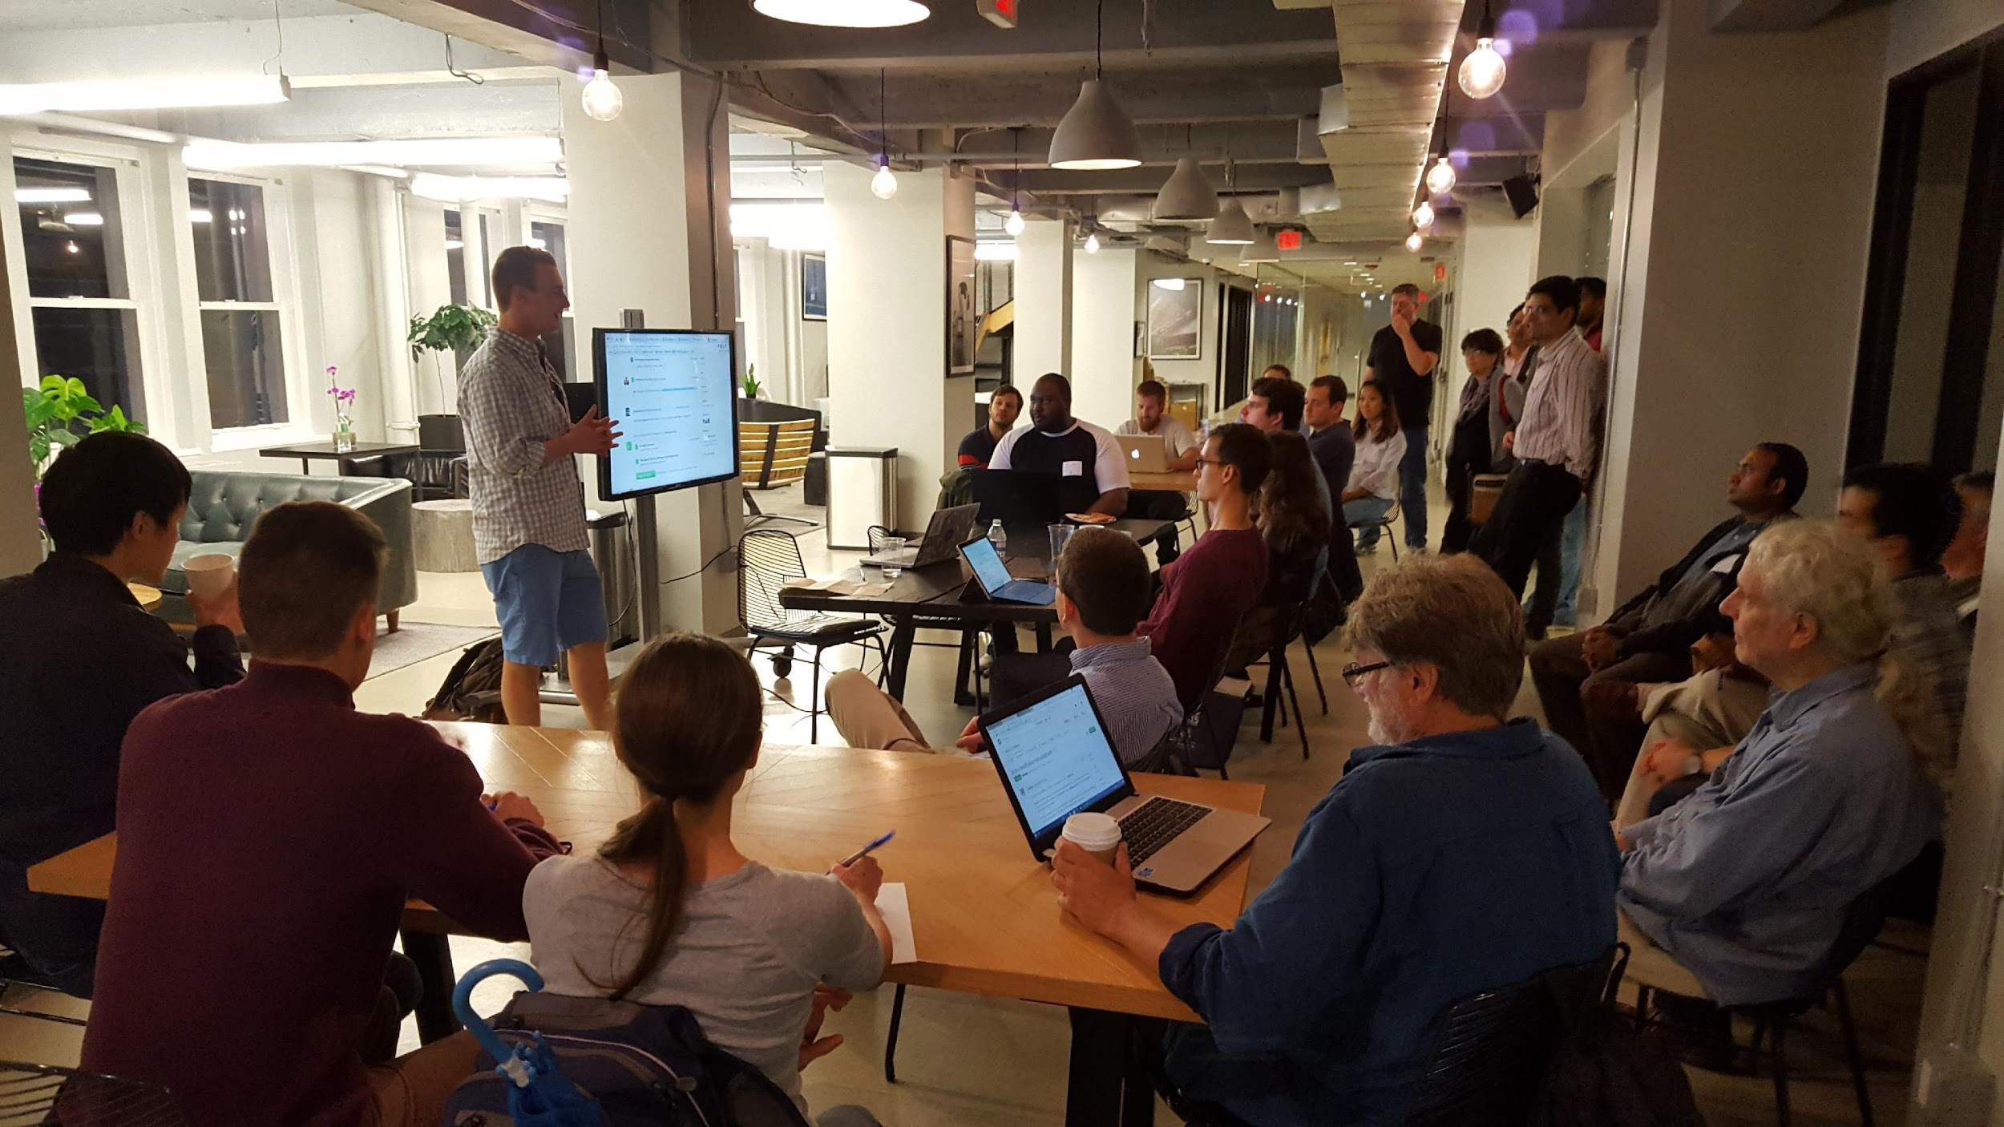

Slide 16
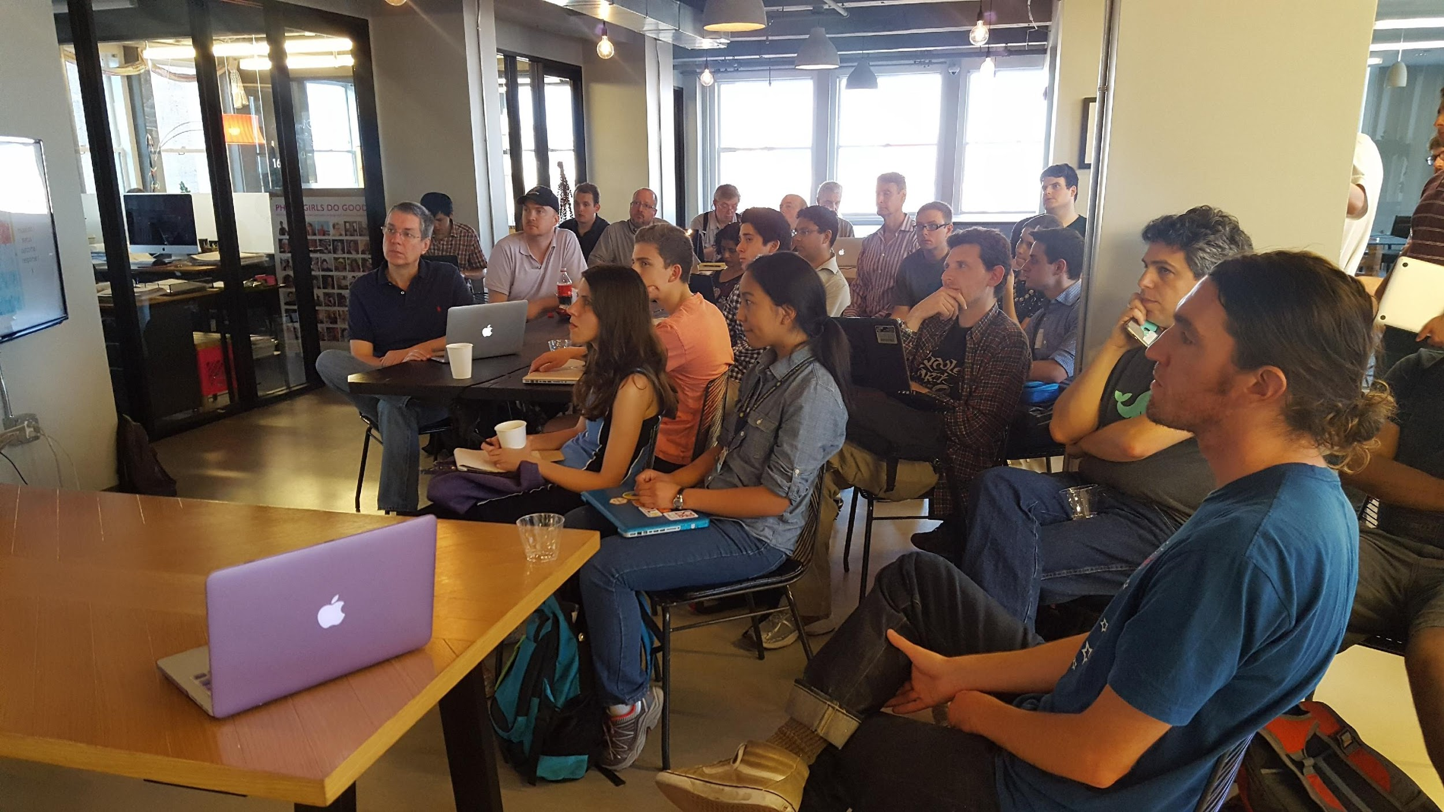

Slide 17
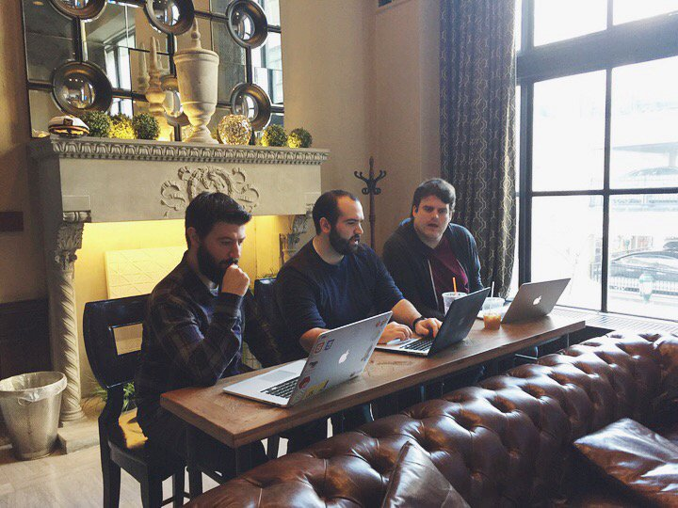

Slide 18
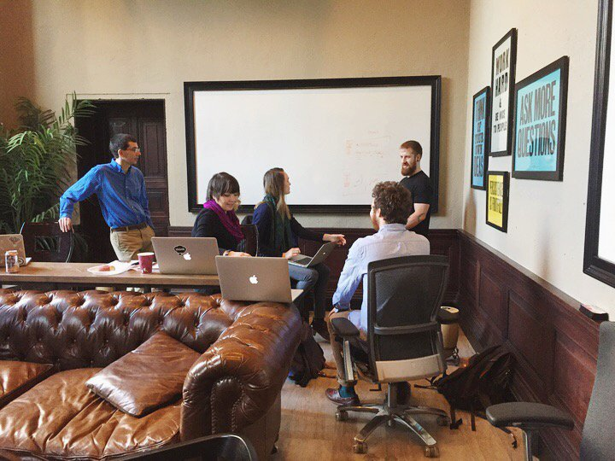

Slide 19
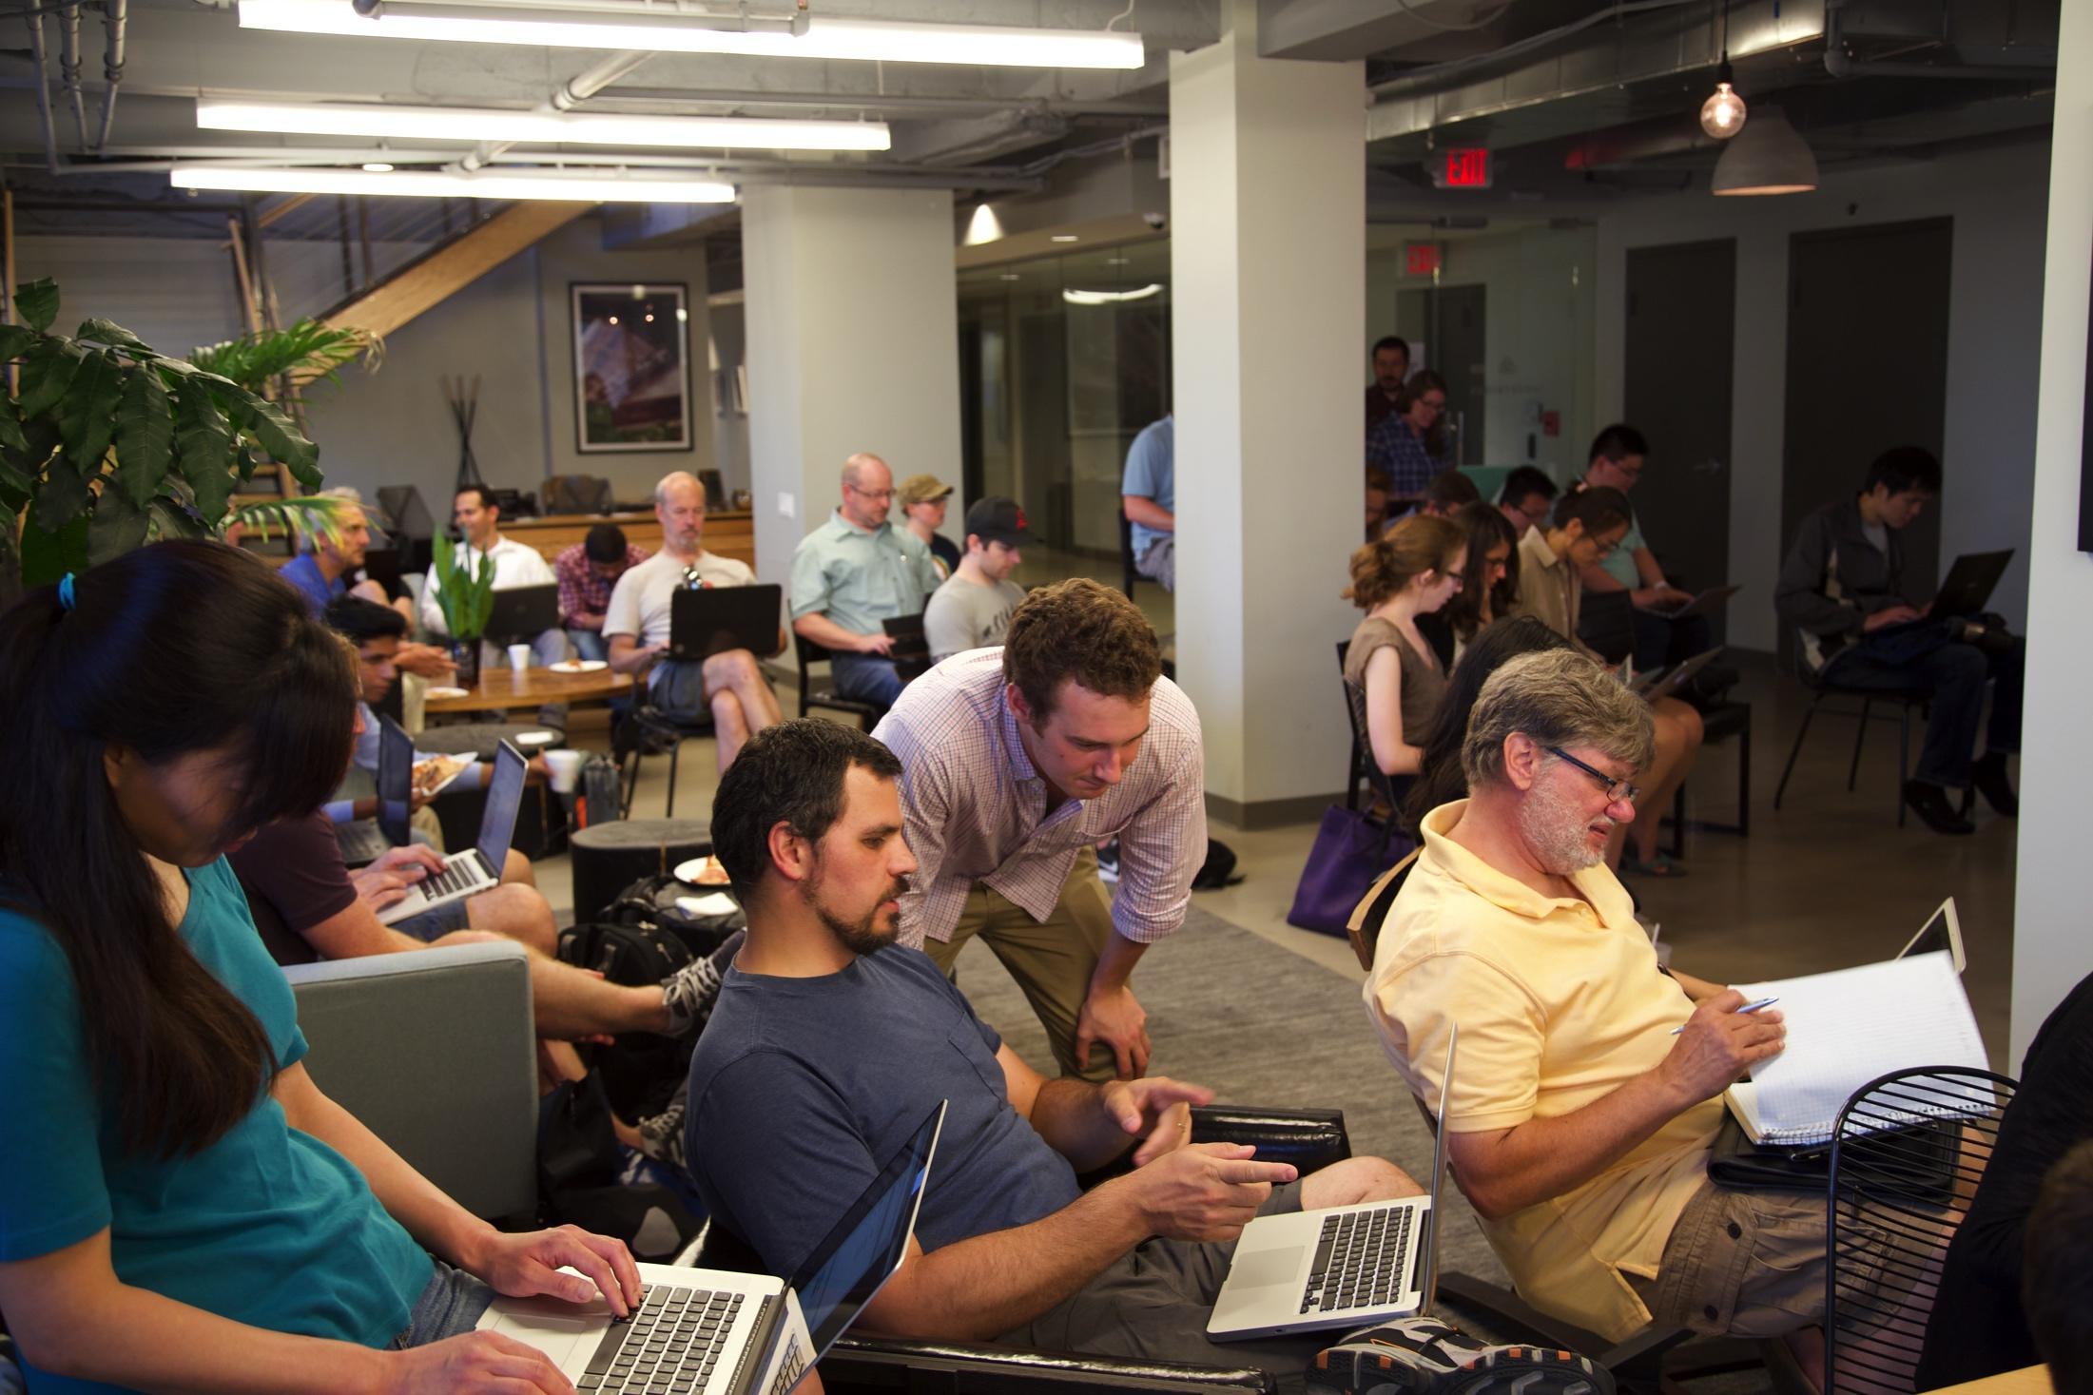

Slide 20
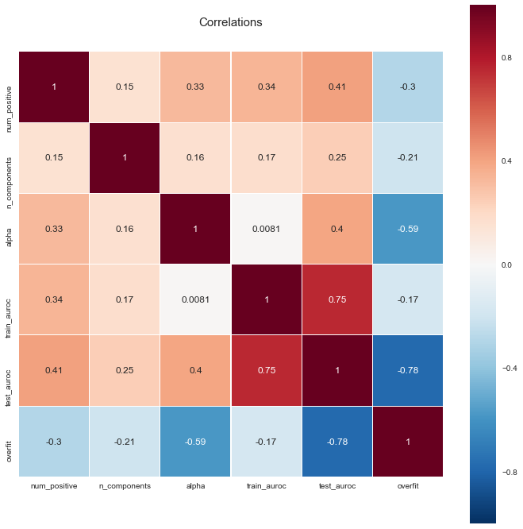

Slide 21
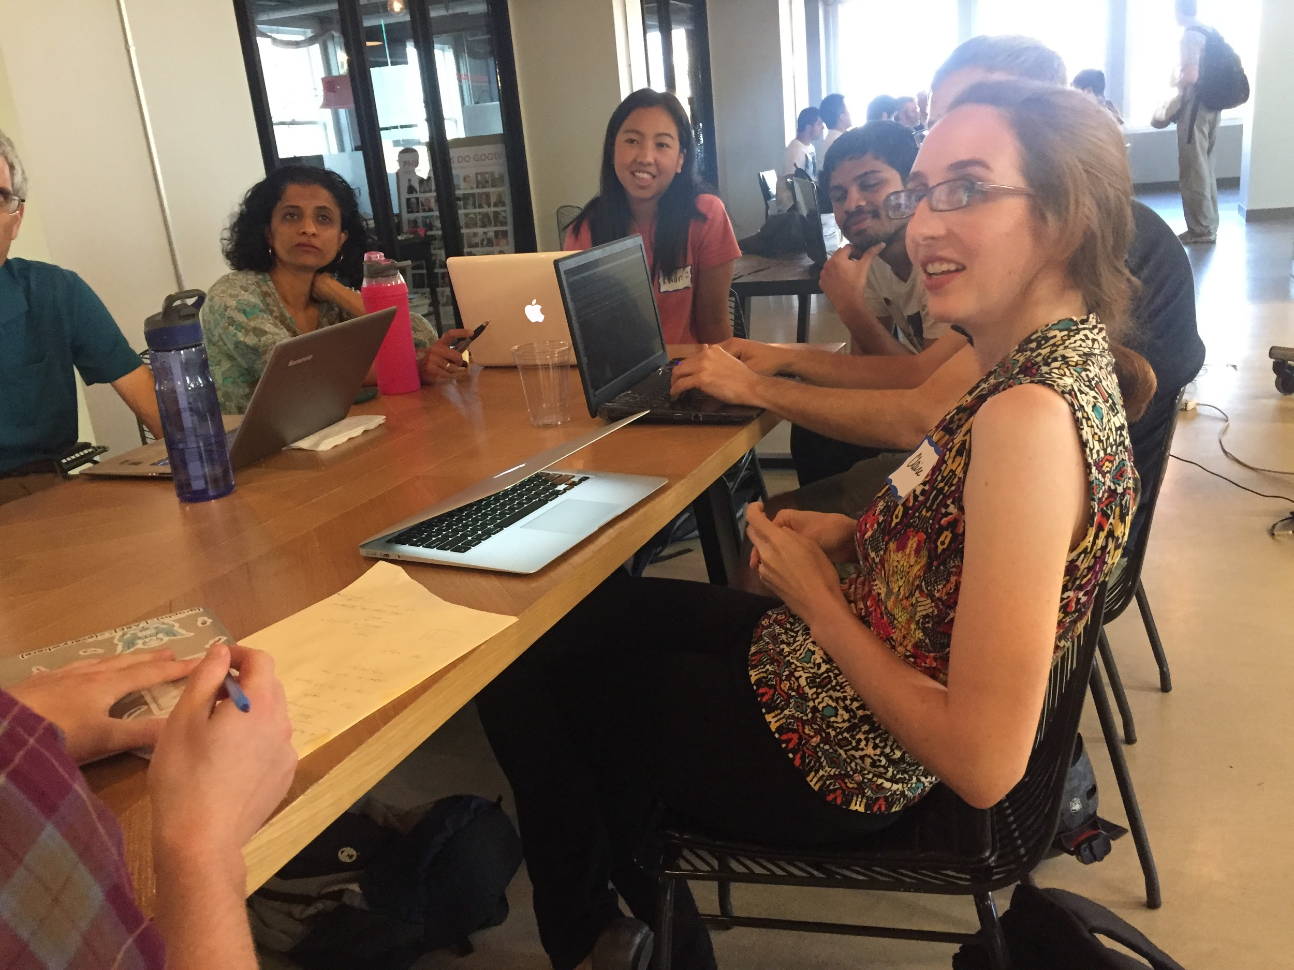

Slide 22
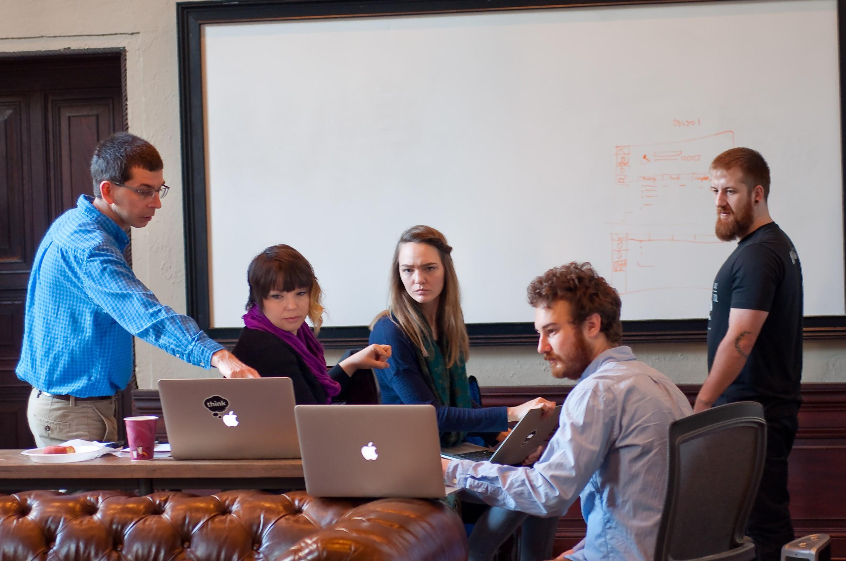

Slide 23
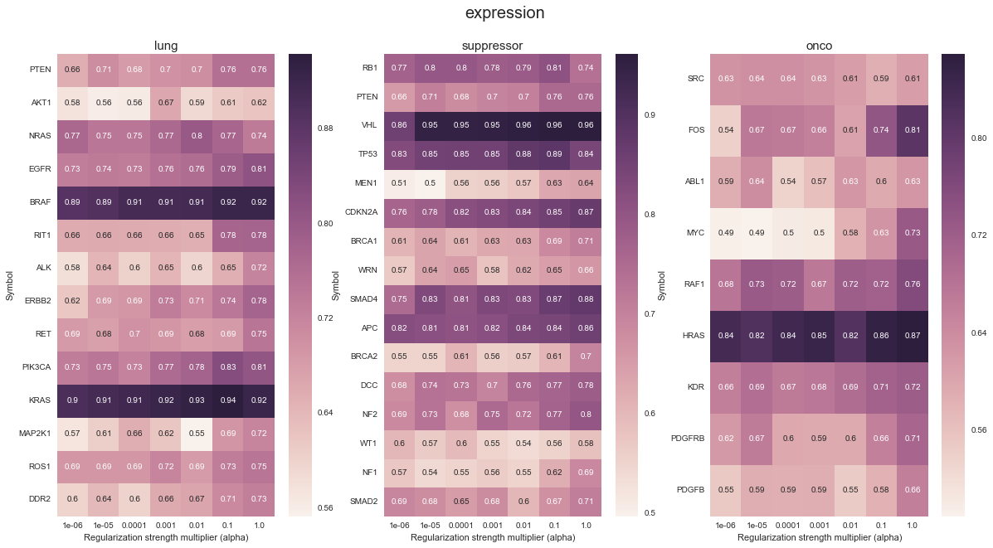

Slide 24
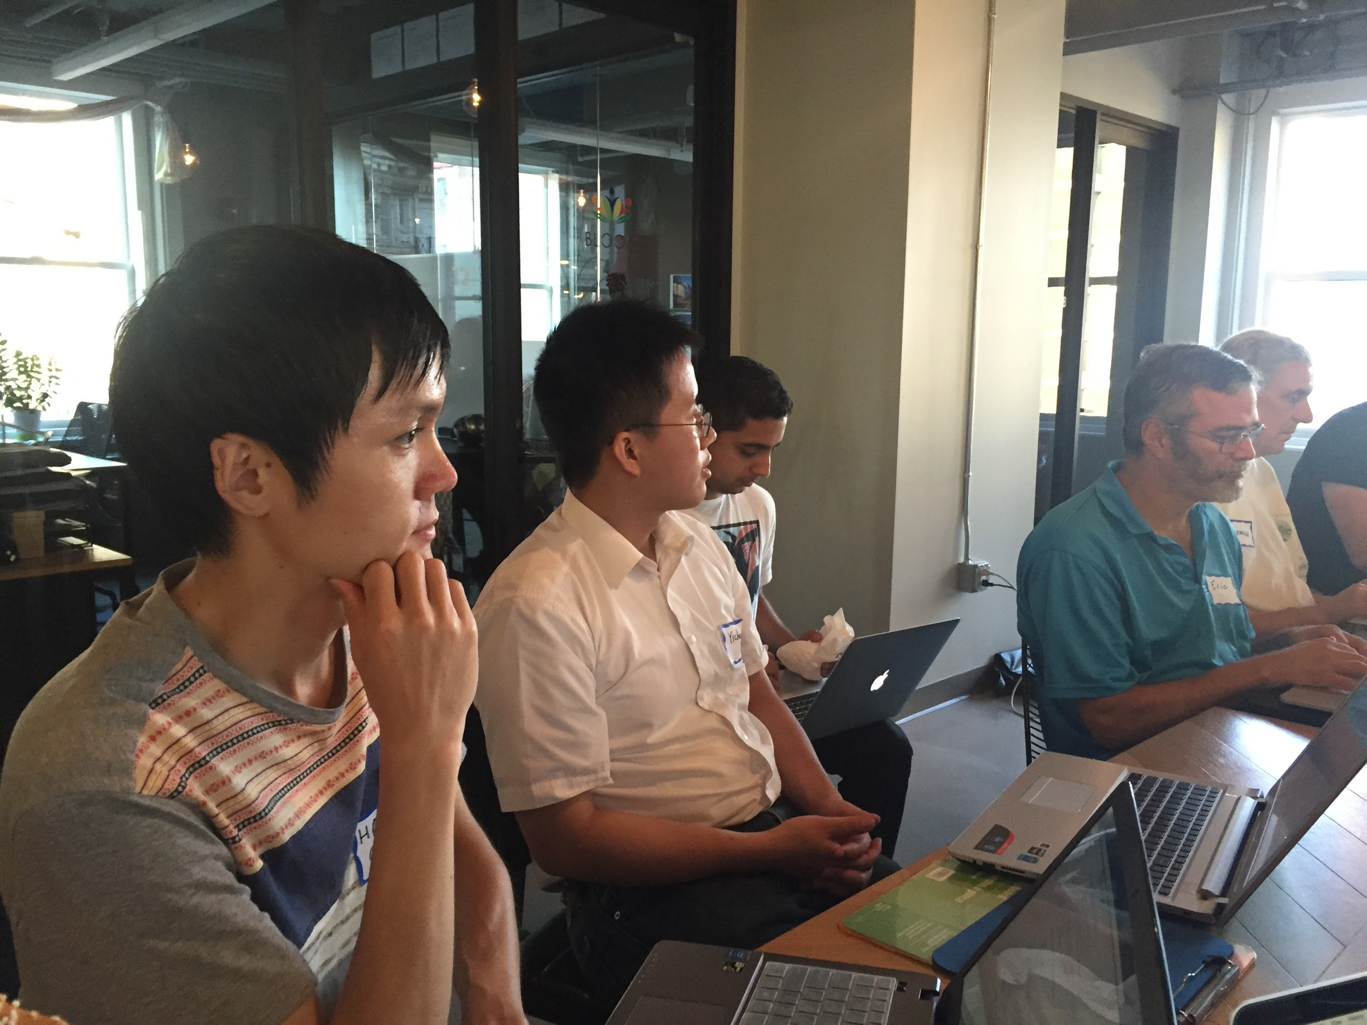

Slide 25
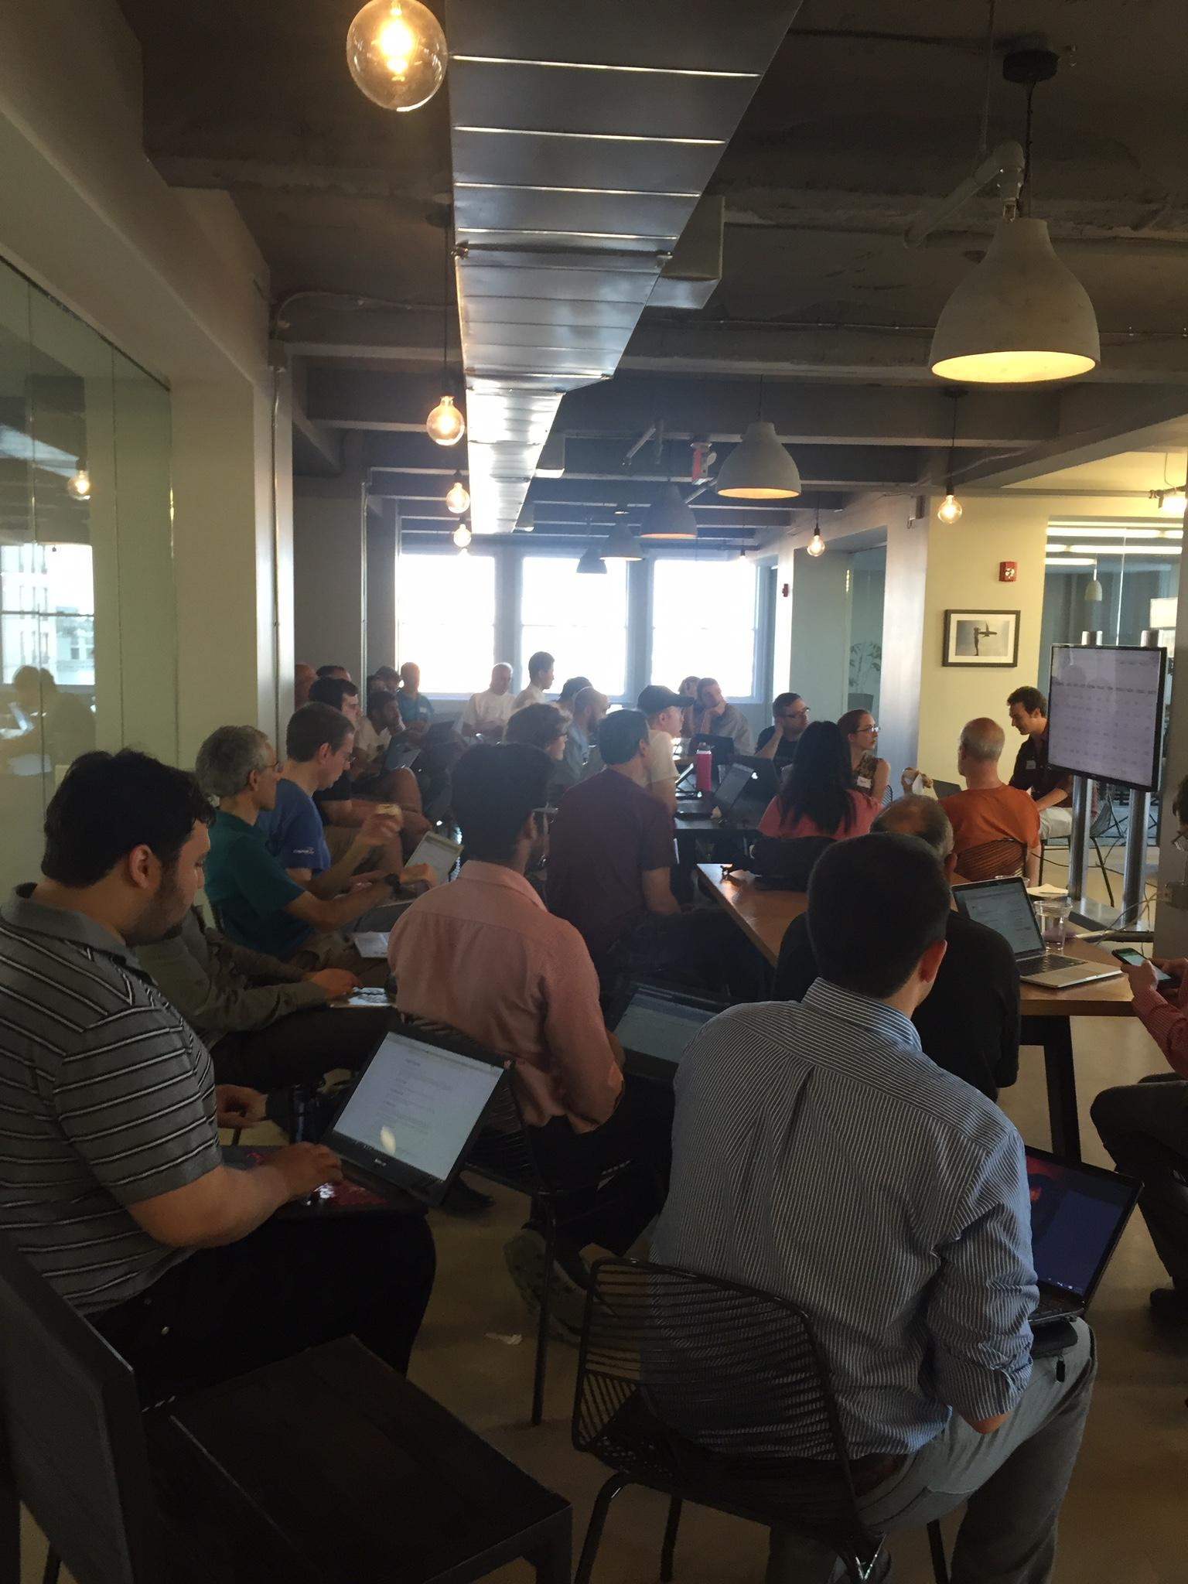
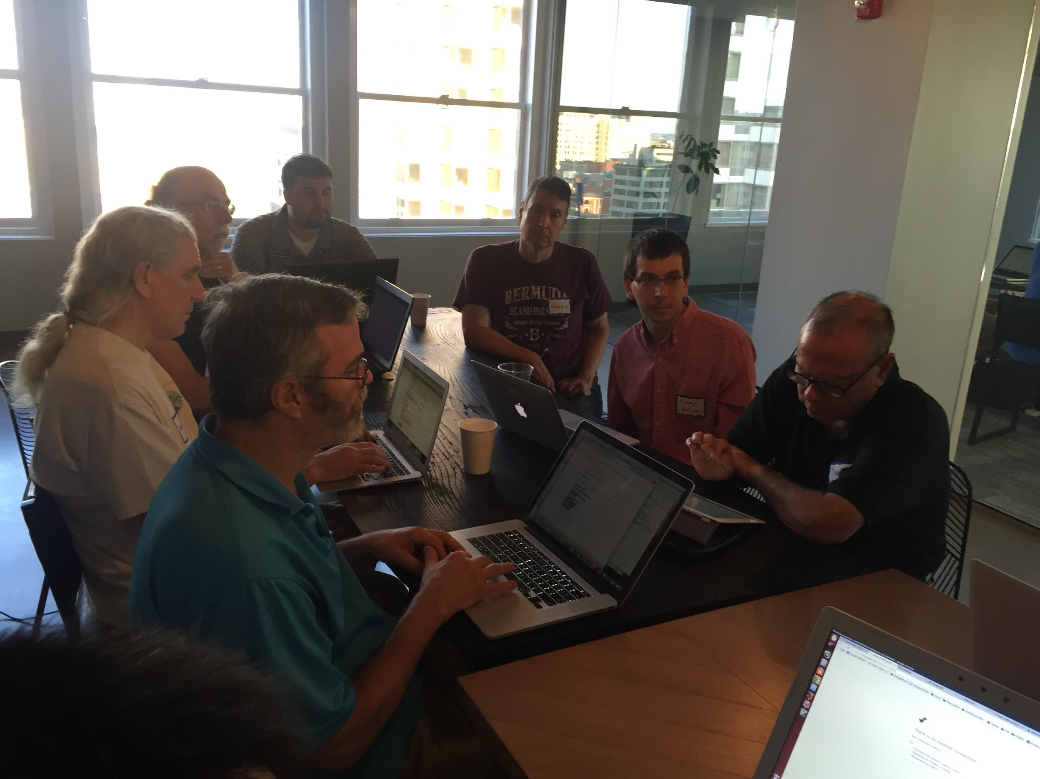

Slide 26
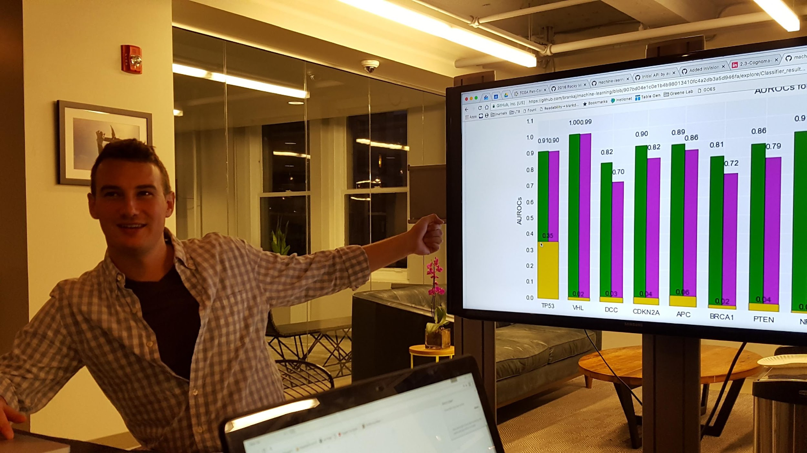

Slide 27
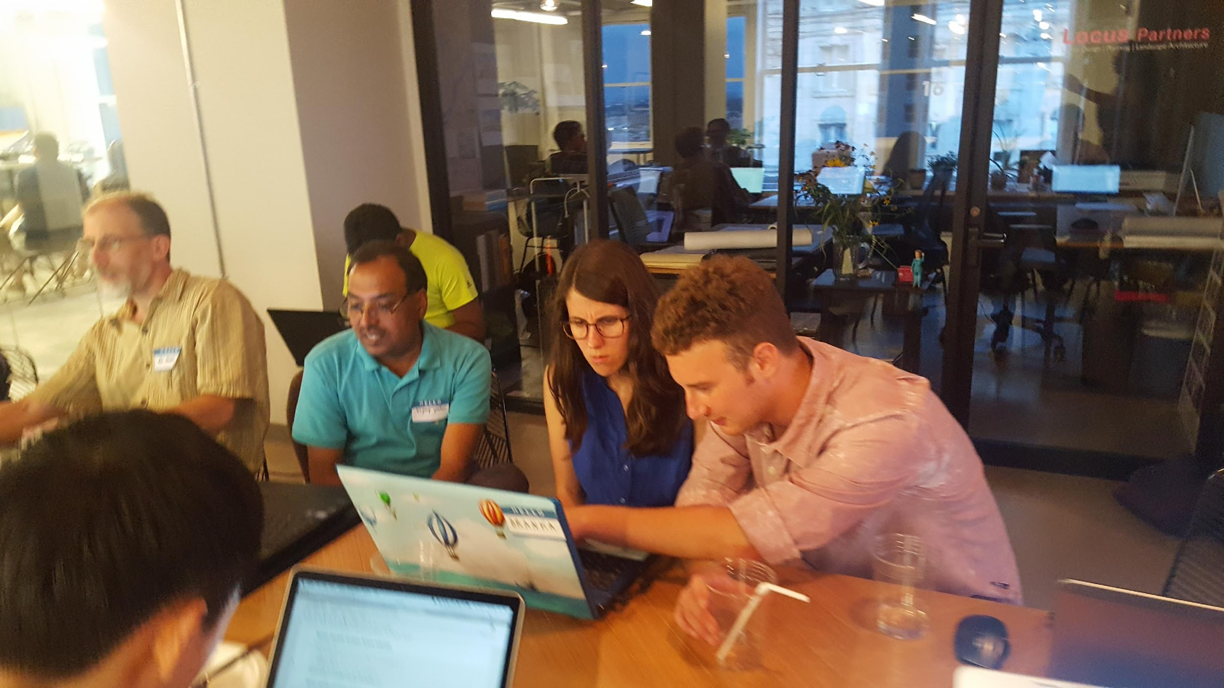

Slide 28
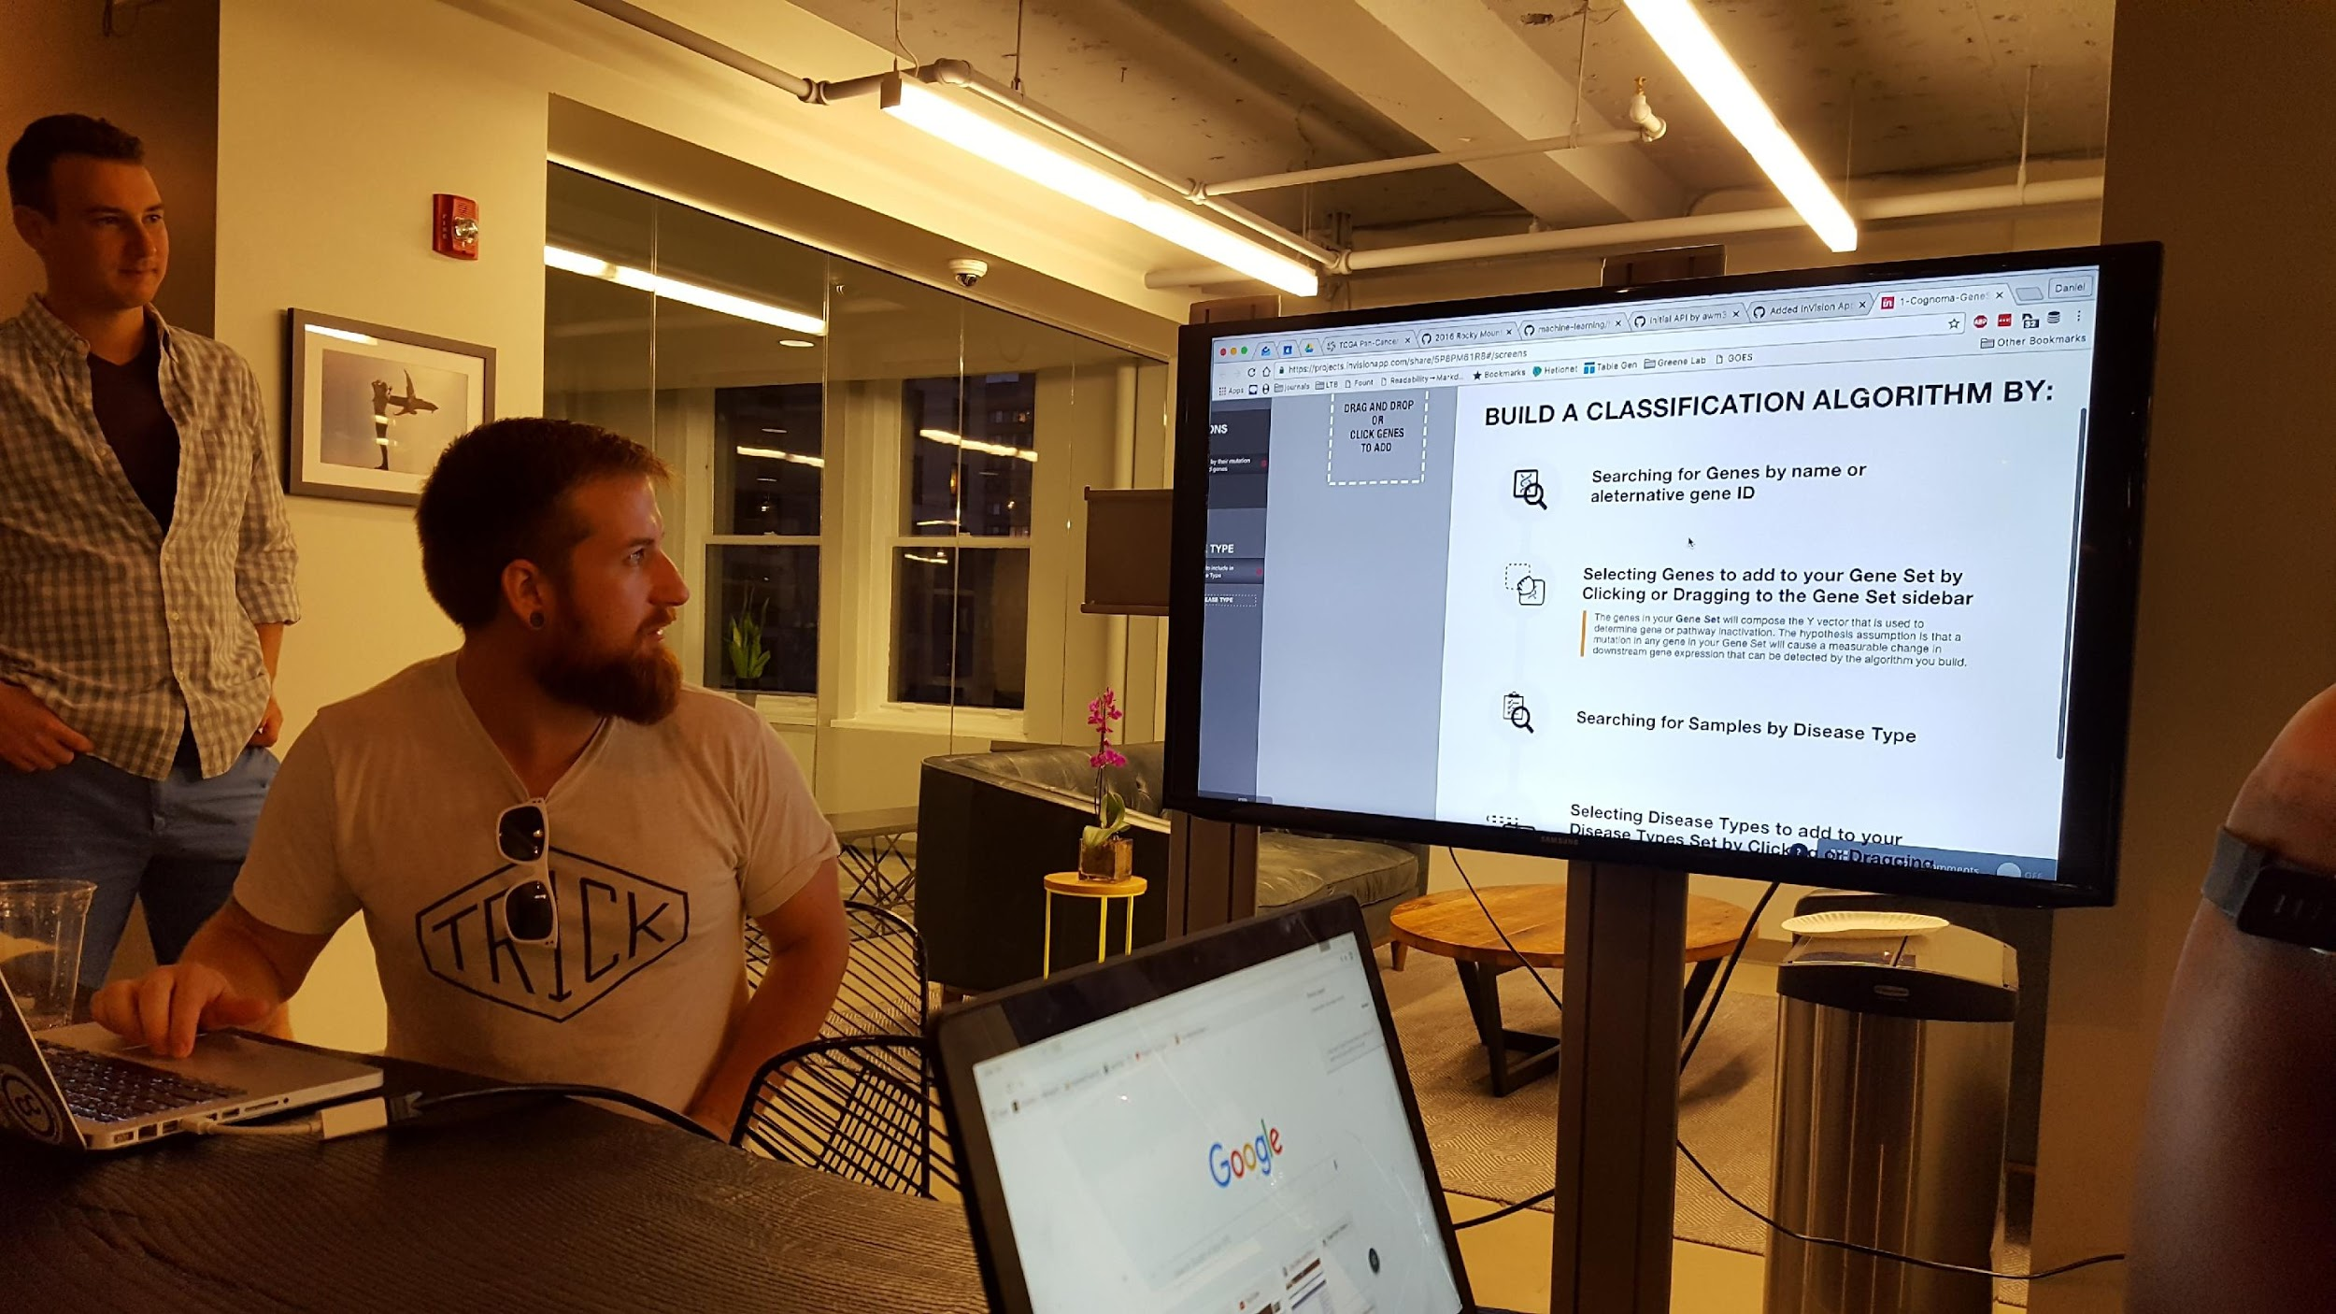

Slide 30
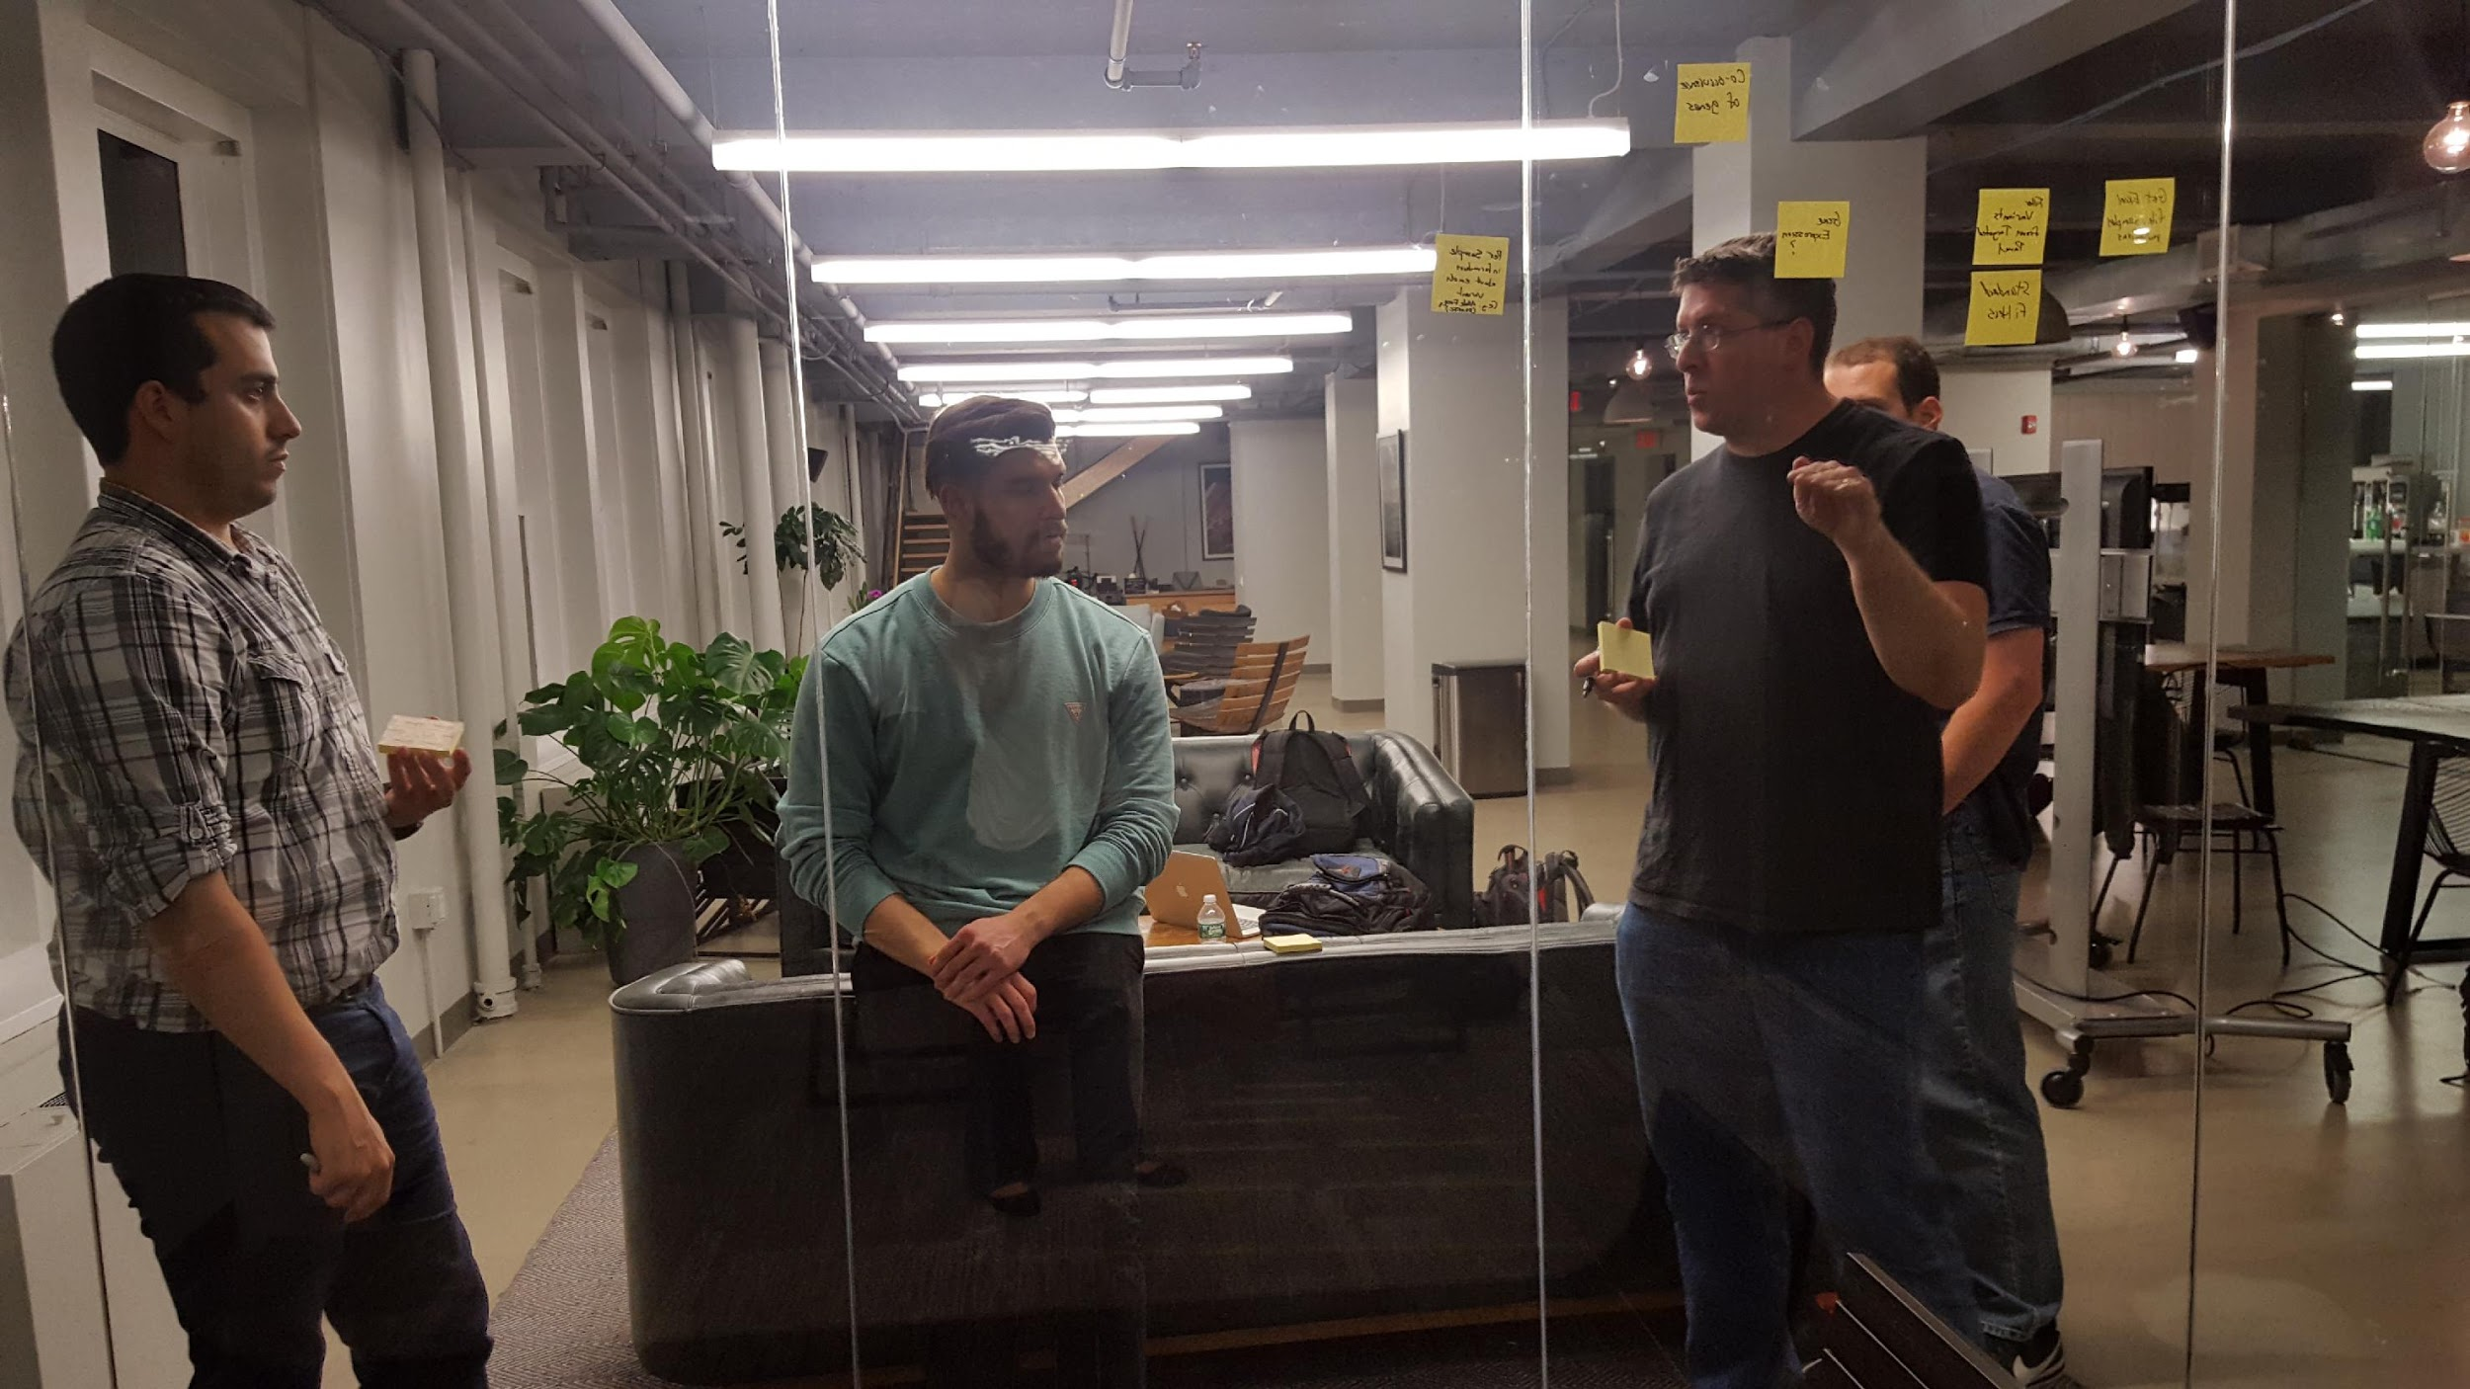

Slide 31
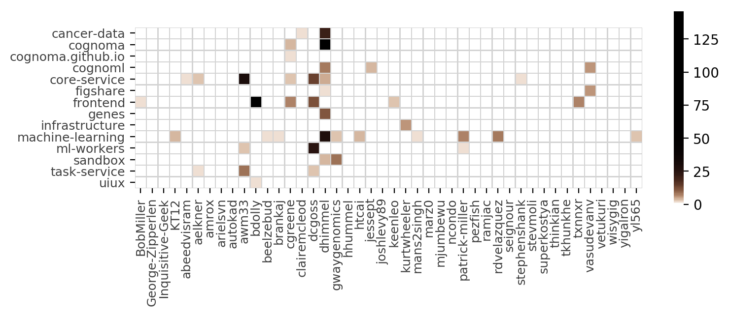
GitHub Contributors

Slide 32
Special thanks to everyone who made this incredible project come to fruition!
Drew Banin
Geeta
James Brown
Rahul Rattan
Gaby OC
Yehia Ahmed
Dan Larson
Jerome R Barnes
Parvez Bahadur
Yoni Nachmany
Jess M
Nathan Goldschmid­t
Jeff Escalante
Sunny Liu
Daniel Himmelstei­n
Tim Wisniewski Casey Greene
Anil Sinha
Vilas
George Zipperlen
Jason McGibbon
Bill Lynch
Kevin Lee
Pimppm
Padma Sridharan
Chirag Dadia
Nooreen
Brandon Harrell
Ed Segall
Natasha Singh
Patrick Miller
Mike Lanza
Gerald Tom
Mahesh Ramkumar
Ryan V.
Paul Freeman
Meysam Golmohamma­di
Ramya
Jenna

Slide 33
Special thanks to everyone who made this incredible project come to fruition!
Rasagna pulapaka
Pallavi
Pavan Vijayapura­m
Gijo
Abhishek Farande
Mike
Ken_T
Alex Newell
Kostyantyn­ Borysenko
Meghana V
Isaac Luxford
Keith Aumiller
Jen Kelly
Gabriel Ansah
Michael
Haibin Shu
Abeed Visram
Michael P.
Parth Shah
Maps Bolt
Tu Tran
Rosemary Christian
Carlton Stith Jr.
Marija Stanojevic
Greg Way
Damond Lowe
Kyle Siegfried
xiubin Zheng
Jay Scott
Jilani
David Frigeri
Rocco Rock
Alan Elkner
Kyle Whittener
Eunice Hameyie-Sa­non
Khai Tran
Victoria
Manish
Ke Ye

Slide 34
Special thanks to everyone who made this incredible project come to fruition!
Robin
Dan Atkins
Corey Chivers
J. Matthew Cahill
Blake Justice
Volha Samusik
Vasu Venkateshw­aran
Ghafar Shah
Tony Chang
Terrence Madlinger
Carl
Arush Saxena
Chris Maenner
Jatin Patel
Darshan
Amber Wanner
Pavel Belov
Fred Behnke
Sree Boyapati
Walt Mankowski
João Júnior
Andrew Heim
Ariel Rodriguez
Laxma
BESegal
Anupinder Rai
Arita Joan
Andy
Jordan Silberman
Diane
Lovepreet Singh
Staccee Ramey
East Coast
Stephen Shank
Chuck
Mohamed
Edward Bukstel
Daniel File
John Hayran

Slide 35
Special thanks to everyone who made this incredible project come to fruition!
Sam Ackerman
Jizhou Jijo
Bhavani
Siddharth Bhattachar­ya
Donald William Cheng
Ke Qiang Ye
dinesh kumar
Thomas Marshall
Nicholas Steele
Rohith
Juanca Briceño
Max Reznichenk­o
Paul Seignourel
Lynn Peng
Robert Tokarchyk
Vivek A Singh
Nadine Manjaro
Danny Harvith
Bob Miller
Pete Abraldes
Leanna
Suruchi Fialoke
Peter Korman
Tracey Scanlon
Andrew Madonna
Tom
Roi
Lawrence Powell
Jeremy Leipzig
Josh Levy
Jim Forsythe
Branka Jokanovic
Karin Wolok­
Lori Smith
Szu Tien Lin
Basanta Kharel
Jesse Prestwood-­Taylor
Rachelle Faroul
Nabeel Sarwar

Slide 36
Special thanks to everyone who made this incredible project come to fruition!
JZ
Ben Dolly
Dimos Anagnostop­oulos
Vibhor Nigam
Firat Akincilar
Cameron Fen
Lev Kavinsky
Fran Rabuck
Jason Walsh
Arlene
Vijay
Peter K
Kam
Anita R
Dora Heng
Eileen Gadsden
Amarildo Zeneli
Freddy
Kevin Chen
Ryan
Dexter Cooke
Kyle K
Sirish
Akim
Levani Zandarashv­ili
Stephen Woloszynek
Hoofar Pourzand
Natasha Singh
Douglas Makey Mendez Molero
Andy Mroczkowsk­i
Haitao Cai
Vinay Raj
Jerry
Dana
Jianyong
Sundaram
Soheil Mohajerjas­bi
Shiyao Yuan
Eric Ross

Slide 37
Special thanks to everyone who made this incredible project come to fruition!
Ceci Zhao
Jaydeep Bardhan
Michelle
Deanne
Utpal
Krishna Chaitanya
Jorge Guerra
Rodrigo Saavedra
Marcel Kooi
Brian Weiss
Kediel Morales
Evan
Weerawat Cherdshuskulchai
Michelle Chen
Tanner Wells
Niranjan Reddy
Nick Weber
Vinay Raj Agathamudi­
Abraham Walters
Wing Mai
Erik Sjoeland
David Steinmetz
Phanivikra­nth Kaja
Stephen
Vikram Anand
Parvez Bahadur
Erin Hopper
Kimberly Chan

