Slide 1
PSY102: Introduction to Cognitive Psychology
Day 25 (06/19/19): Imagery

Slide 2
Today’s Goals + Agenda
LO1: Continue to build a supportive classroom culture & discuss science communication
Last time you'll experience a podcast: now, let's compare all of them; some from psychologists, some more general.
LO2: Describe the basic fundamental principles of imagery research
Lots of imagery related demos, including those on how to improve memory
Discussion of Chapter 10 from the Goldstein textbook

Slide 3
Tomorrow’s Work
Dunlosky et al. (2013) (summary of best tips for how to learn, via psychologists)
Smith et al. (2016) (retrieval practice/testing effect helps even when you’re stressed)
Hard et al. (2019) (what you remember from Psych 101 and how projects can predict your future project management skills)
Science summary piece due

Slide 4
Today’s themes
How do “pictures in your head” compare to your experience when you perceive an object? How can imagery improve memory?
Notes:
Perception was Day 3. Today, we’re three days away from last day of class.
Nice cyclical way of returning to the start point - thinking about how all these concepts relate.

Slide 5
Podcasts
Continue to build a supportive classroom culture & discuss science communication

Slide 6
Pros, Cons, Audience, & SciComm of Podcasts You’ve Listened to This Semester
Pick however large a group as you’d like (e.g., 2-4)
Person whose favorite color is blue or green, act as the recorder & write within in the blocks (you’ll turn in 1 copy at end)
Fill out the podcast sheet together as a group, identifying the strengths & weaknesses of each podcast, how it fulfilled or did not fulfill good SciComm principles, and who you think the primary audience is.
I’d like to post these to the website as a future reference for the podcasts & show that at the end of the semester, you’ve become SciComm pros
Also, make sure to write what everyone’s favorite podcast was at the top! (I’m just curious)

Slide 7
Imagery
Describe the basic fundamental principles of imagery research

Slide 8
Imagery
Mental imagery: experiencing a sensory impression in the absence of sensory input
Visual imagery: “seeing” in the absence of a visual stimulus
Provides a way of thinking that adds another dimension to purely verbal techniques

Slide 9
Early Perspectives on Imagery
Imageless-thought debate
Is thinking possible without images?
Imagery was important in the cognitive revolution we previously discussed.

Slide 10
Imagery Debate
Spatial
Aka “analog”; aka “depictive”
You use spatial mechanisms (perception)
Propositional
You use propositional mechanisms
You feel like you’re “seeing” something, but it’s an epiphenomenon (side effect)
Notes:
Spatial: Different parts of mental image represent different parts of space (like a visual image)
•Spatial correspondence between imagery and perception
–Mental scanning
–Participants create mental images and then scan them in their minds
Propositional representation & tacit knowledge explanation: imagery is like language, abstractly represented; tacit knowledge: “what should this look like?”
•Spatial representation is an epiphenomenon
–Accompanies real mechanism but is not actually a part of it
•Proposed that imagery is propositional
–Can be represented by abstract symbols

Slide 11
The Imagery Debate: Central Q
“What is the functional significance of a mental image?”
In other words: “Do we actually use the images we see in our heads for anything, or are they just side effects of some other mental process?”

Slide 12
The Imagery Debate: Central Q
We know that we can form images of things we’ve seen – e.g., the layout of your parents’ backyard
If I ask you a question about the layout of your parents’ backyard, what do you do?
Option 1: “Look” at the image in my mind for the answer
This is basically taking advantage of visual perceptual mechanisms
Option 2: Access some non-visual, abstract “chart” in my mind for the answer
This is basically taking advantage of linguistic mechanisms
Which option is which (spatial vs. propositional)?
Notes:
–Imagery debate
•Proposition representation: symbols, language
•Depictive representation: similar to realistic pictures

Slide 13
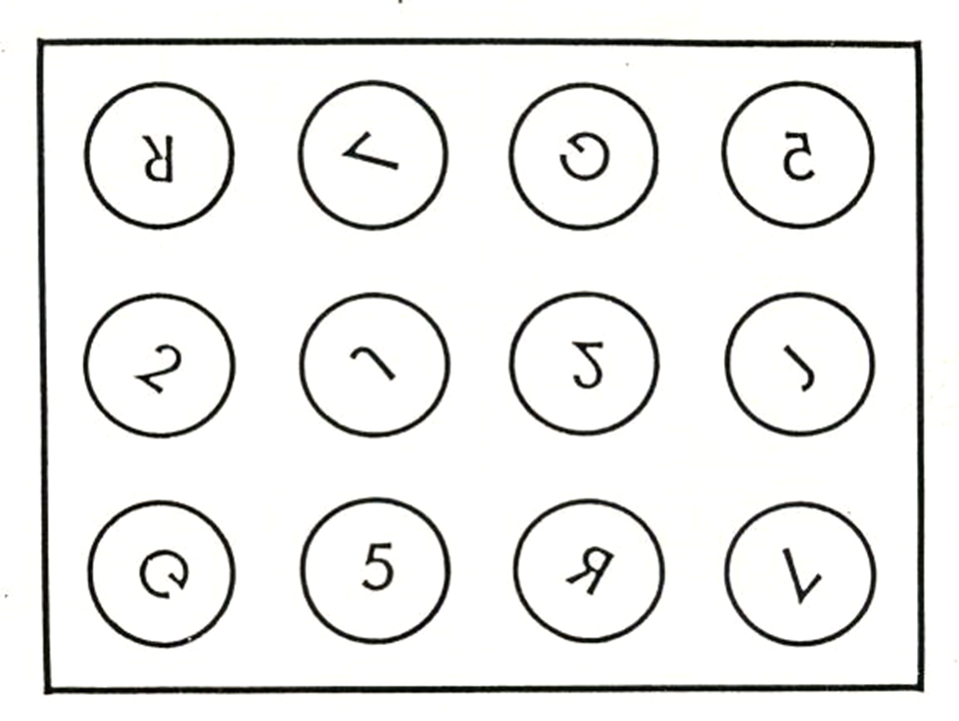
Notes:
“Okay, subject – is this number mirror image or not?”
Visual stimulus… now off screen - it’s a mental image

Slide 15
If the spatial people are right...
You literally rotate the mental image right side up so you can see if it’s mirror image or not
The same mechanisms that you use for visuospatial perception and visuospatial working memory are responsible for helping you answer questions about the thing the image represents
Interfering with perceptual mechanisms is likely to interfere with imagery
Brain activity in response to perceiving Thing A is likely to look like brain activity in response to imagining Thing A

Slide 16
If the propositional people are right...
We might have a mental image…
…but it’s not what we use to figure out if the 2 is mirror image or not
Instead, we access a “proposition” to get that information

Slide 17
If the propositional people are right...
You already have knowledge about:
The numeral “2”
The concept of things being upside down
What a mirror-image reflection does to an image
What a circle is
These are NOT MENTAL IMAGES THEMSELVES
Concepts, linguistic representations

Slide 18
Demo
Please follow these steps:
Take out a piece of paper and write a description of an object w/o naming it
Trade descriptions with your nearest neighbor and see if you can identify the described object
Return the written descriptions
Now, create a visual representation of the object below the written description of it…

Slide 19
Demo Debriefing
How does a written description differ from a visual representation?
Which is better? What was easier for you to do?
What are propositional and depictive representations?
How do the concepts of a propositional representation and depictive representation apply to this demonstration?
Notes:
Propositional representation: mental relationships between objects are represented by symbols and not by mental images of the scene → is an abstract, language-like representation → storage is not visual or spatial, nor does it physically resemble the stimulus → they are symbolic and descriptive
Depictive representation (analog code): states that a representation created in the mind (a mental representation) closely resembles the physical object → images are stored in a code that closely matches the way it looks in the real word
Applying to demo likely relies on how easy it was for each person (visual vs. descriptive). And this can obviously be applied to whether you learn or remember things better etc.

Slide 20
So what do the results say about the imagery debate?

Slide 21
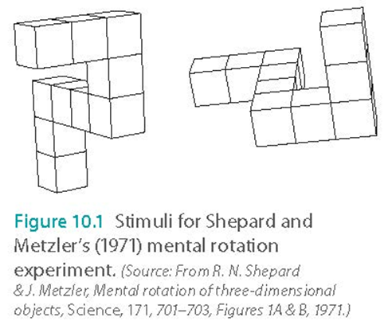
Shepherd: Imagery is spatial!
Results:
RTs are higher the more rotated the characters are
Invisible cognitive process:
Mental rotation!

Slide 22
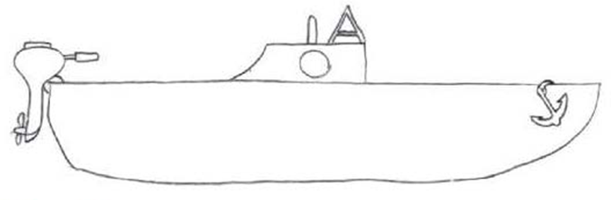
Notes:
•Spatial correspondence between imagery and perception
–Mental scanning
–Participants create mental images and then scan them in their minds

Slide 23
Kosslyn (1973): Imagery is spatial!
Memorize picture, create an image of it
In image, move from one part of the picture to another
It took longer for participants to mentally move long distances than shorter distances (e.g., anchor to motor vs. anchor to cabin)
Like perception, imagery is spatial

Slide 24
Lea (1975): Imagery is NOT spatial!
You’re not using an image...you have a mental list
Imagery might involve feeling like you’re mentally seeing something, but it’s really more about underlying knowledge
Sort of more about language than anything else
•
Anchor
Porthole
Rudder
Notes:
–More distractions when scanning longer distances may have increased reaction time
–Interesting things encountered during the mental scan are responsible for these distractions

Slide 25
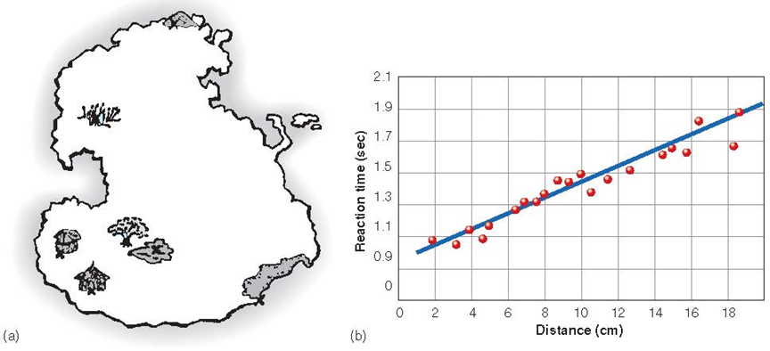
Kosslyn: Imagery IS TOO spatial!
Notes:
–Island with 7 locations, 21 trips
–It took longer to scan between greater distances
–Visual imagery is spatial

Slide 26
Pylyshyn: Imagery is PROPOSITIONAL!
Spatial representation is an epiphenomenon
Accompanies real mechanism but is not actually a part of it
Proposed that imagery is propositional
Can be represented by abstract symbols
The functional part of imagery is really kind of more about language than about perceptual mechanisms
Notes:
-we experience imagery as spatial, but underlying representation doesn’t have to be spatial

Slide 27

Propositions

Slide 28


Slide 29
Pylyshyn
Kosslyn’s results can be explained by unconscious use of “tacit knowledge”
Notes:
-So then scanning across the boat would require a longer time for longer distances, because you have multiple “links” of representations to get through (anchor to front deck to cabin to rear deck to motor, etc.)
-responding to Kosslyn’s tasks based on what they know about what usually happens when they’re looking at a real scene; so if you know it takes longer to get to longer distances, they’re really simulating that.

Slide 30
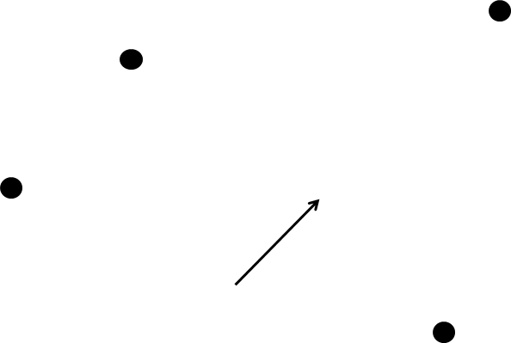

Slide 32
Notes:
Was the arrow pointing to any of the dots you just saw?

Slide 33


Slide 35
Notes:
Was the arrow pointing to any of the dots you just saw?

Slide 36
Finke & Pinker: Imagery doesn’t need tacit knowledge to work!
Participants judge whether arrow points to dots previously seen
Longer reaction time when greater distance between arrow and dot (as if they were mentally “traveling”)
Not instructed to use visual imagery
No time to memorize, no tacit knowledge

Slide 37
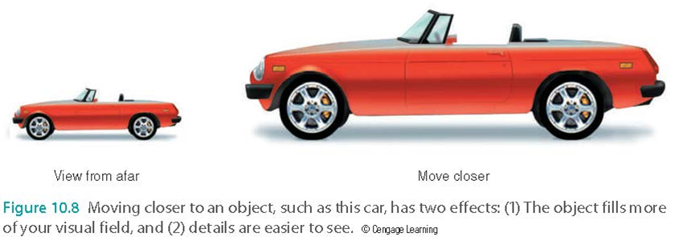
Imagery v. Perception
Relationship between viewing distance and ability to perceive details
Imagine small object next to large object
Quicker to detect details on the larger object

Slide 38
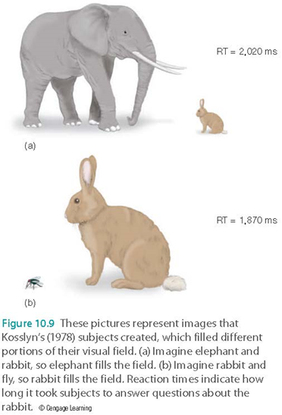
Imagery v. Perception
Mental-walk task
Move closer to small animals than to large animals
Images are spatial, like perception
Notes:
-answer questions more quickly about the animal that fills the visual field more fully
-imagine you’re walking toward their mental image of an animal - how far away they were from the animal when they began to experience “overflow” (image filled visual field, edges started becoming fuzzy)
-had to move closer to small animals than to large animals, just as they would if actually walking

Slide 39
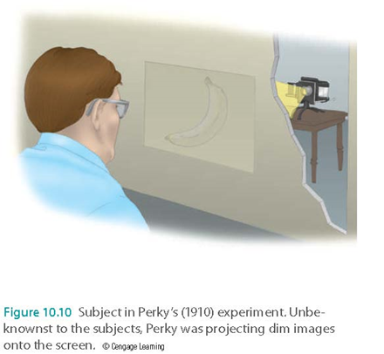
Imagery & Perception Interact?
Perky (1910)
Mistake actual picture for a mental image
Notes:
-subjects asked to create banana, researcher also backprojecting banana onto screen

Slide 40
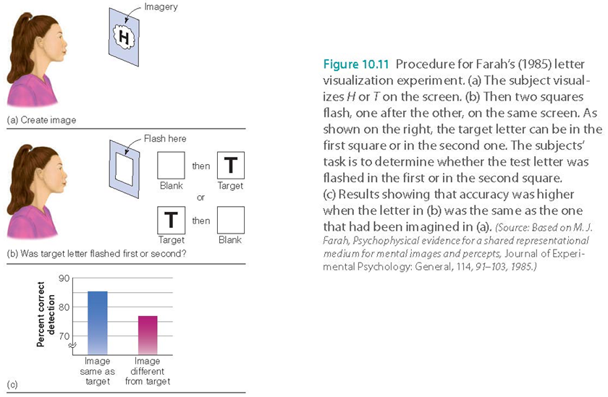
Notes:
This is a basic replication of the Perky expt, where subjects are imagining either letter H or T on screen. Press a button that makes squares flash, one after the other. One of the squares contained target letter - either T or H. Target letter detected more accurately when person was imagining the same letter than the different letter.

Slide 41
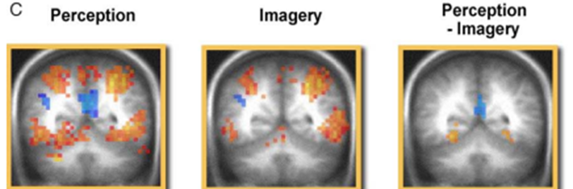
Can cognitive neuroscience help? Imagery debate
Spatial vs. propositional?
Sensory experience!
Notes:
•Imagery neurons respond to both perceiving and imagining an object
–Overlap in brain activation
–Visual cortex
•Le Bihan et al. (1993)
–Overlap in brain activation
–Visual cortex
•Ganis and coworkers (2004)
–Complete overlap of activation by perception and imagery in front of the brain
–Differences near back of the brain
•Amedi and coworkers (2005)
–Again, overlap
–Deactivation of non-visual areas of brain
•Hearing
•Touch
–Mental images more fragile, less activation keeps other things from interfering
–Some differences, but a lot of similarities. Differences aren’t surprising.
•Brain activity in response to imagery
–May indicate something is happening
–May not cause imagery

Slide 42
M.G.S.
Removing part of the visual cortex decreases image size
Mental walk task comparison with woman who had part of right occipital lobe removed (before/after surgery)
Notes:
-15 feet away from imaginary horse before
-35 feet after the surgery

Slide 43
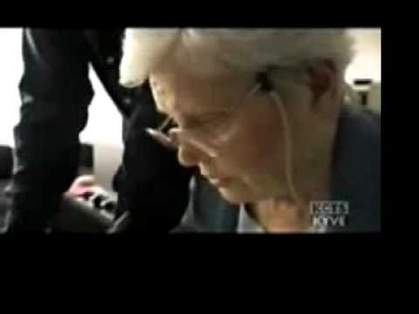
Hemispatial neglect & imagery
Notes:
•Hemispatial neglect and imagery
•Unilateral neglect
–Patient ignores objects in one half of visual field in perception and imagery (i.e., shared mechanisms)

Slide 44
Imagery v. Perception
Kosslyn and coworkers (1999)
TMS to visual area of brain during perception and imagery task
Response time slower for both
Brain activity in visual area of brain plays a causal role for both perception and imagery
Notes:
•Transcranial Magnetic Stimulation (TMS)
–Decreases brain functioning in a particular area of the brain for a short time
–If behavior is disrupted, the deactivated part of the brain is causing that behavior
–Pylyshyn, brain activity in response to imagery: something is happening, but may have nothing to do with causing imagery
–TMS task here was to judge whether the stripes in one quadrant were longer than the others. Imagery: had to base judgments on mental image of display.

Slide 45
Imagery v. Perception
R.M.
Damage to occipital and parietal lobes
Could draw accurate pictures of objects in front of him
Could not draw accurate pictures of objects from memory (using imagery)
Notes:
“A grapefruit is larger than an orange” - statement correct or not?

Slide 46
Imagery v. Perception
C.K.
Evidence that he was unable to perceive objects, even his own drawings, in front of him
Could draw objects in great detail from memory (using imagery)

Slide 47
Imagery v. Perception
Which of those were evidence for shared mechanisms between imagery and perception?
Which of those were evidence that imagery and perception are dissociated?
How can both be partly true?
The evidence:
Woman with hemispatial neglect
M.G.S.
TMS studies with perception and imagery
fMRI studies
R.M. can perceive but not imagine (and has damage in Brain Area A)
C.K. can imagine but not perceive (and has damage in Brain Area B)
Notes:
•Evidence for a double dissociation between imagery and perception
–Indicates separate mechanisms
•Also evidence for shared mechanisms
•Behrmann and coworkers (1994)
–Mechanisms partially overlap
–Visual perception involves bottom-up processing; located at lower and higher visual centers
–Imagery is a top-down process; located at higher visual centers
–Explains C.K. and R.M. but not M.G.S.
•Differences in experience
–Perception is automatic and stable
–Imagery takes effort and is fragile
•

Slide 48
Takeaways
Between Kosslyn, Lea, and Pylyshyn, who’s on team spatial imagery and who’s on team propositional imagery?
When you’re doing a mental scanning task, what evidence would make it look like you were using a propositional representation? What evidence would make it look like you were using a spatial representation?
Are visual imagery and visual perception the same exact process? Are they totally different?

Slide 49
Image Inspection: Visual Elaboration Scale
Think of the front of a particular familiar house -- that is, the side where the entrance is.
Were you clearly aware of the colors of the front of the house? Or wasn’t color clearly relevant until I mentioned it?
Did your thought register any specific features of the house other than color? Or was your thought a more general or abstract idea of a house, not including other specific features?
Was the house firmly fixed in its usual setting? Or was there just a house, detached from any setting? Or wasn’t it really there in a physical-type way at all?
Can you imagine yourself moving closer to, or further from, the house, from some spot from which you first thought about it? Or doesn’t the idea of yourself moving really apply to your style of thinking about the house?

Slide 50
Image Inspection: Visual Elaboration Scale
2. Think of a box and a cup on a table.
Describe the particular spot on the table occupied by the box. Or didn’t you originally allocate it a particular spot?
How high off the ground was the table top? Or wasn’t this relevant until I mentioned it?
Were you originally aware of the shape of the table? Or wasn’t this relevant until I mentioned it?
Were you aware of the nature of the table’s surfaces? Or wasn’t this detail important until I mentioned it?

Slide 51
Image Inspection: Visual Elaboration Scale
3. Think of a relative whom you know well.
In your thought, did it seem as if you were near to, or far from, your relative in physical distance? Or wasn’t your physical distance from your relative relevant, as it is when you look at me now?
Were you aware of any specific article of clothing that your relative was wearing? Or wasn’t this type of detail included in your thought?
Did your thought register specific facial features of your relative? Or was it a general or ‘mood’ idea only of his/her face?
Were you aware of enough of the relative to be able to say that he/she had a special position or posture, for example, standing, sitting, or kneeling? Or wasn’t position or posture registered in your original thought?
In your thought, were you aware of being able to the left, to the right, or directly in line with your relative? Or wasn’t your direction from him/her relevant in the way it’s relevant when you look at me now.

Slide 52
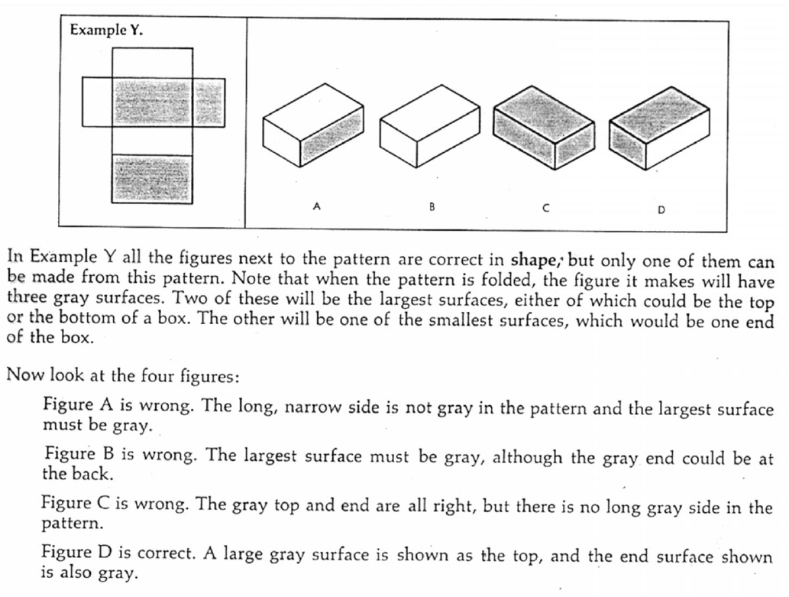
Spatial Imagery: Paper Folding Test

Slide 53
Spatial Imagery: Paper Folding Test

Slide 54
Mnemonics: Method of Loci
Principles
Construct a mental memory place
Place memory targets in each room
To remember, mentally walk through the rooms
Notes:
•Placing images at locations
•Method of loci
–Visualizing items to be remembered in different locations in a mental image of a spatial layout
–Easiest example is when teachers are first learning student names

Slide 55
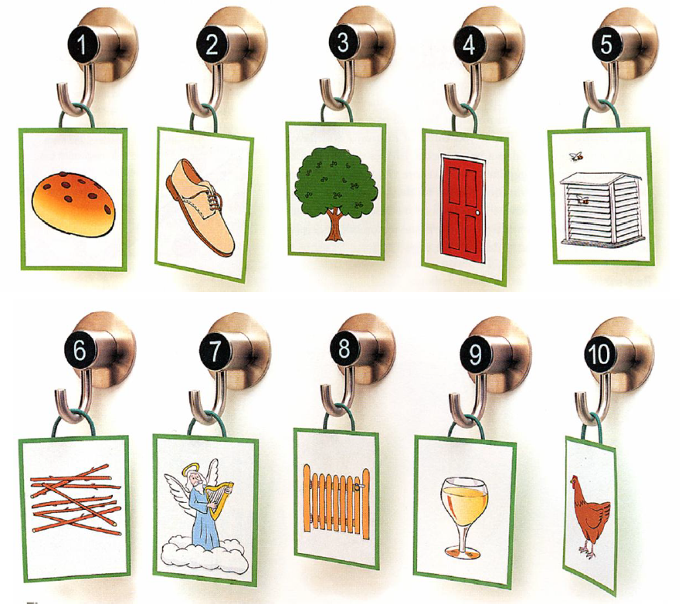
Pegwords
Notes:
•Pegword technique
–Associate items to be remembered with concrete words
–Pair each of these things with a pegword
–Create a vivid image of things to be remembered with the object represented by the word
E.g., Concrete nouns create images that other words can “hang onto.” Boat-hat creates an image of a boat, so people can hang the hat in a number of places.

Slide 56
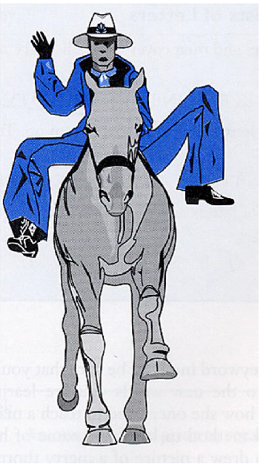
Learning Foreign Words with the Linkword Method
Find an English word that sounds similar to the foreign word you want to learn
E.g., “rodilla” (knee in Spanish) → rodeo
Create a mental image linking the meaning of the foreign word and the meaning of the English linkword
E.g., image linking “knee” and “rodeo”
Notes:
•Associating images with words

Slide 57
Today’s Goals + Agenda
LO1: Continue to build a supportive classroom culture & discuss science communication
Last time you'll experience a podcast: now, let's compare all of them; some from psychologists, some more general.
LO2: Describe the basic fundamental principles of imagery research
Lots of imagery related demos, including those on how to improve memory
Discussion of Chapter 10 from the Goldstein textbook

Slide 58
Participation + Minute Paper
https://tinyurl.com/PSY102Participation
https://tinyurl.com/PSY102MinutePaperJune19

Slide 59
Additional Practice
Optional: Test Yourself

Slide 60
Mental scanning experiments tend to find
A. A direct relationship between scanning time and distance on the image
B. An absence of mental scanning when processing a mental geometric image
C. A constant scanning time between all pairs of locations on an image
D. Support for a propositional, as opposed to spatial, view of imagery

Slide 61
Ben has had problems with the pipes in his apartment. First, he had a clog in his bathroom sink, and then two months later, his garbage disposal in the kitchen sink clogged. Ben's superintendant told him he was not adequately flushing the debris from his pipes. She suggested that he run the water a little longer and visualize the debris (be it carrot peelings or toothpaste) traveling through the pipes all the way out to the sewer connection in the street. Using this technique, Ben has had no more clogs. The superintendant's suggestion involved:
Image synthesis
Mental scanning
Method of loci
Propositional representations
Notes:
B

Slide 62
Luis is taking his girlfriend, Rosa, to a resort town neither one of them has visited. Luis wants to make a good impression on Rosa, so he spends the week before the trip reading about fun places to go while they are there. He also memorizes a map of the small resort town so he can lead her around without bothering to ask for directions. When they arrive, they first visit a botanical garden. When Rosa says, "Where to next?" Luis conjures a mental image of the map and says, "art museum." Let's assume the garden was six inches due south on the map and that it took Luis four seconds to scan the map image between the two. After they visit the museum, Luis takes Rosa to a fancy restaurant. On the map, the restaurant was three inches northwest of the museum, so it is most likely that when Luis scanned the image to find the restaurant, the scan took approximately _____ seconds.
2
3
4
6
Notes:
A

Slide 63
Which of the following has been used as an argument AGAINST the idea that imagery is spatial in nature?
The results of scanning experiments
Depictive representations
The tacit-knowledge explanation
The distinction between propositional and spatial representations
Notes:
C

Slide 64
Wilma is a famous chef. Since she does not like to share her secret family recipes, she does not write down her special creations, which makes it difficult to remember their ingredients. To aid her memory, she has created a unique "mental walk" that she takes to recall each recipe. For each one, she has a familiar "route" she can imagine walking through (e.g., from the end of her driveway to her living room) where she places each item in the recipe somewhere along the way (e.g., Tabasco sauce splattered on the front door). By doing so, Wilma is using _____ to organize her memories
Mental synthesis
Paired-associate learning
The pegword technique
Method of loci
Notes:
D

Slide 65
Imagery General Q
Most cognitive psychologists who study imagery tend to favor the spatial approach over the propositional approach.
A. Psychologists who favor the spatial approach tend to think that imagery makes use of __________ mechanisms, whereas those who favor the propositional approach think imagery makes use of ___________ mechanisms.
B. Describe one piece of behavioral (i.e., non-neuroscience) evidence that supports the spatial approach. Make sure you explain (1) what subjects were asked to do, (2) how subjects’ performance supported the spatial approach and WHY that counts as evidence for the spatial approach, and (3) what the results should have looked like if the propositional approach were being supported instead.
C. Briefly describe one piece of neuroscience evidence that has been found in studies on imagery. Mention which part of the imagery debate it was focusing on (i.e., spatial or propositional). Say whether this evidence suggests that imagery shares mechanisms with (whatever process you noted that it mapped onto in part A).

