Slide 1
PSY102: Introduction to Cognitive Psychology
Day 11 (05/30/19): LTM Structure (Episodic Memory)

Slide 2
Today’s Goals + Agenda
LO1: Continue to build a supportive classroom culture & discuss science communication
Paragraph-by-paragraph breakdown of the scientist summary piece we read for today
Comparison between what the actual article (JoN) discussed vs. what the scientist summary piece did
Discuss reverse outlines - for multi paragraph expansion of SciComm & scientist summary pieces
LO2: Describe the basic fundamental principles of long-term memory structure
What is episodic memory? How does it relate to knowledge? Autobiographical memory? etc. Discuss Goldstein Chpt 6
LO3: Summarize and critically analyze academic journal articles
Now that research has been contextualized, what makes a memory its own event? How are memories constructed (cc: Science News piece from today)? Different perspectives on event segmentation.

Slide 3
Checking In + Feedback
Wikipedia
Keys on Quizzes; want quizzes returned in full?
Summary of week instead of quizzes
Multiple paragraphs assignment Friday -- all good?

Slide 4
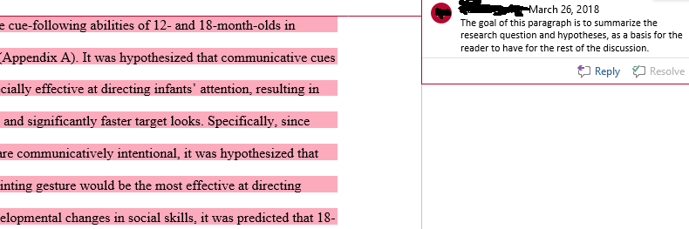
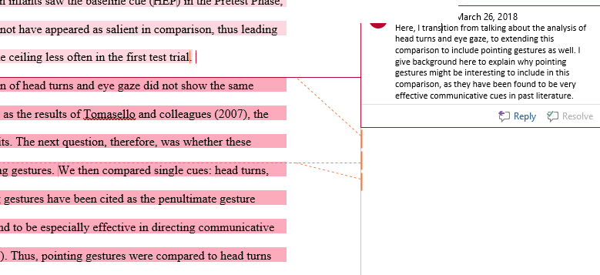
Reverse Outline - Multiple Paragraphs SciComm Piece

Slide 5
From Minute Paper:
Can we review the working memory model? + What’s the difference between working memory & short term memory?

Slide 6
STM vs. working memory
Working memory = short-term storage AND MANIPULATION of information
Ex: STM → remember phone number
Ex: WM → remember #s while reading a paragraph.
Ex: “Multiply 43 times 6 in your head.”
Visualize 43 x 6, multiple 3 x 6, hold the 8 in memory, carry over the one… etc.
If only storage (STM) involved, can’t do this!
Understanding conversations… etc.
Notes:
•Similar concept to short-term memory
•Baddeley and Hitch (1974)
•Working memory: limited capacity system for temporary storage and manipulation of information for complex tasks such as comprehension, learning, and reasoning
•Working memory differs from STM
–STM holds information for a brief period of time
–WM is concerned with the processing and manipulation of information that occurs during complex cognition
→ basically a kind of passive vs. active

Slide 7
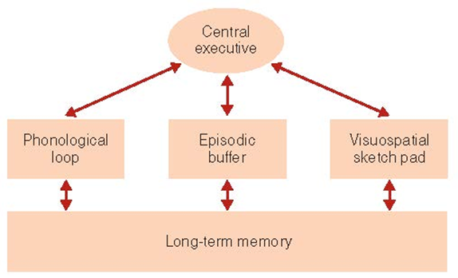
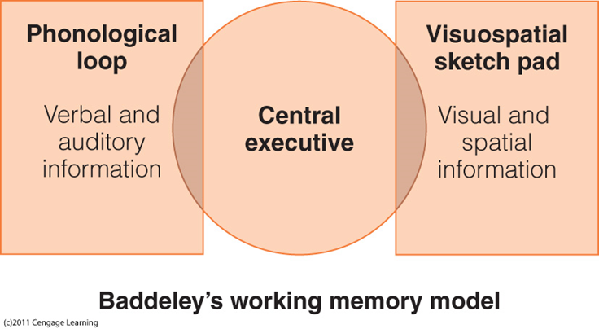
STM vs. working memory
Baddeley’s revised model w/ episodic buffer
Phonological loop
Verbal/auditory information
Visuospatial sketch pad
Visual and spatial information
Central executive
Retrieves information from LTM and coordinates phonological loop and visuospatial sketch pad; not for storing information, but for managing its use in the other parts of working memory
Episodic buffer
Can store information & connects to LTM
Notes:
•Attention controller
–Focus, divide, switch attention
•Controls suppression of irrelevant information
•Backup store that communicates with LTM and WM components
•Hold information longer and has greater capacity than phonological loop or visuospatial sketch pad
•Visual and spatial information
•Visual imagery: The creation of visual images in the mind in the absence of a physical visual stimulus
•Phonological similarity effect
–Letters or words that sound similar are confused
•Word-length effect
–Memory for lists of words is better for short words than for long words
–Takes longer to rehearse long words and to produce them during recall
•Articulatory suppression
–Prevents one from rehearsing items to be remembered
•Reduces memory span
•Eliminates word-length effect
•Reduces phonological similarity effect for reading words
•WM is set up to process different types of information simultaneously
•WM has trouble when similar types of information are presented at the same time

Slide 8
Brain Training
Evaluate the claims proposed by brain training programs

Slide 9
Brain Training
How many of you have heard the claim that ‘Brain training makes you smarter’ or some version of it?
Where? What versions?
Do you believe it?
Do you think others would believe it?
Why would someone believe it?
Notes:
Activity adapted from https://www.psychologicalscience.org/uncategorized/myth-brain-training-will-make-you-smarter.html

Slide 10
“Brain Training makes you smarter”
What evidence supports the claim and how strong is that evidence?
Is there evidence that does not support the claim and how strong is the opposing evidence?
Do we need additional evidence before drawing conclusions about the claim, and if so, how could we collect it?
What conclusions are most reasonable given the evidence available so far?

Slide 11
With the two handouts...
You have both an article for & against brain teaching, and each person has a different article in favor of brain training
What is the actual claim being made? Does the site attempt to justify the claim? Does the site give evidence to support the claim? What types of evidence? How clearly is evidence related to the claim? Does the site provide a source for the evidence or a way of accessing the source?
Are the claims supported by the data? Why is it important that the research methodology relate directly to the claim being made?

Slide 12
Brain Training: Pro
Usually do not claim improvement in cognitive function, but rely on readers to infer use of product = you’ll improve
Evidence? Testimonials, researchers at XYZ (no source), lists of reported research (but you know to evaluate)
Why does it matter?
What types of evidence support what types of claims?
How do you recognize the difference?
Why do you think the FTC judged Lumosity’s claim as unjustified? What types of research would need to be done to make such claims?

Slide 13
Brain Training: Against
Are the claims supported by the data? Why is it important that the research methodology relates directly to the specific claim made?
Claims versus evidence
Health claims must be backed by research that rules out alternative explanations; “active control groups”
The nature of scientific claims
What is the importance of reviewing the body of evidence? Opportunity costs? Scientific consensus statement?
Intelligence
Is intelligence “one thing”?

Slide 14
Brain Training: In Sum
What is the best conclusion you can draw?
Evidence evaluation and why claims seem believable despite their providing weak evidence
Trouble thinking critically; “cognitive misers”
The nature of intelligence
Don’t want to get into different definitions, BUT you can improve on one task without it generalizing to another task (near vs. far transfer)
Learning & Development
Lifetime of engagement is good

Slide 15
SciComm: Science Summary
Continue to build a supportive classroom culture & discuss science communication

Slide 16
Science Summary Piece
Take a couple of minutes to refresh your memory of the Williams et al. (2019) coverage of the Ben-Yakov article in Journal of Neuroscience
Pay attention in particular to:
The audience
The structure
How this piece differs from Science News
What information was in this piece relative to the article being covered
After a couple of minutes, discuss with the person next to you. We will come together afterwards to discuss as a class what this means in terms of writing science summary pieces.
Notes:
Paragraph-by-paragraph breakdown of the scientist summary piece we read for today
Comparison between what the actual article (JoN) discussed vs. what the scientist summary piece did

Slide 17
Long-Term Memory Structure
Describe the basic fundamental principles of long-term memory structure
Summarize and critically analyze academic journal articles

Slide 18
Key Terms
Encoding
Transferring information into LTM
Retrieval
Pulling information out of LTM (into STM/WM)
Key concept: Memory is NOT just one thing. We have many KINDS.
Notes:
LTM:
•“Archive” of information about past events and knowledge learned
•Works closely with working memory
•Storage stretches from a few moments ago to as far back as one can remember
•More recent memories are more detailed
•30 seconds to earliest memories

Slide 19
Demo: Serial Position Curve
I’m going to read off a list of words to you. When I finish reading off the words, I will say “Recall” and you can write down all the ones you remember.
Ready?
Notes:
Barricade, children, diet, gourd, folio, meter, journey, mohair, tomato, cabin, phoenix, crossbow, doorbell, muffler, mouse, menu, airplane, armchair, dresser, baseball

Slide 20
Check Answers
Barricade
Children
Diet
Gourd
Folio
Meter
Journey
Mohair
Tomato
Cabin
11. Phoenix
12. Crossbow
13. Doorbell
14. Muffler
15. Mouse
16. Menu
17. Airplane
18. Armchair
19. Dresser
20. Baseball

Slide 21
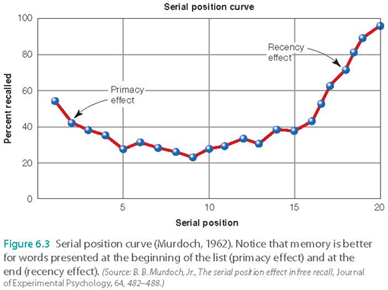
Serial Position Curve
Primacy Effect
Recency Effect
What happens w/ delay? Slow presentation?
MTL amnesic patients?
MTL includes hippocampus, amygdala, etc.
Notes:
–Primacy effect gave more time to rehearse info, more likely to enter LTM
–Recency effect
–Stimuli still in STM

Slide 22
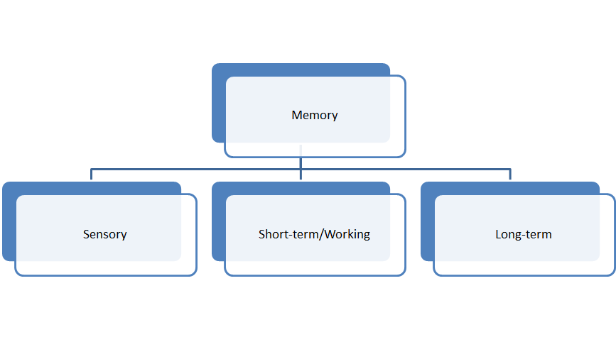
Subdivisions of Memory

Slide 23
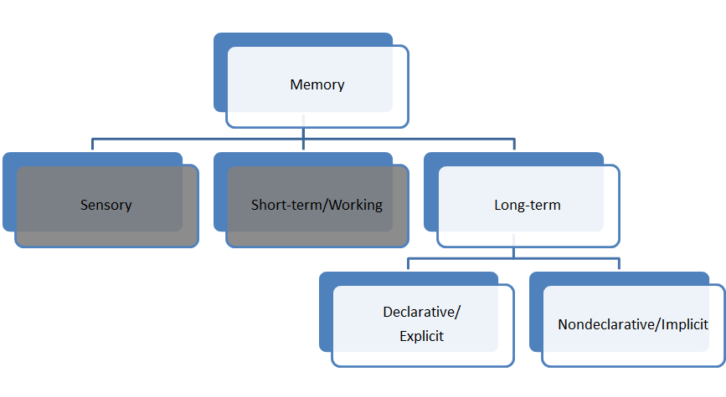
Subdivisions of Memory

Slide 24
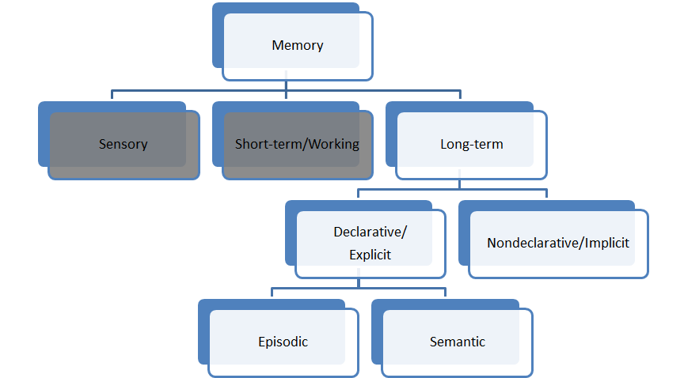
Subdivisions of Memory

Slide 25
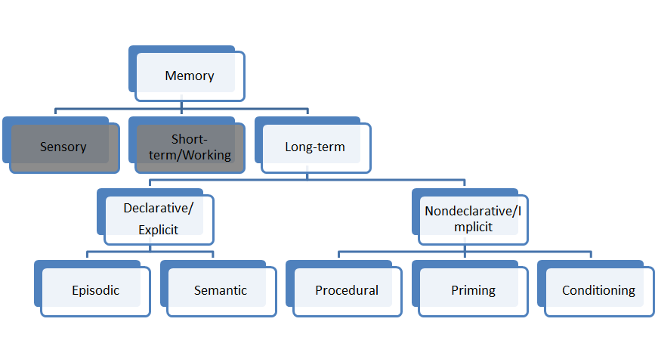
Subdivisions of Memory

Slide 26
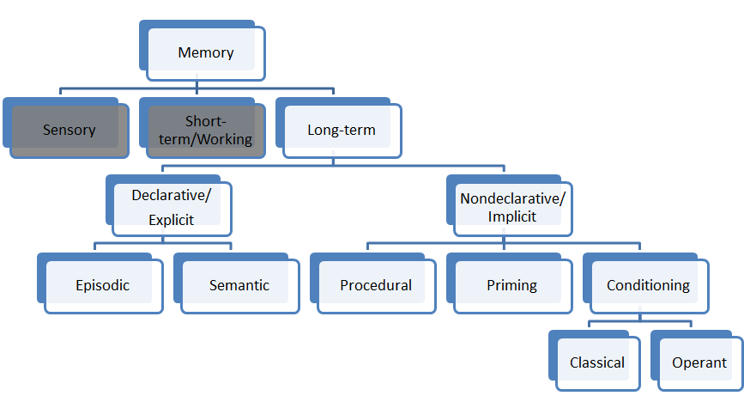
Subdivisions of Memory

Slide 27
Trivia: Fact
What is the only U.S. State that borders only one other (state)?
Rhode Island
Maine
Washington
Florida
Notes:
Maine; from: https://www.rd.com/culture/trivia-questions/

Slide 28
What’s Declarative/Explicit?
Memories that we are aware of
Available for explicit recall
Episodic
Memory for specific experiences
Semantic
Memory for facts

Slide 29
Episodic vs. Semantic
Episodic:
Events you experienced (or can imagine based on experience)
Mental time travel
“Remember”/Recollection
Remote memories become more semantic over time
Semantic:
Facts and knowledge
No mental time travel
“Know”/Familiarity
BOTH
Autobiographical (memories about yourself)
Declarative
Will discuss in more detail on Monday
Notes:
•Episodic involves mental time travel (traveling back in time to reconnect with events that happened in the past)
–No guarantee of accuracy
•Semantic does not involve mental time travel
–General knowledge
•Episodic and semantic show a double dissociation
•Episodic can be lost, leaving only semantic
–Acquiring knowledge may start as episodic but then “fade” to semantic
•Semantic can be enhanced if associated with episodic
–Autobiographical memory: memory of specific experiences, includes semantic and episodic
–Personal semantic memory: semantic memories that have personal significance
–Can influence what we experience (episodic) by determining what we attend to
–Remember/Know procedure
•Remember if a stimulus is familiar and the circumstance under which it was encountered?
•Know if the stimulus is familiar but don’t remember experiencing it earlier?
•Don’t remember the stimulus at all
–Semanticization of remote memories
•Loss of episodic details for memories of long-ago events

Slide 30
Nondeclarative/Implicit
Memories that we “aren’t aware of”
Unconsciously influence our behavior or cognition
Procedural learning
Memory for skills
Priming
When presenting one stimulus changes the way a person responds to another stimulus
Classical conditioning
Pairing one stimulus with another so that the conditioned stimulus evokes the same response as the unconditioned stimulus

Slide 31
Procedural
Describe the steps involved in tying your shoes. Describe how you type.
Describe taking notes in class. Describe playing an instrument.
Ex: Clive Wearing playing piano
Notes:
•Skill memory: memory for actions
•No memory of where or when learned
•Perform procedures without being consciously aware of how to do them
•People who cannot form new LTMs can still learn new skills (e.g., H.M.)
–

Slide 32
Priming
S O _ _
W O _ _
_ _ K E
L _ _ B
K I _ _ E N
_ _ A I R
M A _ _ E
S _ P
SO _ _
Soar
Solo
Soft
_ _ K E
Cake
Wake
Bake
Like
S _ P
Sap
Sop
Sup
Notes:
Another ex of priming: repetition priming

Slide 33
Classical conditioning
Neutral/“conditioned stimulus” (e.g., tone)
(Doesn’t yet cause the response we’re talking about; think of it as “to-be-conditioned”)
+
“Unconditioned stimulus” (e.g., puff of air to make you blink)
(Already resulted in response we’re talking about)
=
Classical conditioning
(The neutral stimulus now causes the same response the unconditioned stimulus did)

Slide 34
Evidence for LTM: Structure Model
Neuropsychology of amnesia
Single dissociations
Double dissociations
Cognitive neuroscience
fMRI
Notes:
Henry Molaison (H.M.) – surgery for epilepsy
Clive Wearing- encephalitis
K.F. – brain injury in a motorbike accident

Slide 35
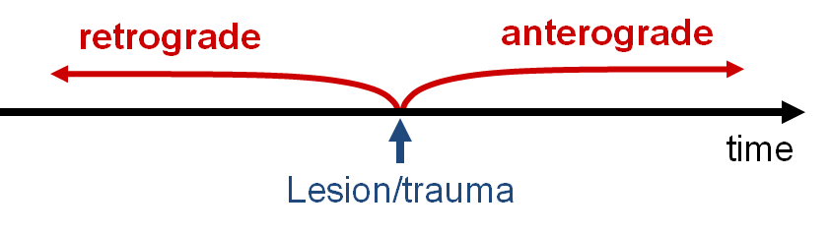
Types of Amnesia
Anterograde Amnesia
Inability to form new memories
Retrograde Amnesia
Inability to recall old memories

Slide 36
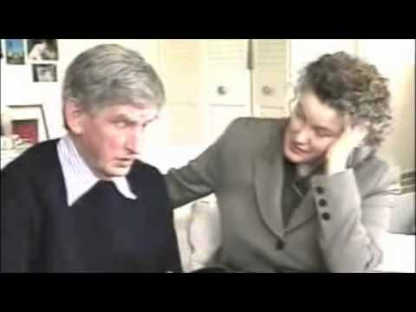
Clive Wearing
Notes:
https://www.youtube.com/watch?v=c62C_yTUyVg
Go through about 3 minutes, mention that he can still play piano though

Slide 37
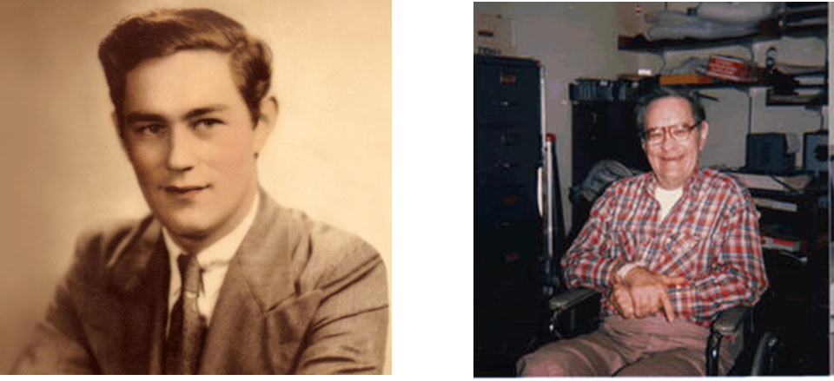
H.M.
Notes:
Impaired memory abilities
– Could not learn new information
• Verbal or nonverbal, visual or auditory
Global anterograde amnesia
– Could not remember recent events
• Severe amnesia for the last 1-2 years
• Some memory loss for previous decade
• Childhood memories: intact
Temporally-graded retrograde amnesia
• Spared memory abilities
– Short-term memory OK
• e.g., digit span
– Repetition priming OK
– Skill learning OK
• e.g., mirror drawing
Provided the evidence of multiple memory systems with
different neural substrates
• Impaired long-term memory but spared short-term memory
• Impaired declarative (explicit) memory but spared nondeclarative
(implicit) memory
– Highlighted the importance of medial temporal lobe structures
to the formation of long-term explicit memory (vs. retrieval)

Slide 38
Interview with H.M. from Hilts’ Memory’s Ghost: The nature of memory and the strange tale of Mr. M.
•Hilts: “Do you know who you live with?”
•H.M.: “No”
•Hilts: “Do you know if you live with your parents?”
•H.M.: “No, I’m not sure”
•Hilts: “Why do you have trouble remembering?”
•H.M.: “Well, what I keep thinking of is that possibly I had an operation. And somehow the memory is gone… And I’m trying to figure it out… I think of it all the time.”
•Hilts: “What about your parents?” [This was asked in 1992, when HM’s Dad had been dead 25 years, and his mother 15. He had lived in a nursing home alone for more than 12 years.]
•H.M.: “Oh! That’s a big question mark I have right there! I don’t remember fully if we’re living in the same house, or have moved and sold that house. It was a house we had down on Crescent Drive… with a big empty lot next to us.”

Slide 39
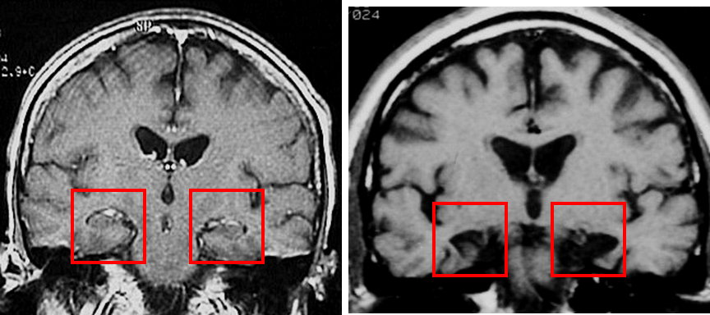
H.M.

Slide 40
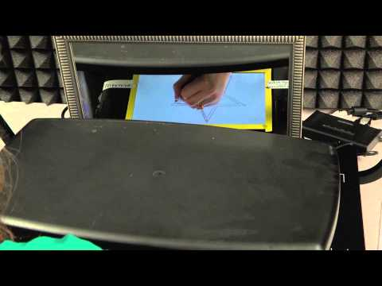
H.M. Mirror Tracing
Notes:
https://www.youtube.com/watch?v=wFoIvB-04YY

Slide 41
Single Dissociation
Brain area X: LESIONED
Cognitive function Y: DAMAGED
Evidence consistent with a link between brain area X and cog function Y.
BUT...

Slide 42
Double Dissociations
Patient #1
Brain area 1 LESIONED
Brain area 2 INTACT
Cog function A IMPAIRED
Cog function B PRESERVED
Patient #2
Brain area 1 INTACT
Brain area 2 LESIONED
Cog function A PRESERVED
Cog function B IMPAIRED
identify brain structures that are necessary for certain cognitive functions
strongly suggest that two neurocognitive functions are independent from each other

Slide 43
Double Dissociations - EX.
EXAMPLE Patient #1
Broca’s area LESIONED
Wernicke’s area INTACT
Comprehension (Syntax) IMPAIRED
Speech (Semantics) PRESERVED
EXAMPLE Patient #2
Broca’s area INTACT
Wernicke’s area LESIONED
Comprehension (Syntax) PRESERVED
Speech (Semantics) IMPAIRED
What does this model then strongly suggest?
Notes:
identify brain structures that are necessary for certain cognitive functions
strongly suggest that two neurocognitive functions are independent from each other

Slide 44
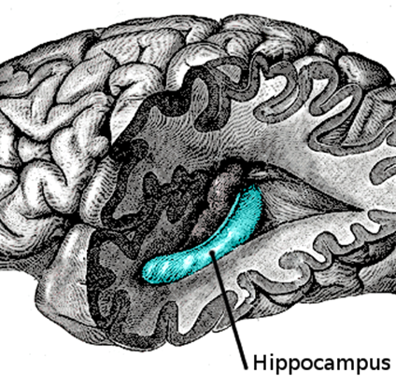
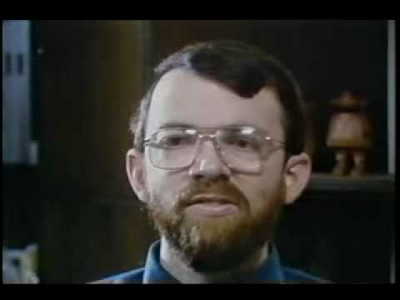
Episodic vs. Semantic
K.C. (hippocampus; motorcycle accident)
Poor memory for events of his life
Intact memory for facts
Italian woman (different part of temporal lobe; encephalitis)
Poor memory for facts
Ex: identity of Beethoven
Intact memory for events of her life
Notes:
KC (https://www.youtube.com/watch?v=tXHk0a3RvLc&list=PL00152A5753A22423):
Motorcycle accident at age 30
– Lesions in MTL, frontal, parietal, and occipital regions
– Spared intelligence (IQ=94), working memory, nondeclarative memory
• Episodic-semantic dissociation
– Impaired episodic memory
• Both anterograde and retrograde
• Both autobiographical and lab tests
– Spared semantic memory
• Retrograde SM normal
– Word and factual knowledge
• Anterograde SM impaired
– But can learn simple semantic associations with many repetitions
Other examples (not necessary to go over, but in case of Qs):
Vargha-Khadem et al. (1997)
– 3 children who suffered selective hippocampal lesions due to anoxic accidents at an early age
• Impaired episodic memory
– everyday events
– laboratory tests: verbal & visual
• Spared semantic memory
– Normal IQ and reading abilities
– normal or near-normal schooling
– abundant factual knowledge
Semantic dementia
Other names:
– primary progressive aphasia
– temporal variant of fronto-temporal dementia
• Case AM (Hodges, Graham, et al.)
– MRI typical SD pattern
• Left anterior temporal lobe atrophy
– Word finding difficulty (anomia)
– Pronounced deficits in word fluency
– Impaired associative semantic knowledge (e.g., pyramids –palm trees test)
– Normal episodic memory (e.g., delayed Rey Figure recall)
– Progressive disorder semantic loss started to interfere with everyday activities (e.g., object misuse)

Slide 45
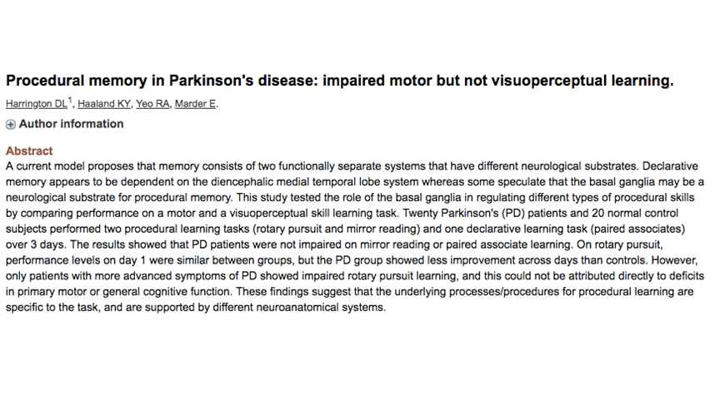
Episodic vs. Procedural

Slide 46
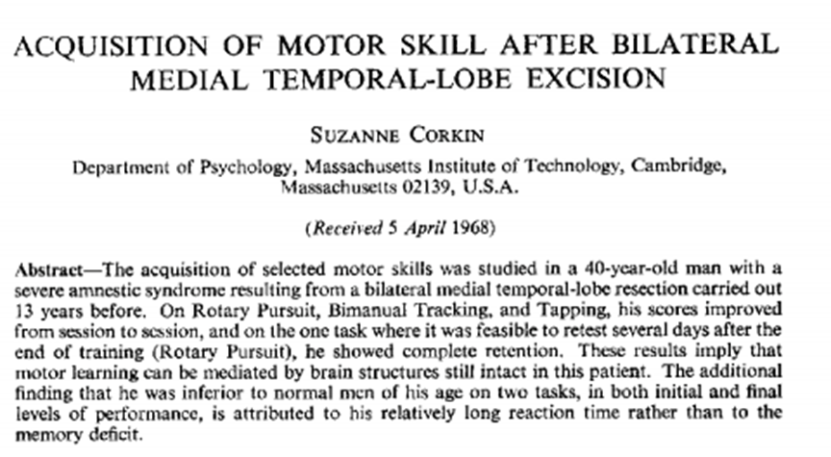
Episodic vs. Procedural

Slide 47
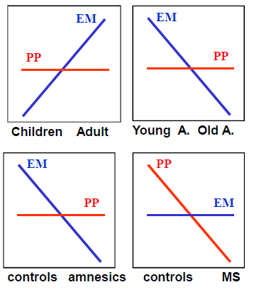
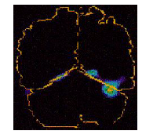
Episodic vs. (Perceptual) Priming
Developmental dissociations
Brain damage
MS had right occipital lobe lesion
Notes:
• Developmental dissociations
– Children vs. young adults
– Young adults vs. older adults
• Brain damage
– Amnesic patients
• Impaired EE, preserved PP
– Patient MS (right occipital lesion)
Gabrieli et al. (1995)
• Impaired PP, preserved EE
• Functional Neuroimaging
– EM: right PFC, MTL, medial parietal, cb
activations
– PP: occipital deactivations

Slide 48
Short-Term Memory vs. LTM
H.M. & Clive Wearing both OK on STM, but impaired in LTM
K.F. impaired in STM, but OK in LTM
Lesion close to language processing area
Digit span only 3 digits
Recency vs. primacy effect; MTL amnesics vs. controls on serial position curve
Recent research suggests maybe more complicated (isn’t it always?)
Notes:
Patient K.F. (Warrington & Shallice, 1969)
• Lesion
– close to left Sylvian fissure (language processing area)
– hesitant speech but no aphasia
• Specific deficit in immediate verbal memory
– Digit span only 3 digits!
• McCarthy & Warrington patient with word span of 1 word!
– Poor performance in Brown-Peterson
• Normal long-term memory

Slide 49
If you can’t find a neuropsych patient...
See what part of the brain activates in healthy participants
E.g., semantic & episodic activate different regions of the brain
Temporarily turn off parts of healthy participants’ brains
What methods are these pts?
Complementary w/ lesions

Slide 50
Subdivisions of Memory

Slide 51
Subdivisions of Memory
Declarative/Explicit vs. Nondeclarative/Implicit: H.M./Clive
Episodic vs. Semantic: K.C. vs. Italian Woman
Episodic vs. Procedural: H.M./Clive vs. Parkinson’s
Episodic vs. Priming: Developmental & MS
Episodic vs. Conditioning: exists, not discussing
STM vs. LTM: HM/Clive vs. K.F.; recency vs. primacy
Emotion: amygdala
Motor: cerebellum
Past exp
facts
skills
MTL
diencephalon
MTL
Left Temporal Cortex
striatum
neocortex

Slide 52
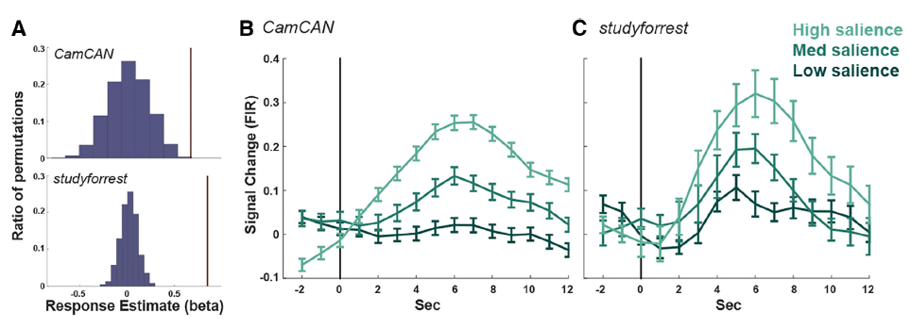
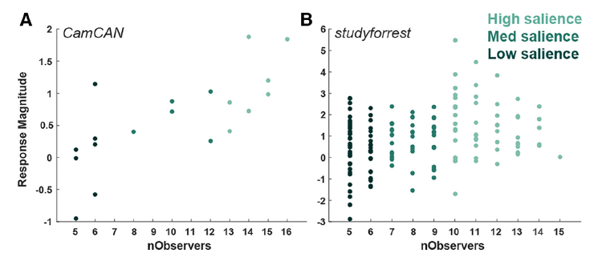
Ben-Yakov & Henson (2018)

Slide 53
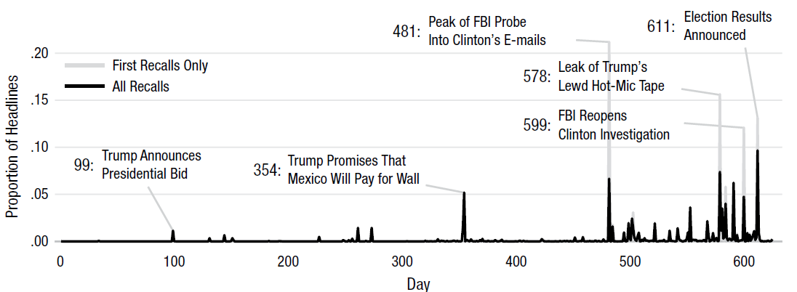
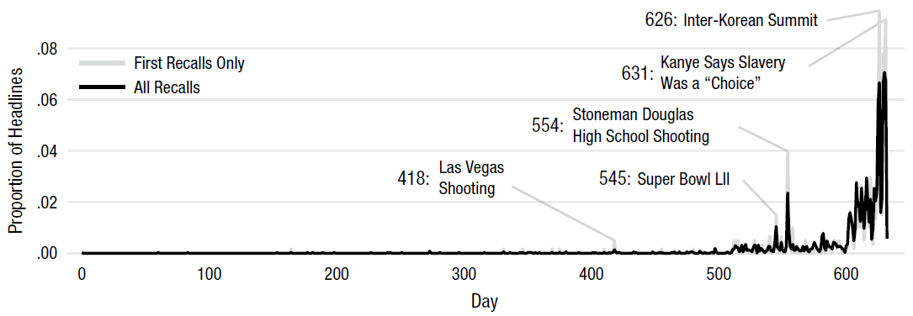
Uitvlugt and Healey (2018)

Slide 54
Today’s Goals + Agenda
LO1: Continue to build a supportive classroom culture & discuss science communication
Paragraph-by-paragraph breakdown of the scientist summary piece we read for today
Comparison between what the actual article (JoN) discussed vs. what the scientist summary piece did
Discuss reverse outlines - for multi paragraph expansion of SciComm & scientist summary pieces
LO2: Describe the basic fundamental principles of long-term memory structure
What is episodic memory? How does it relate to knowledge? Autobiographical memory? etc. Discuss Goldstein Chpt 6
LO3: Summarize and critically analyze academic journal articles
Now that research has been contextualized, what makes a memory its own event? How are memories constructed (cc: Science News piece from today)? Different perspectives on event segmentation.

Slide 55
Tomorrow’s Work
Readings
Vaz et al. (2019)
Gelinas et al. (2019) (summary of Vaz)
Goldstein Chapter 7 on LTM: Encoding, Retrieval, Consolidation
Tells you about Effective Studying
Assignment
Multiple paragraphs of SciComm piece; reverse outline, use fb from opening paragraph to improve

Slide 56
Participation + Minute Paper
https://tinyurl.com/PSY102Participation
https://tinyurl.com/PSY102MinutePaperMay30

Slide 57
Additional Practice
Optional: Test Yourself

Slide 58
General Questions
What is the evidence for our LTM model? How is each component of memory subdivided? What do you think it would take to show that this model is not completely accurate? What happens when neuroimaging or behavior conflicts w/ lesion evidence?

Slide 59
When investigating the serial position curve, delaying the memory test for 30 seconds
Has no effect on the curve
Increases the primacy effect
Decreases the recency effect
Increases both the primacy and recency effects

Slide 60
In which of the following examples of two different brain-injured patients (Tom and Tim) is a double dissociation demonstrated?
Both Tom and Tim have good episodic memory but poor semantic memory
Tom and Tim both show deficits in episodic and semantic memory
Tom has good semantic memory and poor episodic memory, while Tim has good episodic memory but poor semantic memory
Both Tom and Tim have good semantic memory but poor episodic memory

Slide 61
Which of the following is NOT a conclusion from the case of H.M., who had an operation to help alleviate his epileptic seizures?
The hippocampus is necessary for forming new LTMs
Short-term and long-term memories are controlled by different mechanisms
Short-term and long-term memories can operate independently of each other
LTMs are unaffected by damage to the hippocampus.

Slide 62
According to Tulving, the defining properties of the experience of episodic memory is that
It involves mental time travel
It always corresponds to events from our past that actually happened
It accesses knowledge about the world that does not have to be tied to any specific personal experience
It involves both explicit and implicit memories.

Slide 63
Which of the following is NOT an example of semantic memory?
I remember that more than 33% of U.S. drivers have admitted to using a cell phone when driving
I remember that experiments have shown that talking on cell phones can impair driving ability
I remember the day we learned about how talking on cell phones can impair driving ability
None of the above (a, b, and c are all examples of semantic memory)

Slide 64
Phoebe steps up to the golf ball and hits it down the fairway. She sees that the ball is heading towards someone, so she yells "Fore!" After her two partners hit their balls, they pick up their bags and start walking to the next hole. But Phoebe says, "Wait a minute, I haven't teed off yet." This behavior shows that Phoebe has a problem with ____ memory
Semantic
Procedural
Episodic
Working

Slide 65
In the movie Groundhog Day, Bill Murray's character grows frustrated as he experiences the same day in his life over and over again. With each "passing" day, he is able to respond to people's actions more and more quickly because of
Repetition priming
Distributed practice
Reconsolidation
Mental Time Travel

Slide 66
MC Answer Key
Decreases recency
Tom good semantic, Tim good episodic (3rd one)
LTM unaffected by damage
Mental time travel
Day we learned about how talking (3rd)
Episodic
Repetition Priming

