Slide 1
PSY102: Introduction to Cognitive Psychology
Day 13 (06/03/19): Autobiographical Memory

Slide 2
Today’s Goals + Agenda
LO1: Continue to build a supportive classroom culture & discuss science communication
Peer feedback on multiple SciComm paragraphs
LO2: Define, identify, and apply previous constructs that we have discussed in class
Quiz on material covered since last class: multiple choice & short answer
LO3: Describe the basic fundamental principles of autobiographical memory
Review LTM: Processes material
First memories, flashbulb memories, reminiscence bump, memory as constructive, deficient & superior AM
LO4: Summarize and critically analyze academic journal articles
Are there practical applications of these memory findings, like in Leung (2019)? Worksheet on journal articles

Slide 3
Minute Paper
Nothing!

Slide 4
Peer Feedback on Multiple Paragraphs SciComm
Continue to build a supportive classroom culture & discuss science communication

Slide 5
Peer Feedback
Exchange your outlined multiple paragraphs with someone nearby
Take about 5 minutes to read & mark-up the paper, then 5 minutes to discuss over your comments with your FB partner

Slide 6
Review: LTM Processes & Mechanisms
Describe the basic fundamental principles of autobiographical memory

Slide 7
Spaced Learning
Distributed versus massed practice
Difficult to maintain close attention throughout a long study session
Studying after a break gives feedback about what you already know
To remember something for one week, it’s recommended that you intersperse your studying of particular topics by periods spaced 12 to 24 hours apart; for longer retention, extend the spacing interval
In part why summer session is not actually good, via cog psych...

Slide 8
Other Factors that Aid Encoding
Visual imagery (paired associates; boat-tree)
Generation effect (demos, worksheets)
Relating words to survival value
Study tips:
Elaborate
Generate & test
Avoid “illusion of learning”
Sleep
Notes:
•Elaborate - associate what you are learning to what you already know
•Generate and test – The generation effect
•Take breaks
–Memory is better for multiple short study sessions (the spacing effect)
–Consolidation is enhanced if you sleep after studying (in other words, no all nighters!)
•Avoid the “illusion of learning”
–Familiarity does not mean comprehension

Slide 9
Consolidation
Transforms new memories from fragile state to more permanent state
Synaptic consolidation occurs at synapses, happens rapidly
Systems consolidation involves gradual reorganization of circuits in brain

Slide 10
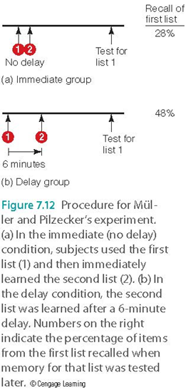
Consolidation

Slide 11
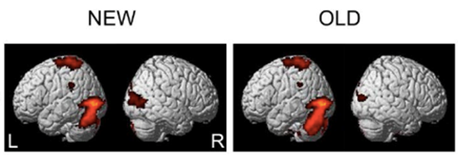
Information Storage at the Synapse
Long-term potentiation (LTP)
Enhanced firing of neurons after repeated stimulation
Structural changes & enhanced responding in the postsynaptic neuron
Repetition suppression
Notes:
•Hebb (1948)
–Learning and memory represented in the brain by physiological changes at the synapse
–Neural record of experience
Image credit:
https://bmcneurosci.biomedcentral.com/articles/10.1186/1471-2202-13-124, Kim et al., 2012
Link between repetition suppression and LTP = Grill-Spector et al., 2006

Slide 12
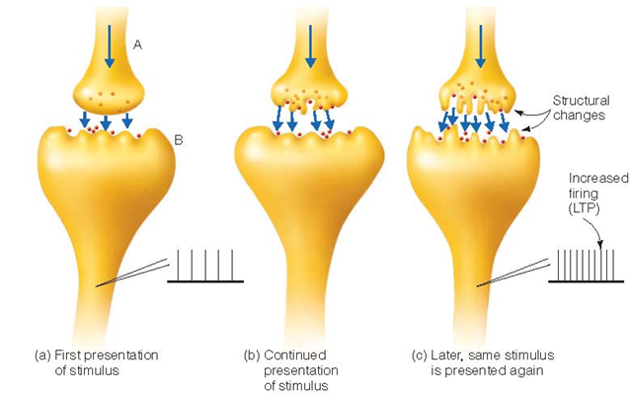
Information Storage at the Synapse

Slide 13
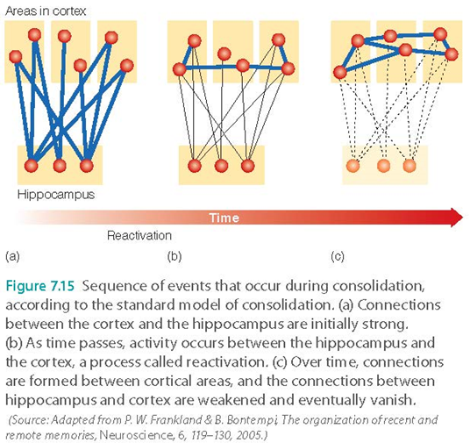
Standard Model of Consolidation
Retrieval depends on hippocampus during consolidation; after consolidation hippocampus is no longer needed
Reactivation: hippocampus replays neural activity associated with memory

Slide 14
Consolidation: Not Everything Has Been Solved
Multiple trace hypothesis
Questions the assumption that the hippocampus is important only at the beginning of consolidation
Hippocampus: activated during retrieval of recent & remote memories
Hippocampus response can change over time
Ripples...

Slide 15
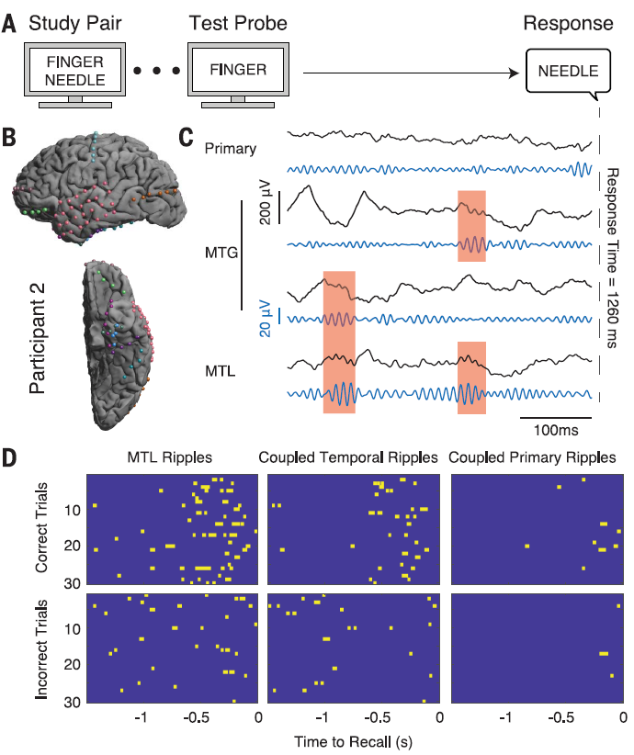
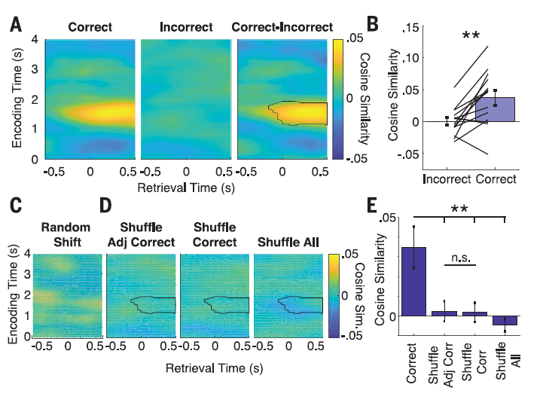
Vaz et al. (2019)

Slide 16

Can You Modify Memories?
Propranolol
Reconsolidation
Memory is constructive, possibly never permanent b/c needs to be updated (cc: Shute, 2014)
Real-world clinical impact?
Notes:
https://www.youtube.com/watch?v=AhK0EX4G018

Slide 17
Autobiographical Memory
Describe the basic fundamental principles of autobiographical memory

Slide 18
Interactions between Episodic & Semantic
Episodic can be lost, leaving only semantic
Acquiring knowledge may start as episodic but then “fade” to semantic
Semantic can be enhanced if associated with episodic
Autobiographical memory: memory of specific experiences, includes semantic and episodic
Personal semantic memory: semantic memories that have personal significance
The seating arrangement y’all have locked into
Can influence what we experience (episodic) by determining what we attend to

Slide 19
Autobiographical Memory (AM)
Memory for specific experiences from our life, which can include both episodic and semantic components
Mental time travel
Multidimensional
Spatial, emotional, and sensory components

Slide 20
Autobiographical Memory (AM)
Sensory component
Greenberg and Rubin (2003)
Patients who cannot recognize objects also experience loss of autobiographical memory
Visual experience plays a role in forming and retrieving AM

Slide 21
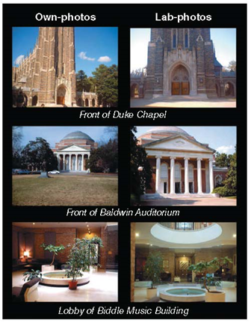
AM at Duke
Cabeza and coworkers (2004)
Comparing brain activation caused by autobiographical memory and laboratory memory
Participants viewed
Photographs they took (A-photos)
Photographs taken by someone else

Slide 22
AM at Duke
Both types of photos activated similar brain structures
Medial temporal lobe (MTL) (episodic)
Parietal cortex (processing of scenes)
A-photos activated more of the
Prefrontal cortex (information about self)
Hippocampus (recollection)
Note that you can’t “reverse inference” what activation in these brain regions means
Like in the “All in the Mind” podcast, this is “autobiographical memory network”

Slide 23
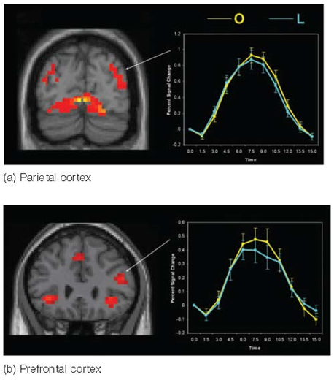
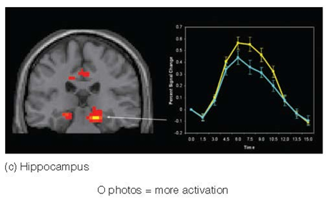
AM at Duke
Is it really meaningful to say that one activates more?

Slide 24
Memory Over the Lifespan
What events are remembered well?
Significant events in a person’s life
Highly emotional events
Transition points
Beginning of college? End?

Slide 25
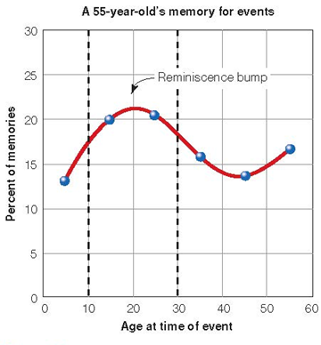
Reminiscence Bump
Participants over the age of 40 asked to recall events in their lives
Memory is high for recent events and for events that occurred in adolescence and early adulthood (between 10 and 30 years of age)

Slide 26
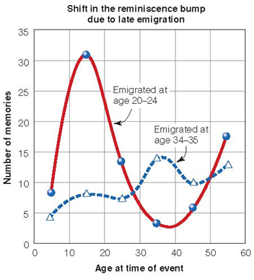
Reminiscence Bump - Why?
Self-image
Becoming who you are
Cognitive
Encoding better during rapid change
Cultural life script
Maybe culture pushes us to remember (falling in love, college, getting married, kids)
Notes:
•Self-image hypothesis
–Memory is enhanced for events that occur as a person’s self-image or life identity is being formed
–People assume identities during adolescence and young adulthood
•Many transitions occur between ages 10 and 30
•Cognitive hypothesis
–Encoding is better during periods of rapid change that are followed by stability
–Evidence from those who emigrated to the US after young adulthood indicates reminiscence bump is shifted
•Cultural life-script hypothesis
•Each person has
–A personal life story
–An understanding of culturally expected events
•Personal events are easier to recall when they fit the cultural life script

Slide 27
Emotion x Memory
Emotional events remembered more easily and vividly
Emotion improves memory, becomes greater with time (may enhance consolidation)
Brain activity in amygdala
Usually tested with emotional vs. neutral words, pictures, etc.
Notes:
-cortisol enhances memory for emotional but not neutral stimuli
-weapons focus, flashbulb memories

Slide 28
Flashbulb Memories
Memory for circumstances surrounding shocking, highly charged important events
Mass shootings, eclipse
Election Days, college acceptance
9/11/01
Kennedy assassination
Challenger explosion
(Cultural components of memory: Collective Memory day)
Where you were, and what you were doing
Highly emotional, vivid, and very detailed
But does that make them more accurate?

Slide 29
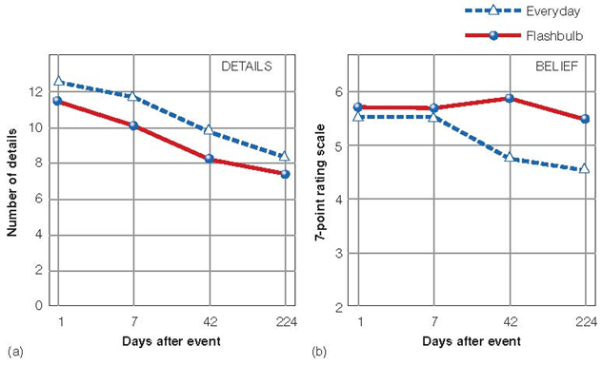
Flashbulb Memories
Flashbulbs are not “photograph” memories, as they can change with the passage of time
Repeated recall
Initial description: baseline
Later reports compared to baseline
Results suggest that these memories can be inaccurate or lacking in detail
Even though participants report that they are very confident and that the memories seem very vivid

Slide 30
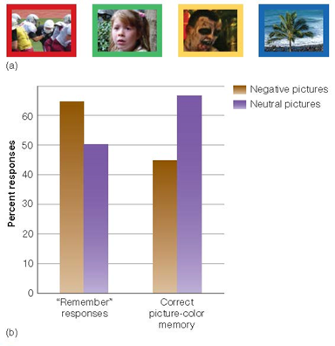
Perhaps because of Emotion?
Rimmele and coworkers (2011)
Memories for negative emotional pictures were stronger, and associated with greater confidence
Notes:
-subjective sense of remembering (vividness of memory, confidence it’s accurate, sense of reliving) but then causing decrease in memory for details
-here participants: 67 percent of emotional pictures got confidence rating of 6+, while only 51 percent for neutral pictures
-Yet despite increased recollection (remember responses), they are actually less accurate at remembering the detail associated with the memory (i.e., the color surrounding the frame)

Slide 31
Or Narrative Rehearsal
Narrative rehearsal hypothesis
Repeated viewing/hearing of event
TV, newspaper, radio, talking with others
E.g., Princess Diana, 9/11
Could introduce errors in own memory

Slide 32
Memory Is Constructive
Memory = What actually happens + person’s knowledge, experiences, and expectations
More later on the ramifications re: False Memory & Misinformation

Slide 33
What do you notice here?
“It was 23 December 1989 when I was 12 days old. I was lying down on the sheepskin car cover of the four-wheel-drive and my parents were taking a picture of me, and I was just looking up at the camera wondering what it was, looking up at the steering wheel of the car because I was on the driver's seat wondering what it was…”
-Becky Sharrock from All in the Mind podcast
Notes:
https://www.abc.net.au/radionational/programs/allinthemind/a-highly-superior-memory/11021088#transcript

Slide 34
Memory Is Constructive
“It was 23 December 1989 when I was 12 days old. I was lying down on the sheepskin car cover of the four-wheel-drive and my parents were taking a picture of me, and I was just looking up at the camera wondering what it was, looking up at the steering wheel of the car because I was on the driver's seat wondering what it was…”
-Becky Sharrock from All in the Mind podcast
Notes:
https://www.abc.net.au/radionational/programs/allinthemind/a-highly-superior-memory/11021088#transcript

Slide 35
First Memories
Recall and write a title and description for your earliest memory. Has to be something you remember, not just based off a photograph or story. Title should be long & specific enough that if you read it again, you know the memory.
Do you see the memory in your PoV or from an observer perspective?
How old (in years) were you when the event happened?
How intense was your emotional response to the remembered event? 1 = not very intense, 2 = very intense
How vivid is the memory? 1 = low, 3 = moderate, 5 = high
How often have you talked & thought about the memory? Same 1-5
Notes:
https://journals-sagepub-com.proxy.lib.duke.edu/doi/full/10.1177/0956797618778831
They were instructed to recall and then type a title and description (in the box provided) of their very earliest memory. The title was to be only a few words in length but of sufficient specificity that if they read it again, it would remind them of the memory they had recalled. The memory description was to be about a paragraph or so in length. The memory itself had to be one that they were certain they remembered. It should not be based on, for example, a family photograph, family story, or any source other than direct experience. The memory had to be for a specific one-off event that lasted no longer than minutes or hours. It was specifically emphasized that the memory should not be of a routine or repeated event. After entering the title and memory description, respondents were then asked to enter, in years, the age they believed they were in the memory. Following this, the respondents answered a series of questions regarding the recollective qualities of the memory (see the Supplemental Material for details).
(1) Is the memory seen from a field perspective (approximating your original point-of-view) or from an observer perspective in which you “see” yourself in the memory? Responses to this question were optional and if respondents felt they could not make this judgment they left the boxes unchecked. (2) How vivid is the memory? (3) How intense was your emotional response to the remembered event? (4) How often have you talked and thought about this memory? (5) How old were you when the remembered event happened (in years)? Questions 2 and 4 were answered by checking a box on a 5-point scale where 1=low, 3=moderate, and 5=high, intermediate numbers were used for more fine-grained answers. Question 3 was answered by checking a box on a 2-point scale where 1 was “not very intense”, and 2 was “very intense”.

Slide 36
Examples
“I can still see the pattern of the hood trim from the inside, the toy strung across with yellow, pink and blue plastic lambs that rattled when I hit them, and the inside of the sun shade that was clamped to the pram when the sun was shining green lining and a tiny abstract/flower pattern”
--Improbably Early memory (1 year)
“I remember that it was my 4th birthday and that mu uncle had bought me a loopy loo doll. It was almost as big as me and had blue hair and a blue check dress”
--Probable memory (3 year)

Slide 37
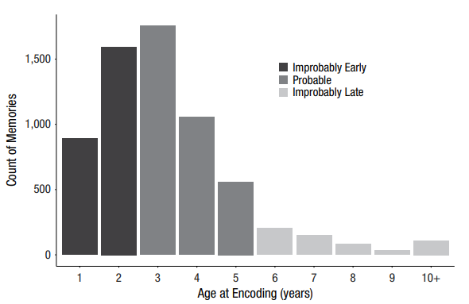
What age group do you fall in?
Akhtar et al., 2015, Psych Sci
Notes:
“Thus, the age at encoding of most memories fell in the predicted range, 2 years to 5 years old; however, the second largest group of memories had ages at encoding that were unexpectedly early, falling in the period of 2 years and less, and these were greater in number than improbably late memories dating to 6 years and older.”
“These means were reliably different, t(1695) = 6.02, p < .001, d = 0.19, 95% CI = [0.13, 0.25]), showing that the older group had reliably earlier first memories than the younger group. “

Slide 38
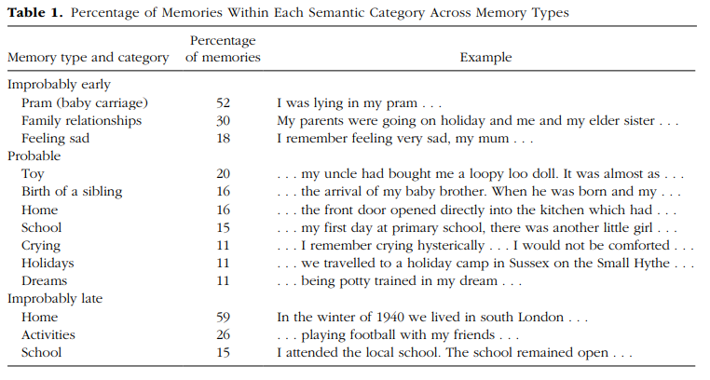
Memory Content
Akhtar et al., 2015, Psych Sci
Notes:
“It is hypothesized that early memories are fragments of memories (Bruce et al., 2000), lacking rich and detailed descriptions. “
“ improbably early memories had a reliably shorter word count than improbably late memories (M = 70.33, 95% CI = [65.78, 74.88]; p < .001, b = 0.025, 95% CI = [0.011, 0.039])”
“In Table 1, it can be seen that 100% of descriptions of improbably early memories fit into one of three categories, the dominant category being memory descriptions in which a pram (baby carriage) featured across various contexts”

Slide 39
An Explanation?
“The present findings pose a major conundrum: The child and young adult research, as reviewed earlier, concludes that earliest memories cannot exist below about the age of 2 years and that there would be comparatively few memories below the age of 3 years….”
Incorrect estimates of dates? But semantic analysis
Self-selection bias? No differences in rehearsal
Largely imagined...fictional memories?
“Thus, we suggest that what a rememberer has in mind when recalling fictional improbably early memories is an episodic-memory-like mental representation consisting of remembered fragments of early experience and some facts or knowledge about his or her own infancy or childhood. In addition, further details may be nonconsciously inferred or added, such as that one was wearing a nappy (diaper) when standing in the cot. “
Akhtar et al., 2015, Psych Sci
Notes:
Memory is constructed!!

Slide 40
Severely Deficient Autobiographical Memory
“...Here we report data from three healthy, high functioning adults with the reverse pattern: lifelong severely deficient autobiographical memory (SDAM) with otherwise preserved cognitive function.”
Successfully employed (one w/ PhD!)
Remember/Know
Selected two events from each of six lifetime periods (1 week ago, 1 month ago, 1 year ago, 10 years ago, teenage years, and childhood) that were specific in time and place.
Future & Past Events Rated for Detail, etc.
Notes:
https://www.sciencedirect.com/science/article/pii/S002839321500158X
–Remember/Know procedure
•Remember if a stimulus is familiar and the circumstance under which it was encountered?
•Know if the stimulus is familiar but don’t remember experiencing it earlier?
•Don’t remember the stimulus at all
“humorous word-definition pairings (e.g., “A talkative featherbrain–parakeet”) presented either auditorily or visually; 72 humorous definitions were presented in four study blocks. Study items were randomly assigned to tests at 30 min or 24 h delays. At test, participants completed cued recall (i.e., generating the word upon presentation of the definition), old/new recognition (i.e., discriminating previously studied items from unstudied lures), source recall (i.e., determining whether the items were presented auditorily or visually), and remember/know judgements, which refer to subjective reports of recollection of physical or mental associations from encoding (“remember” response) versus familiarity with the studied item in the absence of recollection (“know” response)
“These details were assigned to one of five detail categories (event, place, time, perceptual, and emotion/thought) that were summed to form an internal detail composite score (see Levine et al., 2002). To avoid subjectivity in detail categorization, the AI scoring instructions stipulate that any detail that could reasonably be interpreted to reflect episodic re-experiencing be scored as “internal.” Otherwise, details were considered “external,” and consisted of semantic facts (factual information or extended events that did not require recollection of a specific time and place), autobiographical events tangential or unrelated to the main event, repetitions, or other metacognitive statements (“I can't remember”) or editorializing (“It was the best of times”)
“Finally, participants provided subjective ratings for each event, which included the following: (1) how clearly can you visualize this event (1, vague; to 6, highly vivid), (2) how much did your emotional state change from before the event occurred to after it happened (1, no change; to 6, tremendous change), (3) how personally important is this event to you now, and (4) how personally important was this event to you then (1, not important; to 6, of great importance).”

Slide 41
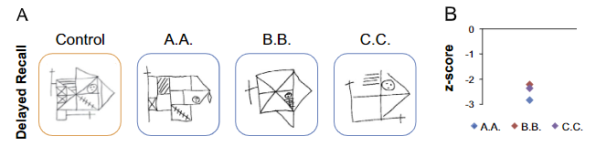
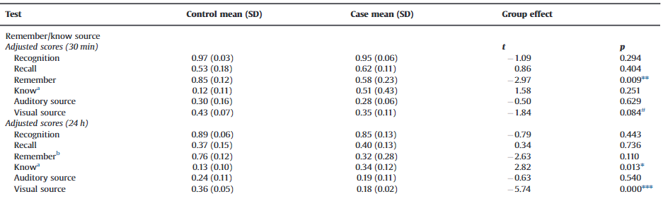

Slide 42
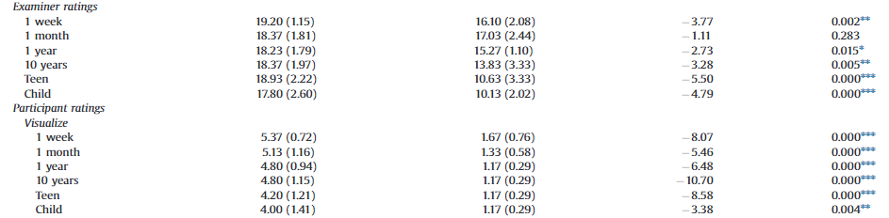
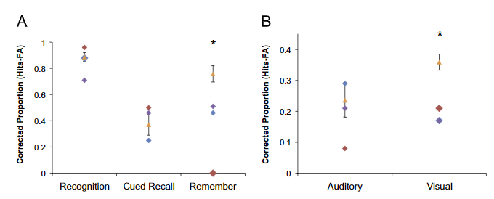

Slide 43
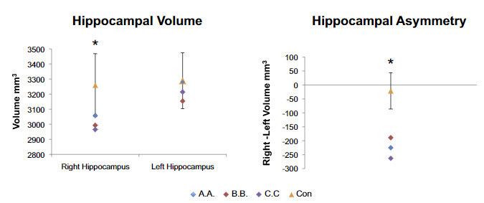

Slide 44
What Does It Mean?
“We report data from three healthy adults with a mnemonic syndrome that is confined to an inability to mentally travel backwards in time in the absence of detectable neuropathology or significant daily life handicap…”
“Their self-reported selective inability to vividly recollect personally experienced events from a first-person perspective was corroborated by absence of functional magnetic resonance imaging (fMRI) and event-related potential (ERP) biomarkers associated with naturalistic and laboratory episodic recollection, as well as by behavioral evidence of impaired episodic retrieval, particularly for visual information. Yet learning and memory were otherwise intact, as long as these tasks could be accomplished by non-episodic processes.”
Notes:
The SDAM cases' profile of laboratory memory test scores was notable for impaired recovery of visual information. Their delayed complex figure recall was uniformly poor. Whereas comparison subjects tended to be more accurate at identifying the visual than auditory presentation modality of verbal paired associates, all of the SDAM cases showed the opposite pattern, with impairment for visually presented items, particularly after 24 h
The SDAM cases' production of internal details (i.e., details specific in time and place) on the AI was significantly different from comparison participants for the teenage and childhood time periods only..

Slide 45
How does HSAM differ from SDAM?

Slide 46
Academic Articles
Summarize and critically analyze academic journal articles

Slide 47
Rubin et al. (2019) & Stanley et al. (2017) - Autobiographical Memory
Fill out or discuss the associated worksheet on the papers you read for today with the person closest to you

Slide 48
Quiz # 3
Define, identify, and apply previous constructs that we have discussed in class

Slide 49
Today’s Goals + Agenda
LO1: Continue to build a supportive classroom culture & discuss science communication
Peer feedback on multiple SciComm paragraphs
LO2: Define, identify, and apply previous constructs that we have discussed in class
Quiz on material covered since last class: multiple choice & short answer
LO3: Describe the basic fundamental principles of autobiographical memory
Review LTM: Processes material
First memories, flashbulb memories, reminiscence bump, memory as constructive, deficient & superior AM
LO4: Summarize and critically analyze academic journal articles
Are there practical applications of these memory findings, like in Leung (2019)? Worksheet on journal articles

Slide 50
Tomorrow’s Work
Readings
Chapter 9 from textbook on Knowledge/Categorization
I.e., no accessible academic articles…
Assignments
Opening paragraph of science summary
Midsemester feedback survey

Slide 51
Participation + Minute Paper
https://tinyurl.com/PSY102Participation
https://tinyurl.com/PSY102MinutePaperJune3

Slide 52
Additional Practice
Optional: Test Yourself

Slide 53
General Questions
What do we mean when we say that memory is constructive? What does it mean that autobiographical memory is multidimensional & includes semantic & episodic components? What happens to folks with great or bad AM? What events are most memorable & why? What are flashbulb memories & the theories underlying them?

Slide 54
Asking people to recall the most influential events that happened during their college careers shows that _____ in people’s lives appear to be particularly memorable.
Trauma-based experiences
Family-centered challenges
The freshman year
Transition Points

Slide 55
The observation that older adults often become nostalgic for the ‘good old days’ reflects the self-image hypothesis which states that
Life in a society gets more complicated & difficult as generations pass
Memory for life events is enhanced during the time we assume our life identities
People tend to remember more of the positive events in their lives than negative ones
Our memories change as we live longer and have more ‘lifetime periods’ to draw from

Slide 56
Flashbulb memory is best represented by which of the following statements?
It is vivid memory for emotional events
It is vivid, highly accurate memory for the circumstances surrounding how a person heard about an emotional event
It is memory for the circumstances surrounding how a person heard about an emotional event that remains especially vivid but not necessarily accurate over time
It is vivid, highly accurate memory for emotional events.

Slide 57
Let’s say two scientists measured people’s memories of the terrorist attacks on 9/11/01. Which of the following would best represent the results we’d expect?
Participants would have very little confidence in the accuracy of their memories of the events 32 weeks after they occurred
Participants would have a very high level of confidence of the terrorist events and also have high confidence in their present “everyday” memories 32 weeks later
Participants would have high confidence in the accuracy of their memories of the terrorist events 32 weeks later, but when actually tested, would make significant errors when asked what they were doing on the day of the attacks.
After 32 weeks, participants would have a higher level of confidence in their memories of the terrorist events, but lower belief in their memories of ‘everyday’ events

Slide 58
MC answer key
Transition
Memory for life events
Memory for circumstances (3rd)
After 32 weeks

