Slide 1
PSY102: Introduction to Cognitive Psychology
Day 14 (06/04/19): Knowledge / Categorization

Slide 2
Today’s Work + Agenda
LO1: Continue to build a supportive classroom culture & discuss science communication
Peer feedback on opening science summary paragraphs
Tomorrow: will get back to the worksheet from yesterday on memory articles & tie all together
LO2: Describe the basic fundamental principles of categorization & knowledge
Discussion of Chpt 9 in Goldstein book
Compare and contrast the prototype and exemplar approaches to categorization
Compare and contrast the semantic category approach to the connectionist model of representing knowledge

Slide 3
Tomorrow’s Work
Scientist Summaries:
Hutter & Wilson (2018) -> category learning
Frankland & Josselyn (2018) -> conditioning
Ramirez (2018) -> consolidation of memories
Just read 1; gives you an extra example of scientist summary, since you haven’t had as many
Podcast:
Looking Back from Hidden Brain
Can think of this in light of Stanley et al. (2017) (the counterfactuals, imagine memory worse/better)
Wikipedia Biography (see Slides on Friday for guide)
Midsemester Course Feedback - please!

Slide 4
Peer Feedback on Scientist Summary
Continue to build a supportive classroom culture & discuss science communication

Slide 5
Peer Feedback
Take the next minute or two to read through the opening paragraph of the person next to you.
Then, take some time (~5 min) to discuss what could be improved and what was already strong in the paragraph.

Slide 6
Categorization & Knowledge
Describe the basic fundamental principles of categorization & knowledge

Slide 7
Concepts & Categories
Provide a means to organize and use your knowledge / semantic memory
Helps us know things about an item
it’s a car, so it’s likely to need gas
QOTD: How does the mind represent categories?
Notes:
•Conceptual knowledge: knowledge that enables us to recognize objects and events and to make inferences about their properties
•Concept: mental representation used for a variety of cognitive functions
•Categorization is the process by which things are placed into groups called categories
–Categories are all possible examples of a particular concept

Slide 8
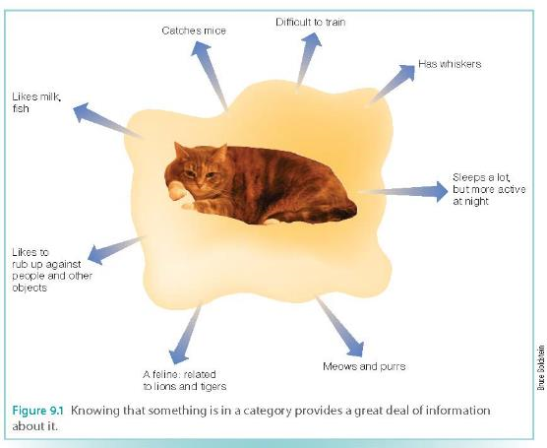
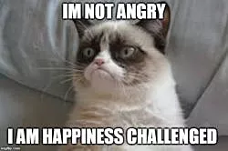
Inferences You Can Make
Notes:
•Help to understand individual cases not previously encountered
•“Pointers to knowledge”
–Categories provide a wealth of general information about an item
–Allow us to identify the special characteristics of a particular item
(EMOTIONS!! Connect back to our previous discussion on emotions too).
Credit: https://fansided.com/2019/05/17/grumpy-cat-dead-long-live-grumpy-cat-memes/

Slide 9
Definitional approach
Necessary conditions (definition of category)
Window
Rectangular, clear material, separates inside and outside of building, does not function as an entrance/exit under normal circumstances
What about a round window, stained glass window, or a window in front of a bank teller or clinic receptionist?
What’s the problem?
What about family resemblance?
Notes:
•Determine category membership based on whether the object meets the definition of the category
•Does not work well
•Not all members of everyday categories have the same defining features
•Family resemblance
–Things in a category resemble one another in a number of ways
•

Slide 10
Demo:
In 1 minute, list as many items as you can in the category “birds”...
Notes:
When asked to list as many objects in a category as possible, people tend to list the most prototypical members of the category first. So, people saw sparrow before penguin.

Slide 11
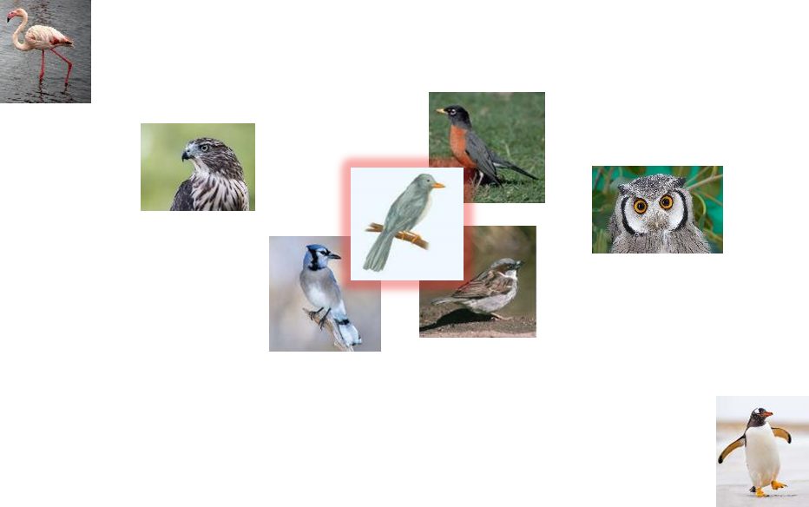
Notes:
Image credits: Cengage 2015; http://animals.sandiegozoo.org/animals/flamingo; http://mentalfloss.com/article/56416/20-fun-facts-about-penguins-world-penguin-day; http://animals.sandiegozoo.org/animals/owl; https://study.com/academy/lesson/what-do-hawks-eat-lesson-for-kids.html

Slide 12
Prototype approach
How similar is an object to the most typical, average case?
Only one prototype per category
Does not need to be a real example
What is your idea of a typical window?
Rate how much an item matches category:
High prototypicality: close member-prototype match
Low prototypicality: not a close match
Strong, positive relationship between prototypicality & family resemblance
Notes:
•Prototype = “typical”
•An average representation of the “typical” member of a category
•Characteristic features that describe what members of that concept are like
•An average of category members encountered in the past
•High-prototypicality: category member closely resembles category prototype
–“Typical” member
–For category “bird” = robin
•Low-prototypicality: category member does not closely resemble category prototype
–For category “bird” = penguin
•Strong positive relationship between prototypicality and family resemblance
•When items have a large amount of overlap with characteristics of other items in the category, the family resemblance of these items is high
•Low overlap = low family resemblance

Slide 13
Demo: Family Resemblance
List as many characteristics and attributes as you can that you feel are common to these objects.
Chair
Sofa
Mirror
Telephone
Notes:
Similar characteristics for chair and sofa (having legs, having backs, sitting on them, etc.)
-Family resemblance of sofa/chair is high
•Strong positive relationship between prototypicality and family resemblance
•When items have a large amount of overlap with characteristics of other items in the category, the family resemblance of these items is high
•Low overlap = low family resemblance

Slide 14
Sentence verification
Say “yes” if the statement is true and “no” if the statement is false.

Slide 15
An apple is a fruit.

Slide 16
A pomegranate is a fruit.

Slide 17
A tomato is a fruit.

Slide 18
Typicality Effect
You’re faster to respond for objects that are high in prototypicality.
Fastest for apple, then pomegranate, then tomato

Slide 19
Demo:
Say “same” out loud if the color dots I present you with are of the same color and “different” if the dots differ in color.

Slide 20
blue

Slide 22
blue

Slide 24
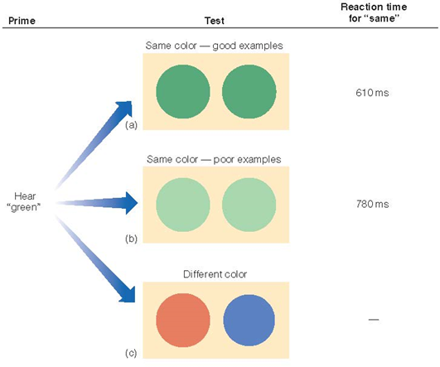
Typicality Effect
Notes:
•Typicality effect: prototypical objects are processed preferentially
–Highly prototypical objects judged more rapidly
•Sentence verification technique
•Smith et al. (1974)
•Typicality effect: prototypical objects are processed preferentially
–Prototypical objects are named more rapidly
–Prototypical category members are more affected by a priming stimulus
–Rosch (1975b)
•Hearing “green” primes a highly prototypical “green”

Slide 25
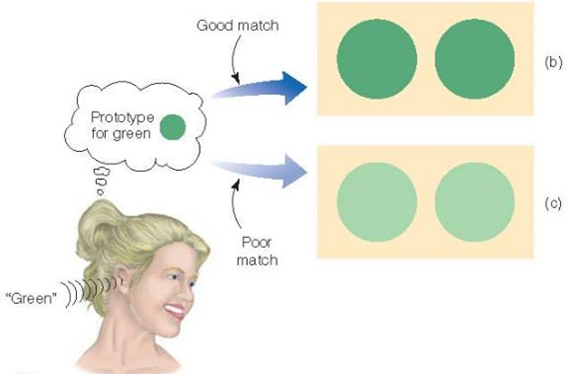
Typicality Effect
Notes:
Can draw us back to how language shapes perception

Slide 26
In sum...
Family Resemblance: High prototypical items rated higher as “good” members of categories (e.g., ~ sofa/chair demo)
Typicality: Respond faster/Categorize more quickly members that are “typical” of category (e.g., fruit demo)
Naming: Name high prototypical items first when thinking of category members (e.g., bird demo)
Priming: faster same-different color judgments for high prototypical items (e.g., blue dots demo)

Slide 27
Let’s answer some MC...

Slide 28
Which of the following statements is NOT a reason why categories are useful?
Categories provide definitions of groups of related objects
Categories help us understand behaviors that we might otherwise find baffling
Categories serve as a valuable tool for making inferences about things that belong to other categories
Categories have been called “pointers to knowledge” because once you know an object’s category, you know a lot of general things about it.
Notes:
A

Slide 29
The principle illustrated when most people are able to recognize a variety of examples of chairs even though no one category member may have all of the characteristic properties of “chairs” (e.g., most chairs have four legs but not all do) is
Family resemblance
Prototypicality
Graded membership
Instance theory
Notes:
A

Slide 30
The prototype approach to categorization states that a standard representation of a category is based on
The definition of the category
A universal set of category members
A defined set of category members
Category members that have been encountered in the past
Notes:
D

Slide 31
A task for determining how prototypical an object is would be
A fill-in-the-blank task where participants generate paired members within a category
A task where participants rate the extent to which each member represents the category title
A task where participants rate the extent to which category members resemble one another
A fill-in-the-blank task where participants generate the category classification for a list of members
Notes:
B

Slide 32
Exemplar approach
How similar is an object to previous examples?
Multiple exemplars per category
Exemplars are real cases (not abstract averages)
What are representative examples of different types of windows you have encountered?
Test object
How well does it match any of those exemplars?
Similarly… the more similar a specific exemplar to a known category member, the faster it’s categorized (family resemblance effect)
Notes:
•Concept is represented by multiple examples
(rather than a single prototype)
•Examples are actual category members
(not abstract averages)
•To categorize, compare the new item to stored examples
•Similar to prototype view
–Representing a category is not defining it
•Different: representation is not abstract
–Descriptions of specific examples
•The more similar a specific exemplar is to a known category member, the faster it will be categorized (family resemblance effect)
•
•Explains typicality effect
•Easily takes into account atypical cases
•Easily deals with variable categories
•

Slide 33
Exemplars
Like prototypical categories, the question is “How much does X resemble” something
(Instead of “Does it meet every single criterion”)
Instead of resembling a prototype, it’s resembling known category members
Exemplars

Slide 34
Using Different Approaches
You encounter Item X. You want to see if it’s in Category Y.
Which of these do we definitely not want to use and why?
Definitional approach?
Prototype approach?
Exemplar approach?

Slide 35
Using Different Approaches
You encounter Item X. You want to see if it’s in Category Y.
Which of these do we definitely not want to use and why?
Definitional approach?
Prototype approach? - “How closely does X resemble the prototypical Y?”
Exemplar approach? - “How closely does X resemble a Y I’ve seen in the past?”

Slide 36
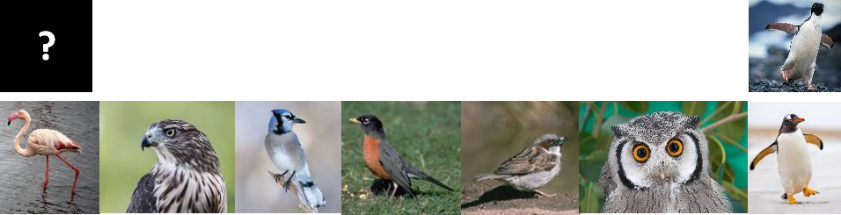
Notes:
Image credits: https://seaworld.org/en/animal-info/animal-infobooks/penguin/

Slide 37
Which do we use?
Most likely both, but in different situations
Prototype = large categories
Exemplar = small categories
Why?
Notes:
•May use both
•Exemplars may work best for small categories (can handle atypical cases)
•Prototypes may work best for larger categories

Slide 38
Let’s Answer Some MC...

Slide 39
Not all of the members of everyday categories have the same features. Most fish have gills, fins, and scales. Sharks lack the feature of scales, yet they are still categorized as fish. This poses a problem for the ____ approach to categorization.
Prototype
Exemplar
Definitional
Family resemblance
Notes:
C

Slide 40
Olin and Bob are neighbors. Olin loves birds and his father works for the zoo. He has been to a dozen bird sanctuaries, and he and his dad go on bird watching hikes once a month. In contrast, Bob doesn’t think much about birds. His only contact with them is in his backyard. It would be correct to say that Olin’s standard probably involves
More prototypes than Bob’s
More exemplars than Bob’s
More prototypes and more exemplars than Bob’s
The same prototypes and exemplars as Bob’s
Notes:
B

Slide 41
Imagine that a young child is just learning about the category “dog.” Thus far, she has experienced only two dogs, one a small poodle and the other a large German shepherd. On her third encounter with a dog, she will be LEAST likely to correctly categorize the animal as a dog if that animal
Matches the size of the poodle but is of a different breed
Is a dog that does not bark
Matches an exemplar of one of the dogs she has experienced
Is similar to an “average” for the dogs she has encountered
Notes:
B

Slide 42
For the category ‘fruit,’ people give a higher typicality rating to ‘banana’ than to ‘kiwi.’ Knowing that, we can also reason that
The word ‘fruit’ will lead to a larger priming effect for banana than for kiwi
When people are asked to list all the fruits they can think of, kiwi will usually appear on their list before banana
Neither kiwi nor banana are likely to be the fruit ‘closest’ to the prototype of the fruit category
People will have a similar number of exemplars for kiwi and banana
Notes:
A

Slide 43
How do we know how specific to get in our categorization?
Vertebrates
Birds
Flamingo
Hawk
Blue-jay
Robin
Sparrow
Owl
Penguin

Slide 44
Hierarchical Organization of Categories
Superordinate categories
Basic categories
Specific (or subordinate)
Furniture (Global)
Chairs
Armchairs
Dining room chairs
Tables (Basic)
Coffee table
Kitchen table (Subordinate / specific)
Beds
Queen-sized bed
Bunk beds
Notes:
•Hierarchical organization: larger more general categories divided into smaller, more specific categories
•To fully understand how people categorize objects, one must consider
–Properties of objects
–Learning and experience of perceivers

Slide 45
Basic = best
Basic categories are the most psychologically important
It’s the label you are likely to assign an item that you see
You answer quickest to basic categories
RT for “Is this a pumpkin?” < RT for “Is this a vegetable?” or “Is this a small sugar pumpkin?”
Rosch (1976) asked subjects:
“How many things do all pieces of furniture have in common?”
“How many things do all tables have in common?”
“How many things do all kitchen tables have in common?”
Notes:
•Going above basic level results in a large loss of information
•Going below basic level results in little gain of information

Slide 46
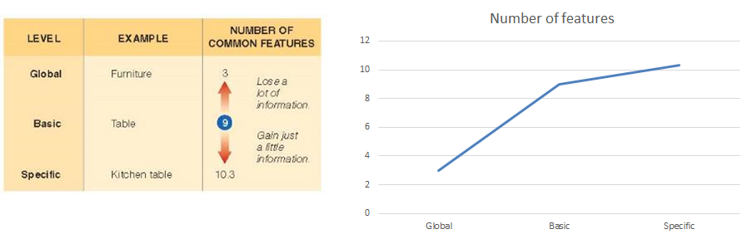
Table as the basic category
Notes:
•Going above basic level results in a large loss of information
•Going below basic level results in little gain of information

Slide 47

Notes:
Image credits: http://cphpost.dk/news/carpentry-in-denmark-and-the-rise-of-the-hipster-chippy.html

Slide 48
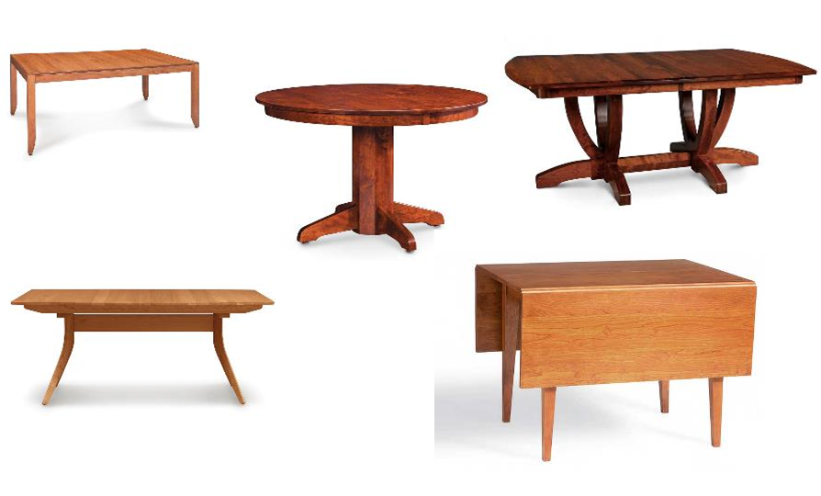
Notes:
Image credit: https://creativeclassics.com/dining-table-types/

Slide 49
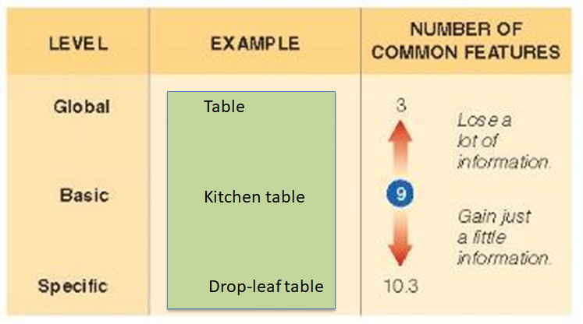
Kitchen table as the carpenter’s basic category - effect of expertise/familiarity
Notes:
Teaching as another example – my basic levels of knowledge about a subject are very different from a student at intro level

Slide 50
Let’s Answer Some MC...

Slide 51
Jumping from ____ categories results in the largest gain in information.
Superordinate level to basic level
Basic level to subordinate level
Subordinate level to basic level
Basic level to superordinate level
Notes:
A

Slide 52
If we were conducting an experiment on the effect knowledge has on categorization, we might compare the results of expert and non-expert groups. Suppose we compose horticulturalists to people with little knowledge about plants. If we asked the groups to name, as specifically as possible, five different plants seen around campus, we would predict that the expert group would primarily label plants on the _____ level, while the non-expert group would primarily label plants on the _______ level.
Superordinate; subordinate
Superordinate; basic
Subordinate; basic
Basic; subordinate
Notes:
C

Slide 53
Takeaways
How do we decide what fits in a category?
Definition? (nope)
Prototype? (sometimes)
Exemplar? (sometimes)
Hierarchy of categories
Global/superordinate > basic > specific/subordinate
Basic categories are “privileged” (psychologically important)
What counts as “basic” to you depends on your life history and situation
Basic = the point at which getting more specific stops adding that much more detail

Slide 54
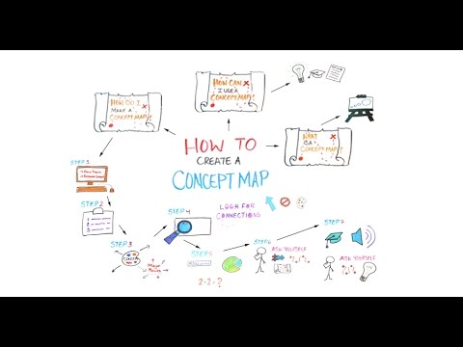
Apply to Everyday Life?
Aside from relation to research on emotion & language that we’ve discussed… (and memory systems)...
Notes:
https://www.youtube.com/watch?v=sZJj6DwCqSU

Slide 55
Computational models for knowledge storing

Slide 56
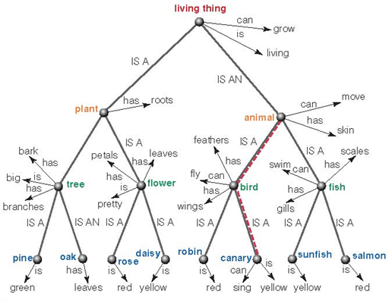
Collins & Quillian, 1969: Semantic Network Approach
Cognitive Economy
Exceptions (e.g., ostrich)
Inheritance
Notes:
•Concepts are arranged in networks that represent the way concepts are organized in the mind
•Collins and Quillian (1969)
–Node = category/concept
–Concepts are linked
–Model for how concepts and properties are associated in the mind
•Cognitive economy: shared properties are only stored at higher-level nodes
•Exceptions are stored at lower nodes
•Inheritance
–Lower-level items share properties of higher-level items

Slide 57
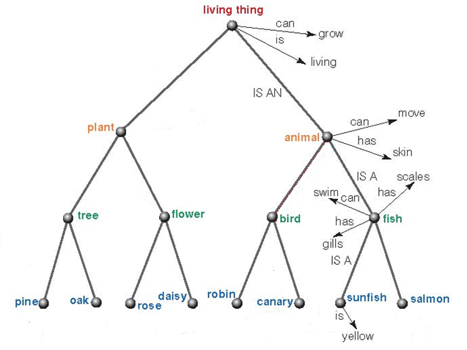
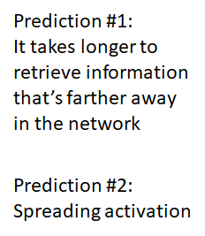
Collins & Quillian, 1969: Semantic Network Approach
Notes:
•Spreading activation
–Activation is the arousal level of a node
–When a node is activated, activity spreads out along all connected links
–Concepts that receive activation are primed and more easily accessed from memory

Slide 58
Collins & Quillian, 1969: Semantic Network Approach
Is cognitive economy right?
RT for “A pig is a mammal” > RT for “A pig is an animal”
Typicality effect
Less prototypical stuff should be slower to recognize as part of that category, but…
A canary is a bird > An ostrich is a bird
Notes:
•Criticism of Collins and Quillian
–Cannot explain typicality effects
–Cognitive economy?
–Some sentence-verification results are problematic for the model

Slide 59
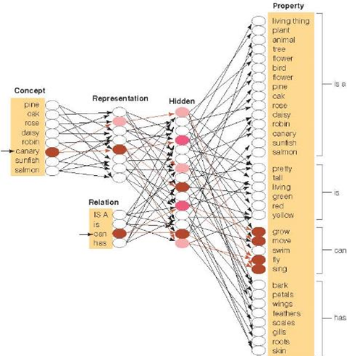
Connectionist Models
Units
Weights
Knowledge rep
Notes:
•Creating computer models for representing cognitive processes
•Parallel distributed processing - Knowledge represented in the distributed activity of many units
•Weights determine at each connection how strongly an incoming signal will activate the next unit

Slide 60
Connectionist Models
The representation of an item is distributed across a lot of units (sound familiar?)
Similar concepts have similar representations
There are intermediate units (middle) which can allow us to have complicated representations on the other side (right) of the item (left)
Not only is the representation that codes for an item distributed across a lot of units, that representation is repeated across the network…
...So if you knock out any one part of the network, you don’t lose the whole concept
“Graceful degradation”
The representation isn’t just made up of binary 1s and 0s – there are “connection weights” that differ
A network can be “trained” by having experiences over time, and those connection weights can be updated

Slide 61
The representation of an item is distributed across a lot of units

Slide 62
Similar concepts have similar representations
Notes:
Generalization of learning: training to recognize properties of one concept provides information about other related concepts

Slide 63
There are intermediate units (middle) which can allow us to have complicated representations on the other side (right) of the item (left)

Slide 64
Not only is the representation that codes for an item distributed across a lot of units, that representation is repeated across the network…

Slide 65
...So if you knock out any one part of the network, you don’t lose the whole concept

Slide 66
The representation isn’t made up of binary 1s and 0s – there are “connection weights” that differ

Slide 67
A network can be “trained” by having experiences over time, and those connection weights can be updated
Notes:
-where back propagation & error signals come in

Slide 68
Takeaways
Collins & Quillian/Semantic Network approach
Reflects the hierarchical nature of categories
Puts shared attributes at the right nodes to make the most efficient design possible (cognitive economy)
But it doesn’t seem to always work
Typicality not explained
Connectionist models
Know the attributes of a connectionist model
Can you create walk yourself through how one concept from this class works? Use memory as an example.
How does this model differ from the one above?

Slide 69
Today’s Work + Agenda
LO1: Continue to build a supportive classroom culture & discuss science communication
Peer feedback on opening science summary paragraphs
Tomorrow: will get back to the worksheet from yesterday on memory articles & tie all together
LO2: Describe the basic fundamental principles of categorization & knowledge
Discussion of Chpt 9 in Goldstein book
Compare and contrast the prototype and exemplar approaches to categorization
Compare and contrast the semantic category approach to the connectionist model of representing knowledge

Slide 70
Participation + Minute Paper
https://tinyurl.com/PSY102Participation
https://tinyurl.com/PSY102MinutePaperJune4

