Slide 1
PSY102: Introduction to Cognitive Psychology
Day 19 (06/11/19): False Memory

Slide 2
Today’s Goals + Agenda
LO1: Continue to build a supportive classroom culture & discuss science communication
Peer feedback of the multiple paragraphs of science summary piece
LO2: Describe the basic fundamental principles of false memories
Basic principles of memory modification (constructive, schemas, inferences), false memories; demo on Deese-McDermott-Roediger paradigm; eyewitness testimony issues
Discuss small section in Goldstein Chpt 8 on false memories
LO3: Summarize and critically analyze academic journal articles
How does this work impact policy? What are the limitations of this work relative to real-world scenarios of false memories?

Slide 3
Tomorrow’s Work
Fazio et al. (2015) (Duke, illusory truth)
Vosoughi et al. (2018) (spread of fake news)
Lazer et al. (2018) (scisummary on fake news)
Computer game on groupthink, idea propagation & social networks
Continuing to think about the practical implications of memory being constructive - now, with regard to misinformation

Slide 4
Peer feedback on SciSummary paragraphs
Exchange SciSummary papers with someone who hasn’t given you feedback as often.
Take the next 3-5 min, read & mark-up their papers.
Then come together to discuss comments verbally.

Slide 5
Memory Is Constructive
Memory = What actually happens + person’s knowledge, experiences, and expectations
Highly superior autobiographical memory (and general updating of memories, Shute, 2014)
Propranolol and consolidation
Fictional first memories
Stanley et al. (2017) - counterfactuals
Rubin et al. (2019) - scene construction
So now what are the implications of this process?

Slide 6
False Memories
Use of schemas (today)
Misinformation effect (tomorrow)
Source monitoring effect (tomorrow)

Slide 7
Warm-up question
Write down a time when you found out that a memory you were pretty sure about turned out to be wrong.
Keep this. We will return to it at the end of tomorrow.

Slide 8
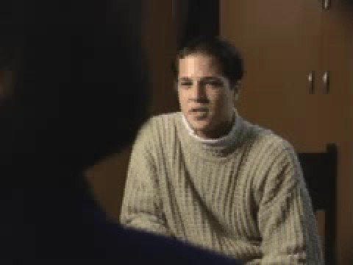
Excuse the old school music
Notes:
https://www.youtube.com/watch?v=PQr_IJvYzbA
Can connect back to Bridgette’s own implanting of false memories in PSY101!
This is one of the first types of studies that Loftus and folks did to show false memory implantation
-Basically pretty similar to what Fraser discussed in his TED talk right?

Slide 9
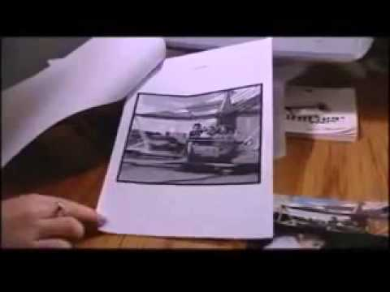
That Hot Air Balloon Ride
Notes:
https://www.youtube.com/watch?v=1qOBwNsb7bw

Slide 10
One night two young men from Egulac went down to the river to hunt seals, and while they were there it became foggy and calm. Then they heard war-cries, and they thought: "Maybe this is a war-party". They escaped to the shore, and hid behind a log. Now canoes came up, and they heard the noise of paddles, and saw one canoe coming up to them. There were five men in the canoe, and they said:
"What do you think? We wish to take you along. We are going up the river to make war on the people".
One of the young men said: "I have no arrows".
"Arrows are in the canoe", they said.
"I will not go along. I might be killed. My relatives do not know where I have gone. But you", he said, turning to the other, "may go with them."
So one of the young men went, but the other returned home.
And the warriors went on up the river to a town on the other side of Kalama. The people came down to the water, and they began to fight, and many were killed. But presently the young man heard one of the warriors say: "Quick, let us go home: that Indian has been hit". Now he thought: "Oh, they are ghosts". He did not feel sick, but they said he had been shot.
So the canoes went back to Egulac, and the young man went ashore to his house, and made a fire. And he told everybody and said: " Behold I accompanied the ghosts, and we went to fight. Many of our fellows were killed, and many of those who attacked us were killed. They said I was hit, and I did not feel sick".
He told it all, and then he became quiet. When the sun rose he fell down. Something black came out of his mouth. His face became contorted. The people jumped up and cried.
He was dead.
Notes:
War of the Ghosts, Bartlett Experiment; story is from Canadian Indian Folklore
•Bartlett’s “war of the ghosts” experiment
–Had participants attempt to remember a story from a different culture
–Repeated reproduction
•Results
–Over time, reproduction became shorter, contained omissions and inaccuracies
–Changed to make the story more consistent with their own culture

Slide 11
Two youths were standing by a river about to start seal-catching, when a boat appeared with five men in it. They were all armed for war.
The youths were at first frightened, but they were asked by the men to come and help them fight some enemies on the other bank. One youth said he could not come as his relations would be anxious about him; the other said he would go, and entered the boat.
…
In the evening he returned to his hut, and told his friends that he had been in battle. A great many had been slain, and he had been wounded by an arrow; he had not felt any pain, he said. They told him that he must have been fighting in a battle of ghosts. Then he remembered that it had been queer and he was very excited.
In the morning, however, he became ill, and his friends gathered round; he fell down and his face became very pale. Then he writhed and shrieked and his friends were filled with terror. At last he became calm. Something hard and black came out of his mouth, and he lay contorted and dead.
Notes:
War of the Ghosts, Bartlett Experiment

Slide 12
Memory is constructive
“War of the Ghosts” (Bartlett, 1932)
Listen to an unfamiliar story (story from different culture)
Repeated reproduction
Reproduce story from memory (Free Recall)
Results
Omissions (recall shorter than original)
Alterations based on what is familiar to the participant
E.g., change “canoe” to “boat”
Notes:
Repeated reproduction - same subjects tried to remember the story at longer and longer intervals after they had first read it
–Over time, reproduction became shorter, contained omissions and inaccuracies
–Changed to make the story more consistent with their own culture
-> recreating the memory from 2 sources: the original memory, plus the memory of similar stories in their own culture
-> source misattribution

Slide 13
False Memories
Our memory has evolved to be efficient and to effectively guide our behavior
We remember general knowledge and the “gist” of an event, and not always the specifics
Usually good results … but things can go wrong
Understanding how false memories happen can help us understand how memory works and vice versa

Slide 14
Demo:
Read the following sentences, pause for a few seconds after each. Raise hand when finished.
The children’s snowman vanished when the temperature reached 80.
The flimsy shelf weakened under the weight of the books.
The absentminded professor didn’t have his car keys.
The karate champion hit the cinder block.
The new baby stayed awake all night.

Slide 15
Demo:
These sentences are the ones you read, with a few words missing. Fill in the blanks with the words you initially read.
The flimsy shelf ________________ under the weight of the books.
The children’s snowman ________________ when the temperature reached 80.
The absentminded professor ________________ his car keys.
The new baby ________________ all night.
The karate champion ________________ the cinder block.

Slide 16
Demo: Common Errors
Substituting vanished for melted
Substituting weakened for collapsed
Substituting didn’t have for lost
Substituting hit for broke or smashed
Substituting stayed awake for cried
-Brewer (1977) & McDermott & Chan (2006)
Notes:
-demo on pragmatic inference

Slide 17
Making Inferences
Memory can be influenced by inferences that people make based on their experiences and knowledge
Pragmatic inferences: based on knowledge gained through experience
Memory often includes information that is implied by or is consistent with the to-be-remembered information but was not explicitly stated

Slide 18
Schemas & Scripts
Schema: knowledge about some aspect of the environment
e.g., Post office, ball game, classroom
Script: conception of sequence of actions that usually occurs during a particular experience
Going to a restaurant; playing tennis

Slide 19
Schemas & Scripts
Schemas and scripts influence memory
Memory can include information not actually experienced but inferred because it is expected and consistent with the schema
The constructive nature of memory can lead to errors or “false memories”

Slide 20
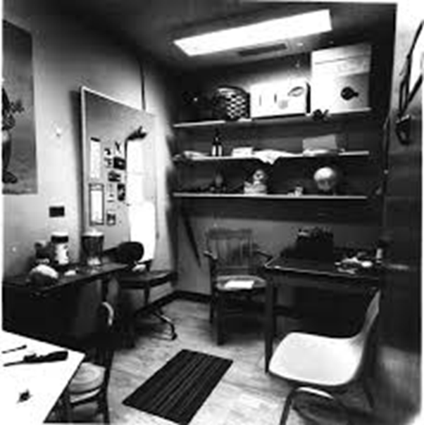
Notes:
-subjects who come to participate in an expt, told to wait in an office while experimenter checks on something else
-after 35 seconds, subs called into another room and told they were being tested on memory of the office & they needed to write down what they had seen while they were sitting in the office

Slide 21
Schemas & Scripts
Office schema includes books
30% of participants reported seeing books, in spite of books not being present

Slide 22
Demo: List
I’m going to read a list of words to you at about a rate of 1 word/sec.
When I finish, you can write down the words that you heard.
Notes:
Bed, rest, awake, tired, dream, wake, night, blanket, doze, slumber, snore, pillow, peace, yawn, drowsy

Slide 23
Demo: Check Answers
Bed, rest, awake, tired, dream, wake, night, blanket, doze, slumber, snore, pillow, peace, yawn, drowsy
Do any of you have words that are not in this list, like sleep?

Slide 24
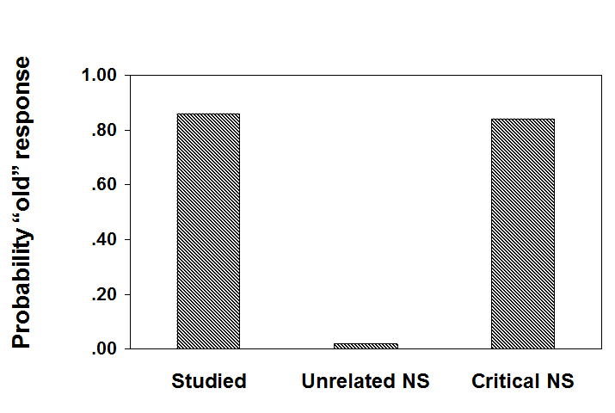
Critical non-studied items are erroneously recognized with a high probability
Roedgier & McDermott, 1995
Notes:
-sleep is the critical nonstudied word in this circumstance

Slide 25
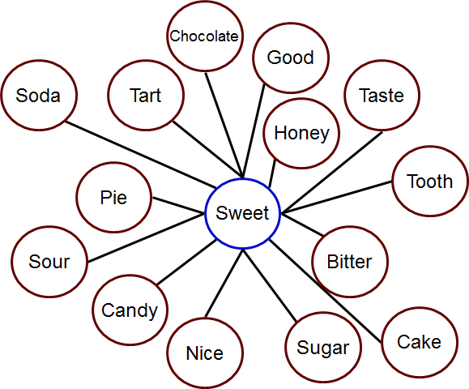
Deese-Roediger-McDermott Paradigm (DRM)
Recalled studied words: 65%
Recalled critical word: 40%
Roedgier & McDermott, 1995
Notes:
New list of words; sweet is the critical (nonstudied) word

Slide 26
False Memories
“All remembering is constructive in nature. . . The illusion of remembering events that never happened can occur quite readily. Therefore, as others have also pointed out, the fact that people may say they vividly remember details surrounding an event cannot, by itself, be taken as convincing evidence that the event actually occurred.”
- Roediger & McDermott (1995, p. 812)

Slide 27
Eyewitness Testimony Matters
“According to the Innocence Project , 358 people who had been convicted and sentenced to death since 1989 have been exonerated through DNA evidence. Of these, 71% had been convicted through eyewitness misidentification and had served an average of 14 years in prison before exoneration. Of those false identifications, 41% involved cross-racial misidentifications (221 of the 358 people were African American). And 28% of the cases involved a false confession.”
Notes:
https://www.psychologicalscience.org/uncategorized/myth-eyewitness-testimony-is-the-best-kind-of-evidence.html

Slide 28
Myths related to the Myth of Eyewitnesses Being Reliable
People won’t confess to a crime they did not commit.
Flashbulb memories, vivid and emotionally compelling memories of the circumstances of learning about a subjectively important event, are more accurately remembered than mundane memories.
Accurate memories can be recovered or enhanced through hypnosis
We repress traumatic childhood memories but these memories can be recovered through therapy and they should be taken as valid and accurate.
Lie detector tests reliably detect deception
Children make good eyewitnesses
Notes:
https://www.psychologicalscience.org/uncategorized/myth-eyewitness-testimony-is-the-best-kind-of-evidence.html

Slide 29
Errors in Eyewitness Testimony
Testimony by an eyewitness to a crime about what he or she saw during the crime
One of the most convincing types of evidence to a jury
Assume that people see and remember accurately
But, like other memory, eyewitness testimony can be inaccurate
Mistaken identity
Constructive nature of memory
People assume that memory works like a camera or video recorder. They also don’t know how memory works & how these eyewitness memories are usually formed under less than ideal circumstances.

Slide 30
Errors in Eyewitness Testimony
Wells & Bradfield (1998)
Participants view security videotape with gunman in view for 8 seconds
Everyone identified someone as the gunman from photographs afterwards
The actual gunman’s picture was not presented
Notes:
1 source of error: does the witness actually perceive what happened???
-identifications are difficult
-emotions are usually high during a crime

Slide 31
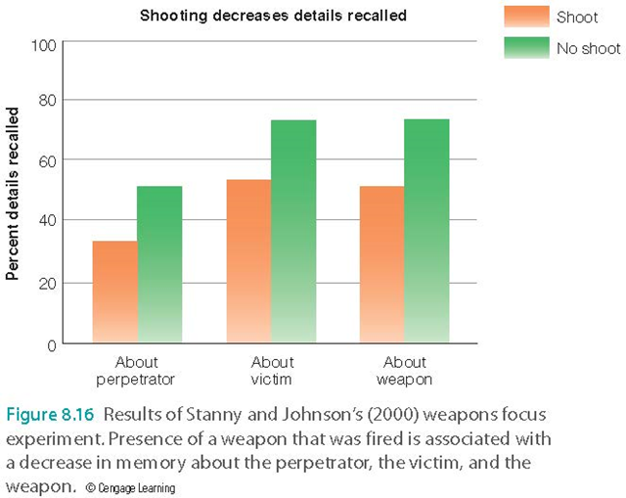
Errors in Eyewitness Testimony
Errors due to attention & arousal
Attention can be narrowed by specific stimuli
Weapons focus
Stanny & Johnson (2000)
Notes:
-emotions are usually high during a crime, so this affects what you pay attention to
-tendency to focus attention on a weapon -> narrowed focus
-subs more likely to recall details of perpetrator, victim, and weapon in the “no-shoot” condition (gun present but not fired) vs. “shoot” condition (gun fired)

Slide 32
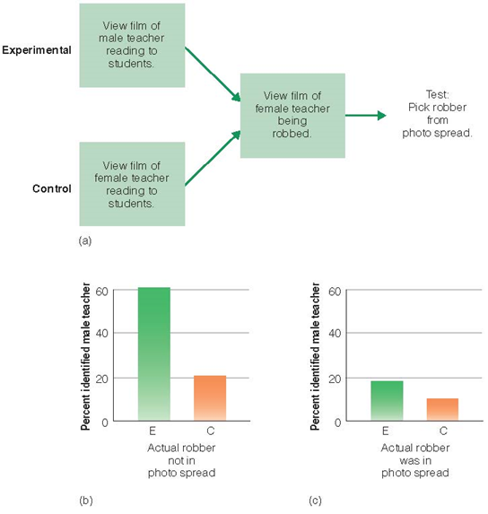
Errors in Eyewitness Testimony
Errors due to familiarity
Source monitoring
Notes:
•Source monitoring error
–Failure to distinguish the source of the information
–MPI is misattributed to the original source
Will get more into this for the Misinformation pptx
-bystanders could be identified as perps due to familiarity
-saw a film of a male teacher reading to students vs. film of female teacher reading to students
-both groups then saw a film of the female teacher being robbed and were asked to pick the robber from a photo spread
-photographs didn’t include actual robber, but did include the male teacher, who resembled the robber…
-3x more likely to pick the male teacher than subs in control group (w/ female teacher)
-even when the robber’s face was in the photo spread, 18% in the expt group still chose the teacher!

Slide 33
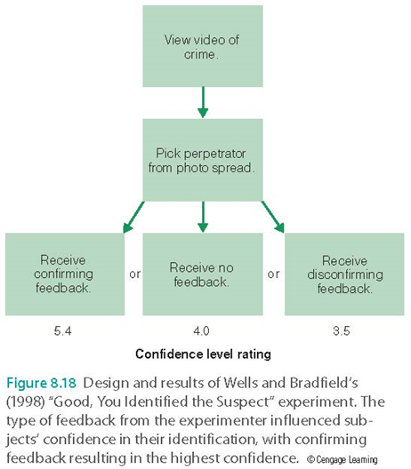
Errors in Eyewitness Testimony
Errors due to suggestion
Suggestive questioning
“Which one of these men did it?”
Misinformation effect
Confirming feedback
Post-identification feedback effect
Notes:
-suggestive questioning will increase chances witness picks someone
-”Good, you identified the suspect.” No feedback. Or disconfirming feedback: “Actually, the suspect was ___.
-Asked then how confident they were in their identification… confirming feedback: way more confident!

Slide 34
Transcript of an Actual Case
Eyewitness to crime on viewing a lineup: “Oh, my God… I don’t know… It’s one of those two… but I don’t know… Oh man… the guy a little bit taller than number two… It’s one of those two, but I don’t know.”
Eyewitness 30 minutes later, still viewing the lineup and having difficulty making a decision: “I don’t know… number two?”
Officer administering lineup: “Okay.”
Months later, at trial: “You were positive it was number two? It wasn’t a maybe?”
Answer from eyewitness: “There was no maybe about it… I was absolutely positive.” (Wells & Bradfield, 1998)

Slide 35
Transcript of an Actual Case
Eyewitness to crime on viewing a lineup: “Oh, my God… I don’t know… It’s one of those two… but I don’t know… Oh man… the guy a little bit taller than number two… It’s one of those two, but I don’t know.”
Eyewitness 30 minutes later, still viewing the lineup and having difficulty making a decision: “I don’t know… number two?”
Officer administering lineup: “Okay.”
Months later, at trial: “You were positive it was number two? It wasn’t a maybe?”
Answer from eyewitness: “There was no maybe about it… I was absolutely positive.” (Wells & Bradfield, 1998)

Slide 36
Errors in Eyewitness Testimony
Confidence in one’s memories may be increased by postevent questioning
May make memories easier to retrieve

Slide 37
What Should Be Done?
Inform witness perpetrator might not be in lineup (cc: Fraser TED talk)
Use “fillers” in lineup similar to suspect
Use sequential presentation (not simultaneous)
Use “blind” lineup administrator & get immediate confidence rating
Improve interviewing techniques
Cognitive interview - let witness talk & recreate scene without interruption
Notes:
-witness usually assumes perp in lineup, increases chance of innocent person being identified (cc: Fraser talk)
-increasing similarity does decrease ID of perp, but also causes large decrease in incorrect identification of an innocent person
-simultaneous presentation - increases chances that the witness will make a relative judgment “who is most like the person I saw?”
-person administering should not know if suspect is in the lineup; rating confidence right afterwards should eliminate postevent feedback effect too

Slide 38
“I’ll Believe It When I See It”
Do you remember the individual who walked into our class earlier to give me a piece of paper?
Height? Build?
Eye color? Skin tone?
Hair color? Gender?
Clothing?

Slide 39

“I’ll Believe It When I See It”
Peter Whitehead, male, 6”0, red/ginger hair, blue-eyed, pale-skinned, medium build
How many details did you get correct?
Notes:
False memory / eyewitness testimony demo – I meant to comment on how he likes to wear flower shirts but forgot

Slide 40
If you want to know more
https://www.youtube.com/watch?v=ChgPk2OiZCw&feature=youtu.be
https://www.youtube.com/watch?v=PB2OegI6wvI&feature=youtu.be
https://www.youtube.com/watch?v=u-SBTRLoPuo&feature=youtu.be (part I)
https://www.youtube.com/watch?v=I4V6aoYuDcg&feature=youtu.be (part II)

Slide 41
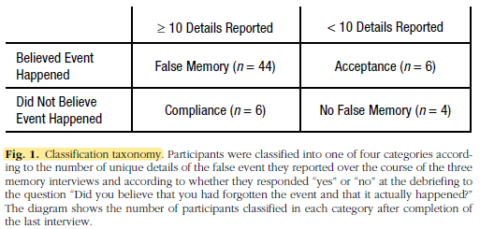
How might you identify the differences between true & false memories?
Shaw & Porter (2015)

Slide 42
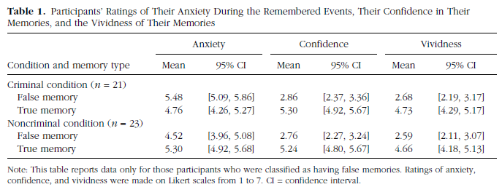
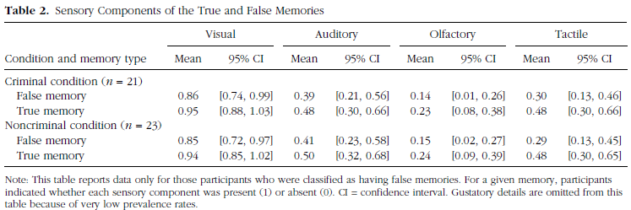

Slide 43
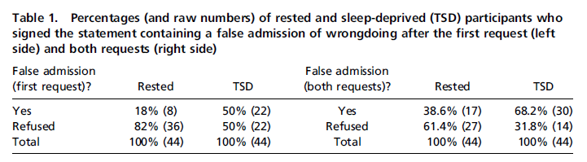
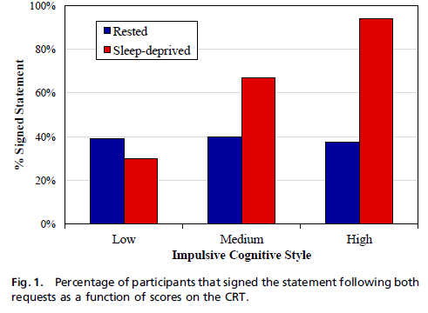
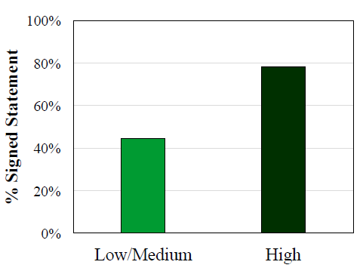
Frenda et al. (2016)

Slide 44
Equipped with this knowledge….
What would you do or recommend? What kinds of changes should be made?
Bringing judges to the crime scene via a forensic psychologist (Fraser)?
What still needs to be done, in terms of understanding more before making recommendations?
Can we actually apply this research to the real world? Are the findings stronger here than the limitations?
Notes:
-gaslighting example re: Shaw & Porter; one limitation is probably the detailed nature of the method, but it does fit what we think

Slide 45
Today’s Goals + Agenda
LO1: Continue to build a supportive classroom culture & discuss science communication
Peer feedback of the multiple paragraphs of science summary piece
LO2: Describe the basic fundamental principles of false memories
Basic principles of memory modification (constructive, schemas, inferences), false memories; demo on Deese-McDermott-Roediger paradigm; eyewitness testimony issues
Discuss small section in Goldstein Chpt 8 on false memories
LO3: Summarize and critically analyze academic journal articles
How does this work impact policy? What are the limitations of this work relative to real-world scenarios of false memories?

Slide 46
Participation + Minute Paper
https://tinyurl.com/PSY102Participation
https://tinyurl.com/PSY102MinutePaperJune11
https://tinyurl.com/PSY102ReviewThurs

Slide 47
Additional Practice
Optional: Test Yourself

Slide 48
In the "War of the Ghosts" experiment, participants' reproductions contained inaccuracies based on
Narrative rehearsal
Source misattributions
Cultural expectations
Shallow processing

Slide 49
____ occurs when reading a sentence leads a person to expect something that is not explicitly stated or necessarily implied by the sentence.
Observer perspective
Pragmatic inference
Prospective memory
Automatic narrative

Slide 50
Jackie went to the grocery store to pick up yogurt, bread, and apples. First, she picked up a hand basket for carrying her groceries, and then she searched the store. After finding what she needed, she stood in a check-out line. Then, the cashier put her items in a plastic bag, and soon after, Jackie left the store. As readers of this event, we understand that Jackie paid for the groceries, even though it wasn't mentioned, because we are relying on a grocery store _____.
Misattribution
Script
Narrative
Schema

Slide 51
Which statement below is NOT true, based on the results of memory research?
Suggestion can create false memories for events that occurred when a person was a young child
Suggestion can create false memories for an event that a person has experienced just recently
Although eyewitness testimony is often faulty, people who have just viewed a videotape of a crime are quite accurate at picking the ‘perpetrator’ from a lineup
Many miscarriages of justice have occurred based on faulty eyewitness testimony.

Slide 52
Eyewitness testimony is frequently influenced by all of the following EXCEPT
Failing to elaboratively rehearse these kinds of events due to fear
Inattention to relevant information due to the emotional nature of these events
Source-monitoring errors due to familiarity
Increased confidence due to postevent questioning

Slide 53
Which of the following statements is true of police lineups?
A sequential lineup increases the chance that the witness compares people in the lineup to each other
A simultaneous lineup decreases the chance of falsely identifying an innocent person as the perpetrator
A sequential lineup increases the chance that the witness will make a relative judgment about all the suspects they saw
A sequential lineup increases the chance that the witness compares each person in the lineup to his or her memory of the event

Slide 54
MC Answer Key
War Ghosts: C
Reading sentence: B
Jackie: B
Not true: C
Eyewitness: A
Police: D

