Slide 1
PSY102: Introduction to Cognitive Psychology
Day 21 (06/13/19): Review

Slide 2
Two comments!!
While we’re waiting, email me any music you want to put on a class Spotify list!
If any of you are interested in misinformation or liked the Fazio article yesterday on the illusory truth effect, Beth Marsh is giving a 1-hr talk here at Duke about her ongoing research on June 28; let me know if you want to attend!

Slide 3
Today’s Goals + Agenda
LO1: Continue to build a supportive classroom culture & discuss science communication
Karl Bates, the editor of News & Communications at Duke, will visit our class today to discuss the editing & publishing process for the Duke Research Blog
How do media biases play a role in misinformation? Are there cultural differences in misinformation? (e.g., 1, 2). What do the academic articles from today & yesterday imply?
LO2: Review material that we have covered so far
Jeopardy style quiz questions, in addition to whatever class feedback suggests we should cover

Slide 4
Tomorrow’s Work: Collective Memory
Quiz
Outline of research for Wiki profile
Optional: Maswood et al. (2019)
Abed et al. (2019)
2 SciNews articles on the same article: Stix (2018) & Cummins (2018)
How is memory shaped beyond the level of the individual?

Slide 5
Yesterday’s Minute Paper
“I am confused on how the prompting of questions like in the thief video has an affect on the witness and if it is negative or not. Is it to assess credibility?”
Suggestive questioning leads to false memories
Misleading postevent information, like in the suggestive questions, can change your memory of what you saw (i.e., the original video watched)

Slide 6
Qualtrics: What do you want to review?
Decision making and cognitive biases please
I want more review and to revisit it
No other responses

Slide 7
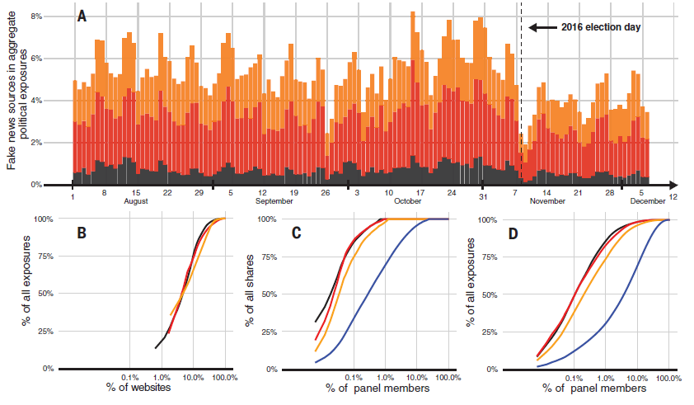
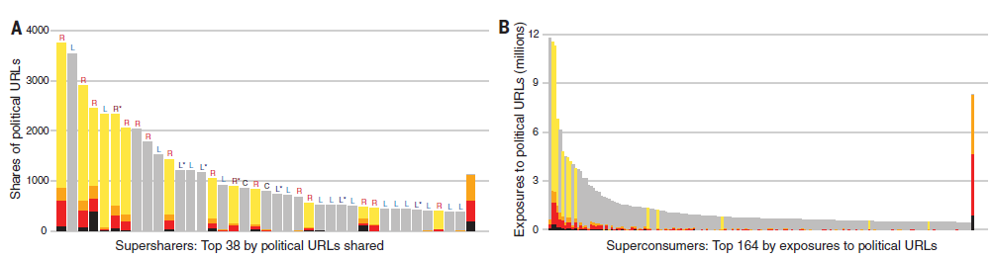
Grinberg et al. (2019): How did misinformation impact the 2016 US election?
Lots of supersharers & superconsumers
Lots of fake news leading up the election
Notes:
-fraction of fake news varies by day
-5% of sources accounted for > 50% of resposures (fig 1b)
-content concentrated among a small fraction of panel members (fig 1c, 1d)
-supresharers & superconsumers: lots of affinity for fake news & measures of activity (fig 2); probably most bots

Slide 8
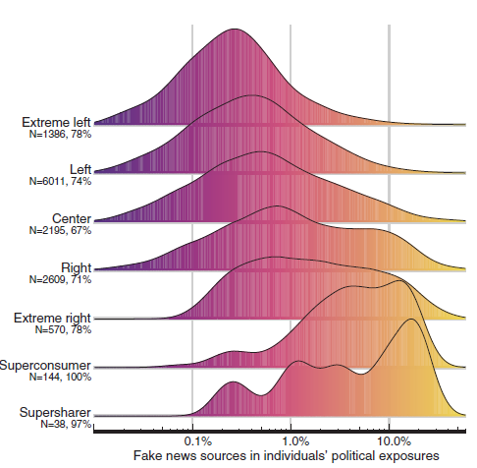
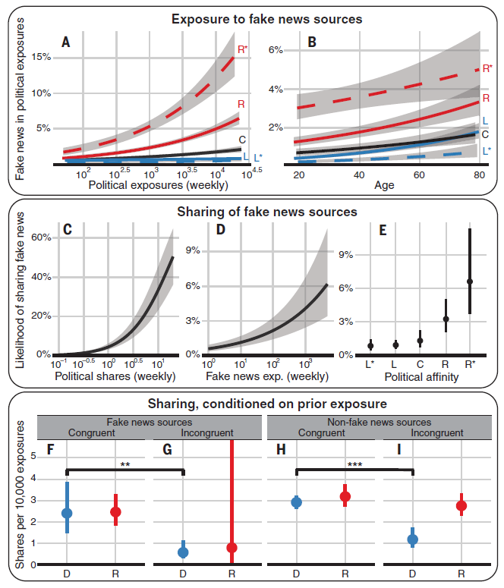
Grinberg et al. (2019): Specific Groups Impacted More?
Notes:
-Distribution of fake news by the political spectrum (exposed to fake news: 2.5% of individuals on the left vs. 16.3% on the right)
-strongest predictors of the proportion of fake news sources in an individual’s feed were an individual’s age and number of political URLs in their feed (Fig 4A-B)
-political affinity also associated with sharing of content from fake news sources (more from conservatives) (Fig 4 c-e); disparity not as large as prev suggested
-no differences in sharing rates between liberals and conservatives across fake & nonfake sources (Fig 4 f-I)
-congruency as the dominant factor in sharing decisions for political news

Slide 9
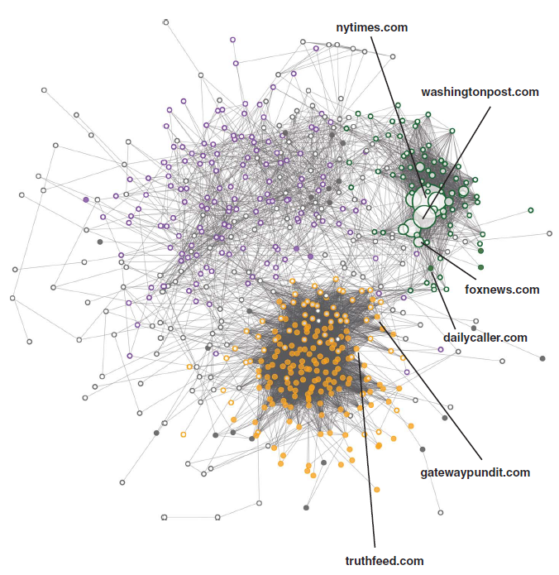
Grinberg et al. (2019)
Policy recommendations for industry?
What are qualities that drive misinformation?
Demographics
Identity
Novelty
Notes:
-Consumers of content from fake news sources were often exposed to multiple fake news sources
-discourage users from following or shareing content from the handful of established fake news sources that are most pervasive
-disincentivize frequent posting
-fake news sources have shared audiences; so maybe establish closer relationships with fact-checking organizations to watch top producers of misinformation

Slide 10
What kinds of questions can be answered with naturalistic social media data?
Not just about misinformation
Affect labeling
Moral-emotional language in conversation (and as it relates to misinformation)
Data journalism
E.g., Economist article just addressed how Google’s search algorithm works
Emerging work on internet impacting cognition (e.g., search for info)

Slide 11
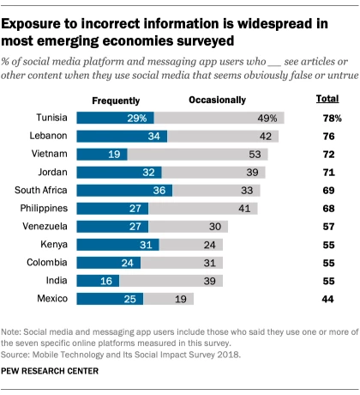
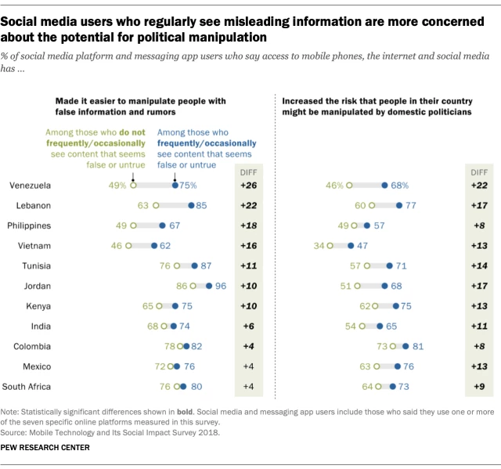
It might not feel like misinformation is that relevant, but it’s a global problem
Notes:
https://www.pewresearch.org/fact-tank/2019/05/13/misinformation-and-fears-about-its-impact-are-pervasive-in-11-emerging-economies/
-emerging research topic: intersection of internet + cognition

Slide 12
How do we combat misinformation?
Finland has a plan
Anti-fake news initiative started in 2014; critical thinking curriculum aimed at increasing media literacy
Generally, for all false memory...
Older folks & misinformation? Fluency heuristic?
NJ: where judges instruct jurors on scientific evidence for eyewitness testimony
Lazer et al. (2018), Lombrozo (2018), Grinberg et al. (2019), Vosoughi et al. (2018) recs
The tips we went over on police investigations
Sleep deprivation is possibly unethical (Frenda et al. (2019))
Notes:
-Finland here: https://www.cnn.com/interactive/2019/05/europe/finland-fake-news-intl/?fbclid=IwAR2rDNKrc6M4ObBTpZrzrQHZl_2uXNHAEIGE0yYBYlfcmkStugng1CD3JSM
-states like Ohio, NJ, California, NC, and Wisconsin have switched to sequential lineups
-NJ supreme Court in 2011 mandated that judges inform jurors about scientific findings regarding eyewitness testimony; may also backfire (cc: https://www.npr.org/sections/health-shots/2016/01/26/464300484/a-judges-guidance-makes-jurors-suspicious-of-any-eyewitness)
-Lombrozo interview w/ Sloman:

Slide 13
Now let’s review~

Slide 14
Name the Error in Judgment
Events that are more easily remembered as judged as more probable
Strong correlation between two events appears to exist, but doesn’t.
Probability that A is a member of class B is determined by how well properties of A resemble properties usually associated with B.
Relative proportions of different classes in the population.
Probability of conjunction of two events (A and B) cannot be higher than the probability of single constituents.
The larger the number of individuals drawn from a population, the more representative the group will be of the entire population.
Tendency for people to generate and evaluate evidence and test their hypotheses in a way that is biased towards their own opinions & attitudes
Selectively looking for information that conforms to a hypothesis and overlooking information that argues against it.
Notes:
Availability heuristic
Illusory correlation
Representativeness heuristic
Base rate
Conjunction rule
Law of large numbers
Myside bias (type of confirmation bias)
Confirmation bias

Slide 15
When do errors occur?
When....
Availability heuristic: ?
Illusory correlation: ?
Representativeness heuristic: ?
Base rate: ?
Conjunction rule: ?
Law of large numbers: ?
Myside bias: ?
Confirmation bias: ?
Notes:
Availability heuristic - Easily remembered event is less probable
Illusory correlation - There is no correlation, or it is weaker than it appears to be.
Representativeness heuristic - Presence of similar properties doesn’t predict membership in class B.
Base rate - Base rate information is not taken into account.
Conjunction rule - Higher probability is assigned to the conjunction.
Law of large numbers - It is assumed that a small number of individuals accurately represents the entire population.
Myside bias (type of confirmation bias) - People let their own opinions and attitudes influence how they evaluate evidence needed to make decisions.
Confirmation bias - There is a narrow focus only on confirming information.

Slide 16
What are...
The peak-end effect
Loss aversion
The framing effect
Status quo bias
Opt-in/Opt-out
Ultimatum game

Slide 17
Using the representativeness heuristic won’t necessarily lead you to an error, unless it leads you to fail to take into account the
A. Base rate
B. Illusory correlations
C. Permission schema
D. Framing strategy
Notes:
A

Slide 18
Wally and Sharon are out on a date. When Sharon asks Wally where they should go for dinner, Wally says "My coworkers keep telling me about that new Japanese place downtown, so it must be a great place to eat." Wally's response illustrates the use of a(n)
Availability heuristic
Confirmation bias
Conjunction rule
Permission Schema
Notes:
A

Slide 19
Mia has lived in New York City all her life. She has noticed that people from upper Manhattan walk really fast, but people from lower Manhattan tend to walk slowly. Mia's observations are likely influenced from a judgment error based on her using
The law of large numbers
An atmosphere effect
An illusory correlation
The falsification principle
Notes:
C

Slide 20
Stereotypes are reinforced by all of the following EXCEPT
The availability heuristic
Illusory correlations
Selective attention
The falsification principle
Notes:
D

Slide 21
Greg was recounting a fishing tale of the one that got away: "I had a huge ahi tuna on my line. I fought for it for a few minutes, then my line snapped. The tuna swam away across the pond." Greg's friend, Matt, didn't believe his story because Matt knew that tuna are salt-water fish and aren't found in ponds. Greg's account contains
Descriptive information that’s inconsistent with base rate information
A belief bias
Inductive reasoning based on observations of multiple, specific cases
A focusing illusion
Notes:
A

Slide 22
Imagine that your friend James has just taken up the habit of smoking cigars because he thinks it makes him look cool. You are concerned about the detrimental effects of smoking on his health, and you raise that concern to him. James gets a bit annoyed with your criticism and says "George Burns smoked cigars, and he lived to be 100!" You might point out that a major problem with his "George Burns" argument involves
Framing
The conjunction rule
Sample size
None of these
Notes:
C

Slide 23
Donovan volunteers his time to campaign for Joel Goodman. He spent all afternoon putting up "Goodman for Congress" signs around his town and arrived back at Goodman headquarters just in time to watch the Goodman-Hernandez debate on TV. Donovan was eager to watch the candidates debate each other, even though he was 100% sure he was going to vote for Goodman. Donovan's first response to the debate will most likely be
“I noticed that Goodman and Hernandez agreed on the new environmental policy.”
“Did you hear how well Goodman answered that question on job creation?”
“I wonder why Goodman was so vague on the school tax issue when I know he has a clear idea about that.”
“Hernandez is really going to make this a tight race.”
Notes:
B

Slide 24
Questions we addressed surrounding decision-making & biases
How do we make decisions? (Note: more on this in Learning & Motivation)
How can we change people’s minds?
What other cognitive biases impact our judgment and reasoning processes?
How should we think about these biases when doing SciComm?

Slide 25
Participation
https://tinyurl.com/PSY102Participation
Sheet of paper with Interesting/Accessible for Grinberg et al. (2019)

