Slide 1
PSY102: Introduction to Cognitive Psychology
Day 27 (06/21/19): Education II

Slide 2
Today’s Goals + Agenda
LO1: Continue to build a supportive classroom culture & discuss science communication.
Critique videos on "How to Study" from a renowned educational psychologist, learning about education work + thinking about SciComm principles
LO2: Define, identify, and apply previous constructs that we have discussed in class
Quiz on previous material since last quiz: multiple choice & short answers
LO3: Describe the basic findings from education research on multitasking.
Discuss the Oppenheimer & military papers & debate policy on banning laptops
How does this research relate to previously discussed work on real-life multitasking? Is there a better way of thinking about multitasking in the classroom?
Has anyone ever experienced the effects described here? How does this relate to concepts on shared attention?

Slide 3
Critiquing Videos on Learning
Education is science communication, too
https://tinyurl.com/SamfordStudy
In teams, pick a video from this website. They all talk about how to learn better & study tips that should be useful for you regardless (i.e., generalize beyond our classroom).
All videos between 5-9 minutes (most are ~7 min)
Watch & critique the video, applying the SciComm principles you’ve learned this semester (e.g., identify audience)
What cognitive psychology principles is this video discussing? How might you reframe the material, if you were to film the video?

Slide 4
Supiano et al. (2019): covering new replication of “Pen Is Mightier than Keyboard”
Is writing by hand better than taking notes on a computer?
Notes:
-paper tried to replicate Oppenheimer
-Oppenheimer study discusses how students who write by hand do better on factual & conceptual tests of knowledge; 2014 - and people have used this as justification for banning laptops
-Study tried replicating this effect; found that they did better on factual knowledge, BUT couldn’t replicate the ‘conceptual knowledge’ compoennt
-Meta-analysis in new study showing a small, statistically insignificant increase in test performance for those who took longhand notes
-Perhaps the differences between the styles is due to how much time elapses by taking notes / end of lecture and start of an exam
-Perhaps the benefit is from what people do with the notes later on and not the encoding stage
-context matters

Slide 5
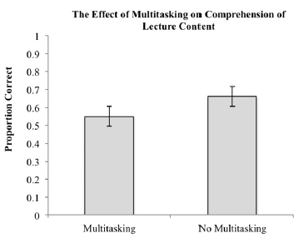
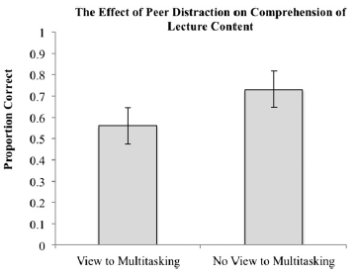
Sana et al. (2013): Laptop use on multitaskers & those nearby
Note that negative effects of laptop use reported in this study have been replicated in US military academy study
Notes:
-On a test following the lecture, 17% worse when in view of multitasking
-Second study: multitaskers did worse
-Students who engaged in multitasking wrote it would hinder their learning a fair bit, but shouldn’t hinder their peers much.
-Students in view of multitasking also thought it would barely hinder their own learning
--
Sana:
-study 1 about people completing side tasks like “what’s on channel 3 tonight at 10 pm?” half the people are multitasking and the other half are not intentionally multitasking
-primary measure of learning: 4-option MC comprehension test w/ 20 questions on simple knowledge and 20 questions w/ applying the knowledge
-how did they know whether the task was done the way they wanted? Fidelity measures: notes for the 2 groups, the person observing from back of class, and discarded data
-scored 11% less on the post-lecture test
-in study 2: scored 17% less on the test
-study 2 involved the confederates who were 45 degrees angled to the person in view of the laptop
-didn’t diminish quality of note-taking, but leads to differences in this comprehension test
-in the discussion, they mention the same metacognition component about how we’re not really aware of multitasking affecting others
--
MILITARY ACADEMY: randomized control trial of Econ 101 where some classrooms allowed laptops, some did not; laptop classes did 0.17 SD worse than classes that didn’t allow laptops

Slide 6
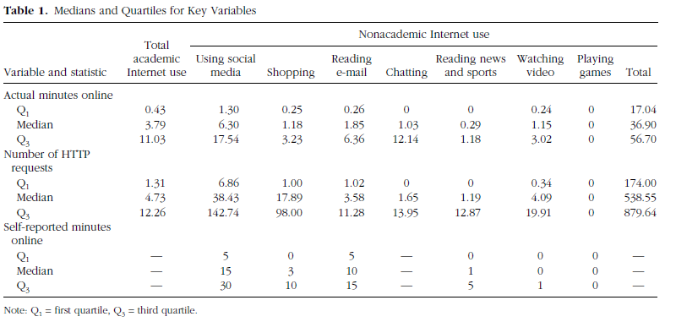
Ravizza et al. (2017): Laptop use in the classroom
Notes:
-Intro Psych course
-students logging into proxy server, knew they’d be monitored; didn’t differ on average from how they used internet elsewhere
-average duration online
-average number of requests
-categorized the content of the site
-self-reported internet use
-classroom performance (cumulative final exam)
-ACT score
-when controlling for ACT, motivation, and interest, doesn’t explain the full relationship between internet use & final exam grade (i.e., the latter contributes at least 5% of the variance)
-not due to idea that higher ACT scores = better multitaskers
-relationship between laptop use and exam score twice as large for students with high ACT vs. low ACT scores
-specific types of internet use: social media & video sites that were worse
-in this case, students were actually accurate in saying that laptop use had a disruptive effect on their learning (those who said that = did actually do worse… but they already knew their scores at that time)
-students actually accurate in estimates spent online

Slide 7
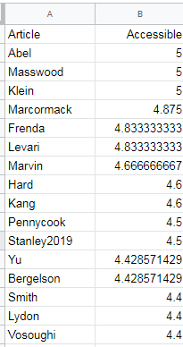
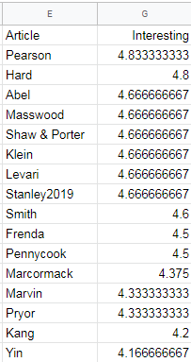
Most Accessible & Interesting Articles
Most Accessible:
Collective Memory (n = 3; both articles; 5/5)
Klein & O’Brien (immediacy of judgments; optional; 5/5)
MacCormack (hanger; 4.875/5)
Levari (prevalence induced concept change; 4.83/5)
Frenda (sleep deprivation & false memory, 4.83/5)
Most Interesting:
Pearson (moral judgments of guilt; 4.83/5)
Hard (Intro psych; 4.8/5)
Applied: most interesting
Accessible: possibly correlated w/ length & applied?

Slide 8
This Semester...
You read:
33 academic papers (3 optional)
5 textbook chapters (1, 2, 7 (LTM Processes), 9 (Knowledge/Categorization), 10 (Imagery))
20 science news papers (3 in class)
5 science summaries papers
1 comic
1 computer game/comic
You listened to:
9 podcasts, 1 optional podcast
You completed:
A Wikipedia Profile
A Duke Research Blog Post
A SciComm Pitch
A Science Summary Piece
6 Quizzes

Slide 9
Real-world applications
Perception
Our eardrums move when our eyes move
The biggest theory of all: predictive coding
Attention
Multi-tasking while driving, studying
Visual search for TSA agents, detecting cancer
Stroop effect for detecting Cold War spies
Emotion
“Hanger”, emotion regulation, mood disorders, spontaneous emotion
Language
Decoding & synthesizing speech
Predicting a baby’s first word & vocabulary size
Working Memory
Brain training claims

Slide 10
Real-world applications
LTM: Structure
We cluster our memories in time; how is memory organized generally?
LTM: Processes & Mechanisms
Study tips & what improves your memory
Can we reconsolidate some memories? Propranolol
Autobiographical Memory
Fictional first memories, flashbulb memories, emotion effect on memory, “what if” on our own memories, how people differ in the level of details in their memory
Knowledge / Categorization
Concept map & how we categorize new objects we encounter
Decision-making, Cognitive Biases, Motivated Reasoning
Why it’s so hard to progress on some social issues
Logical fallacies in our own decision-making processes
How our fallacies impact our judicial system & how arbitrary social norms impact our decisions
How we can change people’s minds & why they might not

Slide 11
Real-world applications
False Memory & Misinformation
Eyewitnesses are not reliable! Sleep deprivation! Misleading postevent info
Illusory truth, fluency, source misattribution, schemas & scripts, fake news
Collective Memory
Our collective memory as a nation and of WWII, what shapes societal identity
Creativity & Problem-Solving
What is creativity, and how does it interact with problem-solving?
Learning & Motivation
What makes us curious & how does that impact our learning?
Imagery
Tips on how to improve memory using imagery
Education
Applying cog psych to study better (e.g., “gold standard” study strategies, strategies for self-control, purpose for learning, test-anxiety & interventions aimed at student agency)! Laptop policies

Slide 12

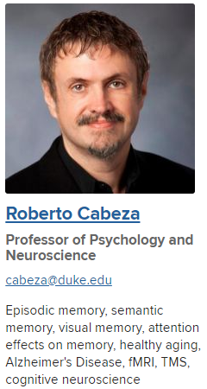
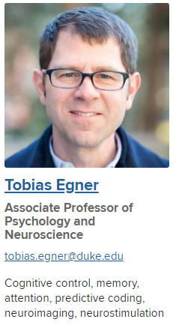
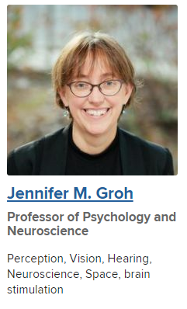
Cog Psych At Duke
Notes:
https://psychandneuro.duke.edu/graduate/ccn
Alison Adcock
Elika Bergelson
Roberto Cabeza
Tobias Egner
Jennifer Groh
Ahmad Hariri
Scott Huettel
Kevin LaBar
Elizabeth Marsh
Tobias Overath
David Rubin
Gregory Samanez-Larkin
Paul Seli
Marty Woldorff
https://www.neuro.duke.edu/people/faculty/john-pearson
Bridgette + John not in the “direct” P&N cog component but have related papers

Slide 13


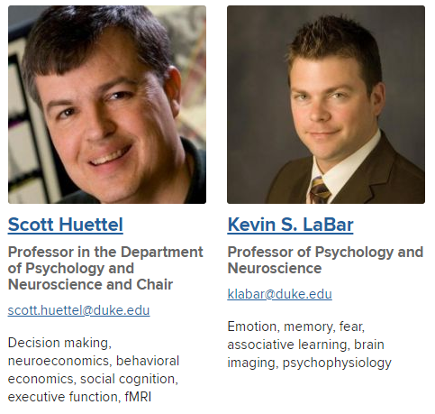
Cog Psych at Duke
Notes:
https://psychandneuro.duke.edu/graduate/ccn
Alison Adcock
Elika Bergelson
Roberto Cabeza
Tobias Egner
Jennifer Groh
Ahmad Hariri
Scott Huettel
Kevin LaBar
Elizabeth Marsh
Tobias Overath
David Rubin
Gregory Samanez-Larkin
Paul Seli
Marty Woldorff
https://www.neuro.duke.edu/people/faculty/john-pearson
Bridgette + John not in the “direct” P&N cog component but have related papers

Slide 14


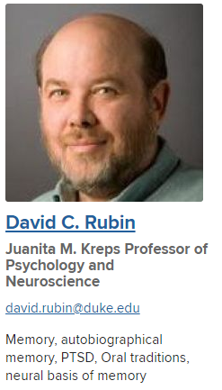

Cog Psych at Duke
Notes:
https://psychandneuro.duke.edu/graduate/ccn
Alison Adcock
Elika Bergelson
Roberto Cabeza
Tobias Egner
Jennifer Groh
Ahmad Hariri
Scott Huettel
Kevin LaBar
Elizabeth Marsh
Tobias Overath
David Rubin
Gregory Samanez-Larkin
Paul Seli
Marty Woldorff
https://www.neuro.duke.edu/people/faculty/john-pearson
Bridgette + John not in the “direct” P&N cog component but have related papers

Slide 15
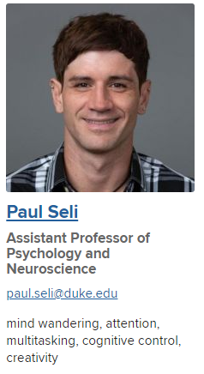
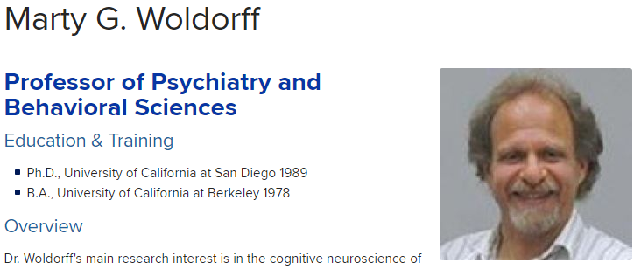
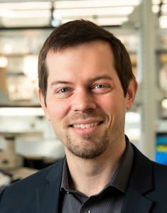
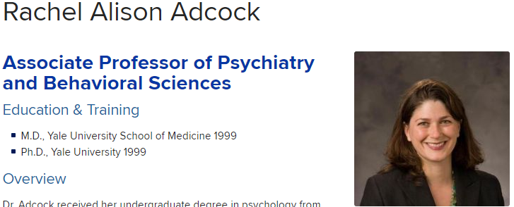
Cog Psych at Duke
John Pearson
Notes:
https://psychandneuro.duke.edu/graduate/ccn
Alison Adcock
Elika Bergelson
Roberto Cabeza
Tobias Egner
Jennifer Groh
Ahmad Hariri
Scott Huettel
Kevin LaBar
Elizabeth Marsh
Tobias Overath
David Rubin
Gregory Samanez-Larkin
Paul Seli
Marty Woldorff
https://www.neuro.duke.edu/people/faculty/john-pearson
Bridgette + John not in the “direct” P&N cog component but have related papers

Slide 16
Expect from me:
▷Support for your success in the course
○Background information
○Rigor
○Prompt replies (within 48 hours)
○Fair and useful feedback on writing
▷Maintain an engaging, enjoyable, and safe learning environment.
▷Assume best intent.
▷Resource for this class and beyond.
Notes:
Slide from Day 1 pptx

Slide 17
The Rest of Class
Check your email for the Qualtrics survey link (this will give me the most thorough FB on class design)
Once finished w/ Qualtrics, please fill out Duke Hub evals
Then take Quiz 6
Grab a sandwich at any time!

