Slide 1
PSY102: Introduction to Cognitive Psychology
Day 24 (06/18/19): Learning & Motivation

Slide 2
Today’s Goals + Agenda
LO1: Continue to build a supportive classroom culture & discuss science communication
Half of class will be spent on brainstorming ideas for other types of science communication (i.e., follow-up to decision-making research)
LO2: Describe the basic fundamental principles of learning & motivation research
Basic principles of learning & motivation (reward, feedback, curiosity); demo from Gruber et al. (2014)
Discuss small bits of research from Purves & Goldstein books
LO3: Summarize and critically analyze academic journal articles
First experience with a preprint: How does this article compare to what you've read from other journals?
Second time you see experience sampling as a method; is it appropriate here?

Slide 3
Tomorrow’s Work
Final Draft of Duke Blog due
Chapter 10 on Imagery
Optional: Podcast on how to make your study groups more effective
Theme: How do “pictures in your head” compare to your experience when you perceive an object? How can imagery improve memory?

Slide 4
What Is Curiosity?
How do you personally define curiosity?
What makes you curious?

Slide 5
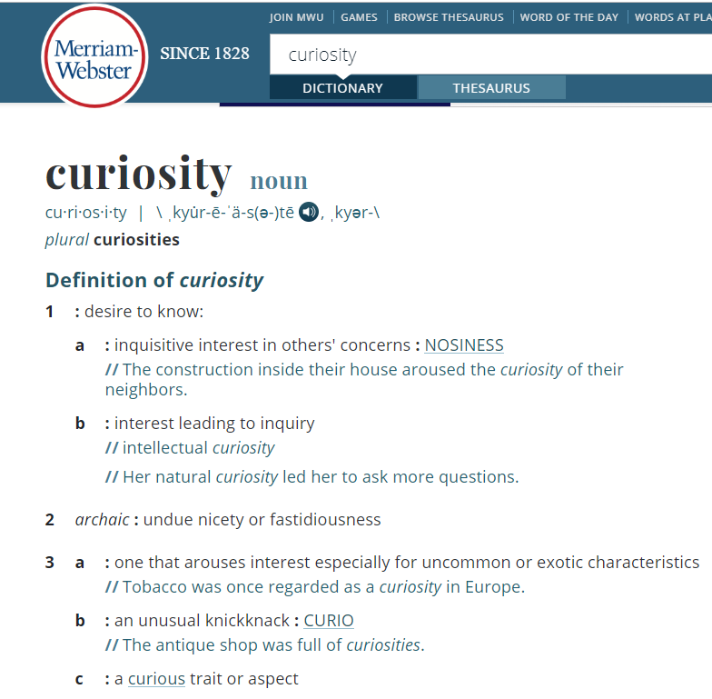
Notes:
https://www.merriam-webster.com/dictionary/curiosity

Slide 6
Curiosity
“Broadly defined as the desire to acquire new information…”
“Intrinsic motivation to learn…”
“An inconsistency or a gap in knowledge…The result of a perceived gap between what one knows and what one wants to know…”
“The anticipation of reward, where the reward is information…”
“The propensity to seek out novel, complex, and challenging interactions with the world…”
Notes:
Definition 1: https://psyarxiv.com/s36e5/
Definition 2: https://www.sciencedirect.com/science/article/pii/S0896627314008046
Definition 3: mentioned in Marvin & Shohamy (2016)
Definition 4: taken by Marvin & Shohamy (2016)
Definition 4: Lydon et al. (2019)

Slide 7
Trivia Time! Gruber et al. (2014)
What song did both Ronald Reagan and Walter Mondale quote in the 1984 presidential campaign?
What taste are cats unable to detect?
What song took over No. 1 from Whitney Houston’s ‘I Will Always Love You?’
What writer’s last words were: ‘Last words are for fools who haven’t said enough?’
How likely is it that you know the answer? 1-6
How curious are you about the answer? 1-6
Notes:
Gruber et al. (2014) questions
-Born in the USA
-Sweet
-A Whole New World
-Karl Marx
For more trivia questions: www.corsinet.com & www.triviaplaying.com

Slide 8

Research in the Adcock Lab - Abby Hsiung
Notes:
https://twitter.com/HsiungAbby/status/1131938018846224385

Slide 9
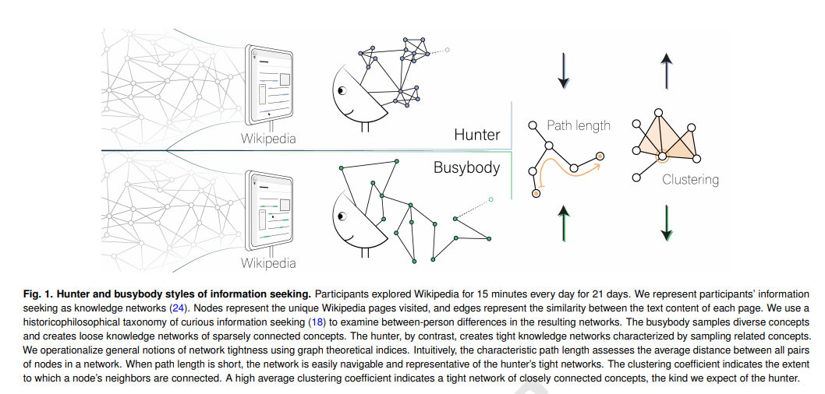
Our Wiki Profiles Could Contribute to Curiosity Research (cc: Collective Memory)
Notes:
https://psyarxiv.com/undy4
Twitter thread: https://twitter.com/DLydonStaley/status/1137346590098776068
-“We made networks of their Wikipedia exploration to capture individual differences in curious practice”
-”In these networks, nodes are Wikipedia pages and edges are the similarity between pages. Networks with high average edge weights, high clustering, and short path lengths are tight networks associated with seeking out conceptually similar pieces of information during browsing”
-”People high in deprivation sensitivity, a facet of curiosity capturing individual differences in the drive to know and to eliminate gaps in knowledge, create tight networks. It is positively associations with edge weight and clustering and negatively associations with path length”
-”We use a generative model to explore network growth mechanisms w/ two parameters: reinforcement captures tendency to return to previously visited/similar pages; regularity captures probability of taking short/long topological leaps. Movie shows differences that model can capture”
-”Deprivation sensitivity is positively correlated with reinforcement suggesting that the tight networks of people high in deprivation sensitivity stems from them returning to previously visited/similar pages as they grow their knowledge network”
-”If you know me, you know that I am obsessed with within-person variability :) so we partitioned each person's time series into three periods and find that periods of higher than usual sensation seeking (assessed via daily diary) are periods of looser than usual knowledge networks”
-”In sum,we quantify open-ended & internally-driven information seeking, operationalize taxonomies of curiosity,provide insight into deprivation seeking. Future work will examine how different curious practices lead to unique information stores that differentially impact well-being”
Significance statement:
“The open-ended, internally driven nature of curiosity makes its capture and characterization challenging. Yet, characterizing how individuals seek information when internally driven is fundamental to understanding curiosity and its robust association with well-being. To meet this challenge, we integrate historical, philosophical, and psychological perspectives on curiosity with techniques from applied mathematics, natural language processing, and evolutionary algorithms to test a knowledge network approach to curiosity. With interdisciplinary perspectives and tools, we capture and quantify complex and idiosyncratic forms of information seeking that span multiple millennia, cultures, languages, and timescales. We find that knowledge networks exhibit small-world and modular structure, and we present a generative mechanism of network growth to explore organizing principles underlying information seeking. “

Slide 10
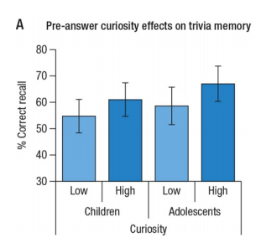
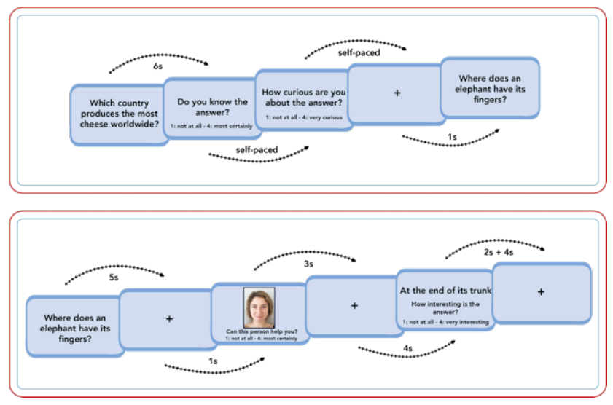
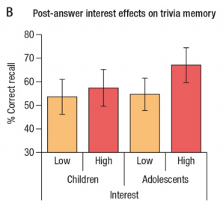
Fandakova & Gruber (2019)
Notes:
“We used a trivia paradigm in which children and adolescents (N = 60, 10 – 14 years) encoded trivia questions and answers associated with high or low curiosity. States of high pre-answer curiosity enhanced later memory for trivia answers in both children and adolescents. However, higher positive post-answer surprise enhanced memory for trivia answers beyond the effects of curiosity in adolescents, but not in children. These results suggest that curiosity and surprise have positive effects on learning and memory in childhood and adolescence, but might need to be harnessed in differential ways across child development to optimize learning”
https://psyarxiv.com/s36e5/

Slide 11
Open Questions
Research has shown curiosity can enhance learning & memory, but does this change across populations (e.g., kids v. adolescents v. adults)?
Might impact educational settings / interventions
Do curiosity and surprise have different effects?
How does curiosity relate to well-being and other cognitive processes (e.g., attention, decision-making)?
How does curiosity as a construct relate to other components that we have studied, like information avoidance? Are they polar opposites?
Do trait & state curiosity have different effects? Does variability in curiosity on a moment-to-moment basis matter?

Slide 12
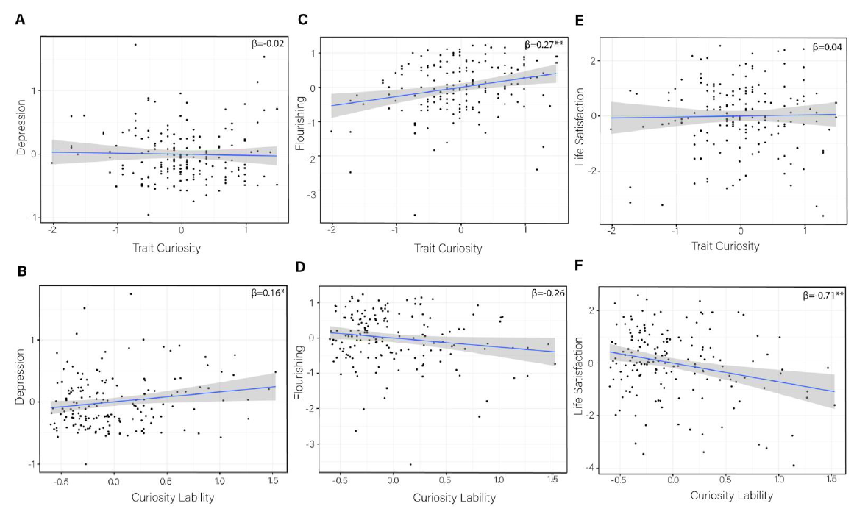
Lydon et al. (2019)
Does curiosity lability predict well-being?

Slide 13
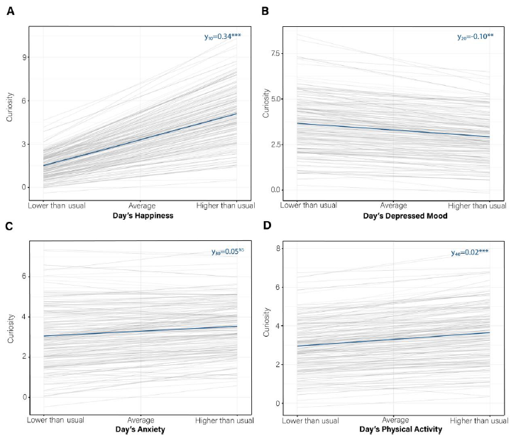
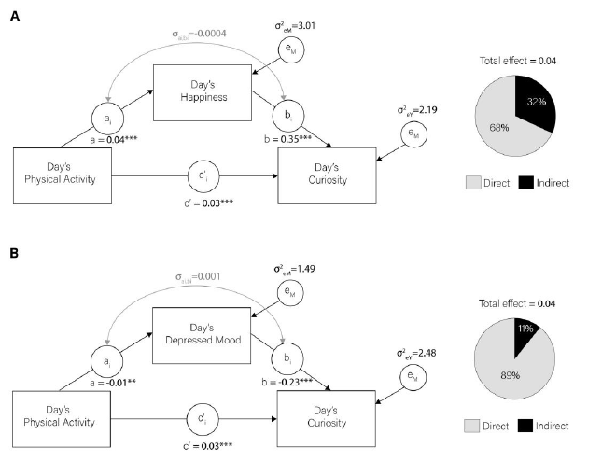
Lydon et al. (2019)
Does curiosity lability predict well-being?

Slide 14
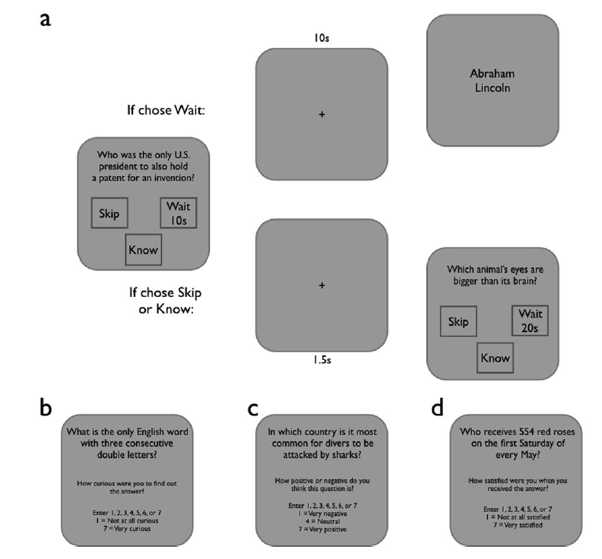
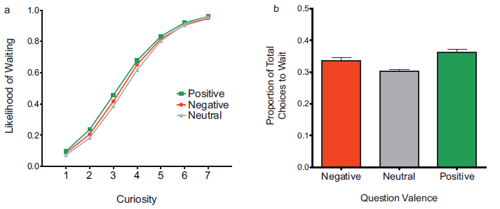
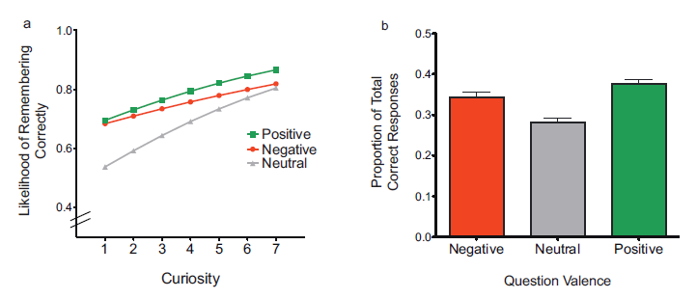
Marvin & Shohamy (2016)
Is information in itself rewarding?
Notes:
“For example, Marvin and Shohamy (2016) calculated information prediction errors (IPEs) which reflect the difference between the subjective interestingness associated with the information and the initial curiosity about the information. The authors showed that IPEs modulated memory in adults with greater memory enhancement for positive IPEs such that participants were more likely to remember information when it was more interesting than the initial level of pre-information curiosity (see also Fastrich et al., 2018).”
-willingness to wait; time is value, waiting used as a measure of the motivational value of rewards
-(1) The valence of information affects curiosity and subsequent learning, specifically that positively and negatively valenced information engender greater curiosity and promote better learning than does neutral information and (2) information prediction errors affect learning.
-”We tested the relevance of this framework to curiosity, proposing that the difference between the satisfaction experienced upon receipt of information and the curiosity experienced in anticipation of information functions as an information prediction error.”
-trivia task: Skip, Wait, or Know
-After trivia task, shown same 69 questions and asked to rate curiosity on seeing question & satisfaction with answer provided
-One week afterwards, they then were asked about the answers to the questions they learned
*major limitation: curiosity on seeing question is *after* the fact; are we good at evaluating in the moment? This is what the prediction error is based off (satisfaction – curiosity)
*the participants in this study did not rate the questions; it is possible the positive/negative/neutral were perceived differently here by their current participants (I wonder if you get a difference in those ratings after satisfaction?)
*what does it mean for a trivia question or information to be positive/negative/neutral? A little unclear here…
-participants more likely to wait for info they were more curious about, less likely to wait for information associated with a longer delay, and more likely to wait for positive, compared to neutral, information
-participants more likely to remember more positive information and information about which they were curious
-participants were more likely to remember information for which there was a more positive prediction error, that is, information for which satisfaction was greater than curiosity

Slide 15
Other Curiosity Findings
(Wade & Kidd, 2019)
You are more curious when you believe that you're close to the right solution, even if you really aren't.
How curious you are, and how much you previously knew, predict learning outcomes
Learning & curiosity may have different underlying cognitive mechanisms
Notes:
http://www.celestekidd.com/papers/WadeKiddPBR2019.pdf
We find evidence for both prior knowledge and curiosity providing a boost to learning. Further, we find that curiosity is best predicted by the learner’s metacognitive estimate of their own knowledge, while learning is instead better predicted by an objective measure of existing knowledge. In other words, the cognitive mechanisms underlying curiosity and learning are distinct.
Curiosity in our task is best predicted by a learner’s estimate of their current knowledge, more so than an objective measure of what they actually know. Learning is best predicted by both curiosity and an objective measure of knowledge. These results suggest that while curiosity is correlated with knowledge, there is only a small boost in learning from being curious.
Thus, people appear to be more curious about questions when they believe that their initial guess is closer to the correct answer
Collectively, these results show that perceptions of prior knowledge, rather than a more objective measure of prior knowledge, predict curiosity.
. Participants were marginally more likely to recall a trivia answer at test when they judged their initial guess as closer to the correct answer than when they judged their initial guess as distant from the correct answer
This analysis shows that while the learner’s perception of prior knowledge predicts the learner’s curiosity, it is a marginal predictor of learning outcomes. Rather, we find that both curiosity ratings and a more objective measure of prior knowledge predict learning outcomes

Slide 16
Reinforcement Learning Generally
Expected value of next trial = current expected value + prediction error (i.e., actual outcome - expected outcome)
DiMenichi & Tricomi (2016): e.g., expects an A and receives a C, negative prediction error
How might the concept of expected value impact decision-making?
Notes:
E.g., DiMenichi and Tricomi, 2016

Slide 17
General Questions & Takeaways
What is curiosity?
How do we typically study curiosity?
What is the relationship between curiosity, memory, and well-being?
What are open future research Qs related to curiosity?
How do prediction errors interact with research on decision-making?

Slide 18

Storyboarding
Notes:
https://www.youtube.com/watch?v=SwPPU5rU_os
Other tips http://web.mit.edu/me-ugoffice/communication/writing_process.pdf

Slide 19
In groups… (however large you’d like)
Write a storyboard for some finding that we have gone over in class (I have a list of topics that I will pass out)
You can do this using a podcast, video, comic, computer game, etc.
Remember our SciComm principles, i.e., be intentional about the choices you make for your storyboard
E.g., you might want to write out all the key points that you’d make about that particular topic & think about *how* you’d get your reader or listener or player there
E.g., since you won’t have an “expert” to interview, how else might you tell the story of this psych effect/finding?
I expect to see a full script or storyboard by the end of class & would like to feature these on our class website

Slide 20
Today’s Goals + Agenda
LO1: Continue to build a supportive classroom culture & discuss science communication
Half of class will be spent on brainstorming ideas for other types of science communication (i.e., follow-up to decision-making research)
LO2: Describe the basic fundamental principles of learning & motivation research
Basic principles of learning & motivation (reward, feedback, curiosity); demo from Gruber et al. (2014)
Discuss small bits of research from Purves & Goldstein books
LO3: Summarize and critically analyze academic journal articles
First experience with a preprint: How does this article compare to what you've read from other journals?
Second time you see experience sampling as a method; is it appropriate here?

Slide 21
Participation + Minute Paper
https://tinyurl.com/PSY102Participation
https://tinyurl.com/PSY102MinutePaperJune18

