Slide 1
PSY102: Introduction to Cognitive Psychology
Day 23 (06/17/19): Creativity & Problem-Solving

Slide 2
Today’s Goals + Agenda
LO1: Continue to build a supportive classroom culture & discuss science communication
Make sure you all feel comfortable with the final drafts due soon
How did you perceive this podcast relative to the others? Here was a psychologist covering a fellow psychologist
LO2: Describe the basic fundamental principles of creativity & problem-solving
Demos on problem-solving & creativity
Discuss Goldstein chapter 12 research

Slide 3
Tomorrow’s Work
Optional: Marvin & Shohamy (2016)
Lydon-Staley et al. (2018) -note this is a preprint
Science summary: DiMenichi and Tricomi (2016)
Theme: How does curiosity contribute to learning? How do scientists usually study learning & motivation, and how does that contribute to decision-making? Also, we’ll work on other science communication pieces.

Slide 4

What are the stakes of good SciComm?
Notes:
https://www.whec.com/news/study-your-brain-type-influences-the-side-of-the-bed-you-sleep-on/5389536/?cat=565

Slide 5
Problems
An initial state and a goal state with an obstacle in between
Difficult – solution is not immediately apparent
Two approaches:
Gestalt approach
Information-processing approach
Notes:
•An obstacle between a present state and a goal
•Not immediately obvious how to get around the obstacle
•Difficult

Slide 6
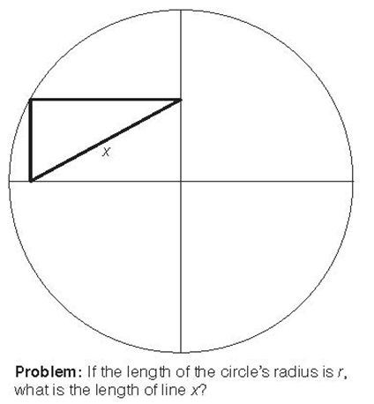
Gestalt Approach
Representation
How is the problem represented in the mind?
Restructuring
Changing the representation
Insight
Sudden realization of the solution
Notes:
Solution to problem depends on how it is represented
One way to describe the problem representation: a circle with thin vertical and horizontal lines that divide the circle into quarters, and darker lines that create a small triangle in the upper left quadrant
To solve the problem, change the last part of the representation to: a small rectangle in the upper left quadrant with x being the diagonal between the corners
Recognize the other diagonal is r, drawn out to the rectangle… x = r
•Representing a problem in the mind
•Restructuring: changes the problem’s representation
–Kohler’s “circle” problem
•Sudden realization of a problem’s solution
•Often requires restructuring the problem
•Metcalfe and Wiebe (1987)
–Insight: triangle problem, chain problem
–Noninsight: algebra
–Warmth judgments every 15 seconds
•Metcalfe and Wiebe (1987)
–Insight problems solved suddenly
–Noninsight problems solved gradually

Slide 7
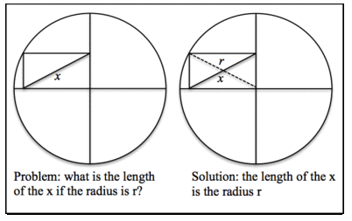
Gestalt Approach
Notes:
•Representing a problem in the mind
•Restructuring: changes the problem’s representation
–Kohler’s “circle” problem
•Sudden realization of a problem’s solution
•Often requires restructuring the problem
•Metcalfe and Wiebe (1987)
–Insight: triangle problem, chain problem
–Noninsight: algebra
–Warmth judgments every 15 seconds
•Metcalfe and Wiebe (1987)
–Insight problems solved suddenly
–Noninsight problems solved gradually

Slide 8
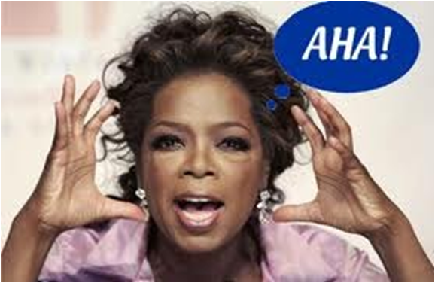
Insight

Slide 9
Gestalt Approach
What was the representation of the problem?
i.e., what did you already know?
How was the representation restructured?
What was the insight?
Notes:
•Representing a problem in the mind
•Restructuring: changes the problem’s representation
–Kohler’s “circle” problem
•Sudden realization of a problem’s solution
•Often requires restructuring the problem
•Metcalfe and Wiebe (1987)
–Insight: triangle problem, chain problem
–Noninsight: algebra
–Warmth judgments every 15 seconds
•Metcalfe and Wiebe (1987)
–Insight problems solved suddenly
–Noninsight problems solved gradually

Slide 10
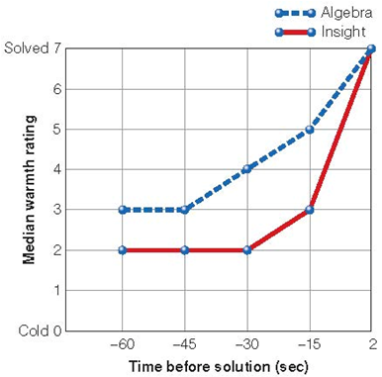
Insight vs. Noninsight
Insight solved suddenly
Noninsight problems solved gradually
Notes:
•Metcalfe and Wiebe (1987)
–Insight: triangle problem, chain problem
–Noninsight: algebra
–Warmth judgments every 15 seconds (warmth means how close to solving the problem)
•Metcalfe and Wiebe (1987)
–Insight problems solved suddenly
–Noninsight problems solved gradually

Slide 11
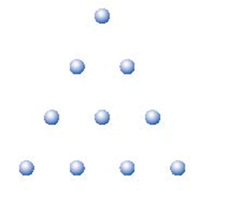
Example Insight Problem
How can you move three of the blue dots to get the triangle to point to the bottom of the page?
Notes:
•Representing a problem in the mind
•Restructuring: changes the problem’s representation
–Kohler’s “circle” problem
•Sudden realization of a problem’s solution
•Often requires restructuring the problem
•Metcalfe and Wiebe (1987)
–Insight: triangle problem, chain problem
–Noninsight: algebra
–Warmth judgments every 15 seconds
•Metcalfe and Wiebe (1987)
–Insight problems solved suddenly
–Noninsight problems solved gradually

Slide 12
Obstacles to Problem-Solving
Functional fixedness: restricting use of an object to its familiar functions
Candle problem
Two-string problem

Slide 13
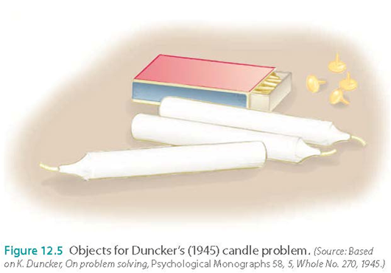
Candle Problem
You’re in a room with a vertical corkboard mounted on the wall. You’re given some candles, matches in a matchbox, and some tacks. Your task is to mount a candle on the corkboard so it will burn without dripping wax on the floor.
Notes:
•Matchbox can be used as a support rather than as a container
•if you’re presenting subjects with boxes containing the materials vs. materials outside the boxes… group presented with the boxes as containers found problem more difficult.

Slide 14
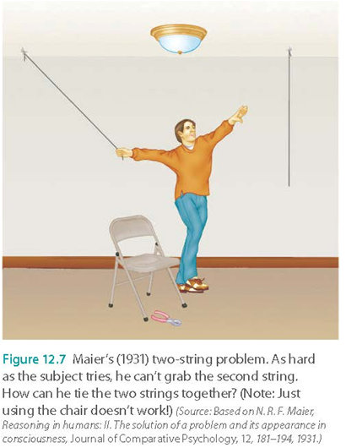
Two-String Problem
Tie together two strings that are hanging from the ceiling. Strings are far apart, so you can’t reach one while holding the other. You have a chair and a pair of pliers.
Notes:
•tie the pliers to one of the strings to create a pendulum, which could then be swung to within the person’s reach.
•most people don’t think of pliers as a weight at the end of the pendulum, just think of them as a tool
•When subjects were provided with a “hint” (i.e., setting the string in motion), 23/37 who hadn’t solved it correctly solved w/in 60 seconds
•Gestalt: once they restructured their representation of how to achieve the solution and their representation of the fxn of the pliers… they solved the problem

Slide 15
Obstacles to Problem-Solving
Functional fixedness: restricting use of an object to its familiar functions
Candle problem: seeing boxes as containers inhibited using them as supports
Two-string problem: function of pliers gets in the way of seeing them as a weight

Slide 16
Obstacles to Problem-Solving
Mental set
A preconceived notion about how to approach a problem
Based on a person’s past experiences with the problem (or similar problems)

Slide 17
Information-processing approach
Initial state, goal state, AND intermediate states
Reduce differences between initial and goal states (means-end analysis)
Create subgoals (intermediate states that move you closer to the goal state)
Problem space
All possible states that could occur
Operators
Actions that take the problem from one state to another. Usually governed by rules.
Notes:
•Tower of Hanoi
•Operators: rules specify which moves are allowed and which are not

Slide 18
Information-processing approach
Initial state: ax – b = x
Goal state: Solve for x (i.e., term x on the left side of the equation; all other terms on the right)
Operators: any algebraic operation (addition, factoring, etc.)
Notes:
Credit: psych.colorado.edu/~ppolson/4145/lecturenotes/problemsolvinglectures.doc

Slide 19
Information-processing approach
GOAL STATE: x on left, all other terms on right
Current state: ax – b = x
Differences: a on left, b on left, x on right
Apply operator: Add b to both sides
Current state: ax = x + b
Differences: a on left, x on right
Apply operator: Subtract x from both sides
Current state: ax – x = b
Differences: a on left, x on left twice
Apply operator: Factor x on left
Current state: x(a – 1) = b
Differences: (a – 1) term on left
Apply operator: Divide both sides by (a – 1)
Current state: x = b/(a – 1)
Differences: none
:D
Notes:
Credit: psych.colorado.edu/~ppolson/4145/lecturenotes/problemsolvinglectures.doc

Slide 20
Information-processing approach
Serial (rather than parallel) process
You can only do one thing at a time, rather than trying a bunch of pathways to the answer in parallel
Depends on how you set up the problem to begin with
Draw on learned problem-solving strategies
Understand all of the properties of the system
Susceptible to dead-ends

Slide 21
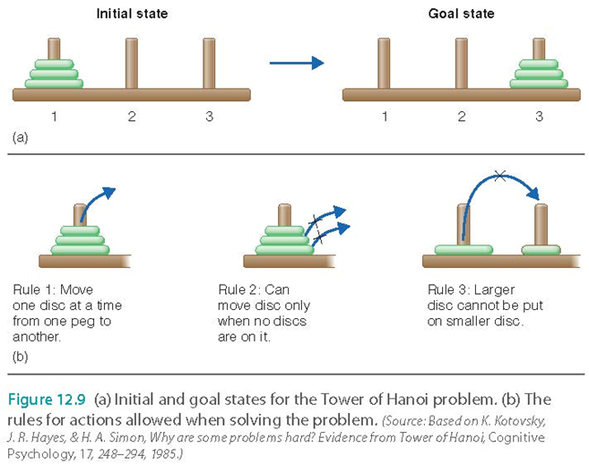
Information-processing approach
What are the subgoals here?
Notes:
•Rules stated in the figure

Slide 22
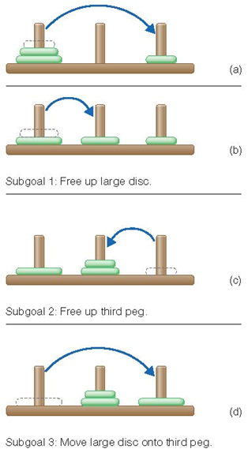
Information-processing approach
Notes:
•Rules stated in the figure
•Solved in eight steps

Slide 23
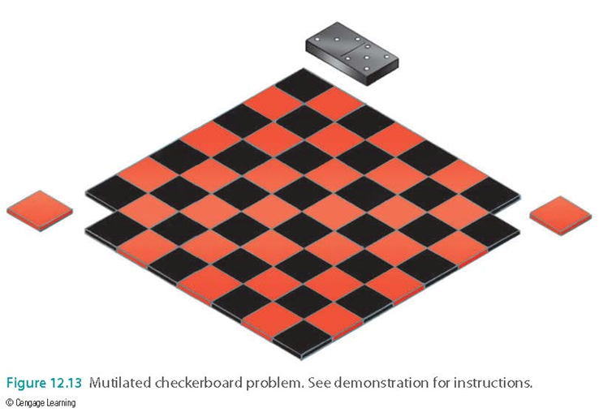
How a Problem Is Stated Is Important
A checkboard has 64 squares, which can be covered by placing 32 dominos on the board, so each domino covers two squares.
If we eliminate two corners of the checkboard, can we now cover the remaining squares with 31 dominos?
Notes:
•Key to solving: each domino covers two squares & squares must be of different colors, so removing the two corner squares with the same color makes it impossible to solve the problem.
•If subjects presented with boards that emphasized the difference between adjoining squares, problem easier to solve.

Slide 24
How do participants solve problems? Let’s ask
Think-aloud protocol
Say aloud what one is thinking
Shift in how one perceives elements of a problem

Slide 25
Russian Marriage Problem
In a small Russian village, there were 32 bachelors and 32 unmarried women. Through tireless efforts, the village matchmaker succeeded in arranging 32 highly satisfactory marriages. The village was proud and happy. Then one drunken night, two bachelors, in a test of strength, stuffed each other with pierogies and died. Can the matchmaker, through some quick arrangements, come up with 31 heterosexual marriages among the 62 survivors?
Notes:
•impossible; 30 men, 32 women
•same situation as the mutilated checkerboard problem
•Usually if you give people this story before checkerboard, able to solve that quicker
•Noticing similar patterns among the problems

Slide 26
Analogical Transfer
Using a solution to a similar problem guides solution to new problem
Russian marriage problem (source problem) → mutilated-checkerboard problem (target problem)
“Analogical problem solving”
Analogical transfer: The transfer from one problem to another
Source problem to target problem

Slide 27
A Case Study
A patient has a malignant tumor in his stomach. It is impossible to operate on the patient, but unless the tumor is destroyed the patient will die.
There is a kind of ray that can be used to destroy the tumor. If the rays are directed at the tumor at a sufficiently high intensity the tumor will be destroyed. Unfortunately, at this intensity the healthy tissue that the rays pass through on the way to the tumor will also be destroyed. At lower intensities the rays are harmless to the healthy tissue but they will not affect the tumor either.
What type of procedure might be used to destroy the tumor with the rays, and at the same time avoid destroying the healthy tissue? (Duncker; 1945; Gick & Holyoak, 1980)?
Notes:
•Duncker’s radiation problem.
•Only 10% could answer this.
•Bombard the tumor with a number of low-intensity rays from different directions, which destroys the tumor without damaging the tissue the rays are passing through
I.e., modern radiosurgery
•Similar again to Gestalt ideas of representation and restructuring - initial rep is of single ray; restructured soln: divide ray into many smaller rays

Slide 28
A Case Study
A small country was ruled from a strong fortress by a dictator. The fortress was situated in the middle of the country, surrounded by farms and villages. Many roads led to the fortress through the countryside. A rebel general vowed to capture the fortress. The general knew that an attack by his entire army would capture the fortress. He gathered his army at the head of one of the roads, ready to launch a full-scale direct attack. However, the general then learned that the dictator had planted mines on each of the roads. The mines were set so that small bodies of men could pass over them safely, since the dictator needed to move his troops and workers to and from the fortress. However, any large force would detonate the mines. Not only would this blow up the road, but it would also destroy many neighboring villages. It therefore seemed impossible to capture the fortress.
However, the general devised a simple plan. He divided his army into small groups and dispatched each group to the head of a different road. When all was ready he gave the signal and each group marched down a different road. Each group continued down its road to the fortress so that the entire army arrived together at the fortress at the same time. In this way, the general captured the fortress and overthrew the dictator.
Notes:
•Fortress: like the tumor; small groups of soldiers: like the low intensity rays
•Read this story, work on the radiation problem
•at least 30% able to then solve the other problem
•Major finding of using analogies: Even when exposed to analogous source problems, most people don’t make the connection between the source problem & target problem.

Slide 29
Analogical Transfer
Notice structural similarities **hardest step
Map corresponding parts of the story
E.g., fortress = tumor, troops = rays
Apply mapping to generate a parallel solution
Often hints must be given to notice connection
Surface features get in the way
Structural features must be used

Slide 30
Make the Problem More Similar
High surface similarities aid analogical problem solving
Surface features: Specific elements of a given problem
E.g., instead of dictator story, make it into a lightbulb, lasers, avoiding broken glass
Making structural features more obvious aids analogical problem-solving
Structural features: The underlying principle(s) that govern the solution to a problem
“Strong ray destroys tissue” and “strong laser breaks lightbulb”

Slide 31
You Can Help People Solve Problems With Training
Analogical encoding: the process by which two problems are compared and similarities between them are determined
Effective way to get participants to pay attention to structural features that aide problem-solving
Notes:
•have participants compare 2 cases that illustrate a principle
•e.g., negotiation strategies and trade-offs

Slide 32
Using Analogies to Solve a Problem
Analogical paradox
It can be difficult to apply analogies in the laboratory, but people routinely use analogies in real-world settings

Slide 33
Expertise
Expert – a person who, by devoting a large amount of time to learning about a field and practicing and applying that learning, have become acknowledged as being extremely knowledgeable or skilled in that field
Notes:
•Experts solve problems in their field faster and with a higher success rate than beginners
•Experts possess more knowledge about their fields
•Knowledge is organized so it can be accessed when needed to work on a problem
–Novice: surface features
–Expert: structural features
•Experts spend more time analyzing problem
•Experts are no better than novices when given problems outside of their field
•Experts less likely to be open to new ways of looking at problems

Slide 34
Expert problem solving
Within the field of expertise:
Solve problems faster and more successfully
Knowledge is organized based on deep understanding of material and is easily retrieved
Notice meaningful patterns of information
Notes:
•Experts solve problems in their field faster and with a higher success rate than beginners
•Experts possess more knowledge about their fields
•Knowledge is organized so it can be accessed when needed to work on a problem
–Novice: surface features
–Expert: structural features
•Experts spend more time analyzing problem
•Experts are no better than novices when given problems outside of their field
•Experts less likely to be open to new ways of looking at problems

Slide 35

Rubik’s Cube
Novice perspective
(0:40-)
Expert perspective
Speedcubing
Notes:
Novice - https://www.youtube.com/watch?v=5HcpYFHsFqA
Expert - https://www.youtube.com/watch?v=MaltgJGz-dU&feature=youtu.be&t=367
Speed - https://www.youtube.com/watch?v=r2H-cnti8GI

Slide 36
Expert problem solving
Within the field of expertise:
Solve problems faster and more successfully
Knowledge is organized based on deep understanding of material and is easily retrieved
Notice meaningful patterns of information
Notes:
•Experts solve problems in their field faster and with a higher success rate than beginners
•Experts possess more knowledge about their fields
•Knowledge is organized so it can be accessed when needed to work on a problem
–Novice: surface features
–Expert: structural features
•Experts spend more time analyzing problem
•Experts are no better than novices when given problems outside of their field
•Experts less likely to be open to new ways of looking at problems

Slide 37
How uniquely human is problem-solving?
But surely it's just great apes, right?
How do other animals measure up to us?
Notes:
https://www.youtube.com/watch?v=vPfjHZfe190 (1 min)
https://www.youtube.com/watch?v=ZerUbHmuY04 (3 min - probably don’t need full)
https://www.youtube.com/watch?v=JwwclyVYTkk (3 min)

Slide 38
Takeaways & General Qs
How does the Gestalt approach work?
How do the information-processing approach guys describe the problem-solving process?
What is the analogical transfer approach to problem-solving? What do you have to do to accomplish it?
What makes an expert different than a novice? What’s the relationship between expertise and flexibility? What do I mean when I say expertise is “domain-specific”?
Is there any adaptive reason humans should be like this?

Slide 39
Creativity
What do you think creativity is?
What did the podcast suggest?

Slide 40
Creativity
Creativity
Innovative thinking
Novel ideas
New connections between existing ideas
Divergent thinking: open-ended; large number of potential “solutions”

Slide 41

Imagine you are stranded on a desert island... What would you do?

Slide 42
Demo
In 3-4 person groups, do the following:
List each group member’s experience with the outdoors (e.g., hiking, camping, etc.).
Decide on what 5 items you would need to survive in your small group. Write these down.
Give an explanation as to why you chose each item for your groups survival.
What strategies would your groups use to survive on a daily basis? Why? Did your group’s experience affect these strategies?
Notes:
In what way is convergent versus divergent thinking used in the sorts of strategies the groups described? Was one group more creative in their responses than others? What features of the group composition might have contributed to such differences (e.g., were some members more “expert” in outdoor survival in the more creative groups?)?

Slide 43
Desert Island Detour
“Divergent thinking is defined as creative thinking that may follow many lines of thought and tends to generate new and original solutions (e.g., listing creative uses for a common object)....”
“Convergent thinking tasks for which there is one correct answer and which are most commonly used in intelligence tests (e.g., solving an anagram).”

Slide 44
Desert Island Debriefing
What is convergent thinking? Give an example.
What is divergent thinking? Give an example.
The strategies that were described by certain groups resembled convergent or divergent thinking?
Notes:
So, for the scenario, there is a right answer to needing to gather food and water and staying warm (convergent thinking). How you actually go about doing that – that might be divergent thinking, e.g., building a boat to catch fish, climbing trees for coconut, building a little hut from wood, building fires, etc.

Slide 45
How do you think creativity relates to the processes we have discussed?
Problem-solving?
Memory?
Decision-making?
Attention?
etc.
Notes:
No right answer - just want to use this time for us to tie back together some threads; e.g., Chess masters who memorize all the ways that a Chess board is laid out - we talk about how quickly they solve the problem, but in reality they are just relying on their stored knowledge of similar problems. Is that less “creative”? Is “creativity” tied to productivity and the decisions you make?
-group brainstorming tomorrow!!! For science communication pieces

Slide 46
Today’s Goals + Agenda
LO1: Continue to build a supportive classroom culture & discuss science communication
Make sure you all feel comfortable with the final drafts due soon
How did you perceive this podcast relative to the others? Here was a psychologist covering a fellow psychologist
LO2: Describe the basic fundamental principles of creativity & problem-solving
Demos on problem-solving & creativity
Discuss Goldstein chapter 12 research

Slide 47
Participation + Minute Paper
https://tinyurl.com/PSY102Participation
https://tinyurl.com/PSY102MinutePaperJune17

Slide 48
Additional Practice
Optional: Test Yourself

Slide 49
Holly was in her mother-in-law's kitchen preparing lunch for the family. When she was ready to dish up the soup, she searched all the cupboards and drawers for a ladle but couldn't find one. She decided to wait until her mother-in-law returned to ask her where the ladle was, leaving the soup in the stove pot. Her mother-in-law later explained that the ladle had been broken, so she told Holly to use a coffee mug to "spoon" the soup into bowls. Holly's ability to solve the "dish up the soup" problem was hindered by which of the following obstacles?
Discriminability
Perseveration
Divergent thinking
Functional fixedness
Notes:
D

Slide 50
Amber lives in a housing development between two parallel streets that both connect to a freeway. She usually takes the street to the south when heading southbound on the freeway to work, but that street is closed for repairs for three months. Amber takes the street to the north during that time. After the street to the south is re-opened, she continues to take the street to the north, even though it is a slightly longer route. Continuing to take the street to the north represents
A single dissociation
A source problem
A mental set
Convergent thinking
Notes:
C

Slide 51
Dr. Curious is doing a follow-up study to the mutilated checkerboard problem experiment. In this new study, participants solve the following shoe problem before tackling the checkerboard problem. By doing this, Dr. Curious is studying the effect of _____ on problem solving.
The shoe problem: A first-grade class is using a trampoline in gym class, so all the children have removed their shoes, which are all jumbled in a large pile. One of the students, Miguel, is leaving early, so the teacher tells him to grab his shoes and report to the lobby. In his hurry, Miguel grabs two identical left-footed, size 6 red sneakers and runs to his mother still sock-footed. Will the remaining students be able to shoe-up with the remaining shoes without getting a foot-ache?
Analogies
Anaphoric interference
Perceptual segregation
Divergent thinking
Notes:
A

Slide 52
Ali works for Citrus Squeeze, a company that makes orange juice. Sales of their calcium-enhanced OJ have been poor, and the product was cancelled. His factory still had three cases of cartons, and Ali was told he could take them if he wanted them. With the cartons, Ali made several birdfeeders for his backyard and also planted tree seedlings in some of them; he used the remaining ones to build a "fort" for his four-year-old son. Ali's use of the cartons represents
Convergent thinking
Divergent thinking
Insight
Hierarchical organization
Notes:
B

