Slide 1
PSY102: Introduction to Cognitive Psychology
Day 16 (06/06/19): Decision-making

Slide 2
Today’s Goals + Agenda
LO1: Continue to build a supportive classroom culture & discuss science communication
Mention selecting Duke Research Blog articles
Apply Lombrozo (2014) piece to our academic journal article readings: mainly, how does a neuroscientific perspective impact decision-making?
LO2: Describe the basic fundamental principles of decision-making research
Describe classic theory of decision-making (expected utility) as it applies to everyday scenarios
Describe endowment effect, how emotions impact decision-making, delay-discounting, loss aversion, risk behaviors, the framing effect, dual systems theory, neuroeconomics, & the trolley problem.
LO3: Summarize and critically analyze academic journal articles
How do these papers inform our understanding of how people make decisions?
How can we apply these findings to everyday life? How does our discussion on sampling factor here? What else would you want to do to build off these studies?
Notes:
https://duke.qualtrics.com/jfe/form/SV_5d4lzbv0RZkdWGV - 5 responses! Need 8!

Slide 3
Tomorrow’s Work
Readings:
Stanley et al. (2019) (motivated reasoning in political behavior)
Pennycook & Rand (2018) (it’s critical thinking, not motivated reasoning!)
Podcast:
NPR Hidden Brain: “I’m Right, You’re Wrong”
Quiz (AM, categorization, today’s topics)
Theme: Can we change people’s minds?

Slide 4
Judgment & Decision-Making
Judgment: holding a conclusion about something
Decisions: the process of making choices between alternatives
Reasoning: the process of drawing conclusions
Very related processes

Slide 5
Splitting Decision-making & Reasoning
Making Judgements (Friday)
Decision-making: Choosing Among Alternatives (Today)
Deductive Reasoning: Syllogisms & Logic (Monday)
Notes:
X endowment effect demo

Slide 6
Endowment Effect
Retain the object you own than acquire the same object when you don’t own it
“What belongs to us, and what we give away, always seems very precious to us.” -Aristotle
Notes:
Beth and I did a live demo of the endowment effect in class. She bought a couple Duke mugs from the bookstore and gave them to randomly selected students in class. Then we asked the students who received the mugs how much they would sell their mug for. We also asked other students how much they would pay to buy one of those mugs. It worked perfectly, as the mug owners wanted a lot more money for their mugs than other students were willing to pay. And of course, the students loved getting free mugs. (This should also work with something cheaper!)
-> could also ask about trading it in
people are more likely to retain an object they own than acquire that same object when they do not own it.

Slide 7
Today’s thesis statement:
Even if we think we are, on balance, rational people, a lot of things other than rationality affect our decisions!

Slide 8
How our decision-making isn’t entirely rational
Expected utility theory
…and how we don’t actually behave in accordance with it
Dual-systems theory
Notes:
•Expected utility theory
–People are rational
–If they have all relevant information, they will make a decision that results in the maximum expected utility
•Utility: outcomes that are desirable because they are in the person’s best interest
–Maximum monetary payoff

Slide 9
Expected Utility
People are rational
If they have all the relevant information, they will behave in the optimal way for their own benefit
“Maximize expected utility”
On this theory, utility = $$
Maximize money
Good: specific procedures to determine “best choice”
BUT….
Notes:
•Expected utility theory
–People are rational
–If they have all relevant information, they will make a decision that results in the maximum expected utility
•Utility: outcomes that are desirable because they are in the person’s best interest
–Maximum monetary payoff

Slide 10
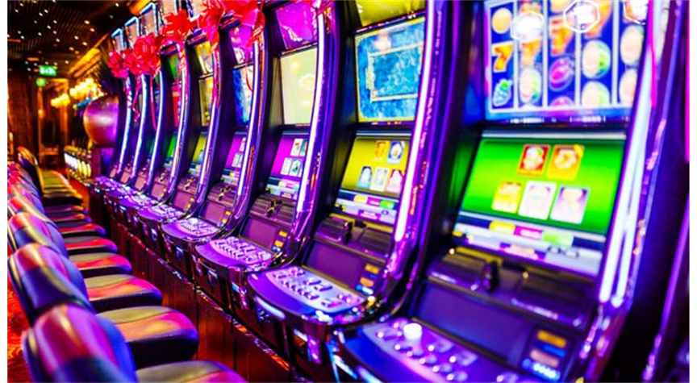
But we tend NOT to maximize our expected utility
Notes:
Image credits:
http://www.cbc.ca/fifth/episodes/2017-2018/gambling-on-addiction-how-governments-rely-on-problem-gamblers
https://www.tastemade.com/videos/avocado-toast
Cengage 2015
•Problems for utility approach
–Not necessarily money, people find value in other things
–Many decisions do not maximize the probability of the best outcome

Slide 11
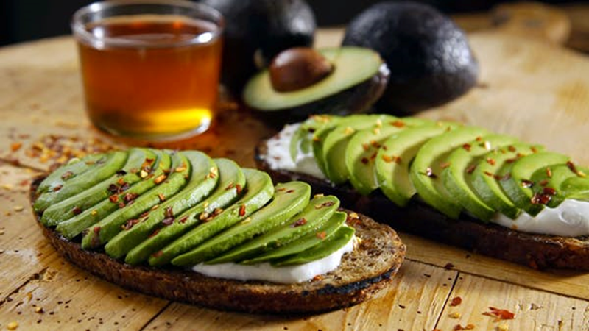
But we tend NOT to maximize our expected utility
Notes:
Image credits:
http://www.cbc.ca/fifth/episodes/2017-2018/gambling-on-addiction-how-governments-rely-on-problem-gamblers
https://www.tastemade.com/videos/avocado-toast
Cengage 2015
•Problems for utility approach
–Not necessarily money, people find value in other things
–Many decisions do not maximize the probability of the best outcome

Slide 12
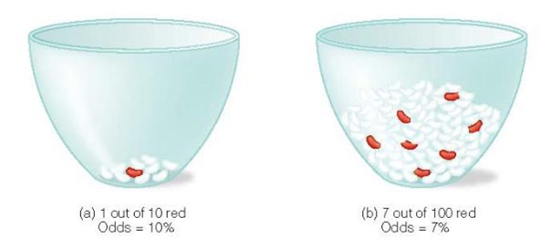
But we tend NOT to maximize our expected utility
Notes:
Image credits:
http://www.cbc.ca/fifth/episodes/2017-2018/gambling-on-addiction-how-governments-rely-on-problem-gamblers
https://www.tastemade.com/videos/avocado-toast
Cengage 2015
→ people often chose B even with worse odds; knew odds were against them, but seeing more red beans made them feel like they had a better chance
→ in this expt, they were explicitly told about the numbers of beans
•Problems for utility approach
–Not necessarily money, people find value in other things
–Many decisions do not maximize the probability of the best outcome

Slide 13
But we tend NOT to maximize our expected utility
You can either have…
$10 today
$15 next week
Notes:
Image credits:
http://www.cbc.ca/fifth/episodes/2017-2018/gambling-on-addiction-how-governments-rely-on-problem-gamblers
https://www.tastemade.com/videos/avocado-toast
Cengage 2015

Slide 14
But we tend NOT to maximize our expected utility
You can either have…
$10 today
$100 next year
Notes:
Image credits:
http://www.cbc.ca/fifth/episodes/2017-2018/gambling-on-addiction-how-governments-rely-on-problem-gamblers
https://www.tastemade.com/videos/avocado-toast
Cengage 2015

Slide 15
But we tend NOT to maximize our expected utility
You can either have…
$10 today
$100 next year
Delay discounting = discounting (devaluing) rewards as the rewards become farther away in time
Notes:
Image credits:
http://www.cbc.ca/fifth/episodes/2017-2018/gambling-on-addiction-how-governments-rely-on-problem-gamblers
https://www.tastemade.com/videos/avocado-toast
Cengage 2015

Slide 16
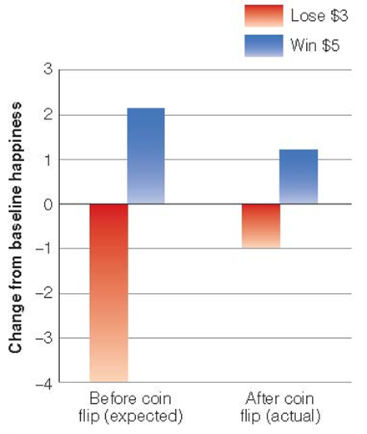
Emotions Affect Decisions, Too
Expected emotions
Emotions that people predict that they will feel concerning an outcome
Imagining vs. imagined event (Stanley et al., AM counterfactual simulation)
People inaccurately predict their emotions
Predictor of risk aversion
Notes:
→ Kermer and colleagues (2006)
→ gave subs $5 and told them that based on a coin flip, they’d either win an additional $5 or lose $3
→ rated happiness before expt started & predicted how happiness would change for gain or loss
→ actual effect of losing was substantially less than predicted +++ positive effect of winning only a little less than predicted
→ overestimating what their negative feelings will be (not really taking into account coping mechanisms)

Slide 17
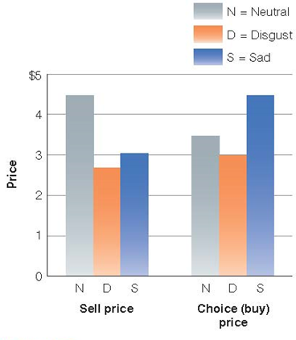
Emotions Affect Decisions, Too
Incidental emotions: Emotions that are not specifically related to decision-making
May be related to one’s general disposition or personality, some recent experience, or one’s general environment or surroundings
Can affect one’s overall decision making processes
E.g., Hanger study / Lindquist!
Notes:
→ Lerner and colleagues (2004)
→ subjects viewed 1 of 3 flips: a person dying (sadness); a person using a dirty toilet (disgust); and fish at the Great Barrier Reef (neutral)
→ sadness & disgust subs also wrote about how they’d feel if they were in the situation in the clip
→ determined then how much subs would be willing to sell a set of highlighter pens for and the price at which they’d be willing to choose the set instead of accepting the money
→ disgust and sadness: sell the highlighters for < money than neutral

Slide 18
Our judgments about risk are also weird
Imagine that the United States is preparing for the outbreak of an unusual disease that is expected to kill 600 people. Two alternative programs to combat the disease have been proposed.
If Program A is adopted, 200 people will be saved.
If Program B is adopted, there is a 1/3 probability that 600 people will be saved, and a 2/3 probability that no one will be saved.

Slide 19
Our judgments about risk are also weird
Imagine that the United States is preparing for the outbreak of an unusual disease that is expected to kill 600 people. Two alternative programs to combat the disease have been proposed.
If Program C is adopted, 400 people will die.
If Program D is adopted, there is a 1/3 probability that nobody will die, and a 2/3 probability that 600 people will die.

Slide 20
Our judgments about risk are also weird
If Program A is adopted, 200 people will be saved.
If Program B is adopted, there is a 1/3 probability that 600 people will be saved, and a 2/3 probability that no one will be saved.
72% wanted to go with Program A (definite strategy (risk aversion)).
If Program C is adopted, 400 people will die.
If Program D is adopted, there is a 1/3 probability that nobody will die, and a 2/3 probability that 600 people will die.
78% wanted to go with Program D (risky strategy (risk-taking)).
Framing effect: decisions are influenced by how the choices are framed
When choices are framed in terms of gains, people tend to be risk-averse
When choices are framed in terms of losses, people tend to be risk-taking
Notes:
•Tversky and Kahnemann (1981)
• Saving 200 lives with certainty is more attractive than ⅔ probability of saving no one
• Certain death of 400 people less acceptable than 2 in 3 risk that 600 people will die
• programs are identical - 400 die, 200 saved in both Program A & C, and in B and D, ⅔ chance of none saved/600 die (+ ⅓ chance of 600 saved, none died)

Slide 21
More Framing Effect
Decisions depend on how choices are presented
Opt-in procedure
Active step to be organ donor
85% Americans approve, only 28% granted
Opt-out procedure
Organ donor unless request not to be
France/Belgium at >99% consent
Status quo bias
The tendency to do nothing when faced with making a decision

Slide 22
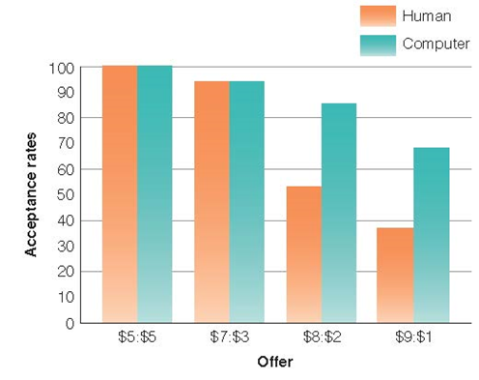
Neuroeconomics
Sanfey and coworkers (2003)
Ultimatum game
Often rejected low offers because they became angry that offers were unfair
Less angry with an “unfair” computer
Notes:
•Neuroeconomics
–One finding: decisions are influenced by emotions, and those emotions are associated with activity in specific areas of the brain
Ultimatum game: two players, oen designated as the proposer and the other as the responder. Proposer is given $$ and designates how much $$ to give to responder. Responder chooses to accept offer => money split according to proposal; if responder rejects offer, neither player receives anything
Utility theory: you should accept the offer no matter what! Anything is better than nothing!!

Slide 23
Dual Systems Theory
System 1
Intuitive
Fast
Nonconscious
Automatic
Heuristic-based (for better or worse)
System 2
Reflective
Slow
Conscious
Controlled
Can overrule heuristics with deliberate thinking (for better or worse)
Notes:
https://www.behavioraleconomics.com/resources/mini-encyclopedia-of-be/dual-system-theory/

Slide 24
How do these theories play out in real-world contexts?
Trolley Problem-
https://www.wnycstudios.org/story/driverless-dilemma
4:30-6:20
Notes:
https://www.wnycstudios.org/story/driverless-dilemma
How does this change in a “automated car?” How do we program computers to solve these moral dilemnas?

Slide 25
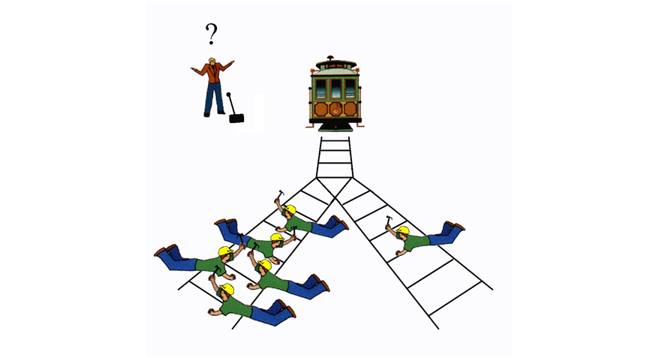

Slide 26
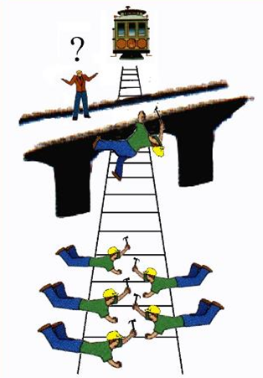

Slide 27
Trolley Problem
Which dilemma would you rather face?
In the lever version, what do you think people are likely to say?
The footbridge version?
What’s the difference between them, subjectively?
What will happen when we have driverless cars?
Notes:
5 lives vs. 1 life - lever
5 lives vs. 1 life - footbridge
You have to opt into killing 1 to save 5 - lever
You have to opt into killing 1 to save 5 - footbridge
Brain areas associated with deliberation and dispassionate thinking - lever
Brain areas associated with emotion - footbridge

Slide 28
Pearson et al. (2018)
Judgements about crimes
What was the question addressed here?
How did they address the question?
What did they find? Think about each figure & summarize overall result & each figure in 1 sentence.
Did they identify any limitations? Do you think they handled these limitations appropriately?
What do you want to know more about, after reading this study?
Notes:
X things I personally want to know more about:
Part of their finding is about how expertise impacts our judgements. It’d be nice to see what this kind of effect looks like with regard to people who know more about DNA vs. other types of physical evidence. The lawyers show less of the crime effect than the MTurkers. Is it an effect of the law (profession) or an effect of actual expertise?
How do details in their cases impact judgments? What if they biased names to sound more exotic or fit certain stereotypes? How much does that cause “evidence” to shift in judgements of guilt? There are a whole lot of ways that you can make this kind of design and task work to address issues of social justice.
I know that the authors are doing an FMRI version of this now. Is that actually *helpful*? Will it add that much?
What kinds of interventions could you do, to make people less biased towards judging others on the basis of accusation? And how do we square the fact that being accused of a crime leads to higher ratings of evidence, but that people don’t judge prior convictions as evidential? It seems at some point that they’d feed on each other.

Slide 29
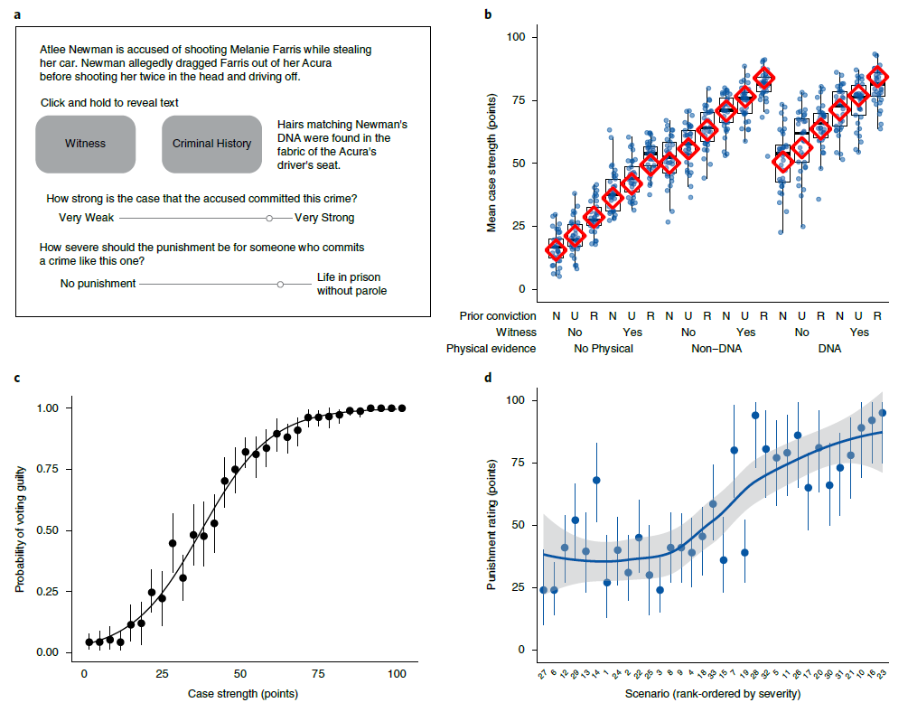
Pearson et al. (2018)

Slide 30
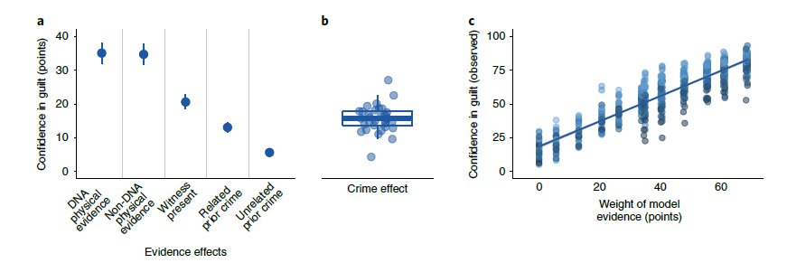
Pearson et al. (2018)

Slide 31
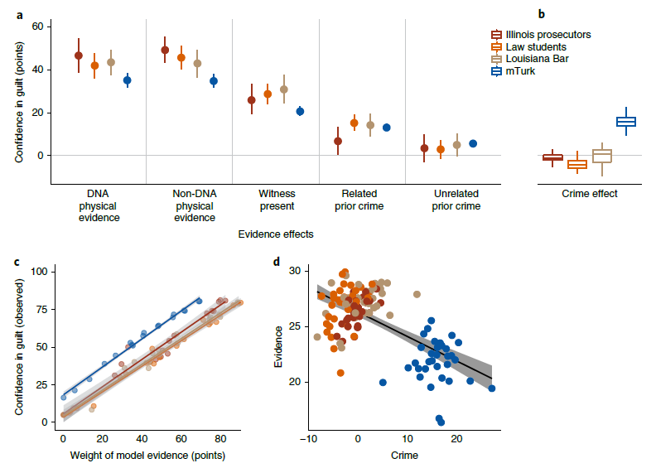
Pearson et al. (2018)

Slide 32
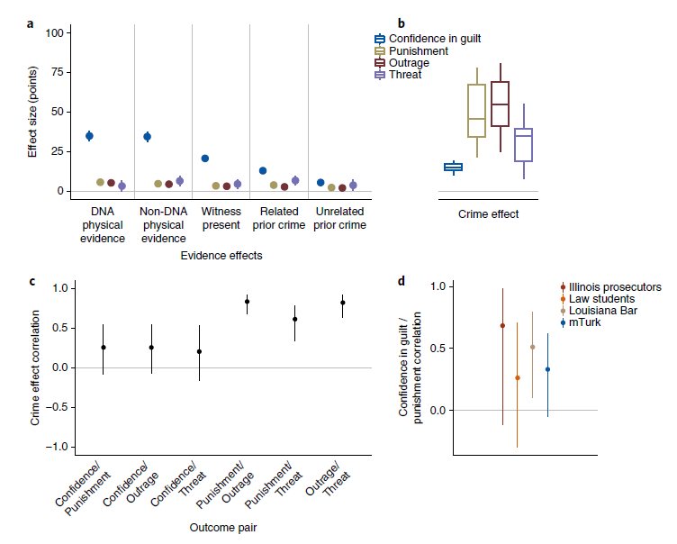
Pearson et al. (2018)

Slide 33
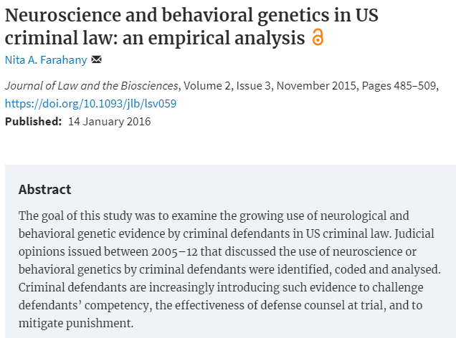
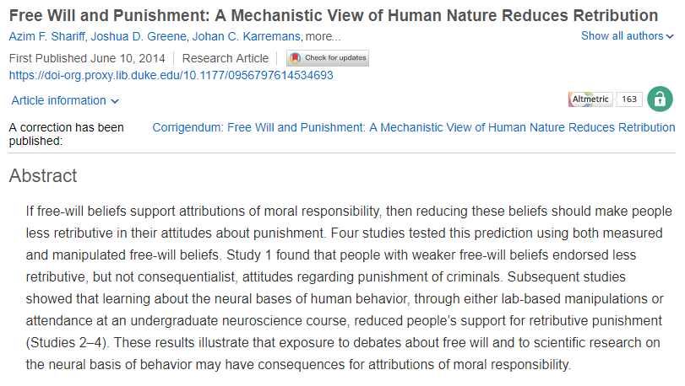
Can we bias people to view evidence differently? How neuroscience shapes punishment (Lombrozo, 2014)
Notes:
Connecting back to Lombrozo (2014)
X What would happen if you redid the Pearson study by presenting participants with neuroscientific evidence? Does that weigh more or less than physical evidence?
X Pearson et al. don’t differentiate between “retribution” punishment and punishment to deter other crimes from happening again. Would their conclusions be the same if so?

Slide 34
Pryor et al. (2019)
Arbitrary Social Norms
What was the question addressed here?
How did they address the question?
What did they find? Think about each figure & summarize overall result & each figure in 1 sentence.
Did they identify any limitations? Do you think they handled these limitations appropriately?
What do you want to know more about, after reading this study?
Notes:
X things I personally want to know more about:
How much of this is framing? Like what if you had a default option already chosen for participants? How many of them would switch their decision over due to the norm? This is essentially asking about a kind of status-quo bias, framing effect scenario for these results.
Why did they chose the “in-group” norms that they did? Like, why is it that its similarity with identity, with respect to a personality questionnaire, gender, and age? How much is it an “arbitrary norm”? If an identity is context-dependent and biased by these norms, can’t you prime other identities?
Is the check for understanding really enough? It’d be nice if they had more ways of actually proving participants gave a damn.

Slide 35
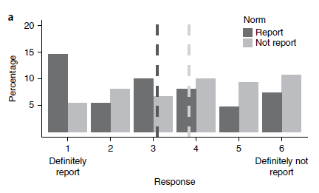
Pryor et al. (2019)
“Imagine you have witnessed a man rob a bank. However, you then saw him do something unexpected with the money. He donated it all to a run-down orphanage that would benefit greatly from the money. You must decide whether to call the police and report the robber or do nothing and leave the robber alone.”

Slide 36
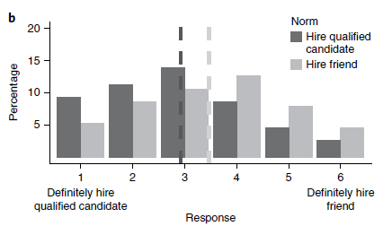
Pryor et al. (2019)
“Imagine you are hiring someone for a job at your firm. Your friend has applied for the position and is qualified. However, another applicant seems to be even more qualified.”

Slide 37
Anchoring Heuristic
When faced with an estimation task…
Use prior knowledge as an anchor (even if you just got it) - i.e., a reference point
Adjust away
(It’s usually an insufficient adjustment, so initial anchor makes a BIG difference)
Notes:
https://www.youtube.com/watch?v=NFiDdbquWJY&index=2&list=PL0q1l3zKRdt4oJHJxEtGWqsiad1exWCcJ
https://www.youtube.com/watch?v=RhyJGwNpEcw&list=PL0q1l3zKRdt4oJHJxEtGWqsiad1exWCcJ&index=6
https://www.youtube.com/watch?v=LBNtChg4t4k&list=PL0q1l3zKRdt4oJHJxEtGWqsiad1exWCcJ&index=4

Slide 38
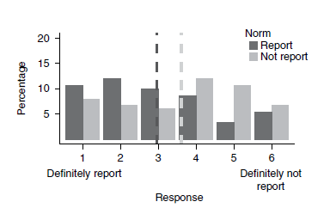
Pryor et al. (2019)
“In the previous study, approximately 25% of [gender] participants aged [age range] that rated high in [personality description] were allocated to [randomly popular action] and then rate how they would feel, due to an error in their random allocation.”

Slide 39
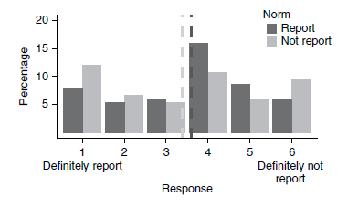
Pryor et al. (2019)
“The previous study used a completely different moral dilemma that happened to also involve a robber. In the previous study, approximately 75% of [gender] participants aged [age range] that rated high in [personality description] were allocated to randomly popular action] and then rate how they would feel, due to an error in their random allocation.”

Slide 40
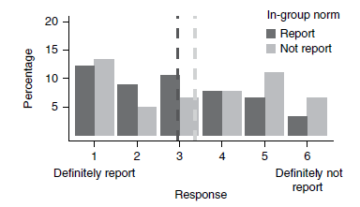
Pryor et al. (2019)
approximately 75% of female participants that rated high in extraversion and agreeableness were allocated to imagine calling the police and reporting the robber and then rate how they would feel, due to an error in their random allocation.
approximately 75% of male participants that rated low in extraversion and agreeableness were allocated to imagine doing nothing and leaving the robber alone and then rate how they would feel, due to an error in their random allocation.”

Slide 41
Today’s Goals + Agenda
LO1: Continue to build a supportive classroom culture & discuss science communication
Mention selecting Duke Research Blog articles
Apply Lombrozo (2014) piece to our academic journal article readings: mainly, how does a neuroscientific perspective impact decision-making?
LO2: Describe the basic fundamental principles of decision-making research
Describe classic theory of decision-making (expected utility) as it applies to everyday scenarios
Describe endowment effect, how emotions impact decision-making, delay-discounting, loss aversion, risk behaviors, the framing effect, dual systems theory, neuroeconomics, & the trolley problem.
LO3: Summarize and critically analyze academic journal articles
How do these papers inform our understanding of how people make decisions?
How can we apply these findings to everyday life? How does our discussion on sampling factor here? What else would you want to do to build off these studies?

Slide 42
Participation + Minute Paper
https://tinyurl.com/PSY102Participation
https://tinyurl.com/PSY102MinutePaperJune6

Slide 43
Additional Practice
Optional: Test Yourself

Slide 44
General Question
Our thesis statement today was about people not always making rational decisions. Do people act in line with the expected utility theory? How would you explain evidence for our thesis to someone else?

Slide 45
Expected utility theory is most applicable to deciding whether to:
Break up or stay involved with a current partner.
Go out for junior varsity hockey or junior varsity basketball
Buy first class or coach tickets for a spring break trip
Take astronomy or geology as a physical science elective course.

Slide 46
Josiah is trying to decide whether or not to take a new job in a new city. He is worried that if he takes the job and fails, he will suffer from intense anxiety and depression. This is an example of:
Expected emotion
Immediate emotion
Integral immediate emotion
Incidental immediate emotion

Slide 47
People tend to overestimate
What negative feelings will occur following a decision more so than positive feelings
What positive feelings will occur following a decision more so than negative feelings
What positive and negative feelings will occur following a decision to the same degree
Subjective utility values following a decision

Slide 48
Juanita is in a convenience store considering which soda to buy. She recalls a commercial for BigFizz she saw on TV last night. BigFizz is running a promotion where you look under the bottle cap, and one in five bottles has a voucher for a free soda. If Juanita decides to purchase a BigFizz based on this promotion, which is framed in terms of _____, she will use a _____ strategy
Losses; risk-taking
Gains; risk-taking
Losses; risk-aversion
Gains; risk-aversion

Slide 49
Many people receive unsolicited calls from telemarketers or unwanted “junk” mailers advertising offers for products such as cable or internet services or cellular phone companies. Most people do not consider these offers and do not make a change to the plans or services that they receive because they do not want to make a decision that requires serious consideration or thought. This is an example of the ________ bias
Actor-observer
Dual systems
Self-serving
Status quo

Slide 50
Cecile has dreamed of owning her own home for years, and she can finally afford a small cottage in an older neighborhood. She notices that she feels more positive about her home when she drives home by the abandoned shacks, but she hates her home when driving past the fancy mansions with their large lawns. Cecile's emotions are influenced by
The principle of diversity
Confirmation bias
The framing effect
The law of large numbers

Slide 51
MC Answer Key
Slide 44: C
Slide 45: A
Slide 46: A
Slide 47: D
Slide 48: D
Slide 49: D
Slide 50: C

