Slide 1
PSY102: Introduction to Cognitive Psychology
Day 22 (06/14/19): Collective Memory

Slide 2
Today’s Goals + Agenda
LO1: Continue to build a supportive classroom culture & discuss science communication.
What do you think the main points of the collective memory article not covered were, based on the two science news papers? How effective was the science video used?
LO2: Define, identify, and apply previous constructs that we have discussed in class
Quiz on material covered since the last class quiz: short answers & multiple choice
LO3: Describe the basic principles thought to underlie collective memory.
Demo on collective memory (collective narcissism paper, plus paper not discussed); where does collective memory sit in the hierarchy of memory systems?
Putting it all together, if memories close together in time are segmented together and if social media can be used to study the spread of fake news, how we can study fundamental principles of memory from history?

Slide 3
Monday’s Work
Outline of your SciSummary piece
Podcast: Creativity with Constraints
I removed most things from Monday so you could think about doing work ahead of time
Monday’s general theme: how do we solve problems, and how might creativity facilitate our problem-solving?

Slide 4
Today’s themes
What can collective memory tell us?
Why do we remember some core events and cultural products more than others?

Slide 5
Wertsch & Roediger (2008): Conceptual foundations of collective memory
Collective memory is hard to define
Instead of a single, neat definition, focus on the conceptual oppositions
Collective memory vs. collective remembering
History vs. collective remembering
Individual versus collective remembering

Slide 6
Collective memory vs. collective remembering
Collective remembering: repeated reconstruction of representations of the past
Would give more emphasis to social & political contestation
Family discussions, museums, monuments, memorials, textbooks, holidays, etc.
National Museum of the American Indian; what is the “real story” of the U.S.?
Collective memory: a space in which local groups engage in an ongoing struggle against elites & state authorities to control the understanding of the past
Wertsch & Roediger, 2008

Slide 7
History vs. collective remembering
If collective remembering is a representation of the past, how does it differ from history?
History tries to provide an accurate account of the past
But collective remembering can involve some identity component (e.g., remembering in service of constructing what kind of pple we are) & may be resistant to change in the face of contradictory evidence
Part of the past can be deleted to serve present needs
E.g., “Columbus discovered America”, Moses vs. Pharaoh Akhenaten; rituals can be threatened by history
Must have ongoing connection w/ contemporary discourse & identity (which is not a prerequisite for history)
Wertsch & Roediger, 2008
Notes:
-Moses vs. Pharoah Akhenaten
-No historical evidence has been found for Moses’s existence, yet he’s been a part of our collective remembering in the Judaeo-Christian monotheistic tradition for ages
-Yet Pharoah Amenophis IV (Akhenaten) has been forgotten - his monuments were dismantled, name deleted from king-lists, but there is archaeological research of him

Slide 8
History vs. collective remembering
Formal history:
Attempts to be objective about the past (regardless of identity)
Recognizes complexity & ambiguity
May revise existing narratives in light of new evidence
Constrained by archival materials
Can change in response to new information
Collective remembering:
Involves an identity project (golden age, narrative of heroism, etc.)
Impatient with ambiguity
Ignores counter-evidence to preserve established narratives
Relies on schemas, scripts, implicit theories that simplify the past & ignore findings that don’t fit into the narrative
Is conservative + resistant to change
Wertsch & Roediger, 2008

Slide 9
Individual vs. collective remembering
We studied episodic memory, semantic memory, working memory… at the level of the individual.
How do the group & individual levels interact? Socially situated individuals are the agents of remembering.
Members of the same group share a “cultural toolkit” for remembering that reflects their setting
How does written or spoken language serve as a cultural tool?
E.g., “Smashed” vs. “hit” in MPI car crash example
How language shapes remembering = role of narrative
Narrative form & organization will be different in individual & collective remembering
Wertsch & Roediger, 2008
Notes:
Lots of agreement on methodology, jargon, tools for individual, but less so for collective remembering

Slide 10
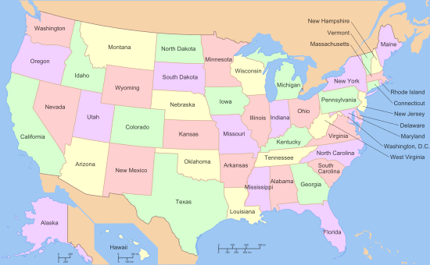
Demo
In terms of percentage, what do you think was your home state’s contribution to the history of the United States?
Choose 10 random states, not including your home state. How much do you think they contributed to U.S. history?
Notes:
https://journals.sagepub.com/doi/full/10.1177/0956797618772504
“In this study, we asked whether biases that influence individual memory and judgment will also influence judgments about groups. Egocentrism—failing to see the world from someone else’s perspective—has been well documented in individuals…”
“In our study, we asked Americans from the 50 U.S. states to estimate how much their home state has contributed to U.S. history. Although it is impossible to objectively answer how much a state has contributed to U.S. history, we can learn much from how Americans answer that question. We can measure a narcissistic bias in two ways. First, we can compare the total average estimated contributions of all states with 100% and see if—and by how much—the total exceeds 100%; logically, the average response across all states should be 2%. Second, we can compare ratings made by the residents of a state with ratings of their state made by nonresidents. Do Americans brag about their states? In our experience, yes. As a recent example, Californian Elizabeth Ashford (a state official) was quoted as saying, “For Californians and California there’s always this concept of a Golden State, a model of what a state can be and achieve” (Arango, 2018). Such “state exceptionalism” can be seen in other states, too, as our results show.”

Slide 11
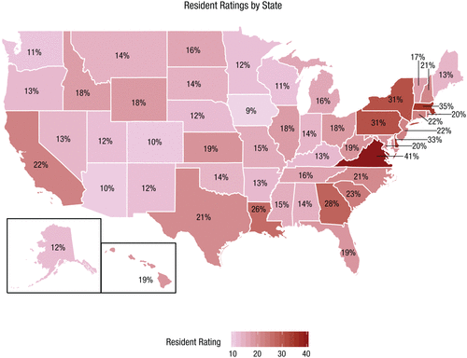
Demo Debriefing
Do your percentages add up to 100%?
How do your percentages for your state compare with the class average for the state?
Notes:
https://journals.sagepub.com/doi/full/10.1177/0956797618772504
“In this study, we asked whether biases that influence individual memory and judgment will also influence judgments about groups. Egocentrism—failing to see the world from someone else’s perspective—has been well documented in individuals…”
“In our study, we asked Americans from the 50 U.S. states to estimate how much their home state has contributed to U.S. history. Although it is impossible to objectively answer how much a state has contributed to U.S. history, we can learn much from how Americans answer that question. We can measure a narcissistic bias in two ways. First, we can compare the total average estimated contributions of all states with 100% and see if—and by how much—the total exceeds 100%; logically, the average response across all states should be 2%. Second, we can compare ratings made by the residents of a state with ratings of their state made by nonresidents. Do Americans brag about their states? In our experience, yes. As a recent example, Californian Elizabeth Ashford (a state official) was quoted as saying, “For Californians and California there’s always this concept of a Golden State, a model of what a state can be and achieve” (Arango, 2018). Such “state exceptionalism” can be seen in other states, too, as our results show.”
“Summing the average contribution from all states (which logically should equal 100%) yielded an astounding 907%, indicating a strong bias to overclaim responsibility.”
“Iowans gave the lowest rating at 9%, whereas Virginians gave the highest rating at 41%, indicating that states showed highly variable estimates of responsibility. Of course, Virginians have contributed more to American history than Iowans, but these judged percentages are still quite high. The editor of this journal referred to such high numbers as “ludicrous,” and he has a point—Virginians and Iowans together were not responsible for 50% of U.S. history.”

Slide 12
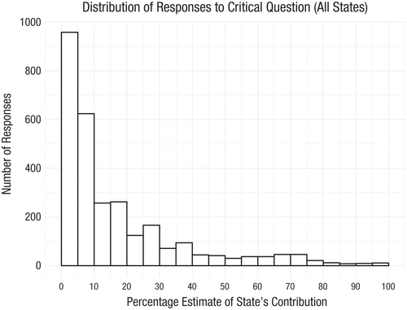
How do you compare, re: home state?
Notes:
https://journals.sagepub.com/doi/full/10.1177/0956797618772504
“Of course, there was also variability within a state in how people responded. Figure 2 shows the aggregate histogram of data from all 50 states, revealing a strong positive skew. Although most estimates (72%) were below or equal to 20%, there were a number of much higher responses, particularly in eastern states (e.g., Virginia, Delaware, and Massachusetts), indicating that some people thought that their home states had made hugely significant contributions to U.S. history.”
“Fig. 2. Distribution of responses to the critical question (“How much has your home state contributed to U.S. history?”), aggregated over all residents in all states (N = 2,898).”

Slide 13
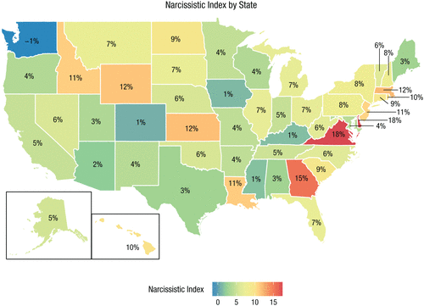
How did you rate other states compared to your own state?
Notes:
https://journals.sagepub.com/doi/full/10.1177/0956797618772504
“A second way to examine a narcissistic bias is to have people who did not grow up in a state (nonresidents) answer the same question as residents. In our study, after rating their home state, people rated 10 randomly selected states so that we obtained an average of 572 ratings (range = 529–621) per state. As expected, these nonresident ratings were much lower than the resident ratings: The average nonresident rating for all states was 11.51%, 95% CI = [11.32%, 11.70%]. Wyoming received the lowest estimate from nonresidents at 7%, and Virginia received the highest estimate at 24%. The summed nonresident estimate for all states was 576%, still far above 100% but nowhere near 907%. By subtracting the total nonresident rating from the resident rating, we can estimate a narcissistic bias of 331% of overclaiming across all states.”
“By subtracting the nonresident ratings from the resident ratings, we calculated a Narcissistic Index for each state, which provides a better estimate of narcissism. For example, Virginia had the highest average resident rating (at 41%), but nonresidents gave Virginia a rating of 24%, indicating that they, too, believed that Virginians had made substantial contributions to U.S. history (although not as substantial as Virginians believed). Thus, the Narcissistic Index adjusts the self-rating by taking into account nonresident estimates of that state’s contributions.”

Slide 14
California… Texas...
“We hypothesized in our preregistration that the original 13 colonies, Texas, and California would be the most narcissistic states. These predictions were based on the authors’ judgments, not on a theory. Nonetheless, both the resident ratings and the Narcissistic Indices suggest that, in general, those states are more narcissistic. The predicted states reported an average contribution of 26.13% (Mdn = 22.46%, 95% CI = [22.47%, 29.79%]), whereas the remaining states reported an average contribution of 14.73% (Mdn = 14.15%, 95% CI = [13.53%, 15.93%]), a statistically significant difference, t(17.48) = 6.32, p < .001, d = 2.46.”
Notes:
https://journals.sagepub.com/doi/full/10.1177/0956797618772504
“We hypothesized in our preregistration that the original 13 colonies, Texas, and California would be the most narcissistic states. These predictions were based on the authors’ judgments, not on a theory. Nonetheless, both the resident ratings and the Narcissistic Indices suggest that, in general, those states are more narcissistic. The predicted states reported an average contribution of 26.13% (Mdn = 22.46%, 95% CI = [22.47%, 29.79%]), whereas the remaining states reported an average contribution of 14.73% (Mdn = 14.15%, 95% CI = [13.53%, 15.93%]), a statistically significant difference, t(17.48) = 6.32, p < .001, d = 2.46. Likewise, the average Narcissistic Index for our predicted states was 9.49% (Mdn = 8.94%, 95% CI = [6.94%, 12.04%]), significantly higher than the Narcissistic Index of 5.39% (Mdn = 5.29%, 95% CI = [4.27%, 6.49%]) for the remaining 35 states, t(20.10) = 3.13, p = .003, d = 1.11.”

Slide 15
Remember how collective memory is insensitive to change?
“We hypothesized that we might be able to reduce the narcissistic bias by having subjects think about the breadth of U.S. history (via taking a history quiz and generating events from history) before answering the critical question. Contrary to our prediction, the history quiz did not influence the resident ratings. People who were primed with the history quiz showed practically identical ratings (18.38%, 95% CI = [17.35%, 19.41%]) as people not primed with the history quiz (18.10%, 95% CI = [17.09%, 19.11%]).”
Notes:
https://journals.sagepub.com/doi/full/10.1177/0956797618772504
“A second, exploratory analysis, however, did reveal a way to reduce the narcissistic bias. After they completed the main survey, we asked all subjects to pick the three states that they thought had contributed the most to U.S. history (the most frequent responses are displayed in Table S4 in the Supplemental Material). Then, subjects estimated the contribution of their home state, the three states they had selected as most important, and a category representing all other states. Critically, subject responses in this section had to add to 100% before the survey would advance. When restricted in this way, the estimated contribution for a home state was reduced to 10.26%, 95% CI = [9.83%, 10.69%], a statistically significant decrease from when the response was not bounded, t(2897) = 27.86, p < .001, d = 0.52. The summed contribution of the home states when using the 100% version of the question was 506%. Thus, requiring people to have their percentages add to 100 ameliorated the narcissistic bias but did not eliminate it.”

Slide 16
Why Narcissistic Bias in Memory?
Ego protection, in-group affection, or myside bias
Availability heuristic
Poor probabilistic reasoning.
People tend to overestimate small quantities.
Notes:
https://journals.sagepub.com/doi/full/10.1177/0956797618772504

Slide 17
Factors also impacting collective memory (Candia et al., 2019)
Familiarity
Alexander Hamilton identified as U.S. president (Roediger & DeSoto, 2016)
Narrative templates
Russian exceptionalism (cc: Abel)
Cultural cues
Repetitive children songs
Count-out rhymes

Slide 18
Candia et al. (2019): The universal decay of collective memory & attention
You read two SciComm pieces covering this article (Stix, 2018; Cummins, 2018)
What do you think Candia et al. (2019) shows?
Notes:
https://www.nature.com/articles/s41562-018-0474-5?dom=prime&src=syn
-> Stix (2018) just has a video, short description that doesn’t really tell you much
-> Points out that the underlying dynamics of collective attn & memory are ‘traced as a bi-exponential curve’ - a ‘steep drop followed by a slow decline over time’
Video:
-Sets up 2 hypotheses: initial burst of attention followed by long and steady decay vs. smoother linear decline
-Tells you the methods: songs, movies, biographies, scientific articles & patents
-> biexponential curve: attention has an intense burst, but decayed fast in the beginning followed by second regime of lower attention and slower decay
-Preferential attachment: popularity attracts popularity (prev. Views, citations)
-Time decay: compare cultural products with same score of initial popularity
-Communicative memory sustained by conversations (1st phase)
-Cultural memory: memory sustained by physical recording of information (2nd phase) (slower decay)
-Differences in medium for length of time for decay
-You even see the 12 different graphs!! No need for me to show that in the slideshow
Cummins (2018)
-turning Wikipedia searches & Youtube views into actionable data for attention
-mentions the 5 types of mediums chosen for cultural objects
-Mentions communicative memory (gives twitter example)
-Mentions cultural memory (gives examples of museums plundered or burned to the ground)
-explains why the curve has to be biexponential (to account for both factors)
-draws connection into why research is important by pointing out how we remember (familiarity, rhymes, templates help facts stick)
-media companies could use his equation to understand the virality of stories, plan their record releases with the math in mind
-how does death affect our collective memories of life?

Slide 19
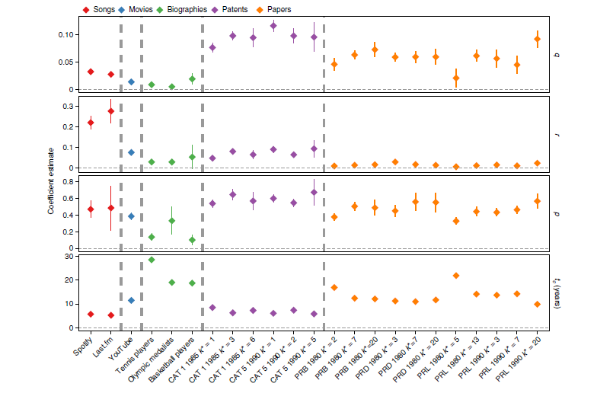
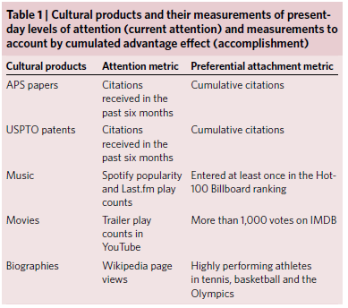
Why do some things stay in our cultural mindset longer?
Also: another use of social media for research (i.e., Youtube views)
Notes:
https://www.nature.com/articles/s41562-018-0474-5?dom=prime&src=syn
Although our results suggest that the functional form of the decay in attention function is universal across multiple cultural domains, its parameters are informative of the domain-specific decay dynamics (Fig. 5). When comparing the obtained parameters, we find that the decay rates of communicative memory are much larger than those of cultural memory (p » q)
In addition, we find that communicative memory decays much faster for music and movies than for biographies (Fig. 5c), resulting in critical times that are relatively low for music, movies and papers (5-10 years, 5d); and much longer for biographies (15-30 years). For biographies, era dominated by communicative memory lasts longer than era dominated by cultural memory.
→ r is the rate of transfer from communicative to cultural memory
→ decay of communicative is p, decay of cultural is q
Fig. 5 | Model parameters described by equation (6) and for the same data deployed in Fig. 2. Each box corresponds to a model’s parameter and the colours represent the type of cultural product. The y axis for parameters q, r and p represents the change rate, measured in the number of citations over time (years). The y axis for tc represents the critical time and it is calculated by equation (7) and measured in years. The x axis represents the cultural domain analysed. Bars represent the standard deviation of the coefficient estimation (see Supplementary Tables 1–3). PRB, Physical Review B; PRD, Physical Review D; PRL, Physical Review Letters.
“Nevertheless, it is interesting to think about the mechanisms that could contribute to the reduction of communicative memory or the flattening of the biexponential function. For example, the level of coordinated consumption of cultural goods (for example, how much people like to go to the movies together) could modulate how much that cultural good is discussed, and hence, the size of the communicative bump. In addition, exogenous effects, such as the cancellation of a conference owing to the weather could reduce the communicative memory effects for the papers discussed in those conferences.”

Slide 20
A thought probe: does our class agree on what constitutes U.S. identity?
Name what you would consider the top 10 “core events” from U.S. history from the past 20 years. Basically, in your lifetime, what do you think are the important events in U.S. history?
Take 5 min to write them down, and we’ll then write some together on the board to see % agreement.

Slide 21
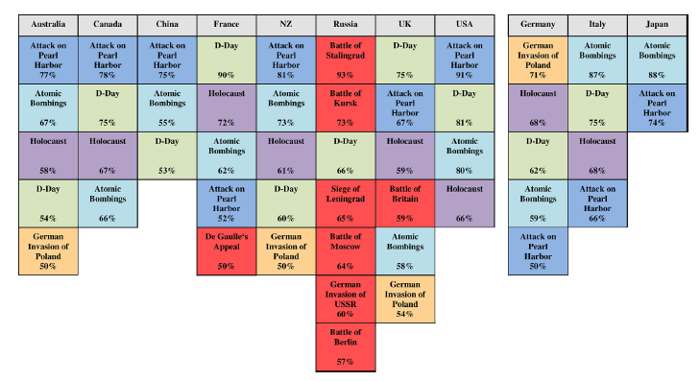
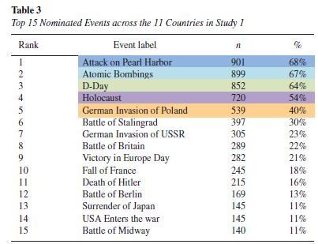
Abel et al. (2019): Collective memory of WWII

Slide 22
Collective Memory - Identity
“Whereas 57% of French citizens surveyed directly after the war in 1945 credited the Soviet Union with having contributed the most to the Nazis’ defeat, more recent polls show that 54% of respondents now credit the USA with having contributed most.”
Notes:
-one reason re: differences in the collective memory: Western-Allied perspective dominating…. Education and mass media?

Slide 23
So far, you’ve seen how collective memory can be compared against collective remembering, and collective remembering against history. What about the individual level?

Slide 24
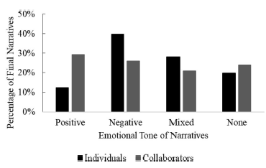
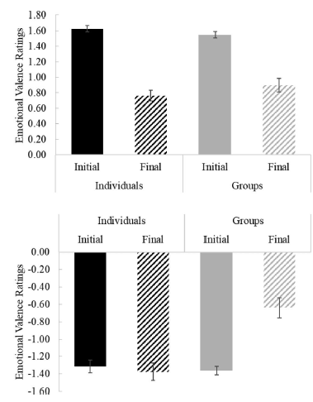
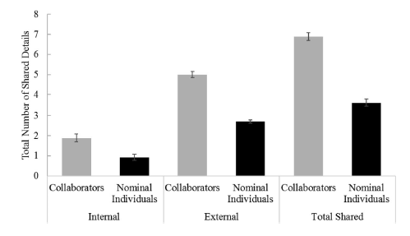
Maswood et al. (2019): collectively remembering an exam makes the memory more positive & externally focused
Notes:
-students enrolled in research methods, cog psych, & intro psych
-2 groups: recalled exam either individually or collaboratively
-divided participants into groups according to who had initial negative, positive, or neutral emotional valence toward the exam
-groups were of triads
-measured emotional valence with Autobiographical Memory Questionnaire (change in valence after collaborative & individual recall)
-Positive & Negative Affective Schedule; Westside Test Anxiety Scale; Acceptance & Action Questionnaire II
-Written narrative as the method of recall
-> AMQ & emotion questionnaires - initial recall - final recall - postexperimental valence question
-top part of bar figure: initial positive views of exam; bottom part: initial negative views of exam. Negative views faded ONLY for groups, while positive views faded for both (i.e., initial positivity bias, doesn’t really matter how you retrieve the memory)
-individual narratives, at initial recall, had more internal details than group narratives. No other differences. So what happens at final narratives?
-Prior recall as a group was associated with a more positive emotional tone in later recall than if you did it alone as an individual
-Final narratives also had more detail when they had collectively remembered the exam than when they were alone
-Finally, when assessed on details, members who had previously collaborated recalled more total shared details than those who hadn’t collaborated/collectively remembered the event
-so in some ways the colelctive memory

Slide 25
Quiz time

Slide 26
Today’s Goals + Agenda
LO1: Continue to build a supportive classroom culture & discuss science communication.
What do you think the main points of the collective memory article not covered were, based on the two science news papers? How effective was the science video used?
LO2: Define, identify, and apply previous constructs that we have discussed in class
Quiz on material covered since the last class quiz: short answers & multiple choice
LO3: Describe the basic principles thought to underlie collective memory.
Demo on collective memory (collective narcissism paper, plus paper not discussed); where does collective memory sit in the hierarchy of memory systems?
Putting it all together, if memories close together in time are segmented together and if social media can be used to study the spread of fake news, how we can study fundamental principles of memory from history?

Slide 27
Participation + Minute Paper
https://tinyurl.com/PSY102Participation
https://tinyurl.com/PSY102MinutePaperJune14

Slide 28
Additional Practice
Optional: Test Yourself

Slide 29
General questions
How is collective memory distinct from collective remembering, history, and individualistic perspectives on memory?
What are open questions within collective memory? Why do some things fade faster from our mindset than others?
What do you think collective memory can tell us about memory generally? Why focus on collective memory?
What does each study we went over suggest about collective memory?

