Slide 1
PSY102: Introduction to Cognitive Psychology
Day 26 (06/20/19): Education I

Slide 2
Today’s Goals + Agenda
LO1: Continue to build a supportive classroom culture & discuss science communication
How did the Dunlosky article compare to the podcast yesterday in conveying good ways to study?
Critique videos on "How to Study" from a renowned educational psychologist, learning about education work + thinking about SciComm principles
LO2: Describe the basic fundamental principles of education research
Demo of testing effect a la Smith et al. paper; explore the meaning of the other education techniques
Active learning, notecards, SoTL research, the small tips from Goldstein chapter 8
LO3: Summarize and critically analyze academic journal articles
Why would what you learn in gateway psychology impact how you do in other courses & life? Would you participate in one of these studies? How much do you remember of Intro Psych now?

Slide 3
Tomorrow’s Work
Ravizza et al. (2017) (multitasking in the classroom via laptop)
Sana et al. (2013) (joint attention when using laptops in class)
Supiano (2019) (news covering other studies on how taking notes on laptop compares to taking notes by hand)
Lombrozo (2013) (covering Sana paper)
Theme: What does education research suggest about using laptops in class?
!!!! You have one day left! There is a final quiz tomorrow!
Bring your computers tomorrow!
Your Wiki profile is still due on Monday, 06/24.
I will likely be doing most of your grading over the weekend.

Slide 4
What Have You Learned So Far?
I’ll pass out an updated sheet of the topics we have covered in this class
Don’t worry if you don’t remember it all; that’s natural
But, I do want us to try and review and test ourselves on some of this old material. That will help with some retention, plus look how much you’ve learned this semester!
Take the next 10 minutes or so to review the questions in each section with the person nearest to you
Come up with a headline that would represent one finding for each section (e.g., 1 headline for “Attention”)
This can be any finding - it’s just applying what you know of SciComm to what you remember now of the material

Slide 5
Other Educational Psych Findings
Learning styles are not real.
Active learning helps.
Test-anxiety is real, but normal; telling first-year students this can help (Brady, Martin Hard, & Gross, 2017).

Slide 6
Brady, Martin Hard, & Gross, 2017
“We know that taking an exam can be a stressful experience, and so before reminding you of exam details, we wanted to provide a note of research-based encouragement: People think that feeling anxious while taking a test will make them do poorly on the test. However, recent research suggests that arousal doesn’t generally hurt performance on tests and can even help performance. People who feel anxious during a test might actually do better. This means that you shouldn’t feel too concerned if you do feel anxious while studying for or taking tomorrow’s exam. If you find yourself feeling anxious, simply remind yourself that your arousal could be helping you do well.”

Slide 7
Other Educational Psych Findings
Learning styles are not real.
Active learning helps.
Test-anxiety is real, but normal; telling first-year students this can help (Brady, Martin Hard, & Gross, 2017).
Having a self-transcendent purpose for learning fosters academic self-regulation (Yeager et al., 2014)

Slide 8
Purpose for Learning (Yeager et al. 2014)
We define a purpose for learning as a goal that is motivated both by an opportunity to benefit the self and by the potential to have some effect on or connection to the world beyond the self.
Embedded in this definition is a focus on the motive or rationale for the goal (e.g., “helping people”) rather than on content of a goal (e.g., “being an engineer”)
Intervention: “I think that having an education allows you to understand the world around you. It also allows me to form well-supported, well-thought opinions about the world. I will not be able to help anyone without first going to school.”
Notes:
Self-transcendent vs. self-oriented
-self-transcendent learning - displayed greater academic self-regulation (grit, self-control)
-more likely to continue toward stated goal of persisting in college
-independent of cognitive ability
-intervention with pen pals, prompts, norms, focus group, quotes
-then in undergrad, in a psych class; deeper learning on a tedious exam review (spending twice as long on review, when suggesting that deeper learning is at stake) - compares between intervention & nonintervention
-Intro psych at UT austin; tedious, low-level task that wasn’t really related to future work goals & could quit at any time… reflecting on future role in society => better able to maintain their level of persistence & overcome temptation

Slide 9
Other Educational Psych Findings
Learning styles are not real.
Active learning helps.
Test-anxiety is real, but normal; telling first-year students this can help (Brady, Martin Hard, & Gross, 2017).
Having a self-transcendent purpose for learning fosters academic self-regulation (Yeager et al., 2014)
Learning how to initiate self-control can help learners meet their goals (Duckworth et al., 2016)

Slide 10
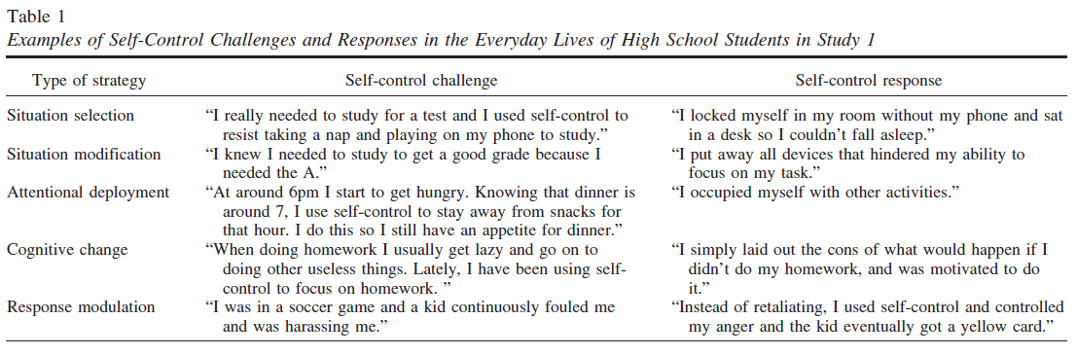
Duckworth et al. (2016)
Notes:
-study 1: high school students use self-control in a variety of everyday scenarios (see above); also suggested many types of strategies
-studies 2 & 3: randomly assigned to implement situation modification strategies = better able to accomplish study goals than students given no strategy or implementing response modulation strategies… strategies may reduce temptation
→ removing temptations from surroundings makes staying on task easier

Slide 11
Other Educational Psych Findings
Learning styles are not real.
Active learning helps.
Test-anxiety is real, but normal; telling first-year students this can help (Brady, Martin Hard, & Gross, 2017).
Having a self-transcendent purpose for learning fosters academic self-regulation (Yeager et al., 2014)
Learning how to initiate self-control can help learners meet their goals (Duckworth et al., 2016)
A values affirmation intervention can reduce the gender achievement gap (Miyake et al., 2010)

Slide 12
Values Affirmation (Miyake et al., 2010)
In this writing task you will be answering several questions about your ideas, your beliefs, and your life. It is important to remember while you’re answering these questions that there are no right or wrong answers.
Please carefully read this list of personal values and think about each of the values. Then choose 2 or 3 values MOST important to you. Even if you feel that many of the values are important, please pick only 2 or 3.
Being good at art
Creativity
Relationships with friends or family
Government or politics
Independence
Learning and gaining knowledge
Athletic ability
Belonging to a social group
Music
Career
Spiritual or religious values
Sense of humor
Look at the values you picked as most important to you. Think about times when these values were or would be very important to you. Describe (Write) why these values are important to you.
Notes:
-Probably not the same values affirmation they do
-Lots of students in a physics class
-Wrote about their values twice at the beginning of the course
-Elevated women’s grades quite a lot, and the benefits were strongest for women who tended to endorse the stereotype that men do better than women in physics

Slide 13
The Testing Effect Demo
I’m passing out a compilation of all the quizzes you’ve taken.
THIS IS NOT GRADED!!
I would like you to try and take these quizzes, testing yourself on past knowledge in this course. If there’s a short answer, just write a word or two representing what you’d write if you had more time.
We’re only going to spend ~15 min on this.
When you’ve had a chance to look through, the key is up here at the front. Grab yourself some candy for each answer you got correct + for testing your knowledge through retrieval practice

Slide 14
How to Make Study Groups More Effective
Notes:
http://www.thepsychfiles.com/2016/10/ep-264-how-to-make-study-groups-effective/
-social loafing and the like
-what types of environments led to better engagement? How did they organize their groups? What are they doing?
-people were often stuck in their roles - let other people talk & listen; especially if one other person knows all
-study groups should be beneficial for anyone regardless of role
-especially if you know the answer
-didn’t force them to think about things in a conceptual way; instead of thinking of new mental models (when asking their own questions)
-how to problem-solve; linear for professor, but messy for student
-recommendation: start with memorization & understanding of concepts, but can’t end there (recognition of cues, knowledge retrieval) - have to do practice problems
Student:
-coming up with a plan ahead of time (practice problems - discussion); do them ahead of time
-everyone should be on the same page, more equal playing field, best field for discussion (everyone done a little struggling)
-make sure to capture their attention & engage your fellow peers (rather than definitions or look in textbook) - knowledge retrieval questions

Slide 15
How to Make Study Groups More Effective
Big issue: everyone needs to be on the same page and struggle a bit with the material rather than relying on a particular person
Plan ahead
If you’re doing practice problems together, have everyone do them ahead of time
Ask questions that do more than retrieve your knowledge of material
Most effective kinds of questions get you thinking about the material rather than just asking about definitions
Notes:
http://www.thepsychfiles.com/2016/10/ep-264-how-to-make-study-groups-effective/
-social loafing and the like
-what types of environments led to better engagement? How did they organize their groups? What are they doing?
-people were often stuck in their roles - let other people talk & listen; especially if one other person knows all
-study groups should be beneficial for anyone regardless of role
-especially if you know the answer
-didn’t force them to think about things in a conceptual way; instead of thinking of new mental models (when asking their own questions)
-how to problem-solve; linear for professor, but messy for student
-recommendation: start with memorization & understanding of concepts, but can’t end there (recognition of cues, knowledge retrieval) - have to do practice problems
Student:
-coming up with a plan ahead of time (practice problems - discussion); do them ahead of time
-everyone should be on the same page, more equal playing field, best field for discussion (everyone done a little struggling)
-make sure to capture their attention & engage your fellow peers (rather than definitions or look in textbook) - knowledge retrieval questions

Slide 16
Intro Psych Is Important
“Intro Psych is the second most popular undergraduate course in the United States (Landrum & Gurung, 2013). Its popularity extends to high schools: Nearly one in three high school students take a psychology course by the time they graduate (Nord et al., 2011). The reach of the course is only expected to increase, given the projected growth in employment for psychology-related professions (nearly 20% by 2024; Clay, 2017) and a rising emphasis on psychology for students going into medicine (Mitchell, Lewis, Satterfield, & Hong, 2016).”

Slide 17
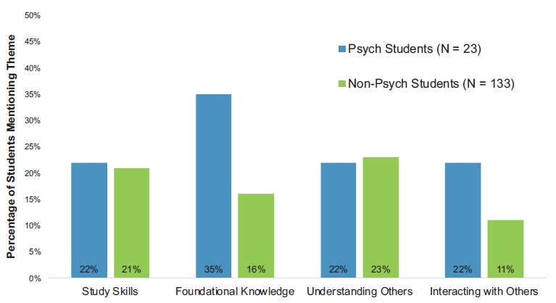
Hard et al. (2019)
“(1) What did you learn in Intro Psych that has been useful to you in your other classes? (2) What did you learn in Intro Psych that has been useful to you in your life in general?”

Slide 18
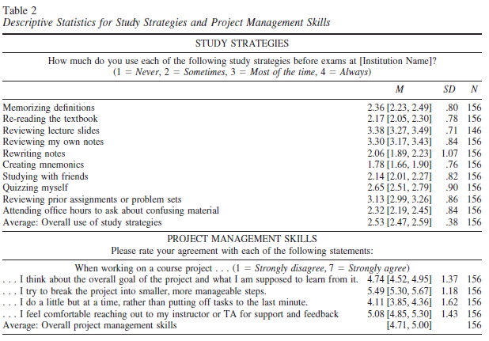
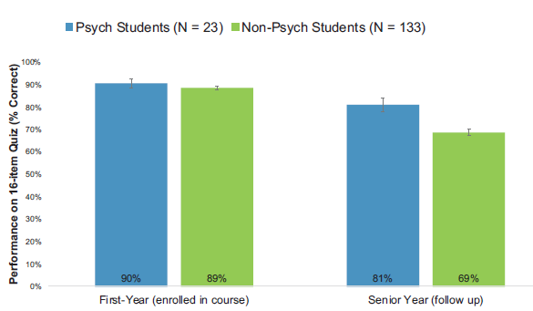
Hard et al. (2019)

Slide 19
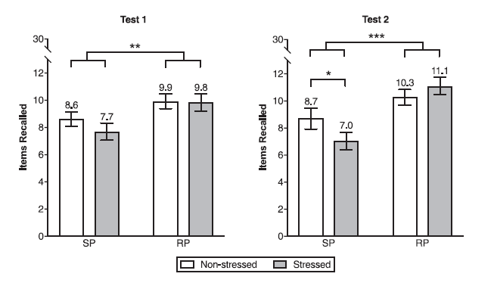
Smith et al. (2016)

Slide 20
So, what are the best study techniques? Dunlosky et al. (2013)
Retrieval Practice
Distributed practice
Elaborative Interrogation
Self-explanation
Interleaved practice
Highlighting, rereading
Also not a fan of: imagery for text learning, summarization, keyword mnemonic

Slide 21
Critiquing Videos on Learning
Education is science communication, too
https://tinyurl.com/SamfordStudy
In teams, pick a video from this website. They all talk about how to learn better & study tips that should be useful for you regardless (i.e., generalize beyond our classroom).
All videos between 5-9 minutes (most are ~7 min)
Watch & critique the video, applying the SciComm principles you’ve learned this semester (e.g., identify audience)
What cognitive psychology principles is this video discussing? How might you reframe the material, if you were to film the video?

Slide 22
Today’s Goals + Agenda
LO1: Continue to build a supportive classroom culture & discuss science communication
How did the Dunlosky article compare to the podcast yesterday in conveying good ways to study?
Critique videos on "How to Study" from a renowned educational psychologist, learning about education work + thinking about SciComm principles
LO2: Describe the basic fundamental principles of education research
Demo of testing effect a la Smith et al. paper; explore the meaning of the other education techniques
Active learning, notecards, SoTL research, the small tips from Goldstein chapter 8
LO3: Summarize and critically analyze academic journal articles
Why would what you learn in gateway psychology impact how you do in other courses & life? Would you participate in one of these studies? How much do you remember of Intro Psych now?

Slide 23
Participation & Minute Paper
https://tinyurl.com/PSY102Participation
https://tinyurl.com/PSY102MinutePaperJune20

