Slide 1

UVA Brainhack!
===== Week 7 =====
7/11/2025

Slide 2
Agenda
Review
Weeks 1-4
Week 5
More Analysis!
Group-level stats
Hacking

Slide 3
Weeks 1-4
MR fundamentals

Slide 4
Overview
MR physics
Strong magnet → nuclear precession
RF pulse + magnetic gradients
BOLD fMRI
Diamag. Hb displaces paramag. dHb
Image generation
Traversing K-space
Data organization (BIDS)
DICOM vs. NIfTI
Preprocessing
Motion is bad ☺
fMRIPrep

Slide 5
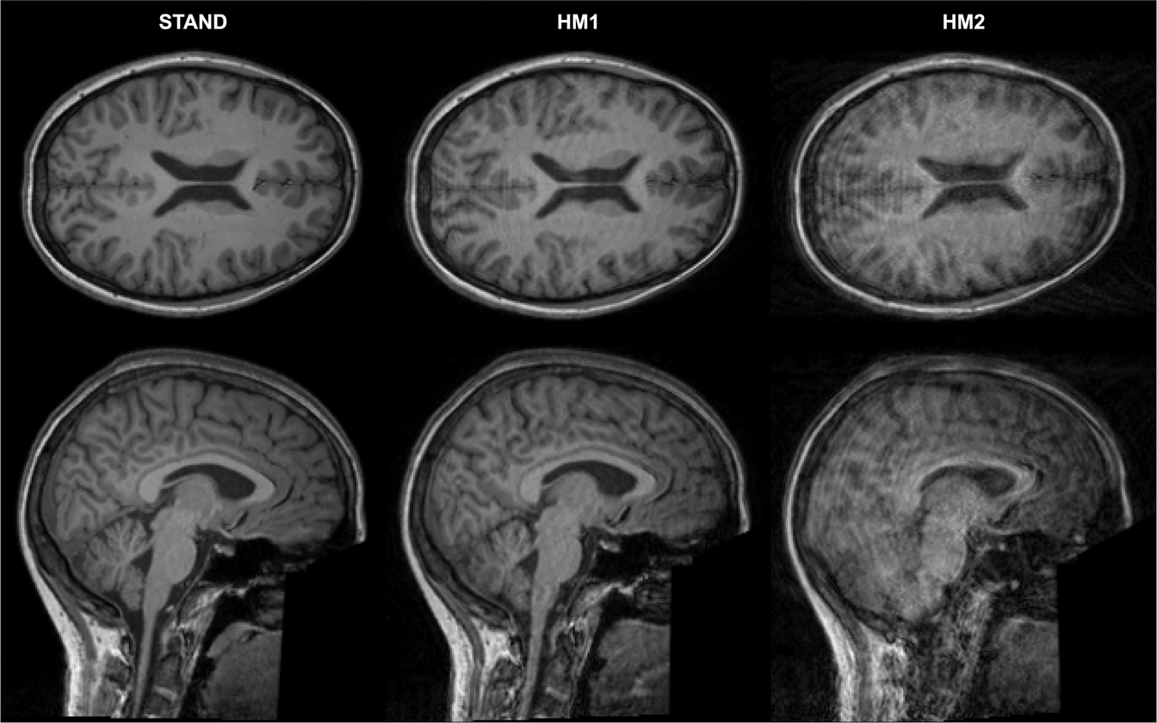
Big decisions so far
RF pulse sequences
Structural + functional + field maps, etc.
Scan parameters: TR, TE, Flip Angle, etc.
FOV → K-space resolution → Image resolution
Task design
Blocked vs. event-related (vs. mixed)
SNR vs. efficiency
Preprocessing
Preproc on the scanner
Preproc off the scanner

Slide 6
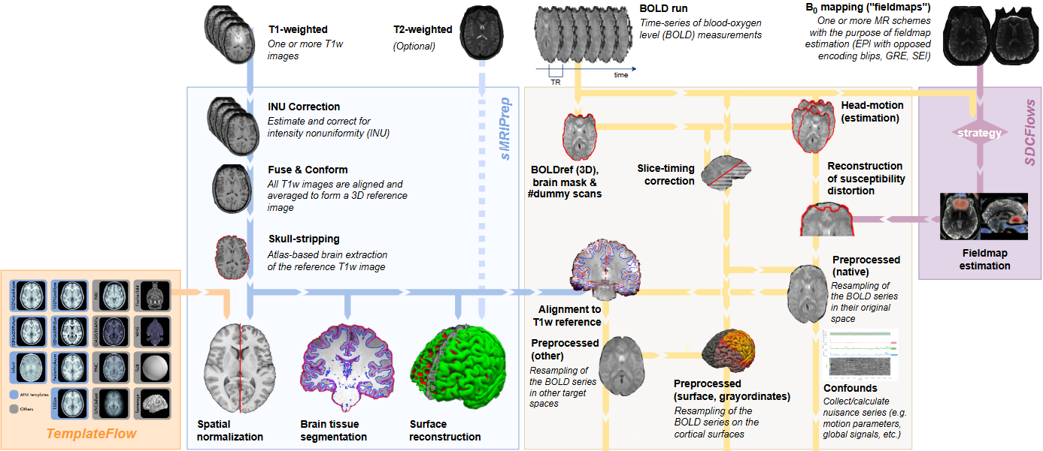
fMRIPrep Pipeline
INPUT
OUTPUT

Slide 7
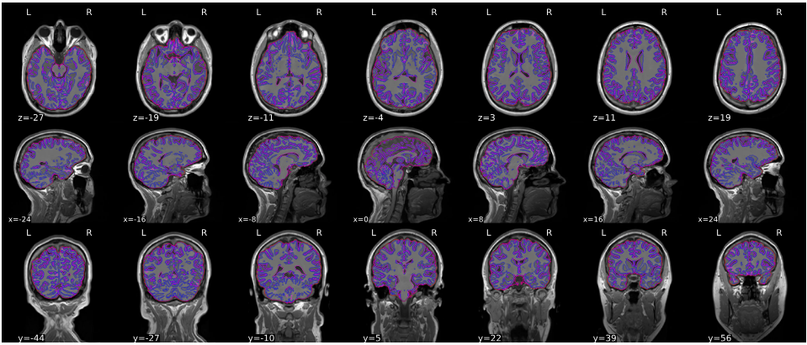
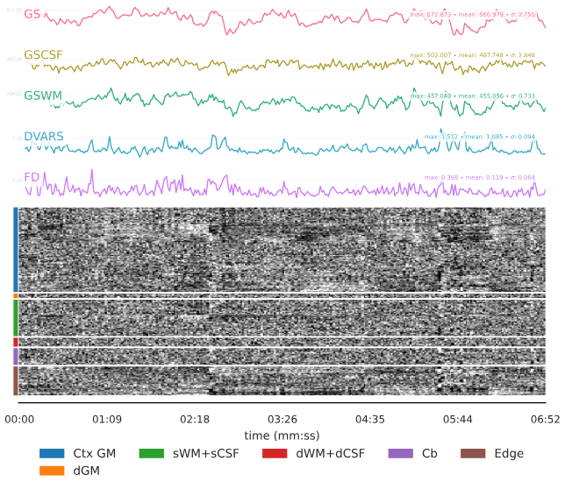
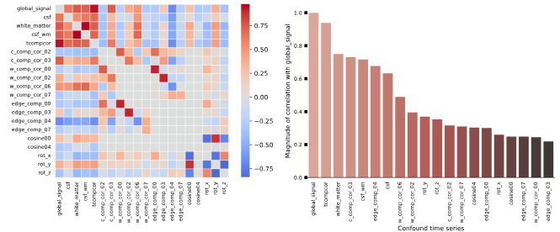
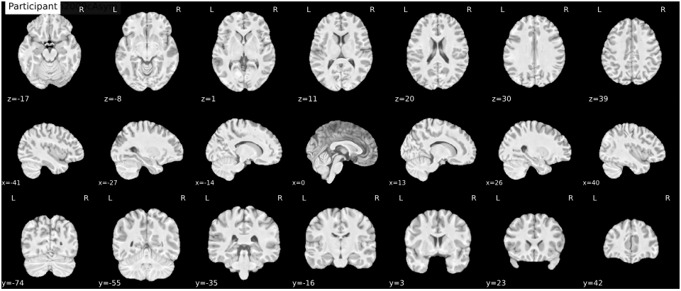
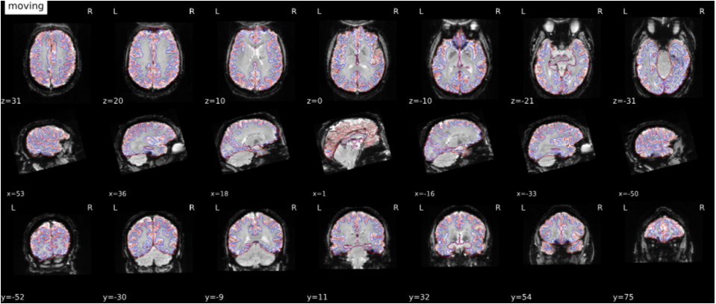
fMRIPrep Output
sub-rcg.html
Skull-strip
Normalize
Co-Register

Slide 8
Week 5
Intro. to Analysis

Slide 9
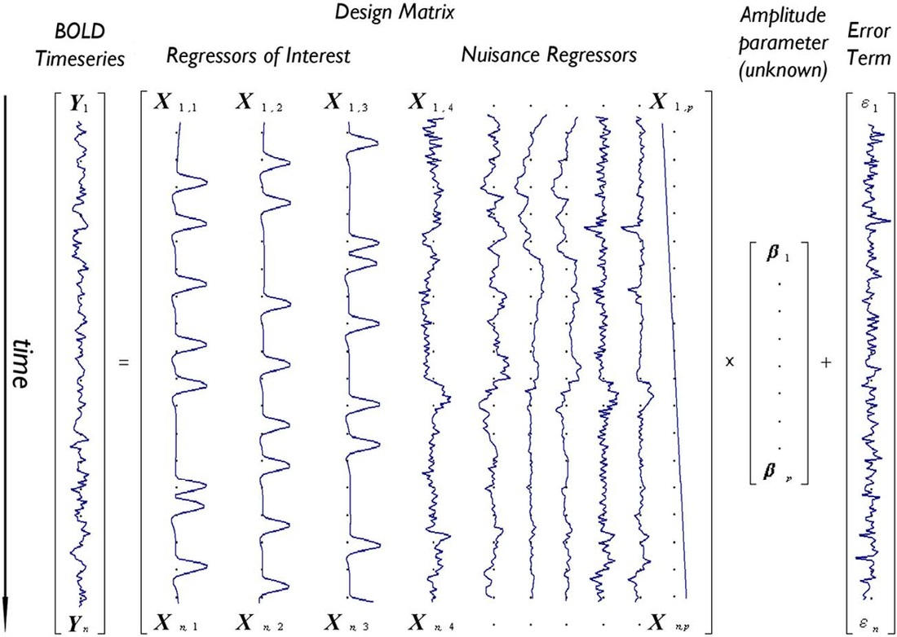
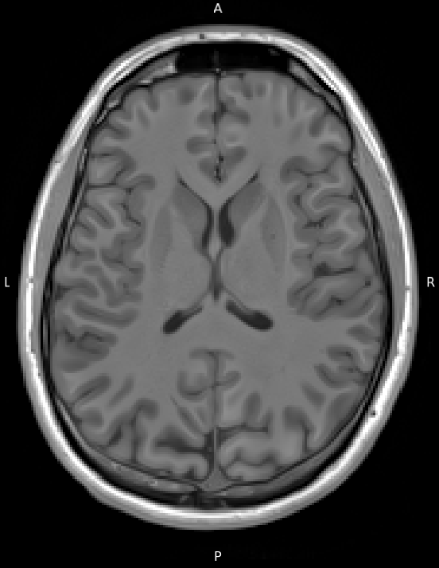
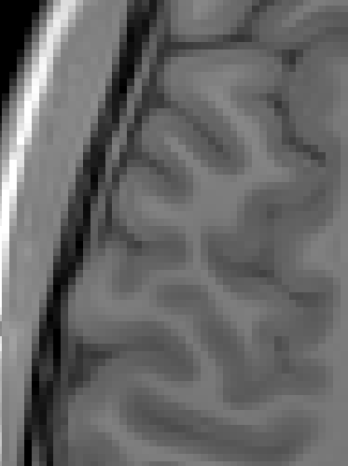

Mass Univariate Analysis
Fitting a separate model for each voxel
~ 500,000

Slide 10
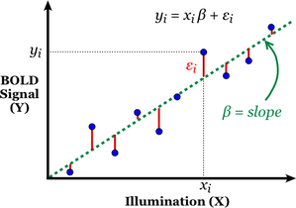
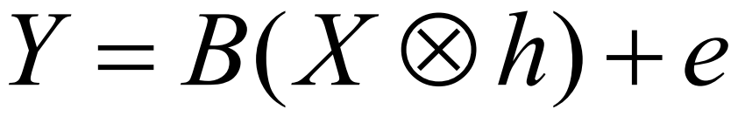
Generalized Linear Model
Measured signal
Design matrix
(events convolved with HRF)
Amplitude (unknown)
Normally distributed random noise

Slide 11
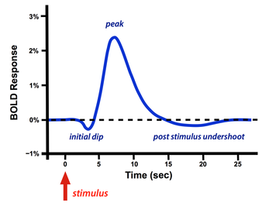
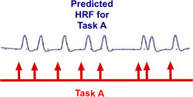
Design Matrix
Recall: HRF

Slide 12
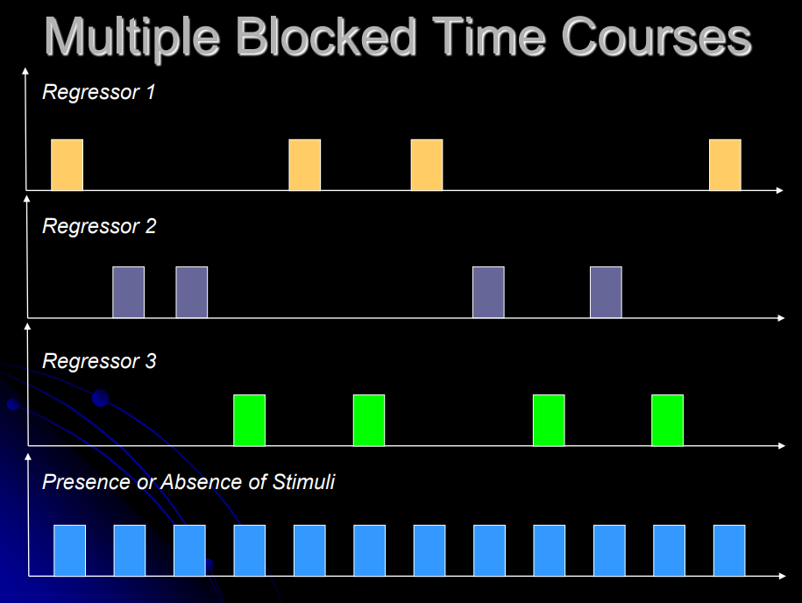
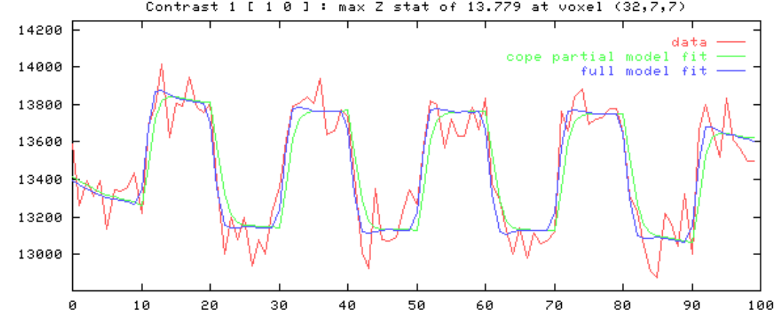
Design Matrix
Recall: HRF
A B C

Slide 13
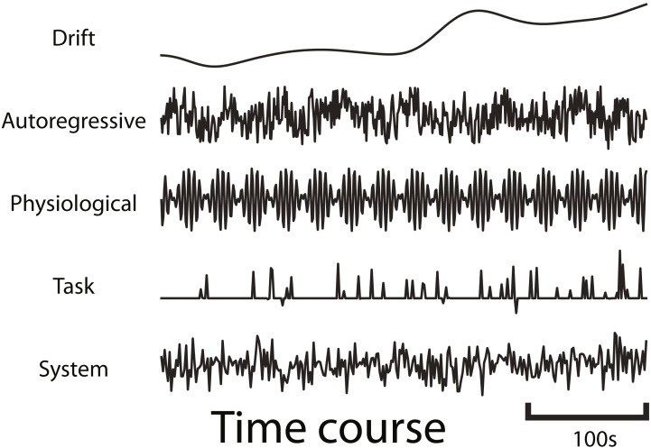
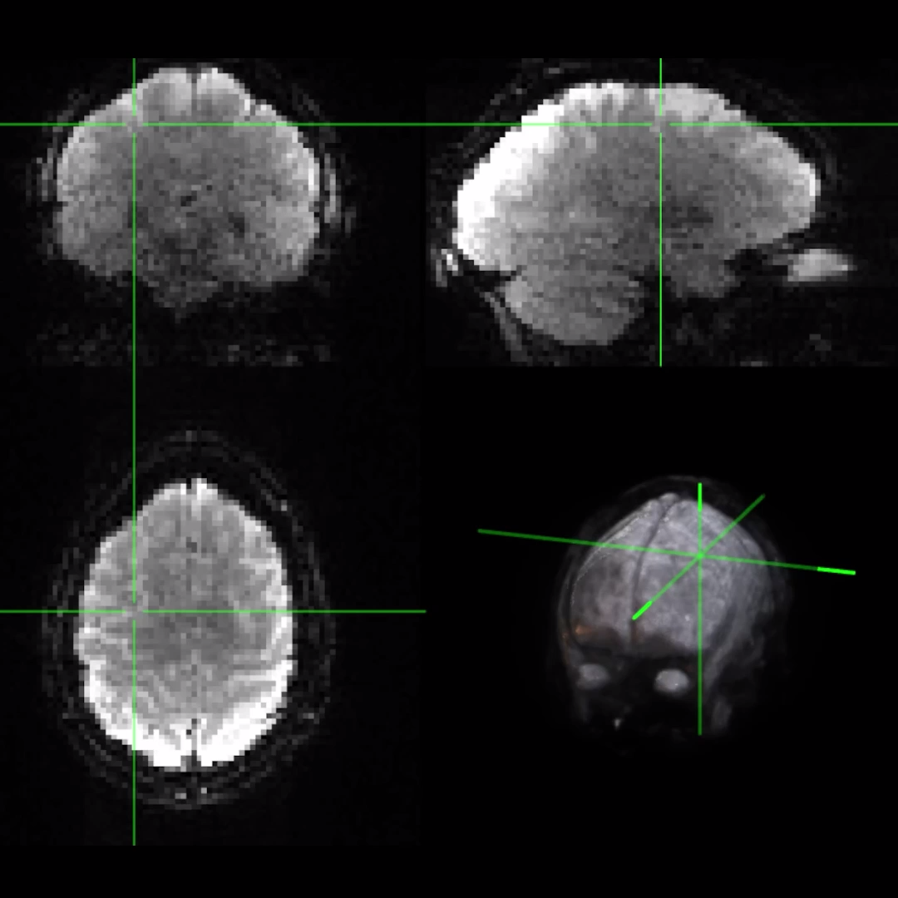
Structured Noise
+ Motion
Notes:
Before applying dynEGA to real fMRI data, we want to ensure that it actually works, i.e., it can recover known dynamic network structures.
We can simulate resting-state fMRI with a known ground truth using fmrisim (part of the BrainIAK library), which allows us to generate artificial fMRI data that mimics the characteristics of real data, including realistic noise/SNR, autocorrelative structure, etc.

Slide 14
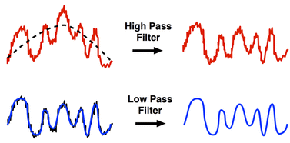
Modeling out structured noise
Temporal filtering / detrending
Motion regressors

Slide 15
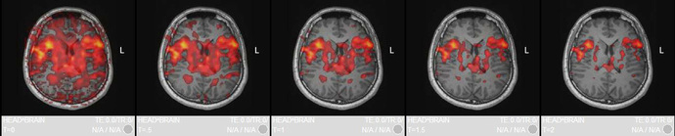
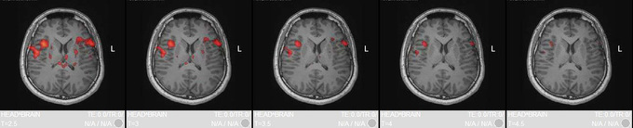
Beta coefficient weights
Individual statistical map thresholded by significance (p-val)
Original
p-val
Adjusted
p-val
(Bonf.)

Slide 16
More Analysis!
Group-level inference

Slide 17
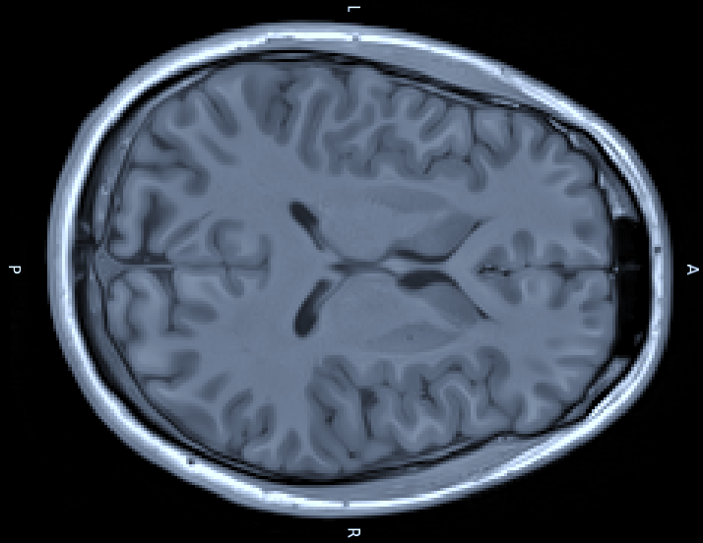
Group-level analysis
How do we go from subject-level maps to population-level inferences?
How do we determine where in the brain activations are statistically meaningful?

Slide 18
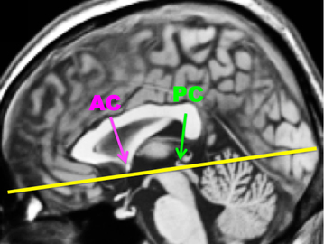
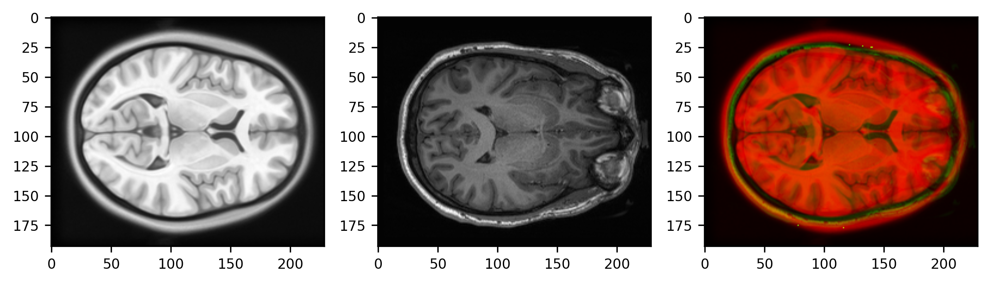
Recall: Normalization + Co-Registration
Common reference: AC/PC
Structural
Spatial Normalization
Rigid “affine” transformations
Non-linear “diffeomorphic” transformations

Slide 19
Recall: Normalization + Co-Registration
Brains must be aligned in order to compare statistical maps across individuals!

Slide 20
Recall: Normalization + Co-Registration
Now we have a distribution of effect sizes for each location (voxel) in a standard coordinate space

Slide 21
Group-level analysis
Fixed Effects
- Sample-specific
Assume results are only relevant to these exact subjects
- Not really used for publication-level inference…
Random Effects
Assume:
- subject-specific effects are drawn from a population distribution
- individual effect sizes are normally distributed
**We want to estimate the mean and variance of the pop. distribution**

Slide 22
Group-level analysis
Goal: Estimate the average effect and variability in the population
“First-level” (within-subject)
Generate statistical maps for each subject (β weights)
Each predictor (task condition) has a corresponding statistical map
Generate contrast image
Contrasts are linear combinations of the β weights
E.g., Faces > Houses = +1*Faces -1*Houses
Result:
Contrast estimate + standard error for each voxel
(Within-subject variance = Residual SS / df)

Slide 23
Group-level analysis
Goal: Estimate the average effect and variability in the population
“Second-level” (between-subject)
Combine contrast estimates @each location
Each voxel location now has a distribution of effect sizes from our sample
Y = βX + ε
Contrast estimates

Slide 24
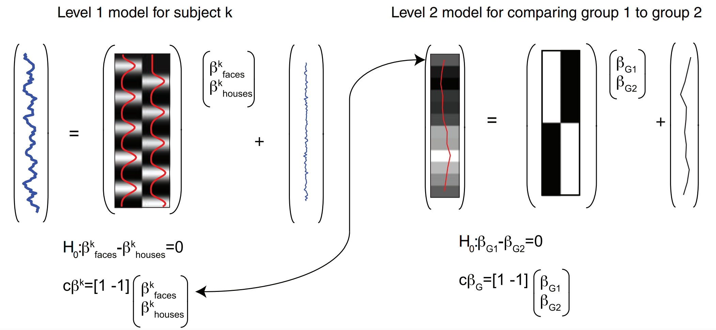
Group-level analysis

Slide 25
Group-level analysis
Goal: Estimate the average effect and variability in the population
OLS vs. GLS
Ordinary
Each subject contributes equally to the group estimate
Assume within-subject variance is the same for all subjects
Never true... and it INFLATES FALSE POS RATE!
SPM default ☺
Generalized / weighted
Scale individual contributions by within-subject error variance
Group effect size ​= (X^{T}Σ⁻¹X)⁻¹X^{T}Σ⁻¹y and variance = (X^{T}Σ⁻¹X)⁻¹

Slide 26

Try it yourself!
Week7 / analysis.py
OR
https://nilearn.github.io/stable/auto_examples/00_tutorials/plot_single_subject_single_run.html#sphx-glr-auto-examples-00-tutorials-plot-single-subject-single-run-py
(NiLearn Tutorial)

