Slide 1

UVA Brainhack!
===== Week 8 =====
7/18/2025

Slide 2
Agenda
Check-in
Advanced Analysis
MVPA
RSA
TBM
Hacking

Slide 3

Check-in

Slide 4
Review
Analysis

Slide 5
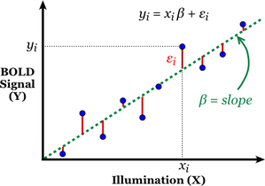
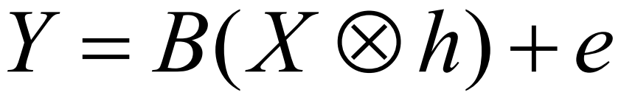
Generalized Linear Model
Measured signal
Design matrix
(events convolved with HRF)
Amplitude (unknown)
Normally distributed random noise

Slide 6
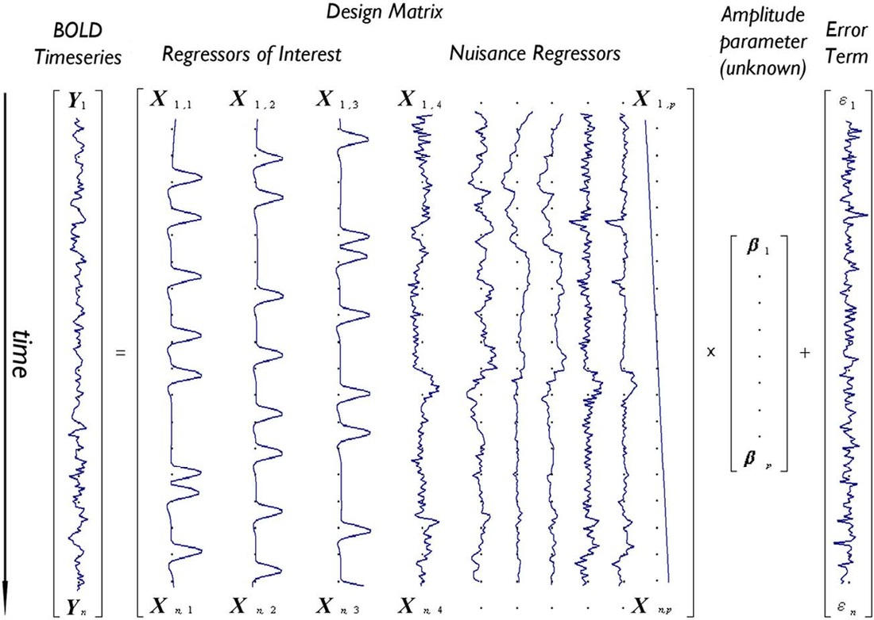
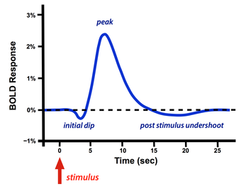
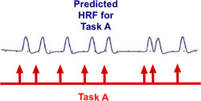
Design Matrix
Recall: HRF

Slide 7
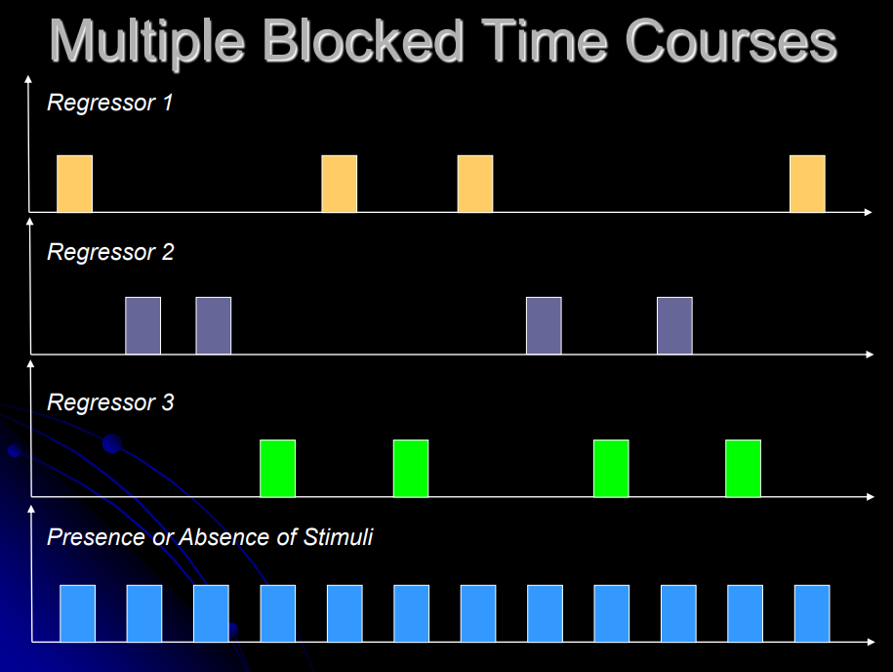
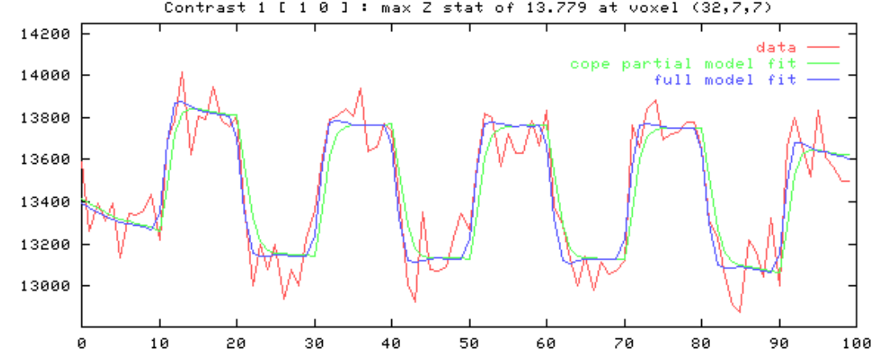
Design Matrix
Recall: HRF
A B C

Slide 8
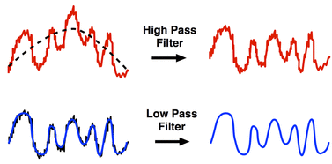
Modeling out structured noise
Temporal filtering / detrending
Motion regressors

Slide 9
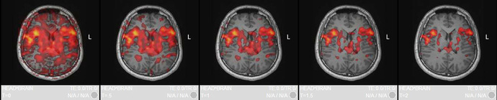
Estimate Beta coefficients for all regressors at every single voxel
Low
Med
High

Slide 10
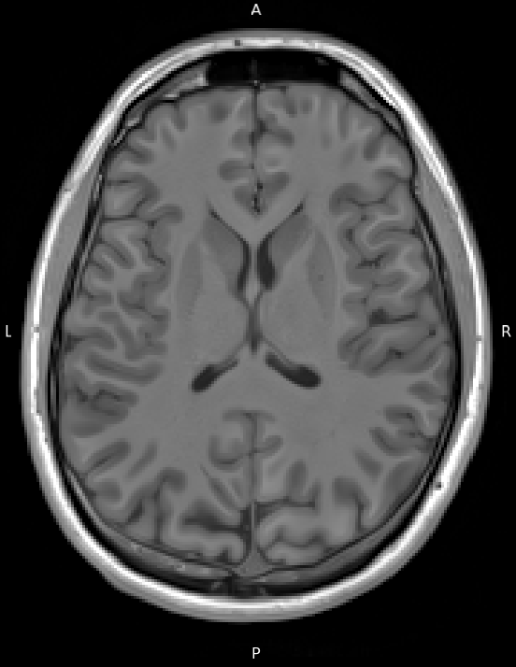
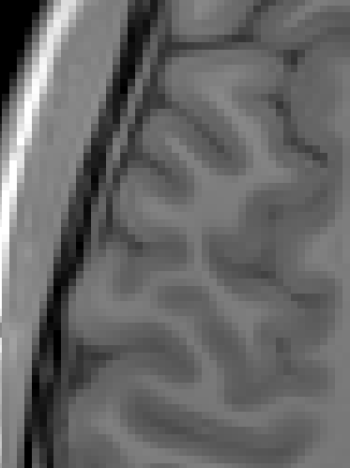

Mass Univariate Analysis
Fitting a separate model for each voxel
~ 500,000

Slide 11
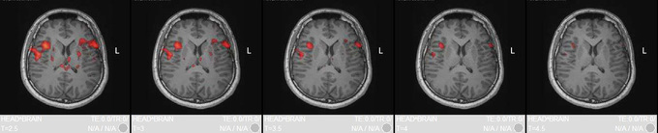
Beta coefficient weights
Individual statistical map thresholded by significance (p-val)
Original
p-val
Adjusted
p-val
(Bonf.)

Slide 12
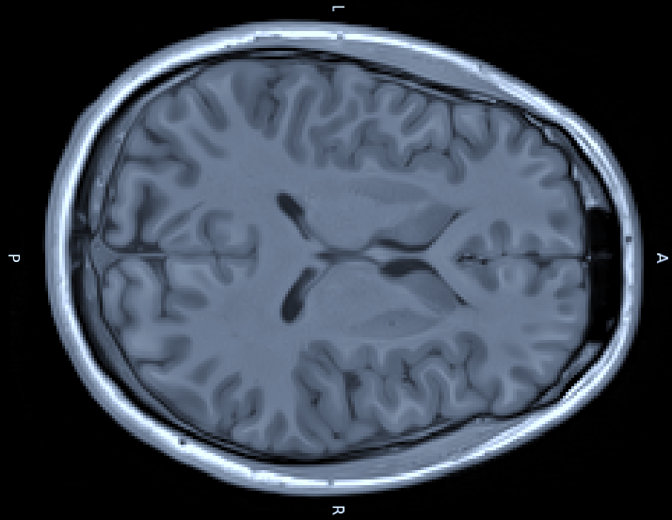
Group-level analysis
How do we go from subject-level maps to population-level inferences?
How do we determine where in the brain activations are statistically meaningful?

Slide 13
Group-level analysis
Goal: Estimate the average effect and variability in the population
“First-level” (within-subject)
Generate statistical maps for each subject (β weights)
Each predictor (task condition) has a corresponding statistical map
Generate contrast image
Contrasts are linear combinations of the β weights
E.g., Faces > Houses = +1*Faces -1*Houses
Result:
Contrast estimate + standard error for each voxel
(Within-subject variance = Residual SS_w / df_w)
#Observations (trials) - #Regressors

Slide 14
Group-level analysis
Goal: Estimate the average effect and variability in the population
“Second-level” (between-subject)
Combine contrast estimates @each location
Each voxel location now has a distribution of effect sizes from our sample
Y = βX + ε
Contrast estimates

Slide 15
Recall: Normalization + Co-Registration
Brains must be aligned to compare statistical maps across individuals!

Slide 16
Recall: Normalization + Co-Registration
Alignment results in a distribution of effect sizes at each location (voxel) in a standard coordinate space
(e.g., MNI space)

Slide 17
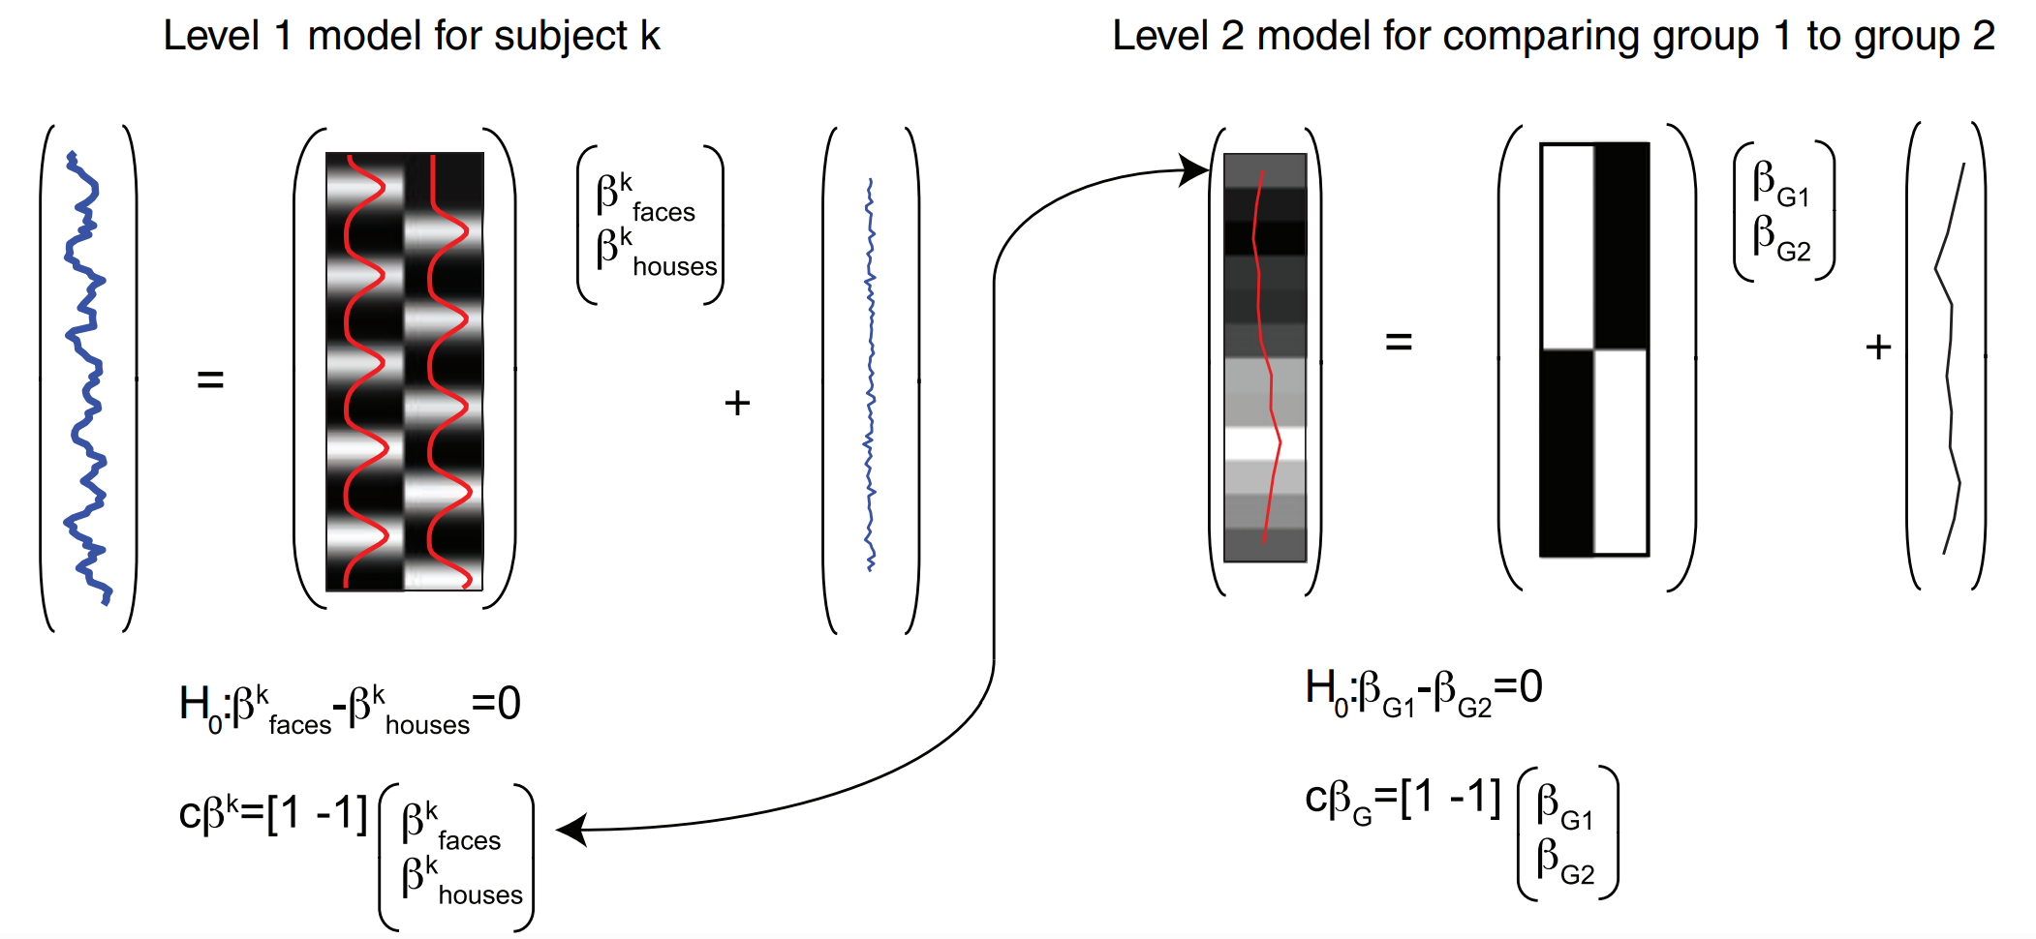
Group-level analysis

Slide 18
Group-level analysis
Fixed Effects
- Sample-specific
Assume results are only relevant to these exact subjects
- Not really used for publication-level inference…
Random Effects
Assume:
- subject-specific effects are drawn from a population distribution
- individual effect sizes are normally distributed
**We want to estimate the mean and variance of the pop. distribution**

Slide 19
Group-level analysis
Goal: Estimate the average effect and variability in the population
OLS vs. GLS
Ordinary
Each subject contributes equally to the group estimate ☹
Assume within-subject variance is the same for all subjects
Never true... and it INFLATES FALSE POS RATE!
Default in most applications (e.g., SPM, NiLearn) ☹☹☹
Generalized / weighted
Scale individual contributions by within-subject error variance (whitening)
Noisier subjects (lots of movement) contribute less to effect size estimate
Linear Algebra: Group effect size ​= (X^{T}X)⁻¹X^{T}y with variance = σ²(X^{T}X)⁻¹
Linear Algebra: Group effect size ​= (X^{T}Σ⁻¹X)⁻¹X^{T}Σ⁻¹y with variance = (X^{T}Σ⁻¹X)⁻¹

Slide 20
Advanced Analysis
Beyond the basics

Slide 21
Multi-Voxel Pattern Analysis
Traditional Analysis
“Is BOLD signal stronger, on average, in condition A than B?”
MVPA
Goal: Determine what info. is represented in each voxel/region
“At each timepoint, can I predict the current condition based on the spatial pattern of BOLD activity?”
?
=
Notes:
Not just interested in which kinds of stimuli most strongly drive a region, but what information is represented in each region

Slide 22



Multi-Voxel Pattern Analysis
Why?
Sensitive to distributed / subtle patterns that may not show a mean-level difference at any single voxel
HOUSES
Small difference on average…
FACES

Slide 23
Multi-Voxel Pattern Analysis
Special Considerations
You need independent data partitions
Typically separate runs
Each run becomes an independent fold for cross‑validation
Why?
So that training and testing are not confounded by temporal autocorrelation or run‑specific noise!
This means longer scan time…
No smoothing!
We want to preserve spatial pattern detail
Run in native space (interpolation = blurring)

Slide 24
MVPA
Step 1) Label blocks / trials and split them into independent regressors
In this case, 2 regressors becomes 16 in total (8H, 8F)
HOUSES
FACES
…

Slide 25
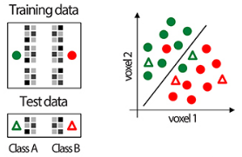
MVPA
Step 1) Label blocks / trials and split them into independent regressors
Estimate effect size for each block / trial
Step 2) Train a classifier (e.g., SVM) on the Beta maps

Slide 26

MVPA
Searchlight decoding analysis
Notes:
Not just interested in which kinds of stimuli most strongly drive a region, but what information is represented in each region

Slide 27
MVPA
Searchlight decoding analysis
E.g., 6 runs
Train on 5, test on 1, rinse & repeat
Notes:
Not just interested in which kinds of stimuli most strongly drive a region, but what information is represented in each region

Slide 28
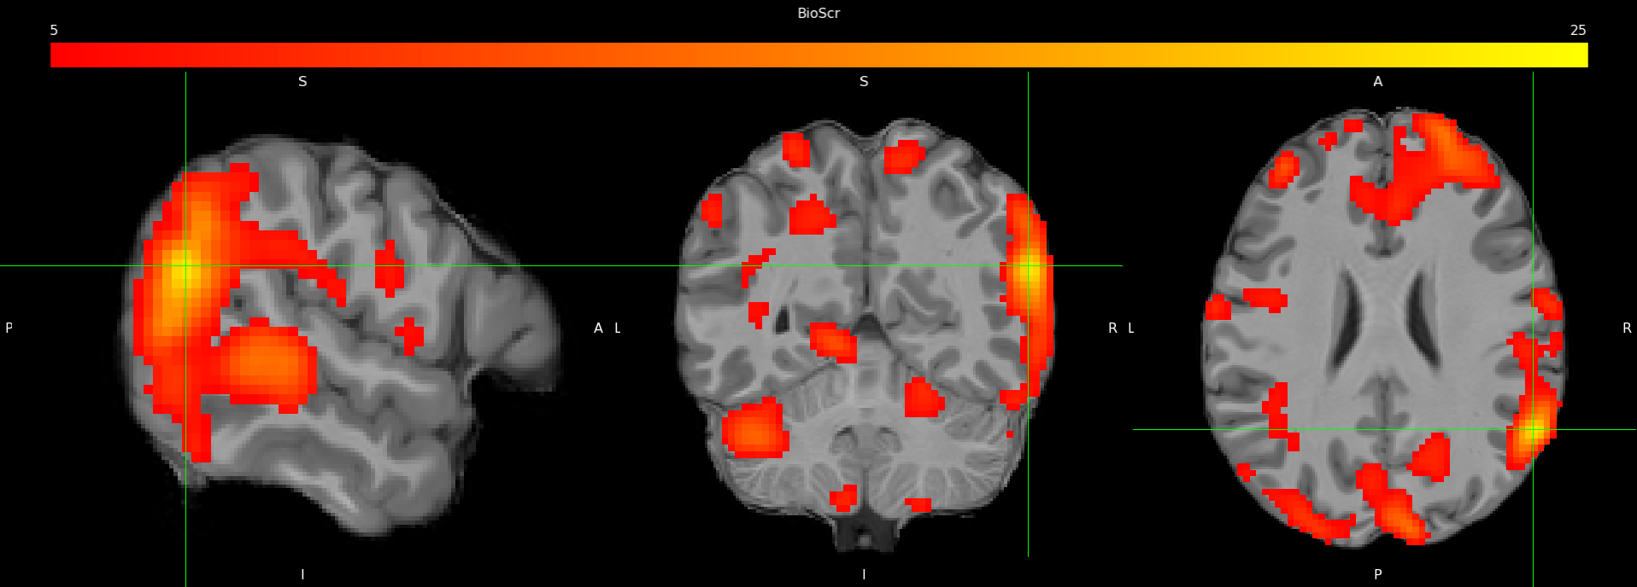
Results
Example Result (Accuracy map for Cond A – Cond B)

Slide 29
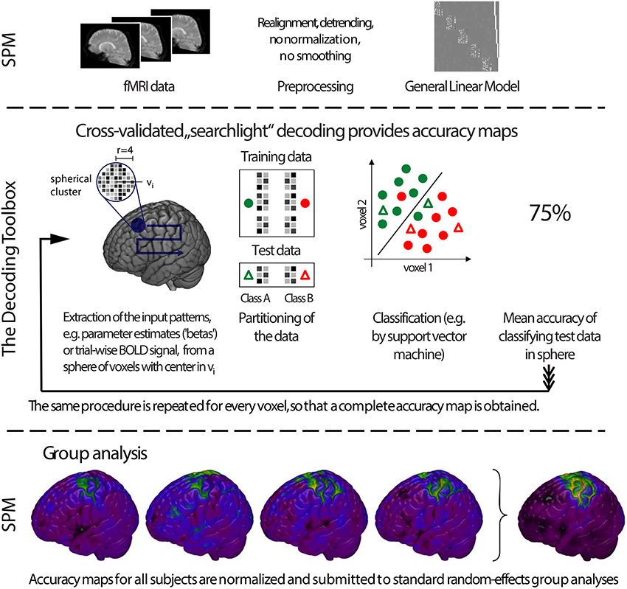
MVPA
Many options:
The Decoding Toolbox
CoSMoMVPA
pyMVPA
NiLearn
And more!

Slide 30
Representational Similarity Analysis
Similar to MVPA
What info is represented in each region?
MVPA: “Can a multivariate brain pattern predict which stimulus/condition the participant is in?”
RSA: “How similar are the representational geometries of different brain patterns?”
Do those geometries match a model, another brain region, or another modality?
Main goal: Comparing neural patterns to computational / theoretical model

Slide 31
RSA
Step 1) Same as MVPA
Step 2) Compute pairwise distances between every pair of patterns → Representational Dissimilarity Matrix (RDM)
Distance metric up to you (Pearson’s r, Euclidean, Mahalanobis, etc.)
Step 3) Compare RDMs
Between regions
Against model (e.g., theoretical RDM w/ semantic dist in feature space)
Step 4) Stats
Permutation on condition labels is common

Slide 32
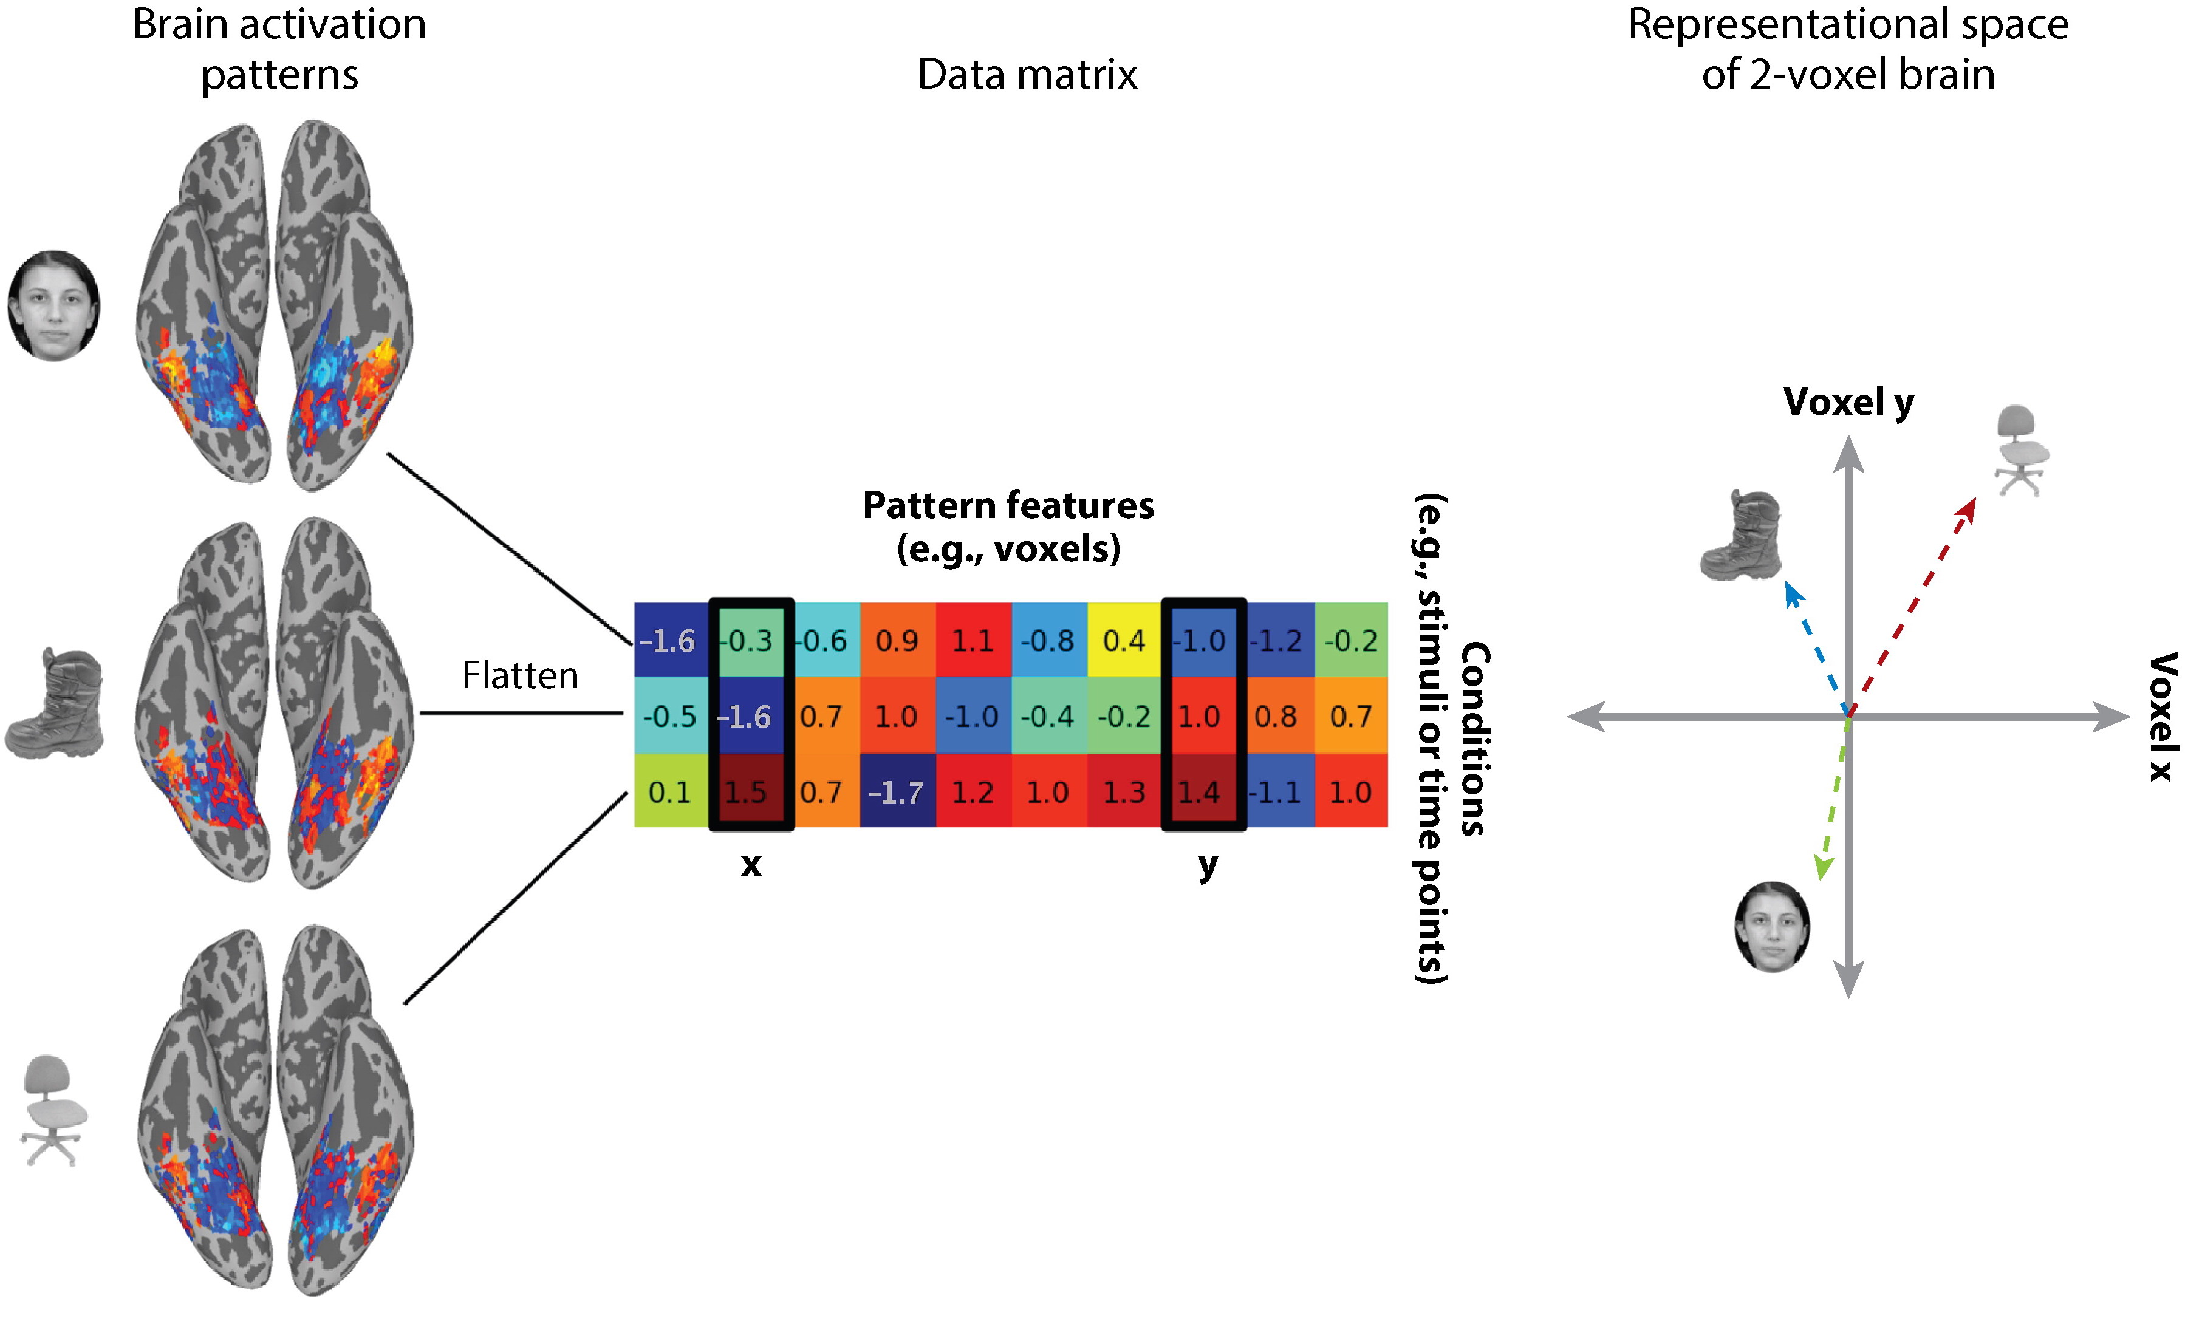
RSA

Slide 33
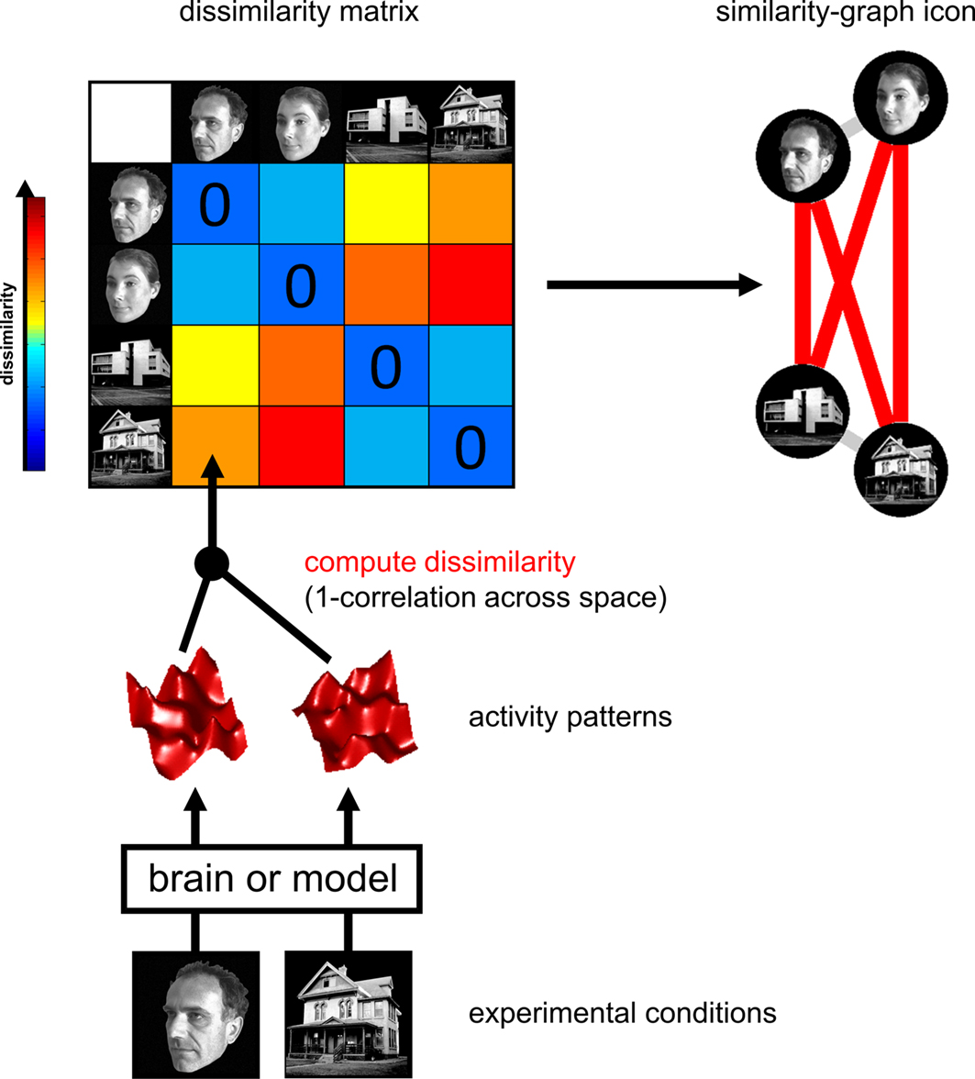
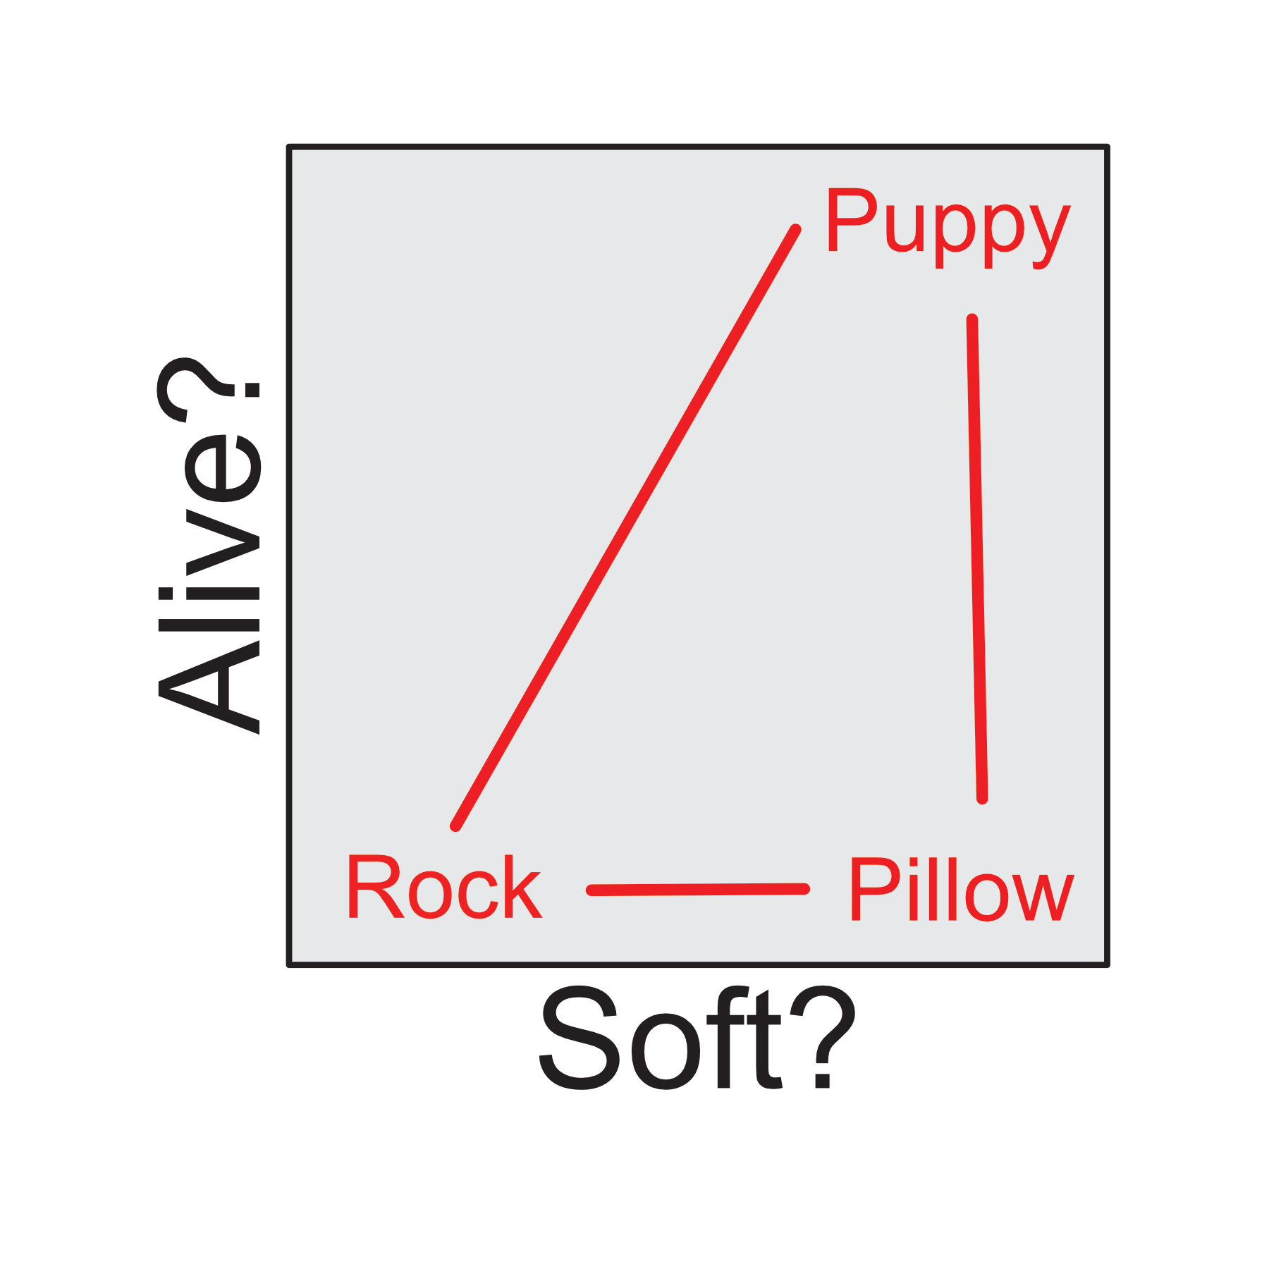
RSA

Slide 34
And many more!
Functional
Region of Interest (ROI)
Resting-State Functional Connectivity (RSFC)
Psycho-Physiological Interaction (PPI)
Finite Impulse Response (FIR)
fMRI Adaptation
Structural
Voxel-Based Morphometry (VBM)
Surface/Vertex-Wise Analysis (cort. thickness, density, etc.)
Transport Based Morphometry (TBM)

