Slide 1

UVA Brainhack!
===== Week 11 =====
8/8/2025

Slide 2
Agenda
Basics of dMRI
DTI & CSD
Preproc
DiPy
Hacking

Slide 3
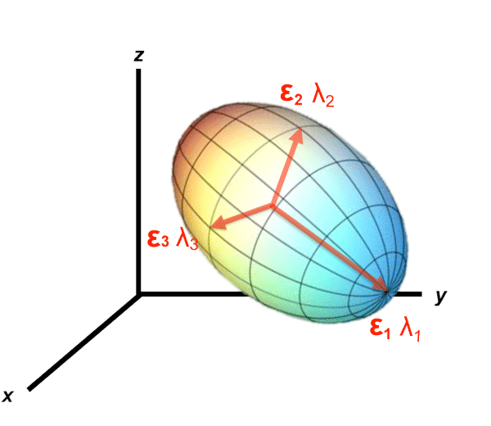
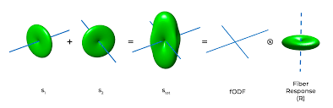
Diffusion-weighted MRI (dMRI)
Where is water diffusing? Where H2O go?
Two major paradigms:
Diffusion Tensor Imaging (DTI)
Constrained Spherical Deconvolution (CSD)

Slide 4
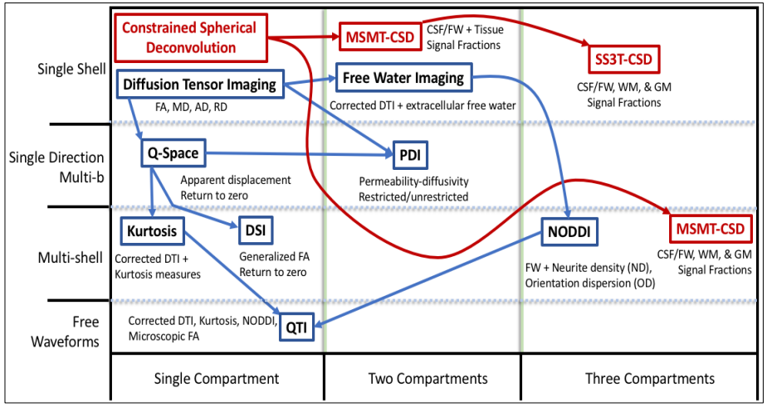
Actually…
Figure credit: Ben Newman

Slide 5
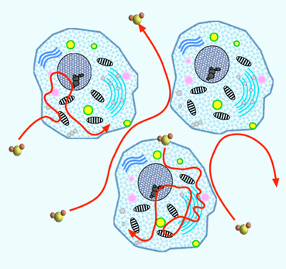
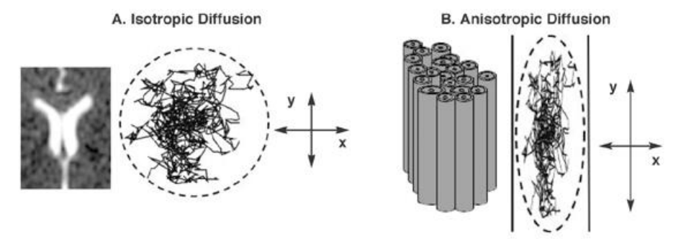
Basic Concepts
Brownian motion: water molecules jitter randomly, structure (e.g., WM) restricts their motion
Anisotropy: diffusion is easier along myelinated axons than across them (hindered by lipid bilayer)

Slide 6
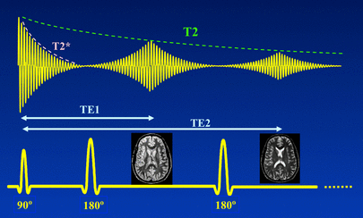
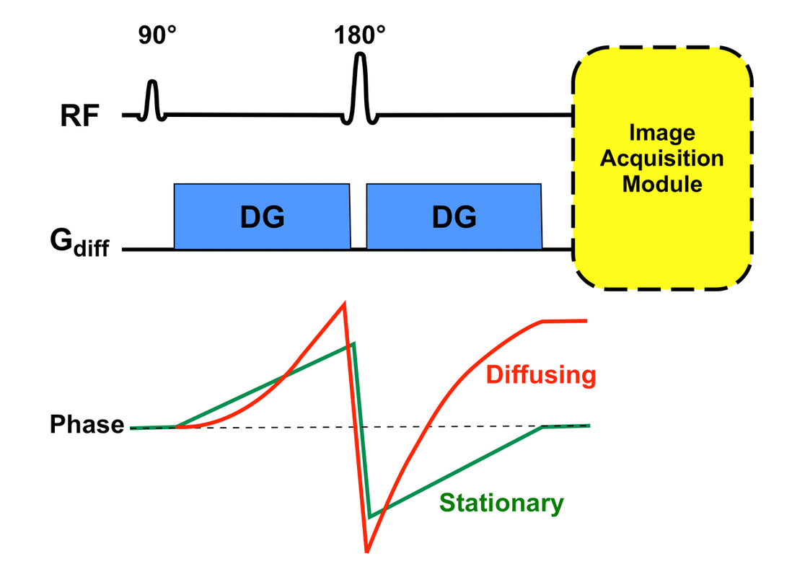
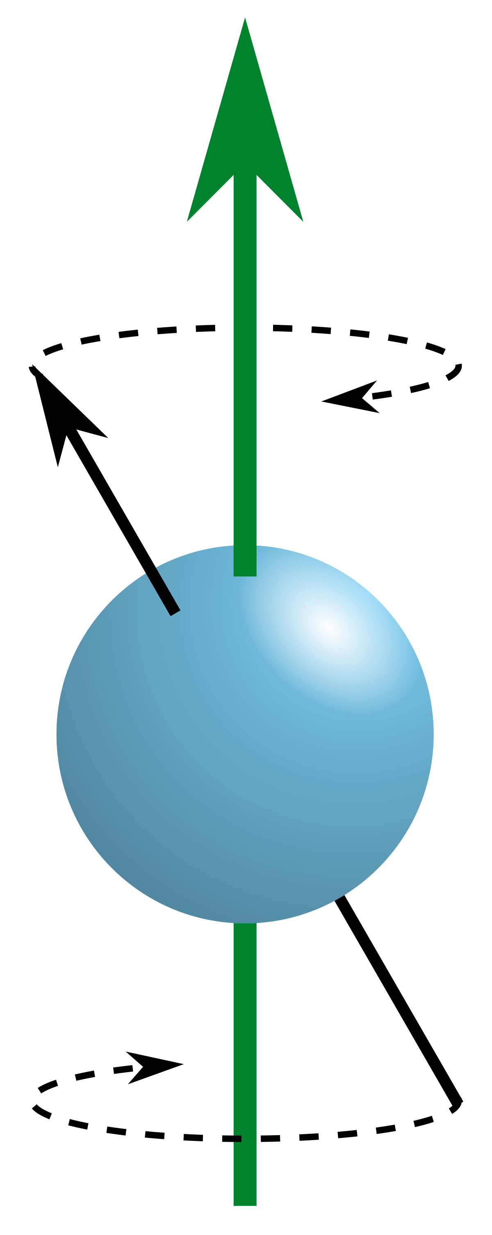
Acquisition
Spin-echo:
Phase tagging:
Spin-echo with two strong pulse gradients
If spins stay put, the second gradient rephases them; if they moved, phases don’t fully re-align
Signal loss = spin displacement
slow
fast
3 Tesla
slow
3 Tesla
fast
3 Tesla
phase behind
1st gradient
phase ahead
2nd gradient
Notes:
Note: original Pulse gradient spin echo sequence was monopolar (two identical gradients oriented in the same direction, with 180degree pulse to flip effective angle of gradient). This slide shows the effective gradient sign

Slide 7
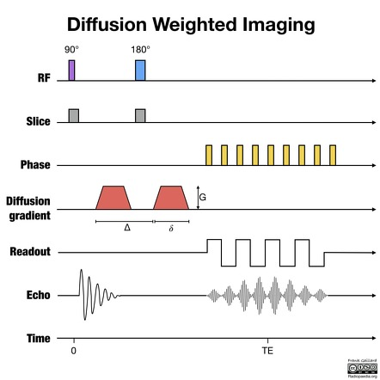
Acquisition

Slide 8
Basic Concepts (cont.)
Angular resolution
Shells
b-value

Slide 9
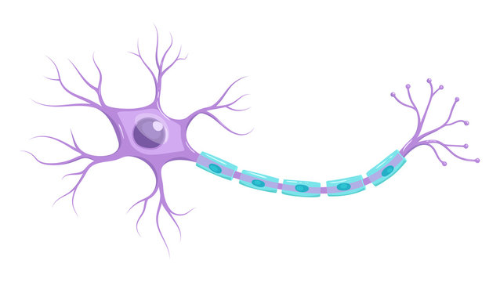
More angles = higher resolution
WM
GM
CSF

Slide 10
More angles = higher resolution
WM
GM
CSF

Slide 11
More angles = higher resolution
WM
GM
CSF

Slide 12
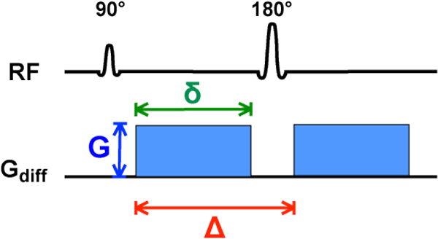
Shells / b-value
b-value reflects the strength and timing of the diffusion gradients
b = γ² G² δ² (Δ−δ/3)
Gyromagnetic ratio
Gradient strength
Gradient duration
Gradient interval

Slide 13
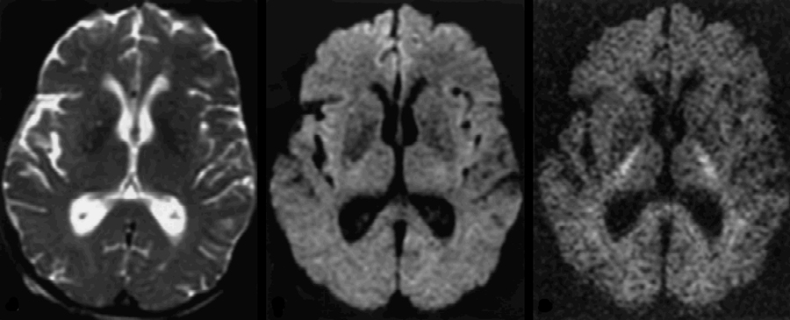
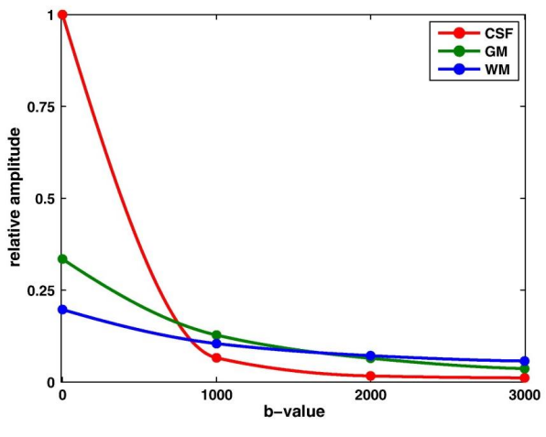
Shells / b-value
Tissue contrast differs across b-values
b=0
b=1000
b=3000

Slide 14
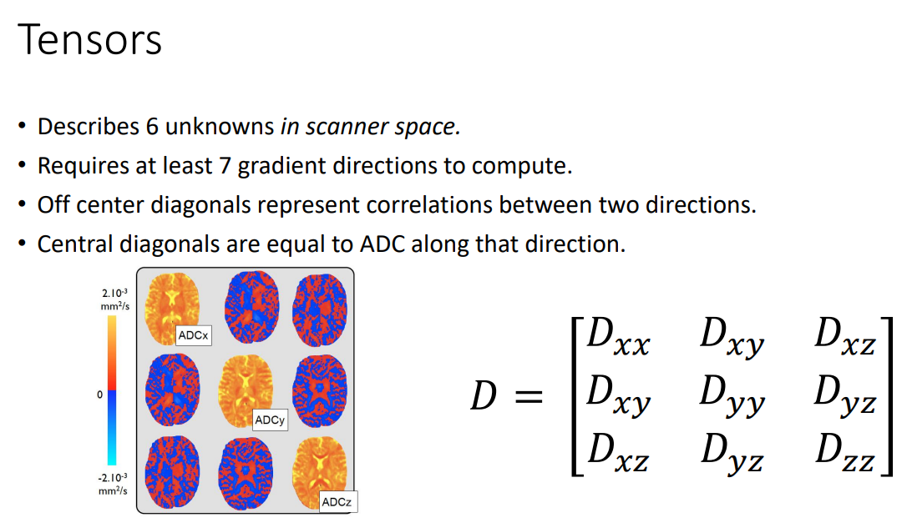
Slide credit: Ben Newman

Slide 15
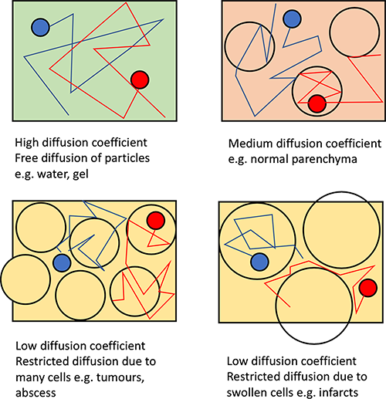
ADC
Apparent diffusion coefficient (ADC)
https://www.radiologycafe.com/frcr-physics-notes/mr-imaging/diffusion-weighted-imaging/
Notes:
Water Diffusion:
Water molecules undergo random, thermally-driven motion, known as Brownian motion. This diffusion is influenced by the microstructural environment.
In free water, diffusion is unrestricted. In biological tissues, barriers like cell membranes, myelin sheaths, and organelles hinder diffusion, making it anisotropic (directionally dependent).
Sensitivity to Diffusion:
DW-MRI encodes the movement of water molecules into the MRI signal using magnetic field gradients. This encoding allows the detection of microscopic variations in diffusion that provide insights into tissue structure and pathology.
2. The DW-MRI Pulse Sequence
DW-MRI uses a modified spin-echo sequence with added diffusion-sensitizing gradients. The typical sequence involves the following components:
a. Standard Spin-Echo Sequence
90° RF Pulse:
Excites the spins in the tissue, tipping them into the transverse plane.
180° RF Pulse:
Refocuses the spins, forming a spin echo to correct for inhomogeneities in the static magnetic field (B0B_0B0​).
b. Diffusion Gradients
To make the sequence sensitive to diffusion, two additional gradients are applied symmetrically around the 180° RF pulse:
First Gradient (Dephasing):
A magnetic field gradient is applied to dephase the spins based on their position in space. Spins in moving water molecules are now phase-shifted according to their displacement.
Second Gradient (Rephasing):
Another magnetic gradient, with the same amplitude and duration as the first, is applied after the 180° RF pulse. If a water molecule has not moved, its phase shift is reversed, and the spin rephases. However, if the water molecule has moved, it will not completely rephase, leading to signal attenuation.
3. Key Parameters in DW-MRI
b-Value:
A measure of the strength and timing of the diffusion gradients, expressed in s/mm². It determines the sensitivity of the sequence to diffusion.
Higher bbb-values increase sensitivity to diffusion but also lead to lower signal-to-noise ratios (SNR).
Typical bbb-values are:
Low ( 0s/mm2~0 s/mm² 0s/mm2): No diffusion weighting.
Intermediate ( 500–1000s/mm2~500–1000 s/mm² 500–1000s/mm2): General diffusion imaging.
High ( 2000+s/mm2~2000+ s/mm² 2000+s/mm2): Characterizing restricted diffusion (e.g., in tightly packed tumor cells).
Echo Time (TE):
The time between the 90° RF pulse and the peak of the spin echo. Longer TE values allow for more diffusion sensitivity but may reduce SNR.
Repetition Time (TR):
The time between successive excitations. TR is typically set long enough to allow full longitudinal relaxation and avoid T1 weighting.
4. Signal Attenuation in DW-MRI
The MRI signal in a diffusion-weighted image is attenuated according to the Stejskal-Tanner equation:
S=S0e−bDS = S_0 e^{-bD}S=S0​e−bD
SSS: Signal intensity in the diffusion-weighted image.
S0S_0S0​: Signal intensity without diffusion weighting (b=0b = 0b=0).
bbb: Diffusion weighting factor (dependent on gradient strength, duration, and spacing).
DDD: Apparent diffusion coefficient (ADC), a measure of the diffusion rate.
5. Data Representation and Analysis
a. Apparent Diffusion Coefficient (ADC) Maps
ADC maps are calculated by acquiring images with different bbb-values and fitting the Stejskal-Tanner equation to estimate the diffusion coefficient for each voxel.
Bright regions on ADC maps indicate fast diffusion (e.g., free water).
Dark regions on ADC maps indicate restricted diffusion (e.g., cytotoxic edema in stroke).
b. Diffusion Tensor Imaging (DTI)
DTI is an extension of DW-MRI that models diffusion as a tensor, capturing the directionality (anisotropy) of water diffusion.
DTI requires diffusion measurements in multiple directions (typically >6).
Outputs include:
Fractional Anisotropy (FA): A measure of the directionality of diffusion.
Mean Diffusivity (MD): The average diffusion rate.
Principal Eigenvectors: Used to map white matter tracts.

Slide 16
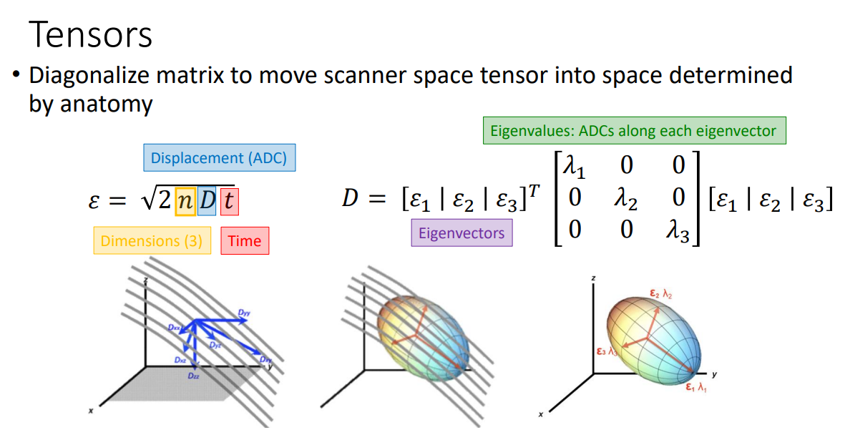
Slide credit: Ben Newman

Slide 17
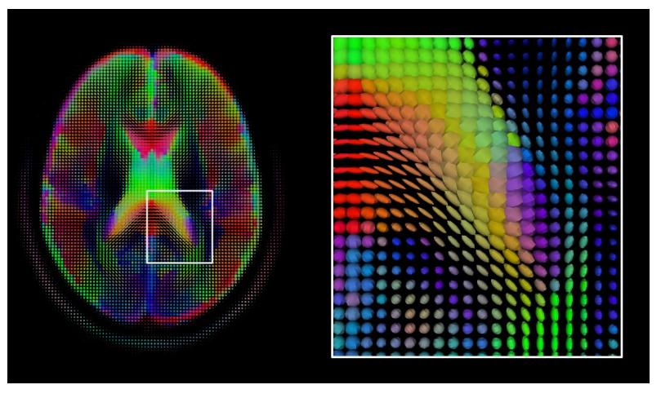
Figure credit: Ben Newman

Slide 18
What can we glean from this?
Scalar diffusion measures:
Axial / Longitudinal Diffusivity (=): 𝜆₁
Radial / Transverse Diffusivity (⊥): (𝜆₂+𝜆₃)÷2
Mean Diffusivity (MD)
Fractional Anisotropy (FA)
Orientation of primary diffusion:
~Tractography~

Slide 19
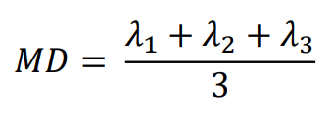
What can we do with this?
Mean Diffusivity
Average diffusion rate
Can reflect tissue damage

Slide 20
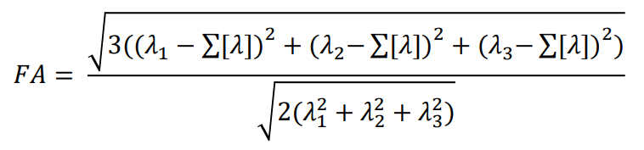
What can we do with this?
Fractional Anisotropy
Variance of the eigenvalues
Reflects WM integrity

Slide 21
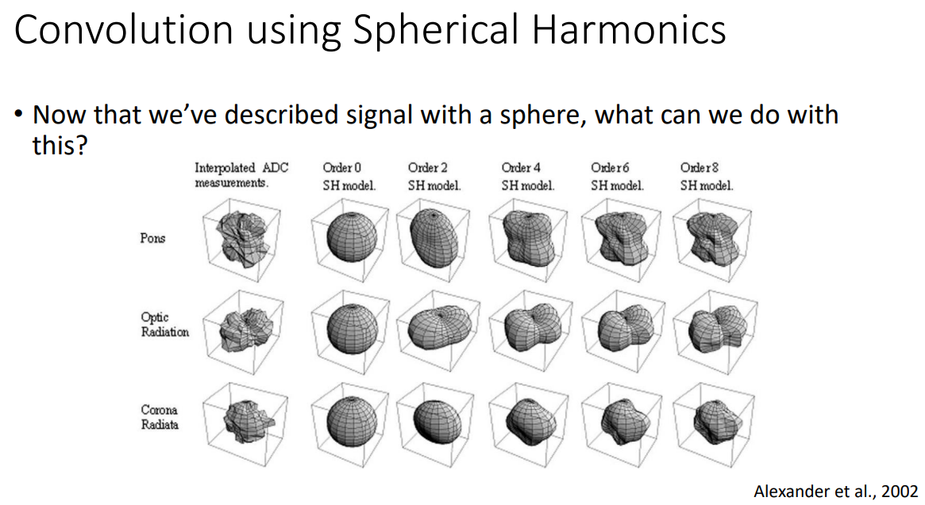
Notes:
3D analog of Fourier series. Instead of sines/cosines on a circle, spherical harmonics are smooth “wave” patterns defined on the surface of a sphere.
diffusion signal depends on direction. Spherical harmonics give a compact, math-clean way to represent that directional dependence.

Slide 22
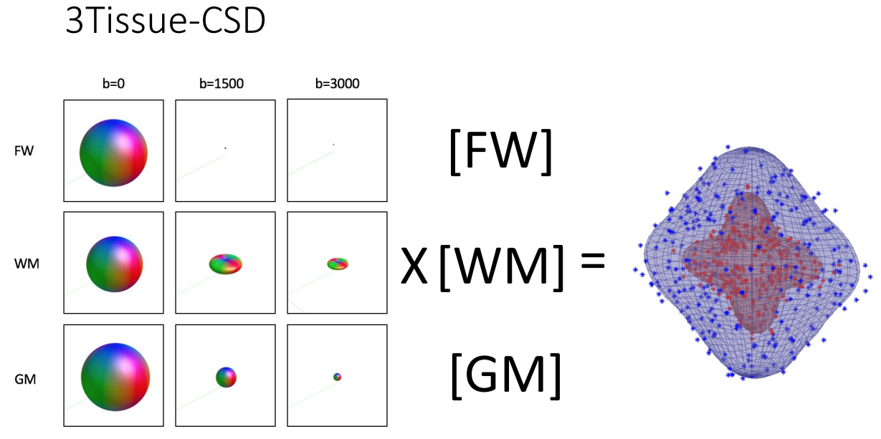
Slide credit: Ben Newman

Slide 23
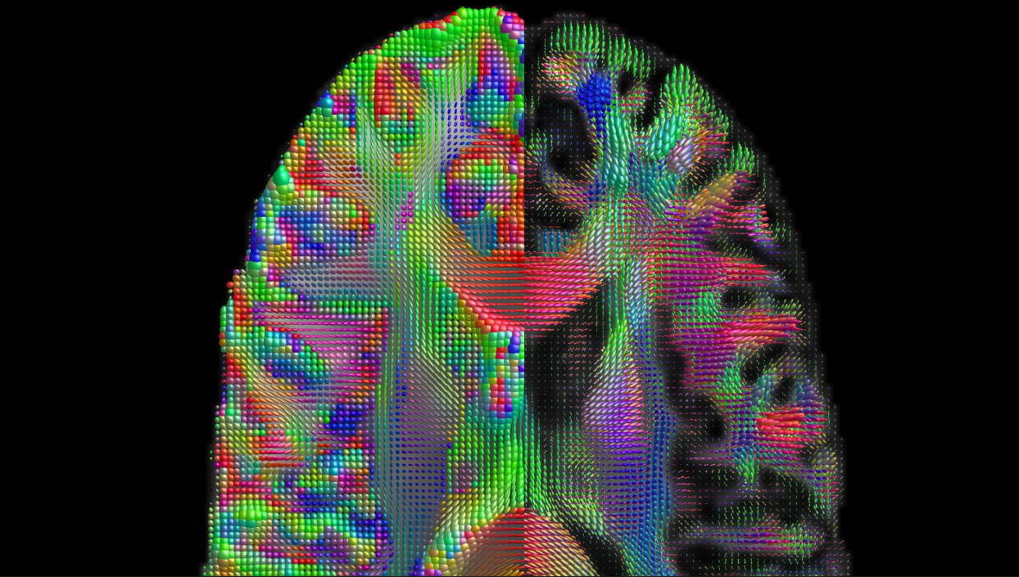
Figure credit: Ben Newman

Slide 24
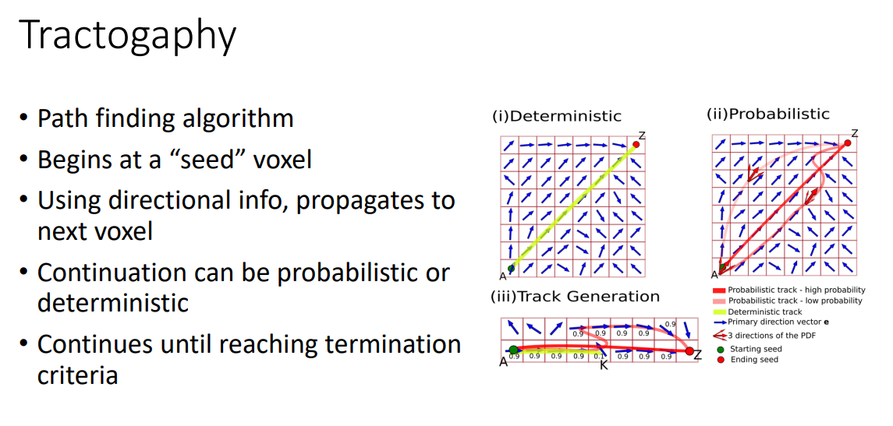
Slide credit: Ben Newman

Slide 25
Preprocessing steps
Denoising
Gibbs unringing
Susceptibility + motion + eddy correction
B1 bias-field correction on b0
Registration (mean b0 to T1)

Slide 26
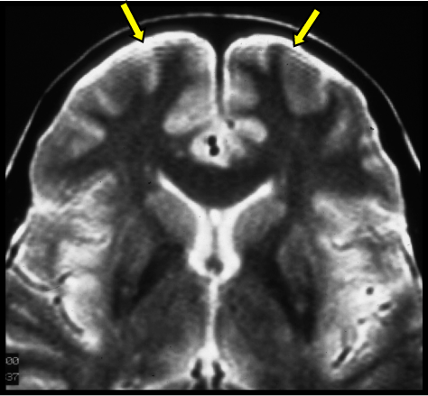
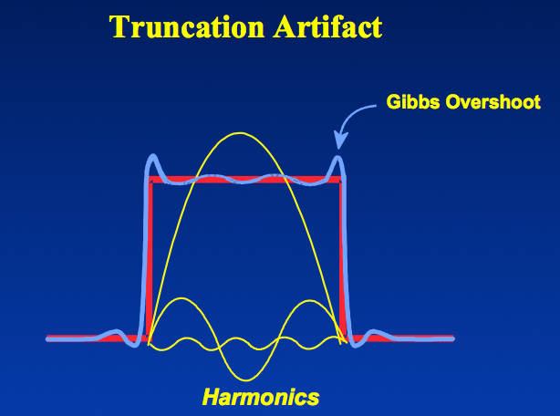
Gibbs ringing
Consequence of using Fourier transforms to reconstruct MR signals into images
Bias tracts @ edges
Mrtrix algo: mrdegibbs

Slide 27
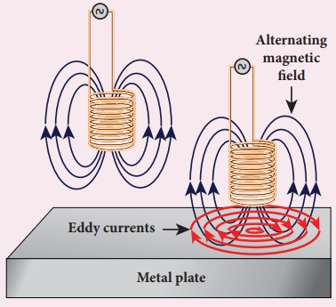
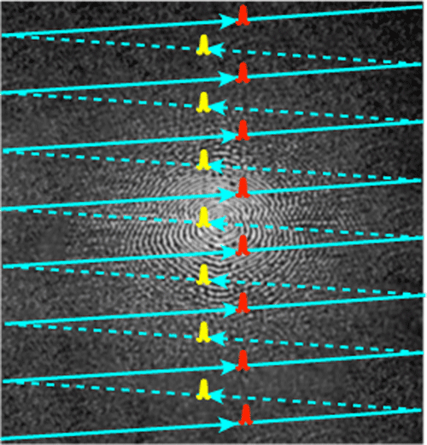
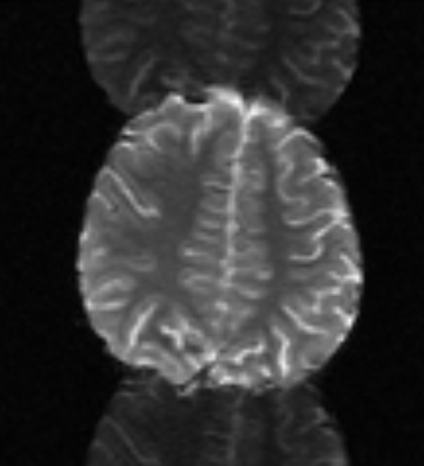
Recall: Eddy Currents
Unwanted phase shifts
Eddy currents
Notes:
Alternating phase is a pattern that flips sign every other ky line.
The highest spatial frequency you can represent on that ky grid is one that toggles every step—the Nyquist frequency.
The Nyquist frequency in k-space corresponds to a shift of exactly one-half of the sampled field-of-view in image space.
Hence the name “N/2 ghost.”
Scanner runs +x and –x gradients at ky = 0 (should be identical), and uses the difference to adjust for eddy currents (subtracts that phase from each even line)

Slide 28
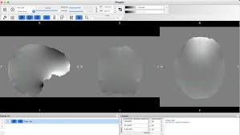
Recall: Susceptibility Distortion
Susceptibility distortion correction
Air/tissue interfaces (sinuses, ear canals) disturb the main B₀ field
In single-shot EPI the off-resonance accumulates during the echo train
Causes geometric stretch/compression along the phase-encoding axis (usually “y”)
REQUIRES FIELD MAP (sort of…)
Notes:
Depends on how you time your slices!

Slide 29
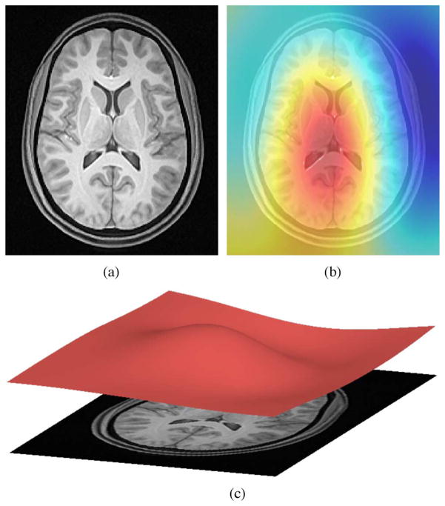
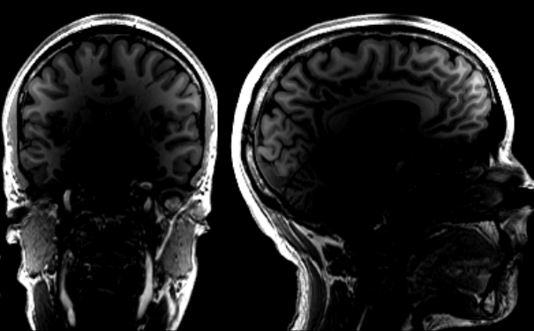
Recall: Bias Field Correction
Signal weakens as a function of distance from the RF coils
Uncorrected bias inflates tissue-class overlap
In dMRI, we use the b0 shell
Notes:
Okay, yeah, it does this – but we don’t want it to! Turn it off and use N4
(We do this for functional images too, but only the BOLD reference -- EPI intensity is arbitrary and later analyzed as percent-signal change (GLM) or temporal correlations (functional connectivity); the slowly varying bias largely washes out)

Slide 30
Example Image Acquisition
Multi-shell HARDI
>= 3 non-zero b-values + b=0
E.g., 0 / 1000 / 2000 / 3000 s/mm^2
Directions per shell:
b0: 5
b1000: 20
b2000: 32
b3000: 50
Collect at least one reversed-PE (b=0) for susceptibility correction

