Slide 1

UVA Brainhack!
===== Week 3 =====
6/13/2025

Slide 2
Agenda
Review
Data Org
OpenNeuro
Hacking

Slide 3
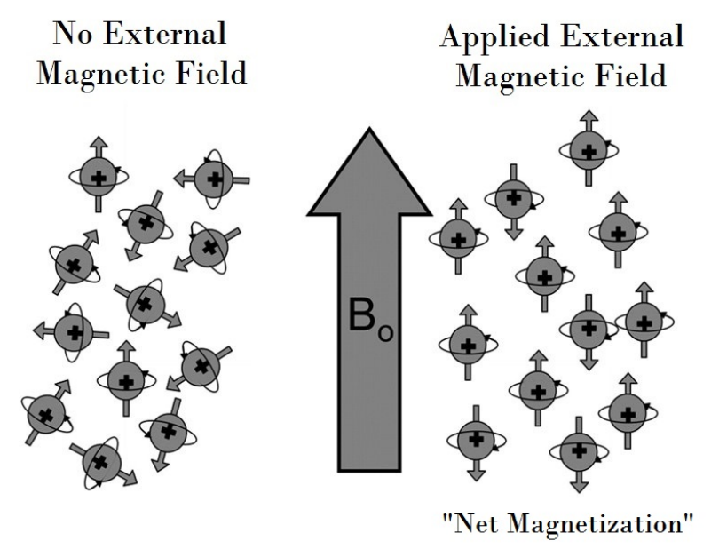
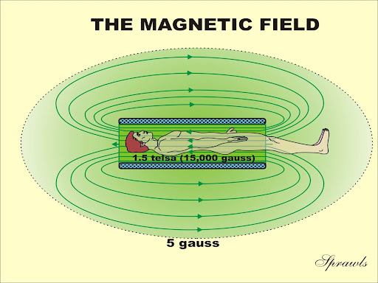
MR physics review

Slide 4
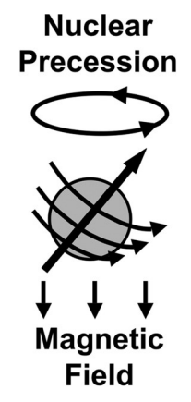
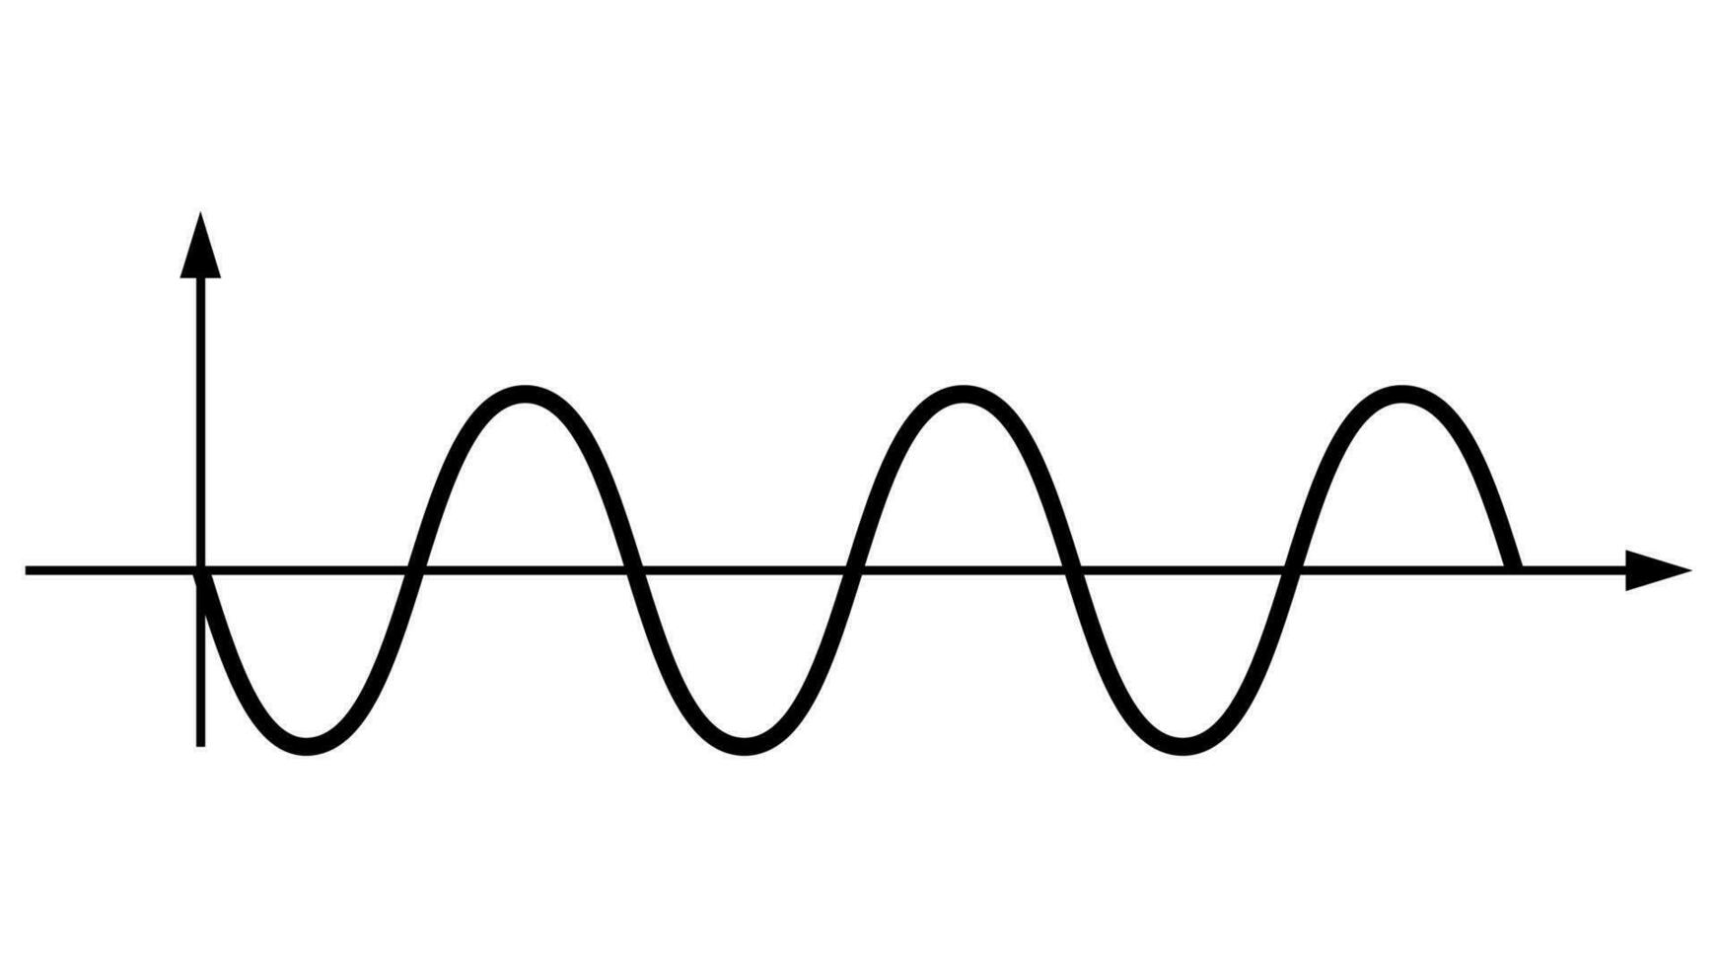
MR physics review
B₀
“Larmour Frequency”
42.58 MHz/T
Aligned with B₀ and precessing at the same rate

Slide 5
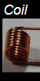
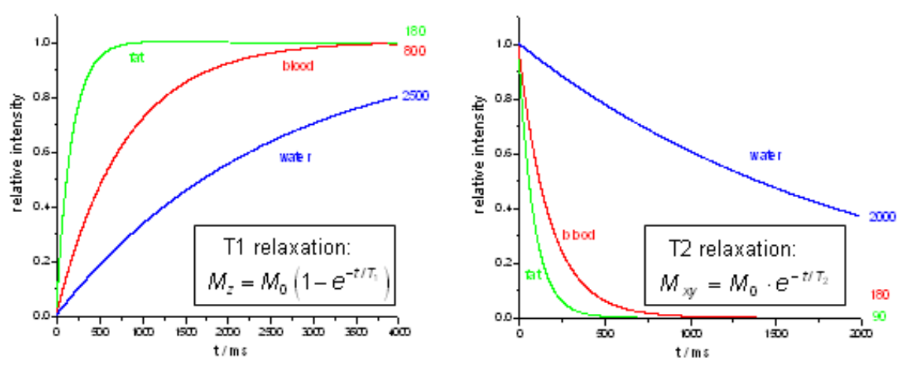
MR physics review
42.58MHz
Inversion and recovery
LONGITUDINAL
TRANSVERSE
Notes:
Technically broad-band RF to capture band around Larmour frequency

Slide 6
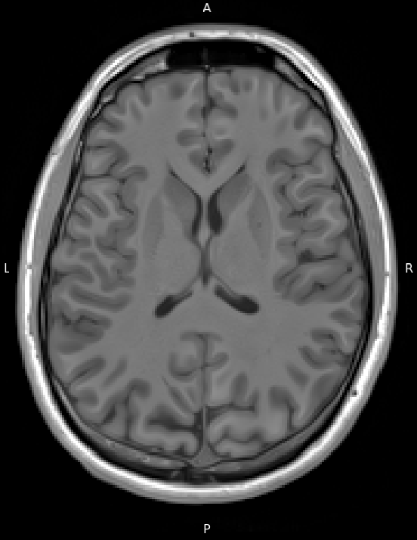
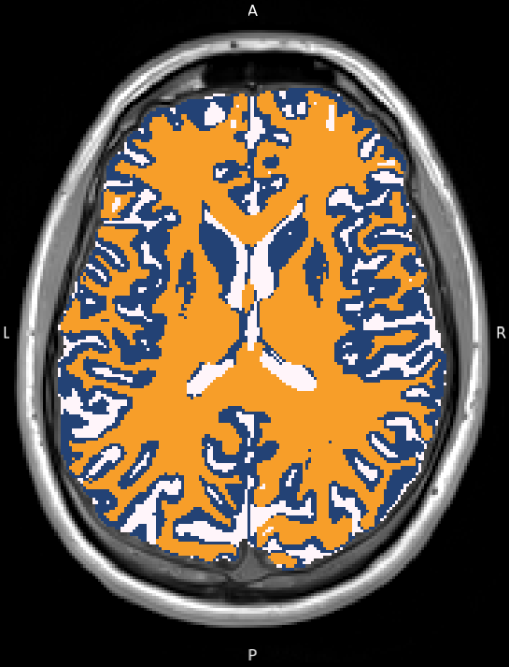
MR physics review
“T1-weighted”

Slide 7
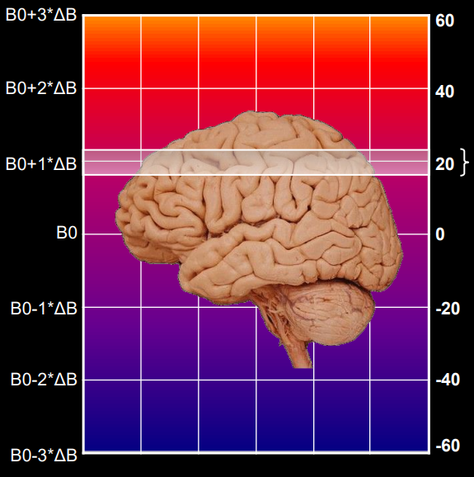
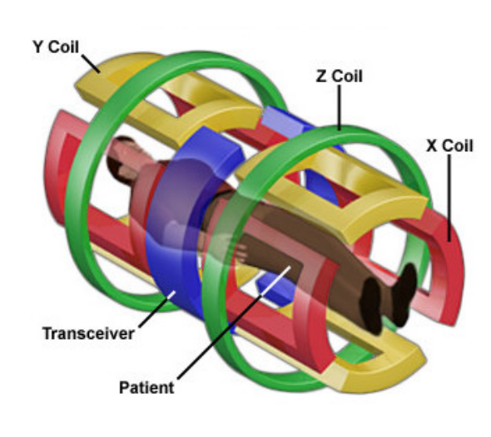
MR physics review
Gradient coils
z

Slide 8
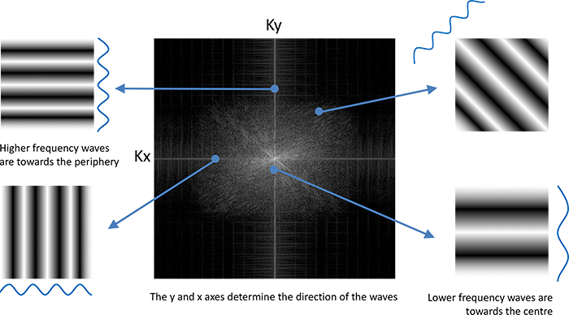
MR physics review
Notes:
DEMO TIME!

Slide 9
Data Organization
Intro to BIDS

Slide 10
DICOM
“Digital Imaging & Communications in Medicine”
2 parts:
Header: Tag-value pairs
patient & study identifiers, scanner/protocol settings, imaging params, etc.
Matrix: either a 2D slice or 3D volume of intensities
The “data” (not in k-space)
Notes:
Open standard for storing, transmitting, and archiving medical images and related data
Adopted by every MRI vendor (Siemens, GE, Philips, etc.)

Slide 11
DICOM (cont.)
Per-slice orientation
Tags Image Position (Patient) (0020,0032) & Image Orientation (Patient) (0020,0037) describe every slice
If the table moves or the gantry tilts, each slice may sit on a slightly different plane
Slice spacing vs. thickness
Slice Thickness ≠ Spacing Between Slices -- overlap or gaps are perfectly legal
Irregular acquisitions
Multi-band EPI, local-shims, partial Fourier and interrupted runs create missing or out-of-order indices
Gantry tilt & oblique stacks
Conversion tools must shearing-correct or embed an affine matrix that some software ignores, risking sub-voxel mis-alignment
Notes:
Open standard for storing, transmitting, and archiving medical images and related data
Adopted by every MRI vendor (Siemens, GE, Philips, etc.)

Slide 12
Example Dicoms (spine)

Slide 13
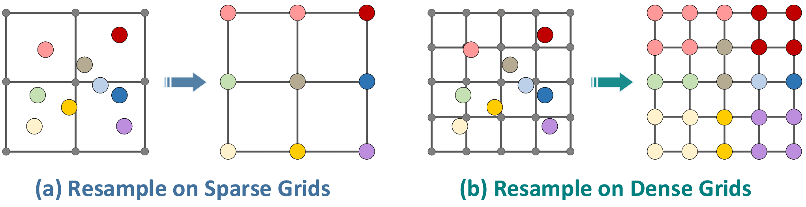
Grid resampling (interpolation)

Slide 14
DICOM → NIfTI (Neuroimaging Informatics Technology Initiative)
Why neuroimaging pipelines convert DICOM → NIfTI
Practical | How NIfTI helps | Why not use DICOM
Single‐step loading of whole scans | A 3-D (or 4-D) data block + 348-byte header live in one .nii (or compressed .nii.gz) file | Each 2-D slice is a separate DICOM object → hundreds or thousands of files per run; slow I/O and error-prone bookkeeping
Fast numerical analysis | Straight binary dump of voxel values after a tiny header ⇒ instant numpy/MATLAB access | Pixel data are wrapped in a verbose tag structure; many libraries must first parse metadata before touching the bytes
4-D fMRI & DWI time-series | Extra dimension* is built-in, so 240 volumes live in one object with one affine | Classic DICOM has no concept of a 4-th dimension (software must re-index thousands of “frames” and guess timing order)
Consistent spatial orientation | A single 4 × 4 affine matrix expresses voxel size, slice spacing, and obliquity (used by FSL/SPM/AFNI, etc.) | Orientation is encoded per slice (Image Position/Orientation tags). If the table/gentry moves, slices no longer share a common plane, preventing a tidy 3-D array
Minimal PHI | NIfTI keeps only technical fields needed for analysis; PHI is removed or pushed to a JSON sidecar in BIDS | DICOM headers are legally required to store patient name, birth date, IDs, institution, operator, etc. – this is a privacy and compliance risk during collaboration
Compatibility | Every modern neuro-tool (fMRIPrep, FreeSurfer, Nilearn, BrainVoyager, SPM, FSL, AFNI…) reads NIfTI natively | Vendor PACS viewers read DICOM, but few analysis packages fully support all vendors’ private tags

Slide 15
BIDS
Brain Imaging Data Structure (BIDS)
Community standard for MRI, MEG, iEEG
Predictable paths: sub-01/ses-pre/anat/sub-01_ses-pre_T1w.nii.gz
Uses NIfTI file format when applicable
Sidecar JSON keeps the missing DICOM metadata (TR, TE, slice-timing, phase-encode dir, etc.)

Slide 16

BIDS (https://bids-specification.readthedocs.io/en/stable/)

Slide 17
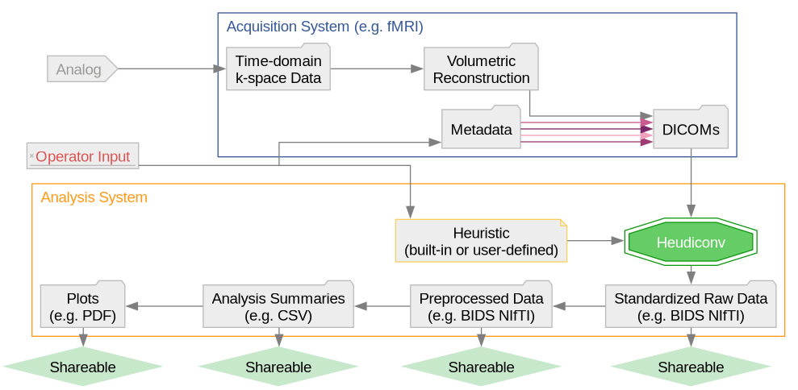
BIDS Walkthrough
HeuDiConv: Heuristic DICOM Converter
https://reproducibility.stanford.edu/bids-tutorial-series-part-2a/

