Slide 1

UVA Brainhack!
===== Week 4 =====
6/20/2025

Slide 2
Agenda
MR Preprocessing
Part I: Inside the scanner
Part II: Outside the scanner
fMRIPrep
Slurm (if there’s time)
Hacking

Slide 3
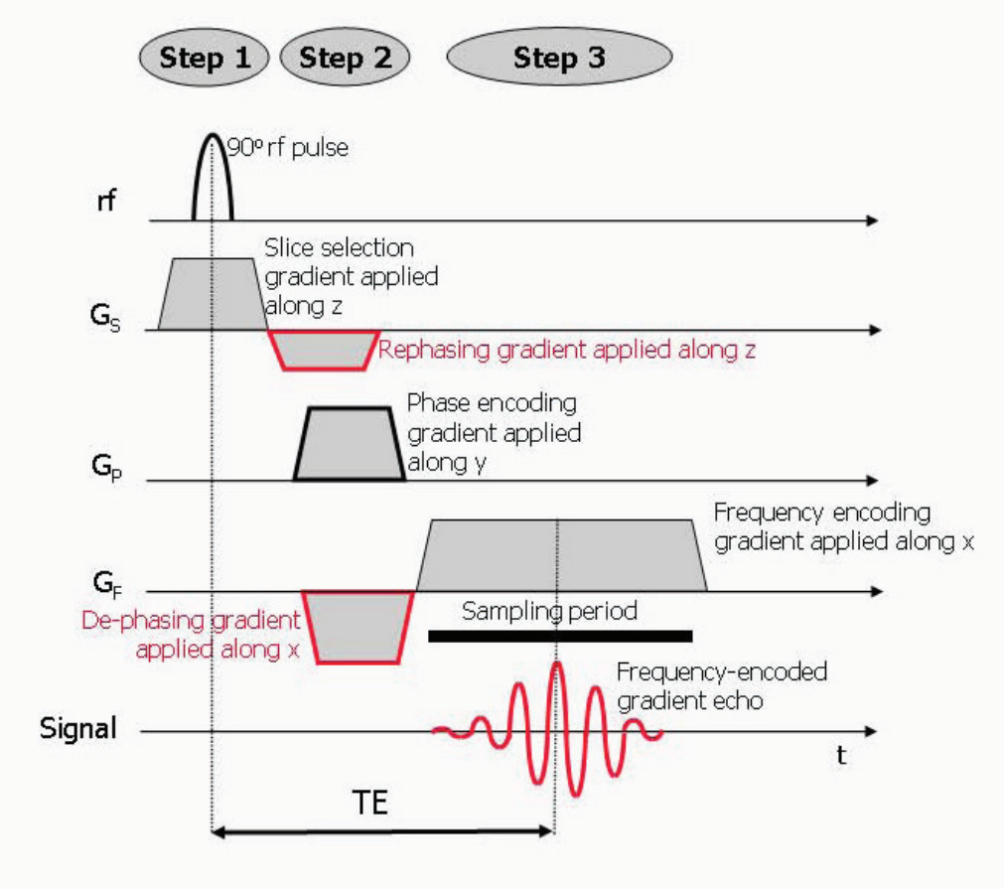
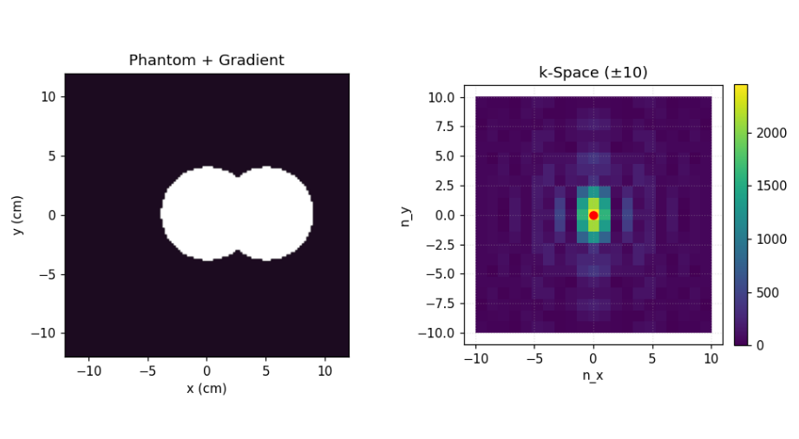
Quick return to K-space
GitHub Week3/scripts/gradients.ipynb ← Review this script!

Slide 4
MR Preprocessing
Scanner → Analysis
?

Slide 5
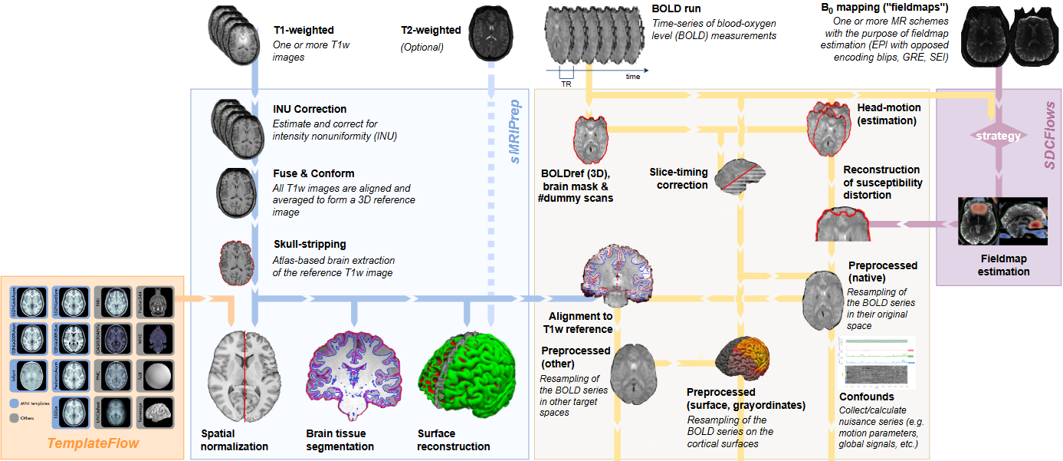
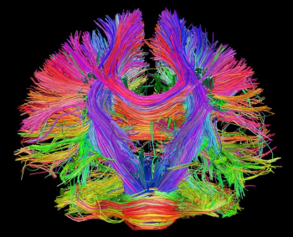
Preamble
anat
Common “types” of images
Structural
Functional
Field Map
Diffusion
Hi-res
func
dwi
fmap
Low-res

Slide 6
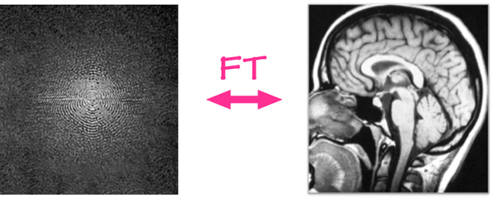
Part I: What the scanner does
Fourier reconstruction from raw K-space
Translates frequency-encoded data to spatial domain
In K-space, spatial information is distributed
Notes:
Where is the amygdala in this image?? The amygdala is everywhere! It isn’t possible to localize anatomical structures in K-space

Slide 7
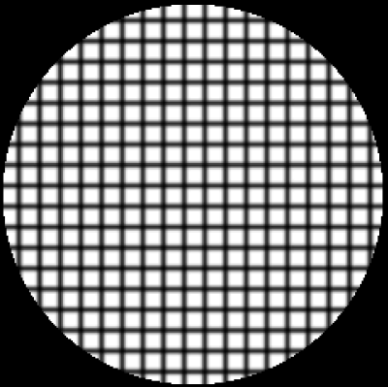
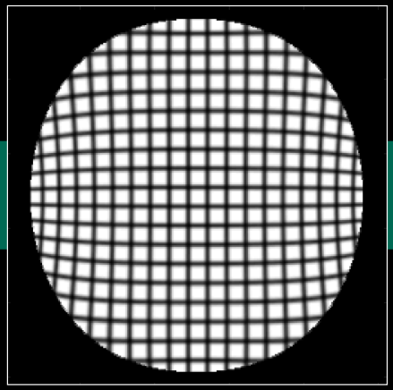
Part I: What the scanner does
Gradient-non-linearity (GNL) warp correction
“NonlinearGradientCorrection == true” usually by default
Notes:
The static B0 field is extremely linear at the magnet’s isocenter, but it deviates from linearity once you zoom out more than 20cm from isocenter. Vendors often correct for this by default, but not always!!! (important to know this!)
Because the gradient coils never move, the same deformation field works for every scan on that system until the next service calibration. Offline tools therefore pre-compute it once and reuse it.
Phantom studies show displacements of 1-2 mm at 12 cm off center and 4-6 mm near 17 cm. Yikes!

Slide 8
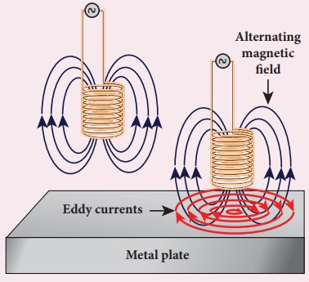
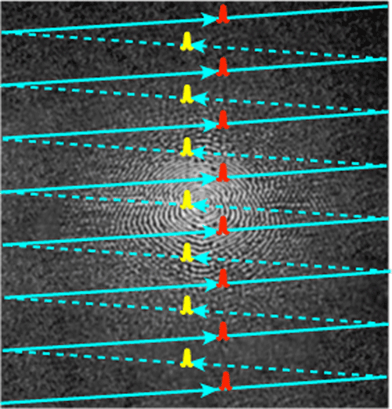
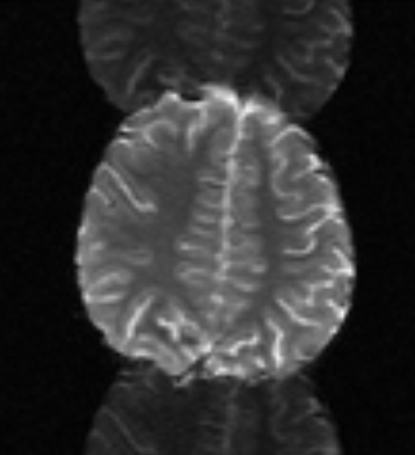
Part I: What the scanner does
EPI Nyquist ghost & phase-correction
Eddy currents
Notes:
Alternating phase is a pattern that flips sign every other ky line.
The highest spatial frequency you can represent on that ky grid is one that toggles every step—the Nyquist frequency.
The Nyquist frequency in k-space corresponds to a shift of exactly one-half of the sampled field-of-view in image space.
Hence the name “N/2 ghost.”
Scanner runs +x and –x gradients at ky = 0 (should be identical), and uses the difference to adjust for eddy currents (subtracts that phase from each even line)

Slide 9
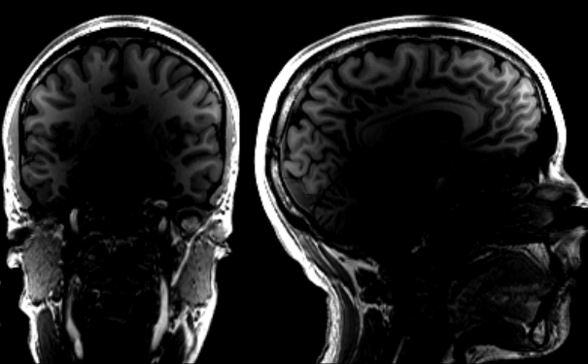
Part I: What the scanner does
Pre-scan normalization (B1⁻ non-uniformity correction)
Surface-coil flare / bias field
TURN. IT. OFF.
ADVICE
Notes:
NORM “ON” makes for pretty images on the console, but it makes trouble for later quantitative work: Hidden scaling complicates interpretation -- offline correction preserves relative units (scales can still differ across scanners, but bias source is explicit). You still need to perform N4 bias correction algo after scanning, but that’s trivial. Prescan normalization, on the other hand, is irreversible, sensitive to head positioning/shifting. Furthermore, any pipeline that interprets absolute signal (qT1, ASL-CBF, T2*, etc.) requires raw, unscaled data, but prescan normalization corrupts those units!!

Slide 10
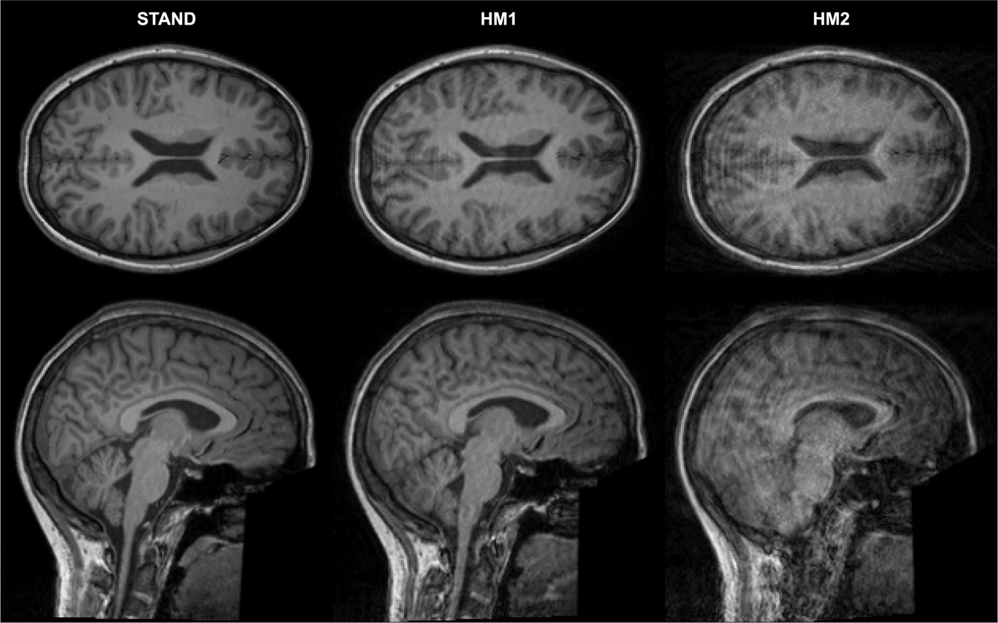
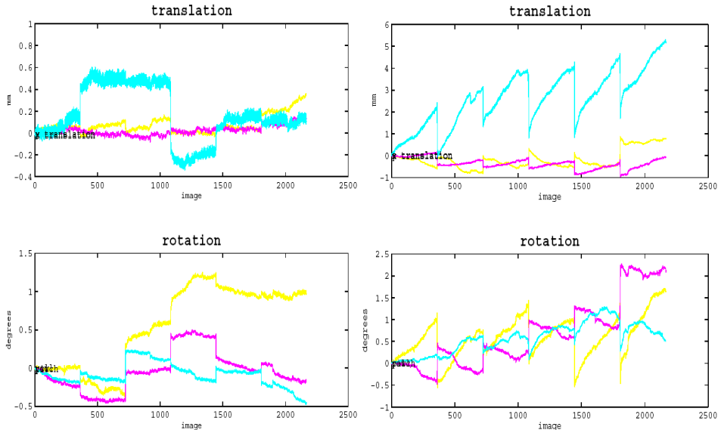
Part I: What the scanner does
Prospective motion correction
P1
P2
P3
Notes:
PACE (Prospective Acquisition CorrEction)
Quick navigator image every TR Right after the BOLD slice stack is read, the sequence grabs a tiny, low-resolution EPI volume (~ 4 mm voxels).
Rigid-body fit to a running reference Software compares the navigator to the running “target” volume and estimates 6 motion parameters (dx, dy, dz, pitch, roll, yaw).
Update gradients & RF before next TR Those parameters are converted into new gradient offsets and RF phase shifts so the next slice package is excited in the head’s new position.
Refresh the reference (slowly) If the head stays in the new spot for a few seconds, that volume becomes the new reference—prevents drift.
Log the motion PACE writes one line per TR in the DICOM header/text file; you can still feed these numbers to fMRIPrep for quality control.
summary: Navigator → Fit → Shift → Update → Log.
Unresolved issues:
Spin-history effects When the head moves, spins in a voxel may have just experienced a different flip-angle or field inhomogeneity. Signal amplitude changes that happened before PACE caught up remain baked into the data.
Intra-TR motion A sudden jerk during readout corrupts that volume’s k-space. PACE only updates before the next TR, so the “bad” volume still needs repairing or censoring.
Susceptibility warping & B₀ changes Head rotations subtly reshape the magnetic field; PACE doesn’t re-shim fast enough to undo these distortions. Offline TOPUP/field-map or field-map-less SDC is still required.

Slide 11


Part I: What the scanner does
Summary
Fourier transform
GNL warp correction
Eddy current correction
Intensity non-uniformity correction
And more!

Slide 12

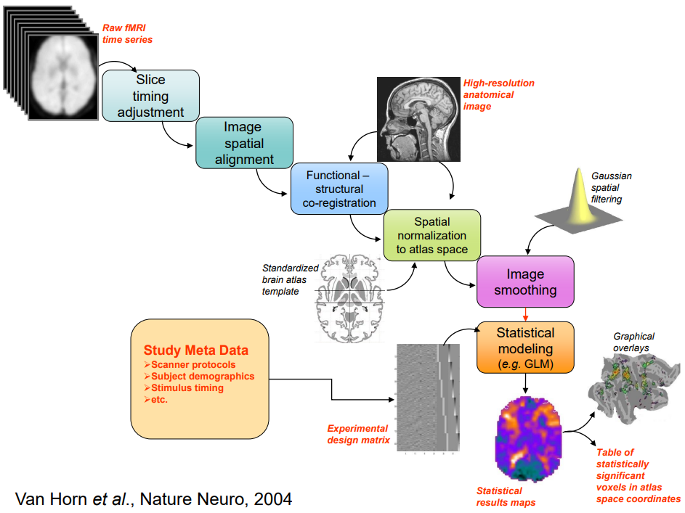
Part II: What the scanner doesn’t do
Location. Location. Location.
Notes:
It’s all about location – We’re putting stuff where it belongs

Slide 13
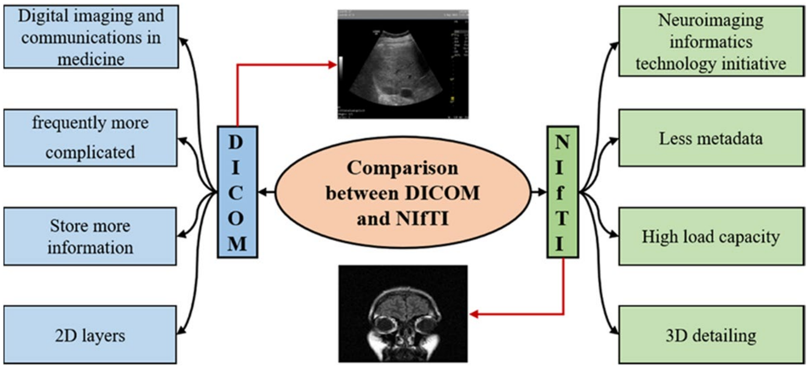
Part II: What the scanner doesn’t do
Convert DICOM → NIfTI (discussed last week)

Slide 14
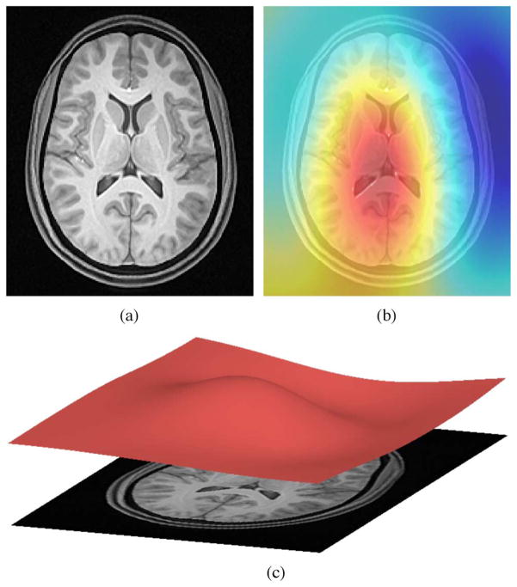
Part II: What the scanner doesn’t do
Structural
Bias-field correction (N4ITK algo)
Don’t rely on the scanner!
Uncorrected bias inflates tissue-class overlap
Helps with future steps
Notes:
Okay, yeah, it does this – but we don’t want it to! Turn it off and use N4
(We do this for functional images too, but only the BOLD reference -- EPI intensity is arbitrary and later analyzed as percent-signal change (GLM) or temporal correlations (functional connectivity); the slowly varying bias largely washes out)

Slide 15
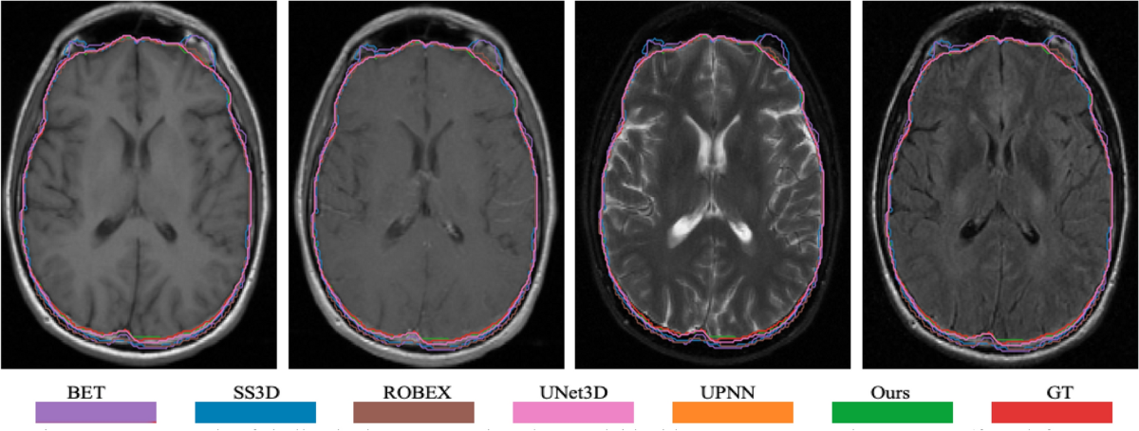
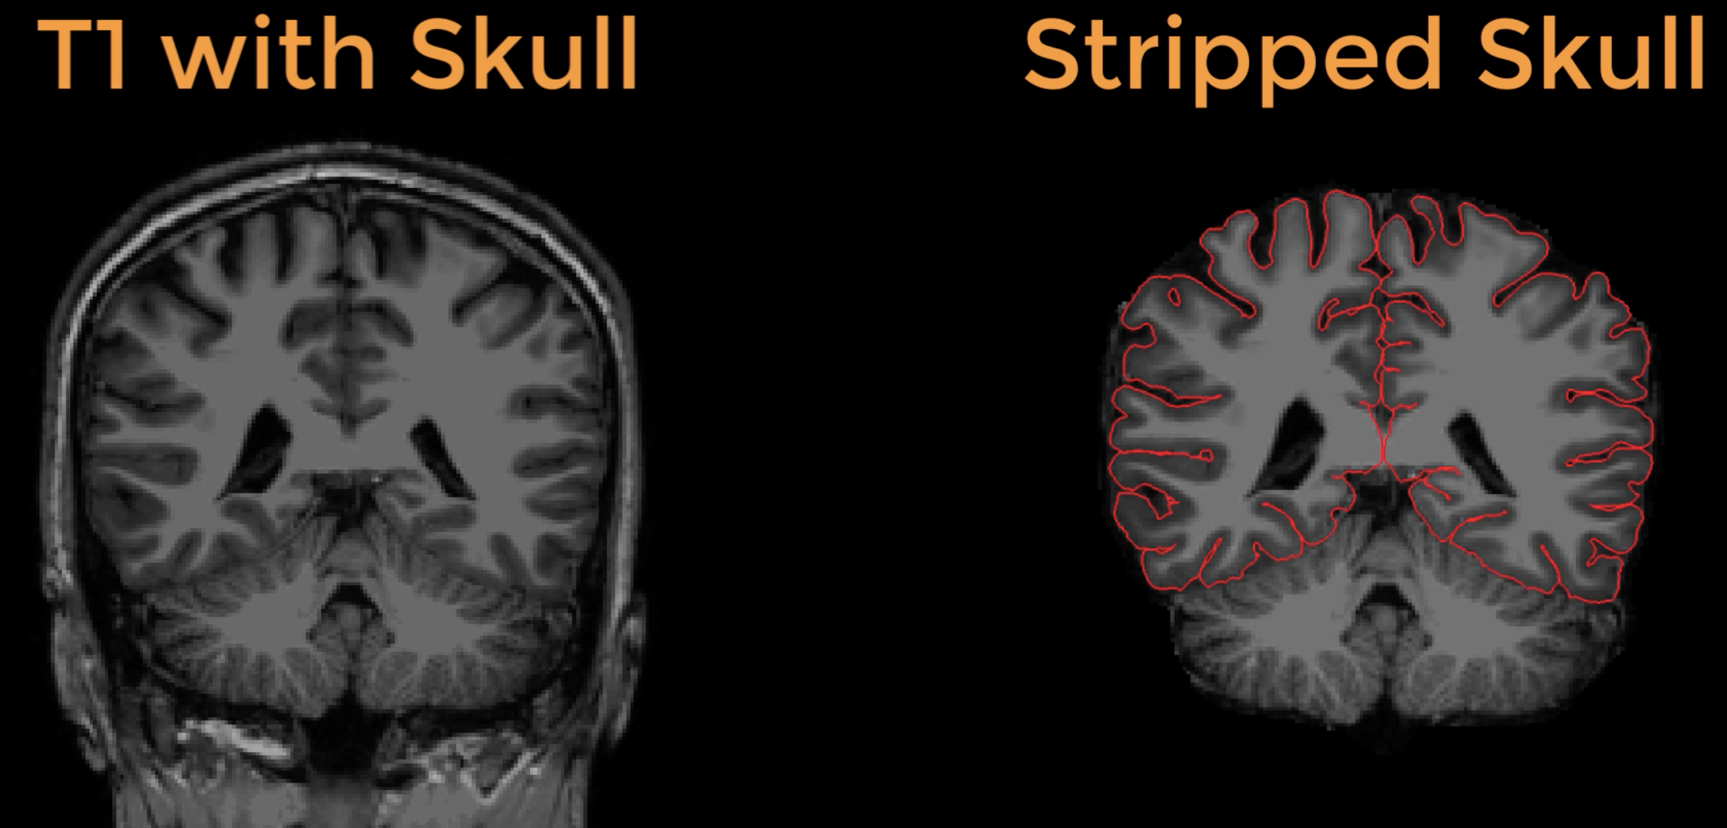
Part II: What the scanner doesn’t do
Structural
Skull-stripping – gold standard is manual (yikes!)
Notes:
We’re interested in brain morphometry – so we need to figure out where the brain is
This is complicated by partial volume effects, bias, etc.

Slide 16
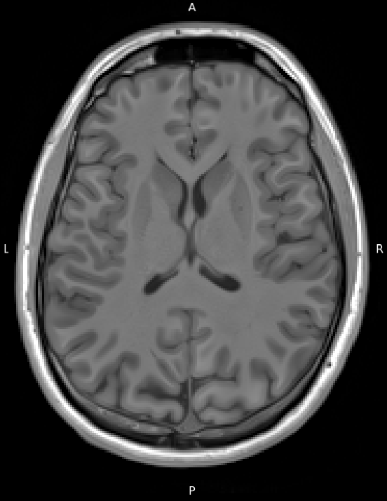
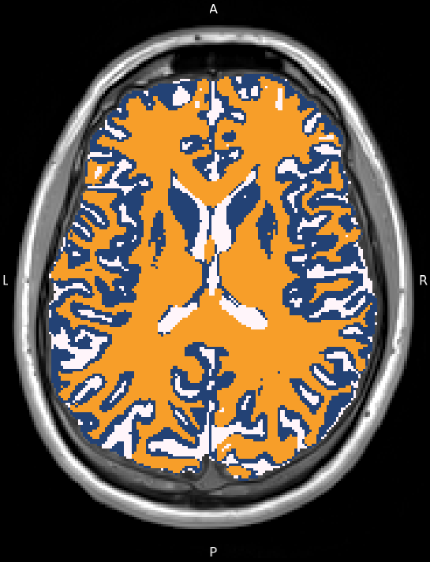
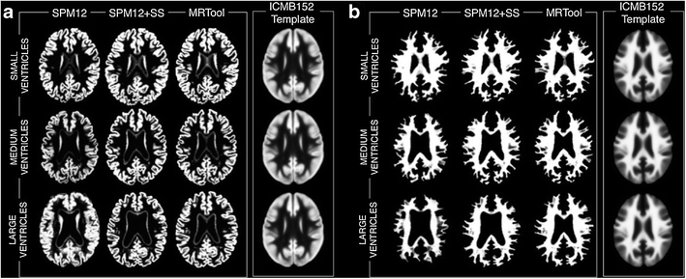
Part II: What the scanner doesn’t do
Structural
Tissue segmentation
Expectation-Maximization with Markov random field smoothing
Often using an existing probabilistic tissue map as a prior
Notes:
We’re interested in brain morphometry – so we need to figure out where the brain is
This is complicated by partial volume effects, bias, etc.

Slide 17
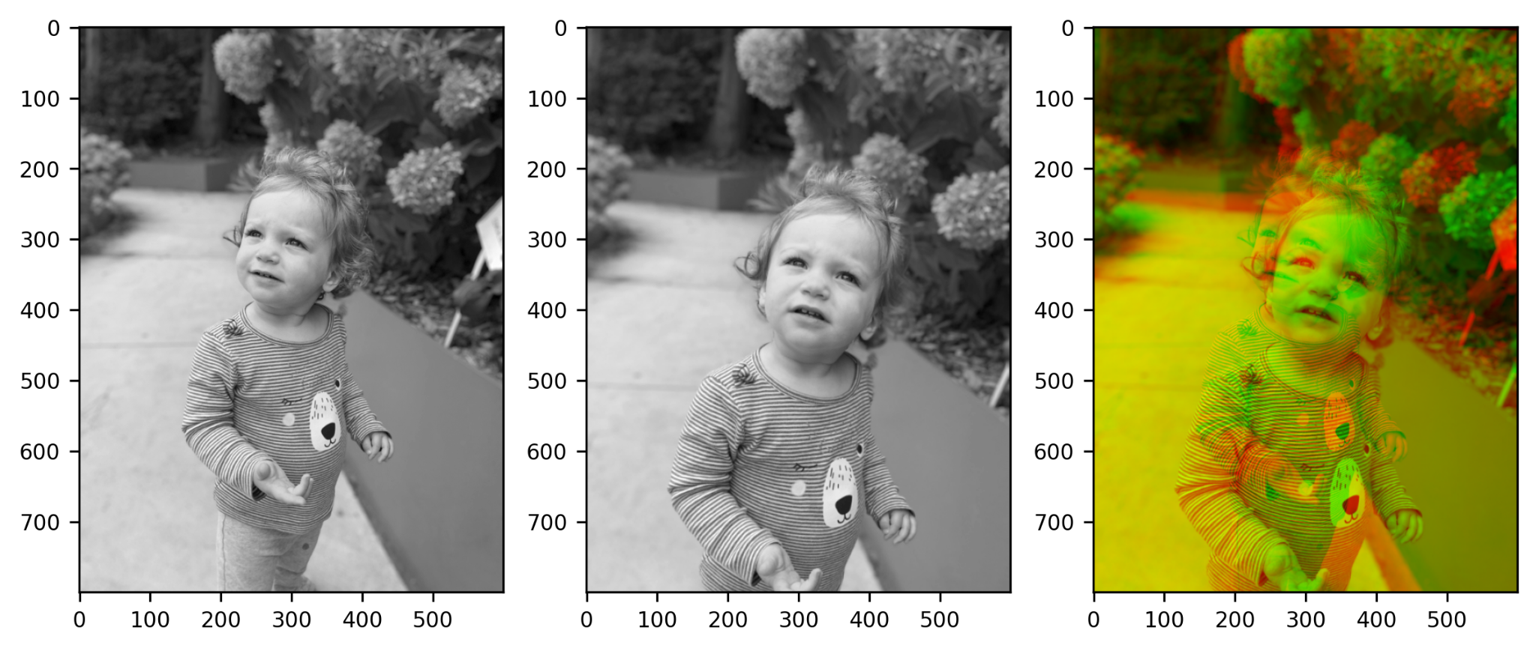
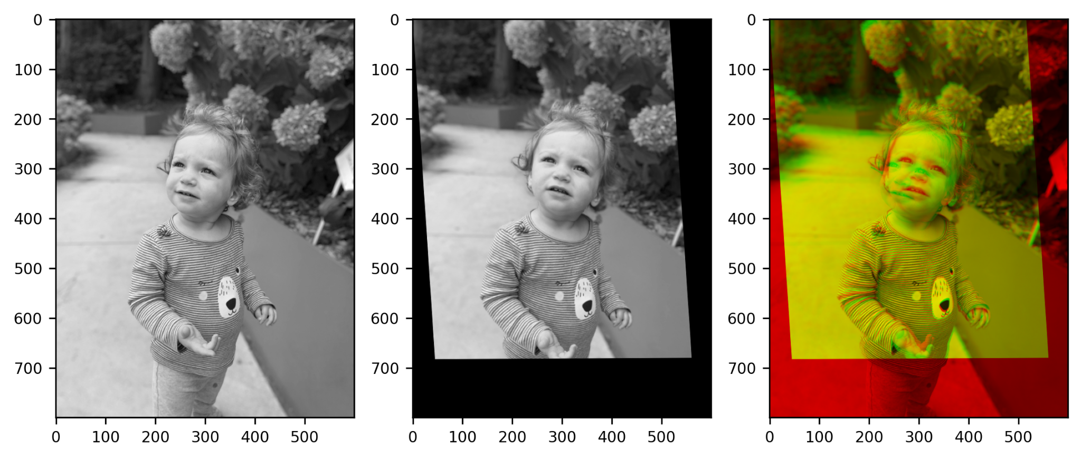
Part II: What the scanner doesn’t do
Structural
Spatial Normalization
Rigid “affine” transformations
Translation
Scaling
Rotation
Shearing
Reflection
Rokem, A., & Yarkoni, T. (2023)

Slide 18
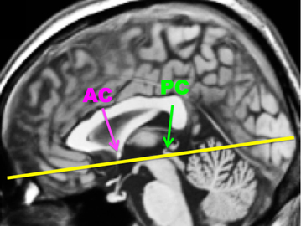
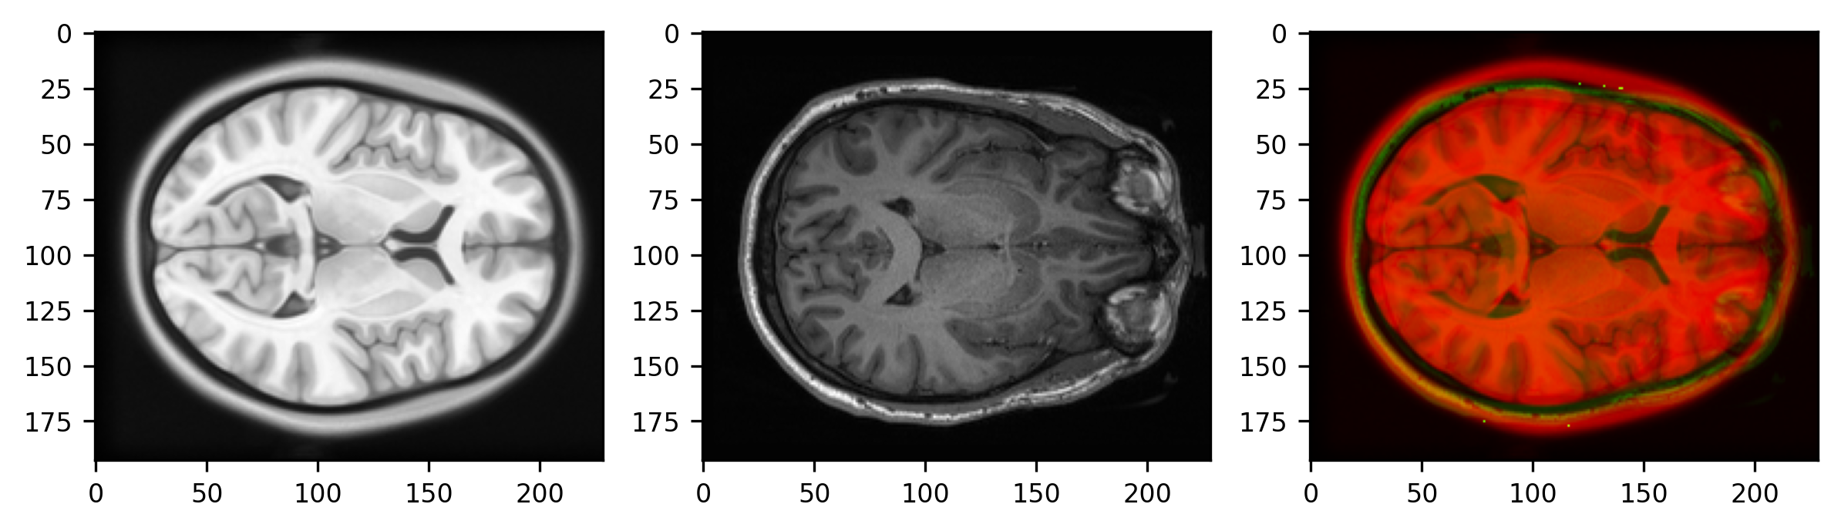
Part II: What the scanner doesn’t do
Common reference: AC/PC
Structural
Spatial Normalization
Rigid “affine” transformations

Slide 19
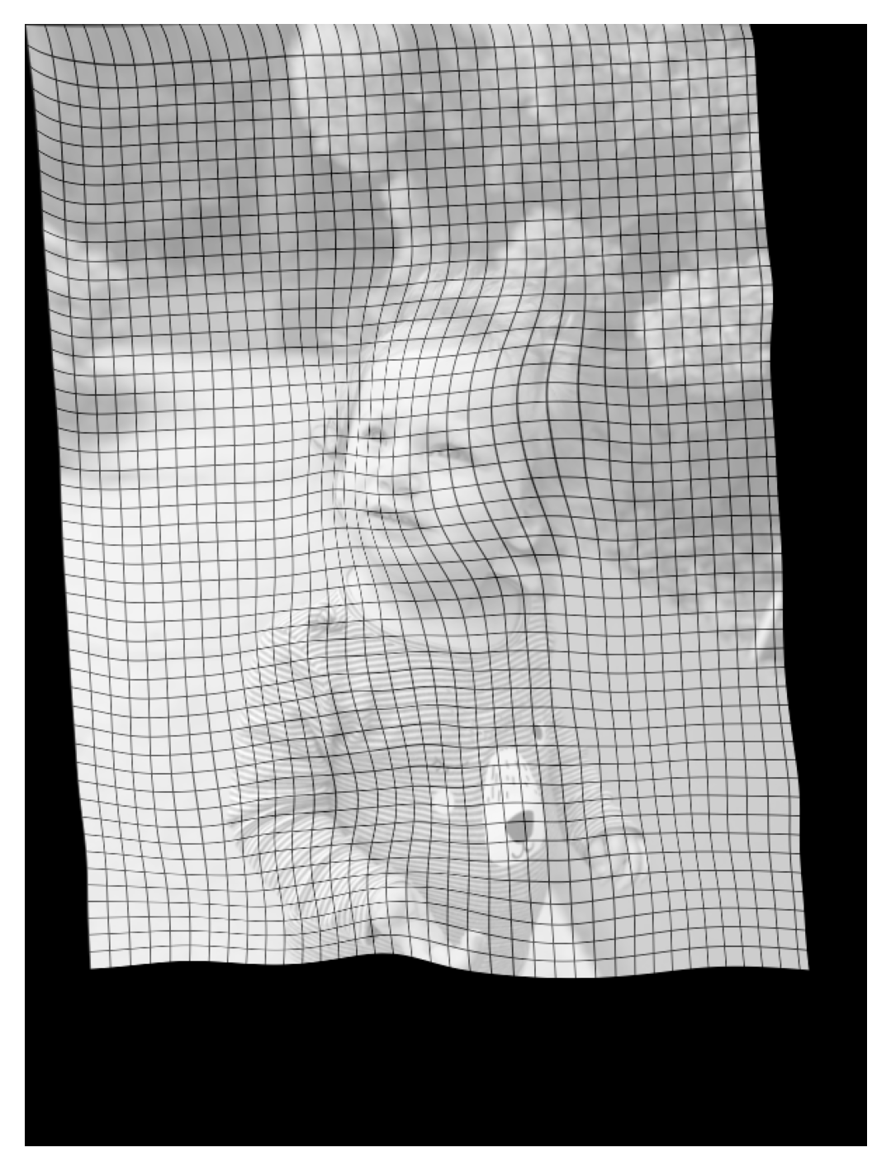
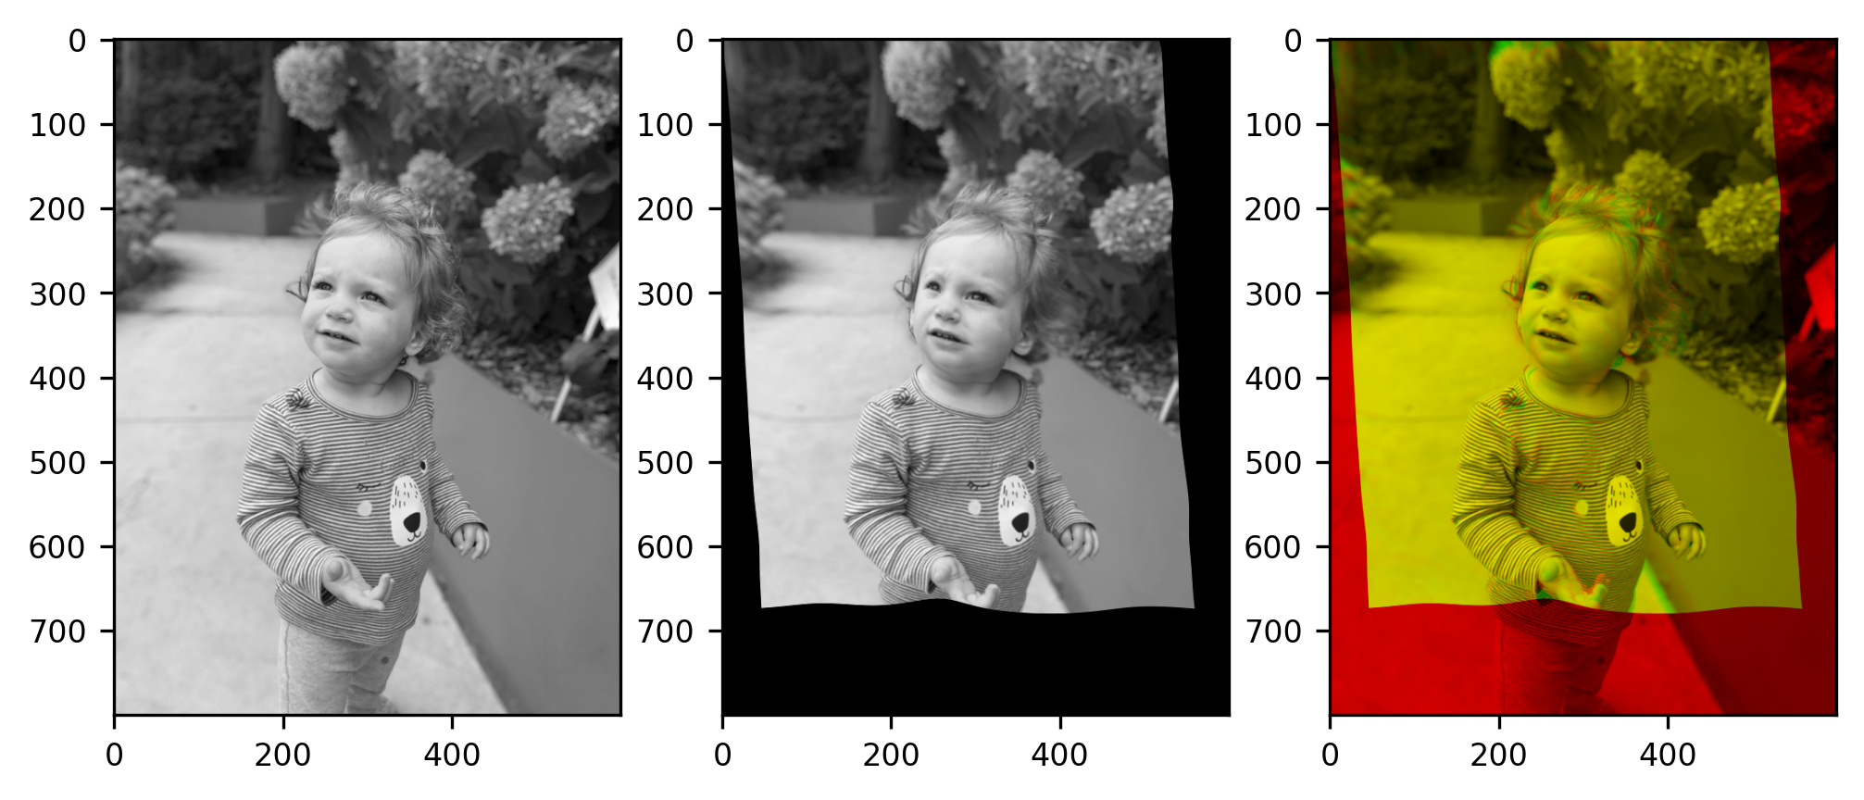
Part II: What the scanner doesn’t do
Structural
Spatial Normalization
Rigid “affine” transformations
Nonlinear “diffeomorphic” transformations
Rokem, A., & Yarkoni, T. (2023)

Slide 20
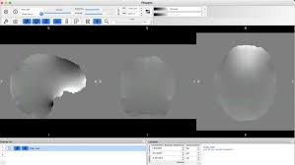
Part II: What the scanner doesn’t do
Functional
Susceptibility distortion correction
Air/tissue interfaces (sinuses, ear canals) disturb the main B₀ field
In single-shot EPI the off-resonance accumulates during the echo train
Causes geometric stretch/compression along the phase-encoding axis (usually y)
REQUIRES FIELD MAP (sort of…)
Notes:
Depends on how you time your slices!

Slide 21
Part II: What the scanner doesn’t do
Functional
Slice-Time Correction
VIDEO @ https://andysbrainbook.readthedocs.io/en/latest/_images/SliceTimingCorrection_Demo.gif
Choose a reference time (common default is 0.5*TR, the volume midpoint)
Phase-shift each slice’s time-series by sinc interpolation so all voxels are aligned to that reference
Notes:
Depends on how you time your slices!

Slide 22
Part II: What the scanner doesn’t do
Functional
Rigid-body motion correction
Realign each volume to a reference (e.g., first volume)
VIDEO @ https://andysbrainbook.readthedocs.io/en/latest/_images/MotionCorrectionExample.gif

Slide 23
Part II: What the scanner doesn’t do
Functional
Co-registration with structural
(+ normalization to standard atlas)
VIDEO @ https://andysbrainbook.readthedocs.io/en/latest/_images/Registration_Normalization_Demo.gif

Slide 24
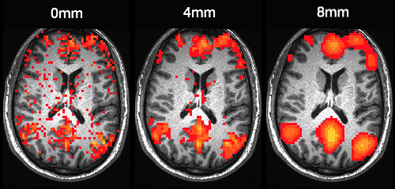
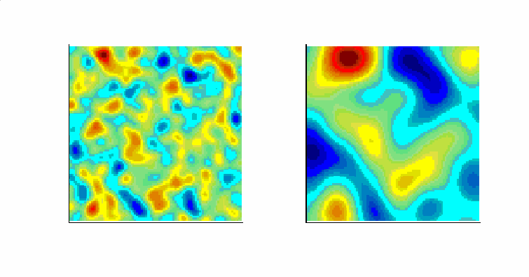
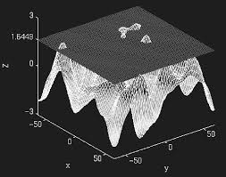
Part II: What the scanner doesn’t do
Functional
(Optional) Smoothing
VIDEO @ https://andysbrainbook.readthedocs.io/en/latest/_images/Smoothing_Demo.gif

Slide 25
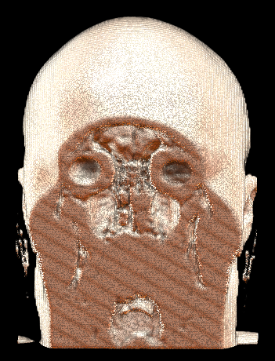
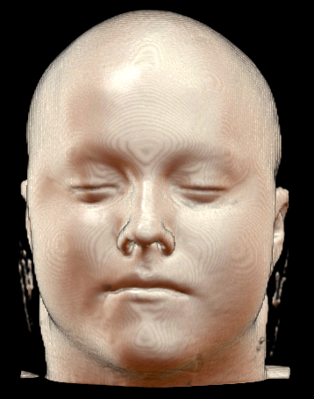
Part II: What the scanner doesn’t do
Structural
(Optional-ish) Defacing
If you plan to share your data outside your lab, you need to do this
NIfTIs may contain less PHI than DICOMS, but they can still contain identifying information
Structural images must be further anonymized

Slide 26
Summary
GNL warp correction
Eddy current correction*
Bias-field correction**
Motion correction*
Susceptibility distortion correction
Slice-time correction
Skull-stripping/tissue segmentation
Spatial normalization and functional-structural co-registration
Smoothing
Defacing
Scanner does it
You do it
* Scanner does it, but you need to do it too
** Scanner can do this, but you should do it yourself (turn Prescan Normalize OFF!)

Slide 27
fMRIPrep
https://fmriprep.org/en/stable/

Slide 28
fMRIPrep Pipeline
INPUT
OUTPUT

Slide 29
fMRIPrep Pipeline – copy and paste in rivanna
No changes necessary! This should work on its own ☺ though it might take a while to run – next week we will discuss how to submit slurm jobs
export NETID=$(whoami) ; export SUBID="rcg"
if [[ ! –d /scratch/${NETID}/brainhack ]] ; then
mkdir /scratch/${NETID}/brainhack
fi
cd /scratch/${NETID}/brainhack
cp -r /project/morrislab/Craig/rcgBIDS /scratch/${NETID}/brainhack
module load apptainer fmriprep
apptainer run --cleanenv --bind /scratch/${NETID}/brainhack/rcgBIDS/:/data:ro --bind /scratch/${NETID}/brainhack/rcgBIDS/derivatives:/out /sfs/weka/applications/resources/containers/apptainer/fmriprep-23.1.4.sif /data /out participant --participant-label ${SUBID} --fs-license-file /scratch/${NETID}/brainhack/rcgBIDS/code/license.txt --output-spaces MNI152NLin2009cAsym:res-native:res-2 T1w func -w /scratch/${NETID}/brainhack/fmriprep_work/${SUBID} --omp-nthreads 16 --skip-bids-validation --fs-no-reconall --low-mem

