Slide 1

UVA Brainhack!
===== Week 5 =====
6/27/2025

Slide 2
Agenda
MR Preprocessing (Continued)
Review fMRIPrep Output
Analysis!
Denoising
Slurm
Hacking

Slide 3
Preprocessing (cont.)
The most important stuff!

Slide 4
Recap
GNL warp correction
Eddy current correction*
Bias-field correction**
Motion correction*
Susceptibility distortion correction
Slice-time correction
Skull-stripping/tissue segmentation
Spatial normalization and functional-structural co-registration
Smoothing
Defacing
Scanner does it
You do it
* Scanner does it, but you need to do it too
** Scanner can do this, but you should do it yourself (turn Prescan Normalize OFF!)

Slide 5
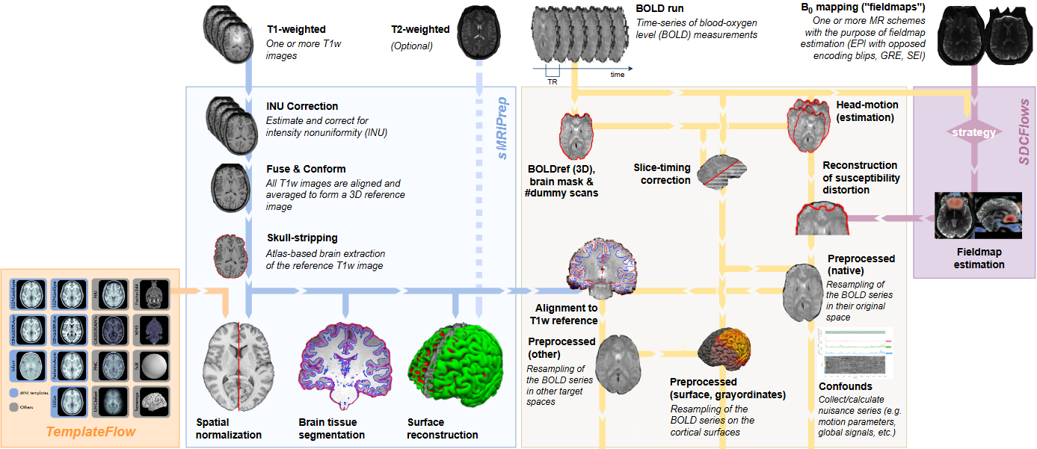
fMRIPrep Pipeline
INPUT
OUTPUT

Slide 6
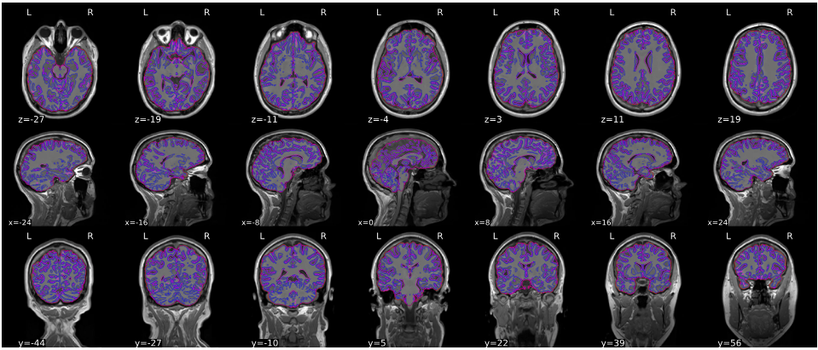
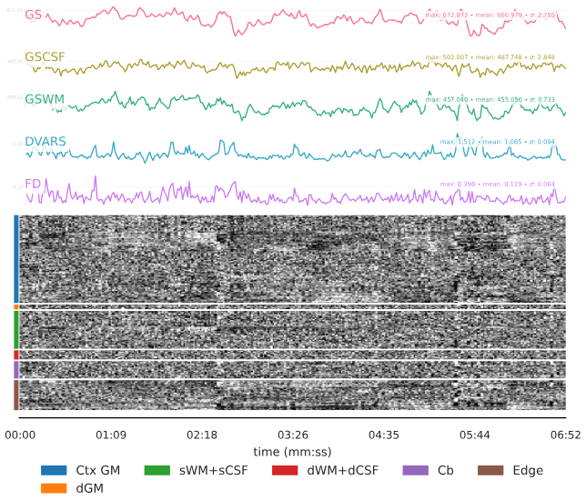
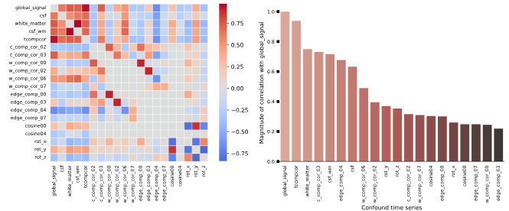
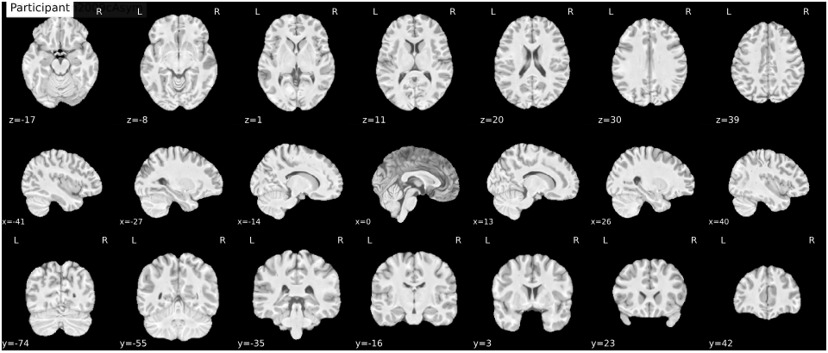
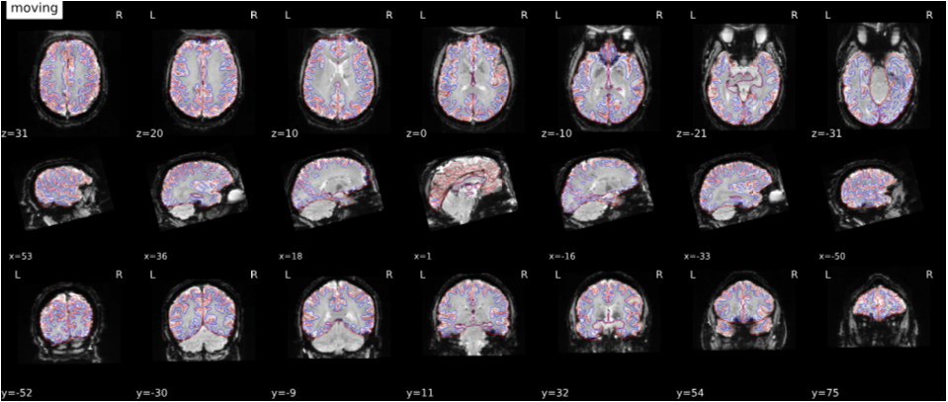
fMRIPrep Output
sub-rcg.html
Skull-strip
Normalize
Co-Register

Slide 7
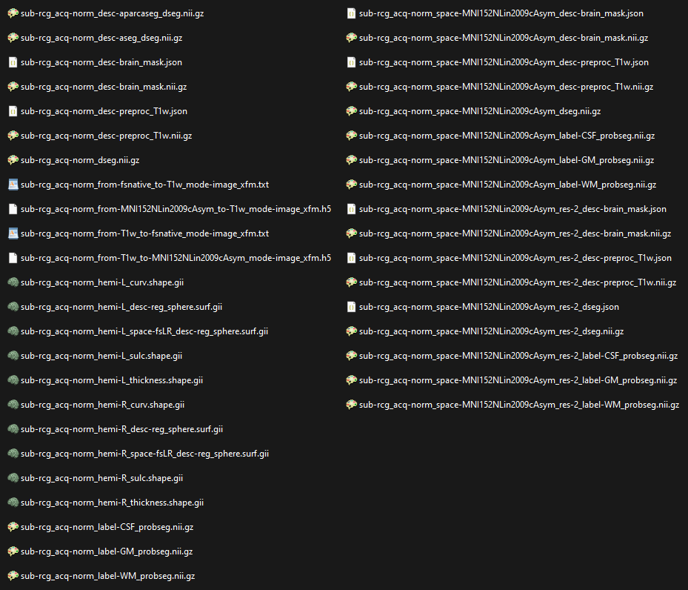
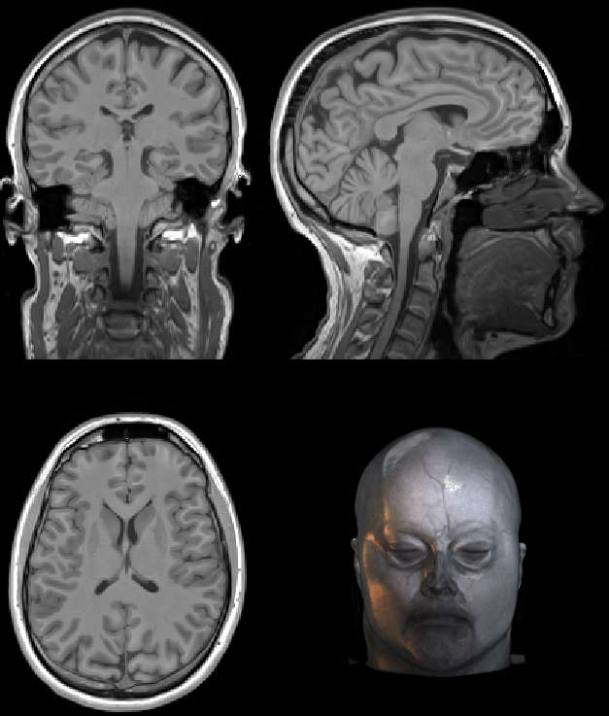
fMRIPrep Output -- anat
Atlas-based parcellations
Brain mask
Preprocessed T1w
Tissue segmentations (combined)
Transformations
Tissue segmentations (separate compartments)

Slide 8
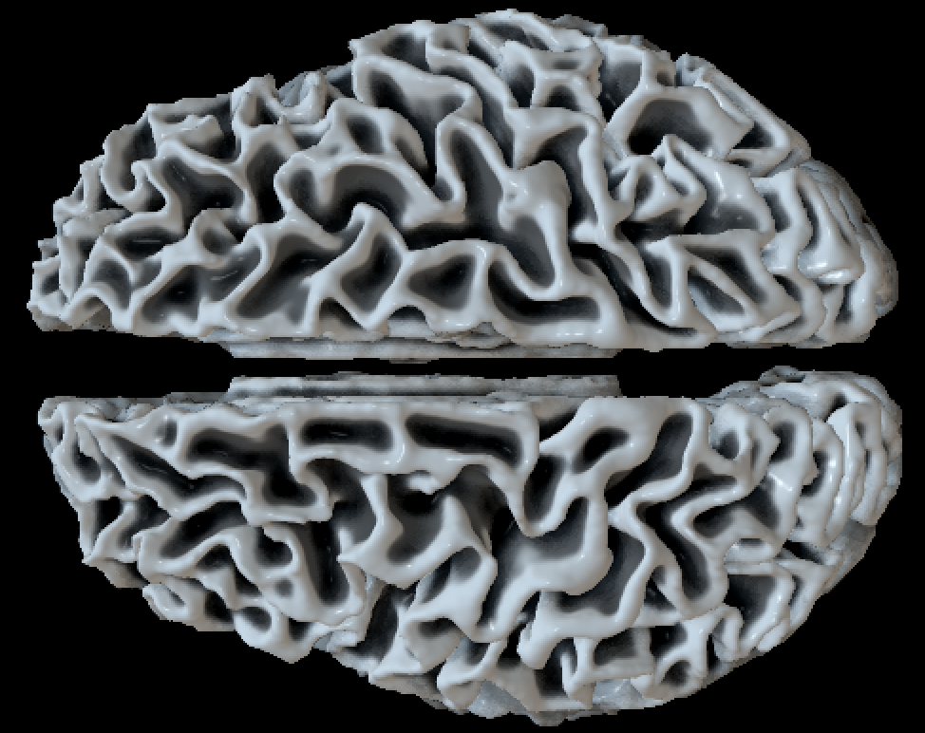
fMRIPrep Output -- anat
Surface reconstruction
Other output spaces (e.g., MNI)

Slide 9
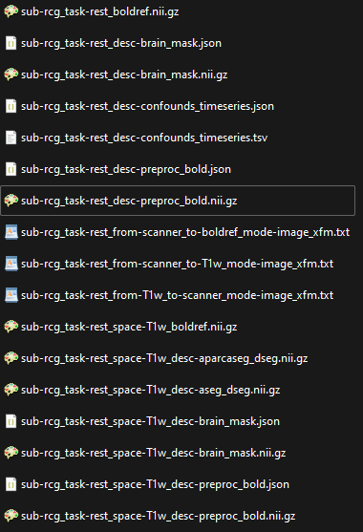
fMRIPrep Output – func
BOLD reference (average)
Brain mask (func)
Confounds
Preprocessed BOLD volumes
Transformations
Same output in T1w-space (co-registered)

Slide 10
Design & Analysis
Introduction

Slide 11
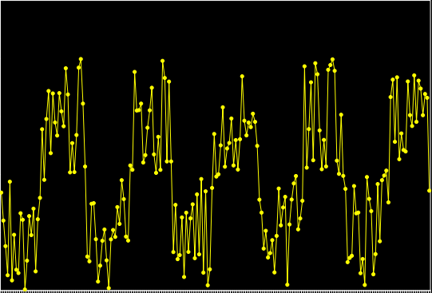
Signal-to-Noise Ratio (SNR)
Task-related
variability
Non-task related
variability

Slide 12
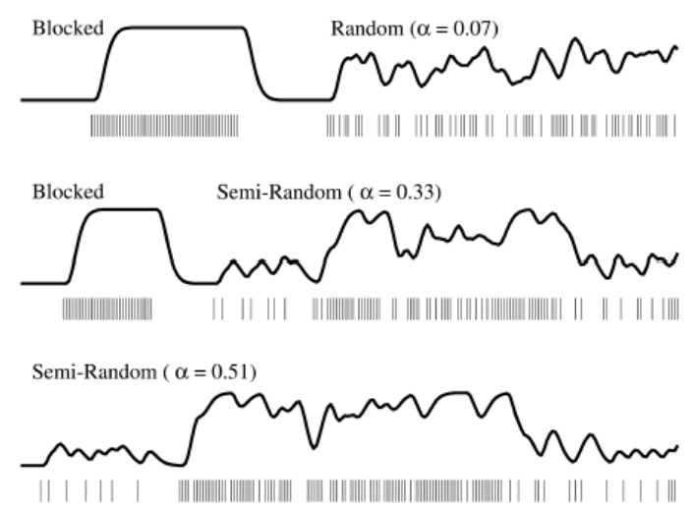
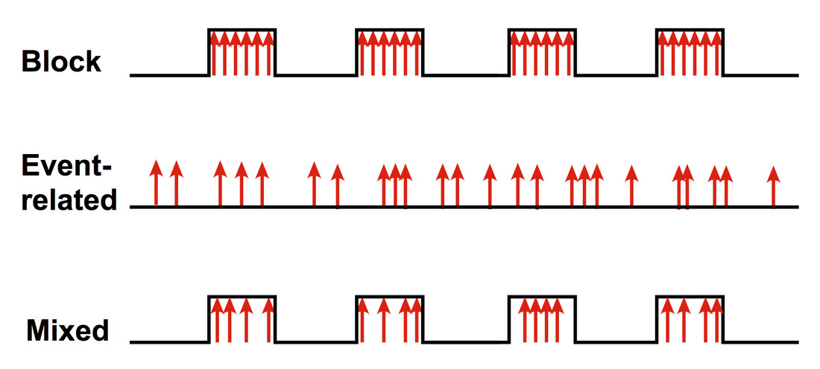
Types
Block/epoch (“boxcar”)
Task periods alternate with rest
Optimizes SNR
Best for simple experiments (e.g., functional localizer)
Event-related
Randomized, short duration tasks/events
Better for complex neuropsychological experiments
Optimizes design efficiency
Mixed design

Slide 13
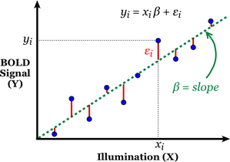
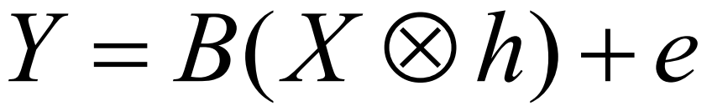
Generalized Linear Model
Measured signal
Design matrix
(events convolved with HRF)
Amplitude (unknown)
Normally distributed random noise

Slide 14
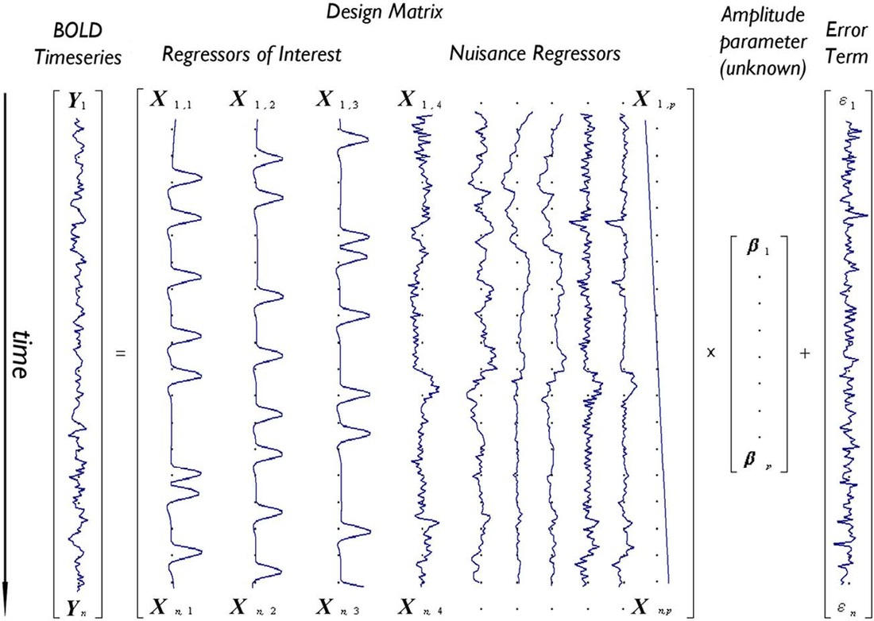
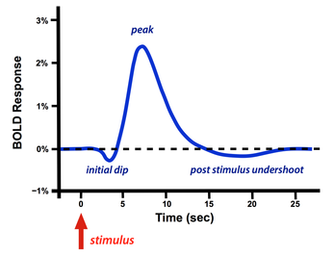
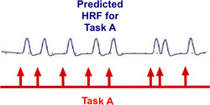
Design Matrix
Recall: HRF

Slide 15
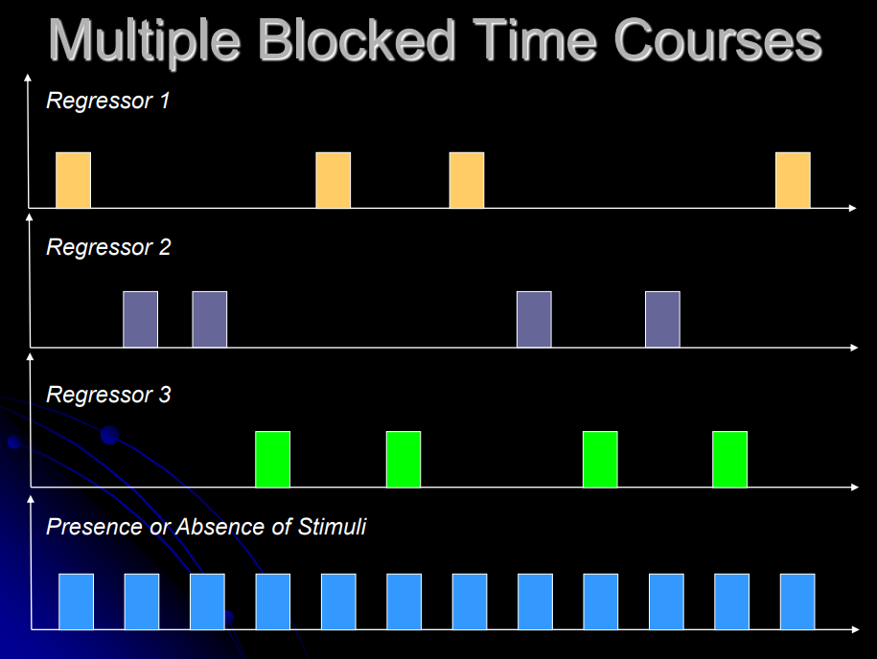
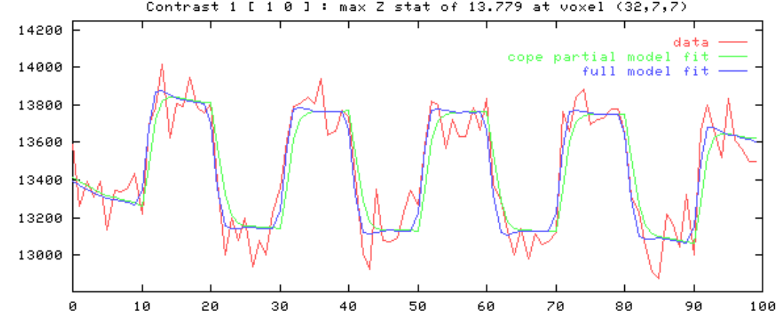
Design Matrix
Recall: HRF
A B C

Slide 16
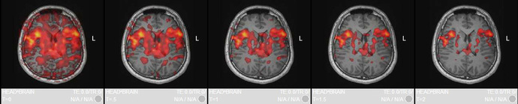
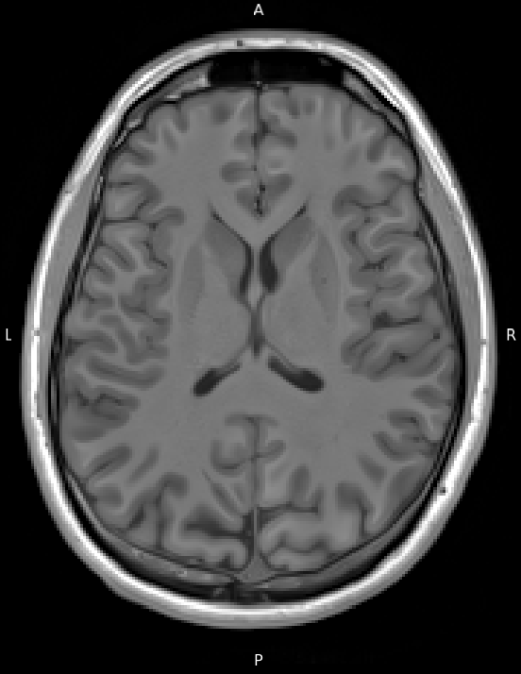
Beta weights

Slide 17
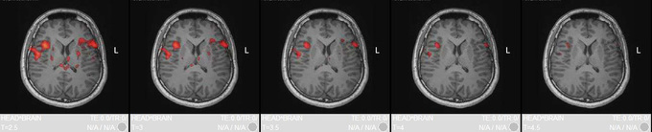
Beta weights

Slide 18
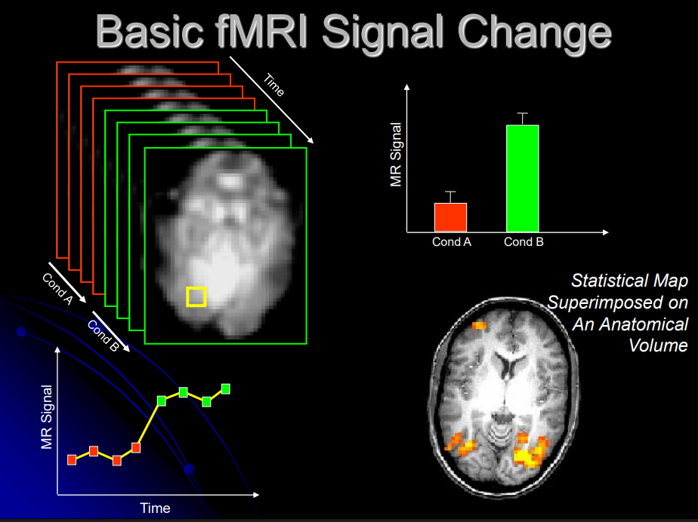
Contrasts
JVH (2023)

Slide 19
Generalized Linear Model
Measured signal
Design matrix
(events convolved with HRF)
Amplitude (unknown)
Normally distributed random noise*
* PROBLEM: There are many sources of
structured noise contributing to the BOLD signal

Slide 20
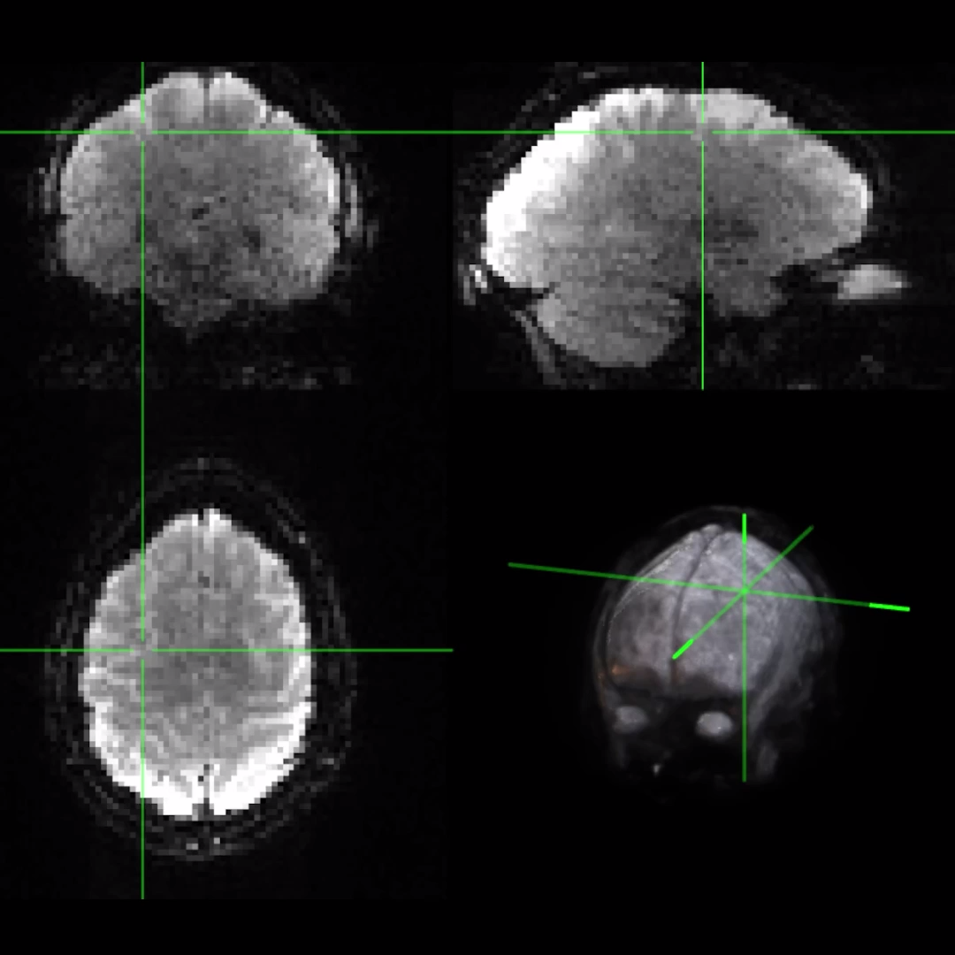
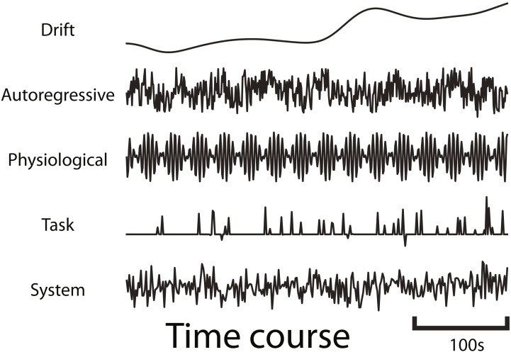
Simulation
fmrisim (Ellis et al., 2020)
Notes:
Before applying dynEGA to real fMRI data, we want to ensure that it actually works, i.e., it can recover known dynamic network structures.
We can simulate resting-state fMRI with a known ground truth using fmrisim (part of the BrainIAK library), which allows us to generate artificial fMRI data that mimics the characteristics of real data, including realistic noise/SNR, autocorrelative structure, etc.

Slide 21
Denoising
Removing structured noise

Slide 22
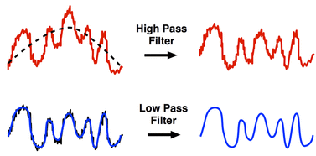
Modeling out structured noise
Temporal filtering / detrending
Motion regressors

Slide 23
fMRIPrep Output
sub-rcg.html
Skull-strip
Normalize
Co-Register

Slide 24
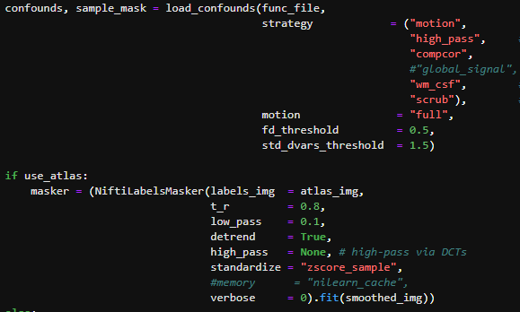
Denoising (NiLearn)

Slide 25

Submitting jobs on Rivanna

Slide 26
fMRIPrep Pipeline – copy and paste in rivanna
No changes necessary! This should work on its own ☺ though it might take a while to run – next week we will discuss how to submit slurm jobs
export NETID=$(whoami) ; export SUBID="rcg"
if [[ ! –d /scratch/${NETID}/brainhack ]] ; then
mkdir /scratch/${NETID}/brainhack
fi
cd /scratch/${NETID}/brainhack
cp -r /project/morrislab/Craig/rcgBIDS /scratch/${NETID}/brainhack
module load apptainer fmriprep
apptainer run --cleanenv --bind /scratch/${NETID}/brainhack/rcgBIDS/:/data:ro --bind /scratch/${NETID}/brainhack/rcgBIDS/derivatives:/out /sfs/weka/applications/resources/containers/apptainer/fmriprep-23.1.4.sif /data /out participant --participant-label ${SUBID} --fs-license-file /scratch/${NETID}/brainhack/rcgBIDS/code/license.txt --output-spaces MNI152NLin2009cAsym:res-native:res-2 T1w func -w /scratch/${NETID}/brainhack/fmriprep_work/${SUBID} --omp-nthreads 16 --skip-bids-validation --fs-no-reconall --low-mem

