Slide 1
Diamond figures

Slide 2
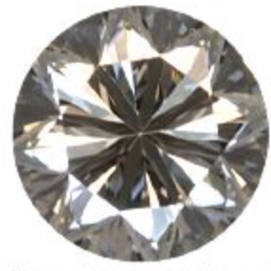
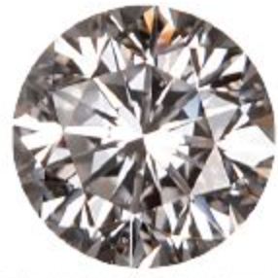
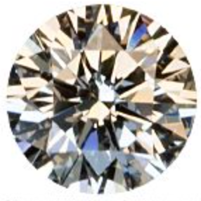
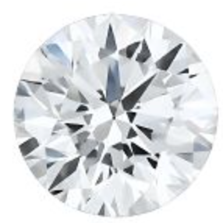
Cut
d
Worst
Best
1 | 2 | 3 | 4 | 5
Fair | Good | Very Good | Premium | Ideal

Slide 3
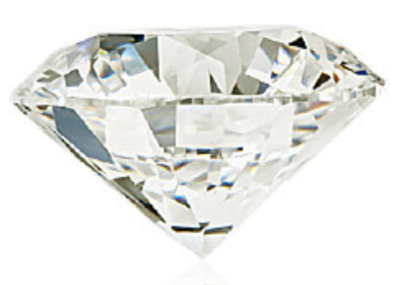
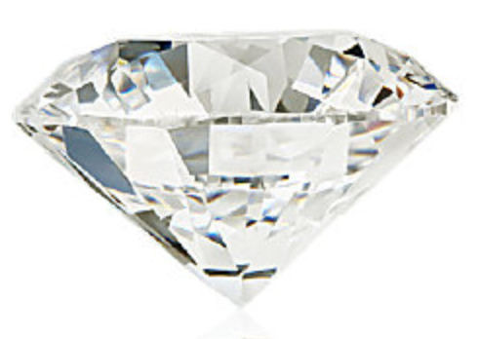

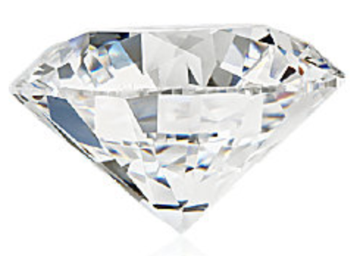
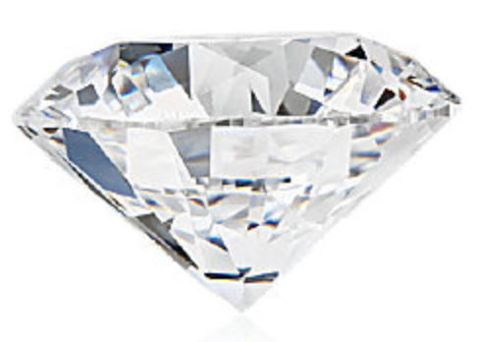
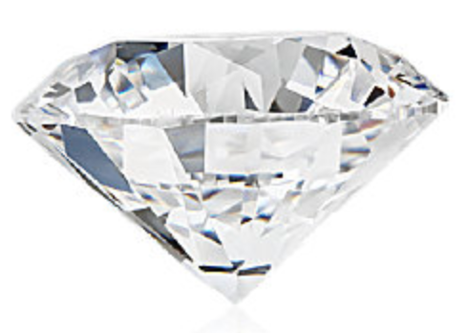
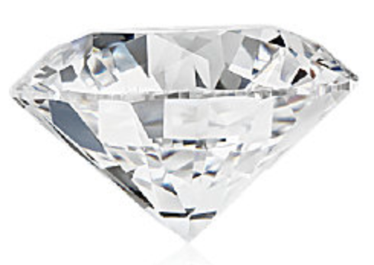
Color
dwe
Worst
Best
1 | 2 | 3 | 4 | 5 | 6 | 7
D | E | F | G | H | I | J

Slide 4
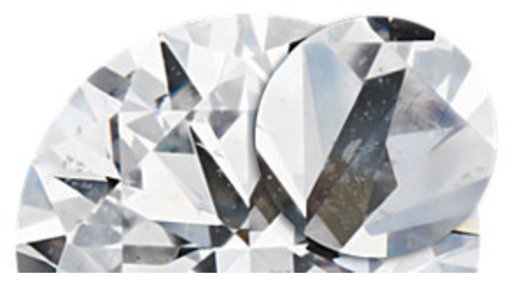
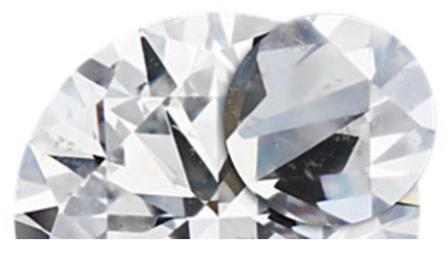
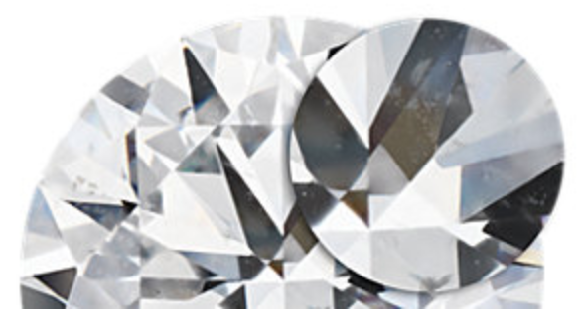
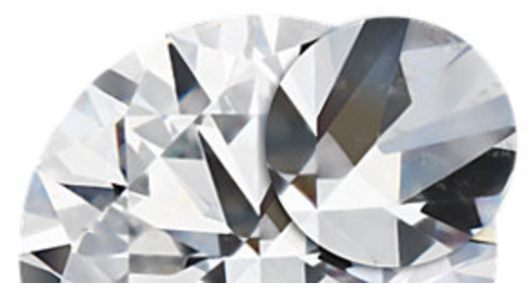
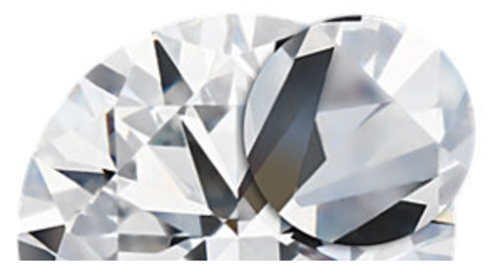
Clarity
d
Worst
Best
1 | 2 | 3 | 4 | 5 | 6 | 7 | 8
I1 | SI2 | SI1 | VS2 | VS1 | VVS2 | VVS1 | IF

Slide 5









Carat
S
0.2--5.01
Light
Heavy
0.2 | 0.5 | 0.75 | 1.0 | 1.5 | 2.0 | 3.0 | 4.0 | 5.1

